Slide 1
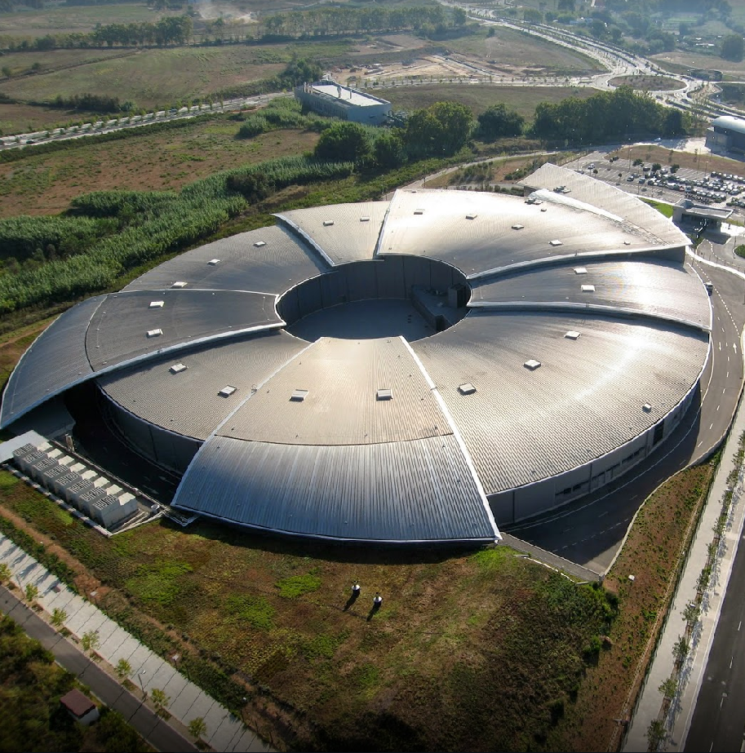

Rethinking Institution Security Approach
Sergio Vicente & Sergi Blanch

Slide 2
Overview
2
What is a CISO and his/her main functions?
The IT security coordination group
Example project: ISPyB / MXCuBE

Slide 3

IT security coordination group
3
A chief information security officer (CISO) is the senior-level executive within an organization responsible for establishing and maintaining the enterprise vision, strategy, and program to ensure information assets and technologies are adequately protected.
Ref: https://en.wikipedia.org/wiki/Chief_information_security_officer
Notes:
Typically, the CISO's influence reaches the entire organization. Responsibilities may include, but not be limited to:
Computer emergency response team/computer security incident response team
Cybersecurity
Disaster recovery and business continuity management
Identity and access management
Information privacy
Information regulatory compliance (e.g., US PCI DSS, FISMA, GLBA, HIPAA; UK Data Protection Act 1998; Canada PIPEDA)
Information risk management
Information security and information assurance
Information security operations center (ISOC)
Information technology controls for financial and other systems
IT investigations, digital forensics, eDiscovery
Security architecture
3

Slide 4
IT security coordination group
4
Definition
The IT security coordination group at ALBA is a consultancy Inter-section group in the Computing Division
Objectives
Afford cybersecurity from a multidisciplinary point of view
Avoid collisions among different section interests.
Propose the measures to be deployed to the section heads in the Computing Division

Slide 5
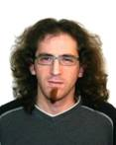


IT security coordination group
5
Current team members
Sergi Blanch Torné
Controls Systems
Alfonso Burgos Olanda
Management Information Systems
Sergio Vicente Molina
IT Systems
Notes:
Controls responsible for the control system of both Accelerators and beam lines. Equipment Protection (EPS), Personal Safety System (PSS), vacuum control, as well as synoptic and Graphical User Interfaces are among its duties.
Management Information Systems (MIS) Section inside the Computing Section has the responsability of the Managament and administrative applications in ALBA synchrotron, covering the following services:
Analyze and specify the functional requirements of administrative applications.
Develop, implement, and maintain administrative applications and all tools required for optimal exploitation of the corporate information.
Support users of these applications, prepare user documentation and provide training.
5

Slide 6
IT security coordination group
6
Tasks already performed since 2016
Development of a checklist to enable remote Internet access to specific applications.
Description of the main concerns and IT security risks for each section in Computing.
Evaluation of different proposals of IT security audits. The chosen will be performed in the following weeks.

Slide 7
IT security coordination group
7
MIS
Controls
Systems

Slide 8

IT security coordination group
8
MIS
Controls
Systems

Slide 9

IT security coordination group
9
MIS
Controls
Systems

Slide 10
IT security coordination group
10
MIS
Controls
DMZ
Systems

Slide 11
IT security coordination group
11
MIS
Controls
DMZ
Field
Systems

Slide 12
IT security coordination group
12
MIS
Controls
DMZ
Field
Systems

Slide 13
IT security coordination group
13
MIS
Controls
DMZ
Field
Systems

Slide 14
IT security coordination group
14
MIS
WebService
Controls
DMZ
Field
Systems

Slide 15
IT security coordination group
15
MIS
WebService
Controls
DMZ
Field
Ldap
Systems

Slide 16
IT security coordination group
16
MIS
WebService
Controls
DMZ
Field
Ldap
Network
Systems

Slide 17
17
Thanks,
any question?
For further contact:
itsecuritycoordination@cells.es
ISPyB: https://ispyb.github.io/ISPyB/
MXCuBE: http://mxcube.github.io/mxcube/

