Slide 1
Kick-off Meeting Organisation
CERN, May 4-5th, 2017
V. Brunner, M. Vretenar

Slide 2
WELCOME TO CERN
Following an established tradition, we welcome at CERN the participants to our Accelerator Projects for the initial kick-off meeting.
For the next Annual Meetings we will go to other places (candidates are welcome!).

Slide 3
PROGRAMME – DAY 1

Slide 4
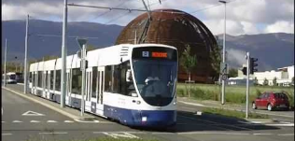
PRACTICAL DETAILS – DAY 1
A buffet lunch will be served here in the Globe.
After lunch, we will take a group photograph outside.
At the end of the afternoon session (around 18:00) you have some free time to go back to the Hostel or visit the World of Particles exhibition in the Globe (ground floor).
You are invited to the Meeting Dinner at the Kempinski Hotel on the Geneva lake, which will start with an aperitif at 19:30.
To reach the Kempinski, you need to take the Tram 18 in front of the Globe and get off at Cornavin train station; from there, reaching the Kempinski is a 10 minute walk.
Tram leaves at 18:32, 18:42, 18:53, 19:03. We advise the 18:53 tram. Collective tickets will be distributed at the tram stop.
Return is free. You can take again the tram (every 20’ from 23:00, last at 00:20) but you have to purchase your own ticket.

Slide 5
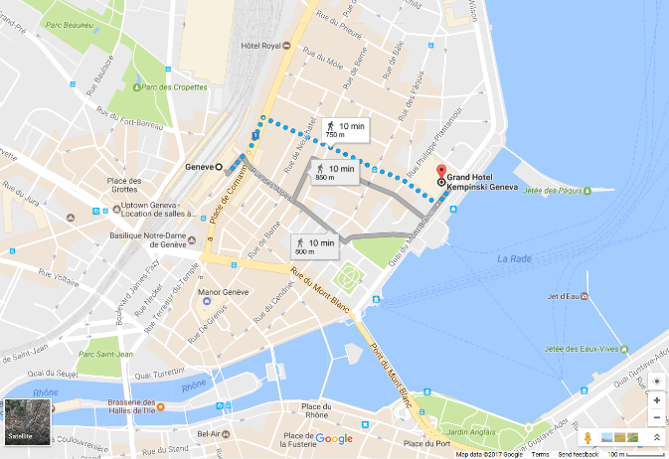
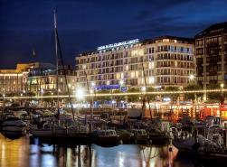
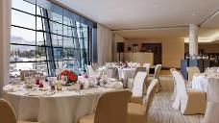
REACHING THE KEMPINSKI
Tram stop
The dinner is kindly offered by EuCARD2 with its remaining matching funds… including a little surprise after the dinner!

Slide 6
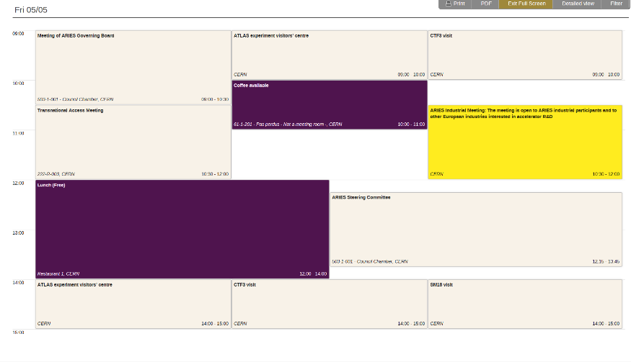
PROGRAMME – DAY2
Council Chamber 503-1-001
Restaurant 1 (Glass Box)

Slide 7
PRACTICAL DETAILS – DAY 2
Day 2 will take place inside CERN, at the 1st floor of the Main Building (entrance from Reception B.33 giving your name, then follow the black line on floor).
The Governing Board (one nominated representative per beneficiary, plus the three partner organisations) will meet from 9:00 to 10:30 in the Council Chamber (503-1-001).
Coffee will be served between 10:00 and 11:00.
At 10:30, two parallel meetings: Transnational Access in 222-R-003, and Industry (and friends) in the Council Chamber.
During the day, different visits will take place for those not involved in the meeting. Participants have been informed of the meeting place with a personal e-mail.
Lunch is free (not organised), available at the CERN restaurant at ground floor. Only the Steering Committee will have an organised lunch meeting (but they have to work for it!).
The meeting will officially end after the last afternoon visits.

Slide 8

A SUCCESSFUL KICK-OFF
134 registered participants (at Wednesday 26.4)
105 are not from CERN: 78% of total
19 are from industry (14%)
29 are female (22%) – (judging from first name)
From 22 countries (4 more than the ARIES countries!)
And a lot of young people!
The start of a nice community!

