Slide 1

Introducing ARIES
Accelerator Research and innovation for European Science and Society
A new Integrating Activity for Particle Accelerator R&D
Maurizio Vretenar, CERN – Project Coordinator
Kick-off, CERN, 4 May 2017
Notes:
Why do we need ARIES

Slide 2
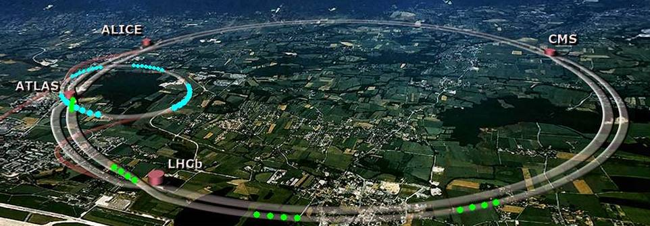
Accelerator Science in the XXI Century
Engines of discovery: 1/3 of all Nobel prizes in physics since 1939 are connected to particle accelerators.
of all particle accelerators,
<1% used for basic science
5% for applied science
35% for medicine
~ 60% in industry
Advanced scientific tools: 18 synchrotron and 8 FEL based light sources in operation in Europe, 1 neutron source in operation and another in construction, more Nobel prizes and strong impact on all scientific domains.
Providers of quality healthcare: >10’000 accelerators for radiotherapy installed in hospitals worldwide, >500 radioisotope production accelerators, 19 particle therapy centers in Europe.
Cutting-edge industrial equipment: analysis and modification of surfaces across many fields (ion implantation, polymer treatment, sterilization, environment, etc.).
Notes:
Century started with great success of lhc, accelerators known by everyone – lhc is the top of an iceberg

Slide 3
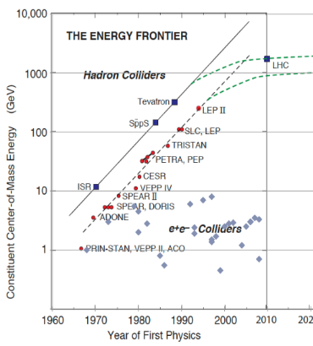
A successful technology, but…
Wide and multidisciplinary community supporting several projects under study or construction – about 4’000 people engaged in accelerator research in Europe.
Is reaching a critical moment in its evolution:
- expectations for physics discoveries are high but requirements in terms of size, cost, electrical power make funding and implementation of new projects increasingly challenging.
- the rapidly growing use of accelerators for applied science, medicine and industry adds further demands to the performance, reliability, cost and compactness of accelerator designs.
Updated Livingstone-type chart (Wikipedia 2014, uploaded by J.Nash, Imperial College)
Exponential growth (Moore’s law) of accelerator energy is slowing down.
Notes:
Accelerators have a huge potential for reaching even further

Slide 4

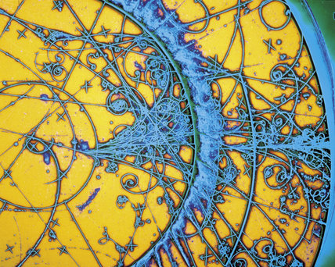

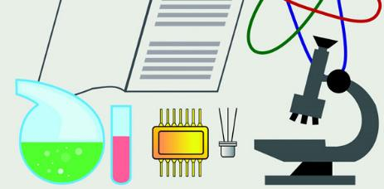
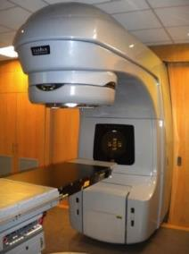
Accelerators in transition
Transition to new more affordable and sustainable technologies for basic science
Transition from basic science to applied science, to medicine and industry
Transition from large scientific laboratories to smaller centres and to industry
Transition from a centralised configuration to a distributed multi-actor scheme
size, cost, energy consumption, operability, reliability of future projects
New ideas and technologies
Basic science
Societal applications (medicine, industry, environmentetc.)
Applied science (photon and neutron sources)

Slide 5
The role of ARIES
The goal of ARIES is to accompany and favor this transition, looking at the future of accelerator science beyond the needs of ongoing projects and studies, and promoting new technologies common to different projects and accelerator types.
In this critical step we need to promote innovation*, in terms of new ideas, new synergies, new applications, new ways of working together, etc.
Need for a new and stronger multidisciplinary collaborative effort involving all innovation actors and promoting cross-fertilization.
Such a collaborative effort is possible only with the support of a higher body like the European Commission.
Example:
For high energy physics there are some established directions: LC, CLIC, FCC.
ARIES wants to look beyond these studies and promote alternative promising options: high-temperature superconductivity, plasma-based colliders, alternative schemes, etc.
*: An innovation is the implementation of a new or significantly improved product (good or service), or process, a new marketing method, or a new organizational method. (from the Oslo Manual, Guidelines for collecting and interpreting innovation data, OECD, 2005)
Innovation is the process of translating an idea or invention into something (object or service) that creates value.
Notes:
This is our playground

Slide 6
EU support to particle accelerator R&D
Integrating Activities
Design Studies,
Preparatory Phases
CARE 01/2004 – 12/2008
5 years, 15.2 M€ EU contribution
FP6
EuroNu DS, 2008/12, 4M€
EuCARD 04/2009 – 03/2013
4 years, 10.0 M€ EU contribution
SLHC-PP, 2008/11, 5.2M€
ILC-HiGrade, 2008/12, 5M€
FP7
EuCARD-2 05/2013 – 04/2017
4 years, 8.0 M€ EU contribution
TIARA-PP, 2011/13, 3.9M€
HiLumi LHC, 2011/15, 4.9M€
EuroCirCol, 2016/19
H2020
ARIES 05/2017 – 04/2021
4 years, 10.0 M€ EU contribution
EUPRAXIA, 2016/19
Low prioritiy of long-term R&D for large laboratories focused on short-term projects, while small institutions lack critical mass and the experience to be effective → a joint collaborative effort with the EU support is the most effective way to push the limits of our technologies.
6

Slide 7
Novelty and added value of ARIES
More focus: The WPs are focused on advancing well-defined key topics of excellence that were identified in EuCARD-2.
More access: Transnational Access strongly increased as a result of the new concept of opening advanced accelerator test infrastructures to the accelerator community and to industry. TA infrastructures from 3 (in EuCARD-2) to 14.
More integration: Consortium widened to include partners from south and east of Europe. 41 partners, 20 participate for the first time. Countries involved from 12 to 18, for the first time Hungary, Latvia, Portugal, Romania, Slovakia, and Slovenia.
More industry: Industrial participation increased from 2 to 8 beneficiaries, including 3 SMEs and one industry association. Role of the industrial partners changes from supporting specific developments to players in co-innovation activities, experts for innovation and market-pull actions, and partners for exploring applications to society.
More innovation: focus on innovation with identification of innovative technologies, co-innovation programmes with industry, and demonstration of novel accelerator technologies for industrial or societal applications via the new Proof-of-Concept fund.
More society: benefits to European society via training of researchers, support for accelerators for medicine, industry and the environment, development of advanced accelerator technologies.

Slide 8




The four ARIES pillars
excellence
access
innovation
sustainability
Develop key accelerator technologies to make more performant, affordable, reliable and sustainable the present and future accelerators
Improve the European accelerator infrastructure
New scheme of Transnational Access opening 14 accelerator test facilities
Enlarged consortium with 20 new partners in accelerator projects and 6 new countries in the East and South of Europe
Enhanced industrial participation (7 industries and 1 association)
3 new co-innovation programmes with industry
Development of societal applications (medicine, industry, environment)
Joint programme with TIARA to develop a model for sustainable accelerator science in Europe
Training programme for the new generations of accelerator scientists and engineers

Slide 9
The ARIES magic formula
Joining together accelerator laboratories, universities and industries on a set of common goals.
EuCARD and EuCARD2 have progressed in the integration of universities and laboratories, ARIES now wants to include industry in the integration of the accelerator research area.
LABORATORIES: Infrastructure, experience
UNIVERSITIES:
Intellectual potential, creativity
INDUSTRY: Focus, market experience, effectiveness

Slide 10
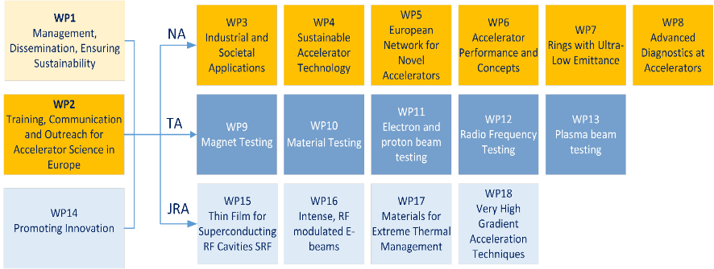
ARIES Structure
18 Workpackages:
8 Networks 5 Transnational Access, 5 Joint Research Activities.

Slide 11
ARIES Tasks, Budgets, Partners

Slide 12
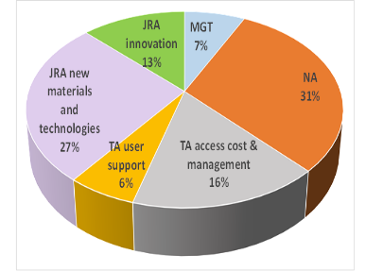
ARIES Key Figures
19 Workpackage Coordinators: 6 from CERN, 4 from UK, 4 from Germany, 3 from France, 1 from Switzerland, 1 from Sweden. 4 female (21%).
EC contribution 10 M€, total cost 24.9 M€, funding rate 40%.
Share of EC contribution: Management 7%, Networks 31%, TA 22%, JRAs 40%.
51 Deliverables and 67 Milestones
42 beneficiaries from 18 EU countries (+CERN, ESS)

Slide 13
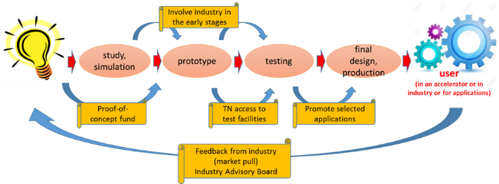
Innovation Strategy
In ARIES Innovation is a Joint Research Activity
idea
Support to all stages of the innovation process:
Proof-of-concept innovation fund: for Business Plan preparation, market assessment, demonstration in connection with industry of the technological viability of new ideas.
Industrial Advisory Board: provide business consultation (eg. business plans) and support market assessments (“market pull”).
ARIES meets industry events
3 co-innovation programmes with industry:
breakthrough in the cost per kAm of industrial High Temperature Superconductors
production of materials for extreme thermal management
production of a standardized timing for medical and industrial applications.

Slide 14
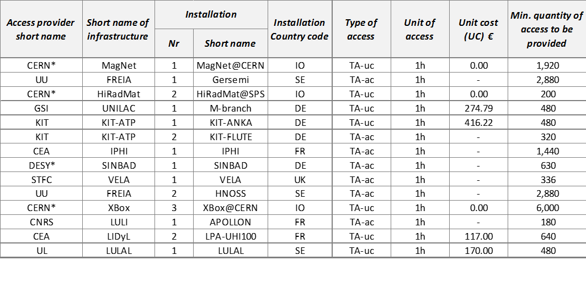
Transnational Access
New concept for the accelerator community: promote a common usage of the test stands used for the development of new accelerator technologies.
14 facilities based in 6 countries, grouped in 5 thematic WPs
664 estimated users for about 18’000 access hours
Set of complementary facilities for testing magnets, materials, components with different beams (protons, high current electrons, variable electron beams, short electron bunches), RF components, plasma acceleration.
Flagships: IPHI, VELA, ANKA, Apollon.

Slide 15
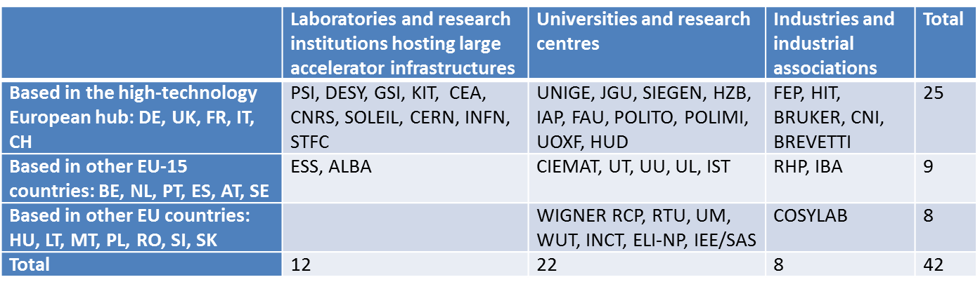
The community
2 axes of expansion
Goal to connect the technological core of Europe with its dynamic periphery and to connect the large laboratories with universities, research centres and industries.
41 beneficiaries from 18 European countries (+CERN and ESS).
20 new beneficiaries with respect to the previous programme.
New in accelerator IA’s: Portugal, Hungary, Latvia, Romania, Slovenia, Slovakia.

Slide 16

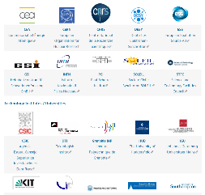
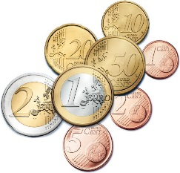
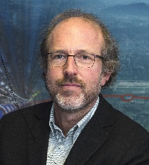

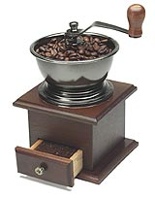
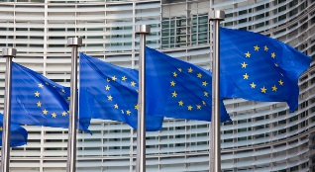
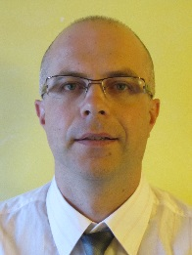

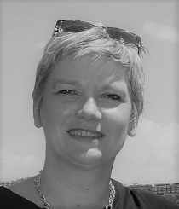

A European project in a nutshell
ARIES partners
Project coordinator
Maurizio Vretenar
Administrative Manager
European Commission
Svetlomir Stavrev
Project assistant
Deliverables and reporting
Valérie Brunner
Science and Innovation
Revision of the mill (servicing):
Every year at the annual project meeting (April – May)

Slide 17
ARIES Governance
Scientific
Advisory Committee
Governing Board
One representative from each beneficiary and partner organisation
Project Coordinator (ex-officio)
Deputy Project Coordinator (ex-officio)
Industry
Advisory Board
Steering Committee
Management Team
Project Coordinator
Deputy Project Coordinator
Administrative Manager
Project Coordinator
18 Workpackage Coordinators

Slide 18
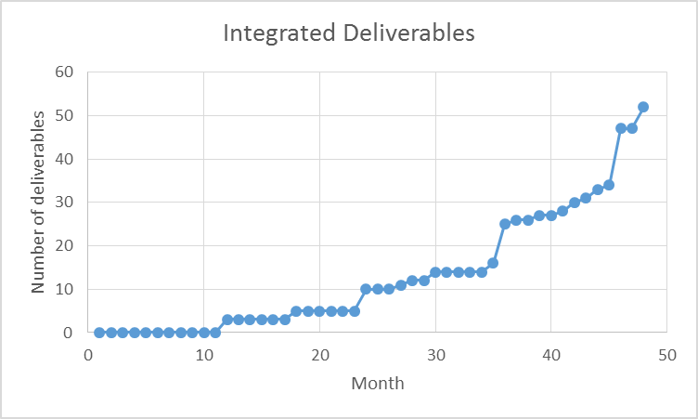
Deliverables and Reporting
Our priority is to keep administrative work at a minimum and let you concentrate on your work.
But it is very important to provide on time the 52 deliverable reports foreseen by the project (with a peak in the last year).
Average of 3 per Workpackage (less than 1/WP.yr): affordable workload, but please help your WP coordinator !
To the mandatory reports for the EC we have added an «internal» report at M12 that will be a rehearsal for the 1st real report (and its content will be recycled for the P1 report).
+ 66 Milestones, shorter reports for the WP coordinator to verify the achievement of an intermediate result.

Slide 19

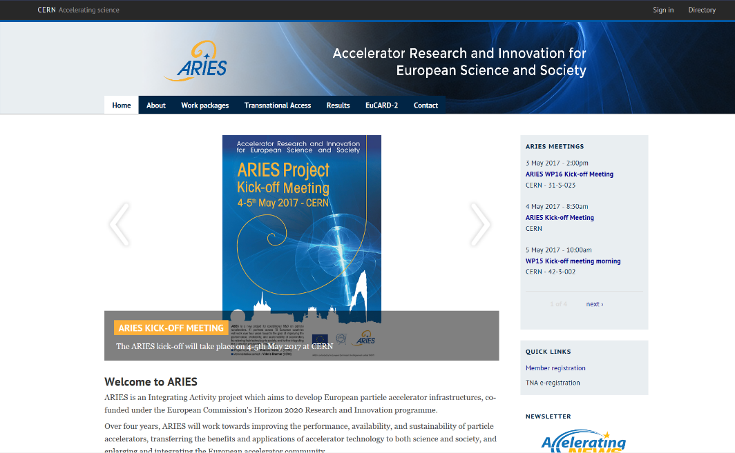
Joining ARIES on the new web site
To be included in the ARIES mailing list and be informed of all ARIES events: from the web site (home page) or directly to
http://aries.web.cern.ch/content/project-member-registration-form
The ARIES web site is hosted at CERN; it is now up and running at https://aries.web.cern.ch/ .
Many thanks to Jennifer Toes who has prepared the site with the help of Livia Lapadatescu and Sabrina El Yacoubi.

Slide 20
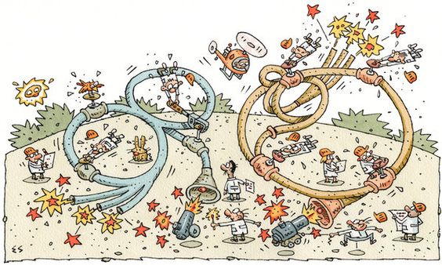
CONCLUSION
And now, it’s time to go to work !
Thanks for your attention and for your help in preparing ARIES !

