Slide 1
ACCESS to magnet testing facilities
ARIES KICK OFF/GENEVA/ May 2017
Marta Bajko CERN

Slide 2
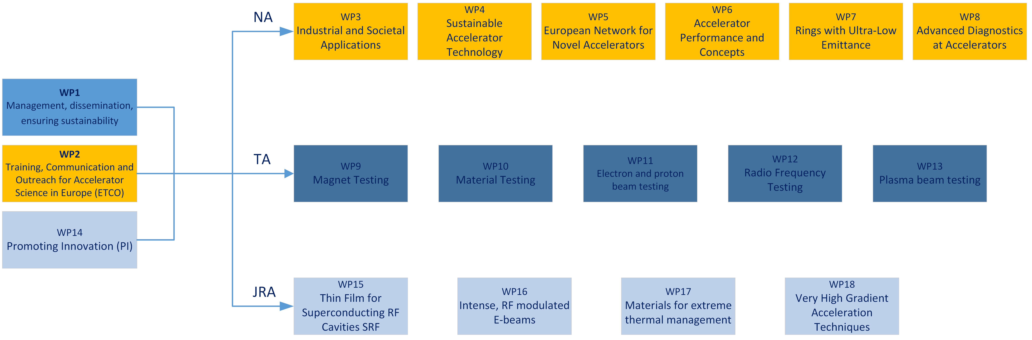
Trans National Accesses in ARIES
Each of the five Transnational Access work packages groups complementary test facilities addressing the same community. Inside each work package, the access facilities offer a complementary set of services to the user community.

Slide 3
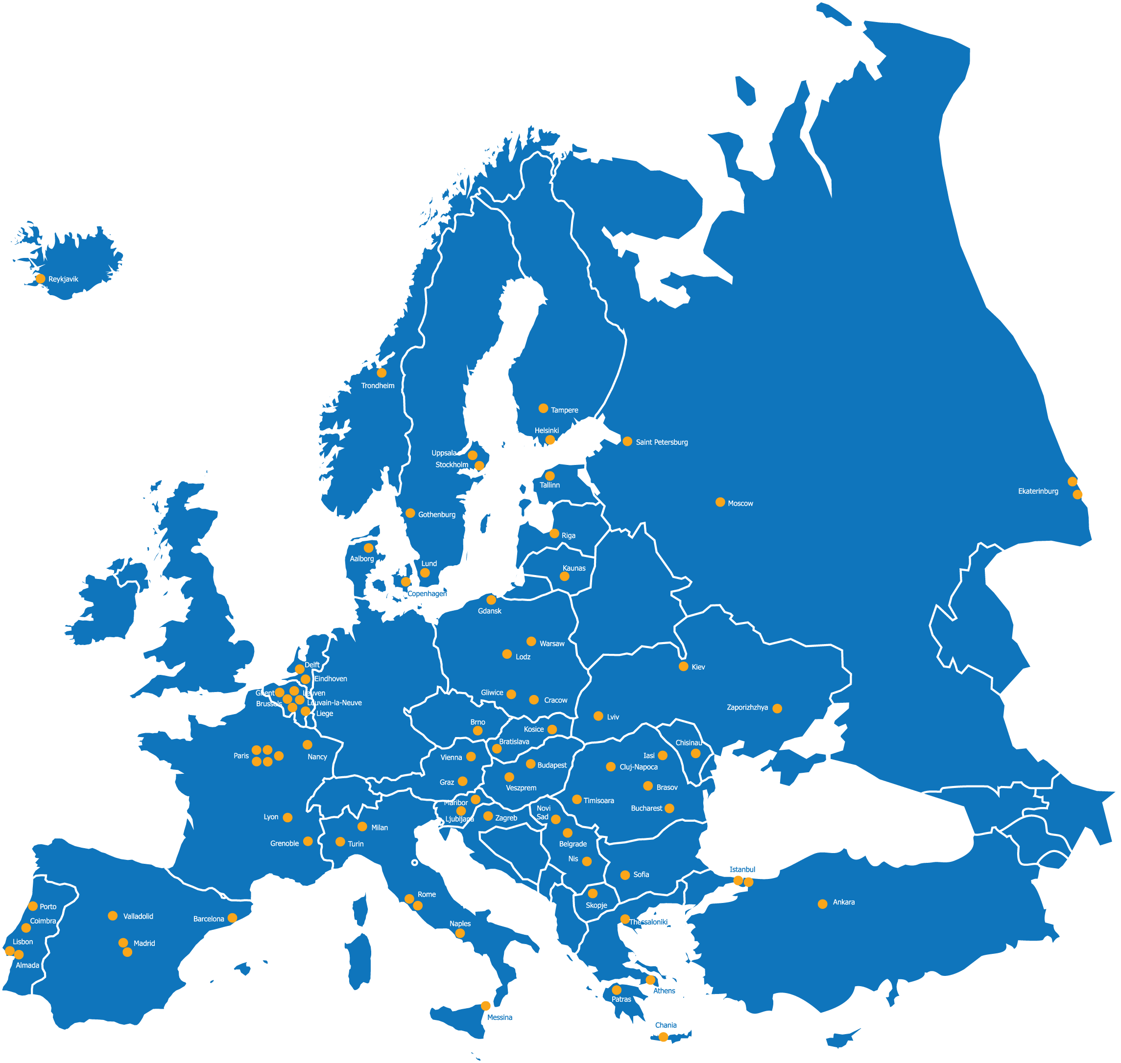

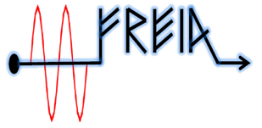

MAGNET TESTING FACILITIES in WP9
GERSEMI @ Uppsala University
TASK 9.2 GERSEMI
MagNet @ CERN GENEVA
TASK 9.1 MagNet
The TNA within WP9 groups TWO facilities devoted to testing of superconducting magnets and of instrumentation operating at cryogenic temperature.

Slide 4
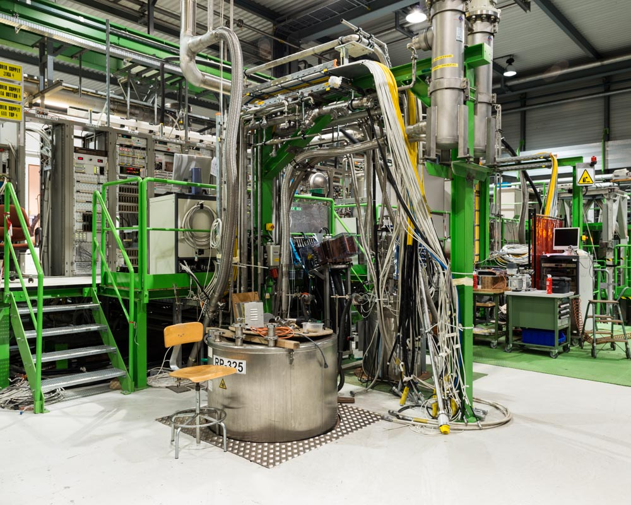
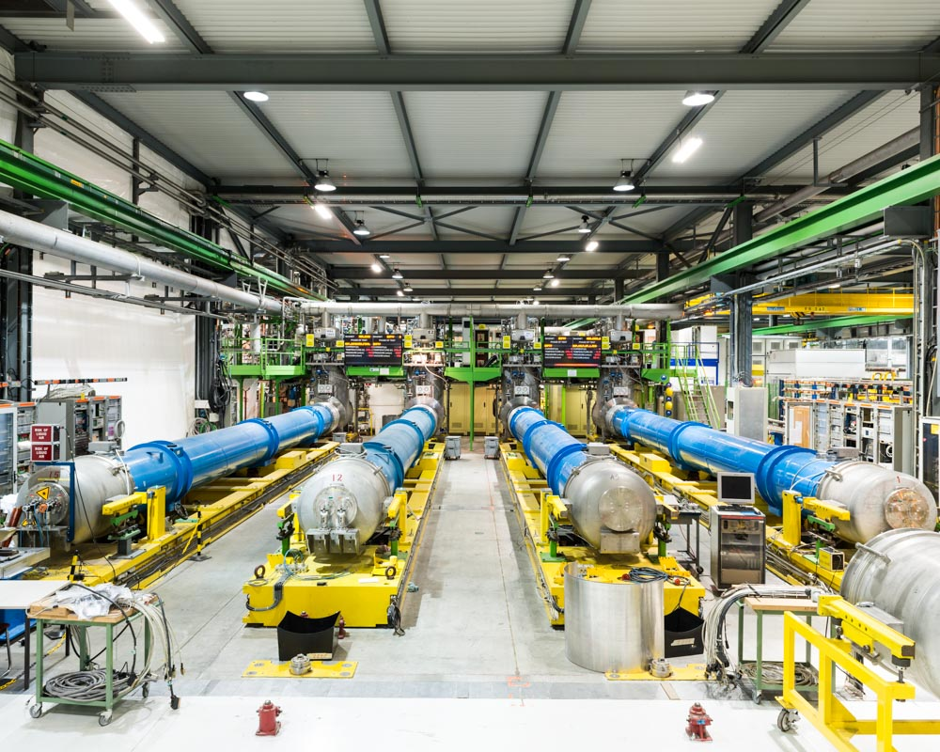
MAGNET TESTING FACILITIES in WP9.1
Annual operating costs: 4,770,404 €
MagNet @ CERN GENEVA
TASK 9.1 MagNet
The MagNet based at CERN in Geneva, (CH) offers testing on superconducting magnets and devices refrigerated at low temperatures and high currents.

Slide 5
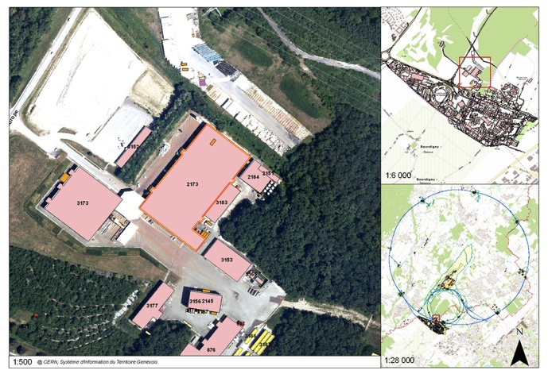
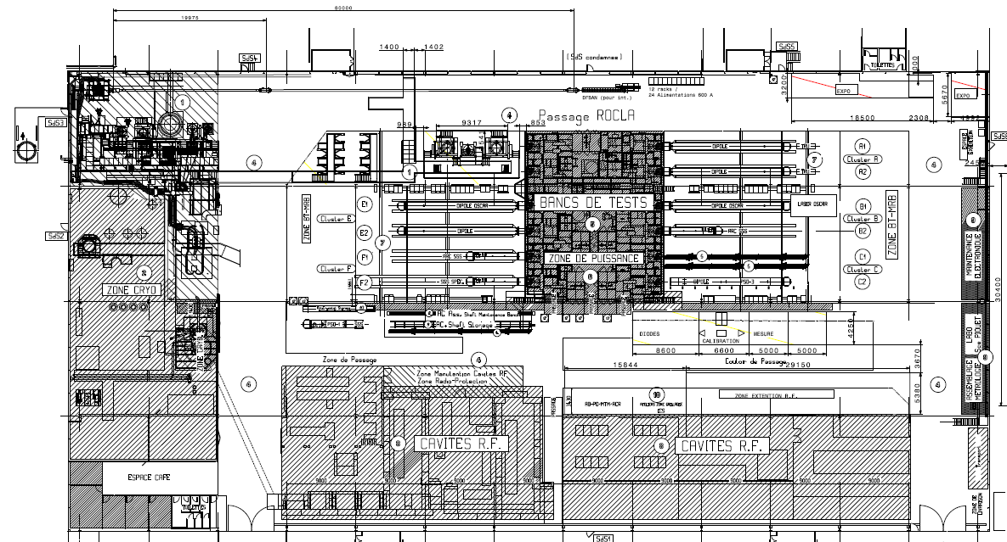
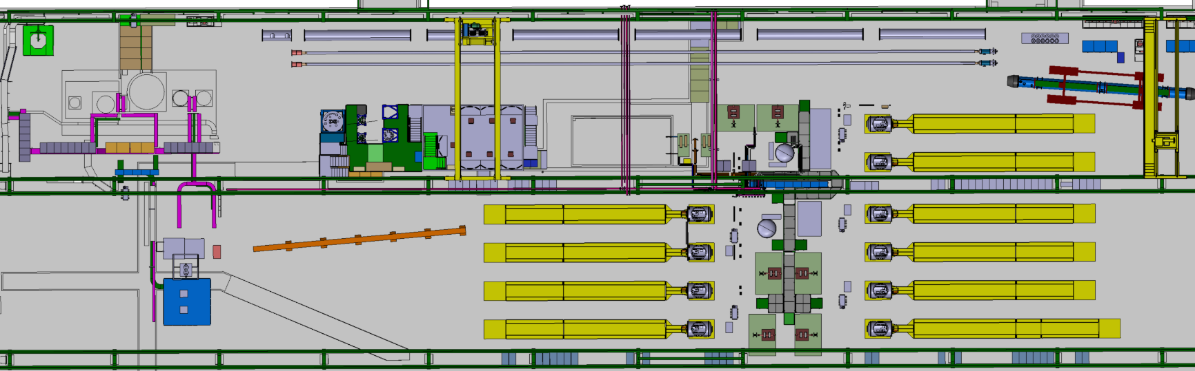
MAGNET TEST STANDS LAYOUT @ CERN
INSTALLATIONS
5 vertical cryostats ,
1 feed box for supercritical He,
1 cryostat for LN₂,
8 horizontal benches
Variable temperature feed box
Cryogen free Cryostat for 4.2 K
OPERATION
I= 0.12 kA-30 kA
T = 1.9 K to 70 K He
withstanding U = 1V to 3 kV
STRING and SC LINK
CLUSTERS
F E D
HORIZONTAL BENCHES
CLUSTERS
C B A
Is in a building of 7200 m² over which the test stands for magnets occupies about 50%.
CRYOGENIC ZONE
Superconducting RF CAVITY TEST ZONE
LN₂ TEST ZONE

Slide 6
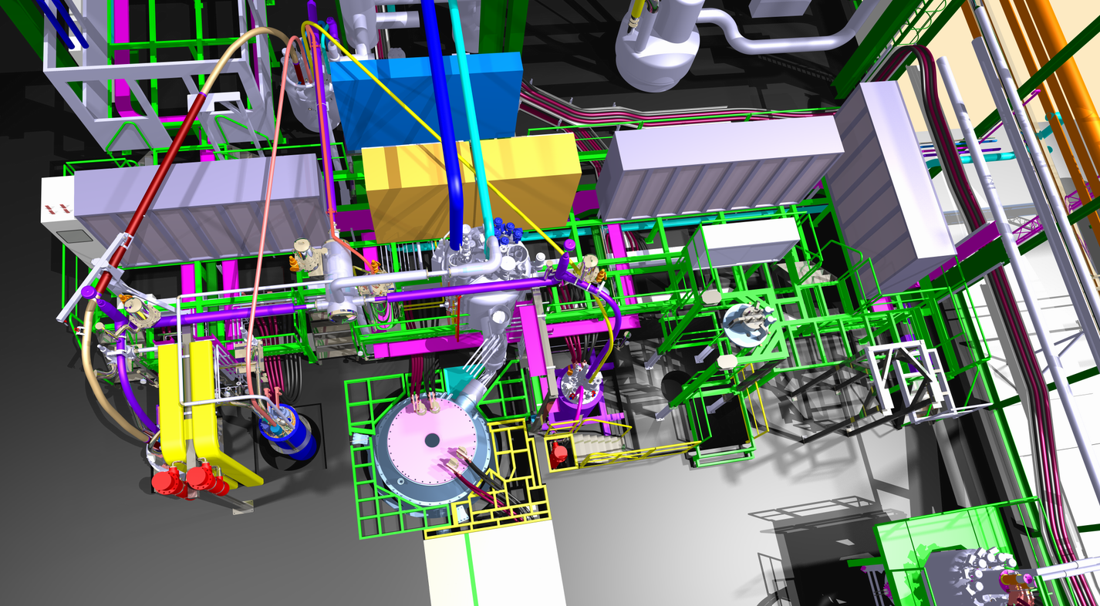
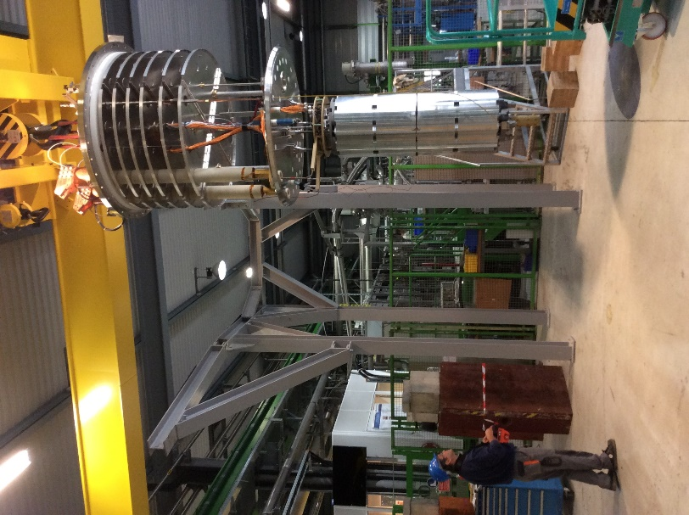
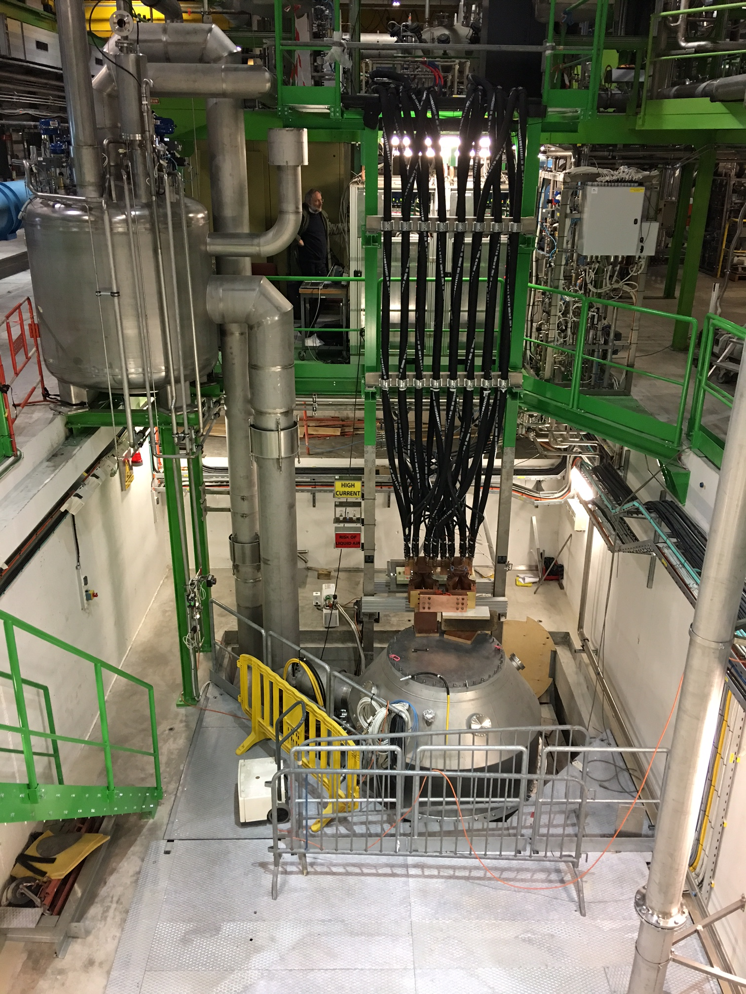
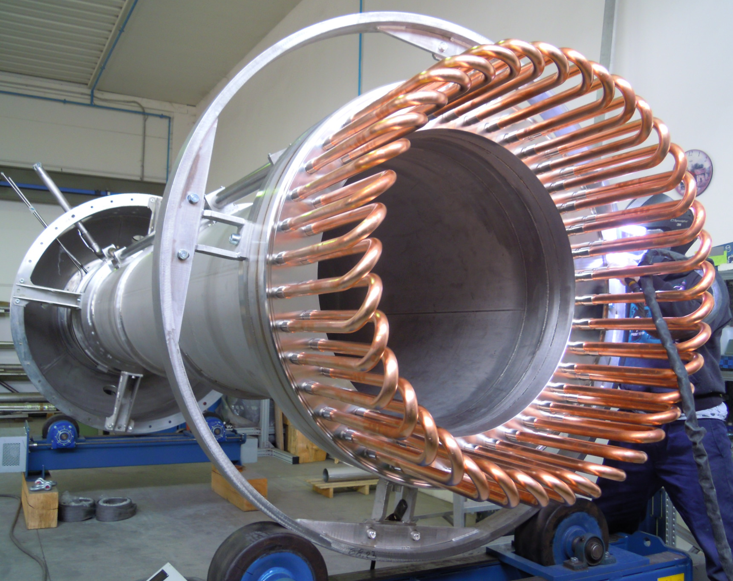
VERTICAL TEST FACILITY at CERN
The VERTICAL test facility is an area regrouping FIVE cryostats with a capacity of up to 30 kA at 1.9 K; this area is typically used for research and development projects.
CRYOSTAT PARAMETERS
(Cluster G/D)
Max internal pressure : 5 bara
Magnet temperature : 1.9 K
Useful diameter : 1500/ 800 mm
Useful length in 1.9 K bath : 2.5/5.2 m
Max. thermal gradient : 50 K
Magnetic measurements: yes
Estimated lifetime : 20 years
Number of thermal cycles : < 1000
Number of Quenches : < 10000

Slide 7
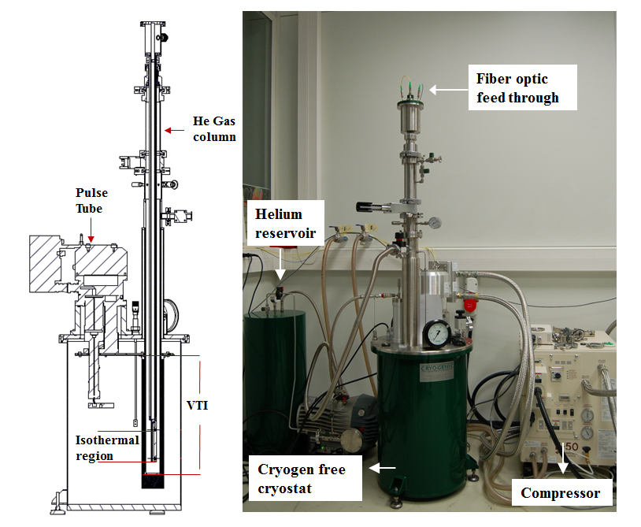
HORIZONTAL TEST FACILITY at CERN
The HORIZONTAL test facility is an area regrouping EIGHT operational cryostats with a capacity of up to 20 kA at 1.9 K; this area is typically used for LHC type magnets
Cryogen free cryostat for instrumentation down to 4.2 K

Slide 8
MAGNET TESTING FACILITIES in WP9. 2
GERSEMI @ Uppsala University
TASK 9.2 GERSEMI
The GERSEMI based at University of Uppsala ( S) offers testing on superconducting magnets refrigerated at low temperatures and medium currents.
.

Slide 9
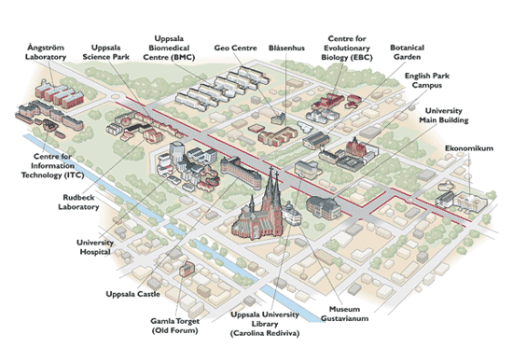
MAGNET TEST STANDS LAYOUT @ GERSEMI
  UNIVERSITY OF UPPSALA
  the oldest university in Sweden is having : 25'000 students, 9'000 staff, 7 faculties of theology, law, medicine, pharmacy,
  arts, social sciences, languages,
  educational sciences, science and technology

Slide 10
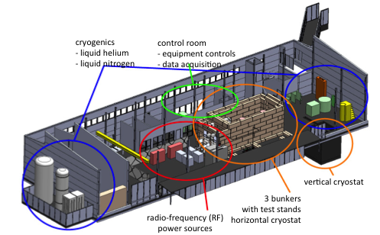
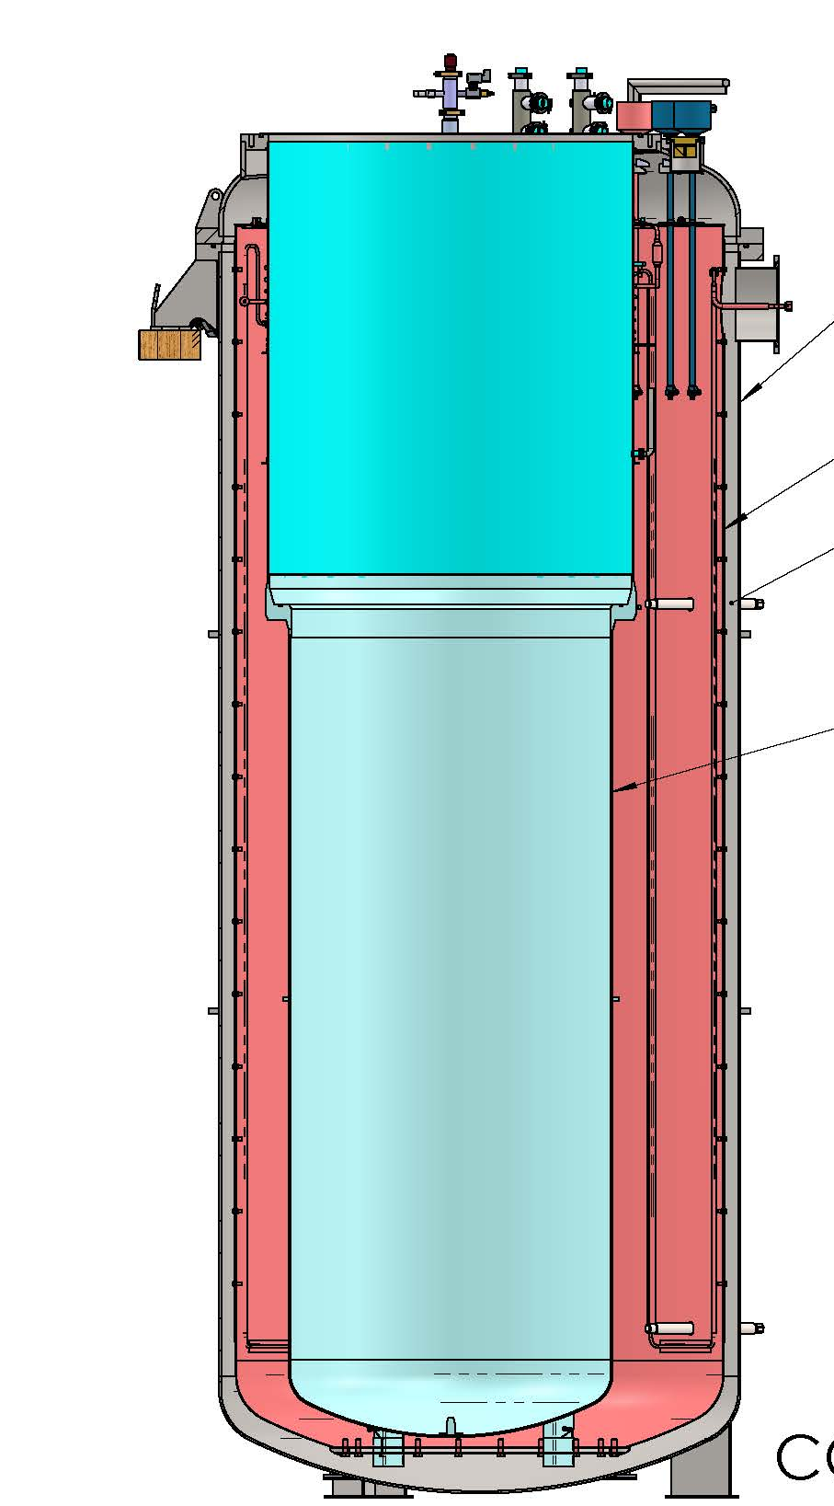
MAGNET TEST STANDS LAYOUT @ GERSEMI
A building of 1100 m² hosts a vertical cryostat for 1.8 K and 4.2 K operation with currents up to 2 kA.
useful diameter = 1.0 m
useful length in 1.9 K bath = 2.1 m

Slide 11


SELECTION PANNEL and MODUS OPERANDI
The TWO test facilities are sharing a COMMON User Selection Panel.
TNA User Selection Panel
is established to select users, based on the SCIENTIFIC QUALITY and FEASIBILITY of their proposals. The panel is composed of representatives of the facilites
M. BAJKO @ CERN AND R. RUBER @ GERSEMI
and also international experts in the field of magnets and instrumentation.
Dr. TATSUSHI NAKAMOTO
KEK - JAPAN
Dr. GIANLUCA SABBI
LBNL - USA

Slide 12
OUR ENGAGEMENT FOR EU
The expected minimum availability for the 4 years covered by the project is 1920 units @ MagNet and 2880 in GERSEMI.
A unit of access is 1 h of use of an installation in operation or in preparation..
THE SUMMARY OF TNA IN EUCARD2
2340 (over 1920) accesses given
9 (over 8) projects
15 universities and institutes
6 countries ( IT, SP, HU, USA, FI, Ru)
38 (over 60) users
> 54 travels to CERN

Slide 13
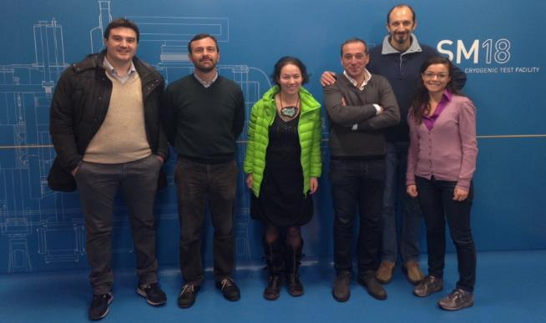
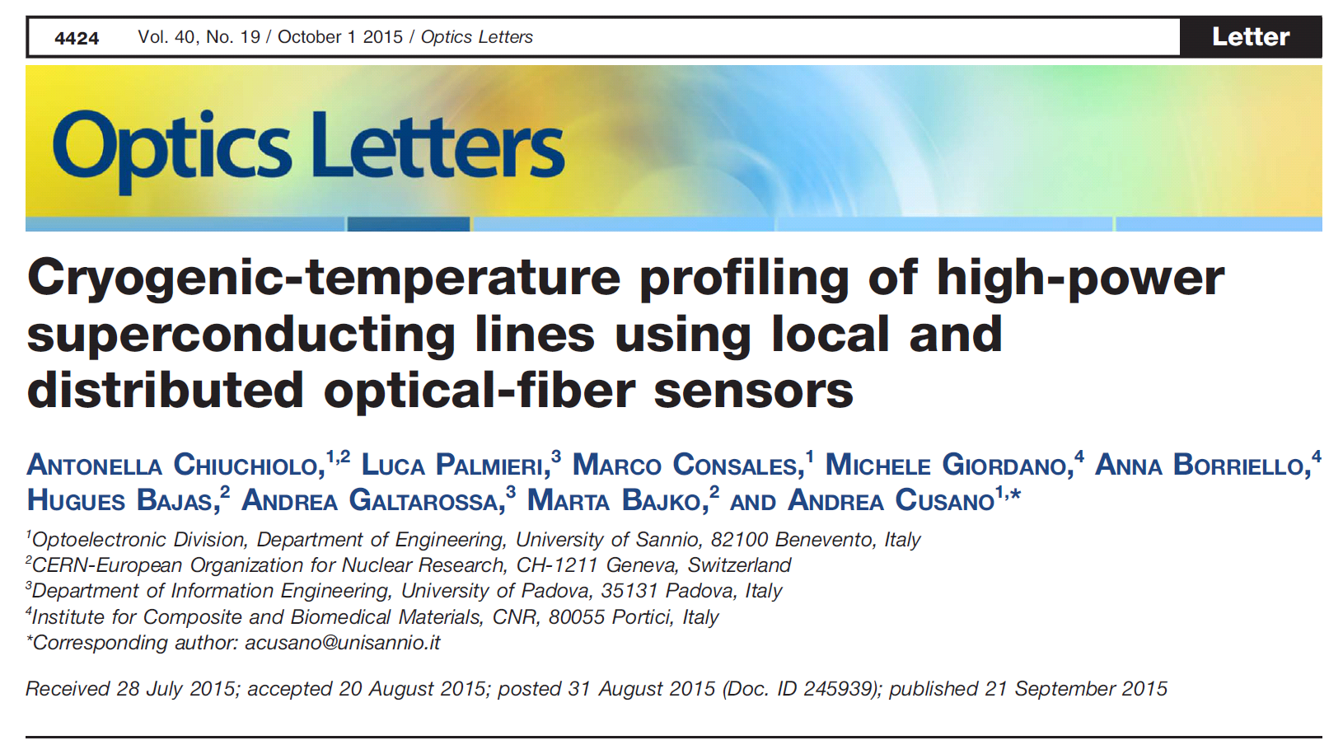
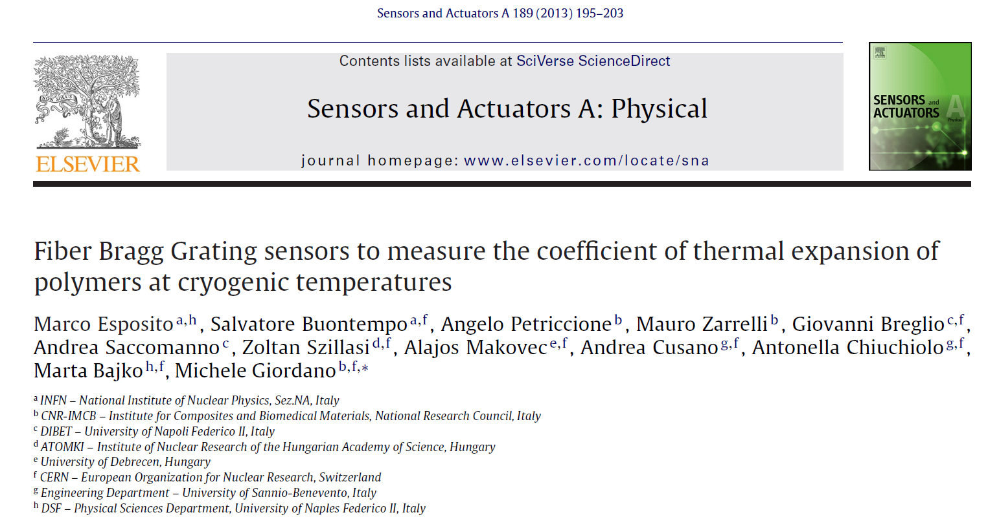
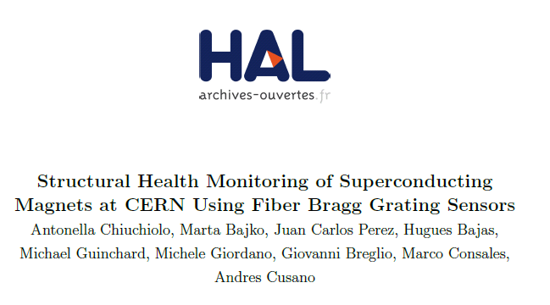
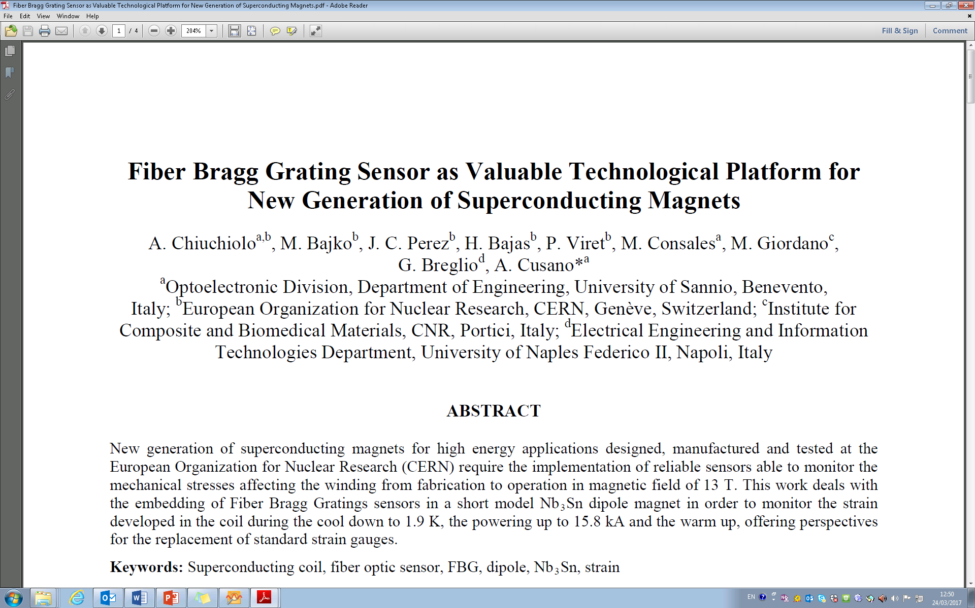
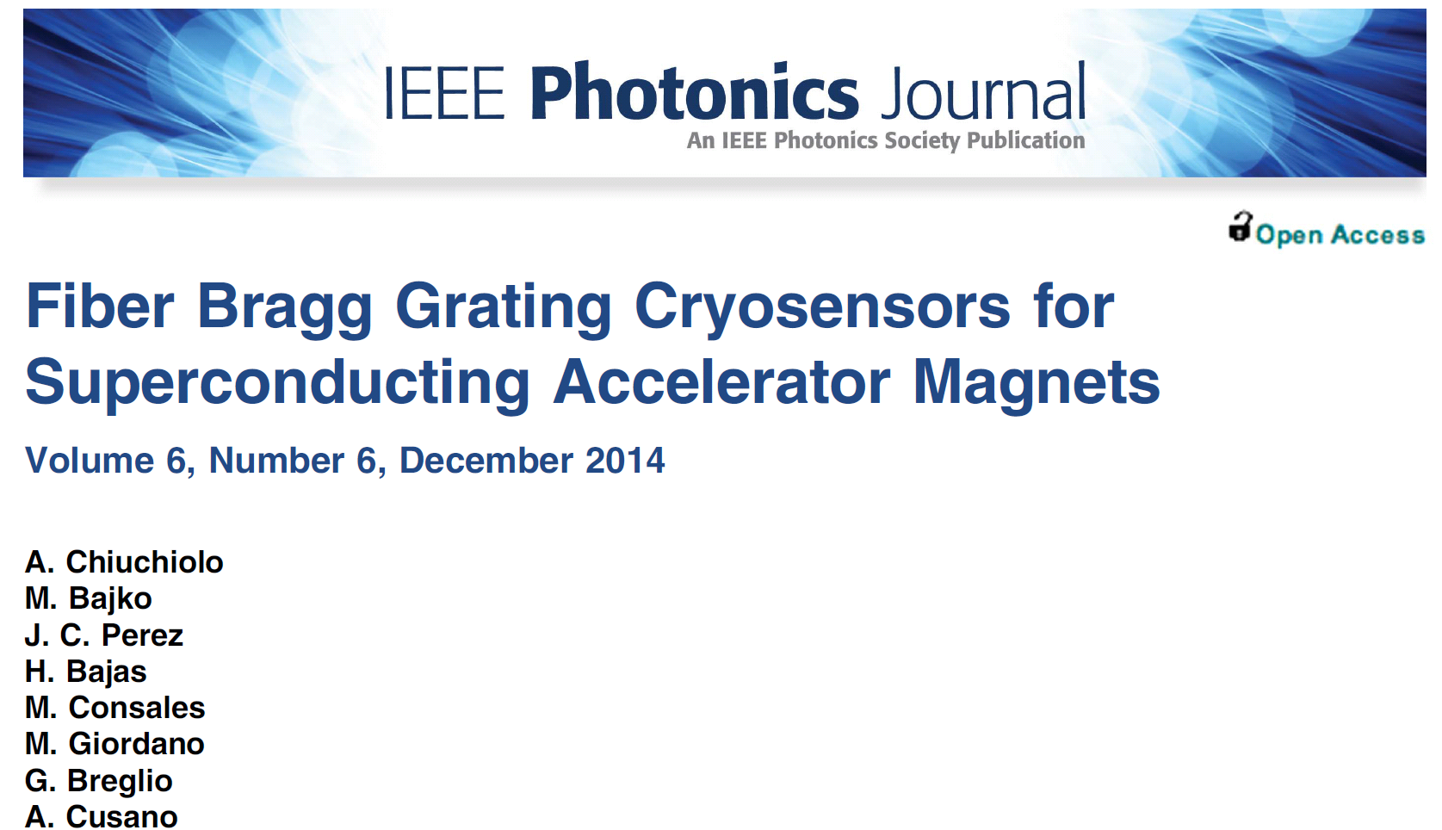
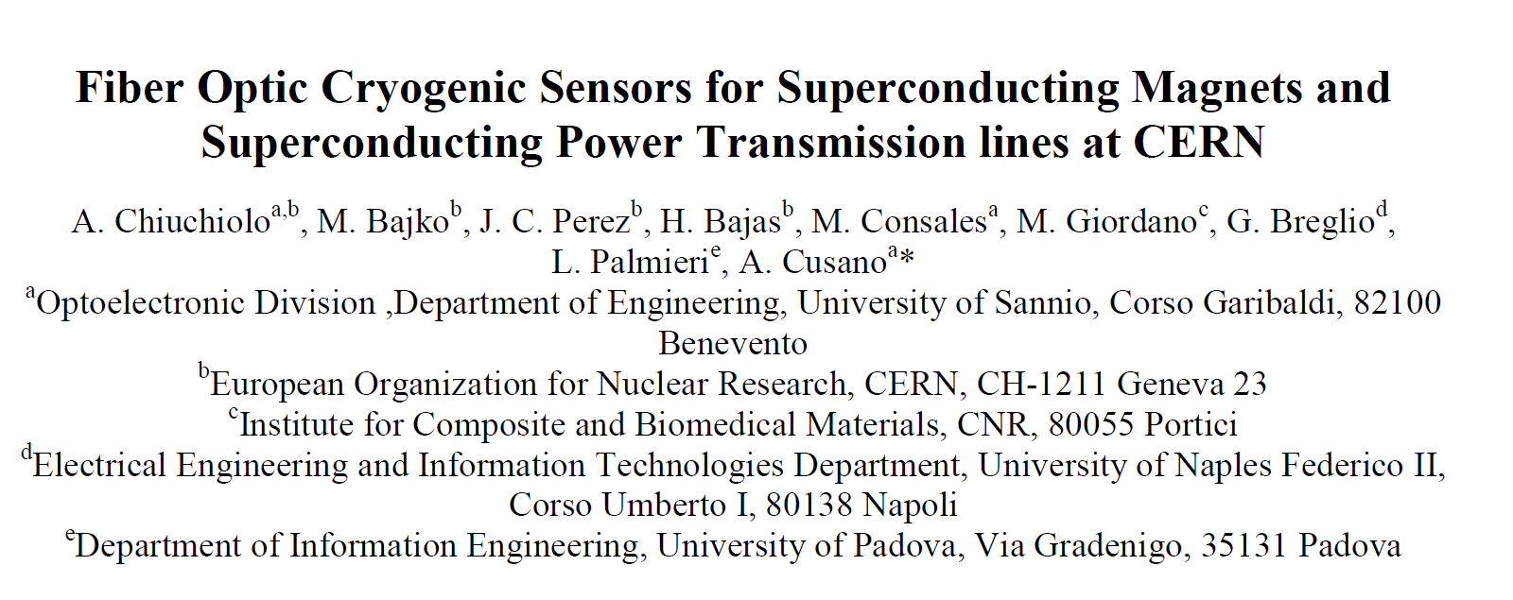
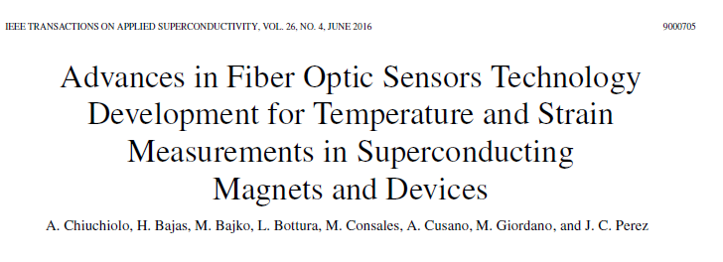
MY PAST EXPERIENCE with TNA
Fiber Optic Sensors FOR CRYogenic ApplicatiOns and Superconducting Magnets
  University of Sannio (IT)
  University of Napoli, Federico II (IT)
  University of Padova (IT)
  University of Debrecen (HU)
  Institute of Polymers, Composites
  and Biomedical materials (IT)
1st access granted 20th of November 2013
13

Slide 14
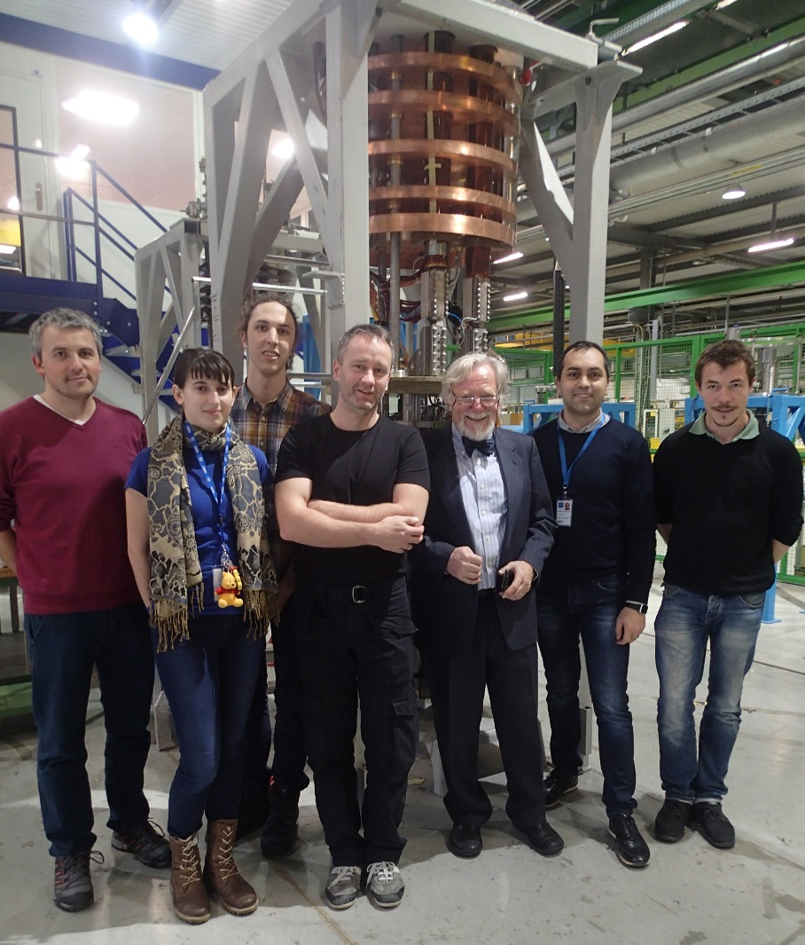
MY PAST EXPERIENCE with TNA
8. SUSHI Septum (Superconducting Shield for Septum )
Project leader: Dr. Daniel Barna
WIGNER RESEARCH CENTRE FOR PHYSICS, BUDAPEST, HUNGARY
5 members ( HU+ RU + IT)
The last granted 20th of April 2017
WITH THE MAGNET TEAM MEMBRES WE HAD:
5 NATIONALITIES
2 GENDERS, ALL AGES, INTITUTES , UNIVERSITIES AND INDUSTRY!!!
.. And many smiling faces!!!
14

Slide 15
THANKS FOR YOUR ATTENTION

