Slide 1


WP11: electron and proton beam testing
ARIES kickoff meeting, CERN 4-5 May 2017
J. Schwindling / CEA Saclay

Slide 2
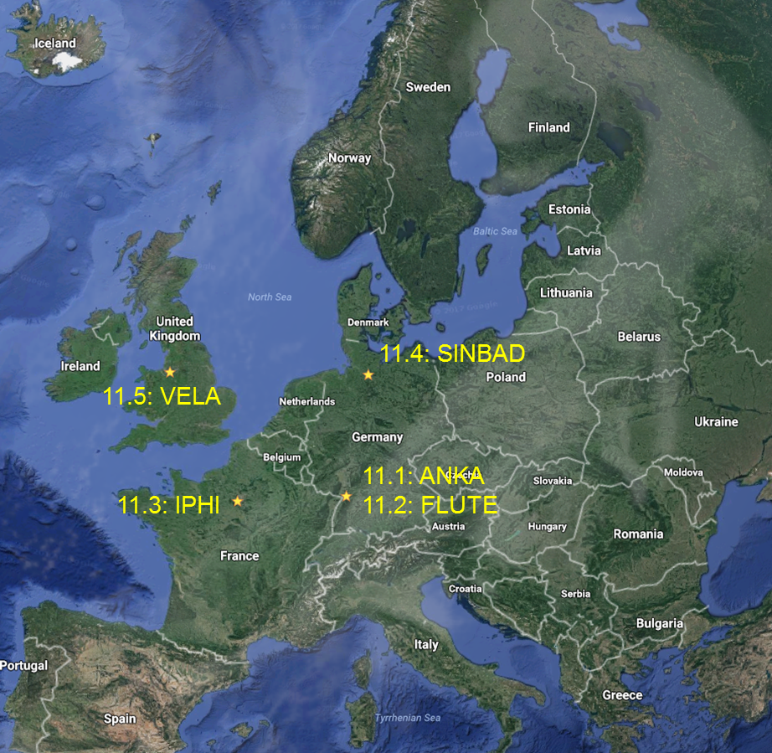
Goal of WP11
Testing of instrumentation, beam optics, RF equipment, accelerator components with low-medium energy proton and electron beams
Also synchrotron radiation, RF, neutrons
5 installations: ANKA, FLUTE, IPHI, SINBAD, VELA

Slide 3

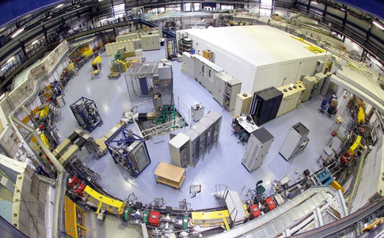
Test Facility ANKA at KIT
KIT Synchrotron
Circumference: 110.4 m
Energy range: 0.5 - 2.5 GeV
Beam current up to 200 mA
RMS bunch length: 45 ps (for 2.5 GeV), down to a few ps (for 1.3 GeV)
ANKA has been in operation for more than 15 years
2016-01-01 Foundation of the KIT Institute for Beam Physics and Technology
2016: IBPT operated the storage ring 3200 hours
IBPT has dual mission
  promote cutting-edge accelerator research
  supply synchrotron radiation for users at KIT and collaborating partners

Slide 4
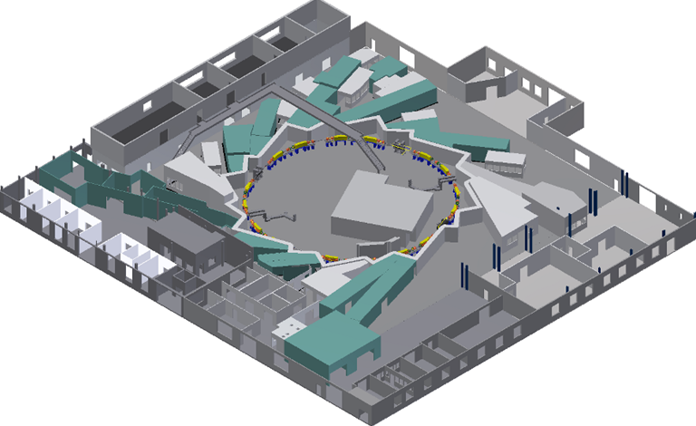


ANKA in ARIES
Give access to:
  Electrons at the accelerator
  Synchrotron radiation
8 beam periods
2.5 days + preparation
24 hours / day
Coating studies
2.7 MHz, sub-ps
Electro-optical
Monitor
www.ibpt.kit.edu/anka
Fast ps THz
detectors
Fast –gated
intensified
camera
05K16VKA
BMBF-Verbund Speaker
A.-S. Müller, 2016 - 2019
Examples of devices / studies

Slide 5



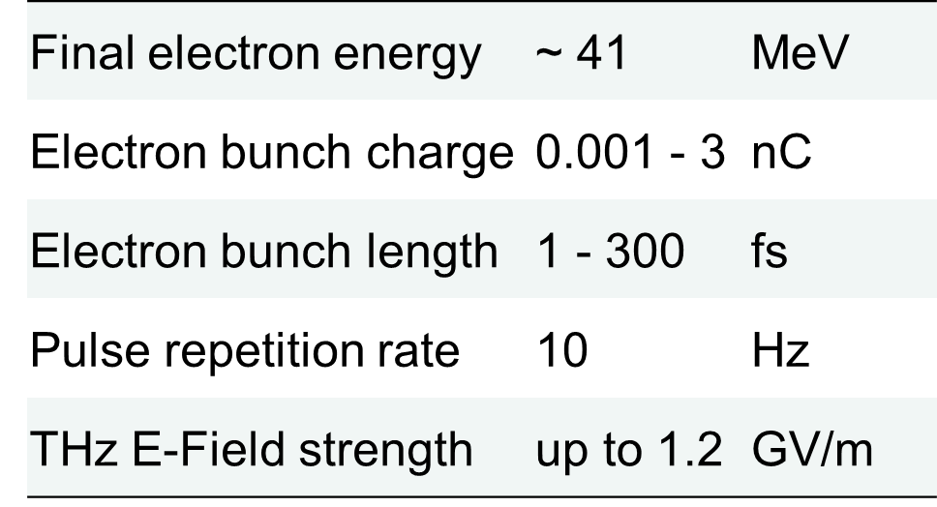
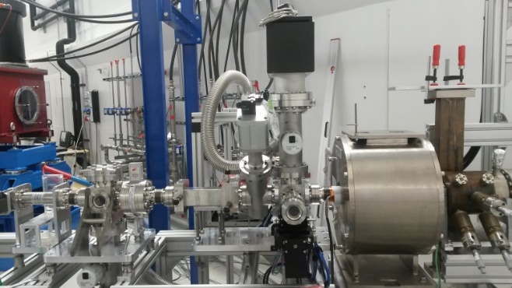
Test Facility FLUTE at KIT
FLUTE (Ferninfrarot Linac- Und Test-Experiment)
  Test facility for accelerator physics
  Experiments with THz radiation
Bunch compressor
Gun
Linac
THz
Laser running, e gun and first diagnostic section for 7 MeV assembled
First experiment autumn 2017
www.ibpt.kit.edu/flute

Slide 6
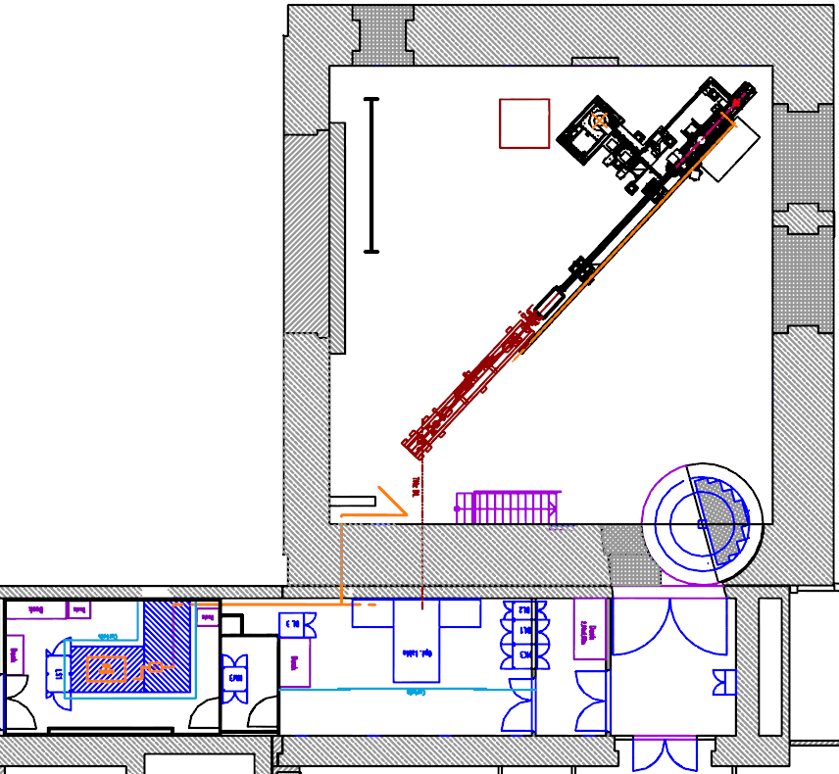
FLUTE in ARIES
Serve as a test bench for new
beam diagnostic methods and tools
Develop single shot fs diagnostics
Synchronization on a femtosecond level
Systematic bunch compression studies
Generate intense THz radiation
Compare different coherent THz radiation generation schemes in simulation and experiment
Topview
FLUTE hall
15 Meter
Gun
Klystron
Linac
Chicane
Laser
beam
8 beam periods
5 days + preparation
8 hours / day
Laser lab
THz lab

Slide 7



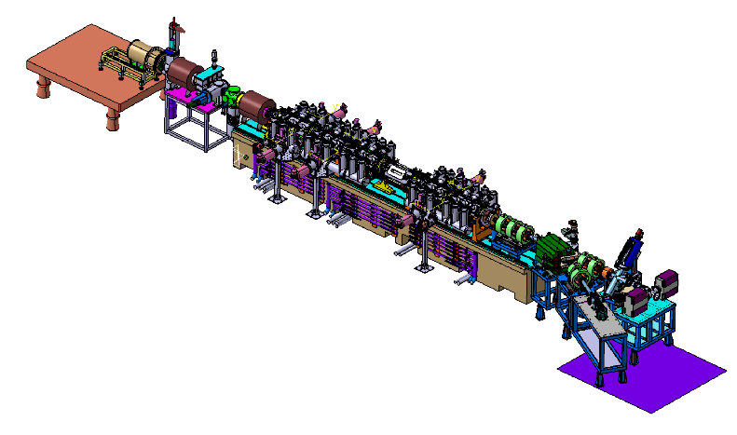
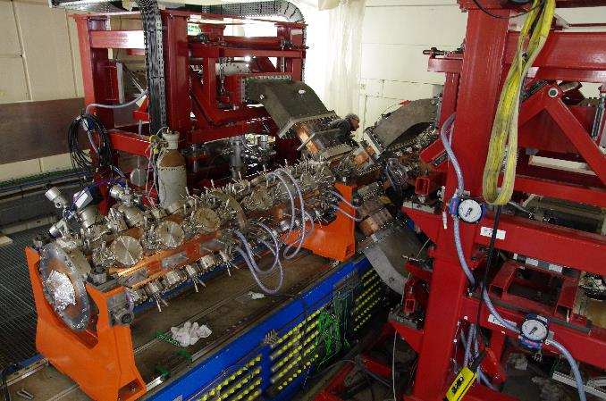
IPHI at CEA Saclay
The High Intensity Proton Injector was built and is being commissioned at CEA Saclay through a CEA – CERN – IN2P3 collaboration
Design performances are 3 MeV – 100 mA – CW proton beam (300 kW)
First beam accelerated in Spring 2016 at low duty cycle (~ 1.5 kW)
Power will be increased gradually in S2 2017
beam
SILHI source
95 keV
100 mA
RFQ
Diagnostic lines
The IPHI RFQ

Slide 8
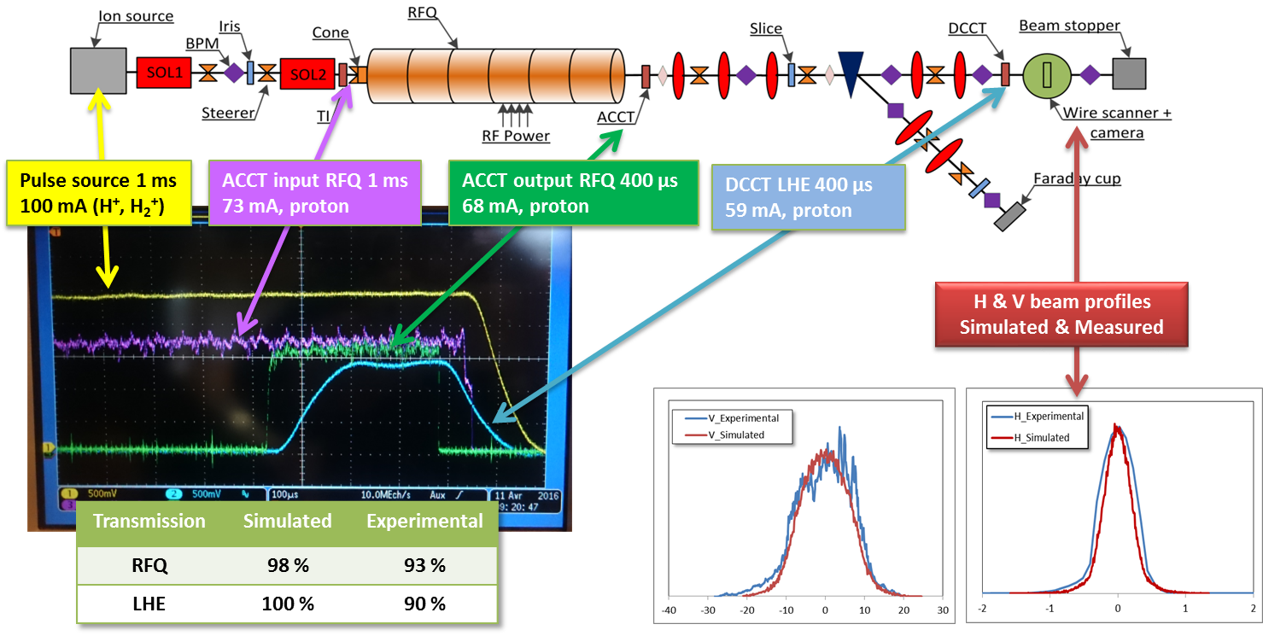
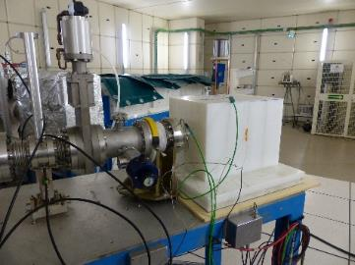
IPHI in ARIES
IPHI will provide:
  Protons at 3 MeV, 1 mA to 100 mA, duty cycle 1 ms / 1 Hz to CW
  Access to 352 MHz RF platform (CW or pulsed, ~ 2 MW peak power)
  Neutrons (10⁹ – 10¹⁰ n/s)
12 beam periods
5 days + preparation
8 hours / day
Beam in IPHI in April 2016
Neutron production and moderation device @ IPHI in June 2016

Slide 9

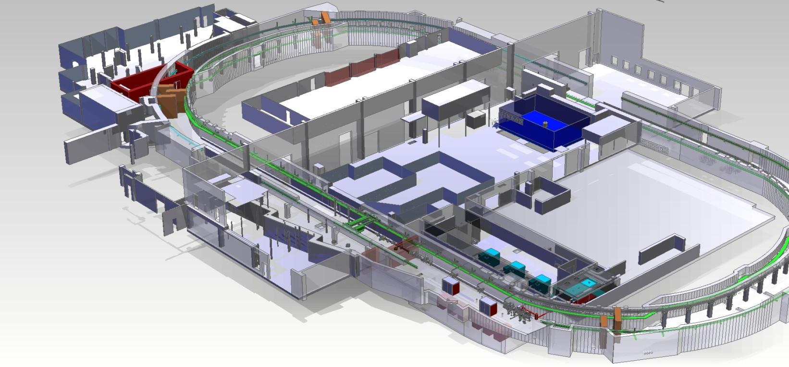
SINBAD at DESY, Hamburg
A dedicate accelerator R&D facility currently under construction at DESY
Reusing the old DORIS tunnel to set up multiple independent experiments
E = 100 MeV, charge: 0.5 - 20 pC, bunch length: few fs, transverse norm. emittance < 0.5 mm*mrad, arrival time jitter stability < 10 fs RMS, rep-rate: < 50Hz
Available: spring 2019
Old DORIS accelerator removed
Building refurbished
Beam line design frozen
Infrastructure installations starting
Procurement of RF-stations, beam line elements,...

Slide 10
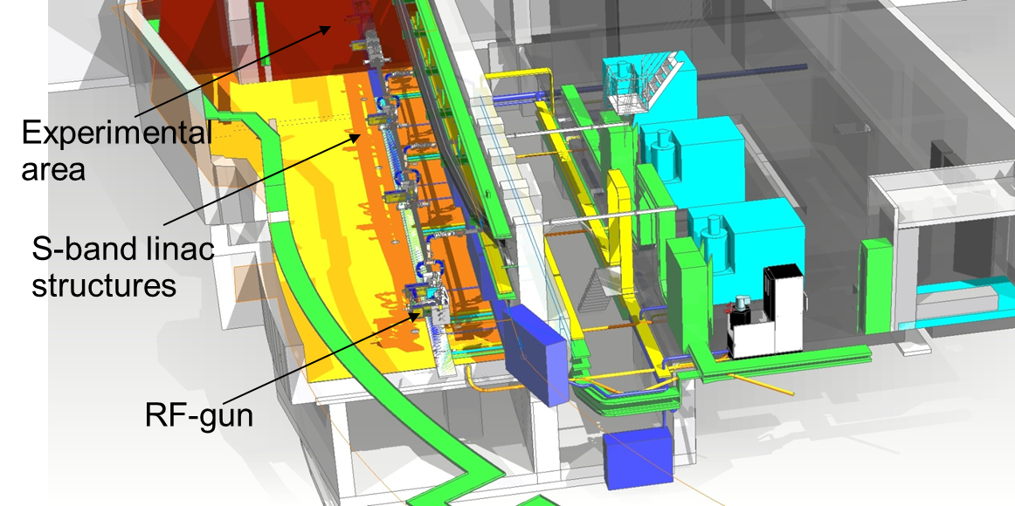
SINBAD in ARIES
TNA - access starting in spring 2019
Access will be granted to the normal conducting, S-band 100 MeV electron linac
Available experimental space in default location:
  ca 3m wide
  length preferably < 4m
9 beam periods
5 days + preparation
14 hours / day

Slide 11

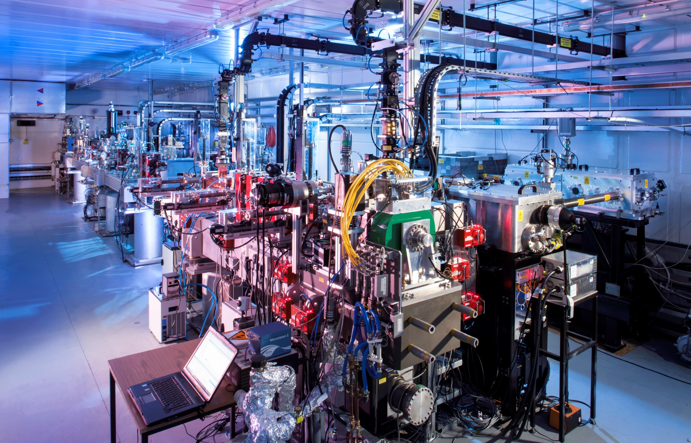
VELA at STFC Daresbury
VELA = Versatile Electron Linear Accelerator
S-Band photo-injector
Up to 250 pC bunch charge
6 MeV beam energy (upgrade to 40 MeV in progress)
10 Hz repetition rate (upgrade to 100 Hz in progress)
Copper photo-cathode driven by UV laser
1 mm profile FWHM at the cathode
10 MW klystron

Slide 12
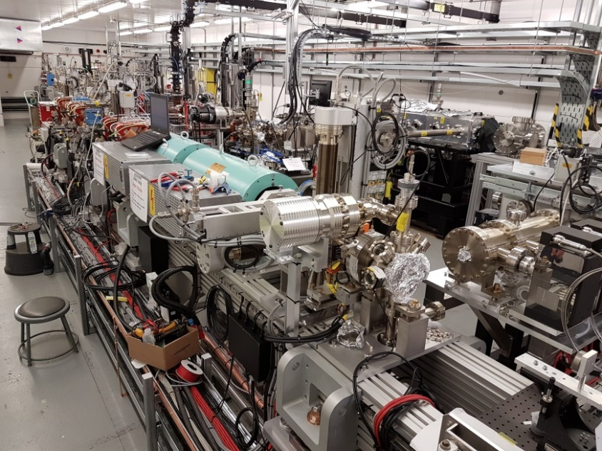
VELA in ARIES
VELA has two experimental areas available:
  Beam Area One
  2 metre long experimental vacuum chamber
  Quadrupole pair for capture post experimental region
  Faraday cup, YAG:Ce screens, non-invasive BPMs
  Beam Area Two
  Customer configurable bunker
14 beam periods
3 days
8 hours / day
 | J | F | M | A | M | J | J | A | S | O | N | D
2017
2018
2019
2020
2021
 |  | Not available
 |  | Low availability
 |  | High availability
VELA/CLARA Jan 2017
Availability, subject to change

Slide 13
Final words
All installations:
  provide local support for users
  need time to check experiment feasibility, safety issues… requests should be sent well in advance to the task leader and to jerome.schwindling@cea.fr
A User Selection Panel is being setup
Task | Installation | Location | Task leader | Beam periods | In operation
11.1 | ANKA | KIT | marcel.schuh@kit.edu | 8 periods x 2.5 days x 24 h | Yes
11.2 | FLUTE | KIT | marcel.schuh@kit.edu | 8 periods x 5 days x 8 h | End 2017
11.3 | IPHI | CEA Saclay | jerome.schwindling@cea.fr | 12 periods x 5 days x 8 h | End 2017
11.4 | SINBAD | DESY | ulrich.dorda@desy.de | 9 periods x 5 days x 14 h | Spring 2019
11.5 | VELA | STFC Daresbury | anthony.gleeson@stfc.ac.uk | 14 periods x 3 days x 8 h | Yes

