Slide 1
New Technologies: New Materials for Extreme Thermal Management – PowerMat (WP17)
ARIES Kick-off Meeting, CERN Geneva 04.05.2017
Alessandro Bertarelli (CERN), Marilena Tomut (GSI)

Slide 2
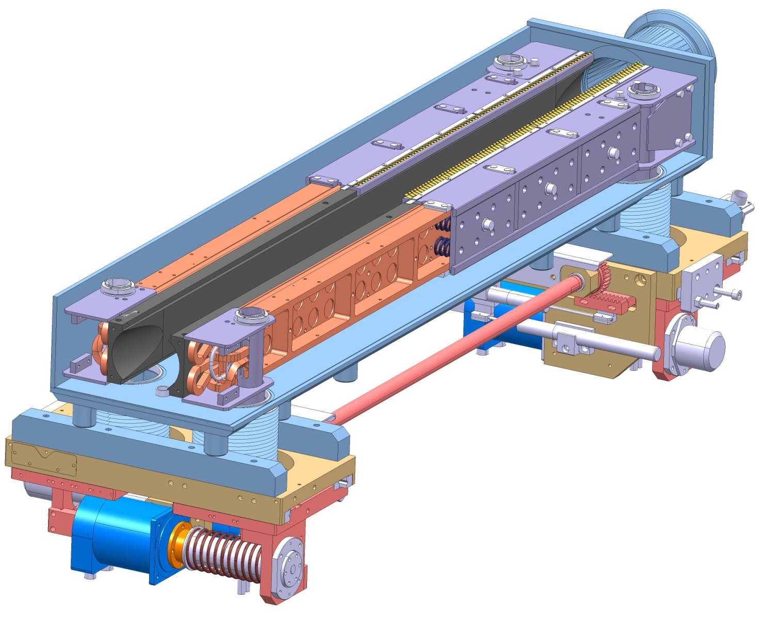
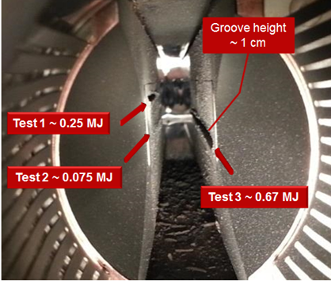
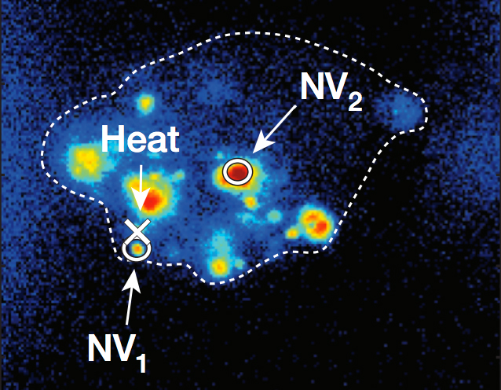
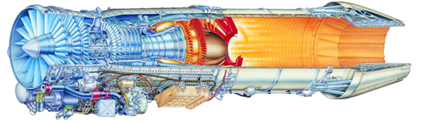
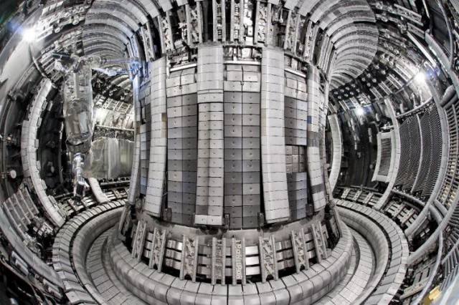

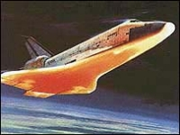
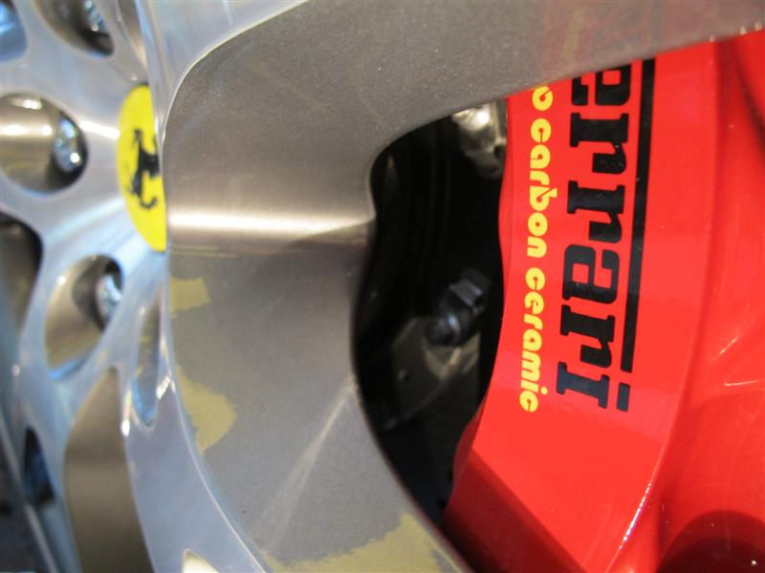
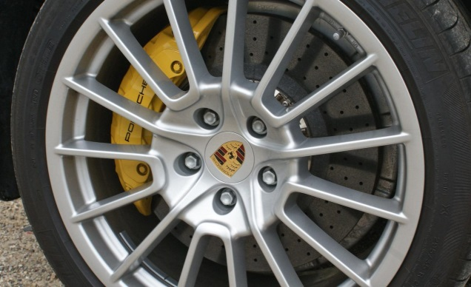
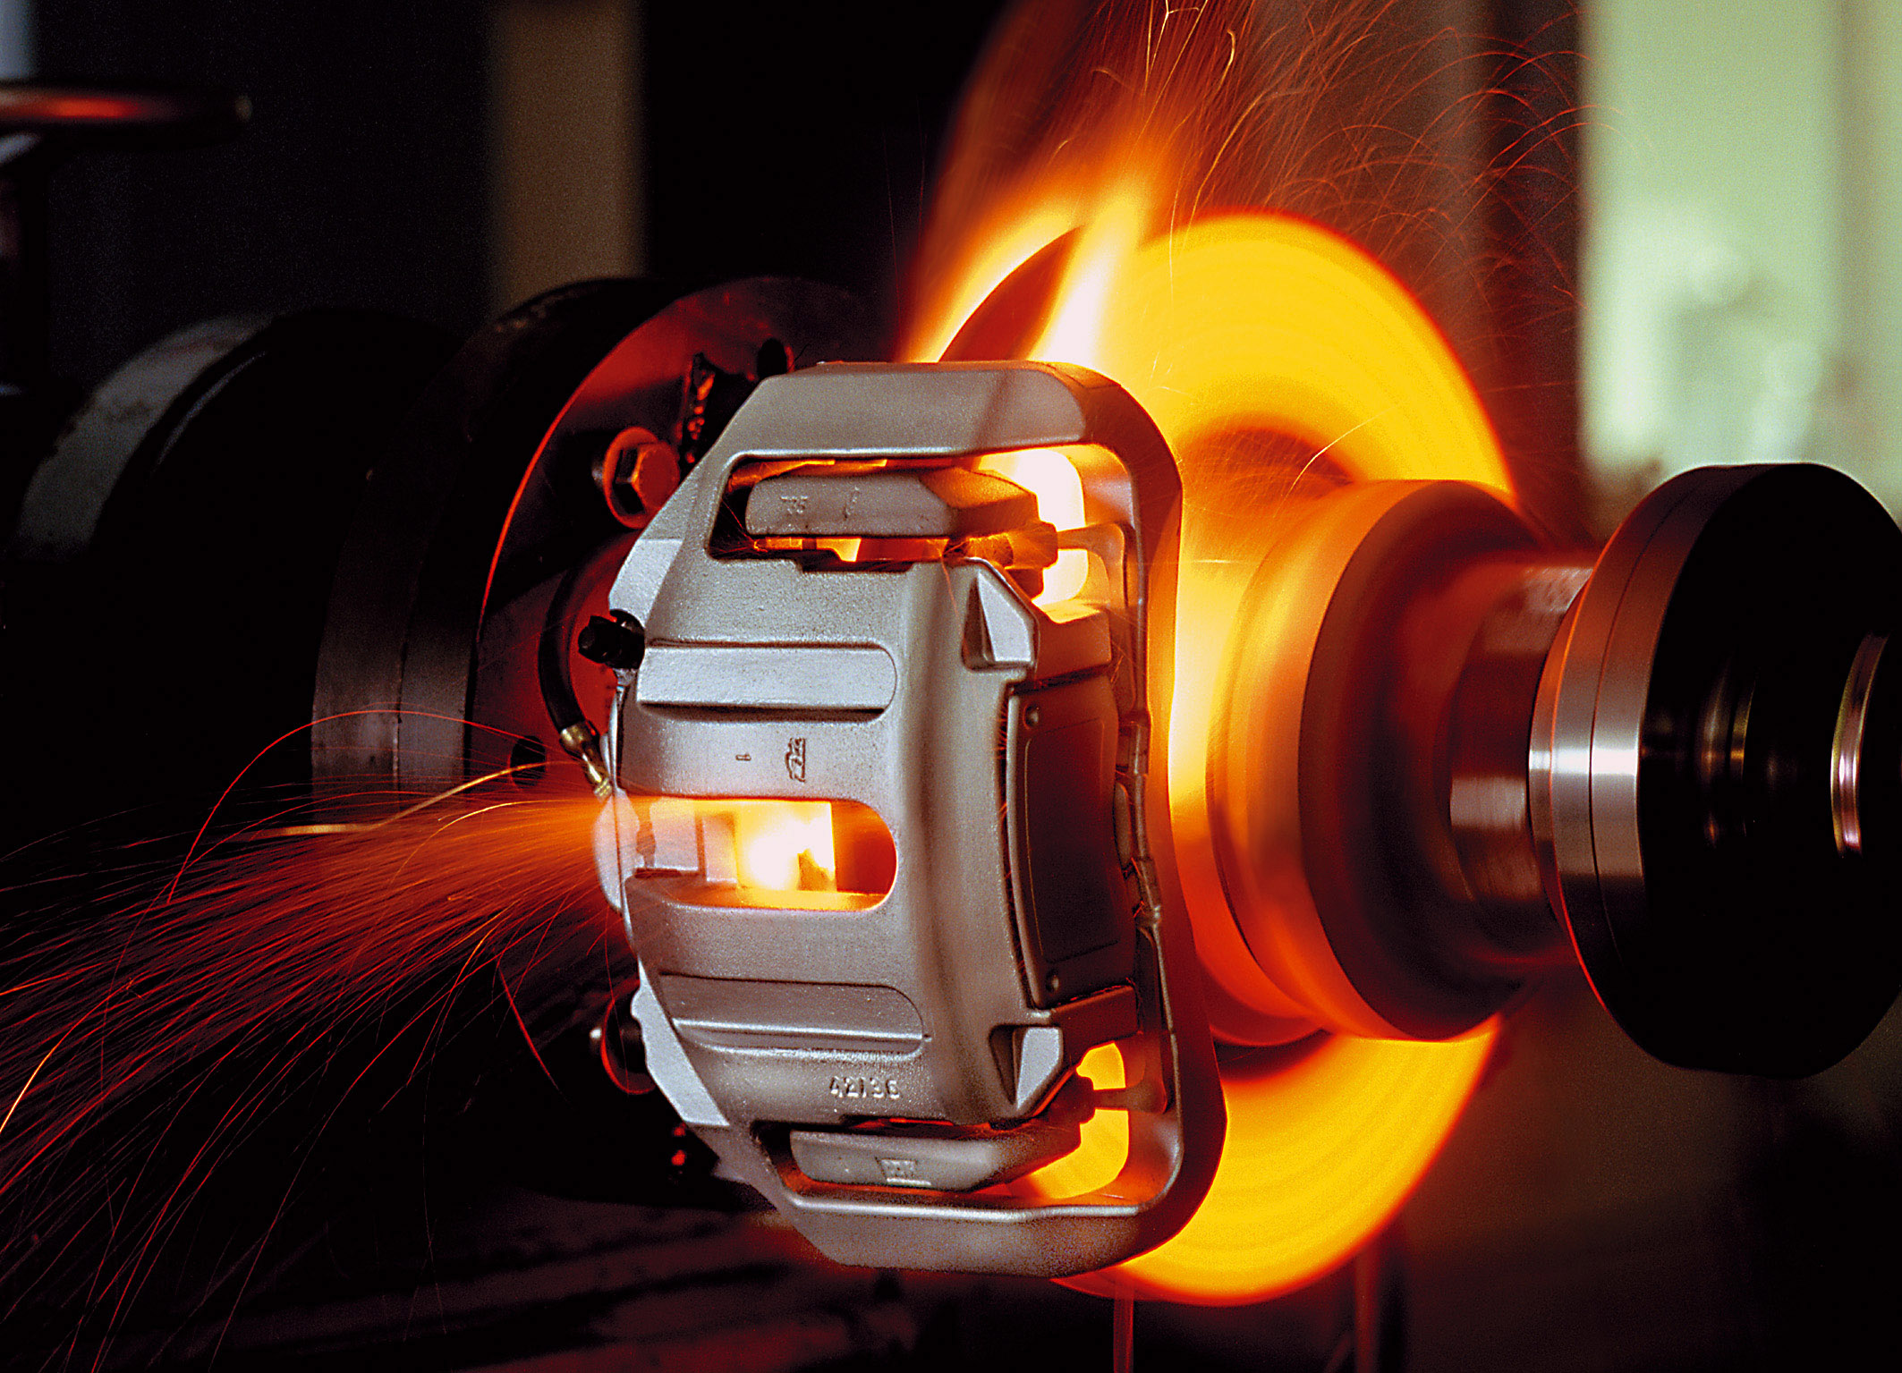
What is Extreme Thermal Management?
Applications dealing with very high temperatures, pressures, strain rates, particle irradiation, in harsh environments …
Particle Beam
Particle Accelerators (Beam Intercepting Devices)
Medical Imaging
High temperature Aerospace Applications
Fusion Engineering
Advanced Braking Systems

Slide 3
PowerMat in a Nutshell
Push forward R&D of novel Ceramic Matrix and Metal Matrix Composites based on graphite and diamond reinforcements with various dopants
Simulate and test materials under extreme thermal shocks (particle- or laser-beam induced) and particle irradiation
Investigate radiation damage from theoretical, numerical and experimental standpoint
Identify materials for a broad range of accelerator applications (high power collimators, beam targets, beam windows and luminescence screens …)
Explore societal applications in advanced engineering, medical imaging, quantum computing, energy efficiency, aerospace …

Slide 4



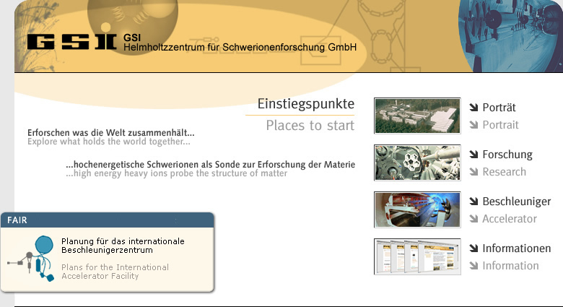


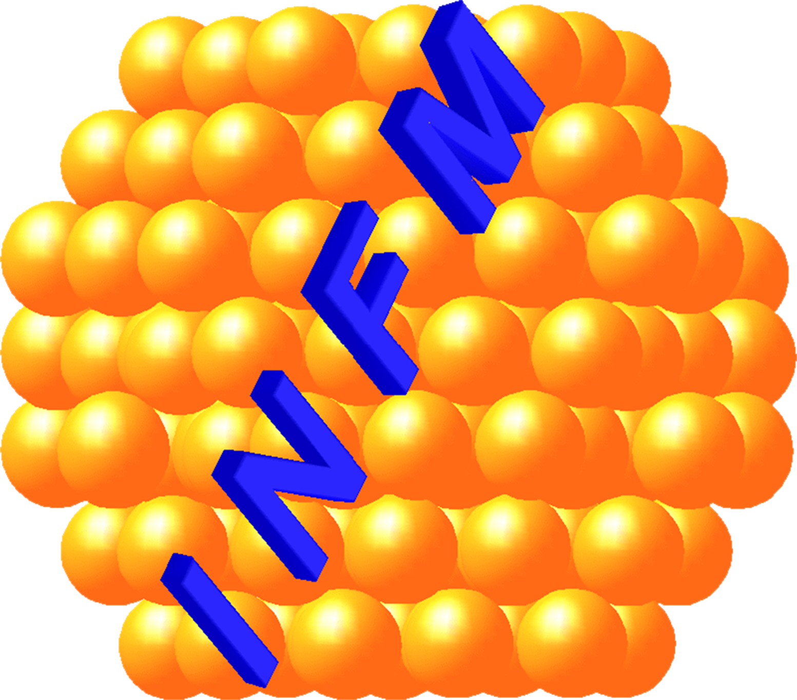


PowerMat Partners
Strong interaction with WP14 (Promoting Innovation) – Task 14.4
WP17: 6 main beneficiaries, 1 associate (NIMP)
WP14: 1 beneficiary industry (RHP-Technology), 1 associate industry (Brevetti Bizz) in Task 14.4

Slide 5
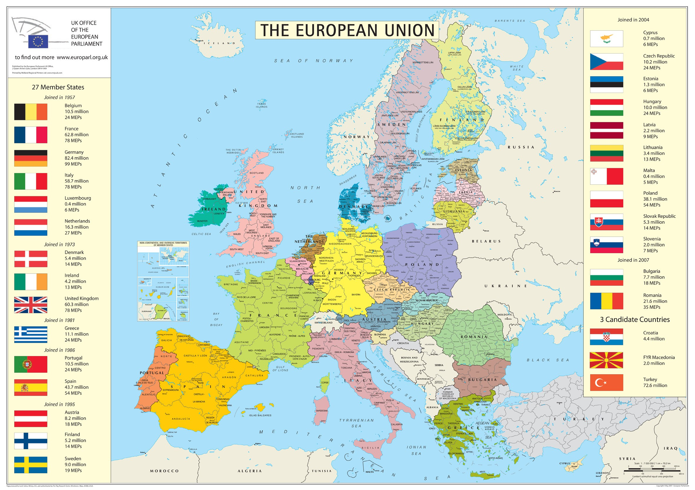
PowerMat Partners

Slide 6
Work Package Organization
PowerMat JRA is organized in 5 Tasks:
  17.1: Communication & Coordination
  A. Bertarelli, CERN; M. Tomut, GSI
  17.2: Materials development and characterization
  A. Bertarelli, CERN
  17.3: Dynamic testing and online monitoring
  L. Peroni, POLITO
  17.4: Simulation of irradiation effects and mitigation methods
  A. Lechner, CERN
  17.5: Broader accelerator and societal applications
  M. Tomut, GSI
Within WP14 (Promoting Innovation):
  14.4: Industrial production of materials for extreme thermal management
  F. Carra, CERN

Slide 7
Task 17.2: Materials development and characterization
Coordinator: A. Bertarelli, CERN
Participants: CERN, GSI, NIMP, POLIMI, POLITO, UM (plus Brevetti Bizz, RHP-Technology through WP14)
Research, investigation, development and characterization of novel CMC and MMC based on graphitic, carbide or diamond reinforcements and dopants (in collaboration with Task 14.4).
Study and development of electrically conductive coatings, resisting the impact of high intensity particle beams.
Characterization of thermophysical and outgassing properties, microstructural analyses, study of phases and of their change under various environments …

Slide 8
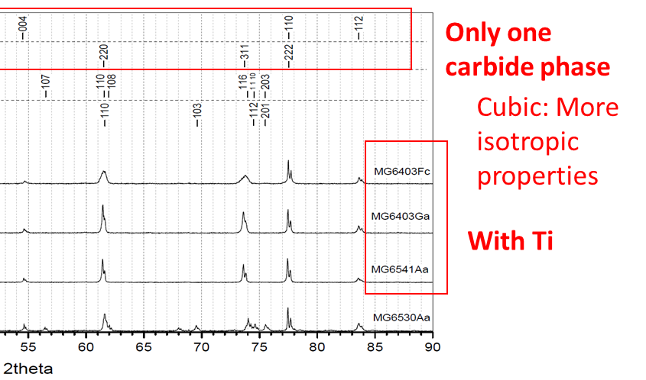

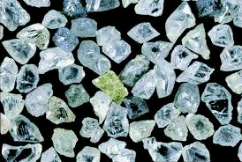
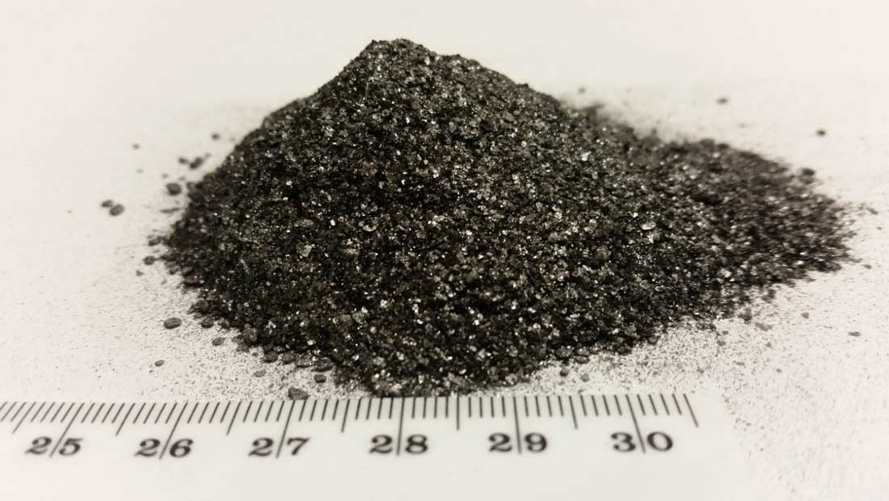
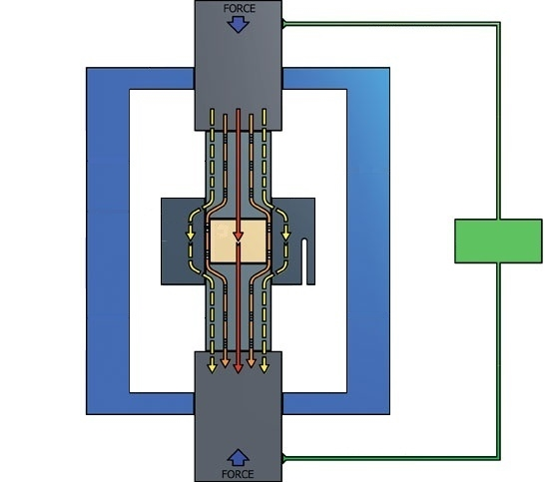
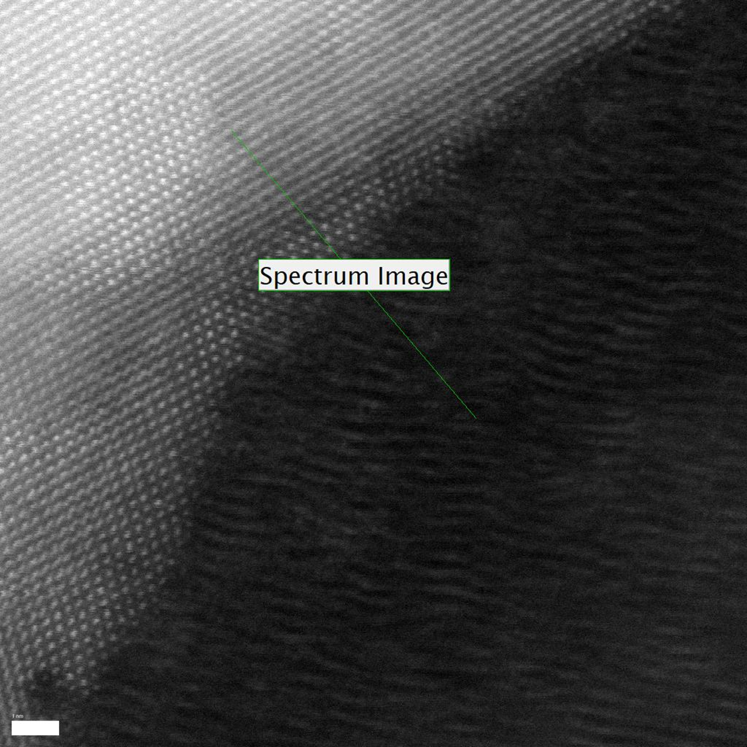
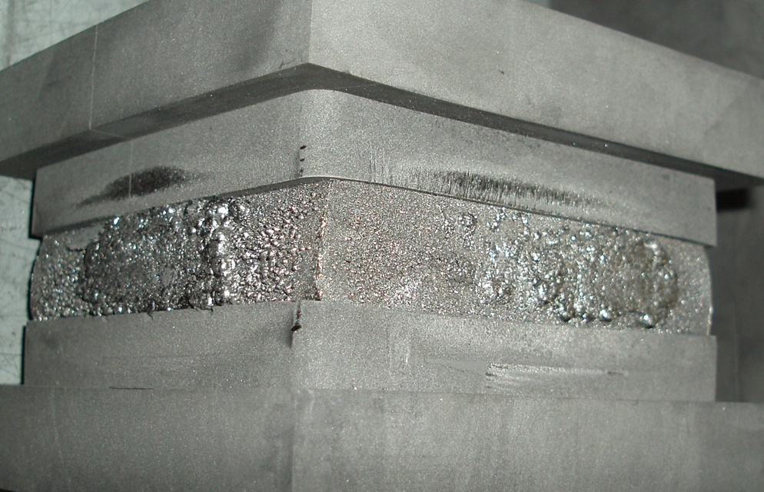
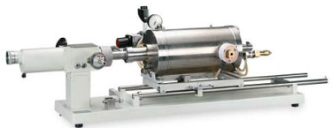
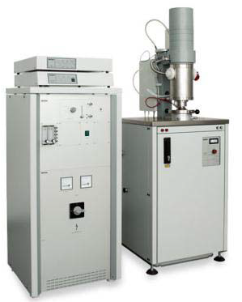
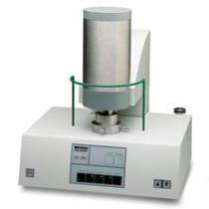
Task 17.2: Materials development and characterization
Choice of components (materials, topology, dopants …)
High-temperature manufacturing (SPS, RHP …)
Thermophysical characterization (DIL, LFA, DSC …)
Microstructural characterization (SEM, FIB, XRD, EDS, TEM …)
Data analysis, investigation, new proposal …
Pressure
Graphite Die
Powders
DC Current
(continuous or pulsed)
Graphite Punch
Vacuum Chamber
Pressure
Task 14.4
in collaboration with University of Zaragoza (SP)

Slide 9
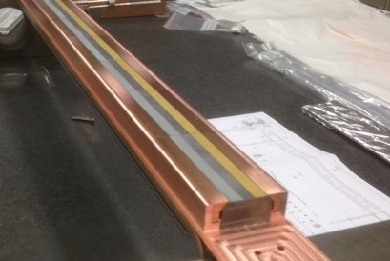
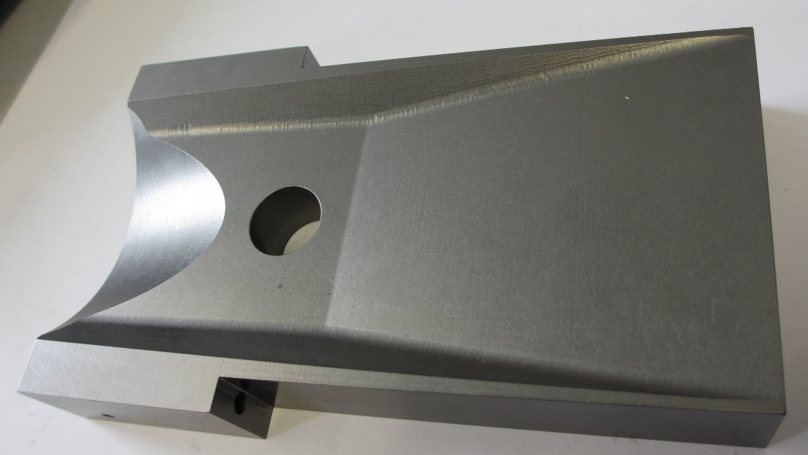
Task 17.2: Materials development and characterization
Example of Ceramic Matrix Composite: Molybdenum Carbide – Graphite (MoGr)
Co-developed by CERN and Brevetti Bizz
Produced by Pressure-assisted Electric Current Sintering attaining liquid phase of carbides (T ≅ 2600°C)
Excellent crystalline structure of carbonaceous phase with highly-oriented Graphene planes. Graphitization favored by the catalyzing effect of molten carbides!
Excellent thermal properties (up to 4 times Cu diffusivity)!
Electrical conductivity: factor of 10 higher than isotropic graphite!
Can be produced in large components (150 x 100 x 25 mm³) and easily machined
Can be coated with metals (e.g. Mo) and ceramics (e.g. TiN)

Slide 10

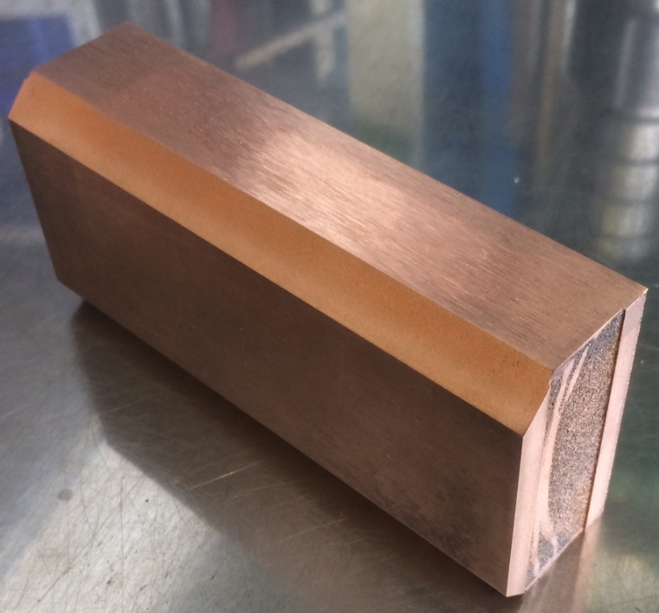
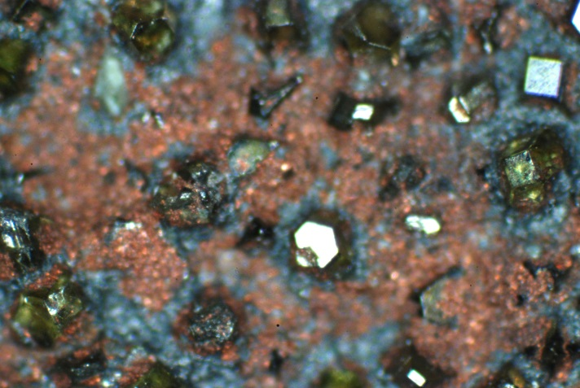
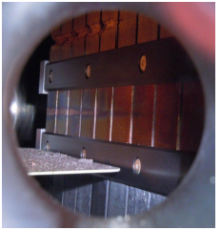
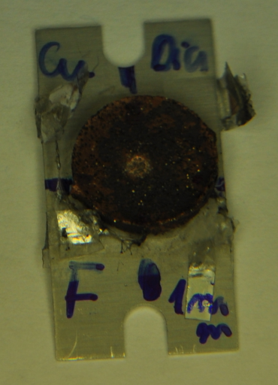
Task 17.2: Materials development and characterization
Example of Metal Matrix Composite:
Copper – Diamond (CuCD)
Developed by RHP-Technology
Produced by Rapid Hot Pressing (T ≅ 1000°C)
Excellent electrical conductivity, very good thermal conductivity
Shock and Radiation resistant
Can be cladded with pure copper
Mo-CD composite
Laser shock experiment
- GSI:
Pulse duration: | 0.7-20 ns
energy: | 0.3-1 kJ
Max. Intensity: | 10¹⁶ W/cm²
Proton beam
HiRadMat,
CERN:
Notes:
Mo-Gr with c oating C (per ridurre impedenza)

Slide 11
Task 17.3: Dynamic testing and online monitoring
Coordinator: L. Peroni, POLITO
Participants: CERN, ELI-NP, GSI, POLIMI, POLITO
Testing of material samples in a broad range of environments:
Mechanical testing in quasi-static and dynamic conditions, at various temperatures
Tests under very high power laser beams
Irradiation tests with online monitoring of properties evolution
Hydrodynamic simulations of experiments – Equations of State, Spall Strengths for new materials

Slide 12
Task 17.3: Dynamic testing and online monitoring
Applications of materials studied in this WP require high resistance to high energy, high energy density impacts, as well as radiation.
Spall
fracture
Reflected shockwaves
Radiation damage
Molten zone/plasma
In this task materials will be tested under severe conditions such as high strains or energy density deposition, as well as irradiate them with protons, ions and laser beam.
P>100GPa
BEAM
r
depth
Vapour
Gas
SPLASH
Cylindrical shockwaves
LASER
attenuation
Solids

Slide 13
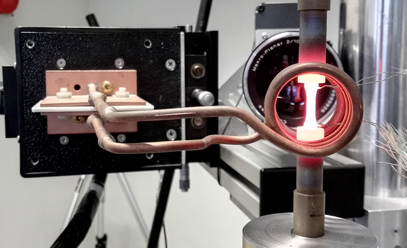
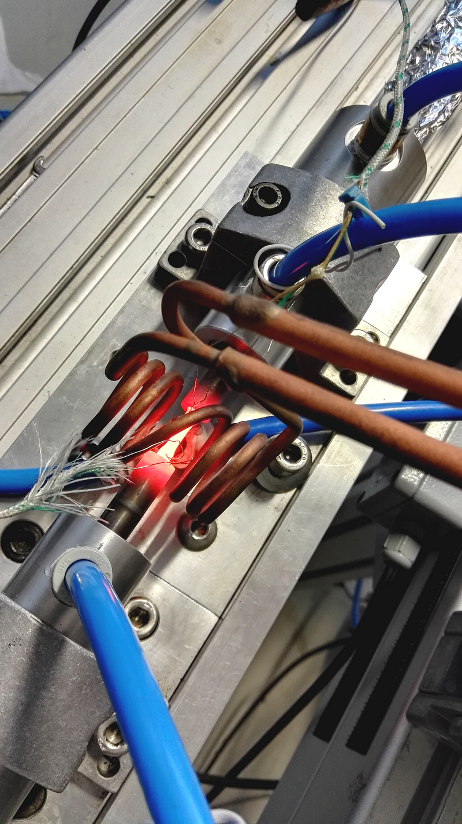
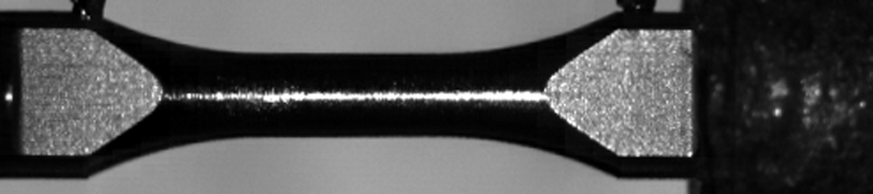
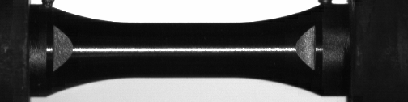
Task 17.3: Dynamic testing and online monitoring
Mechanical testing in quasi-static and dynamic conditions,
at various temperatures

Slide 14
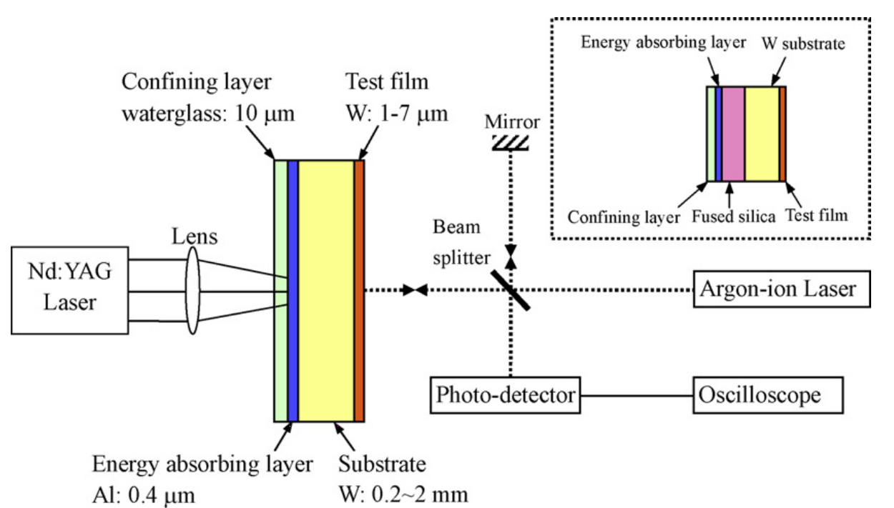
Task 17.3: Dynamic testing and online monitoring
Tests under very high power p⁺ and laser beams (GSI, ELI-NP)
p⁺ from HiRadMat, CERN and ELI-NP
Explore VH intensity (Phelix, GSI), multi PW laser facility (ELI-NP)
Lili Hu, Phillip Miller, Junlan Wang (2009)
High strain-rate spallation and fracture of tungsten by laser-induced stress waves

Slide 15
Task 17.4: Simulation of irradiation effects and mitigation methods
Coordinator: A. Lechner, CERN
Participants: CERN, GSI, POLIMI
Investigation and simulations of material damage induced by irradiation with protons and ions at various energies and doses
Quantify Displacement per atom (DPA), gas production, nuclear transmutations for equipment in complex accelerator environments and provide a relationship with radiation experiments at lower energies and/or different particle species
Ideally, relate radiation damage quantities (e.g. DPA) with change of relevant macroscopic material properties
Open to co-operation with other international collaborations such as RaDIATE – (Radiation Damage In Accelerator Target Environment)

Slide 16
Task 17.5: Broader accelerator and societal applications
Coordinator: M. Tomut, GSI
Participants: CERN, GSI, NIMP, (plus Brevetti Bizz, RHP-Technology through WP14)
R&D towards broader applications of new materials for high-power accelerators, space, society (energy, medicine, computing)
Exploit irradiation-induced defect centres in diamond for luminescent screens, medical imaging and quantum computing
Optimize materials compositions for high power targets, beam catchers, beam windows.
Explore use of intense ion pulses for materials processing
Explore synergies and applications for energy, medicine, biotechnology, aerospace and advanced technologies

Slide 17
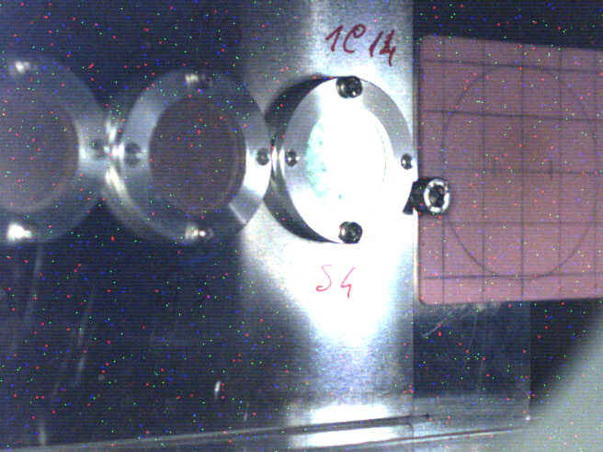
Task 17.5: Broader accelerator and societal applications
Evolution of ion induced luminescence in Cu-CD composites with dose
Beam-induced luminescence in CuCD:
withstands beam intensities
3 orders of magnitude higher than traditional
Chromox
1 x 10 ¹⁰
1 GeV Bi ions/cm²

Slide 18
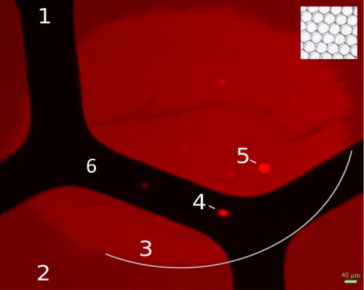
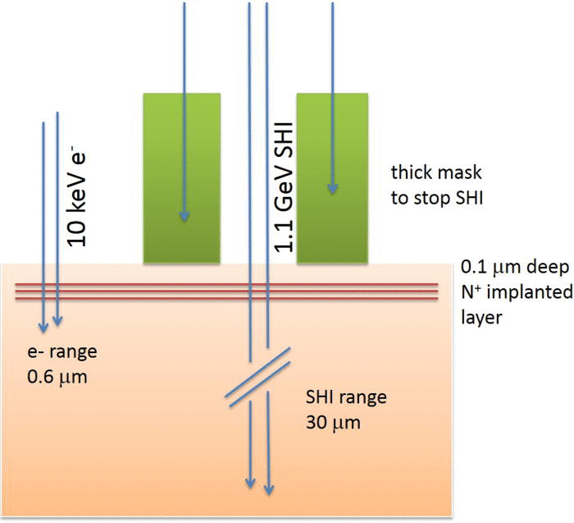
Task 17.5: Broader accelerator and societal applications
Nitrogen-Vacancy formation by electronic excitation from passage of ions through diamond?
10¹³ cm⁻²
 | Nitrogen implant | heavy ions | e⁻ beam | See NVs ?
1 | No | No | No | No
2 | No | Yes | No | No
3 | Yes | Yes | No | Yes !
4 | Yes | No | Yes | Yes
5 | Yes | Yes | Yes | Yes
6 | Yes | No | No | No
Swift heavy ions, 5 MeV/u Uranium-ions, 5x10¹¹ cm⁻²
Electronic stopping power: ~50 keV/nm (Bragg peak)
delta-electrons up to ~10 keV
J. Schwartz, et al., J. Appl. Phys., 2014
Notes:
Hyperspectral image of the PL intensity from NV ⁻ centers (635–642 nm) before thermal annealing. The central region was implanted with nitrogen ions (10 keV, 10 ¹³ cm ⁻², indicated by the white line). During subsequent SHI irradiation (1.14 GeV U, 5 × 10 ¹¹ cm ⁻²), the sample was masked by a honeycomb grid (see inset). (1) pristine diamond, (2) area exposed only to SHI, (3) nitrogen implanted spot with NV ⁻ activated by SHI, (4) NV ⁻ activated by 10 keV electrons without exposure to SHI, (5) NV ⁻ activated by SHI followed by exposure to 10 keV electrons, (6) nitrogen implanted area, not exposed to either SHI or electrons. Unlabeled spots and squares are from SEM imaging.
2: signal from tail of GR1 damage line

Slide 19
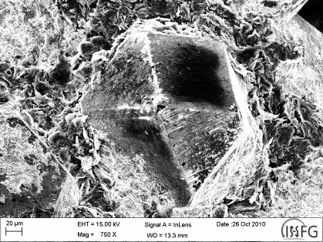
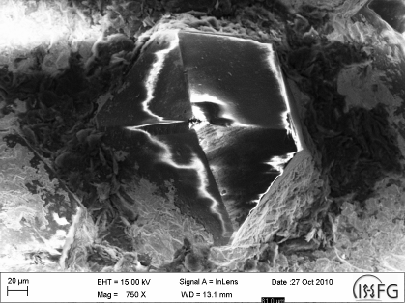
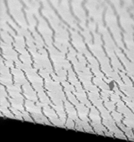
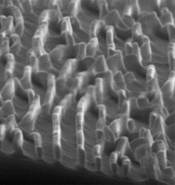
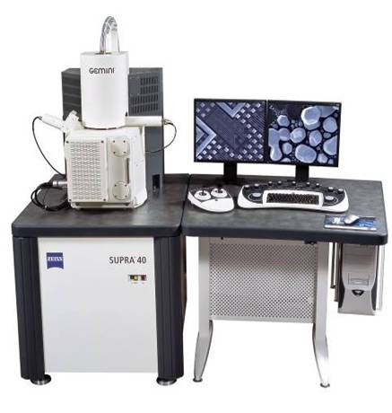
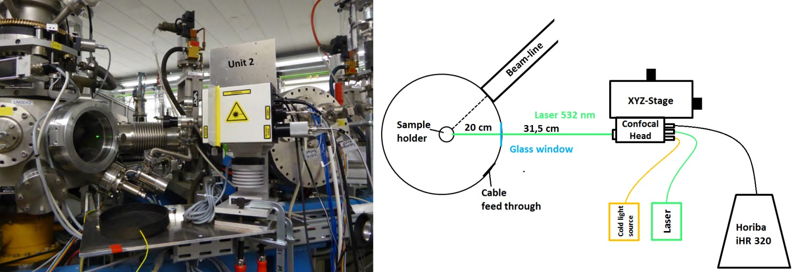
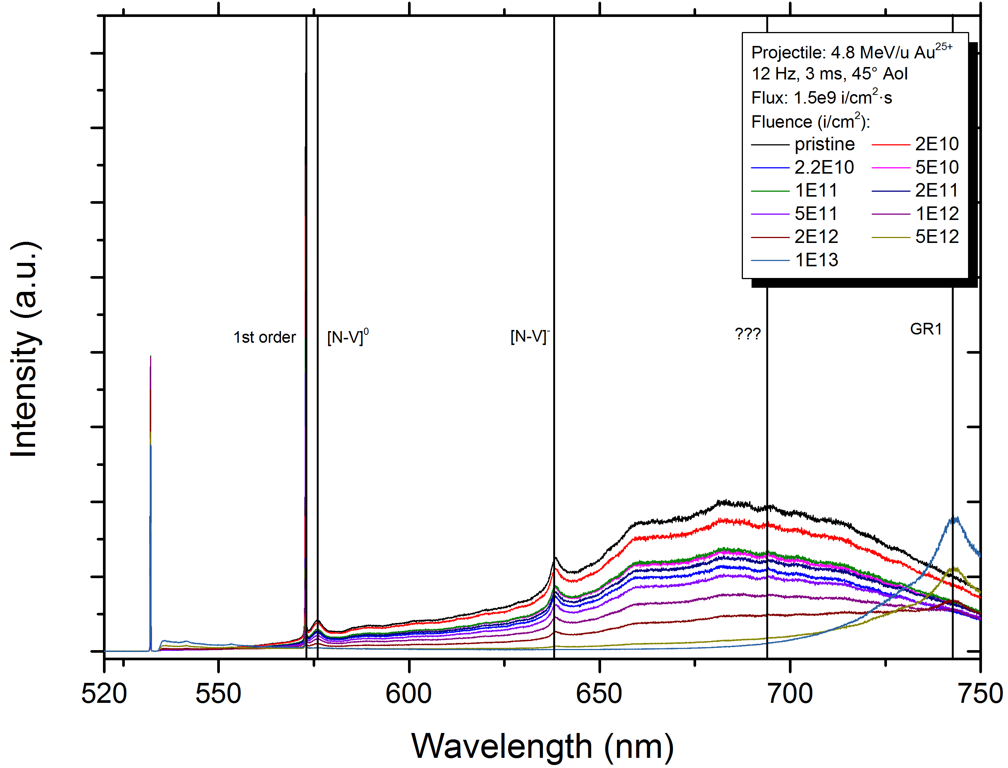
Task 17.5: Broader accelerator and societal applications
In situ analysis of radiation damage effects
HR-SEM
M1-GSI
Electron Microscopy
1 μm
1 μm
pristine
1x10¹³ i/cm²
in collaboration with University of Stuttgart
Raman spectroscopy
in collaboration with University of Heidelberg

Slide 20
PowerMat WP Summary and Outlook
PowerMat is an integrated and comprehensive research activity with challenging and innovative objectives:
  R&D and optimization of advanced materials for a broad range of application in HEP and advanced engineering …
  Innovative numerical and experimental methods to test materials at extreme energy density conditions (beyond HL-LHC) in more accessible experimental facilities and producing less activation.
  Assessment of radiation damage in materials and results scalability between different irradiation conditions (short, low energy tests vs. long-term, high energy in real accelerators)
  Control and exploitation of irradiation-induced effects in novel materials (e.g. diamond luminescence) for new monitoring techniques in accelerators as well as exploration of unconventional applications in society (medicine, biotechnology, quantum computing …)
Strict co-operation with WP 14 (Task 14.4)
PowerMat is already up and running: WP kick-off meeting due tomorrow, following a preparation meeting on 1 February 2017!

Slide 21
Thank you!

Slide 22
Deliverables
Task 17.2 Comparative compendium of the developed materials [month 40]
Task 17.4) Report on simulations on irradiation effects [month 44]
Task 17.3) Irradiation test results: Beam impact on new material and composite [month 46]
Task 14.4) Production of material samples (as large as possible for each industry to demonstrate workability) [month 24]
16 November 2015

Slide 23
Milestones
Task 17.1) Organisation of PowerMat kick-off meeting, with publication of talks on Web [month 6]
Task 17.2) Material characterisation, with publication of results on Web [month 18-24]
Task 17.3) Irradiation, with publication of report on web[month 27]
Task 17.4) Irradiation effects analysis, with publication of report on web[month 36]
Task 17.5) Report on studies, with publication of report on web, [month 46]
Task 14.4) Prepare first samples [month 12]

Slide 24
Deliverables and Milestones
Task | Year 1 |  |  |  | Year 2 |  |  |  | Year 3 |  |  |  | Year 4
 | Q1 | Q2 | Q3 | Q4 | Q1 | Q2 | Q3 | Q4 | Q1 | Q2 | Q3 | Q4 | Q1 | Q2 | Q3 | Q4
17.1 |  | M
17.2 |  |  |  |  |  |  | M |  |  |  |  |  | D
17.3 |  |  |  |  |  |  |  |  | M |  |  |  |  |  |  | D
17.4 |  |  |  |  |  |  |  |  |  |  |  | M |  | D
17.5 |  |  |  |  |  |  |  |  |  |  |  |  |  |  |  | M
1.4 |  |  |  | M |  |  |  | D

Slide 25
Task 17.1 Coordination and Communication
Coordinators: A. Bertarelli, CERN; M. Tomut, GSI
Coordination of JRA tasks, interface with other work packages (specifically WP14), public outreach, knowledge transfer etc.
Budget management
Monitoring task progress. Adherence to milestones and timely reporting of deliverables

Slide 26
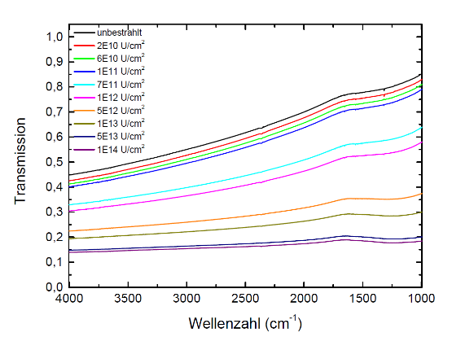
Irradiation tests with online monitoring of properties evolution (GSI)
IR
Quelle
Proben-
halter
Ionenstrahl
Fluenz
IR
Messung
Bestrahlung
IR
Detektor
sp³
sp²

Slide 27
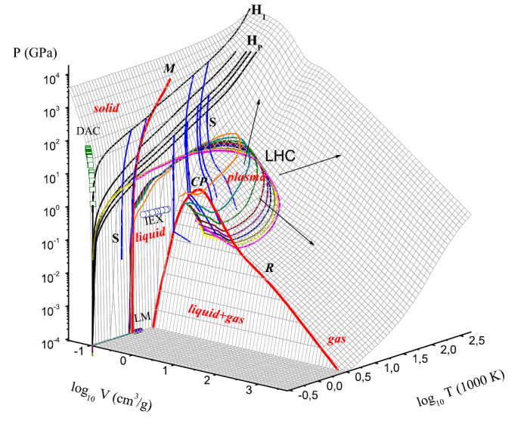
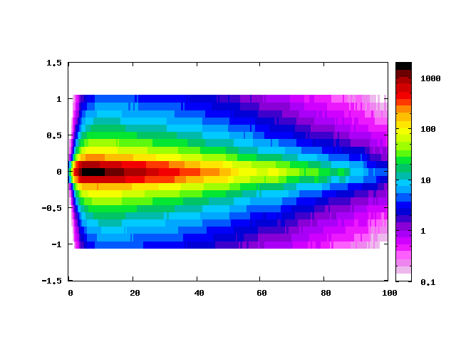
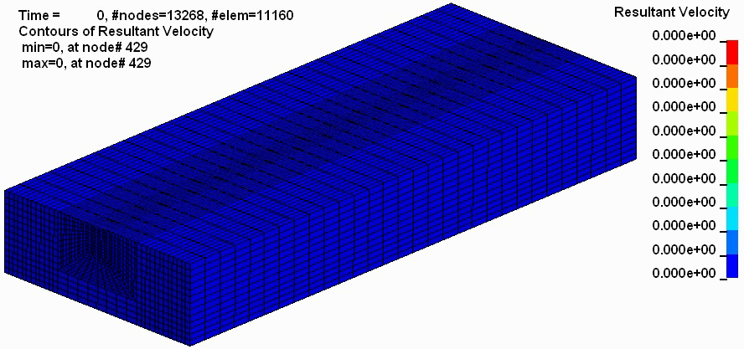
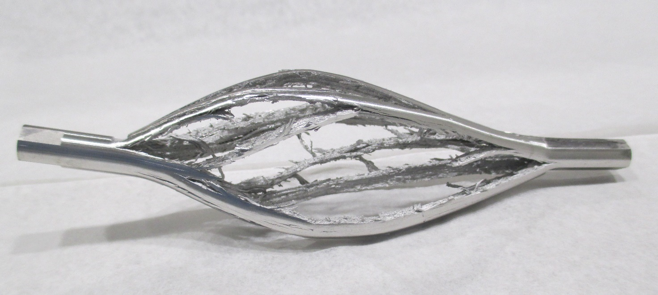
Hydrodynamic simulations of experiments - EOS, spall strengths for new materials
Energy deposition
Equation of state
Particle beam
Hydrocode simulation
W
Cu

