Slide 1
TI8/WIC Incident & UJ87/UA87
Radiation Levels & Analysis
M. Brugger for the R2E Study Group

Slide 2
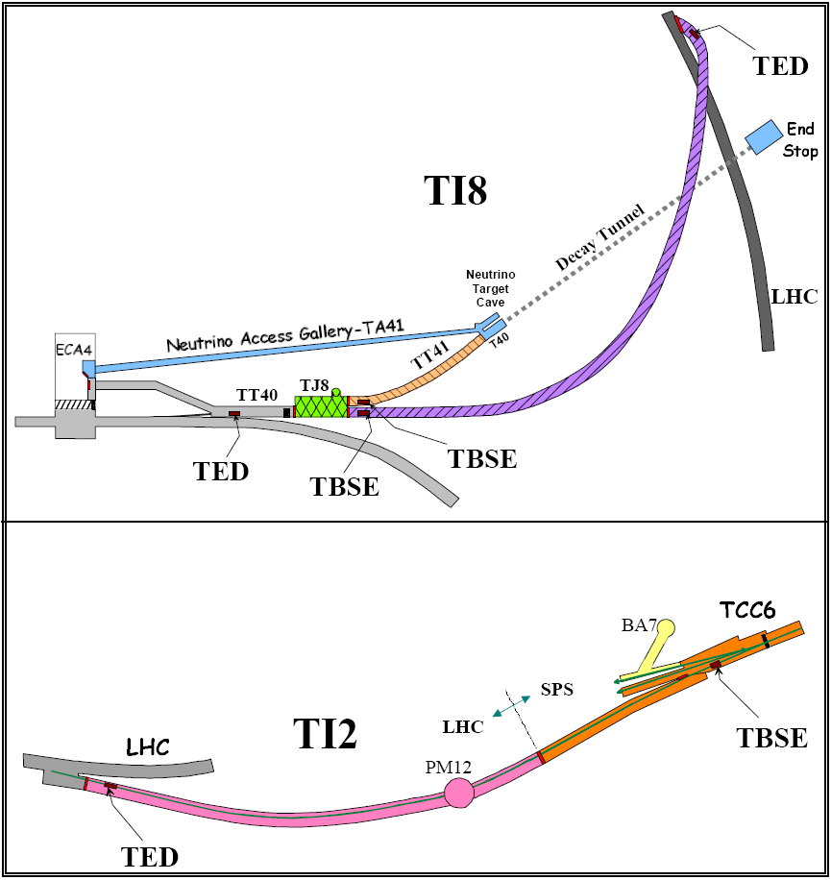
The Injection Lines

Slide 3
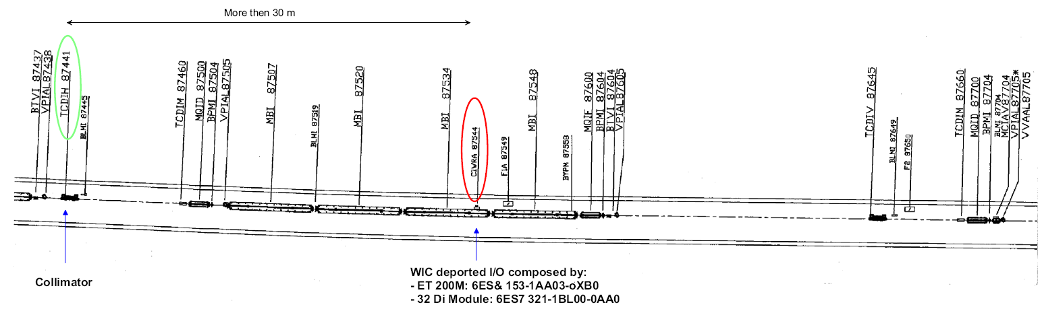
Observations TI8/WIC
~2x10¹² protons were ‘dumped’ on an injection line collimator (TCDIH 87441), i.e., ~1.2x10¹¹ protons per shot
[J. Wenninger, S. Redaelli]
  how many protons have been lost on this collimator before during earlier operations (scaled BLMI 87445)?
a WIC crate installed ~30m downstream (below MBIs) got stuck and this is most probable due to an SEE [P. Dahlen]

Slide 4
Beam Loss & Normalisation
how do the ~2x10¹² (and ~1.2x10¹¹) protons compare to ‘normal’ operation
[based on an old loss analysis by B. Goddard]:
  full injected batch: ~3x10¹³
  (such a loss could arise through a steering error or a converter trip during the interlock dead time prior to extraction -> this was estimated to happen once every few years)
  regular loss (depending on sigma and beam): between 1.5x10¹⁰ and 2.6x10¹¹ per injection and collimator
  (this fits to the estimated 1% of full injected batch)
  2.5x10¹⁰ per injection and collimator was at that time the given ‘work estimate’
the possible number of annual WIC failures will however scale with the integrated fluence, i.e., one has to consider e.g., the annual number of injections, thus about 400!
(in case the operational scenario of one full injected batch per LHC fill is kept)

Slide 5
Radiation Levels
a FLUKA simulation (collimator + downstream magnets) was put in place to have a quick check on the radiation and particle energy spectra at the location of the electronics (see following slides)
  1.2x10¹¹ 450 GeV protons on collimator
  radiation map downstream looking at the rack location below the magnet
  analysing:
    high-energy hadron fluence
    particle energy spectra
    possible low-energy neutron component
an over-the-thumb (very rough) estimate based on available calculations at IR7 currently gave the following conservative estimate:
  a few 10⁸ to 10⁹ high-energy hadron fluence (per 1x10¹¹ protons dumped on the collimator)

Slide 6
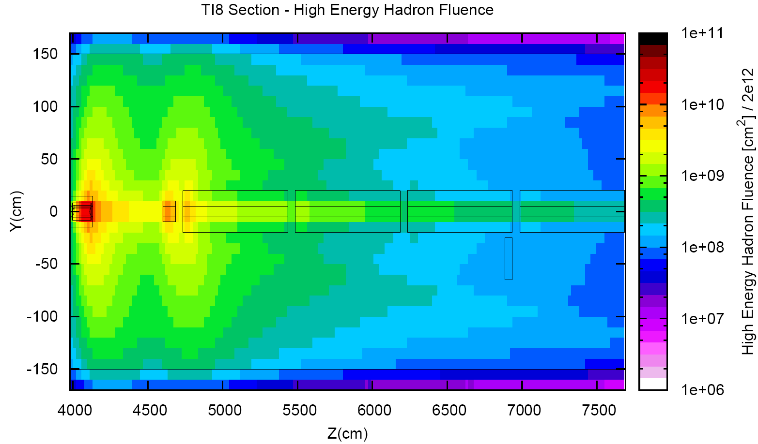
Radiation Levels per 2x10¹² protons lost
!!! SIMPLIFIED CALCULATION !!!
At the WIC location one gets about: 2x10⁸ cm⁻² of High Energy Hadron Fluence
TCDIH
TCDIM
MBIs
WIC
Calculations: K. Røed

Slide 7
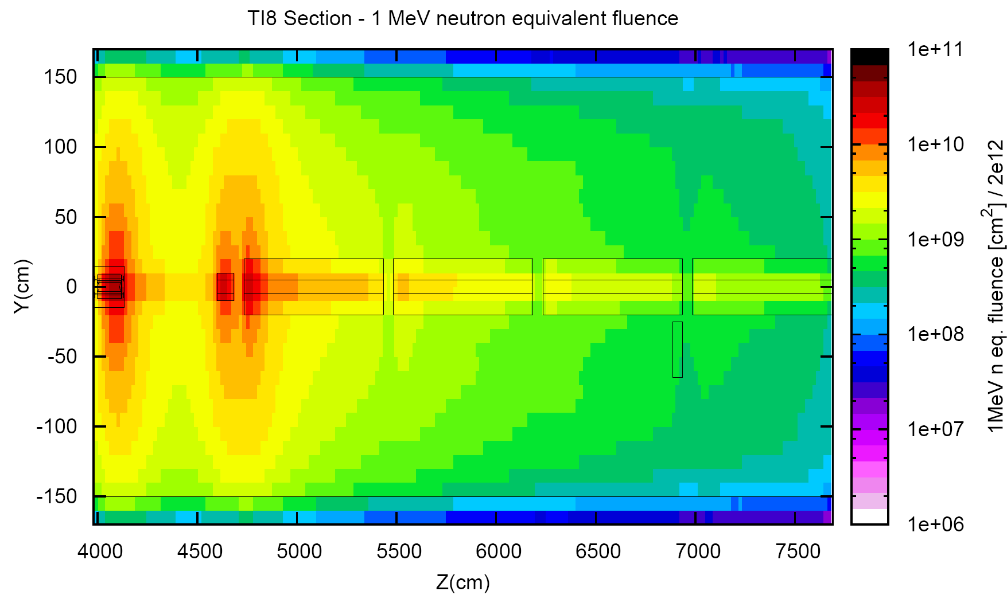
Radiation Levels per 2x10¹² protons lost
!!! SIMPLIFIED CALCULATION !!!
At the WIC location one gets about: : 6x10⁸ cm⁻² of 1MeV Neutron Equivalent
TCDIH
TCDIM
MBIs
WIC
Calculations: K. Røed

Slide 8
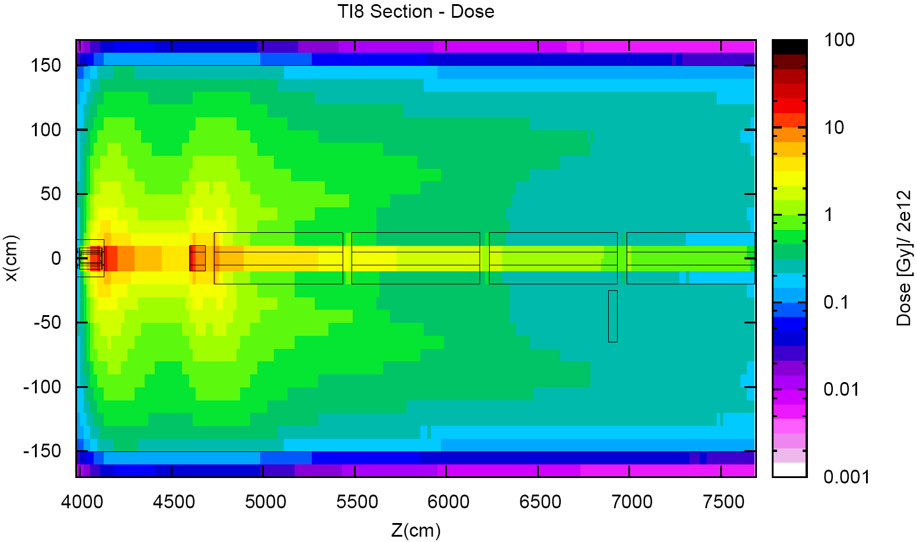
Radiation Levels per 2x10¹² protons lost
!!! SIMPLIFIED CALCULATION !!!
At the WIC location one gets about: 0.3 Gy of Dose
TCDIH
TCDIM
MBIs
WIC
Calculations: K. Røed

Slide 9
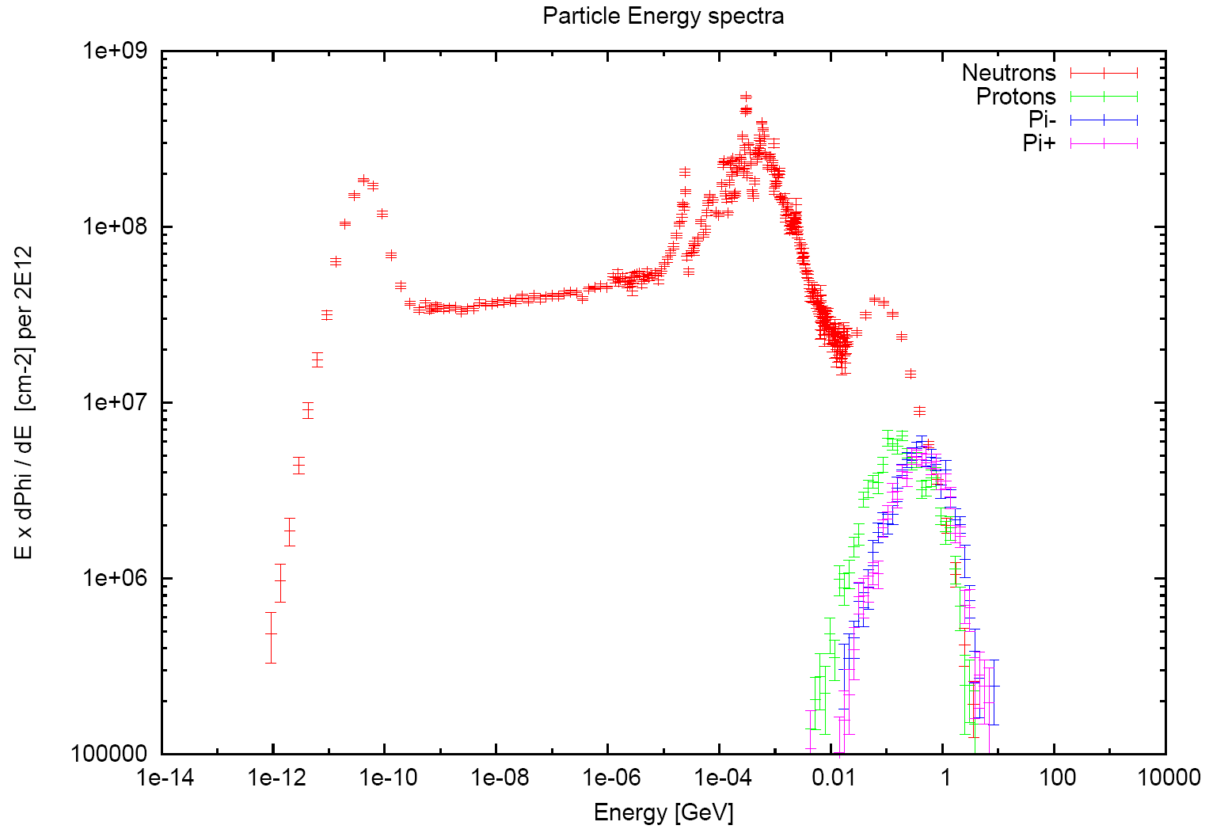
Radiation Levels per 2x10¹² protons lost
Levels at WIC Location (per 2x10¹² protons lost):
- ~2x10⁸ cm⁻² High-Energy Hadrons (>20MeV)
- ~2x10⁸ cm⁻² High-Energy Hadrons (5-20MeV)
- ~1x10⁸ cm⁻² Thermal Neutrons
- ~6x10⁸ cm⁻² 1MeV Neutron Equivalent
- ~0.3 Gy Dose
Calculations: K. Røed

Slide 10
WIC: Affected Module – ET200M
P. Dahlen, T. Wijnands
This module allows the communication of the data from the I/O modules over the Profibus Fieldbus connection
Radiation tests:
  with a flux of ~10⁸ p/cm²/s this module shows bus errors but the module manages to recover without external intervention provided the beam was stopped
  reproducible (six times) up to a total fluence of 1.8x10¹¹ p/cm2
  giving a (very rough estimated!) cross section of 3.3x10-11 cm⁻²
  (an identical module gave ~6 x10⁻¹¹ cm⁻²)
Reason of failure (‘hanging’):
  most probably the Profibus address of the module is changed, thus by reinitializing the module, the correct hardware address is loaded back into the SRAM and the device works normally again
Consequence:
  In case of failure (module ‘hangs’), the device needs to be reset (by distance), thus the beam needs to be dumped
  In TI8 this also leads to a beam-dump for CNGS

Slide 11
WIC Locations & Consequences
Locations and Number:
  racks locations where (for TI8) decided without knowing the collimator locations
  18 racks in TI8 (one of them downstream of collimators)
  all racks in TI2 are upstream the collimators
  a relocation of these racks was already discussed in the past
We have one event only, i.e., a single measurement of a Gaussian distribution (around an tested cross section of ~3x10⁻¹¹), still the integral number of protons for the full operation time (2008/2009) should be checked
A possible contribution due to low-energy neutron fluence would require a significantly higher respective cross-section at these energies (unlikely?)
If the failure is confirmed to be related to SEEs then the affected rack(s) should most probably be relocated (at least upstream the collimator locations) -> to be discussed in this meeting?
Independently, as a precaution the foreseen early WIC relocations from critical LHC areas (e.g., US85) become even more urgent and we need to understand further what happened

Slide 12
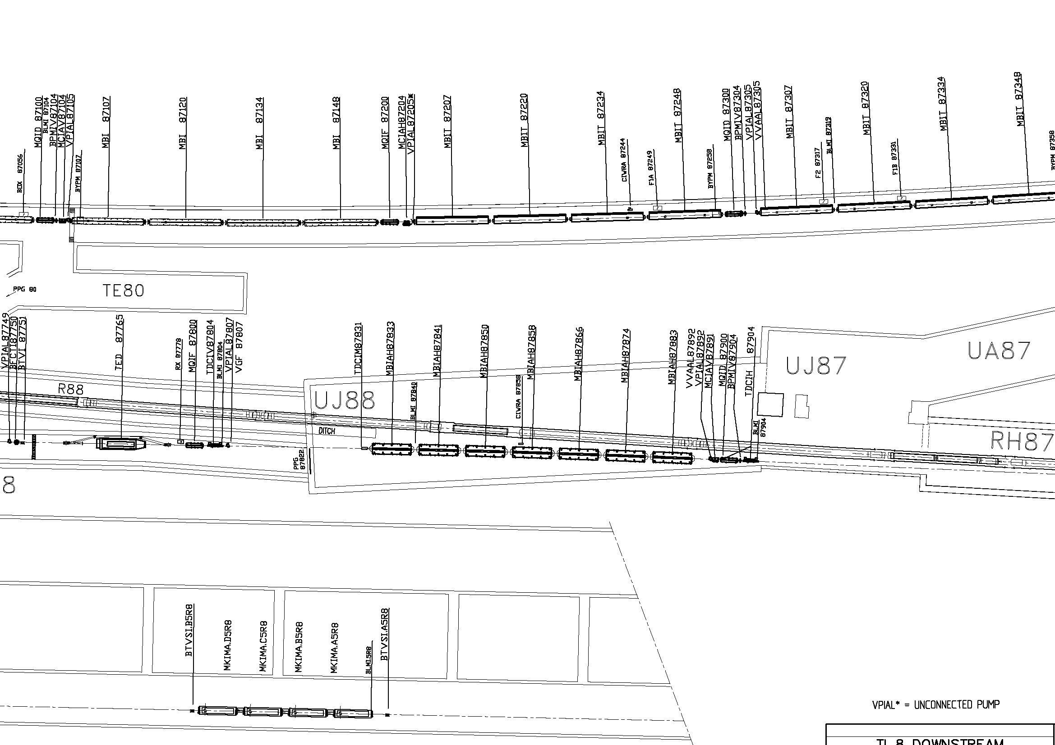
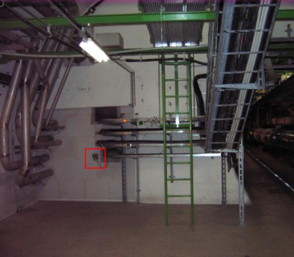
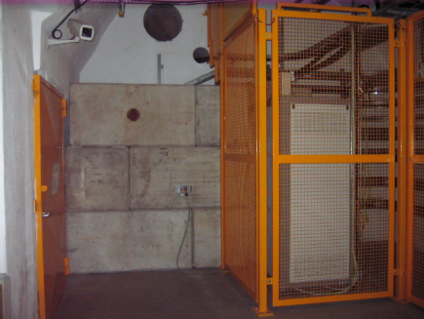
UJ88/UJ87/UA87 Observations
RadMon Positions and Settings (some are set to 3V)!
Integrated values Hadrons>20MeV:
  UJ88 – 8: 6.96e+9 cm⁻²
  UJ88 – 7: 2.68e+8 cm⁻²
  UJ88 – 6: 9.32e+6 cm⁻²
  UJ87 – 1: 1.69e+6cm⁻² (two counts only!)
RMon 1
3V
3V
Refers to total losses of
this weekend, i.e.,
~5.6x10¹³ !!!
RMon 6
RMon 8
RMon 7

Slide 13
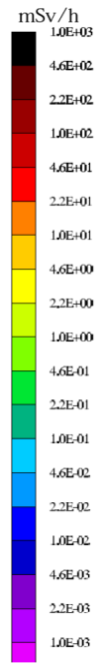
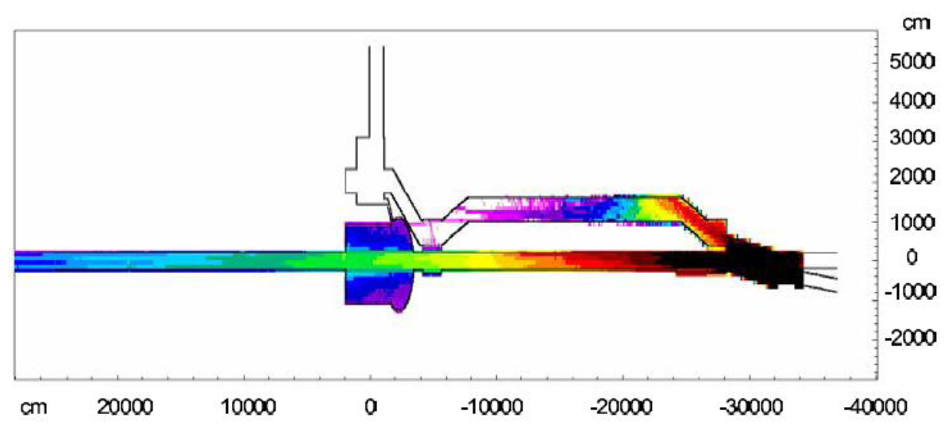
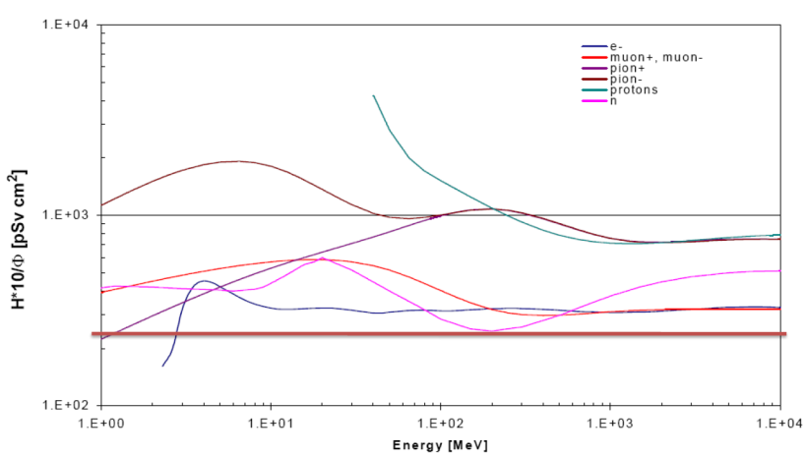
UJ88/UJ87/UA87 Analysis
Estimate based on RP Calculations [H. Vincke et al.] as already analysed through R2E end of 2008, where estimates for prompt dose equivalent can be used to get a rough estimate of a maximum equivalent high-energy hadron fluence
one takes: ~300mSv and a conversion coefficient of ~200pSvcm²
this referred to 1.44x10¹⁶ protons on the TED (maximum annual estimate)
this gave an estimated maximum high-energy hadron fluence of ~10⁸-10⁹/cm²/year, however not including the 80cm of concrete and some other conservative assumptions
fully consistent to the current RadMon reading: ~2x10⁶ (@3V), thus ~some 10⁵ (@5V) high-energy hadrons, which would give ~10⁸/year

Slide 14
UJ88/UJ87/UA87 Conclusions
The situation was identified through R2E already in 2008
The observed (and estimated radiation levels) refer to the worst case location just behind the shielding wall (levels in the UA are lower!)
The shielding wall between the UJ88 and UJ87 can be improved and this area is in the list of suggested actions
The final radiation levels in the UJ87 and especially in the UA87 will strongly depend on the chosen operation scheme (how many full intensity batches are dumped on the TED), thus any action was so far put on hold
This TI8 test measurements are fully consistent with the expectations and the simulation estimates are confirmed within the given uncertainties
Later tests this year (ideally with high-intensity), as well as a decision on the operational scenario shall trigger the decision if and when to improve the concerned shielding wall

