Slide 1
TI8 injection on TED test
6 to 8 June 2009
RadMon measurements

Slide 2
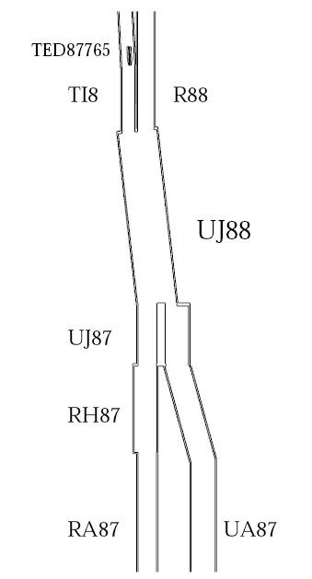
TI8 RadMon positioning
8RM08S UJ88-8 5V
8RM07S UJ88-7 3V
SIMA.UJ88.8RM06S UJ88-6 3V
SIMA.UA87.8RM05S UJ87-0 3V
3V setting has a strong sensitivity to thermal neutrons (several times more than 5V)

Slide 3
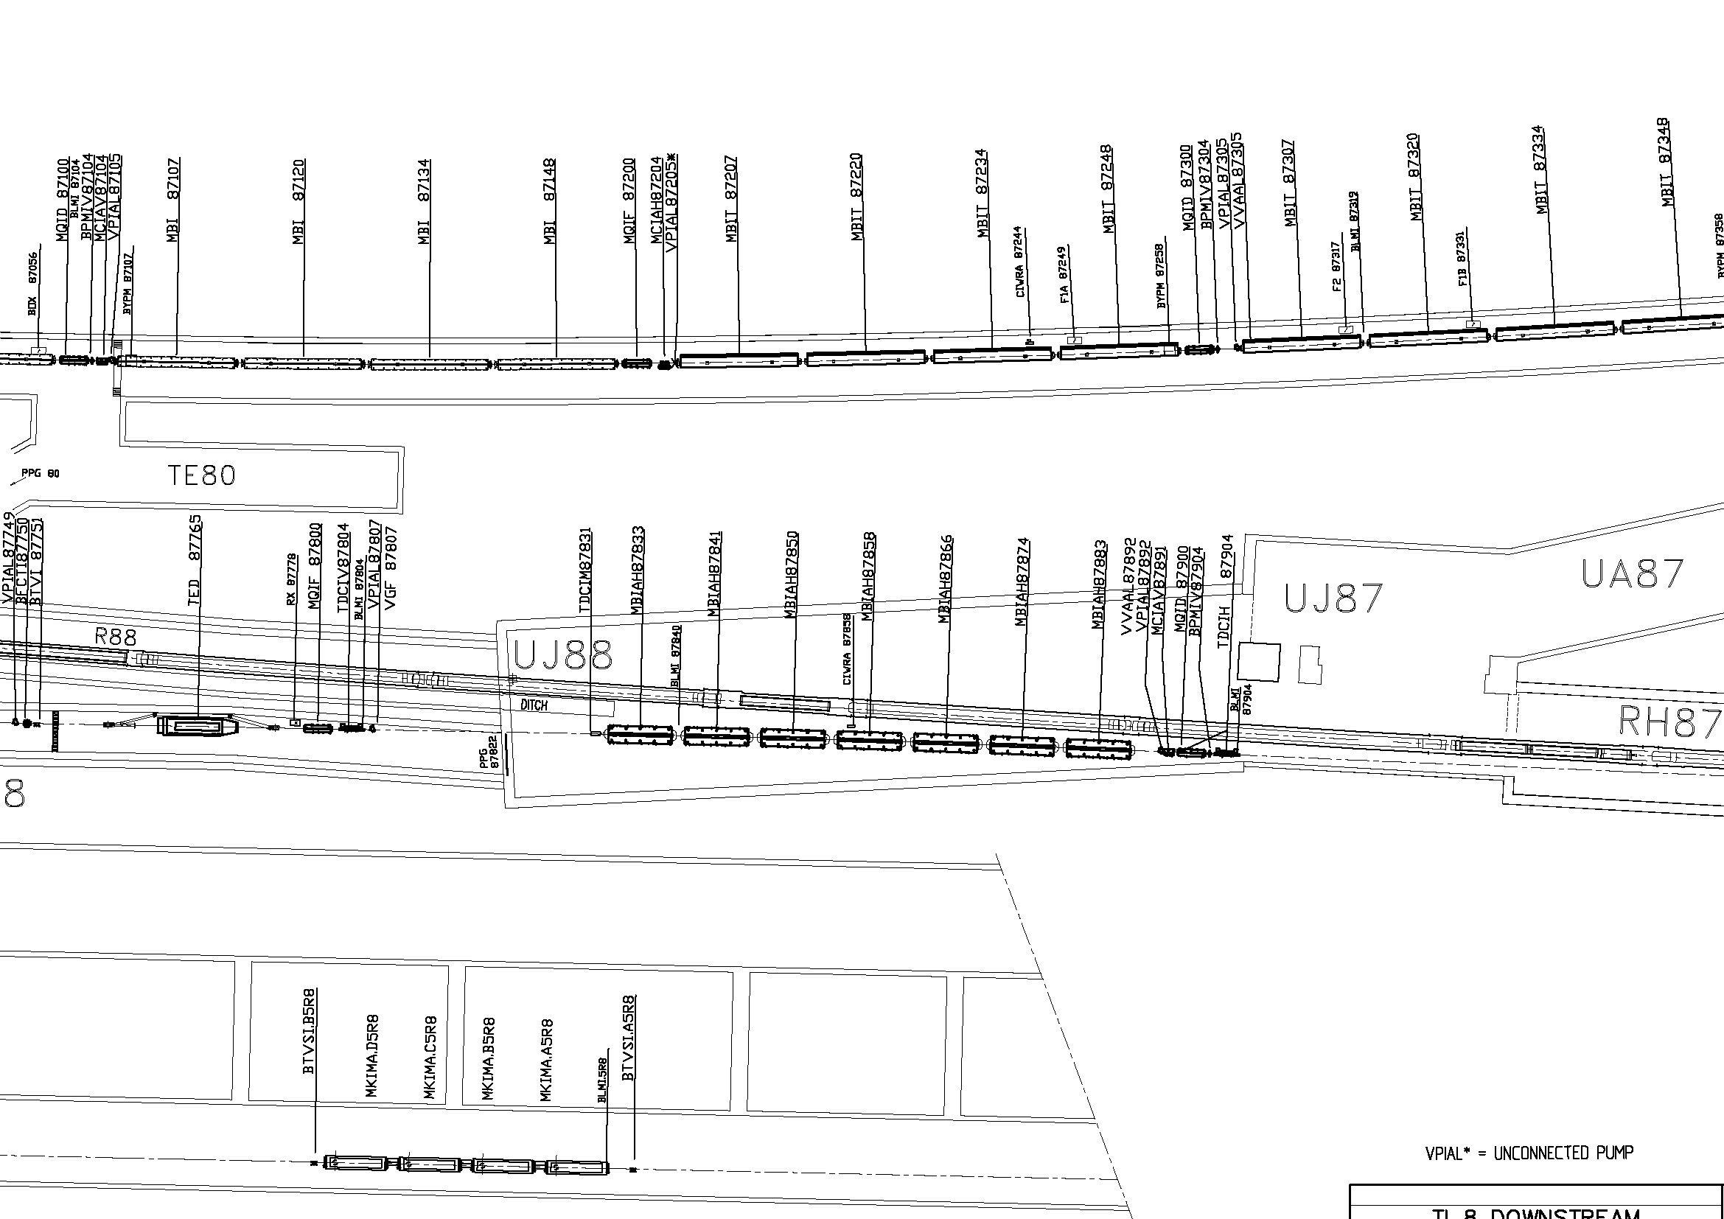
TI8 RadMon positioning
RMon 0
RMon 6
RMon 8
RMon 7

Slide 4
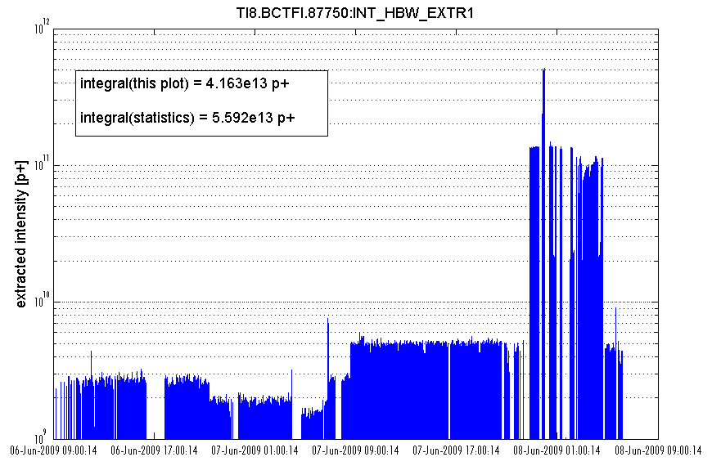
Beam intensity per extraction and integrated intensity
Wrong BCT readings,
has to be scaled to 5e9

Slide 5
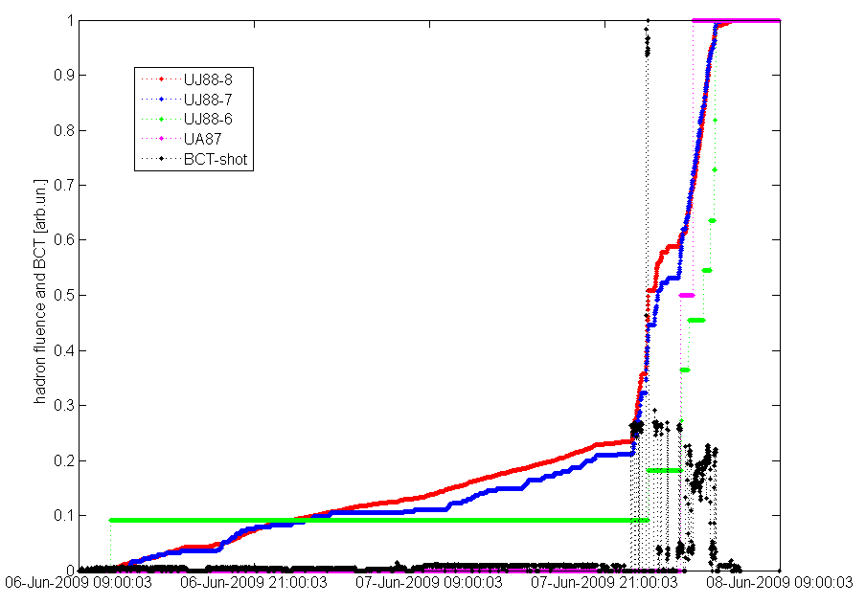
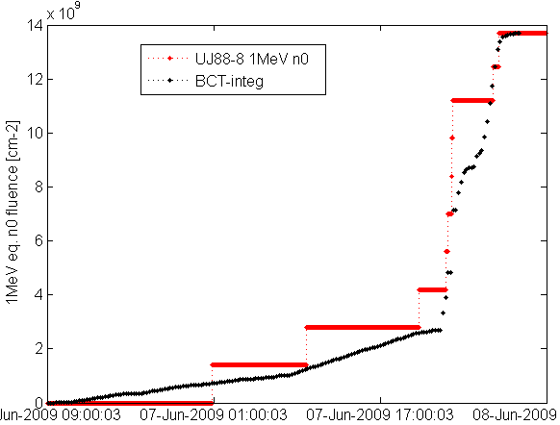
UJ88 and UJ87 Hadron>20MeV compared to BCT intensity per extraction
Integrated values Hadrons>20MeV:
UJ88 – 8: 6.96e+9 cm⁻²
UJ88 – 7: 2.68e+8 cm⁻²
UJ88 – 6: 9.32e+6 cm⁻²
UJ87 – 1: 1.69e+6cm⁻²
1MeV eq. n⁰:
UJ88 – 8: 1.37e+10 cm⁻²

Slide 6
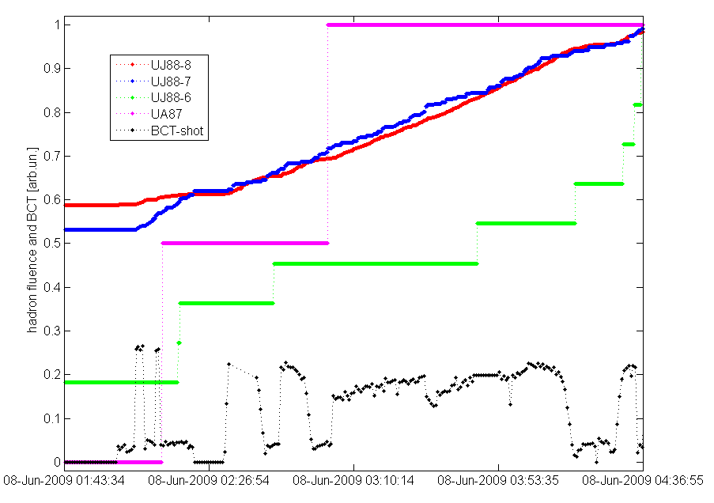
UJ88 and UJ87 Hadron>20MeV compared to BCT intensity per extraction ZOOM
Integrated values Hadrons>20MeV:
UJ88 – 8: 6.96e+9 cm⁻²
UJ88 – 7: 2.68e+8 cm⁻²
UJ88 – 6: 9.32e+6 cm⁻²
UJ87 – 1: 1.69e+6cm⁻²
1MeV eq. n⁰:
UJ88 – 8: 1.37e+10 cm⁻²

Slide 7
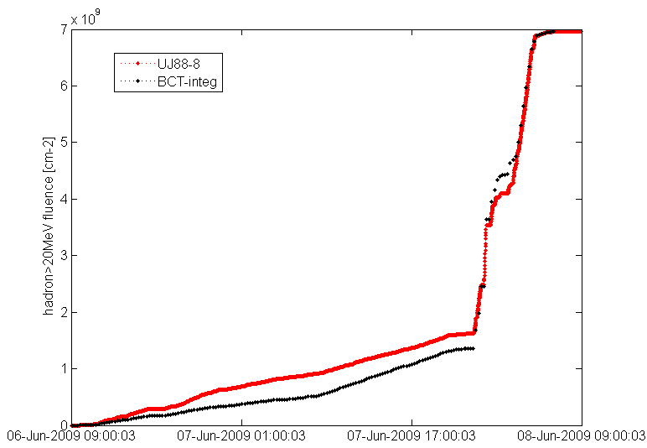
UJ88 Hadron>20MeV compared to BCT intensity per extraction – pos8
Integrated values Hadrons>20MeV:
UJ88 – 8: 6.96e+9 cm⁻²
UJ88 – 7: 2.68e+8 cm⁻²
UJ88 – 6: 9.32e+6 cm⁻²
UJ87 – 1: 1.69e+6cm⁻²
1MeV eq. n⁰:
UJ88 – 8: 1.37e+10 cm⁻²

Slide 8
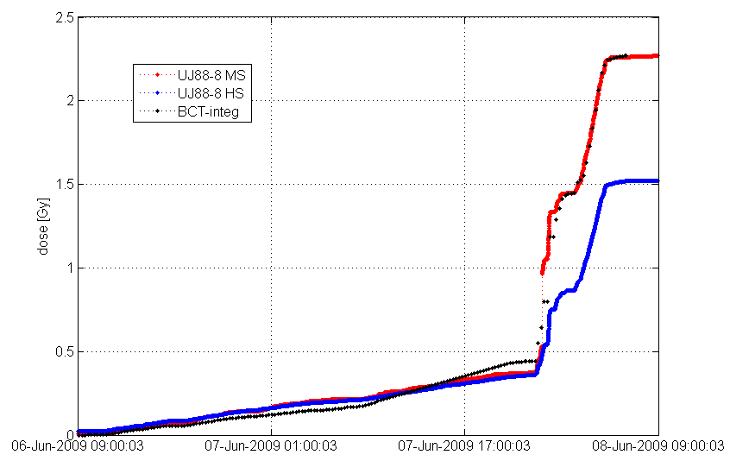
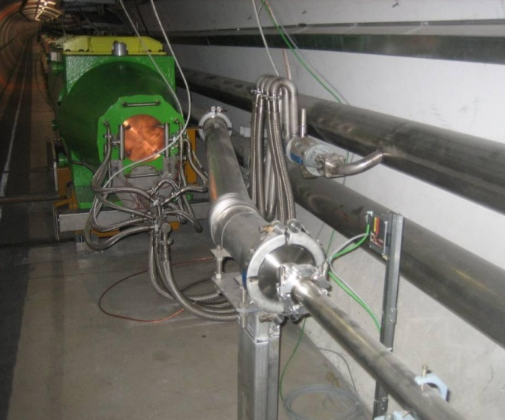
BCT integrated intensity normalized to dose (Medium Sensitivity) - pos8
Integrated values:
UJ88 – 8: 2.27 Gy
UJ88 – 7: 107 mGy
UJ88 – 6: 1.2 mGy
UJ87 – 1: 0.3 mGy

Slide 9
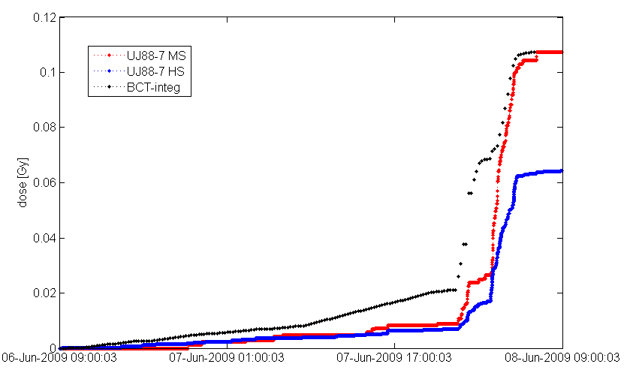
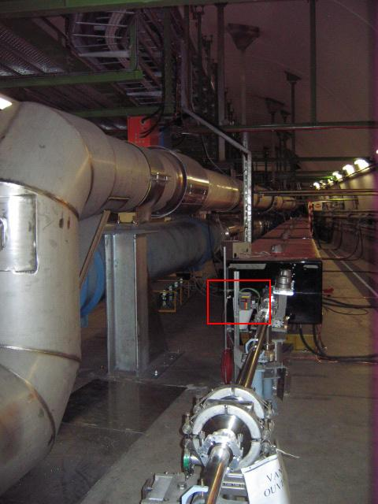
BCT integrated intensity normalized to dose (Medium Sensitivity) - pos7
Integrated values:
UJ88 – 8: 2.27 Gy
UJ88 – 7: 107 mGy
UJ88 – 6: 1.2 mGy
UJ87 – 1: 0.3 mGy

Slide 10
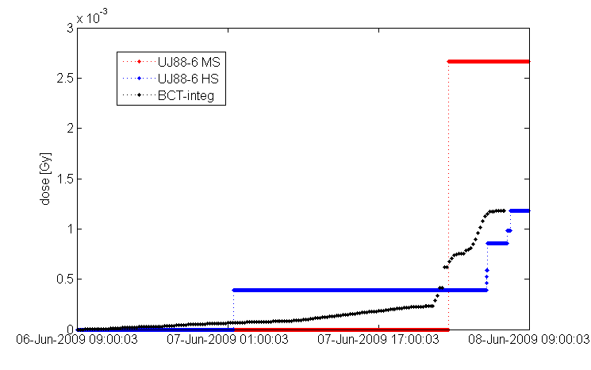
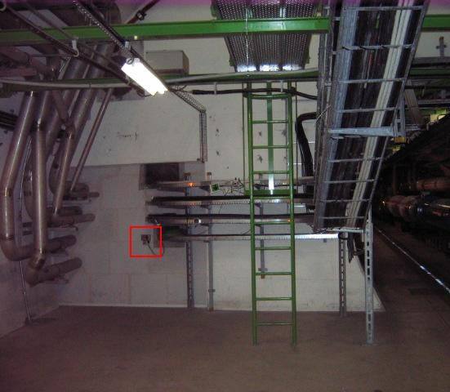
BCT integrated intensity normalized to dose (Medium Sensitivity) – pos6
Integrated values:
UJ88 – 8: 2.27 Gy
UJ88 – 7: 64 mGy
UJ88 – 6: 1.2 mGy
UJ87 – 1: 0.3 mGy

Slide 11
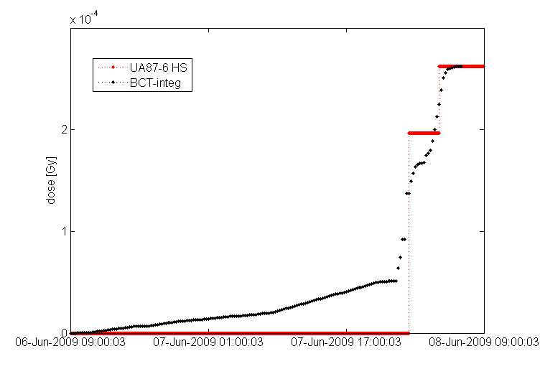
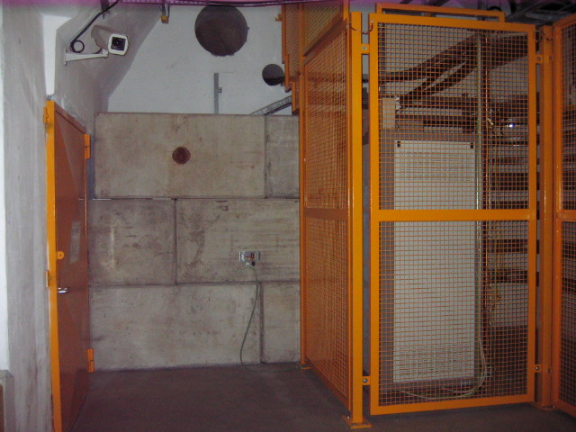
BCT integrated intensity normalized to dose (Medium Sensitivity) – UJ87
Integrated values:
UJ88 – 8: 2.27 Gy
UJ88 – 7: 64 mGy
UJ88 – 6: 1.2 mGy
UJ87 – 1: 0.3 mGy

Slide 12
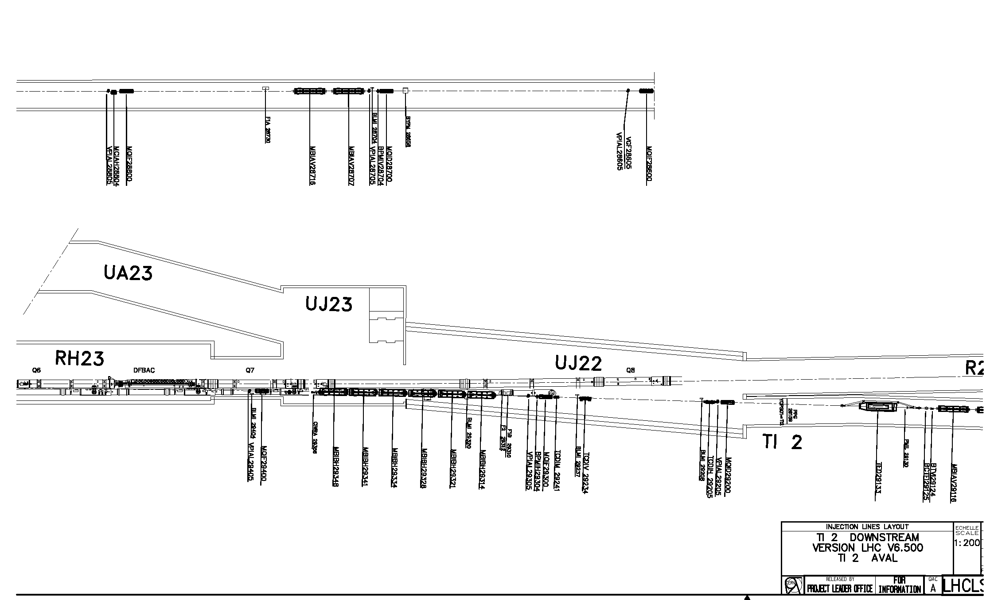
TI2 layout downstream the TED next injection test scheduled for 11-12 July 2009
RadMon 3
RadMon 6
below Q6
RadMon 4
RadMon 5
TED

Slide 13
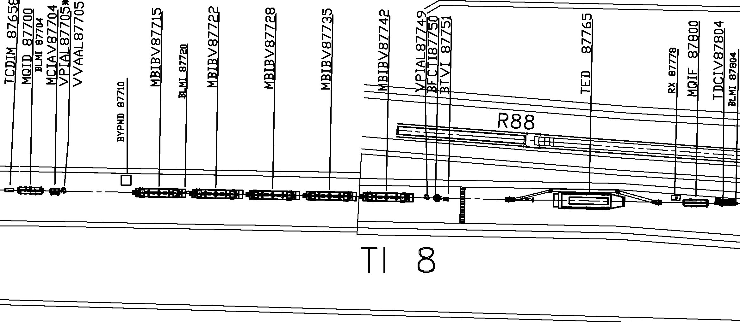
BLM layout in TI8 around TED
BLMI 87704
BLMI 87804
BLMI 87720

Slide 14
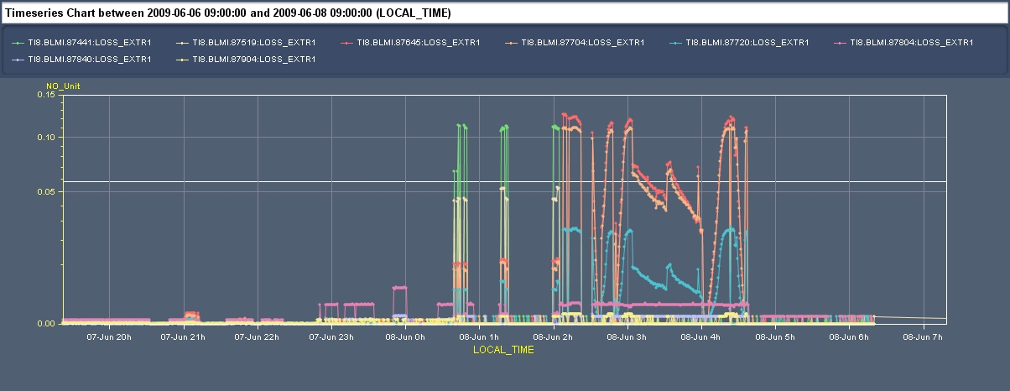
BLM data – loss rates in TI8 including the collimator

