Slide 1



Ground Vibration Monitoring at CERN as Part of the International Seismic Network
EN/STI
Kevin Develle
Cedric Charrondiere
EN/MME
Morgane Cabon
Michael Guinchard
with contributions of many people from integration, civil engineering team, IT…
CERN – LabVIEW Developer Days Genève – 1st June 2017

Slide 2
Contents
Introduction
Technical proposal
Solution implemented
Stations performance
Conclusion

Slide 3
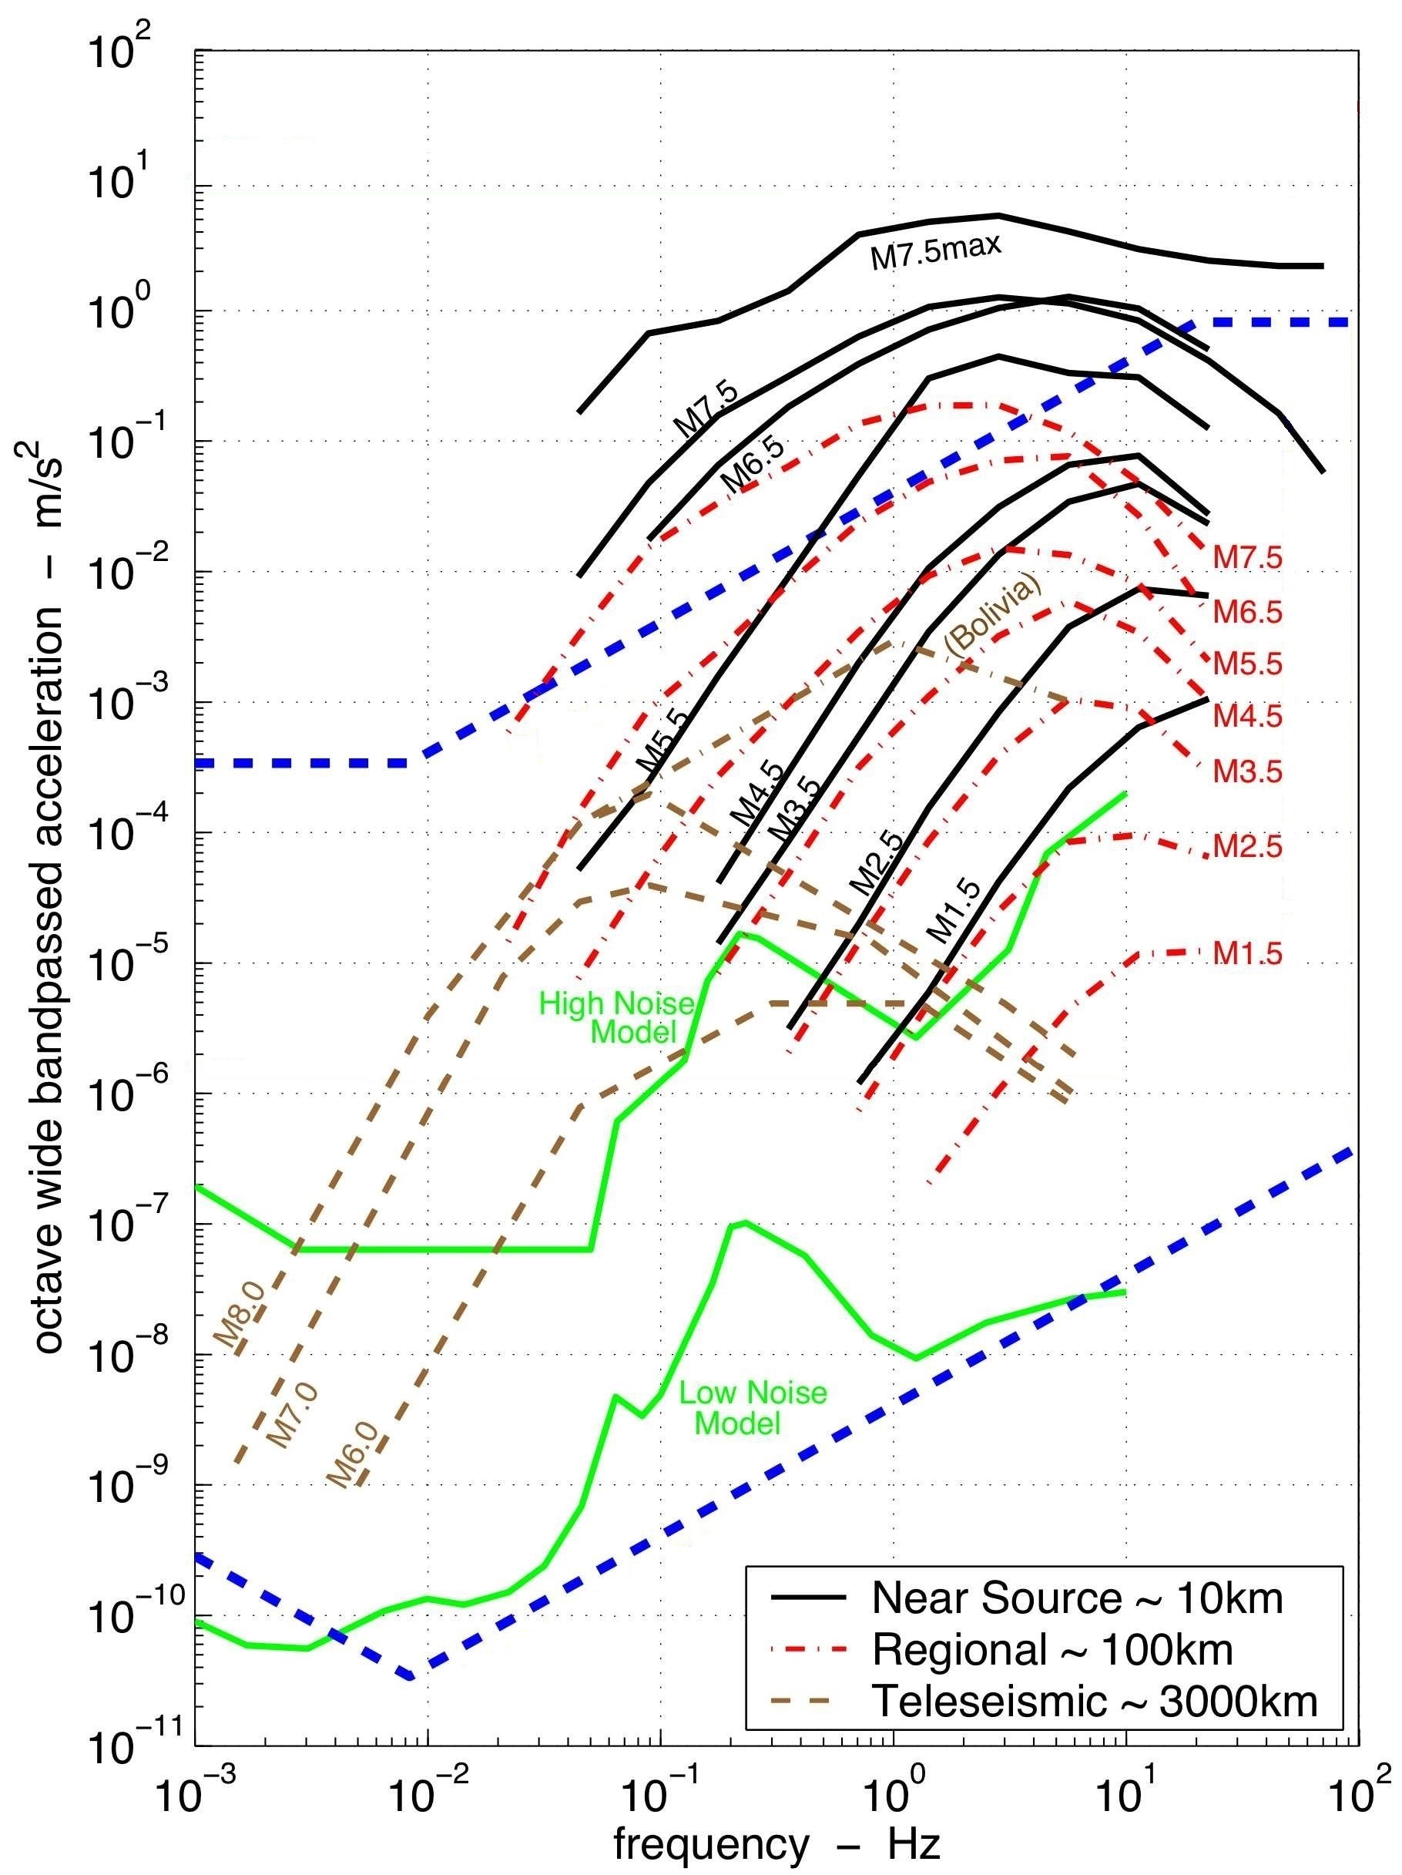
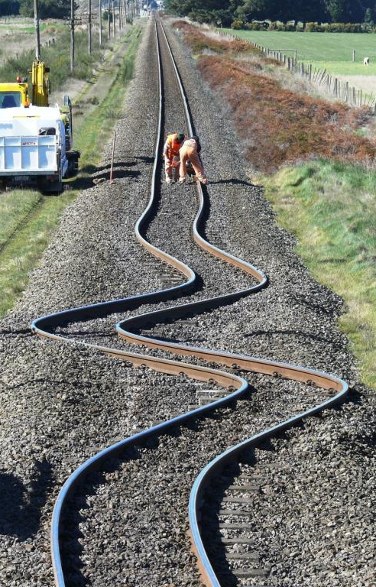
Background knowledge

Slide 4
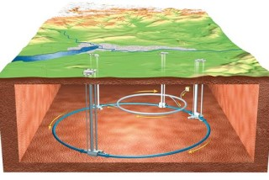

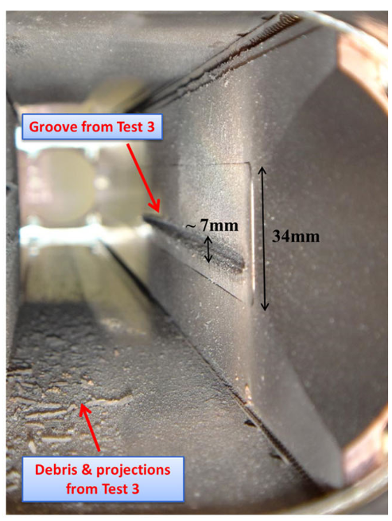
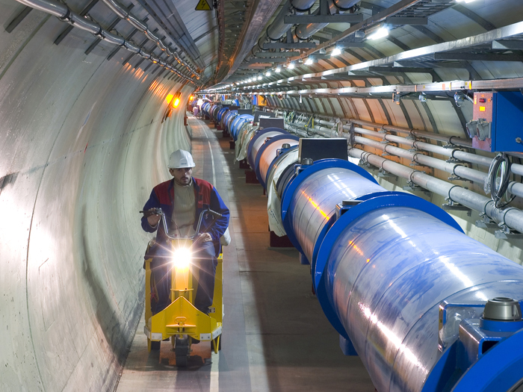
LHC
The Large Hadron Collider (LHC) : A 27km ring
The energy of a 200m long fast train at 155 km/hour
corresponds to
the energy of 360 MJ stored in one LHC beam

Slide 5
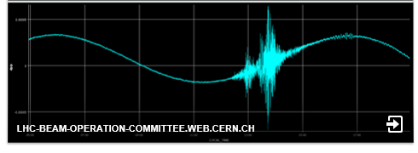
Motivations
  Continuous LHC monitoring
    Beam sizes around 1 mm during injection, 0,25 mm at top energy
    Stability of the magnetic field center (depending LHC operation):
      Safe conditions : < 5 μm
      Unstable conditions : 5 to 20 μm
    Beam abort : > 20 μm

Slide 6
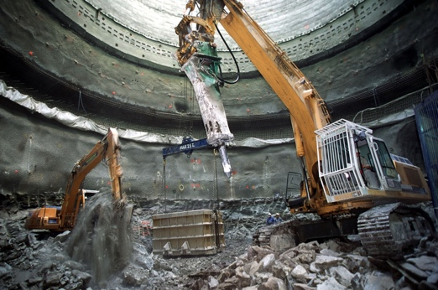
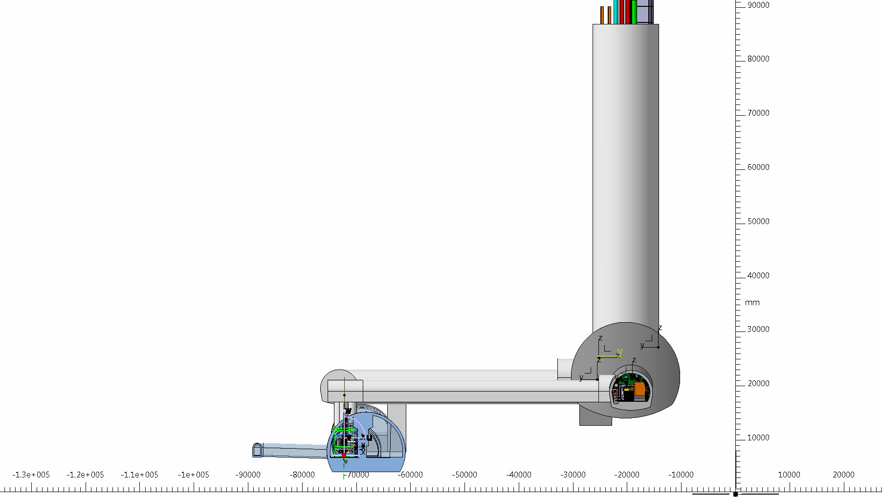
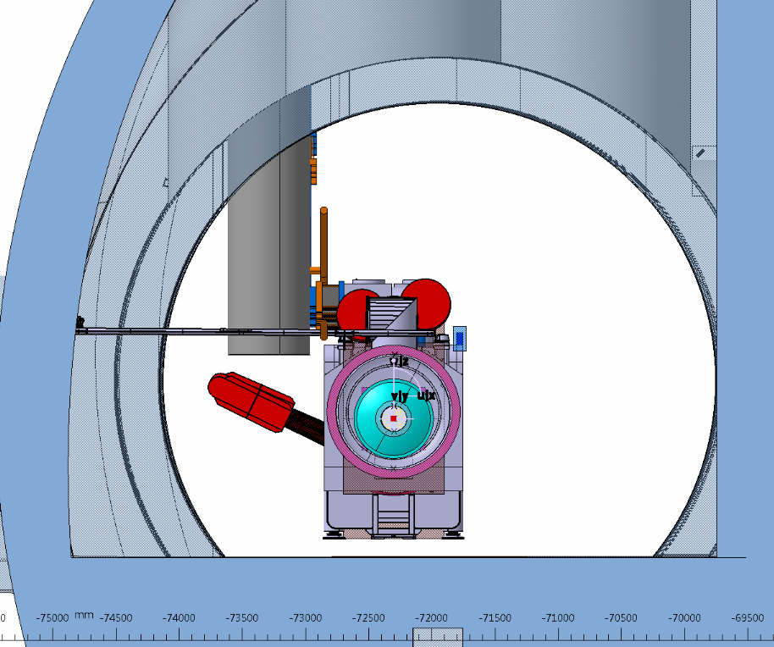
Motivations
HL-LHC Civil engineering activities
      Monitor our installation to anticipate some risks on the beam stability generated by civil engineering activities.
      Study ongoing to determinate the best excavation technique.
H2 (ω)
H1 (ω)
H0 (ω)

Slide 7



Motivations
Geneva Program “Géothermie 2020”
      Evaluate effects of the micro-seismicity induced by the geo-thermal exploitation on CERN installations.
      Study by the engineering company Resonance mandated by SIG (Services Industriels de Genève)
Expected earthquakes | During the stimulation period | During the stationary phase | Expected cold mass movements
Magnitude 2 | Several per week | A few per month | ~1-10 μm
Magnitude 3 | A few per month | 2 to 3 per year | ~10-100 μm
      Need for a seismic network
        Measuring near source earthquakes to better know the region seismicity
        Integrated into the worldwide seismic network

Slide 8
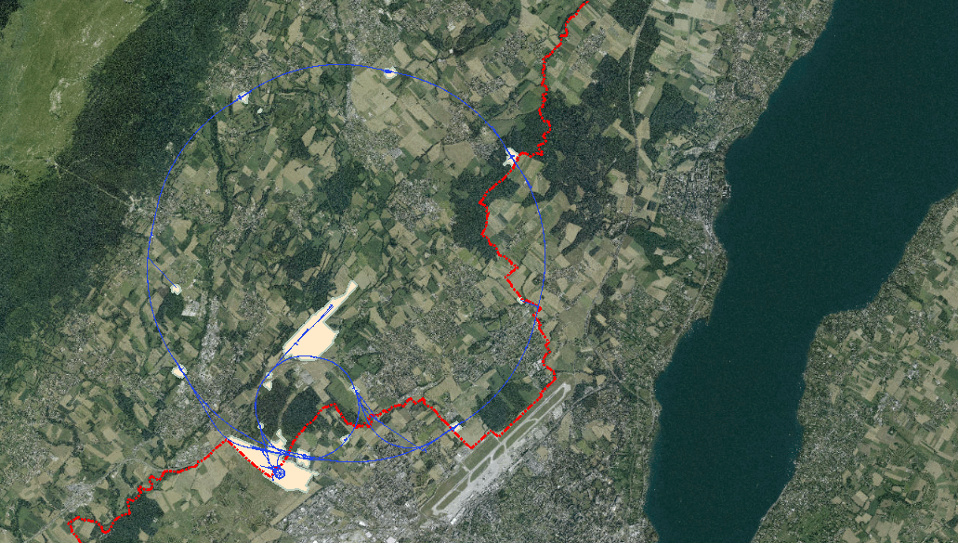
Requirements
Underground station
 | CMS : CERN5
Surface station
 | bdg. 1173 : CERNS
Underground station
 | ATLAS : CERN1

Slide 9
Requirements
 | Needs for a common station | Specific needs for CERN
 | Geothermal exploitation, SED | HL-LHC excavation
Min amplitude | LHC ground motion | LHC ground motion
Max amplitude | 20 m/s² | 20 m/s²
Min frequency | 1/30 Hz | 1 Hz
Max frequency | 20 Hz | 100 Hz
Timestamp precision | ~ 1 ms | ~ 10 ms
Data latency | 10 s | 1 min
Data format | MiniSEED | ASCII
Data transmitted to | SED servers | CERN servers, LHC database
Other needs | Available 24/7 | Independent systems with same software and hardware
Due to different needs, it was easier to develop a solution internally

Slide 10
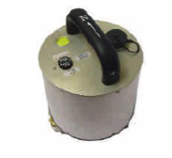
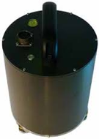
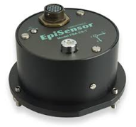
Hardware proposal
Sensors
Model | Guralp 6T | Guralp 40T | Kinemetrics EpiSensor ES-T
Output | Velocity | Velocity | Acceleration
Triaxial | Yes | Yes | Yes
Frequency range | 30s to 100Hz | 60s to 100Hz | DC to 200Hz
Sensitivity | 2000 V/(m/s) | 800 V/(m/s) | 2,5 V/g
Analog/digital | both | both | Analog +-5V differential
Noise | 172 dB | 172 dB | 155 dB
Power supply [V] | 10 to 36V | 10 to 36V | 12V
LHC Ground motion level | Yes | Yes | No
Threshold level for earthquake | ≈ M3 @10km | ≈ M3,5 @10km | M 7,5 @10km
Strong motion sensor
Broadband seismometer
With a 10V, 24 bits ADC

Slide 11
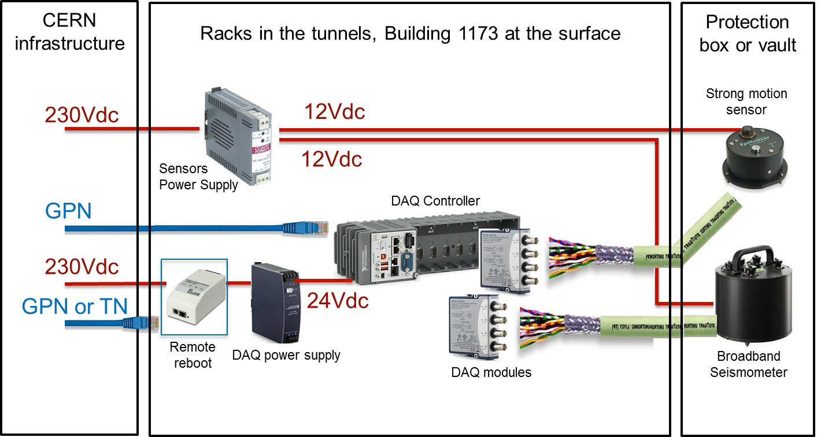

Hardware proposal
      NI CompactRIO 9035 (1 GB RAM, 2 cores)
      with NI C-series 9239 (+/-10V, 24bits, fs = 1.6 to 50kHz, 70uV noise)
      Linux Real Time
      NTP timing source at CERN (<1ms accuracy)
      GPN connection
      Remote reboot: GUDE Expert power control 1103

Slide 12
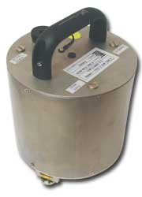


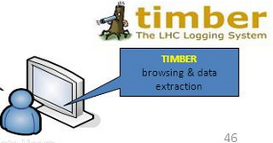
Software proposal
SED and worldwide seismic databases
MiniSEED Files :
Standard for Exchange of Earthquake Data
(time domain)
CERN Users
Power Spectral Density :
Ground motion monitoring
(frequency domain)
Raw data
CERN Experts
Raw data (time domain)
Power Spectral Density (frequency domain)
Sum Level (time domain)
Mechanical Measurement Laboratory

Slide 13


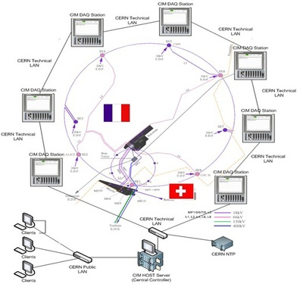
Advantages
Technical proposal
Challenges
      CERN is a LabVIEW Center of excellence
      Huge experience with CompactRIO at CERN
      Timekeeper API
      Sounds and Vibration, HTTP, WebDAV palette from NI
      RADE palette from MTA Team to communicate with CERN infrastructure
      Distributed architecture
      System fulfilling the requirements
      Manpower cost more important for the development
      Mseed converter to be develop
      Quality of the streaming to SED to be proven
      Non-standard seismic station

Slide 14
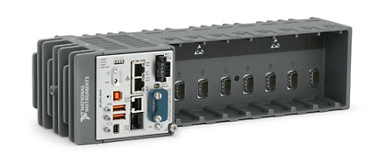
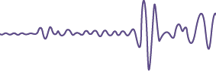

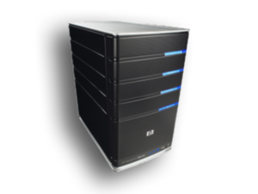
Software architecture
SED and worldwide seismic databases
1173 Station
HTTPS
WEBDAV
Settings
CERN Experts
Program
Mechanical Measurement Laboratory
UL16 Station
CMW GPN
Remote
connection
CMW TN
CERN Users
UP53 Station

Slide 15
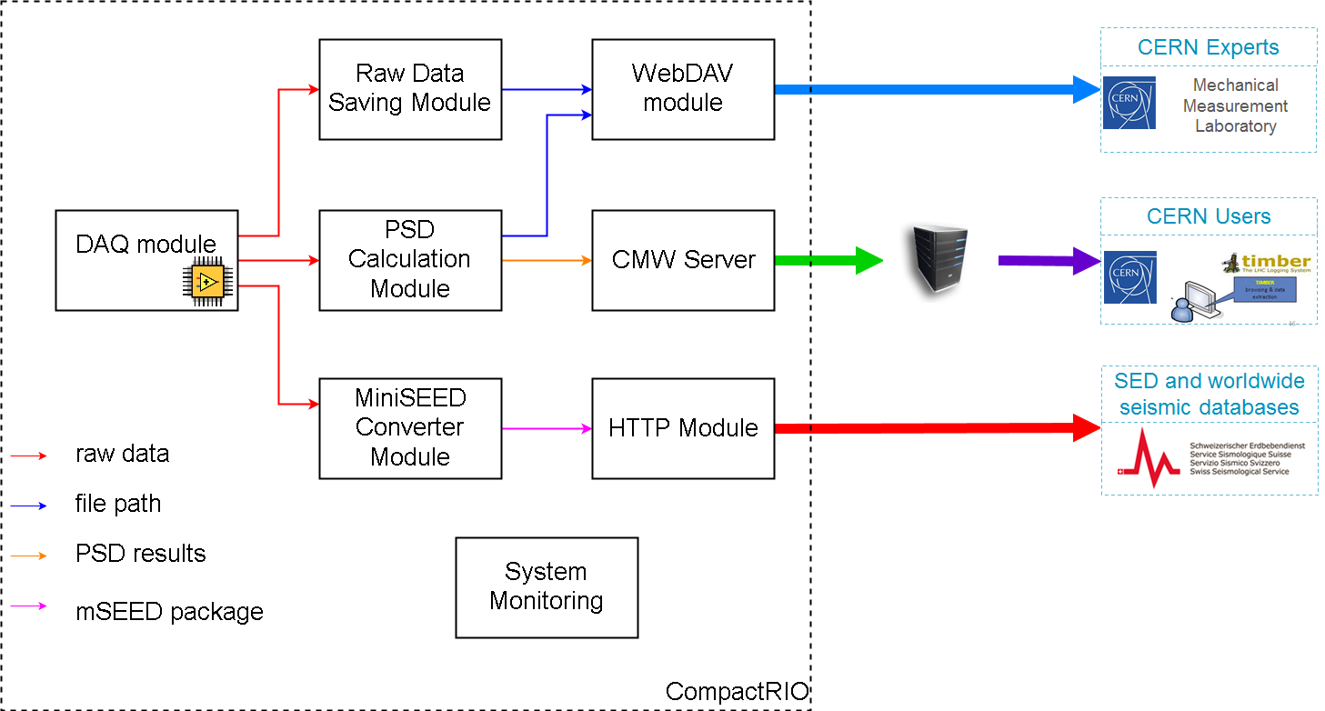
Software architecture
WEBDAV
CMW GPN
CMW TN
HTTPS

Slide 16
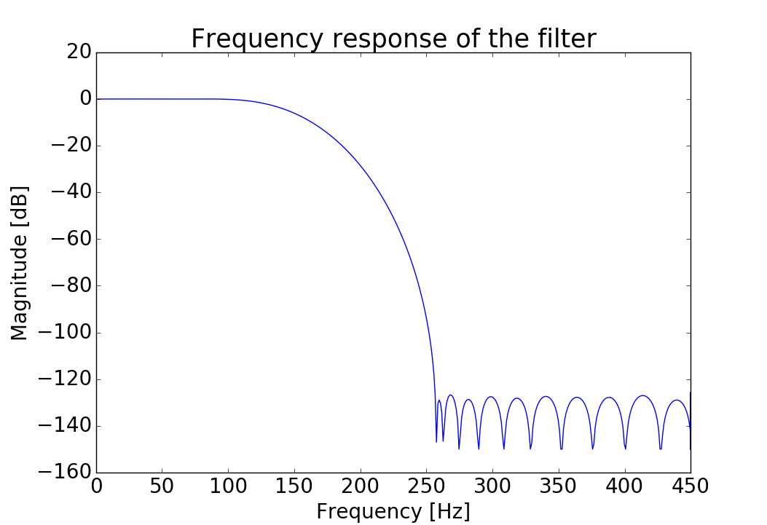
Data Acquisition Module
      Read data from DMA
      Keep Timekeeper synchronized
      Down sample and filter from 2kHz to 250Hz
      Sinc filter with Blackman window

Slide 17
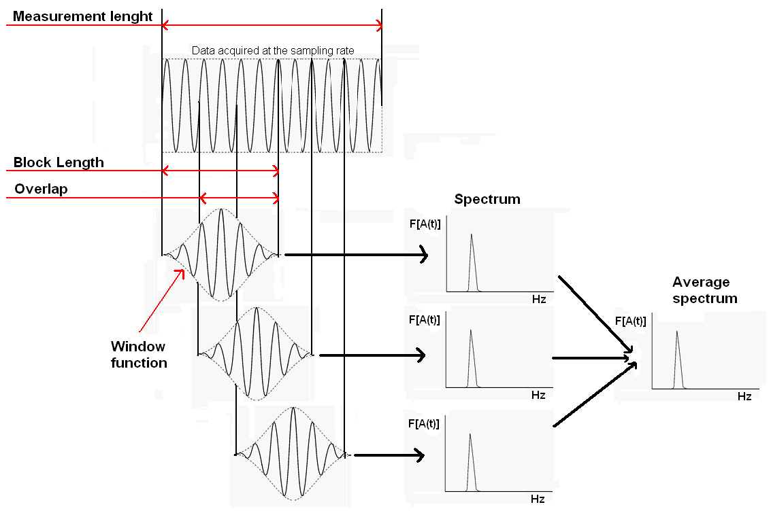
PSD Module
Parameter [unit] | Value
Representation | Quadratic RMS [m²/Hz]
Window | Hanning
Block length | 64s
Overlap | 66.60%
Frequency resolution fr [Hz] | 0.015625
Max. frequency [Hz] | 97.7

Slide 18
MiniSEED Converter & HTTP Module
      Build MiniSEED header (timestamp, sequence number, station name…)
      Send package to SED
      Handle SED server reboot, network disconnection
      Objective: 10s latency
CERN
network
SED
network
data acquisition
mseed conv
HTTP post
mseed read
HTTP answer
6s
300ms
1~2s

Slide 19
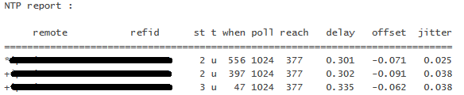
System Monitoring Module
      Monitor CPU/RAM usage
        Maximum CPU peak at 50%
        Average CPU ~ 10%
        About 50% of the 1GB RAM available
      Monitor VI states
      Monitor number of elements in queue and RT fifo
      Send “alive” message to an other machine
      Monitor NTP synchronization
NTP server
seconds
Octal code
milliseconds

Slide 20
The timing challenge
      Problem with SED :
      The 2kHz on-board clock is not perfect. The gap between the timestamp of sample 1999 of DMA 0 and sample 0 of DMA 1 had to be reduced below 1us to fulfil SED requirements
1s
DMA 0
DMA 1
S0
S1
S2
…
S1999
S0
S1
…
500
us
500
us
500
us
~505
us
500
us
T0 from ntp
T0 from ntp
With white rabbit, we measure the loop speed at ~500.003 us
theoretical time vector
http://www.ohwr.org/projects/white-rabbit/wiki

Slide 21
The timing challenge
      Solution :
      The timekeeper API to timestamp every sample on the FPGA
1s
DMA 0
DMA 1
S0
S1
S2
…
S1999
S0
S1
…
500us
+~3ns
500us
+~3ns
500us
+~3ns
500us
+~3ns
No big gap anymore
Time from timekeeper

Slide 22




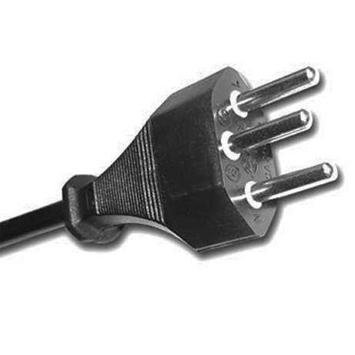
Software Robustness
CompactRIO reaction
Problem
Sends warning and keeps streaming
Stores MiniSEED files on USB drive,
sends it when SED is back
Stores experts files on USB drive
Stores everything on USB drive
Automatic restart

Slide 23
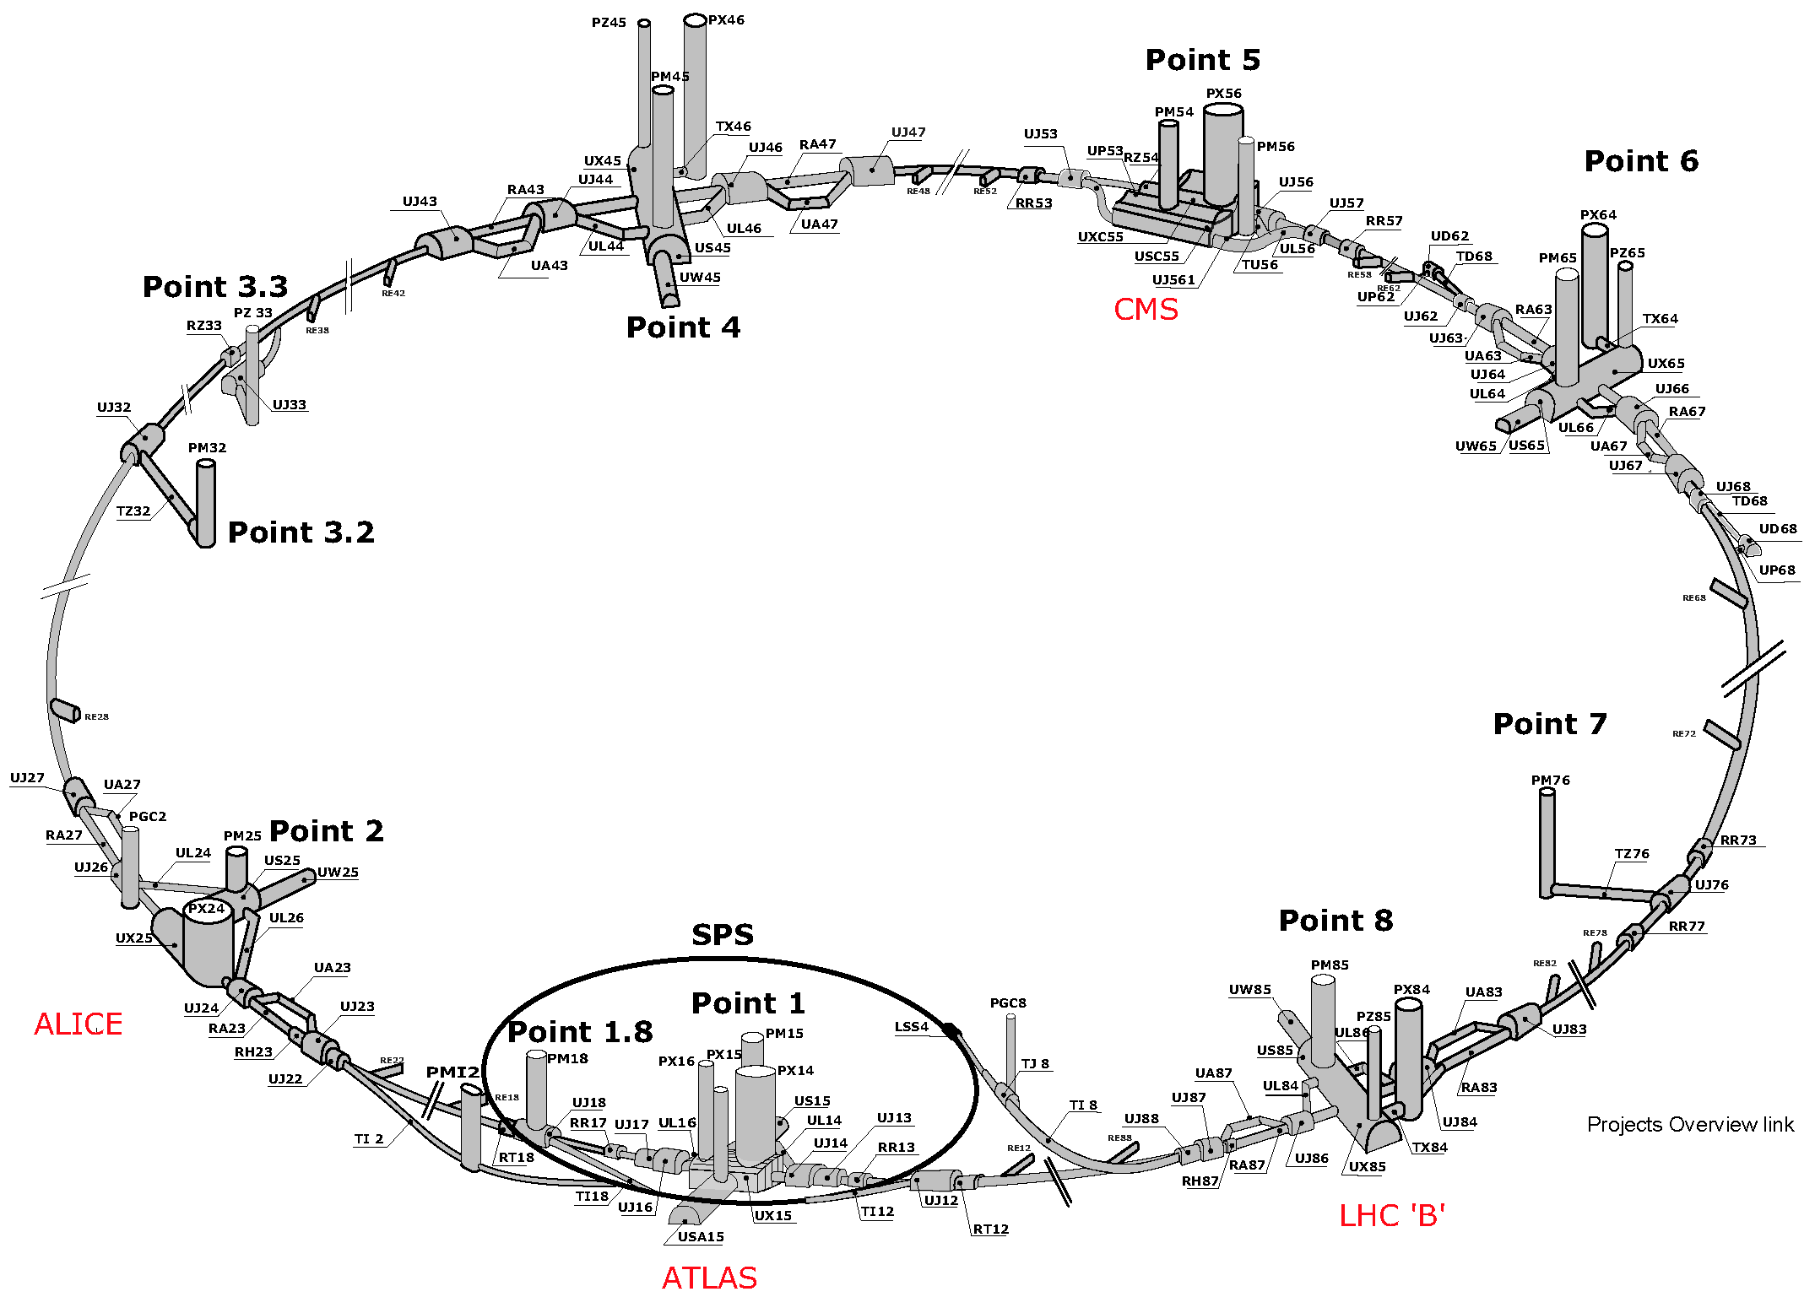
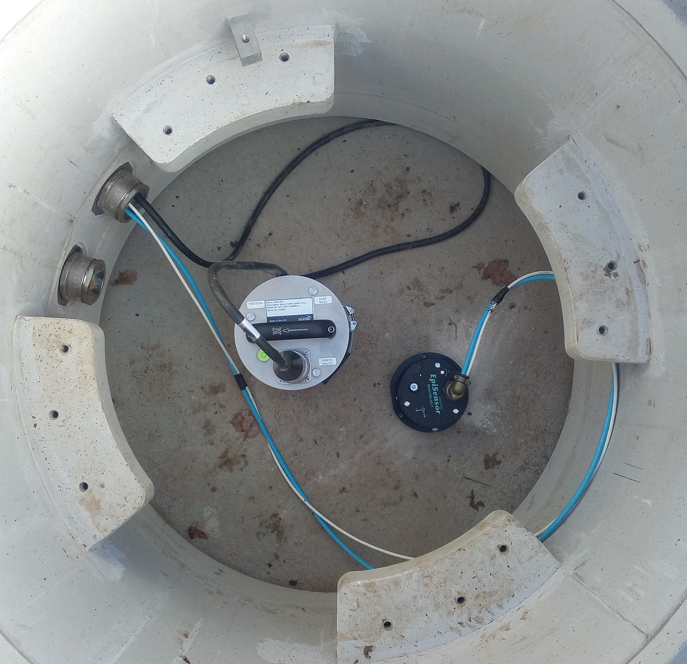
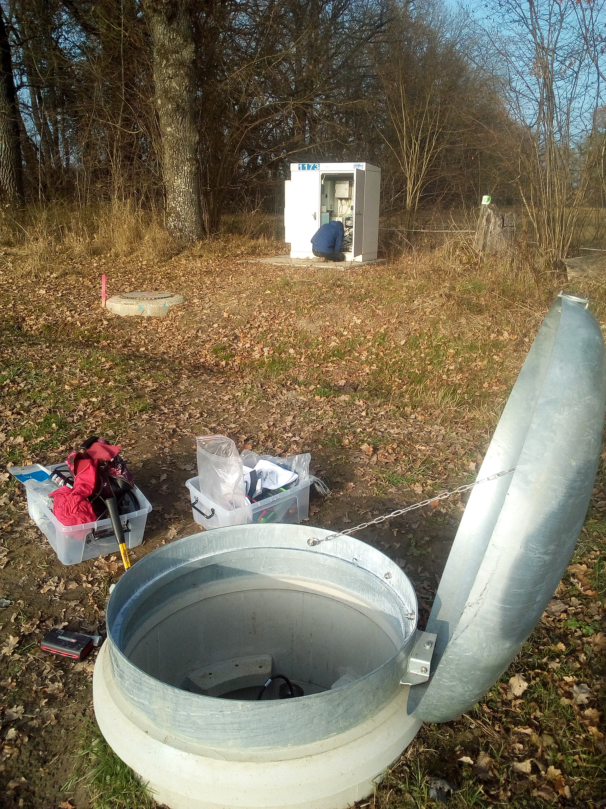
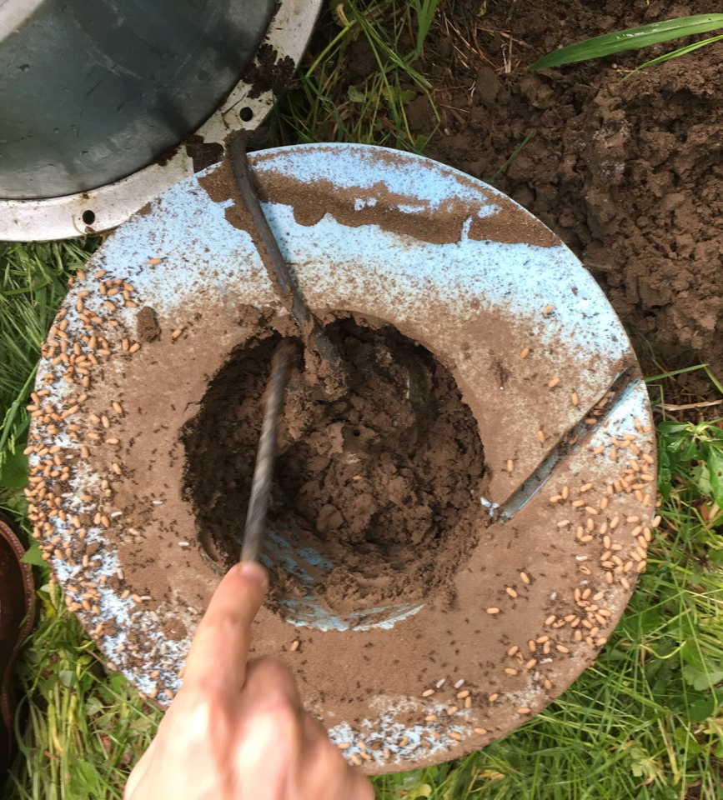
Installation

Slide 24
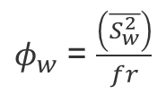
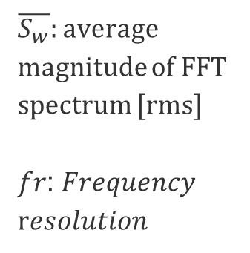

Stations performance
Ground motion measurements versus position
Micro-seismic peak
$$PSD$$
$$Power Spectral Density$$
$φ_{w}$ = $\frac{\left(\overline{S_{w}^{2}}\right)}{fr}$
$\overline{S_{w}}:$average magnitude of FFT spectrum [rms]
𝑓𝑟: 𝐹𝑟𝑒𝑞𝑢𝑒𝑛𝑐𝑦
r𝑒𝑠𝑜𝑙𝑢𝑡𝑖𝑜𝑛

Slide 25


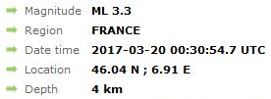
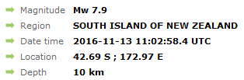
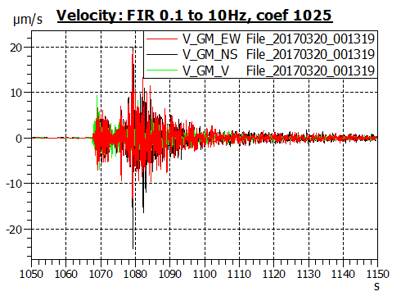
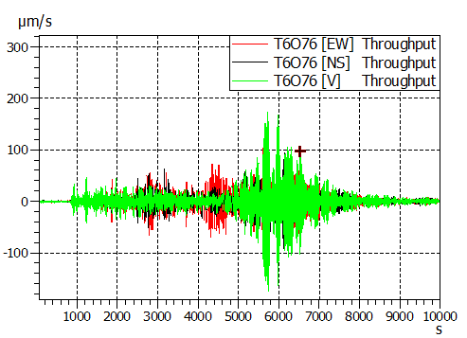
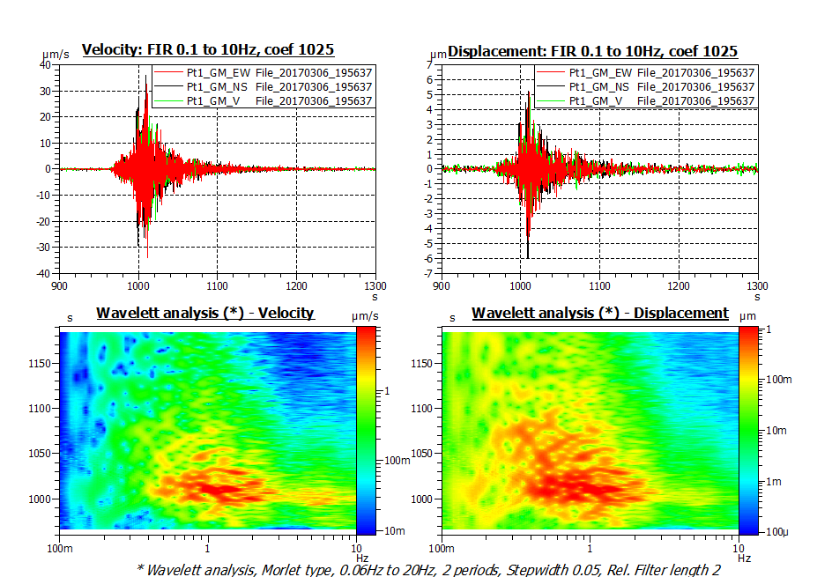
Stations performance
Recorded earthquakes

Slide 26
Conclusion
The seismic network already permits to:
  Monitor the LHC ground motion
  Track earthquakes on a wide range of amplitude
It satisfied successfully the needs of SED and CERN
      System compliant with LHC tunnel and CERN network
      Standard format files for seismologists
    SED is doing some regular checking on CERN stations as for their own stations, CERN is maintaining the stations.

Slide 27
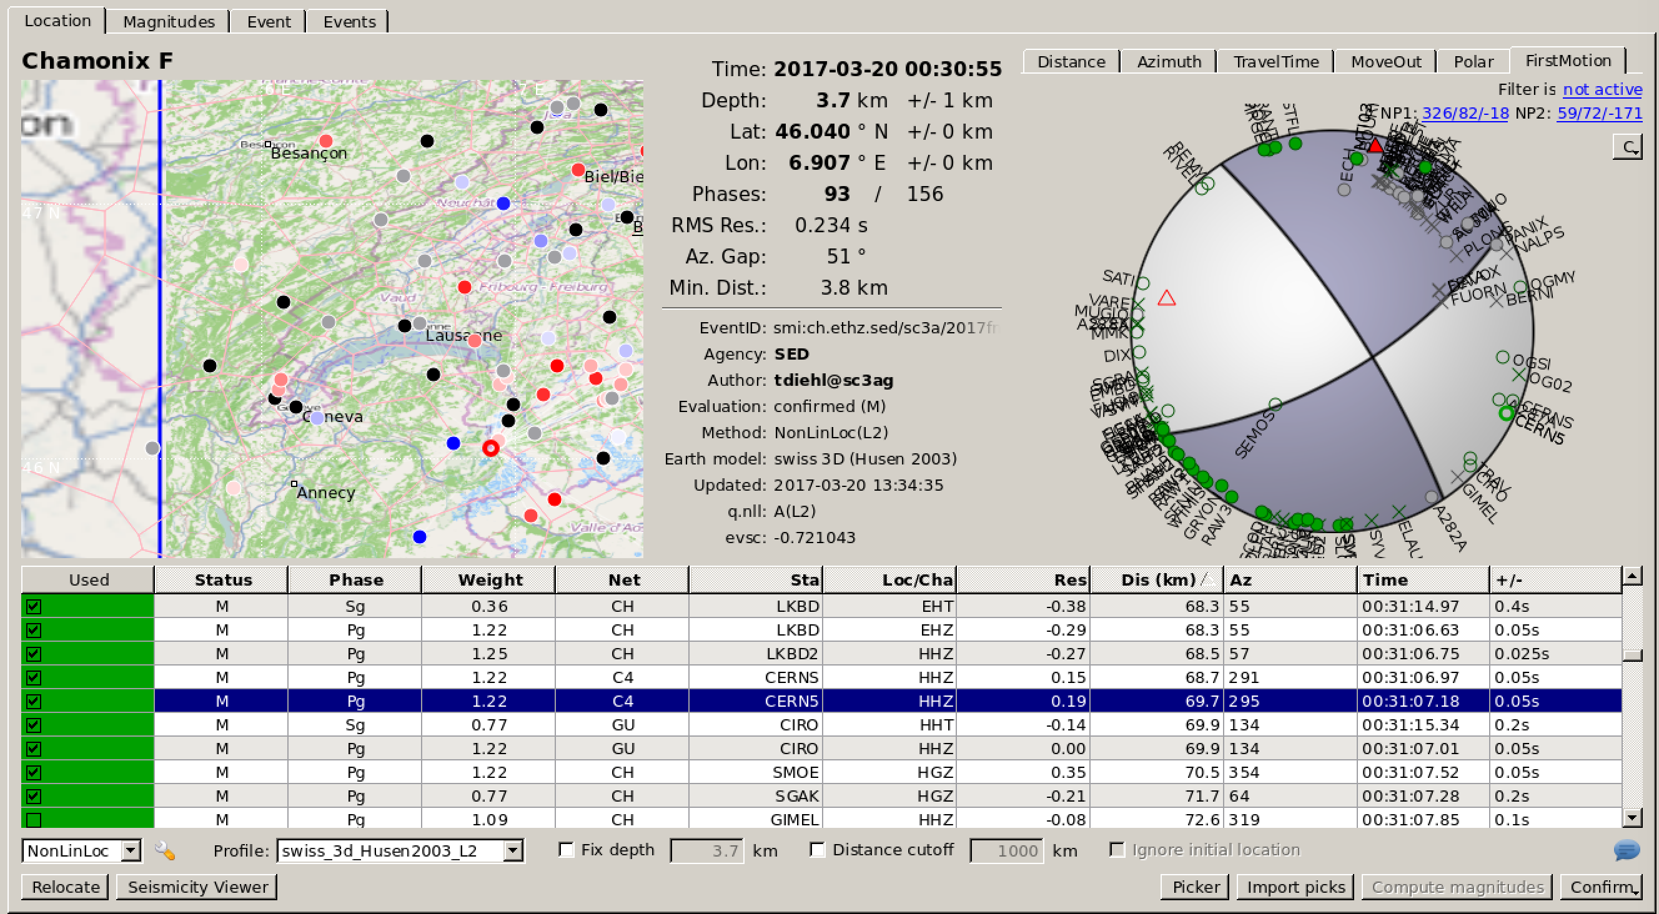
Conclusion
    “CERN stations fully integrated in network, expect to operate like any other SED station, and included permanent archive”
    “CERN stations now used in all earthquake related products”
    Dr. John Clinton, Director of Seismic Networks and Head of the Earthquake Monitoring section at the SED

Slide 28
Future of the project
Further calculations will be implemented in order to set a warning trigger during the excavation.
A further collaboration will permit to get a warning in case of large earthquake.
The possibility of sending the data with a 2s latency could allow to add the stations into the fast triggering system and forecast the earthquakes arrival.
The CompactRIO is not using all of its CPU and RAM: The available slots can be used for future developments.
The price of a future station is estimated to 27 000 CHF.

Slide 29
Thank you!
Questions

