Slide 1
ELICA
(Elimination of TFA Cables)
EDMS No:1773038
Francesco La Torre
on behalf of the ELICA project team

Slide 2
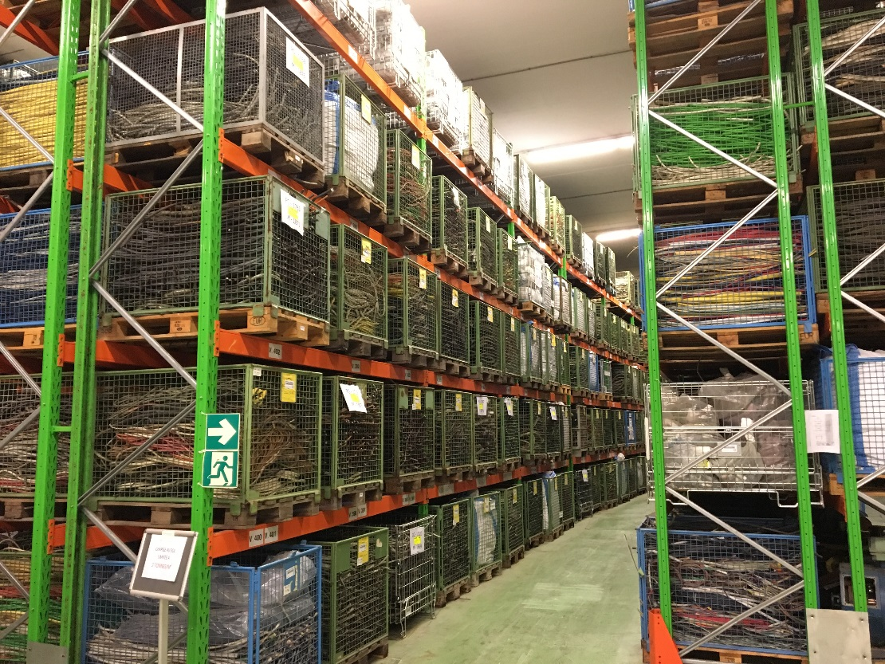

Slide 3
The ELICA pilot project
LS2 will require about 3000 m³ of waste storage
SHERPA can free about 2000 m³
Cable waste stored in the ISR about 1200 m³
Extremely high fire load in the ISR sectors
ELICA allows to liberate1000 m³ of space in due time for the LS2 reducing at the same time the fire load in the ISR

Slide 5
Timeline & deliverables
Start
project
Drafting
Start processing
End processing
[200 m³]
End
project
01/2016
05/2016
09/2016
12/2016
03/2017
ANDRA dossier for the disposal of 1000 m³ over 3 years
200 m³ of processed TFA cables ready to go
Characterization plan
Quality assurance plan
Processing plan
Validation plan

Slide 6
Resources
Budget
Name | Project Role | Engagement
F. La Torre | Project Leader, Characterization | 40% + 30%
B.A. Cellerier | Deputy Project, Operations | 20%
M. Magistris | Quality assurance, characterization | 20%
R. Michaud | Quality controls, ANDRA contacts | 10%
J. Germa | Work instructions and procedures | On request
D. Dalban | Work instructions and procedures | On request
Main budget items | Cost [kCHF]
Radiological characterization | 100
Operators | 100
Containers | 100
Transport and elimination to ANDRA | 200
TOTAL | 500
Elimination of 1 m³ ~ 2’500 CHF
Radioactive Waste Treatment Center (RWTC)
In-situ gamma spectroscopy station
Framework contracts with the CNRS, ANDRA and AMEC company

Slide 7
Work Breakdown Structure (WBS)

Slide 8
What really happened…

Slide 9
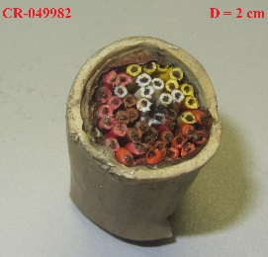
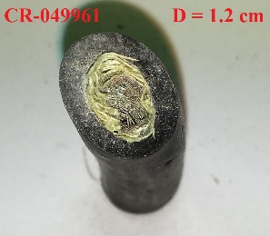
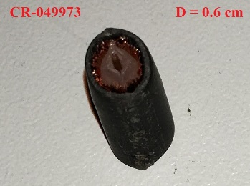
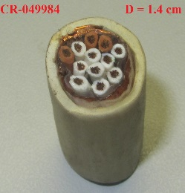
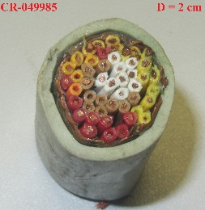
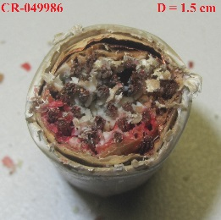
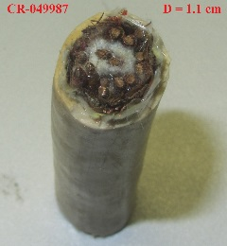
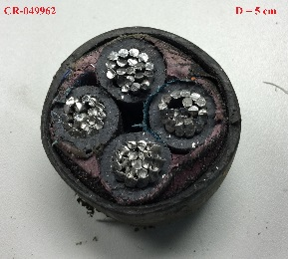
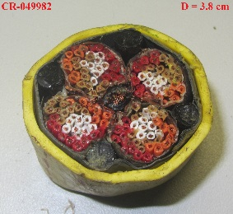
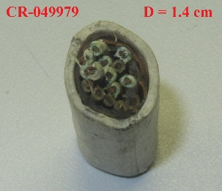
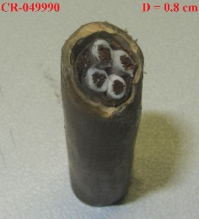
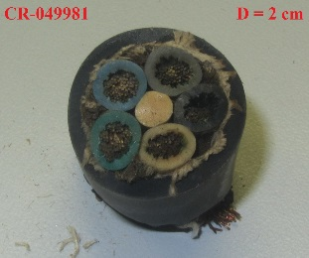
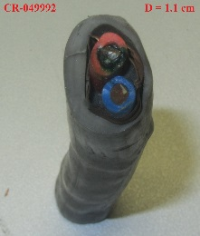
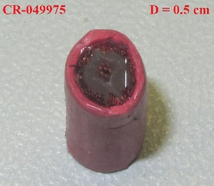
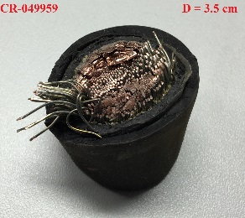
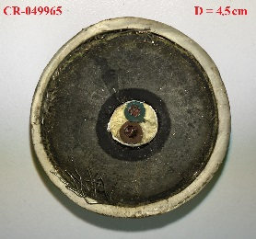
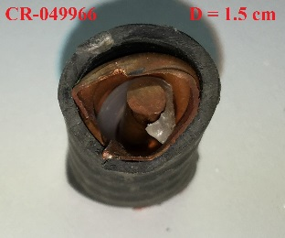
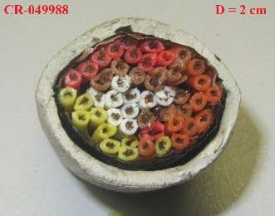
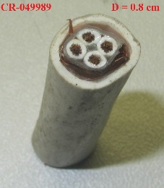
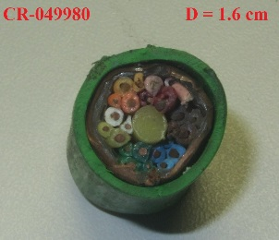
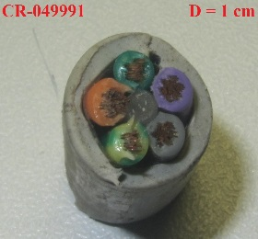
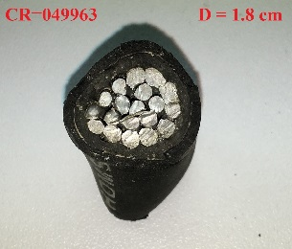
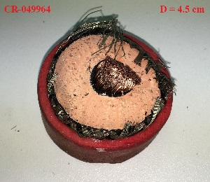
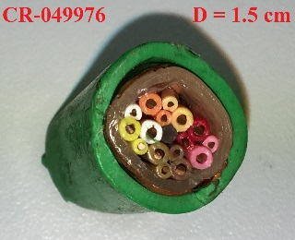
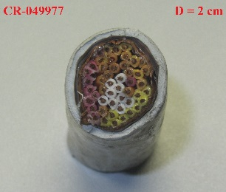
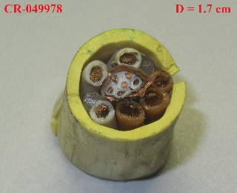
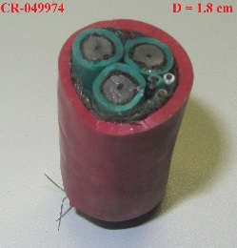
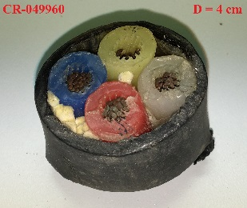
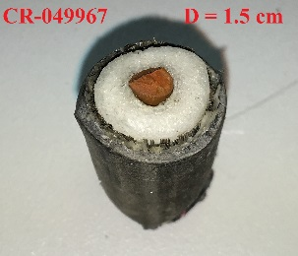
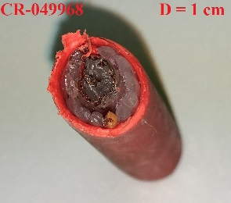
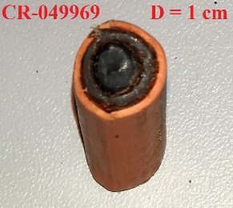
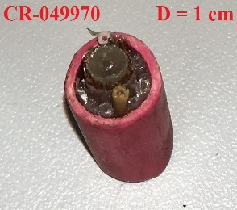
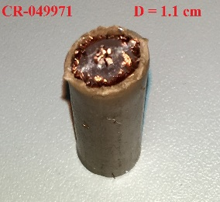
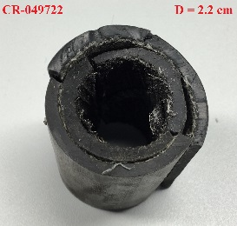
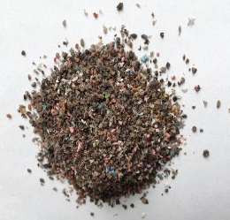

Slide 10
Méthodologie de caractérisation

Slide 11
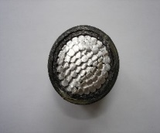
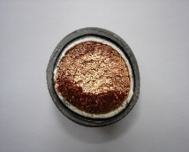
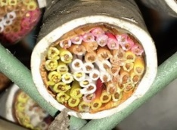
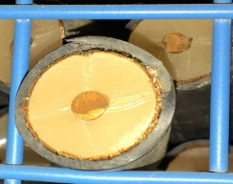
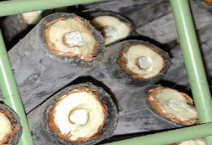
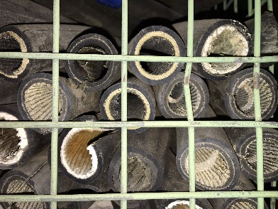
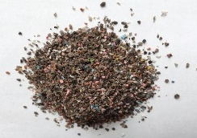
Summary cable families [wt-%]*
Matrix | Power Al | Power Cu | Signal Cu | Coax Cu | Coax Cu+Al | Stripped | Shredded
Density (g/cm3) | 1.9 | 2.8 | 1.6 | 1.7 | 1.3 | 0.95 | 0.5
Total | 100% | 100% | 100% | 100% | 100% | 100% | 100%
Copper | 0% | 63.8% | 47.2% | 42.5% | 31.2% | 0% | 0%
Aluminium | 53.5% | 0% | 0% | 0% | 15.4% | 0% | 0%
Outer insulation | 19.7% | 22.8% | 30.4% | 30.3% | 25.3% | 54.4% | 57.7%
Inner insulation | 26.8% | 13.4% | 22.3% | 27.3% | 28.1% | 45.6% | 42.3%
*based on 40 types of cable samples

Slide 12
A big issue…

Slide 13
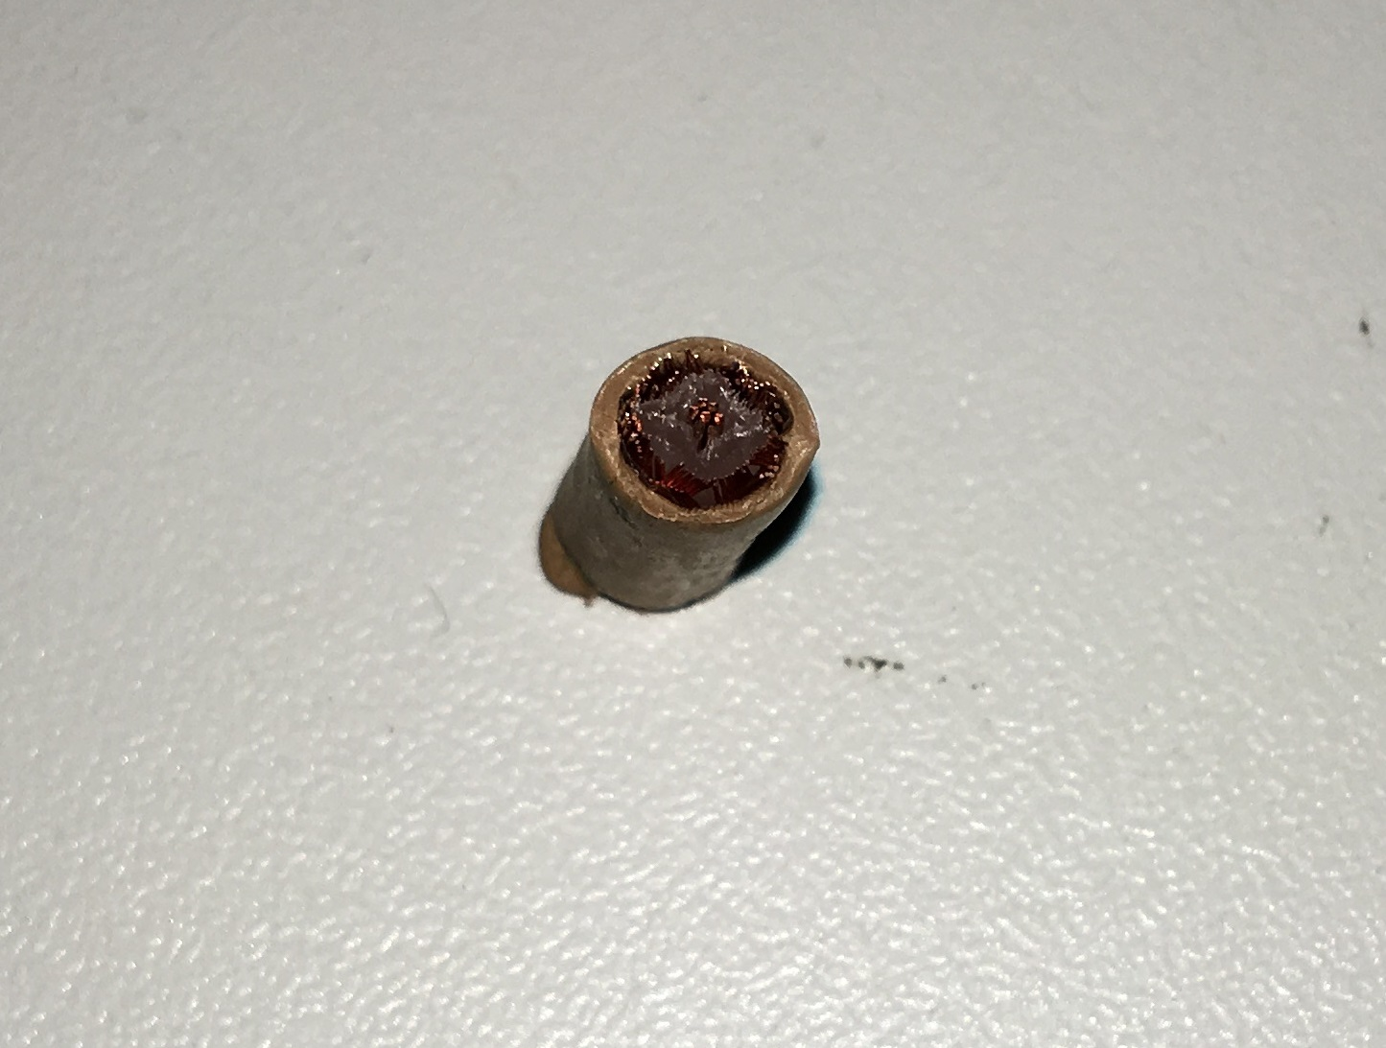
0.5 cm

Slide 15
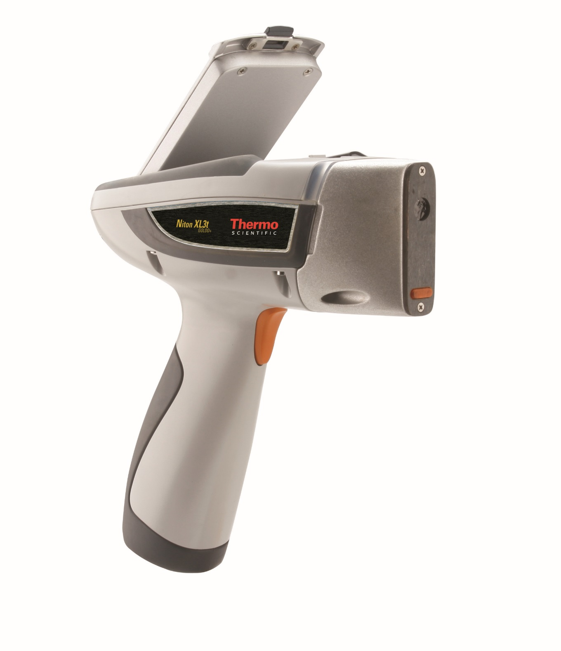
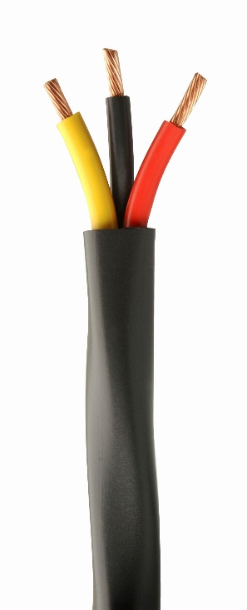
Portable XRF analyzer
Niton XL3t
by Thermo

Slide 16
Lead content measurements for the collected cable samples. The results are given as mass fraction over the entire cable.
Power cables (aluminium)
Sample | CR-049718 | CR-049719 | CR-049962 | CR-049963
Pb [wt-%] | 0.52 | 1.58 | 0.38 | 0.80
Power cables (copper)
Sample | CR-049959 | CR-049960 | CR-049961
Pb [wt-%] | 0.03 | 0.00 | 0.002
Signal cables (copper)
Sample | CR-049976 | CR-049977 | CR-049978 | CR-049979 | CR-049980 | CR-049981 | CR-049982 | CR-049983 | CR-049984
Pb [wt-%] | 1.26 | 2.27 | 2.86 | 1.24 | 0.69 | 0.50 | 0.13 | 0.85 | 0.004
Sample | CR-049985 | CR-049986 | CR-049987 | CR-049988 | CR-049989 | CR-049990 | CR-049991 | CR-049992
Pb [wt-%] | 1,08 | 0 | 0,01 | 0,21 | 0,55 | 0,001 | 0,71 | 1,41
Coaxial cable (copper)
Sample | CR-049964 | CR-049965 | CR-049966 | CR-049968 | CR-049969 | CR-049970 | CR-049971 | CR-049972 | CR-049973
Pb [wt-%] | 1,09 | 0,56 | 0,36 | 0,91 | 0,06 | 0 | 0,8 | 3,25 | 0,54
Sample | CR-049974 | CR-049975
Pb [wt-%] | 1,06 | 2,82
Coaxial cable (copper +aluminium)
Sample | CR-049720 | CR-049721 | CR-049967
Pb [wt-%] | 0,01 | 0,409 | 0,001

Slide 17
ELICA elimination pathway

Slide 18
1 | Program manager | Selection of elimination campaign
2 | Characterization | Campaign boundaries and batch selection (TREC info + visual inspection)
3 | Operation | Radiological info (RADOS or dose rate measurements)
4 | Characterization | Sampling definition (numbers and containers)
5 | Operation | Sample collection and traceability
6 | Characterization | Radionuclides inventory (ActiWiz calculations) and shipping for gamma spectroscopy and radiochemical
7 | Operation | Cable sorting and packaging + in situ gamma spectroscopy of packages
8 | Characterization | Scaling factors and IRAS calculations
9 | Operation | Quality controls on cable containers
10 | Characterization | Quality controls on calculations and IRAS values + communications to ANDRA
11 | Operation | Shipping of cable containers

Slide 19
Lessons learned

Slide 20
Don’ts
Project manager with other tasks in the same project
Increased project effort with a cut of resources
Underestimation of the required info (physical, chemical)
Consultant support with no CERN experience
Dos
Approved project charter
ANDRA and AMEC framework contracts
Project support from the RP management
Team with many years of RW experience at CERN!

Slide 21
Summary (24/03/2017)
Pre-treatment:
452 metallic baskets of cables
ISR occupied volume: ~ 452 m3
Average density: 0.47
Post-treatment:
192 ANDRA container
Total volume: 249.6 m³
Average density: 0.85
211 tons of processed cables
112 containers shipped to ANDRA
348 m³ of space freed at ISR

Slide 22
03/2016

Slide 23
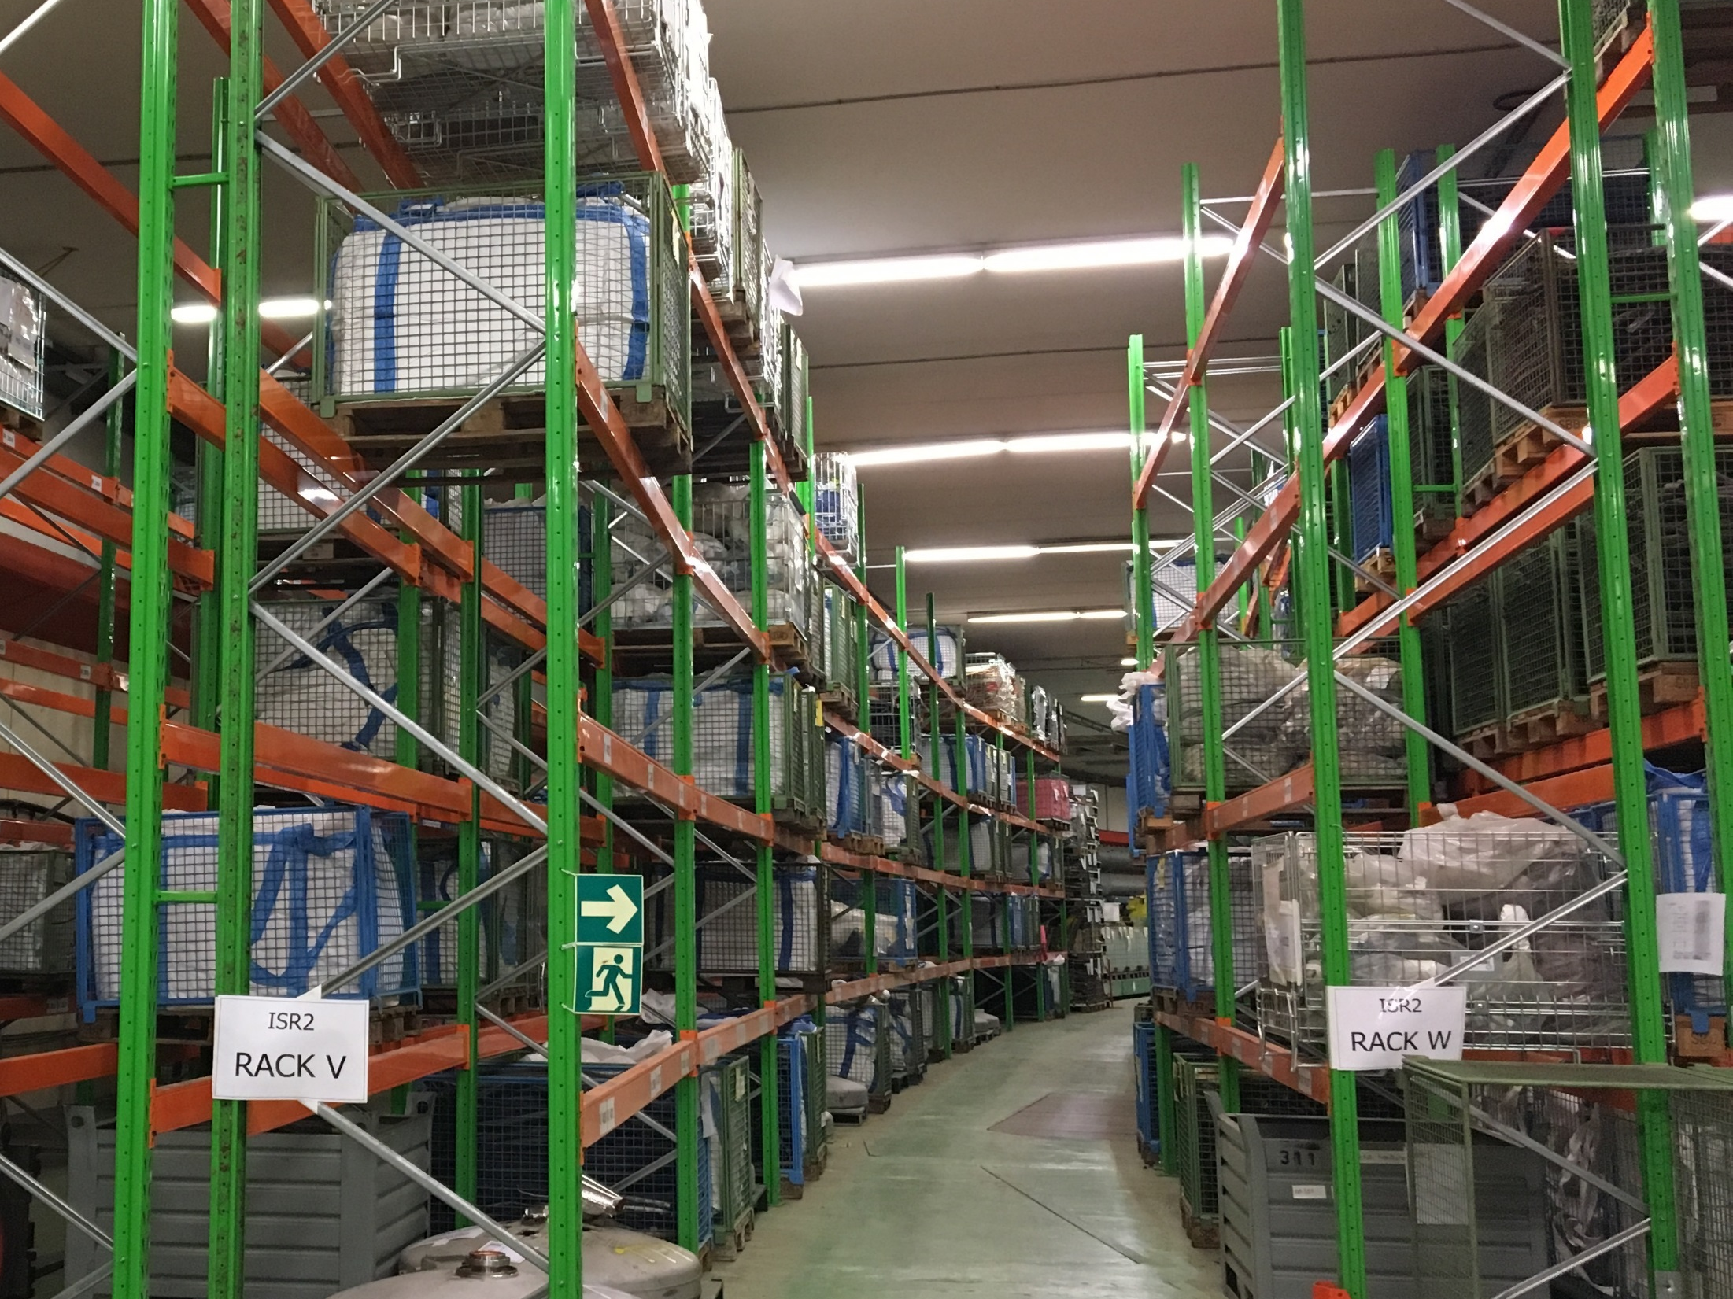
03/2017

Slide 24
Thank you
Luca Bruno
Bertand Cellerier
Matteo Magistris
Regis Michaud
Luisa Ulrici
Nick Walter

Slide 25
Backup slides

Slide 26
Planned |  | Actual
Deliverable | Date | Deliverable | Date
Dossier for the disposal of 1000 m³ of historical TFA cables (2016 – 2018) | Draft: 05/2016 Approval: 09/2016 | Dossier for the disposal of 2110 m³ of historical and future TFA cables (2016-2023) | Draft: 06/2016 Final: 01/2017
200 m³ of processed TFA cables ready to go | January 2017 | 200 m³ of processed TFA cables ready to go | November 2016
Characterization plan for historical TFA cables | Draft: 05/2016 | Characterization plan for historical and future TFA cables | Draft: 05/2016 Final: 06/2016
Quality assurance plan | Draft: 05/2016 | Quality assurance plan | - -
Processing plan | Draft: 05/2016 | Processing plan | Draft: 10/2016
Validation plan | Draft: 05/2016 | Validation plan | Draft: 10/2016
Planned cost per m³ | Actual cost per m³
2500 CHF | 2443 CHF

Slide 27
Determination des colis les plus radioactifs (Debit de dose ou RADOS)
Echantillonnage par famille des câbles
“Echantillons primaires” des colis les plus radioactives du lot
Calculs analytiques (radionuclides en presence)
Spectrométrie gamma
Analyse de radiochimie (principaux radionucléides difficiles à mesurer)
Ratios analytiques (autres radionucléides difficiles à mesurer)
IRAS
IRAS > 0.5
et/ou
Ai > LDFi
IRAS < 0.5
et
Ai < LDFi
Analyse statistique de ratios émetteur beta/traceur (coefficient de corrélation R)
Application d’une activité massique forfaitaire à l’ensemble des colis (même famille)
R < 0.5
Control qualité

Slide 29
