Slide 2
CALLAB, CLEAR and CERF
A wide range RP Fellowship
Fabio Pozzi
HSE-RP-DC and HSE-RP-SP

Slide 3
Table of contents acronyms
CALLAB: Calibration Laboratory
CLEAR: Clearance of LEP Acceleration RF System
CERF: CERN-EU high-energy Reference Field facility

Slide 4
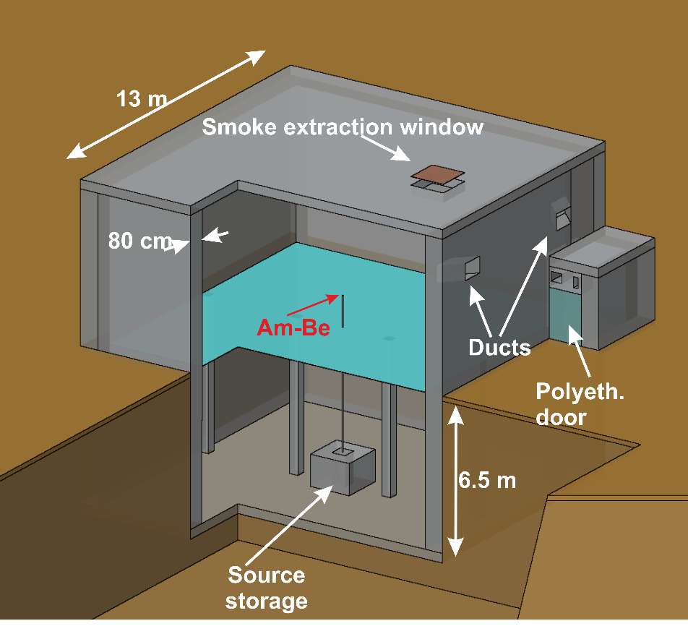
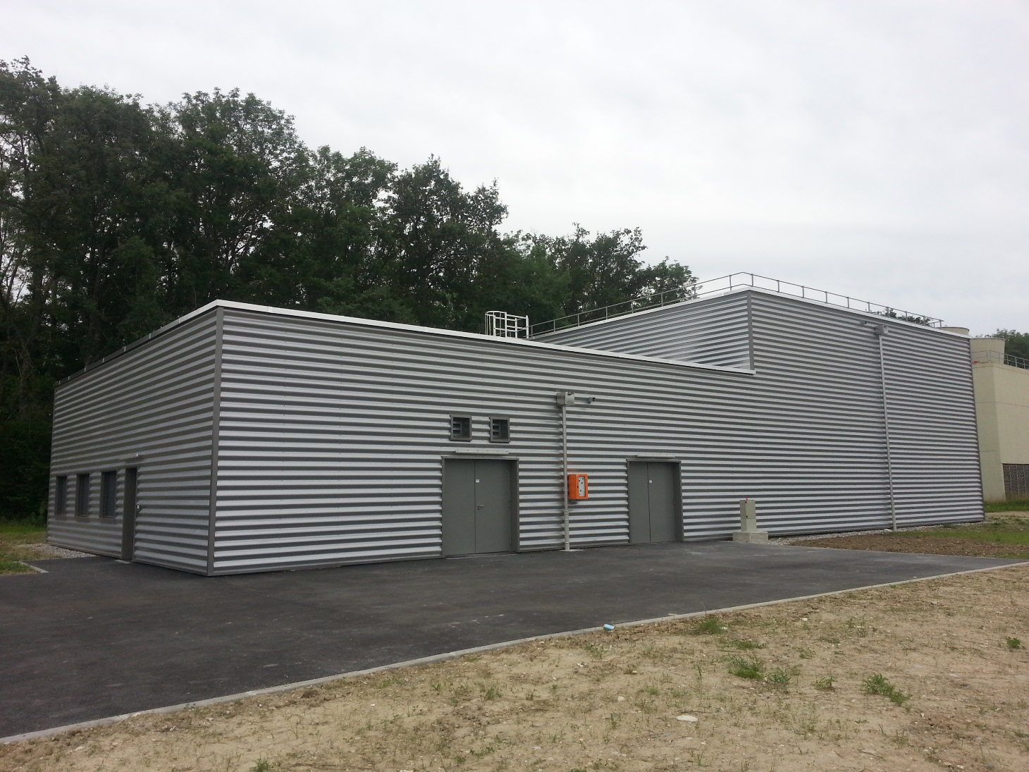
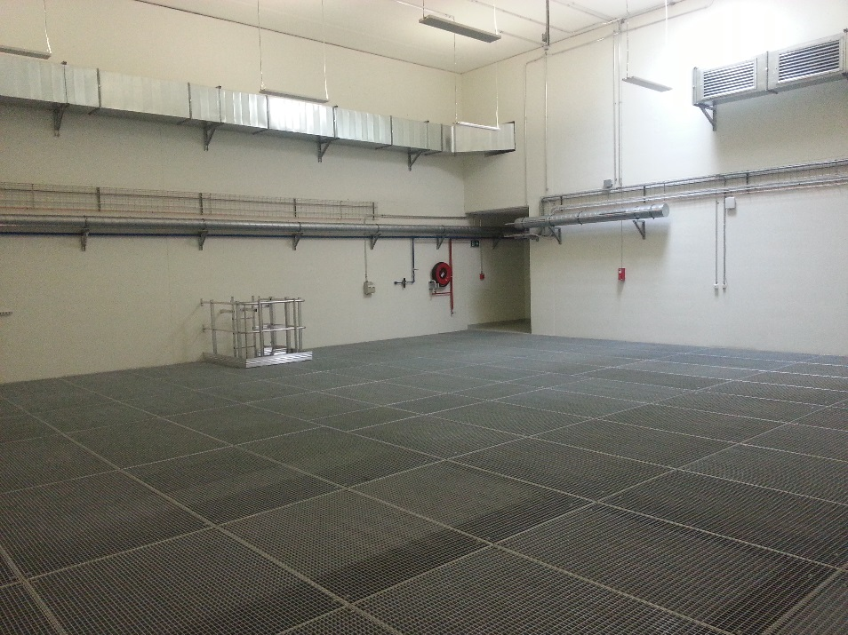
CALLAB: Building
FLUKA simulation
B. 772
Status in 2014

Slide 5
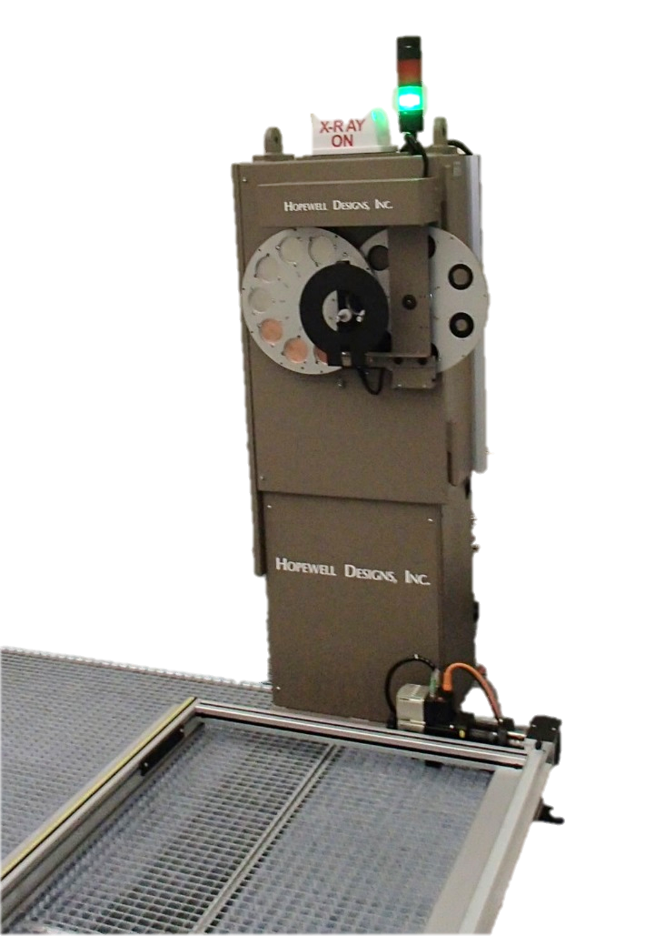
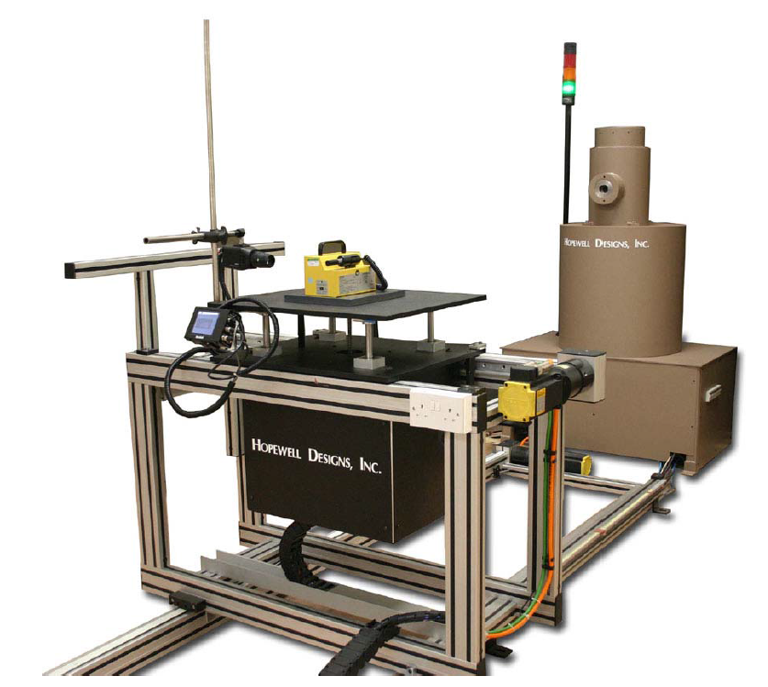
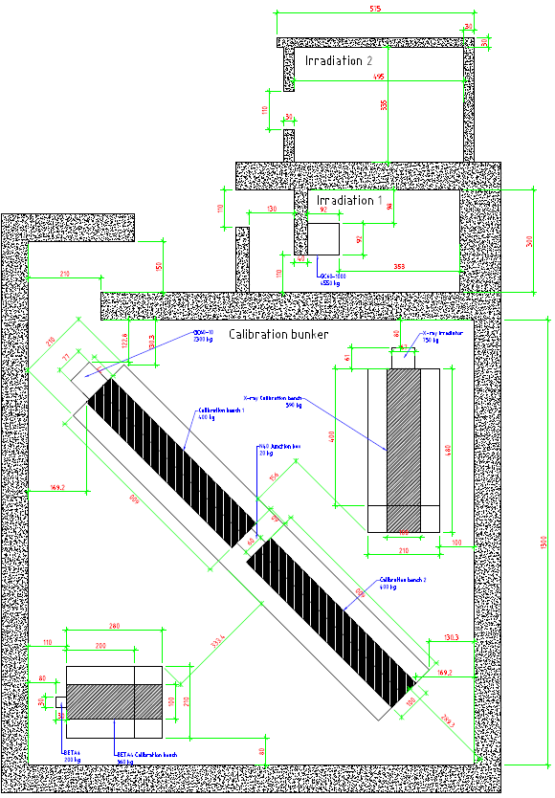
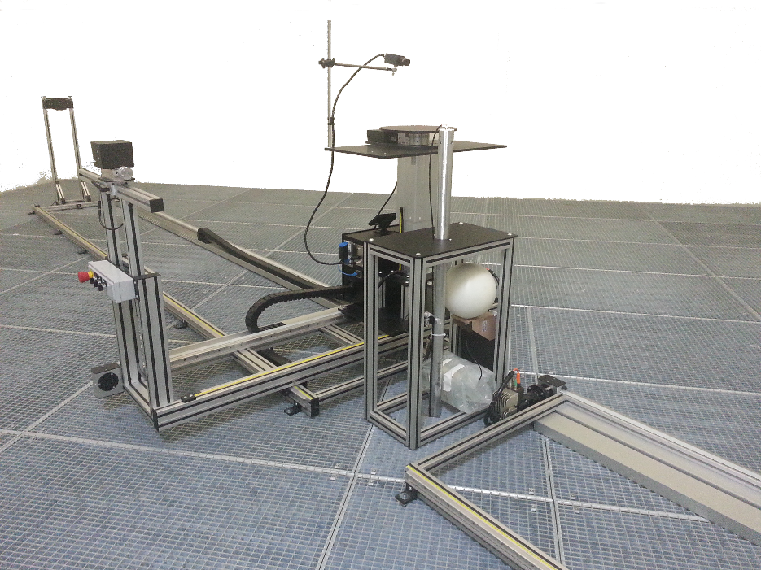
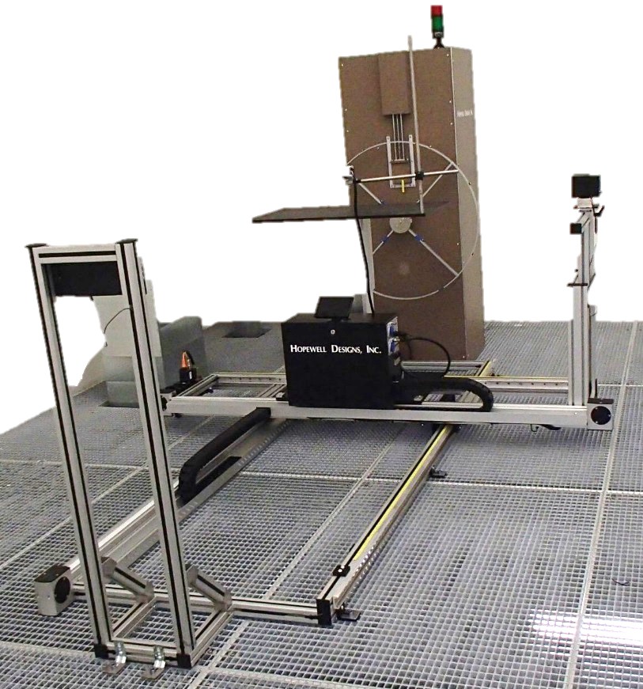
CALLAB: Capabilities
X-ray tube: 320 kV
Cs-137: 1 μSv/h– ~200 mSv/h
Co-60: Sv/h and μSv/h
Sr-90: 1.85 GBq
Kr-85: 4 GBq
Am-Be: 20 nSv/h - 1.4 mSv/h

Slide 6
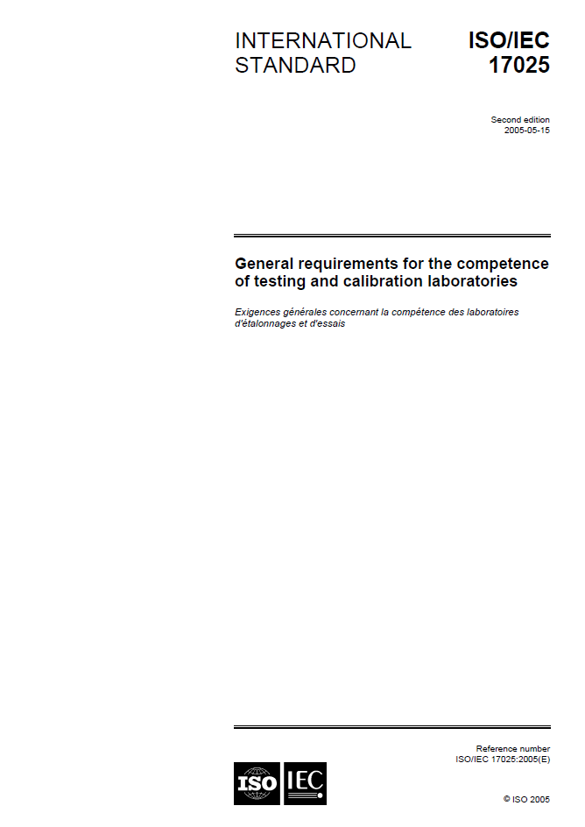

CALLAB: Accreditation 1/2
Objective: ISO 17025 accreditation
Reason: required by Swiss authorities
But first of all is an…
OPPORTUNITY to:
Provide a reliable calibration service
Optimize the calibration process
Identify and prevent risks and errors
…

Slide 7
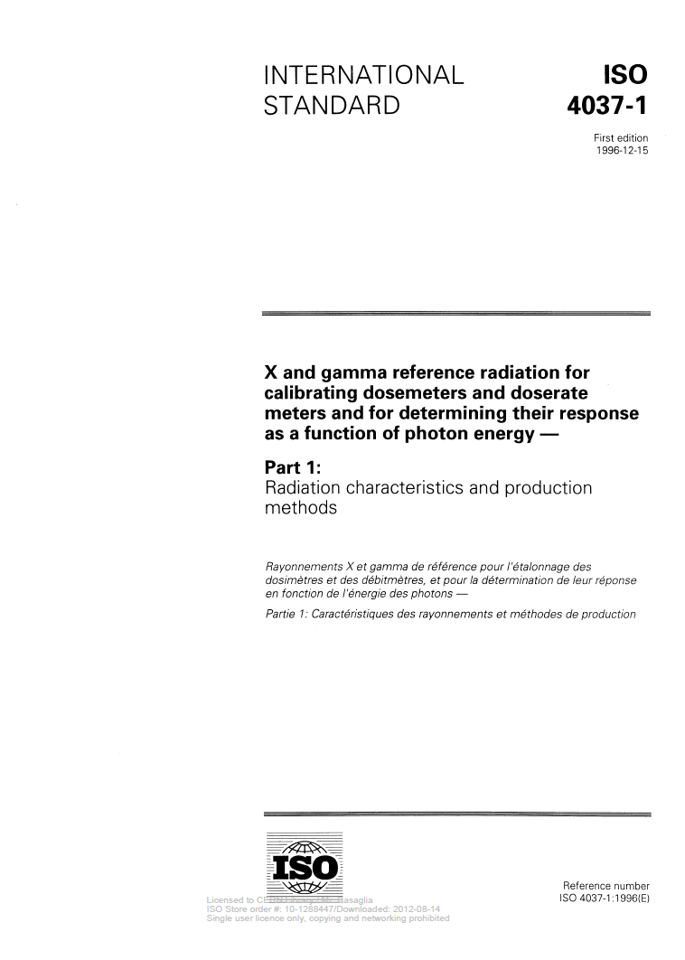
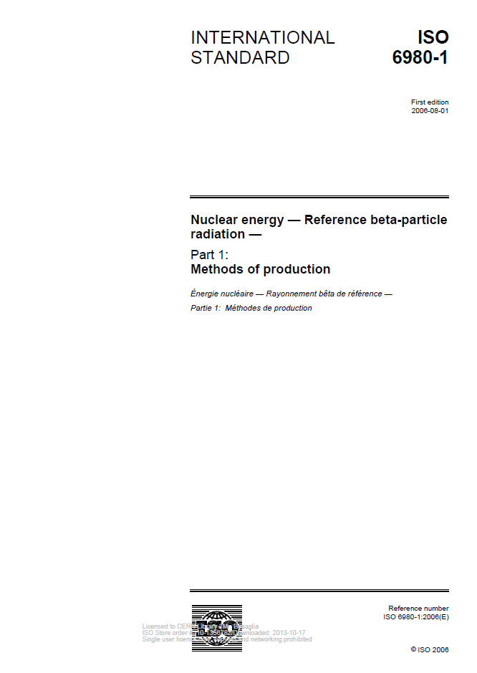
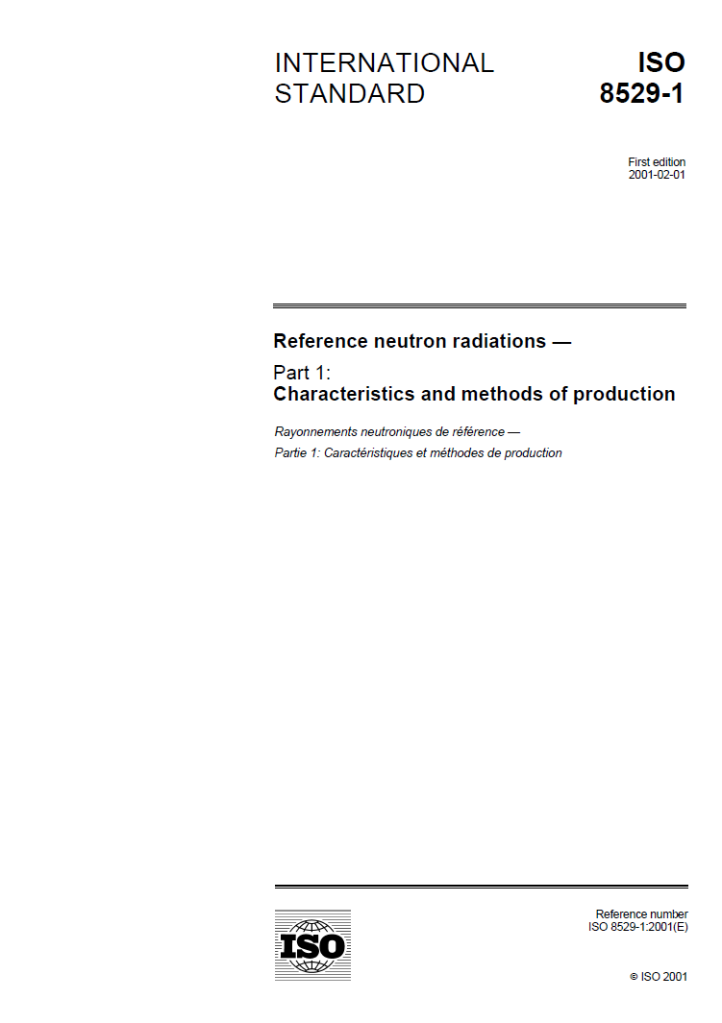
CALLAB: Accreditation 2/2
How to obtain the accreditation:
Quality manual (10-15 pages)
Procedures (15 out of 25)
Forms (3 out of 6)
Working instructions (3 out of 26)
Management committement
Intercomparisons
Audits
…

Slide 8
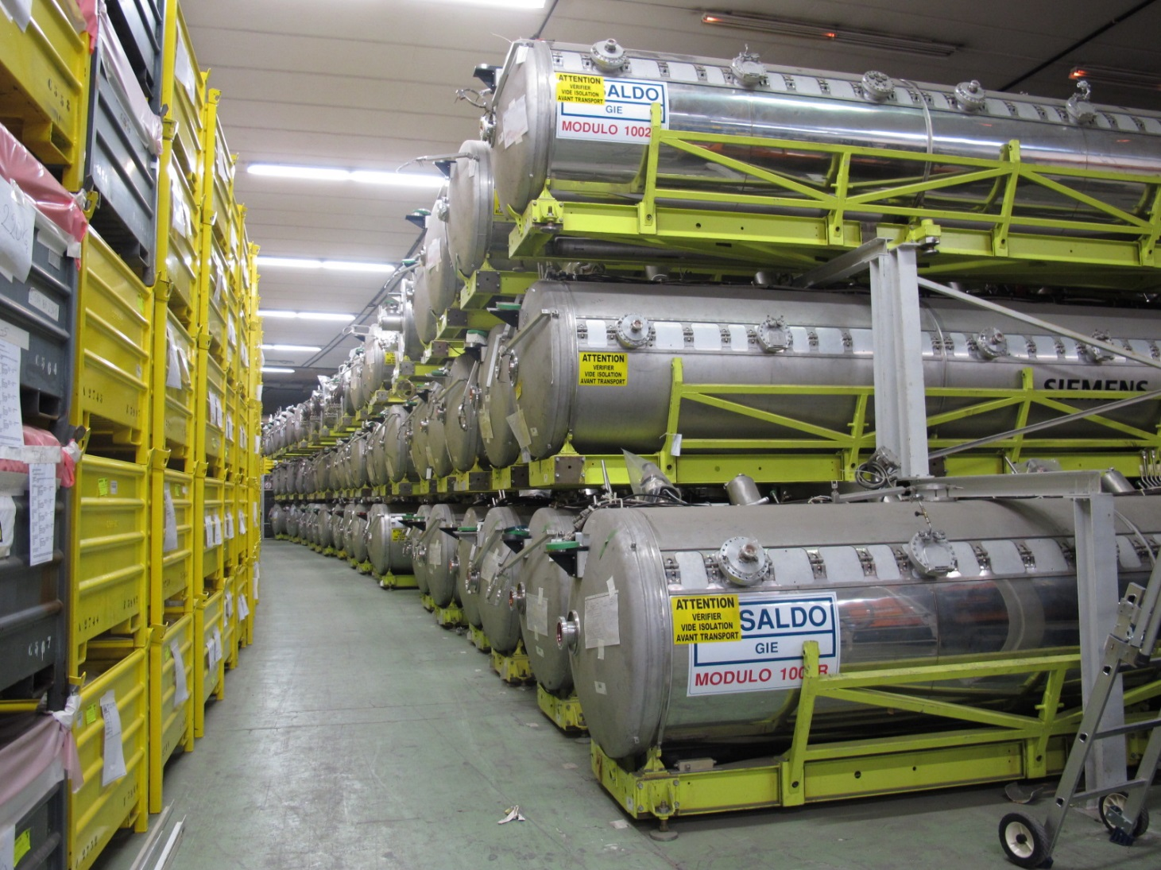
CLEAR: overview
72 modules (68 pur Cu coated with a Nb fil, 4 pure Nb)
1 module sent to India
1 disassembled and pressed for test
70 modules stored in ISR (2000 m³)
Material | Weight
Al (tank) | 134 tons
SS+Cu of the CM | 95 tons
SS plates | 22 tons
Ni rods | 14 tons
Nb | 3 tons
Iron supports | 91 tons
Other (cables, small components, insulations…) | 71 tons

Slide 9

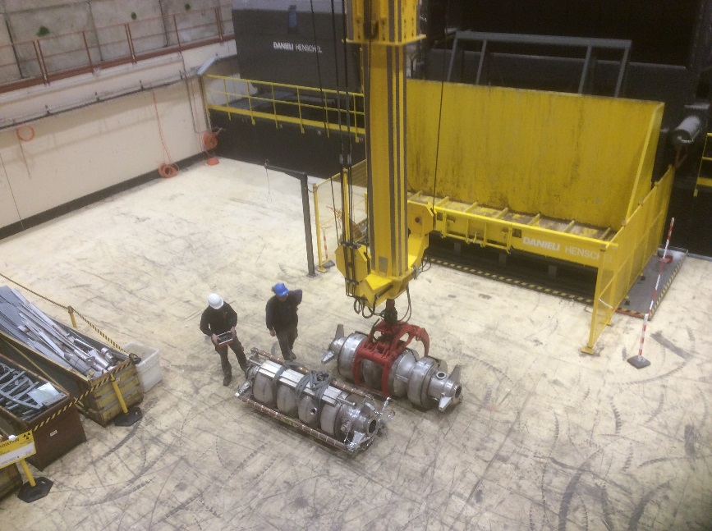
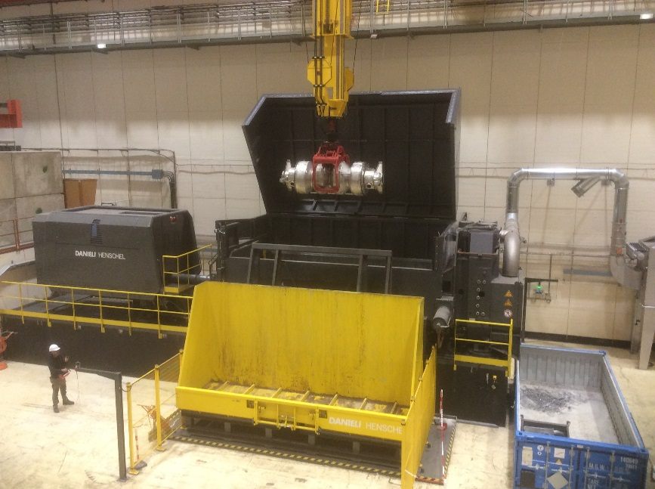
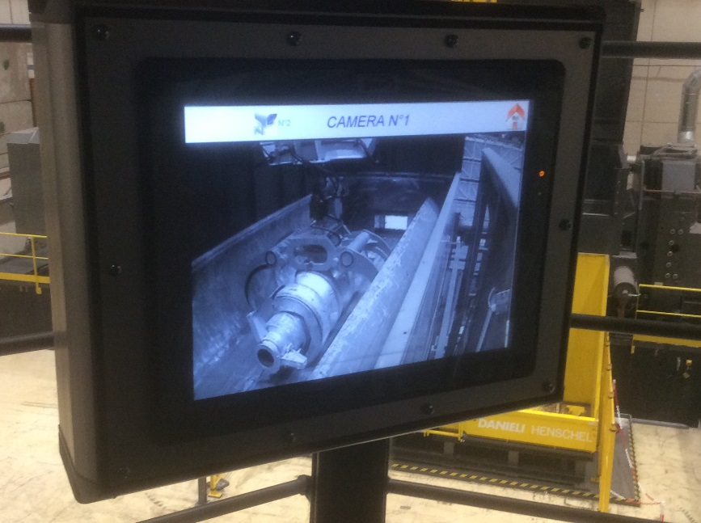
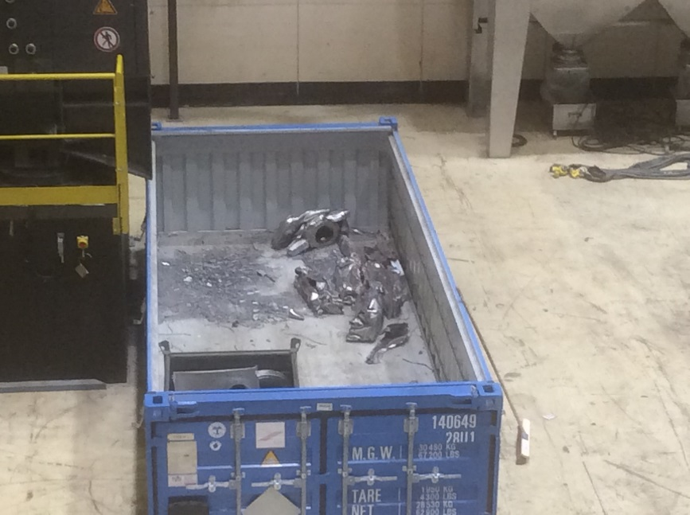
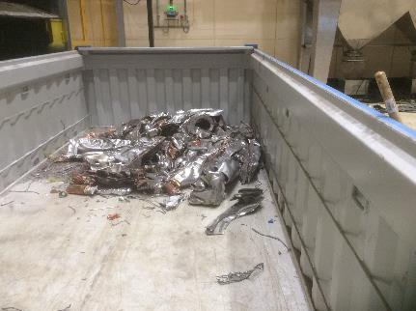
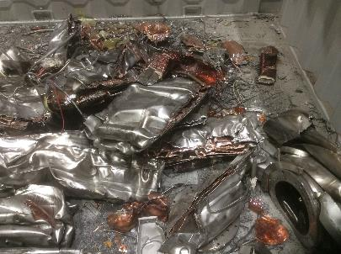
CLEAR: options 1/2
1st option: classification as TFA (très faiblement actif) in France

Slide 10

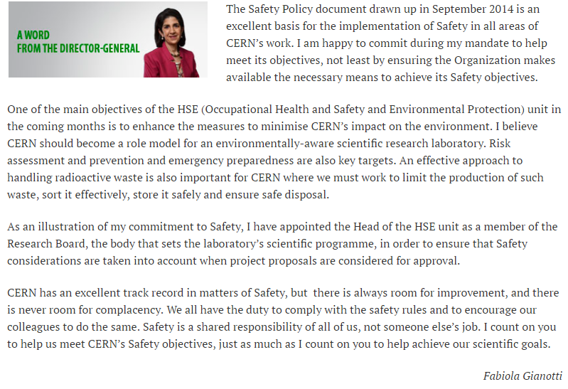

CLEAR: options 2/2
2nd option: clearance from regulatory control in Switzerland
Clearable if (see Swiss ORaP, Radiological Protection Ordinance):
Surface contamination < SC limits
H*(10) at 10 cm above background < 0.1 uSv/h
Specific activity < LE limits
Why clearance?
Conventional waste
Recycling (impact on the environment)
Cost-effective (income)

Slide 11
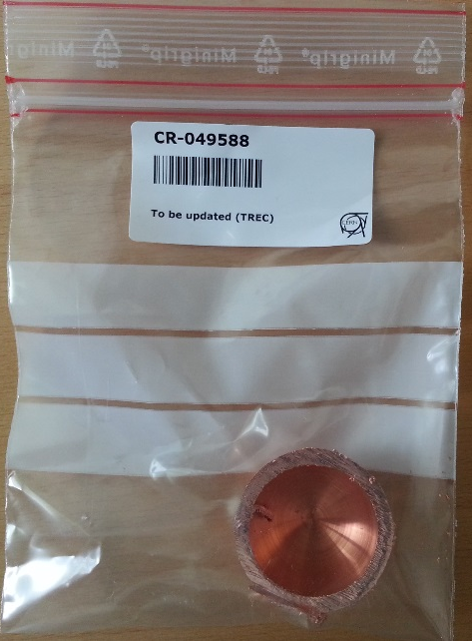
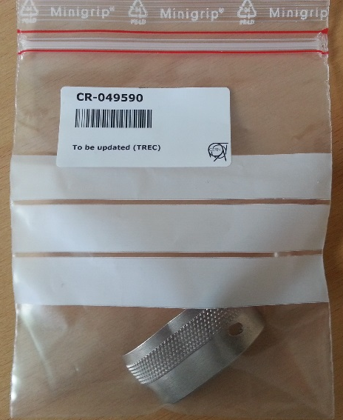
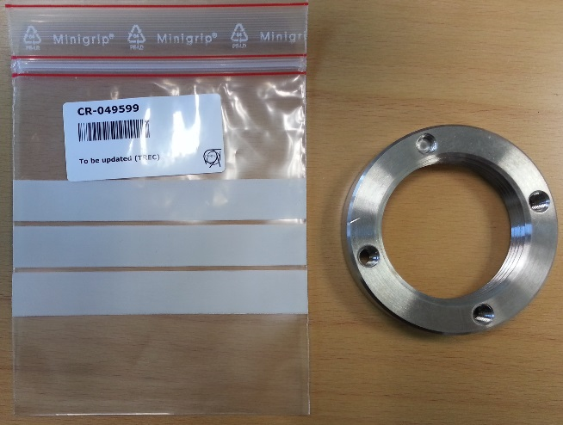
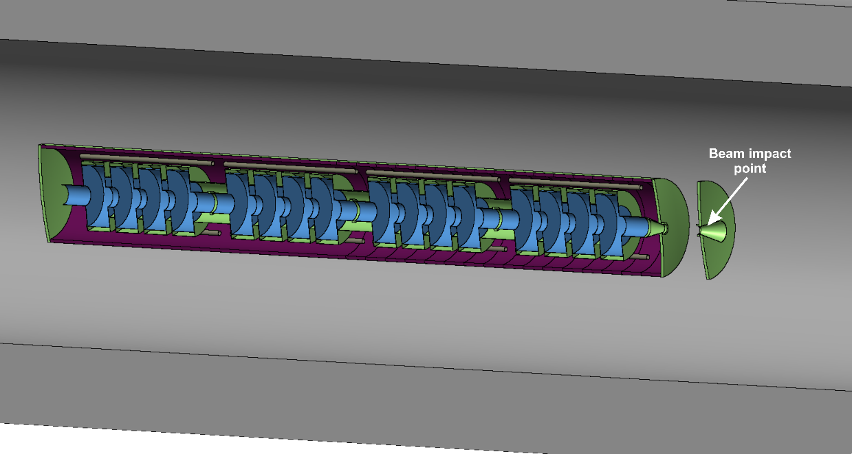
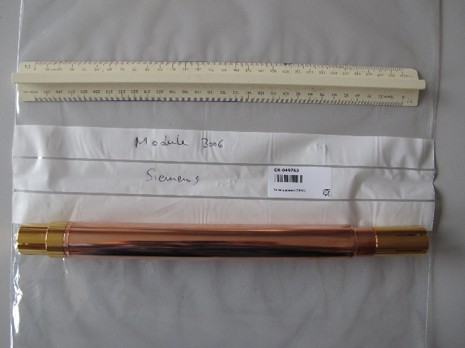
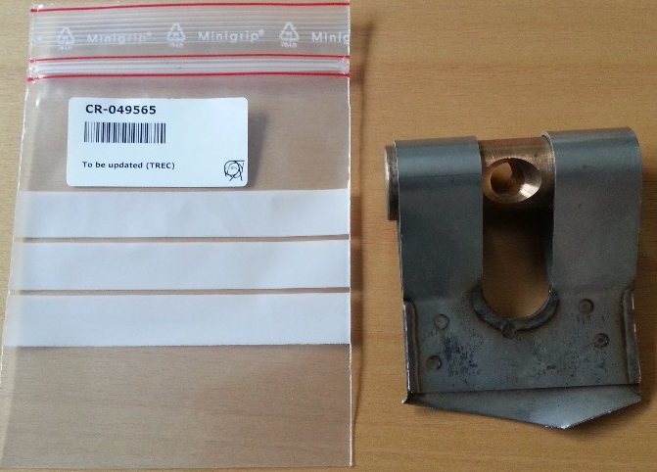
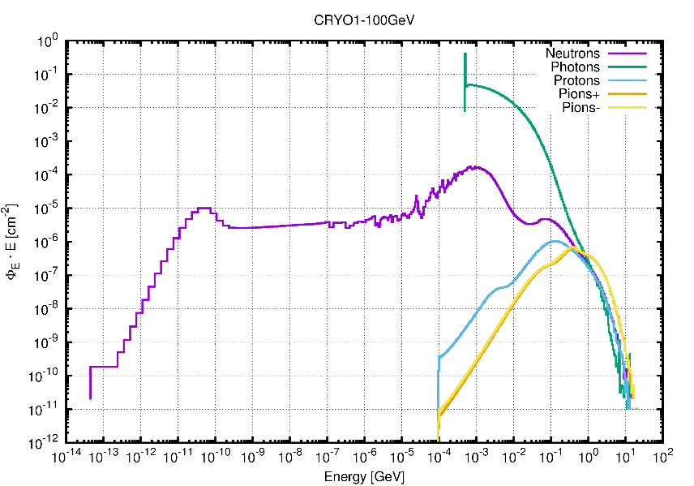
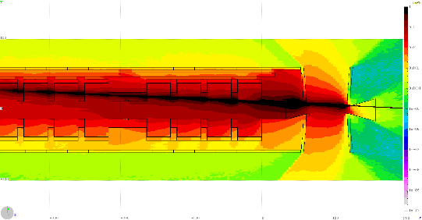
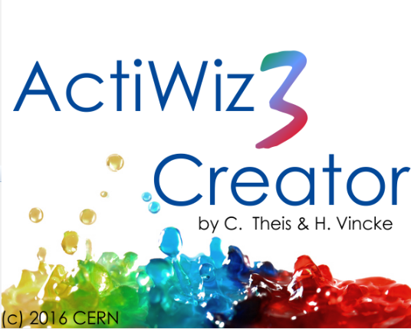
CLEAR project
What clearance meant for CLEAR?
1. Pre-characterization:
γ-spectrometry
Radiochemical analyses
FLUKA simulations
ActiWiz calculations

Slide 12
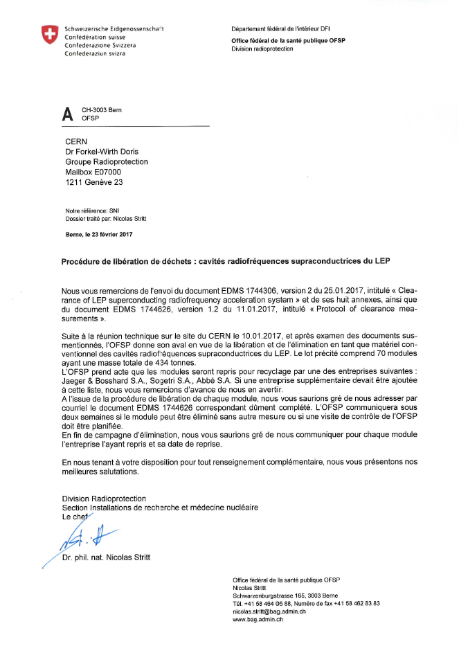
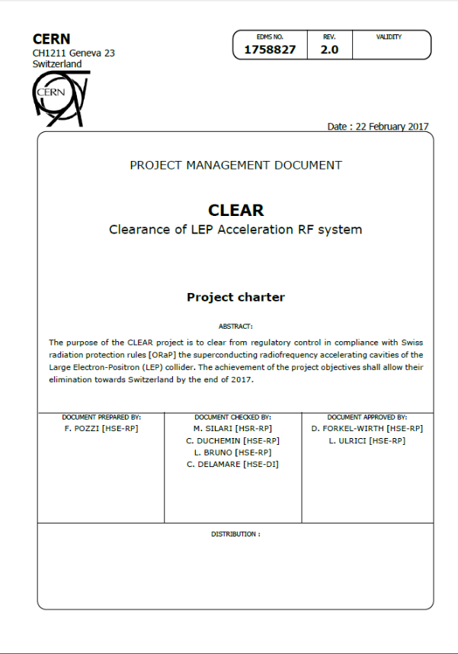
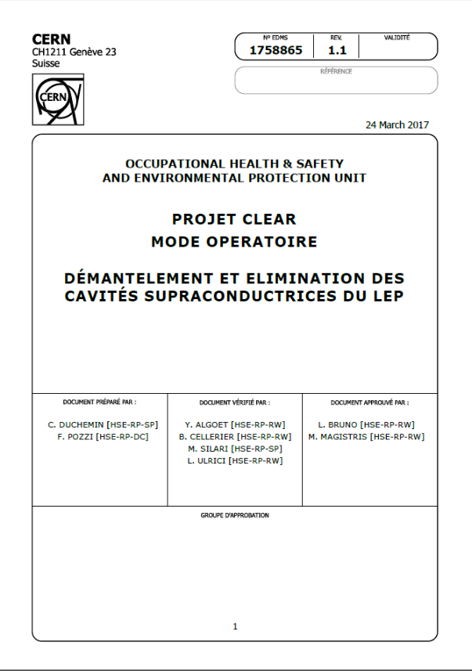
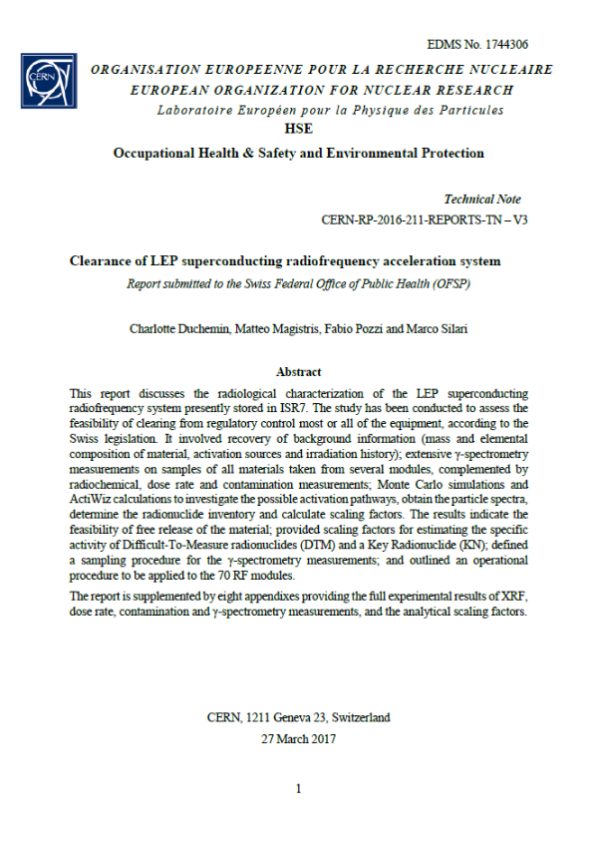
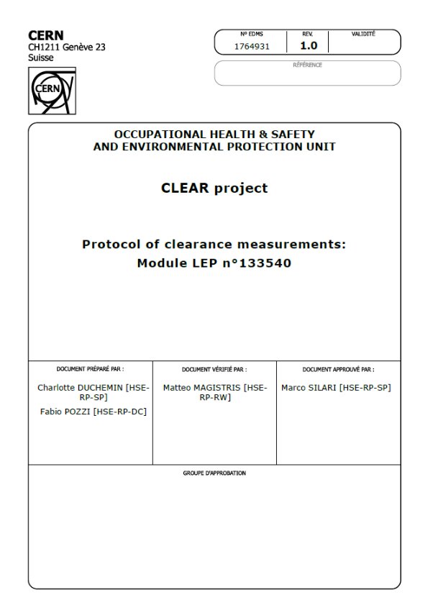
CLEAR project
What clearance meant for CLEAR?
2. Strategy definition and OFSP approval:
Project charter
Working instructions
Report for OFSP
Protocol template for clearance measurements

Slide 13
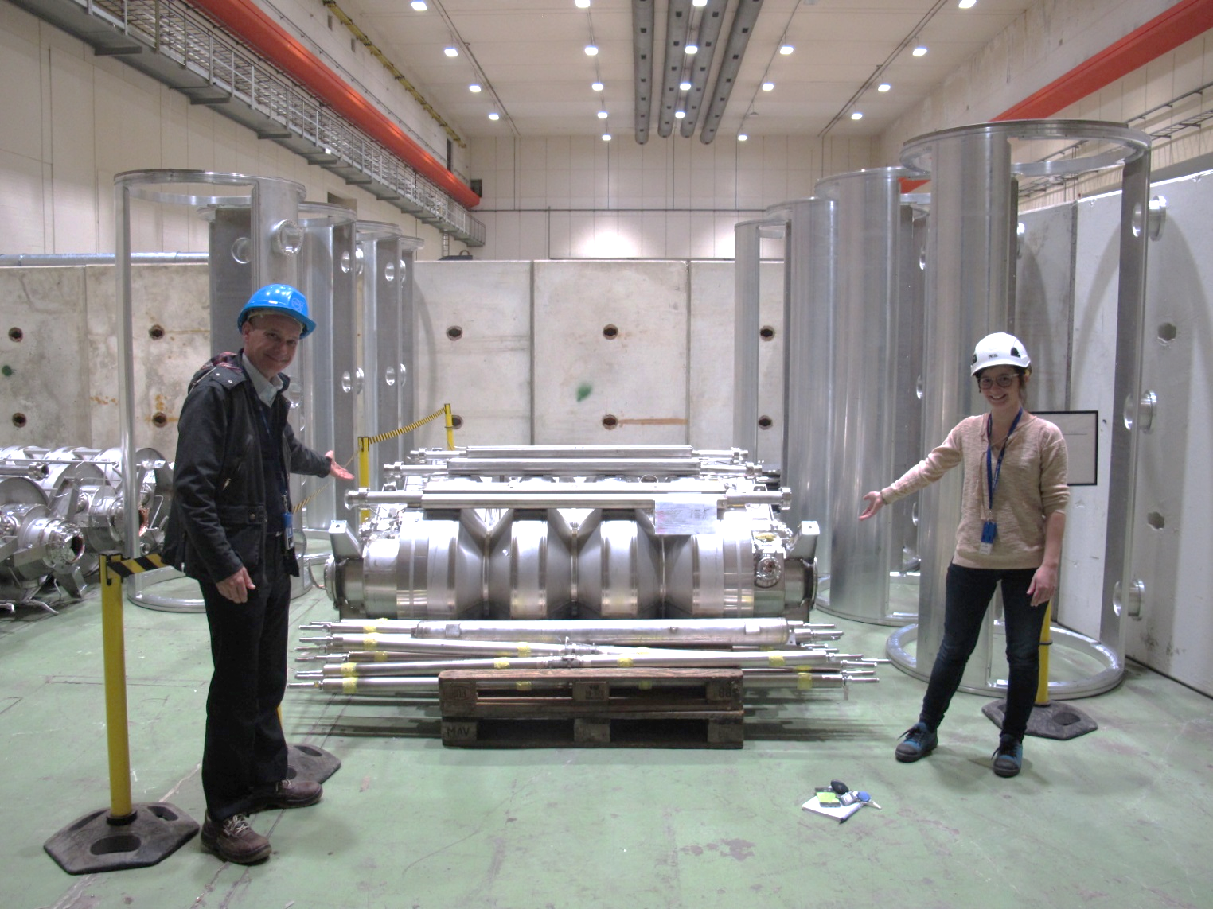
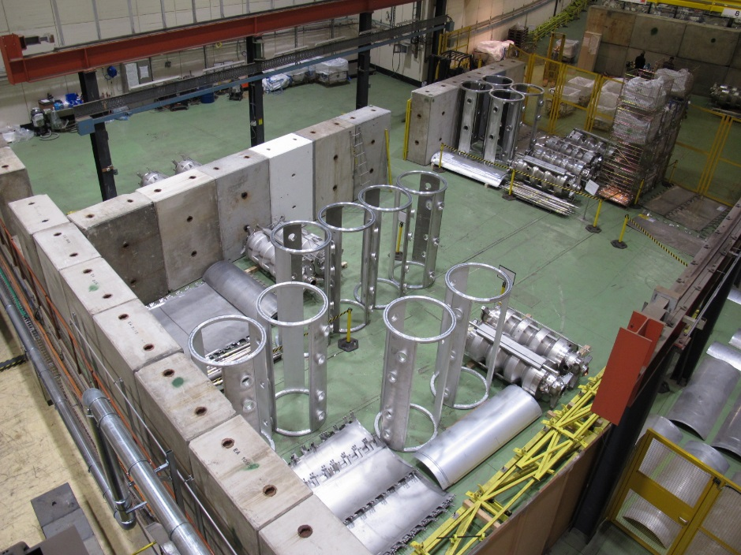
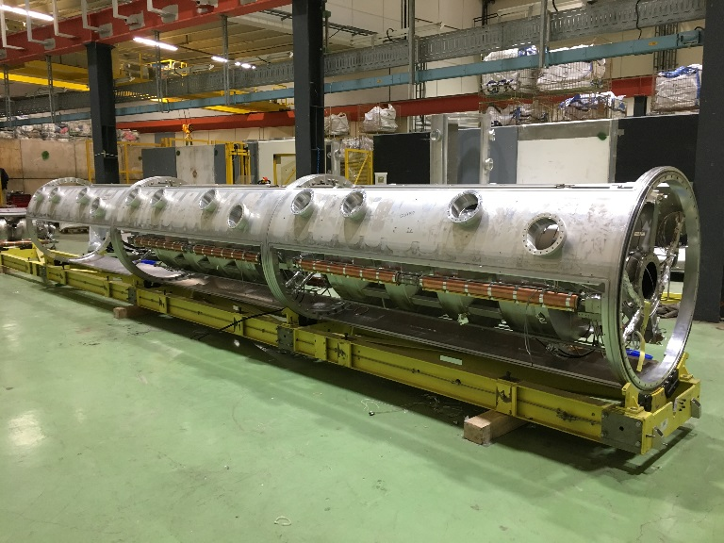
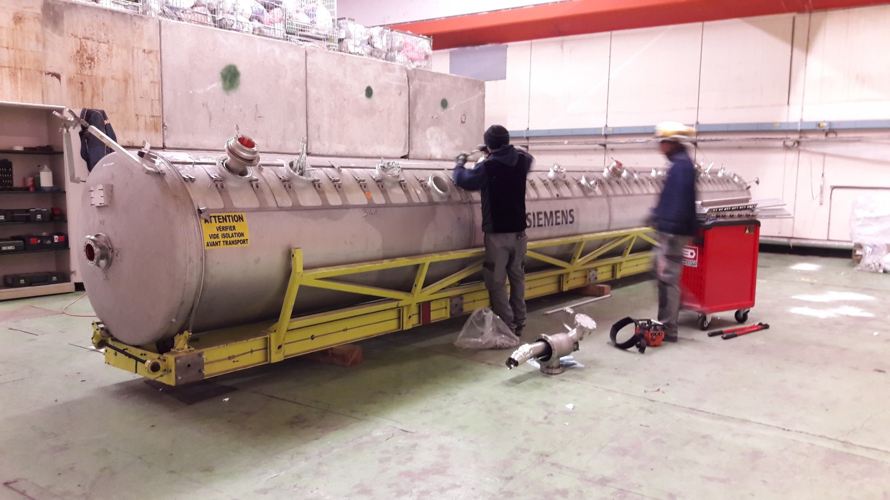
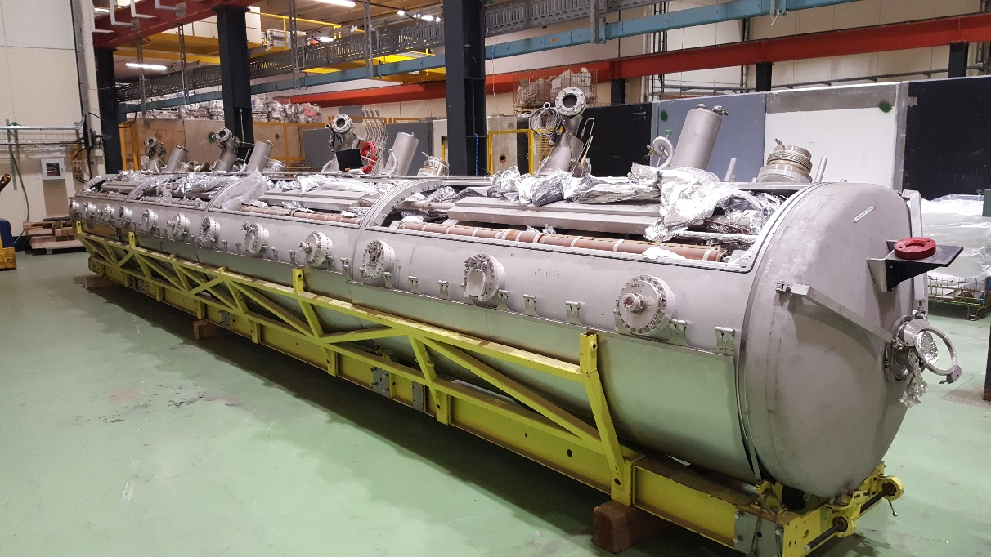
CLEAR project
What clearance meant for CLEAR?
3. Operational phase:
Dismantling and sampling
Measurements
Fill in the clearance protocol
OFSP approval
Back to a)

Slide 14
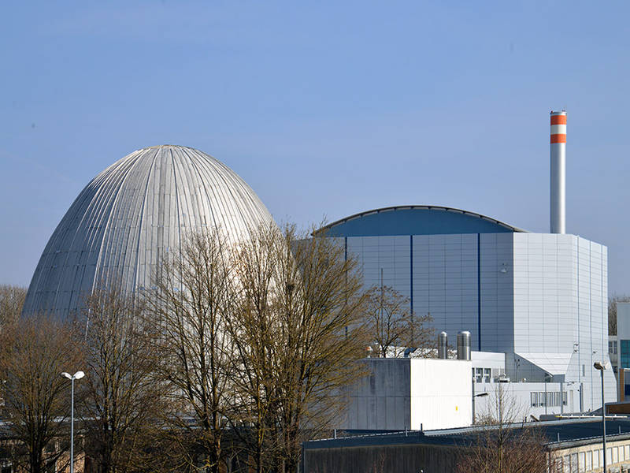
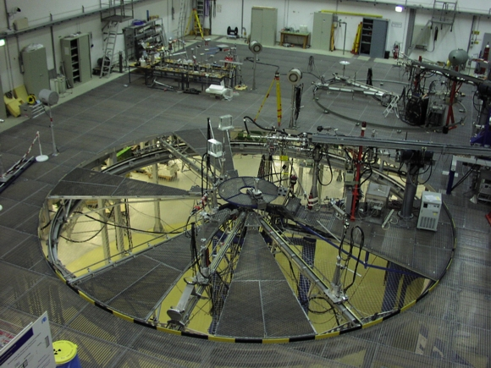
CERF: Let me introduce
Reference fields from thermal up to about 1 GeV:
radionuclide sources
thermal and filtered neutron beams (nuclear reactors)
nearly monoenergetic fields (particle accelerators)
simulated workplace fields
FRM I and II (Munich – Germany)
PTB (Braunschweig – Germany)

Slide 15
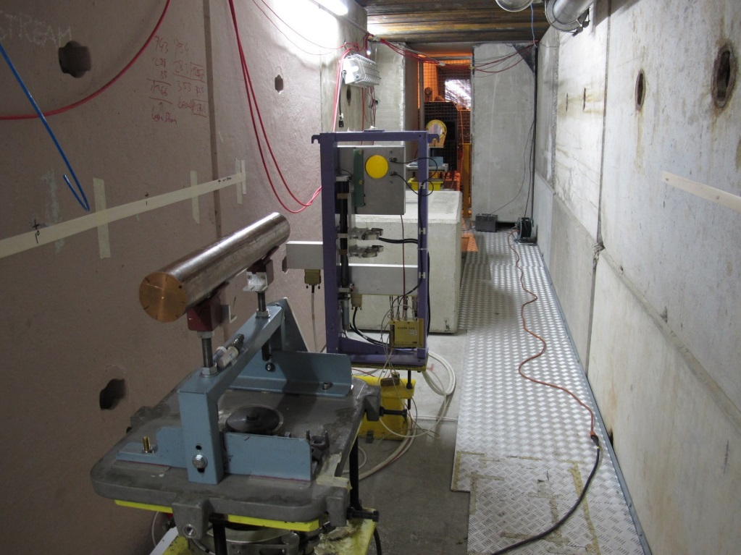
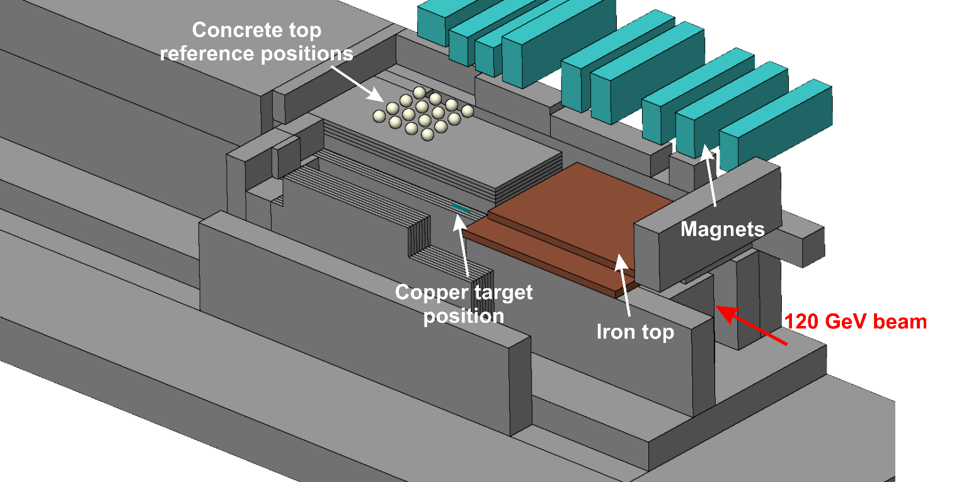
CERF: Let me explain
‘Field calibration’ facility for radiation protection instrumentation used at high-energy accelerators
‘Simulated workplace field’ to determine the response of detectors and dosimeters used around high-energy accelerators and for air-crew dosimetry
Several users from universities, research centers, private companies and CERN

Slide 16
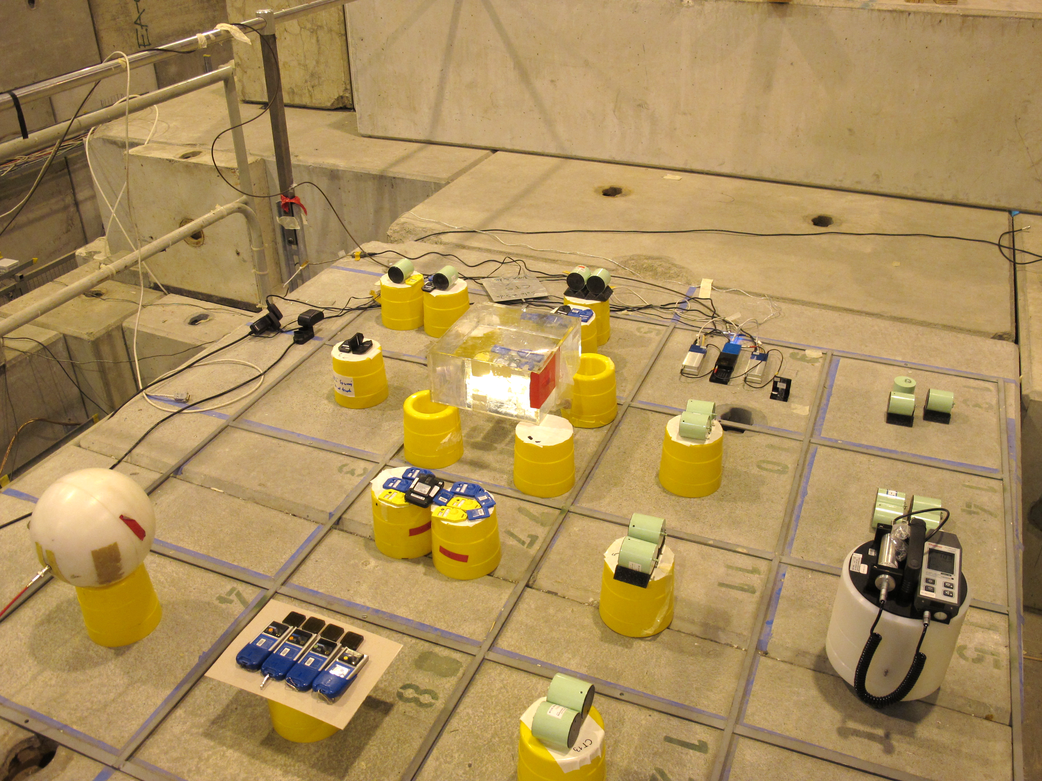
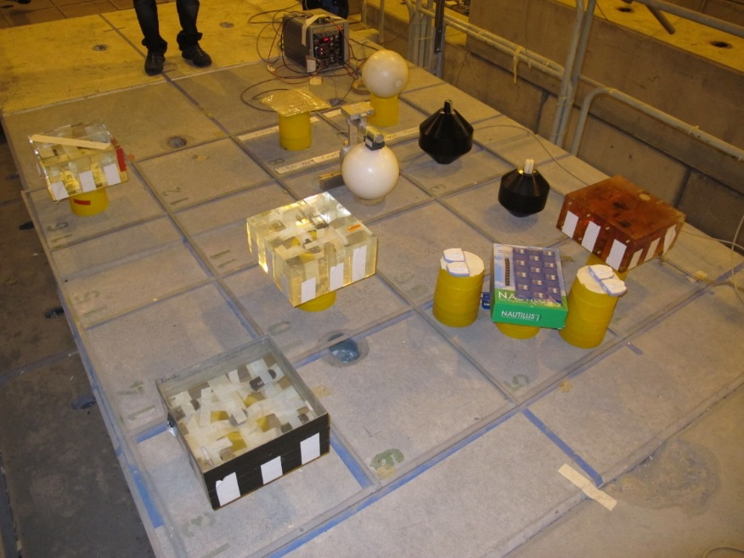
CERF: Applications 1/2
A wide range of instrumentation tested and inter-calibrated
Active monitors: ionization chambers, GM counters, rem counters, TEPCs, Bonner Sphere Spectrometers, recombination chambers, silicon detectors, etc.
Passive dosimeters: films, TLDs, nuclear track detectors, bubble detectors, etc.

Slide 17
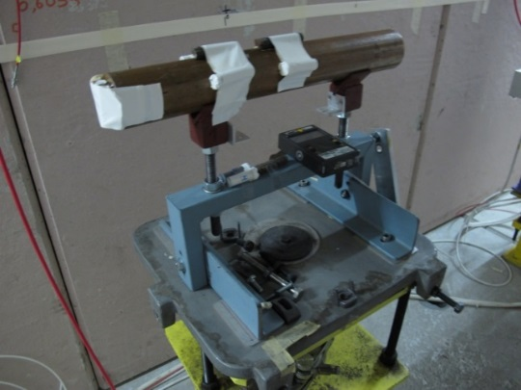
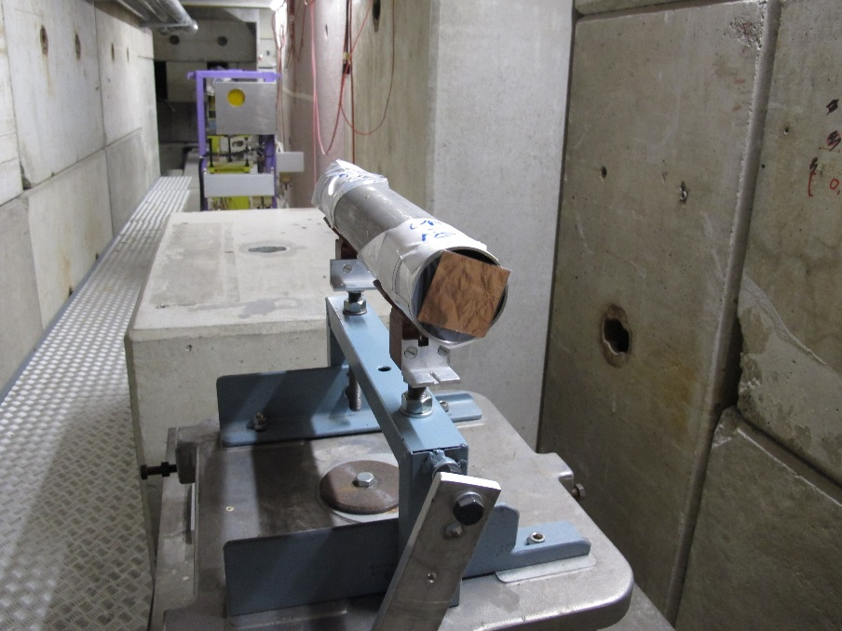
CERF: Applications 2/2
Other (non-instrument) applications:
Spallation cross-section measurements
Activation of accelerator materials
Testing computer memories
Test of prototype beam loss monitor for the LHC
Shielding experiment
…

Slide 18
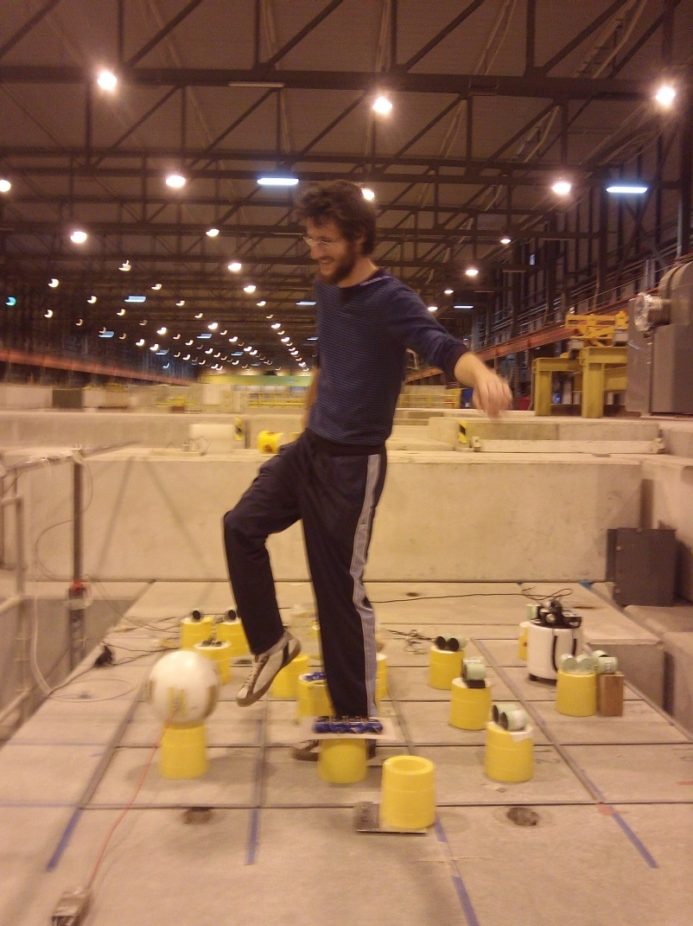
Summary
Radiation protection is a wide, interesting and demanding domain
but (sometimes) can be funny
CALLAB accreditation important step towards quality in radiation protection
CLEAR key project for CERN in view of LS2
CERF important facility provided by CERN to the scientific community

