Slide 1
The CERN Safety Policy and Organization in matters of Safety
Visit A. Leary 16.03.2017, A. Goehring-Crinon
EDMS no: 1767013

Slide 2
I. Introduction to CERN and its specific features
II. The CERN Safety Policy
III. Responsibilities and organizational structure in matters of safety at CERN
EDMS no: 1767013

Slide 3
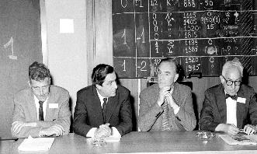
Introduction to CERN and its specific features
Le CERN was created in 1954 to avoid brain drain after WWII and ensure peaceful scientific collaboration between European States
Mission du CERN: ensure collaboration in fundamental HEP research
Main activity: put infrastructure at the disposal of the international HEP community
EDMS no: 1767013

Slide 4
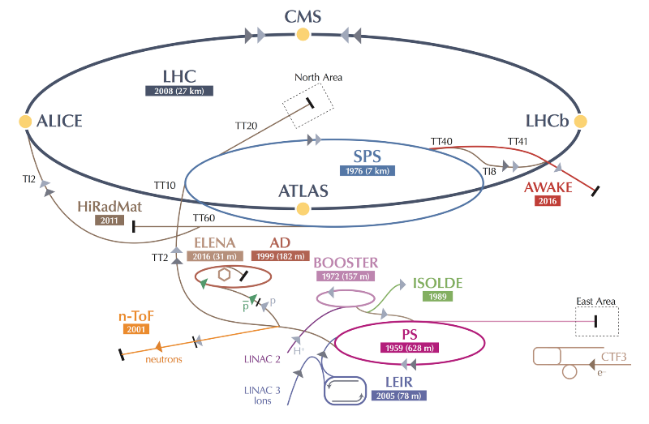
The CERN accelerator complex
EDMS no: 1767013

Slide 5
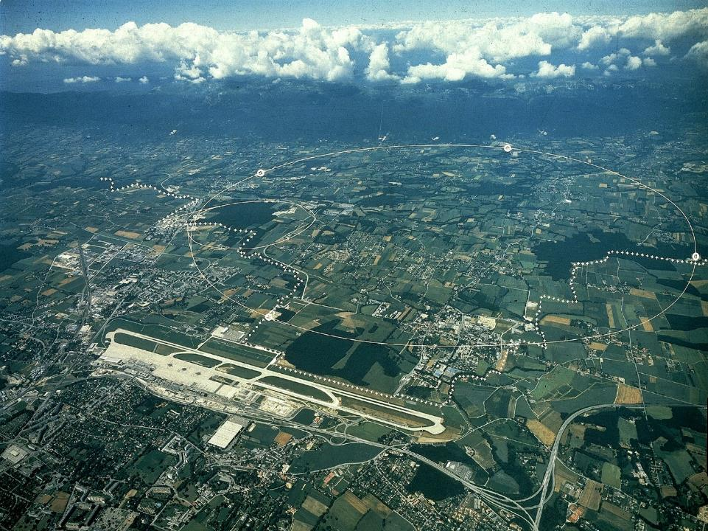
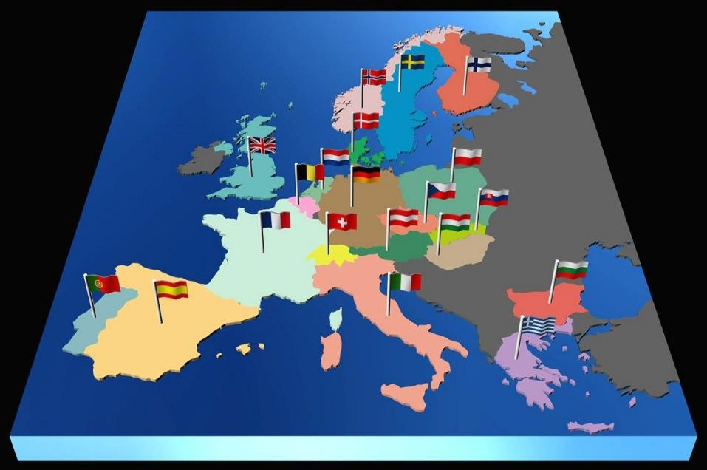

~ 2300 employed member of personnel
~ 1400 other member of personnel
~12500 users from ~ 100 countries
~ 3500 contractors
3 hotels, 3 restaurants, + nursery
~ 800 buildings
~ 19’000 installations
Intergovernmental Organization
LHC
Meyrin
Prévessin
SPS
PS
CNGS

Slide 6
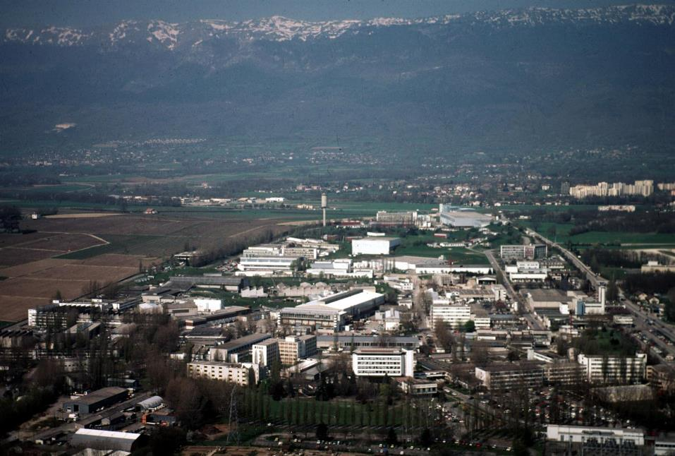
The CERN site today
Meyrin site = one site situated in F and CH with an invisible border

Slide 7
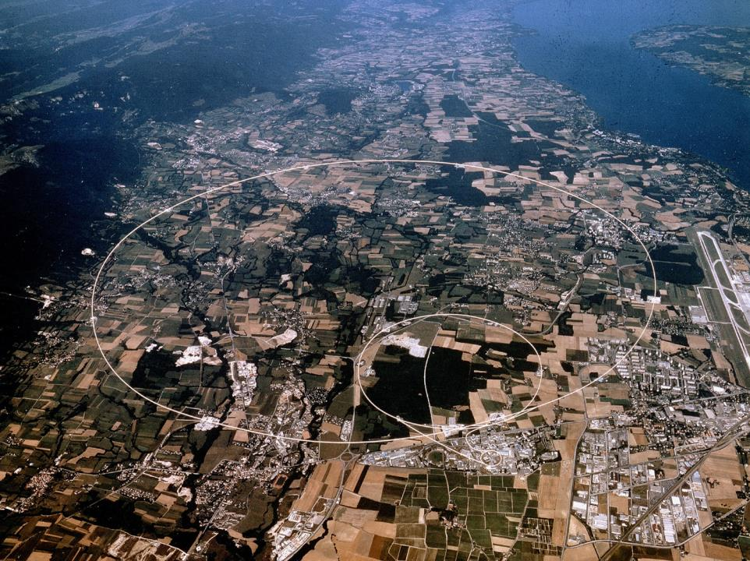
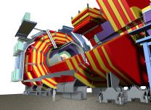

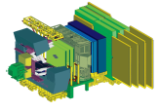
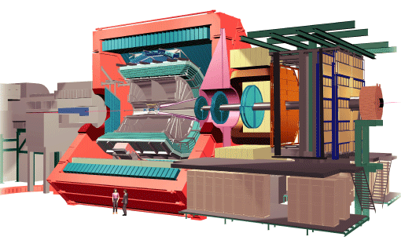

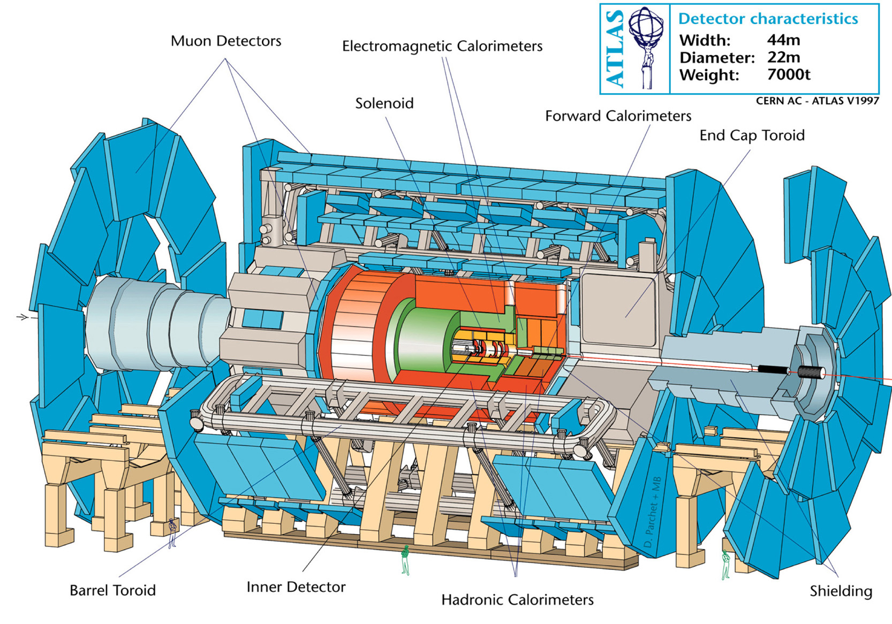
The LHC Experiments
CMS
L’accélérateur
ATLAS
ALICE

Slide 8
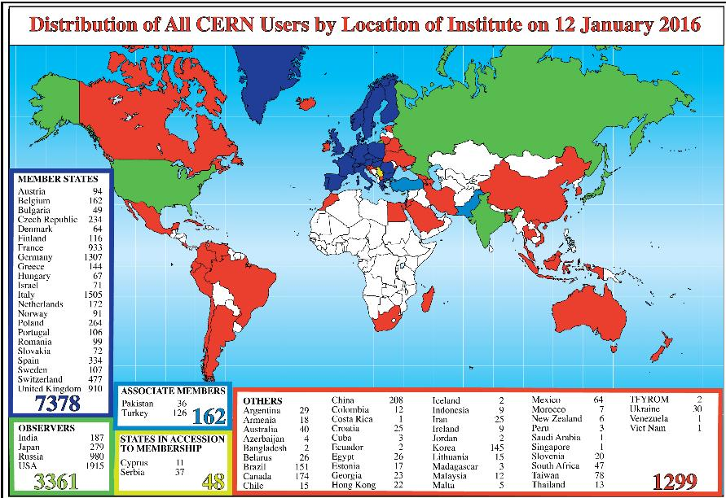
CERN an international research laboratory
Notes:
8
8

Slide 9
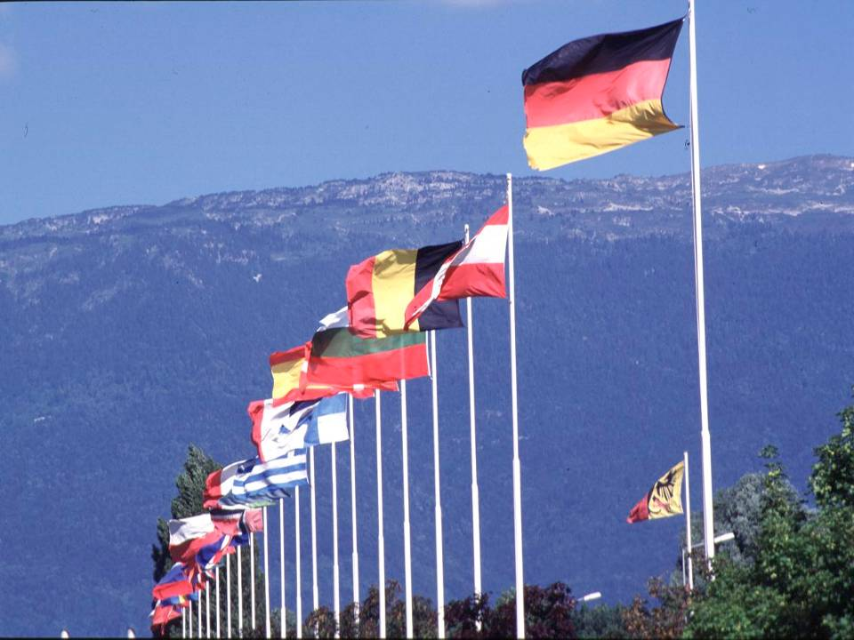

CERN an intergovernmental organisation
22 Member states: Austria, Belgium, Bulgaria, Czech Republic, Denmark, Finland, France, Germany, Greece, Hungary, Italy, Israel, the Netherlands, Norway, Portugal, Poland, Romania, Slovak Republic, Sweden, Switzerland, the United Kingdom, Spain.
+ Associated States and Observers
2 host states: France et Switzerland
9
Notes:
9

Slide 10
The CERN decision making structure
National Governments
COUNCIL
ECFA
European Committee
for Future
Accelerators
Finance
Committee
Scientific
Policy
Committee
SPS/PS
Experiments
Committee
Director General
+
4 Directors
Research
Board
National
Universities,
Laboratories
and Research
Institutes
LHC
Experiments
Committee
INTC
Experiments
Committee
Advisory
Committee
of CERN
Users
EDMS no: 1767013

Slide 11
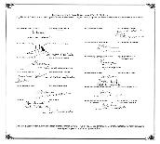
CERN’s legal status
Intergovernmental Organization governed by public international law
Member States recognize international status (IS)
  Host State Agreements concluded with Switzerland and France
  Protocol on Privileges and Immunities with all Member States
IS guarantees functioning of the Organization without interference by individual States
  assures independence from national authorities
EDMS no: 1767013

Slide 12
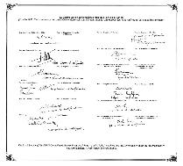
CERN’s legal status
Privileges and immunities
Immunity from national jurisdiction and execution
  legal disputes not submitted to national courts but to international arbitration
  no coercive measures by national authorities can be imposed on CERN
Free circulation of personnel and material
  CERN personnel (employed and associated) not subject to national immigration and labor permit restrictions
  Host States give necessary papers to all participants
  no restrictions on import of goods and services
Inviolability of premises
  national authorities cannot access the site without approval of the Director-General
EDMS no: 1767013

Slide 13
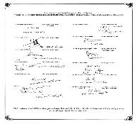
CERN’s legal status
Privileges and Immunities
Financial privileges
  individual Member States should not derive financial advantages from the Organization, therefore goods and services acquired are tax-free
  CERN salaries not taxable in Member States but CERN applies internal taxation
Right to establish internal rules necessary for CERN’s proper functioning, e.g.
  internal labor law allows the Organization to recruit personnel of the highest competence from all Member States
  safety rules take account of CERN’s technical requirements and geographical situation (N.B., no direct applicability of national procedures, but standards of Host States respected in practice)
EDMS no: 1767013

Slide 14
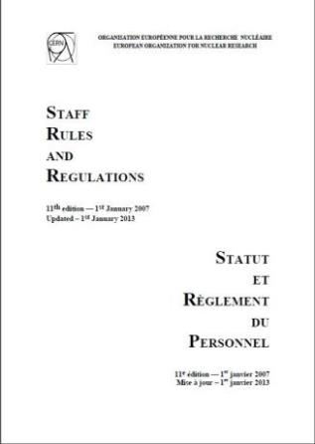
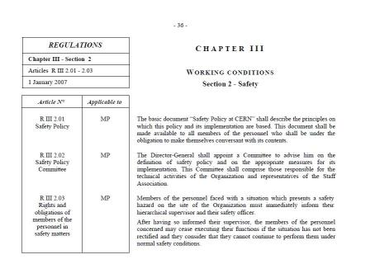
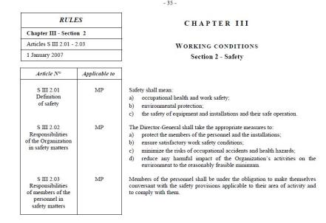
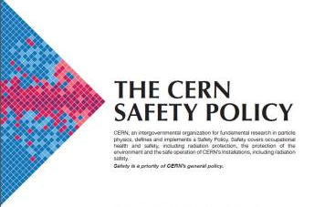
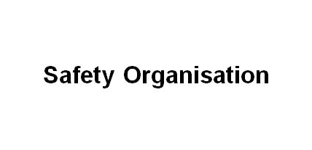
EDMS no: 1767013

Slide 15










Safety Regulation SR-SO
Responsibilities and organisational structure in matters of Safety at CERN
General Safety Instructions
(12 Documents)
EDMS no: 1767013

Slide 16

The CERN Safety Policy
The CERN Safety Policy needs to reflect CERN’s specific legal, technical & operational features, such as:
Intergovernmental Organization establishing its own legal framework as necessary for its proper functioning
CERN is not subject to controls by national authorities
Site straddling the CH-F border ⇒ need to collaborate with host states (tripartite approach in radiation protection/safety, environmental protection and contractor safety
Use of cutting-edge and unusual (“non state-of-the-art”) technologies
major “industrial” sites, ~45 km of radiation areas radiation, …
Dynamic installations according to research needs
‘Open’ organization with many users/trainees from institutes all over the world with a special legal status (associated members of personnel)
Extensive presence of contractors on site
EDMS no: 1767013

Slide 17

The CERN Safety Policy
It covers all aspects of Safety:
occupational health and safety of personnel
environmental protection
safety of equipment
operational safety
It covers all stakeholders:
members of the personnel (employed & associated)
contractors operating on site
neighbours and the general public (incl. visitors)
EDMS no: 1767013

Slide 18

The CERN Safety Policy
The means are:
Continuous improvement in Safety, through:
  risk assessment
  return of experience
  regulatory watch
  safety training
  safety management system
Safety Rules, as necessary for functioning, taking into account
host states, EU- and international regulations
Emergency Procedures
Proactive communication
Collaboration with host states
EDMS no: 1767013

Slide 19

The CERN Safety Policy
Implementation principles
Implementation at all levels of the Organization
HSE Unit provides assistance and monitoring
Specific tasks are assigned to specialized units, as necessary
Safety management to ensure follow-up and updating of prevention objectives and Safety actions
EDMS no: 1767013

Slide 20
Responsibilities in matters of Safety at CERN: the SO Cluster
SAFETY REGULATION SR-SO
RESPONSIBILITIES AND ORGANISATIONAL STRUCTURE IN MATTERS OF SAFETY AT CERN
Annexes:
HSE Terms of Reference
The Safety Policy Committee Terms of References
DSO
GSI-SO-1
TSO
GSI-SO-2
SLP
GSI-SO-3
LEXGLIMOS
GSI-SO-4
EXSO
GSI-SO-5
SSO
GSI-SO-6
PSO
GSI-SO-7
RSSO
GSI-SO-8
DSOC
GSI-SO-9
CSAP
GSI-SO-10
SSOC
GSI-SO-11
SG Competencies of DSO
Idem
SF Appointment
of DSO
Idem
SR = Safety Regulation
GSI = General Safety Instruction
SG = Safety Guideline
SF = Safety Form
EDMS no: 1767013

Slide 21

SO Principles
Principle: Safety responsibilities follow the hierarchical line
but
Radiation protection falls under the exclusive responsibility of the radiation protection group
Occupational medicine falls under the exclusive responsibility of the medical service
need to take into account CERNs matrix structure and the specific situation of large collaborations like the LHC Experiments
EDMS no: 1767013

Slide 22

SO Challenges
Facilities (Complexes) and projects conducted in « matrix » structure i.e. need for safety coordination in facilities/projects
Safety structure with regard to the Organization’s machine and experiment facilities :
  Facilities ’grouped’ within Complexes (e.g. LHC, SPS, PS Complex)
  ‘Complex Manager’ nominated by and reporting to DG responsible for safe operation of CERN Complexes
  Complex Safety Advisory Panels CSAPs (1/Complex) advising and reporting to Complex Manager
  At all levels need to ensure safety of ones own activities but also safe interaction with those of others.
EDMS no: 1767013
Notes:
Memo from DG 2011: Safety structure with regard to the Organization’s machine and experiment facilities (9 August 2011 EDMS # 1157373 )

Slide 23


SO Challenges
Safety management of Experiments: CERN Experiments are (independent) collaborations with financial and organizational autonomy linked to CERN by a MoU
Many experiments of varying size, running time and complexity
The Large (LHC) Experiments are complex very costly installations
and have hundreds of collaborators
Safety Management of Large Experiments:
Technical Coordinator (TC is CERN staff) represents Experiment towards CERN in matters of Safety
  TC’s duties in matter of Safety similar to those of a Department Head
  TC reports to Director responsible for the Large Experiment and is supported by a Large Experiment GLIMOS (LEXGLIMOS)
ATLAS
ALICE
CMS

Slide 24
SO Challenges
Safety Management of CERN Experiments other than Large Experiments
  Under the oversight of the head of hosting Department collaborating institutions are responsible for Safety in accordance with the CERN Safety Policy, the CERN Safety rules and best practices
  The head of the hosting Department is supported by:
    The DSO, and
    an Experiment Safety Officer (EXSO)
    nominated by her/him in consultation with the Experiment.
EDMS no: 1767013

Slide 25

SO Challenges
  Collaborating institutions
  Responsibility of collaborating institutions for Safety reaffirmed
  Collaborating institutions shall ensure that their personnel, activities and material they bring on site comply with the CERN Safety Policy and Rules.
  Each collaborating institution nominates for each activity and Experiment in which it participates a ‘Safety Correspondent’ who represents it towards CERN in matters of Safety.
EDMS no: 1767013

Slide 26
SO Challenges
Safety responsibilities of contractors
  Responsibility of contractors for Safety reaffirmed
  Contractors shall ensure that their personnel, activities and material they bring on site comply with the CERN Safety Policy and Rules.
  Each contractor nominates a safety correspondent who represents him towards CERN in matters of Safety.
EDMS no: 1767013

Slide 27
SO main features
SR-SO covers all Safety functions
Functions defined in terms of responsibilities rather than detailed task descriptions
Specifying minimal competency/experience for Safety functions (still to be completed)
Explicit mention of Safety objectives to be defined regularly by the DG
EDMS no: 1767013

Slide 28
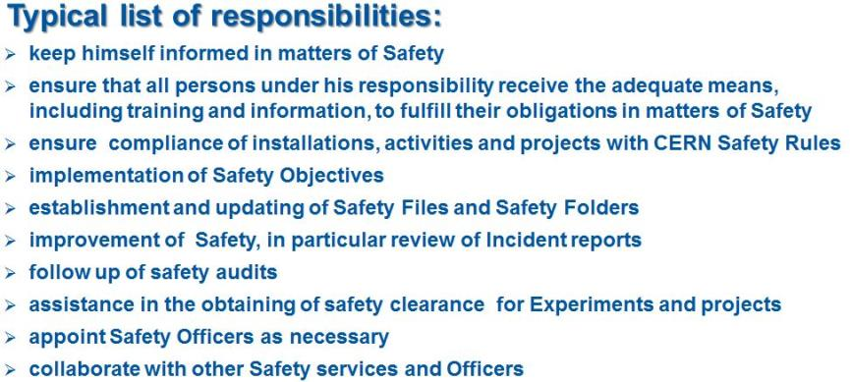
SR-SO
Typical list of responsibilities:
keep himself informed in matters of Safety
ensure that all persons under his responsibility receive the adequate means, including training and information, to fulfill their obligations in matters of Safety
ensure compliance of installations, activities and projects with CERN Safety Rules
implementation of Safety Objectives
establishment and updating of Safety Files and Safety Folders
improvement of Safety, in particular review of Incident reports
follow up of safety audits
assistance in the obtaining of safety clearance for Experiments and projects
appoint Safety Officers as necessary
collaborate with other Safety services and Officers
These responsibilities are repeated at
all levels & functions as they apply
DSO
EXSO
Department Heads
Technical Coordinator
TSO
LEXGLIMOS
Group Leaders
Safety Linkperson
etc.
etc.
EDMS no: 1767013

Slide 29
Line Management Safety responsibilities
HSE Unit
Director General
Safety Policy Committee
(SAPOCO)
Directors
Complex Manager
Complex Safety Advisory Panels
(CSAPs)
Safety Officers
(DSOs,TSOs, SSOs, ..)
Department Heads
Safety Officers Committee
(DSOC)
Safety Support Officers (Safety Linkperson, etc.)
Group Leaders
Specialized Safety Officers Committees
Section Leaders/ Supervisors
Individuals
EDMS no: 1767013

Slide 30
Safety responsibilities for Large Experiments
HSE Unit
Director General
Safety Policy Committee
(SAPOCO)
U
Directors
Responsible for Large Experiments
Complex manager
Complex Safety Advisory Panels
(CSAPs)
Safety Officers
(i.e. LEXGLIMOs+SLIMOs)
Technical Coordinator
Safety Officers Committee
(DSOC)
Specialized Safety Officers Committees
Collaborating Institutions
EDMS no: 1767013

Slide 31
Safety Advisory Committees reporting lines
Director General
Enlarged Directorate (Directors & Dep. Heads)
Complex Manager
Advises DG on Safety Policy
Annual activity Report
Annual activity Report
Executive Committee of Complex concerned
Department Heads
Head of HSE Unit
Safety Policy Committee (SAPOCO)
Technical Coordinators
Report on Safety Rules issues
Report on Safety Policy issues
Report on Safety Implementation issues
Dep. Safety Officers Committee
(DSOs & LEXGLIMOSs)
Complex Safety Advisory Panels (CSAPs)
Specialized Safety Officers Committees (e.g. RSO, CSO, …)
EDMS no: 1767013

Slide 32
Safety Advisory Committees reporting lines
Director General
Enlarged Directorate (Directors & Dep. Heads)
Complex Manager
Advises DG on Safety Policy
Annual activity Report
Annual activity Report
Executive Committee of Complex concerned
Department Heads
Head of HSE Unit
Safety Policy Committee (SAPOCO)
Technical Coordinators
Report on Safety Rules issues
Report on Safety Policy issues
Report on Safety Implementation issues
Dep. Safety Officers Committee
(DSOs & LEXGLIMOSs)
Complex Safety Advisory Panels (CSAPs)
Specialized Safety Officers Committees (e.g. RSO, CSO, …)
EDMS no: 1767013

Slide 33
Department: Safety Officers and their reporting Lines
Department Heads
Group Leaders
DSOs
Section Leaders/ Supervisors
Safety Support Officers
(Safety LinkPersons, RSSOs)
TSOs
(buildings & premises)
SSOs
(RSOs, CSOs, etc.)
EXSOs
(EXperimental Safety Officers)
EDMS no: 1767013

Slide 34
Large Experiments: Safety Officers and their reporting Lines
Technical Coordinator
Large Experiment GLIMOS
(LEXGLIMOS)
Territorial Safety Officers
(TSOs for experimental areas)
Shift Leaders In Matters Of Safety (SLIMOS)
EDMS no: 1767013

Slide 35


Thank you
Accelerating Science and Innovation
Notes:
35

