Slide 1
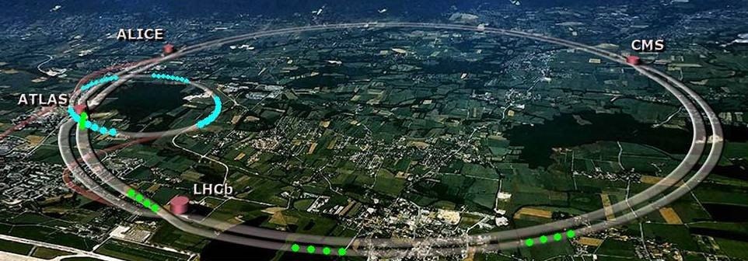
LHC Machine Status
RRB
Frédérick Bordry
24th April 2017

Slide 2
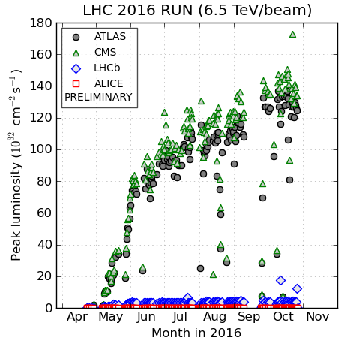
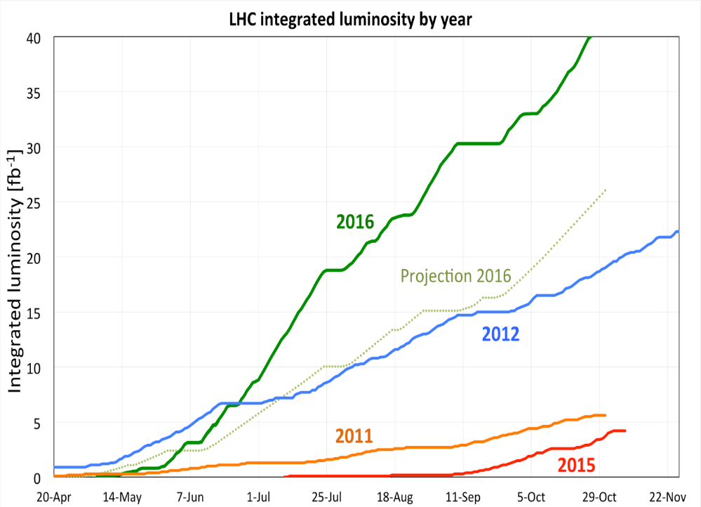
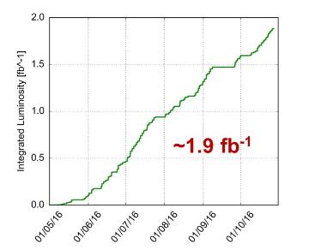
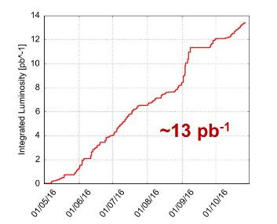
2016 LHC
Peak luminosity > 1.4 x 10³⁴ cm⁻²s⁻¹
OVER 25 fb⁻¹ in both ATLAS and CMS ☺
LHCb
ALICE

Slide 3
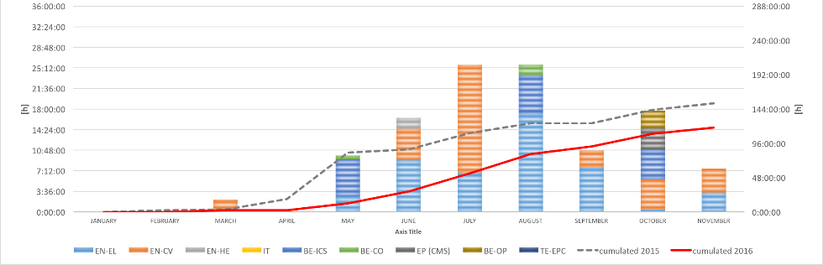
Pre-cycle 2%
2016 Availability
[4%]
[2015 - 25 ns Run]
Remarkable availability:
Increased operational efficiency
Enhanced system availability
New pre-cycle strategy
Downtime
26%
[31%]
Stable Beams
49%
Operation
23%
[33%]
[32%]
Downtime of technical infrastructures
30% less downtime in 2016 than 2015
Non-availability of beams from the injector complex is the largest source of LHC downtime
TS1 - TS2 : stable beams 58 %
TS2 - TS3 : stable beams 54 %

Slide 4
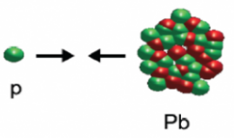
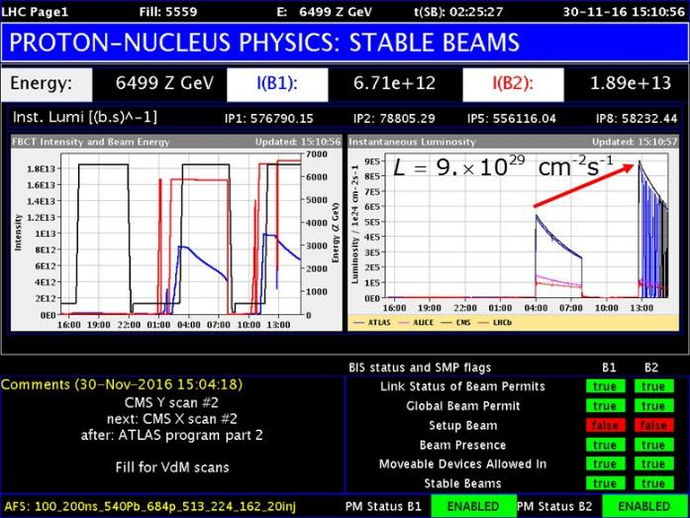
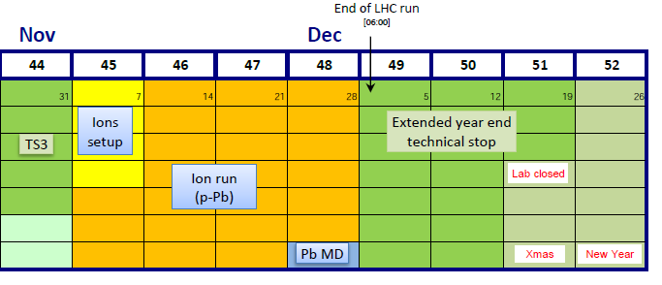
2016 LHC p-Pb run
Configuration | Goal |  | Achieved
5 TeV p-Pb | ALICE | 700x10⁶ min bias events | 780x10⁶
8 TeV p-Pb | ATLAS - CMS | 50 nb⁻¹ | 69.5 - 65.5 nb⁻¹
 | LHCb - ALICE | 10 nb⁻¹ | 14 - 13 nb⁻¹
 | LHCf | 9-12 h at 10²⁸ cm⁻²s⁻¹ | 9.5 h
8 TeV Pb-p | ATLAS - CMS | 50 nb⁻¹ | 124 - 118 nb⁻¹
 | ALICE - LHCb | 10 nb⁻¹ | 25 - 19 nb⁻¹
( E_{beam}=4 Z TeV )
( E_{beam}=6.5 Z TeV )
( E_{beam}=6.5 Z TeV)

Slide 5
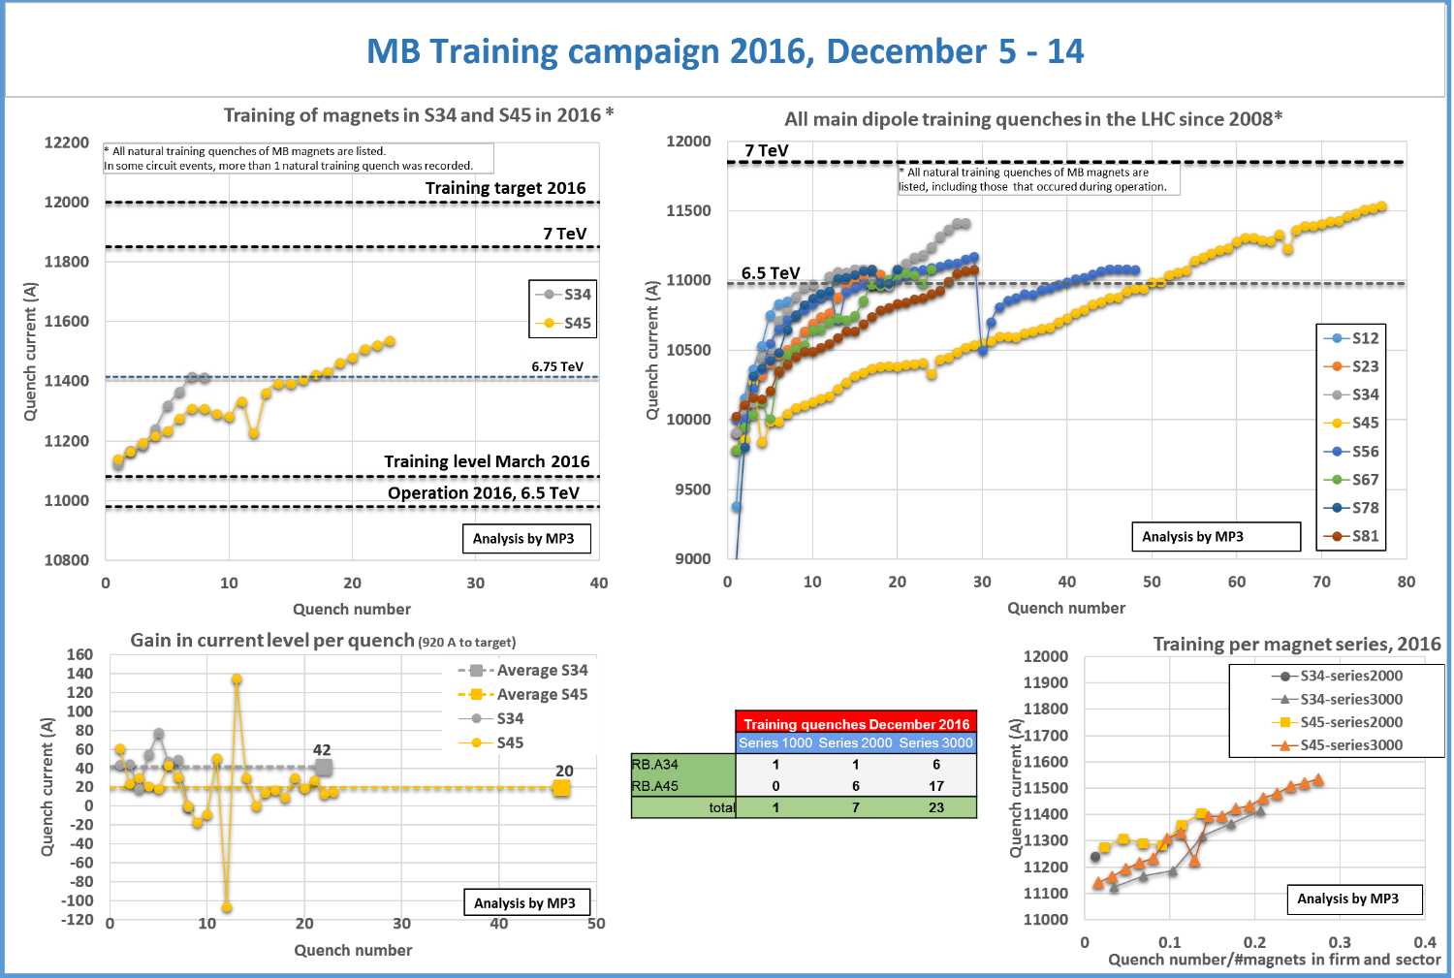
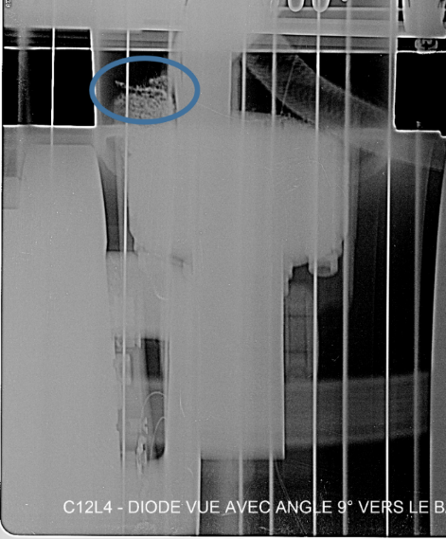
    ramp with a short to ground appearing ∼1.5s after the 1st magnet quench
Earth Fault Burner !
capacitive current discharge

Slide 6
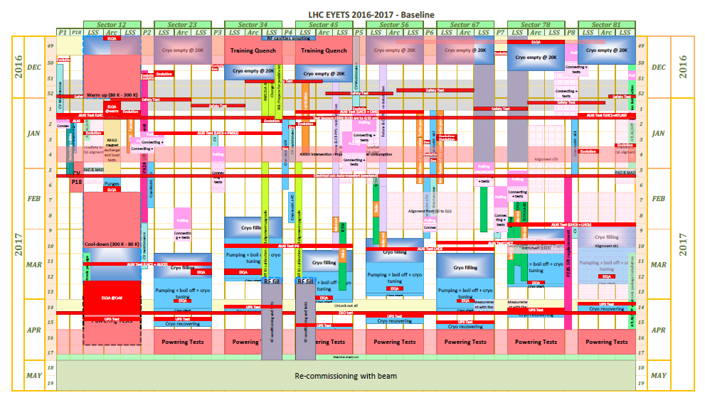
LHC EYETS Overview
Extended Year-End Technical Stop
The duration of the EYETS is 21weeks from Monday 5th Dec. 2016 to Sunday 30th Apr. 2017
(including HWC & Machine checkout)
=> 17 weeks of works for the LHC Machine

Slide 7
Injector Schedule 2017 – Q2
Despite a 2-week delay for the re-powering of PSB equipment all beams for could be delivered in time or even earlier
  - PSB Monday 10/04 (as scheduled)
  - PS Thursday 13/04 (instead of Monday 17/04)
  - SPS Friday 21/04 (instead of Monday 24/04)
ISOLDE beam for setting up since Wed. 19/04 and physics will start Tue. 25/04
Beam to LHC is on track for Monday May 1st as scheduled
Monday May 8th most fixed target physics will start again.

Slide 8
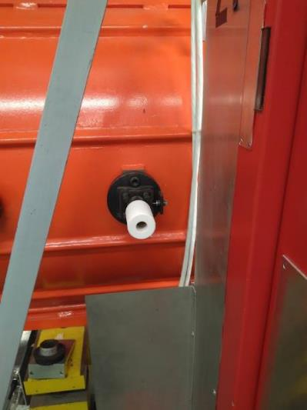
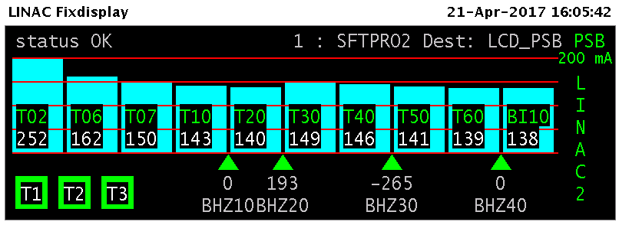
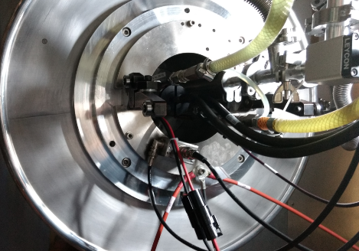
Linac 2 restart
Vacuum leak mitigated
with secondary pumping
Following some issues last year a full spare source has been built is now available if necessary
The LINAC had a difficult start due to vacuum leaks that were solved before Booster beam delivery date
LINAC Beam Current
Source

Slide 9
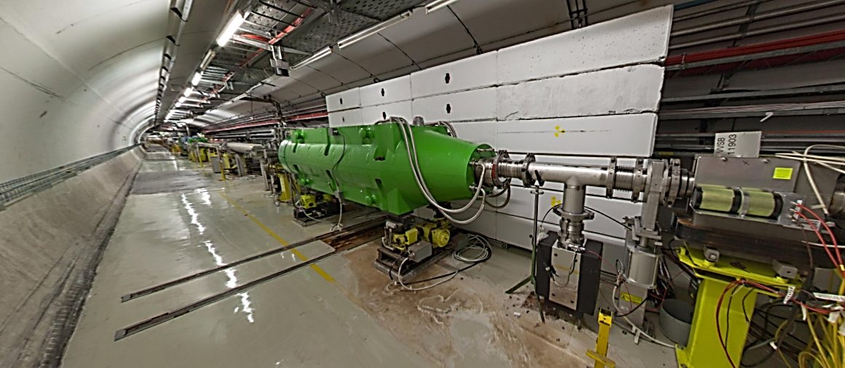
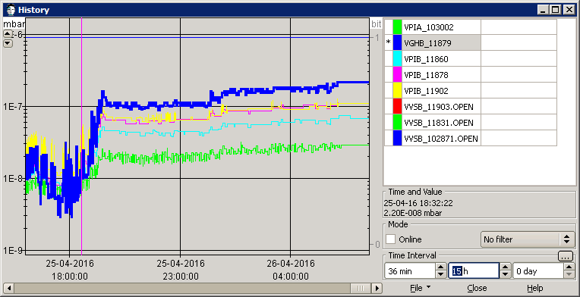
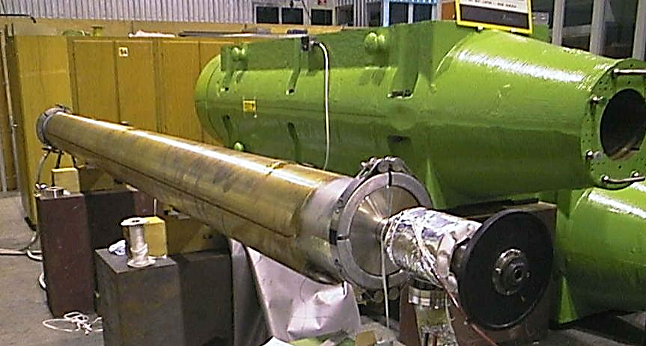
SPS tunnel: internal beam dump (TIDVG#3)
Yoke (iron shielding)
Beam dump core

Slide 10
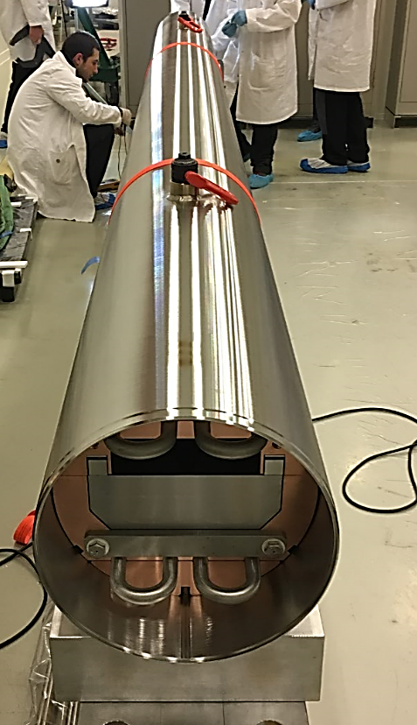
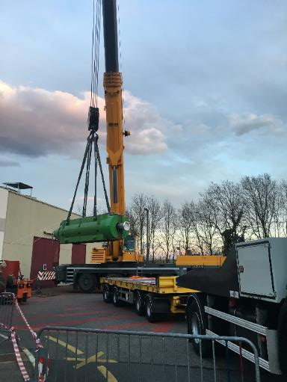
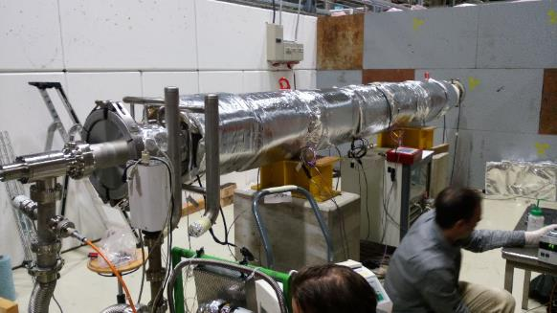
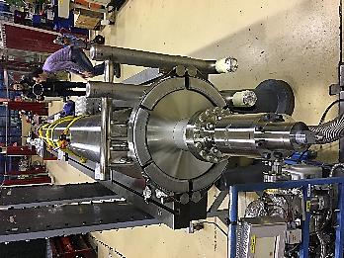
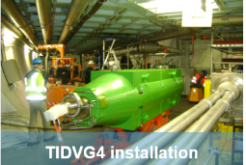
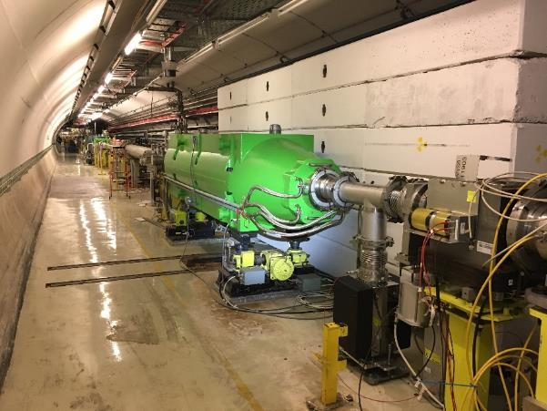
SPS new beam dump: insertion, final assembly and installation
Beginning of the bake-out
TIDVG4 core fully inserted (downstream)
Final leak detection (downstream)
Beginning of March 2017, decision to remove the damaged TIDVG#3 and to install the new TIDVG#4.

Slide 11
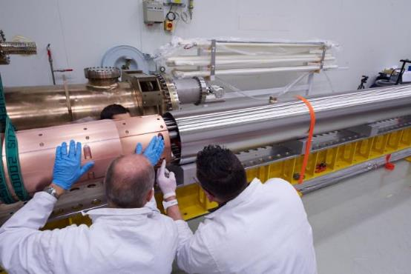
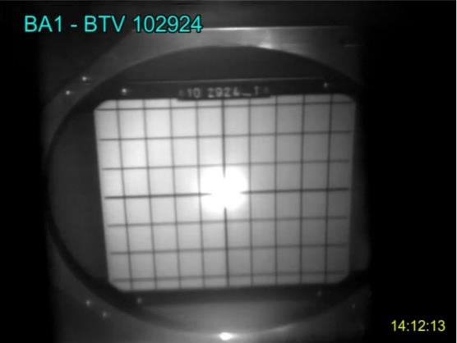
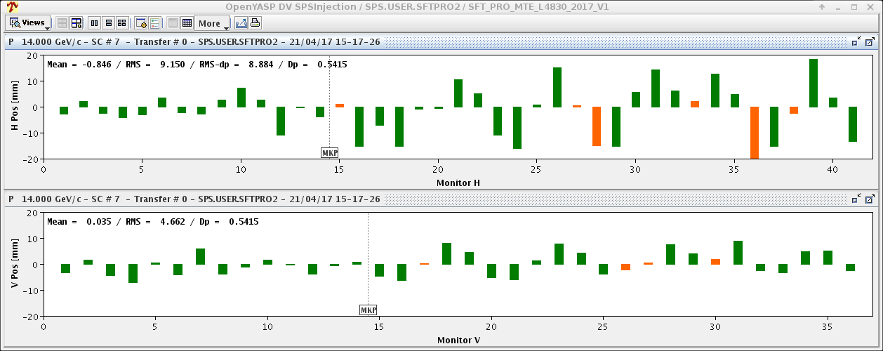
SPS
SPS new beam dump: commissioning with beam
1st beam injected Friday 21/04 and setting up has just started
  Should lift last years limitations and allow 288 bunches per SPS extraction to LHC and nominal extraction for fixed target physics
1st orbit measurements, orbit to be corrected
1st 2017 protons at SPS injection

Slide 12
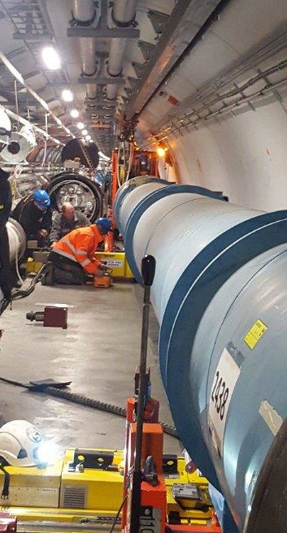
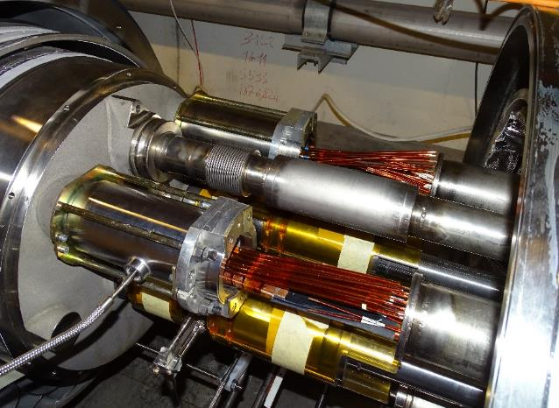
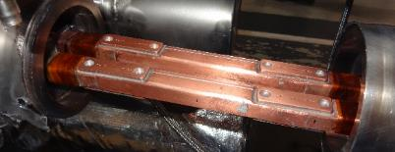
LHC : Magnet Exchange during eYETS
Magnet exchange on January 16th
New A31L2 magnet installation
3 weeks for magnet re-connection and local qualification
Constant quality control validation by TE/MSC
Electrical continuity by ElQA (for correctors)
Welding visual inspection
Vacuum leak test
Additional instrumentation installed by cryogenics group
13kA splices and shunts soldered
Re-connection in progress (All but M lines)
Additional temperature sensors

Slide 13
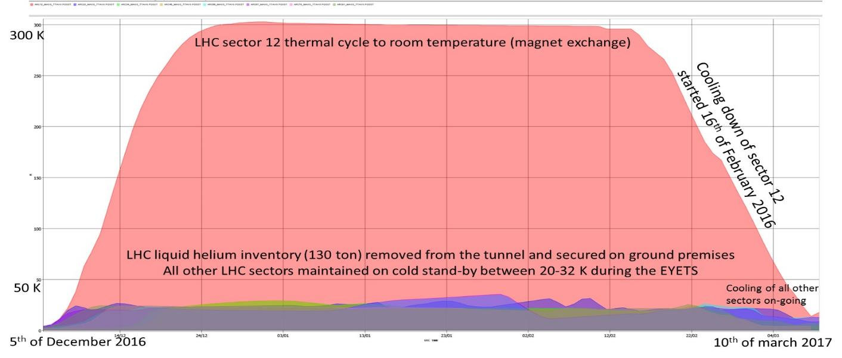
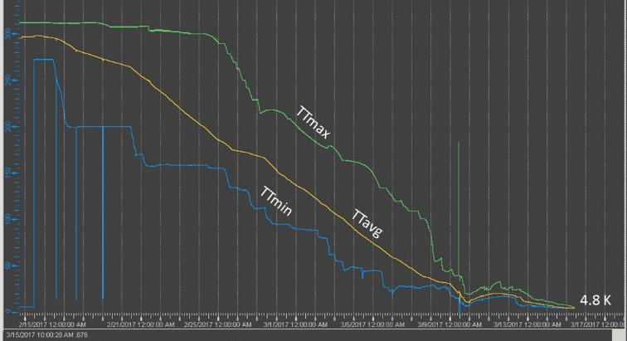
LHC : cryogenics cooling down status
He filling of magnets started Tuesday 14th March
LHC cryo status with
all sectors at 1.9 K
March 9th
general 66 kV cut

Slide 14

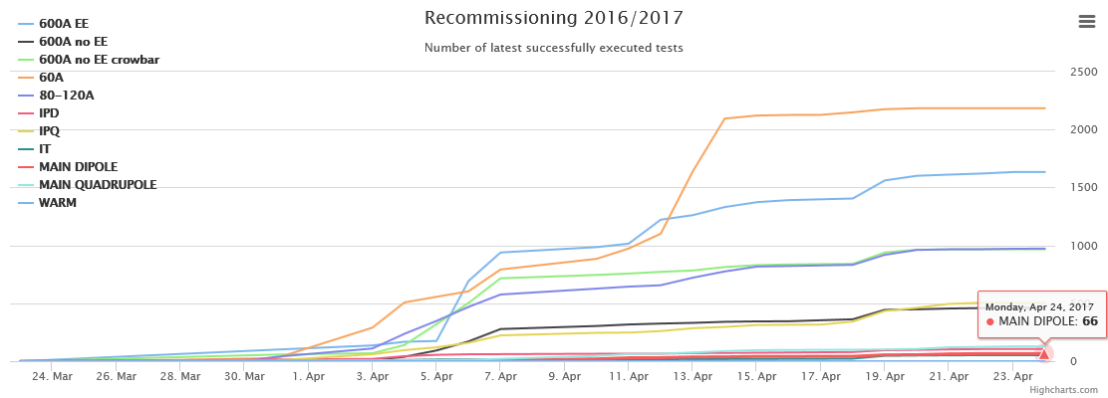
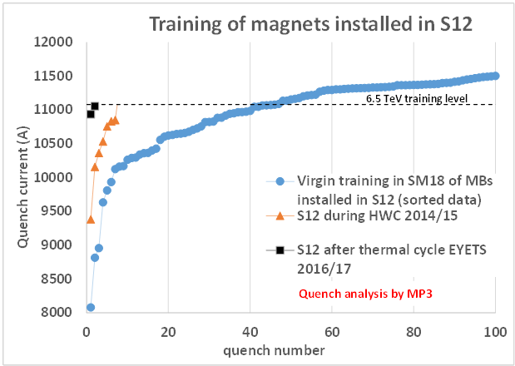
LHC Powering tests: Status
99% of the powering tests have been completed
The main circuits are commissioned in the 8 sectors
  - No training quench in the 7 sectors
  - In sector 1-2, two training quenches during last weekend: 10935 A, 11055 A
Powering of all circuits together will start today:
ready for beam soon (foreseen 1st May)

Slide 15
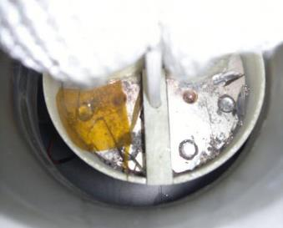
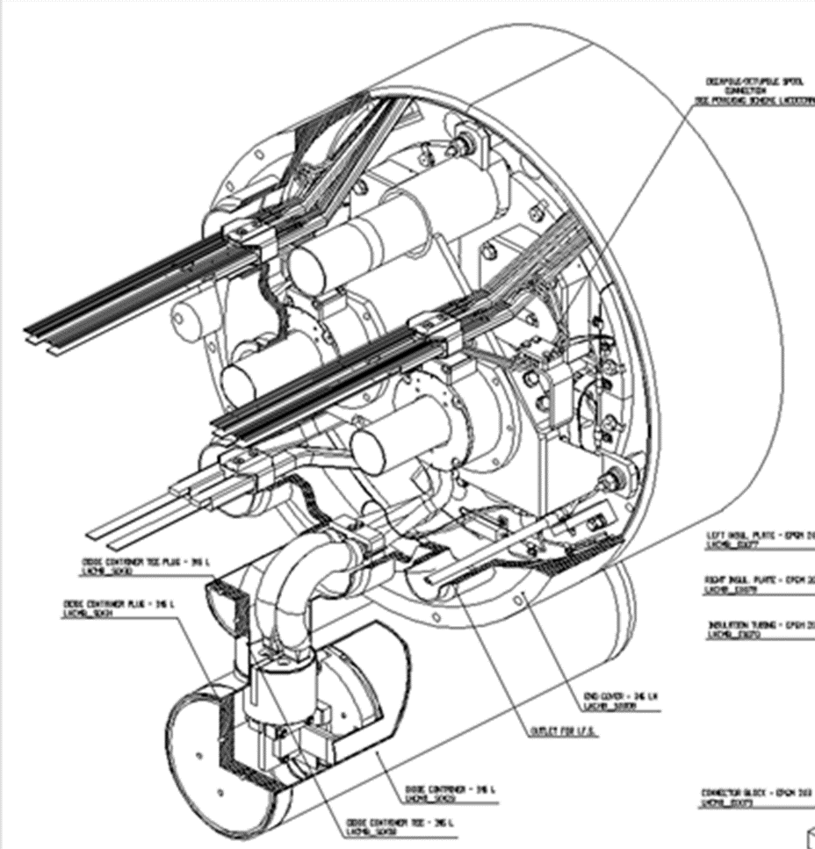
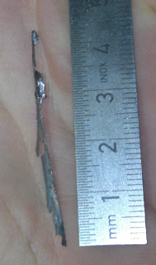
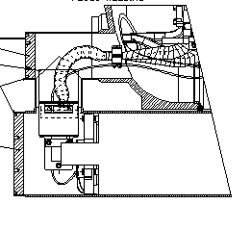
Run 2
Beam energy : Run 2 @ 13 TeV c.m.
NO change of beam energy in 2017 and 2018
Goal is to prepare the LHC to run at 14 TeV during Run 3.
Study how to reinforce the insulation (and to clean) during LS2 the electrical part connecting the dipole bypass diode.
Powering tests before and during LS2 should be defined
Working group was set up after Chamonix workshop:
How ?, How long ?, How much ?

Slide 16
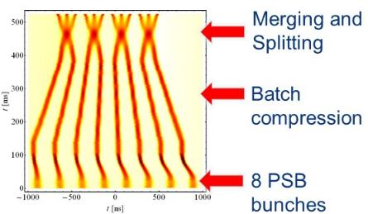
2017 scenarios
 | Nominal | BCMS | BCMS+
Beta* (1/5) [cm] | 40 | 40 | 33
Half crossing angle [urad] | 185 | 150 | 170
No. of colliding bunches | 2748 | 2544 | 2544
Proton per bunch | 1.1e11 | 1.2e11 | 1.2e11
Emittance into SB [um] | ~3.2 | ~2.3 | ~2.3
Bunch length [ns] | 1.05 | 1.05 | 1.05
Peak luminosity [cm⁻²s⁻¹] | ~1.1e34 | ~1.7e34 | ~1.8e34
Peak pile-up | ~28 | ~48 | ~52
Luminosity lifetime [h] | ~24 | ~15 | ~14
BCMS = Batch Compression Merging and Splitting

Slide 17
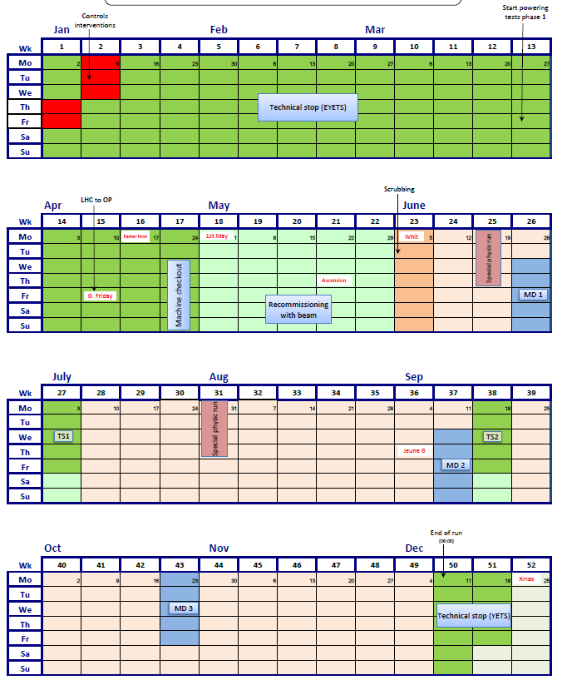
LHC schedule 2017
a new p-p production year at 13 TeV
Goal 45fb⁻¹
keeping the LHC availability close to 50% (stable beams)
Initially 15 days of MD; later during 2017 according
integrated luminosity : + 3 days ?
Special runs: VdM scans,…
and … LHCC recommendations

Slide 18
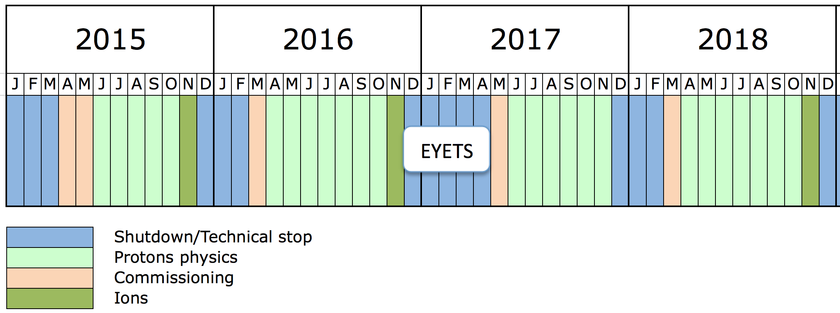
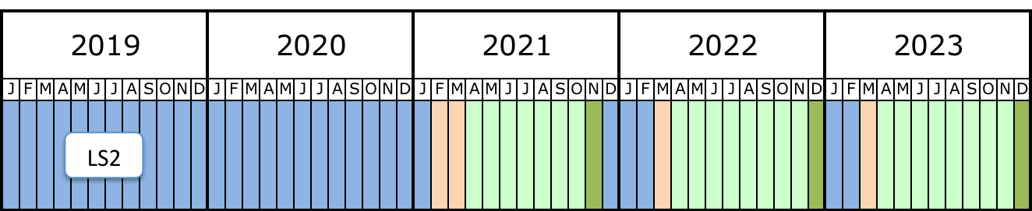
Run 2 and Run 3
Run 2
Ion runs end of 2018 (Pb-Pb)
>120 fb⁻¹ (13 TeV)
Σ 300 fb⁻¹ (14 TeV )
45 fb⁻¹ in 2017 and ∼ 45 fb⁻¹ in 2018 (Σ 90 fb⁻¹; breakdown depending on the special runs)
YETS 2017/2018 : 15 (13+2) weeks but drastic optimization of the “recommissioning with beam” period (less than 2 weeks!)
Prepare for HL-LHC and post-LS2 LIU era (MD time ⇑ in 2018)

Slide 19
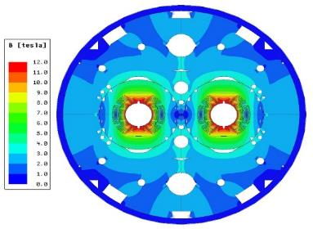
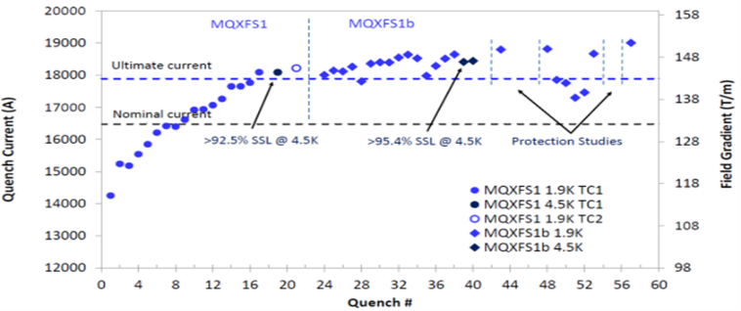
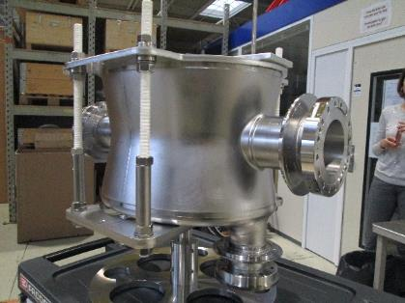
HL-LHC Main achievement 2016
Cross section of the 11 T dipole
The 11 T dipole 2 m long model reached a B_{max} of 12.5 T
Test of the first full cross-section (150 mm aperture) Triplet Quadrupole, 1.5 m long, half CERN, half USA: it went beyond ultimate (B_{max eq.} of 12.5 T)
Completion of the first Crab Cavity, type Double Quarter Wave at CERN just before Christmas!
Test results of the Inner Triplet first 1.5 m long Quad
First Crab Cavity produced at CERN

Slide 20
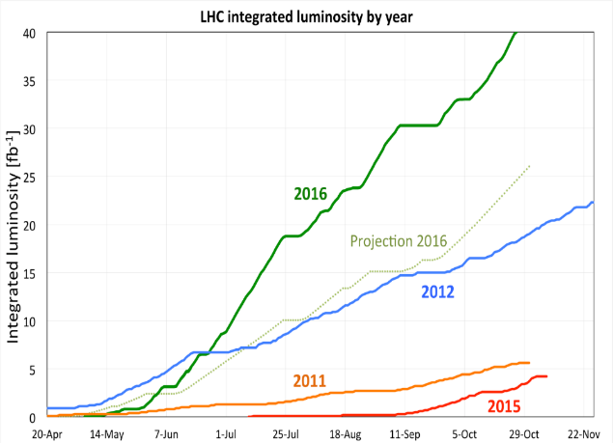
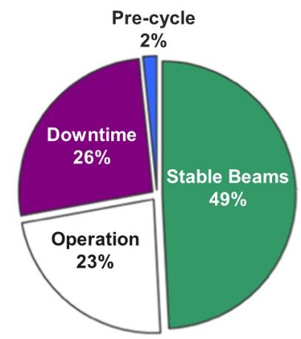
Thanks for your attention
Downtime
26%
Stable Beams
49%
It is more difficult to stay on top than to get there
Mia Hamm

