Slide 1


LHCC Report presented to the
LHC Resources Review Boards
April 24, 2017
Outline
Reminder: Phase II upgrades
Summary of the phase II review process
Update on the plan for next year
Thorsten Wengler, CERN
On behalf of
Francesco Forti
University and INFN, Pisa
CERN-RRB-2017-055

Slide 2
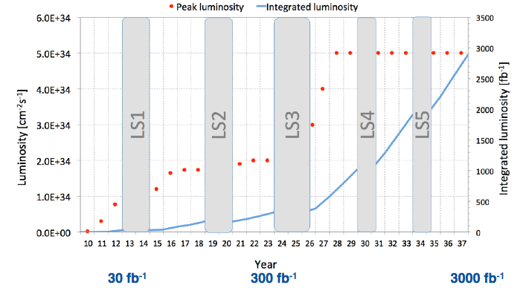
HL-LHC Goals and Running Conditions
3000 fb⁻¹ is the target integrated luminosity
5x10³⁴ —> 140 Pile-up is the nominal peak luminosity
7x10³⁴ —> 200 Pile-up is the ultimate peak luminosity (>LS4)
Phase I
Phase I Upgrades
  All approved and funded
  On-going construction overall on budget and on schedule
Phase II Upgrades
  Scoping document presented and approved
  Technical Design Reports in preparation.
Phase II
Factor x10

Slide 3


Phase II Detectors Upgrades
Why
Maintain detector performance in the presence of high radiation doses, increased pile-up, and challenging trigger rates.
  Possibly introduce moderate performance improvements that will allow to take fully advantage of the HL-LHC physics program, e.g. extended coverage
  Detectors must work well at nominal luminosity (140PU) and only moderately degrade at ultimate luminosity (200PU)
For the most part upgraded detectors will be installed during LS3, currently scheduled for 2.5 years starting in 2024
  Some limited and mature elements may be installed in LS2, with some advantage in terms of schedule: CMS FWD GEM, beam pipes, …
Many detector elements, readout electronics, data acquisition system and online computing will require significant upgrades —> part of this review
  Also distributed offline computing will require significant redesign and improvements —> part of a separate review process
When
What

Slide 4
Phase II Upgrades Approval Process
Document detailing the process prepared in consultation with DRC and the experiments (CERN-LHCC-2015-007)
  Step1: Approval of preliminary design for the complete set of Phase-II upgrades
    Concluded in September 2015 —> presented to Oct 2015 RRB
    Including scoping options
    Reasonable matching of cost to funding availability
  Step2: Approval of baseline design, cost and schedule
    TDRs submission foreseen between end 2016 and end 2017
    Regular monitoring of LHCC and UCG
  Step3: Approval for construction
    After Engineering Design Review or equivalent
DONE
NOW
>2018

Slide 5
Update on Phase II TDRs review
Process progressing as planned
Received Atlas ITk-Strips TDR
  Draft in Dec 2016 – complete document in Jan 2017
  Provisional scientific approval in Feb 2017 (with comments)
  Ongoing UCG review of cost and schedule
  Final approval expected in May 2017
Other TDRs in preparation and expected in the second half of 2017
Costs are being updated for the TDRs, remaining within the limits of the scoping documents
Still good match between costs and fund availability

Slide 6
Observations from first Atlas TDR review
Employed an extended review panel system, using experts from the other experiments for the review
  Very successful – will adopt for all the reviews
Very large TDR was not straightforward to review
  Mandate a specific TDR format to simplify the review process
Need to keep the LHCC and UCG review processes separate
  It is not efficient to mix the scientific and technical review with the cost and schedule review
The review represents a significant load for the referees
  Several intermediate Vidyo meetings were organized with 3-4 rounds of questions/answers
  Enough time must be allowed to ensure the seriousness of the review.

Slide 7
TDRs planned submission dates and CORE values
Experiment | System | Date | CORE MCHF | SOURCE
ATLAS | ITkStrip | Dec-16 | 61 | TDR ITkStrip
ATLAS | Muon | Jun-17 | 34 | SD
ATLAS | LAr | Sep-17 | 36 | SD - sFCal
ATLAS | Tile | Sep-17 | 9 | SD
ATLAS | TDAQ | Dec-17 | 43 | SD
ATLAS | ITkPixel | Dec-17 | 59 | SD(²)
CMS | Tracker | Jul-17 | 112 | SD
CMS | Barrel Cal | Sep-17 | 11 | SD
CMS | Muon | Sep-17 | 25 | SD
CMS | Endcap Cal | Nov-17 | 64 | SD
CMS | Trigger DAQ/HLT(¹) | >2019 | 24 | SD
SD = Scoping
Documents
ATLAS
Letter of Intent + Scoping Document
CERN-LHCC-2012-022
CERN-LHCC-2015-020
CMS
Technical Proposal + Scoping Document
CERN-LHCC-2015-010
CERN-LHCC-2015-019
(¹) Interim document in September 2017
(² ) As modified in ITkStrip TDR

Slide 8
Review process
Final draft submission (complete and final for the collaboration) - available to all LHCC referees and extended panel members
LHCC Scientific and technical review (2-3 months)
Submission of the UCG package - available only to UCG panel members
LHCC provisional approval (with comments and requests)
Submission of the final public TDR
UCG Cost, Schedule and Organizational Review (2-3 months)
UCG approval
Formal LHCC+UCG approval of the TDR
Submission to the RB for endorsement

Slide 9
Review timeline
TDR deluge at the end of 2017 can only be handled over several months.
  It is not possible to review too many TDRs at the same time with the current LHCC / UCG contingent
We will organize special meetings dedicated to Phase II review
Overall plan defined, although details are likely to change

Slide 10
Timeline of RRB interaction
Same source as on slide 7. All numbers MCHF
Date | Status | CORE value in submitted TDRs |  | CORE value in approved TDRs
 |  | ATLAS | CMS | ATLAS | CMS
Apr 2017 | Update of the process | 61 | 0 | 0 | 0
Oct 2017 | Update of the money matrix | 139 | 148 | 61 | 0
Apr 2018 | Verification of envelope | 242 | 212(¹) | 131 | 137
Oct 2018 | Financial closure: end of Step 2 | 242 | 212(¹) | 242 | 212(¹)
  (¹) Total CMS envelope is 236, including the TDAQ TDR (24 MCHF) with submission in 2019. An Intermediate Document will be provided in Sept 2017 to verify envelope
In addition to above numbers: Infrastructure/Integration (not TDRs, covered by Common Fund MoUs). Expected to be 25MCHF per experiment, to be finalized in October 2017.

Slide 11
Financial closure and money matrix
We expect an update on the money matrix by October 2017 with almost final TDR cost estimates
  Confidentiality still needed to protect ongoing negotiations
By Apr 2018 all the TDRs are submitted and the full envelope of the Phase II upgrades can be defined
  Nearly final money matrix will be available for discussion with Funding Agencies
By Oct 2018 all the TDRs should be approved and the full financial closure can be reached
  Final updated money matrix
  End of Step 2

Slide 12
Fast Forward ?
The complexity of the review requires the presented timeline with the current LHCC/UCG composition
If time becomes critical, it is conceivable to go faster by:
  Recruiting additional reviewers
  Temporarily bring back previous LHCC members
This carries the risk of a reduced level of scrutiny and uniformity in the review.

