Slide 1
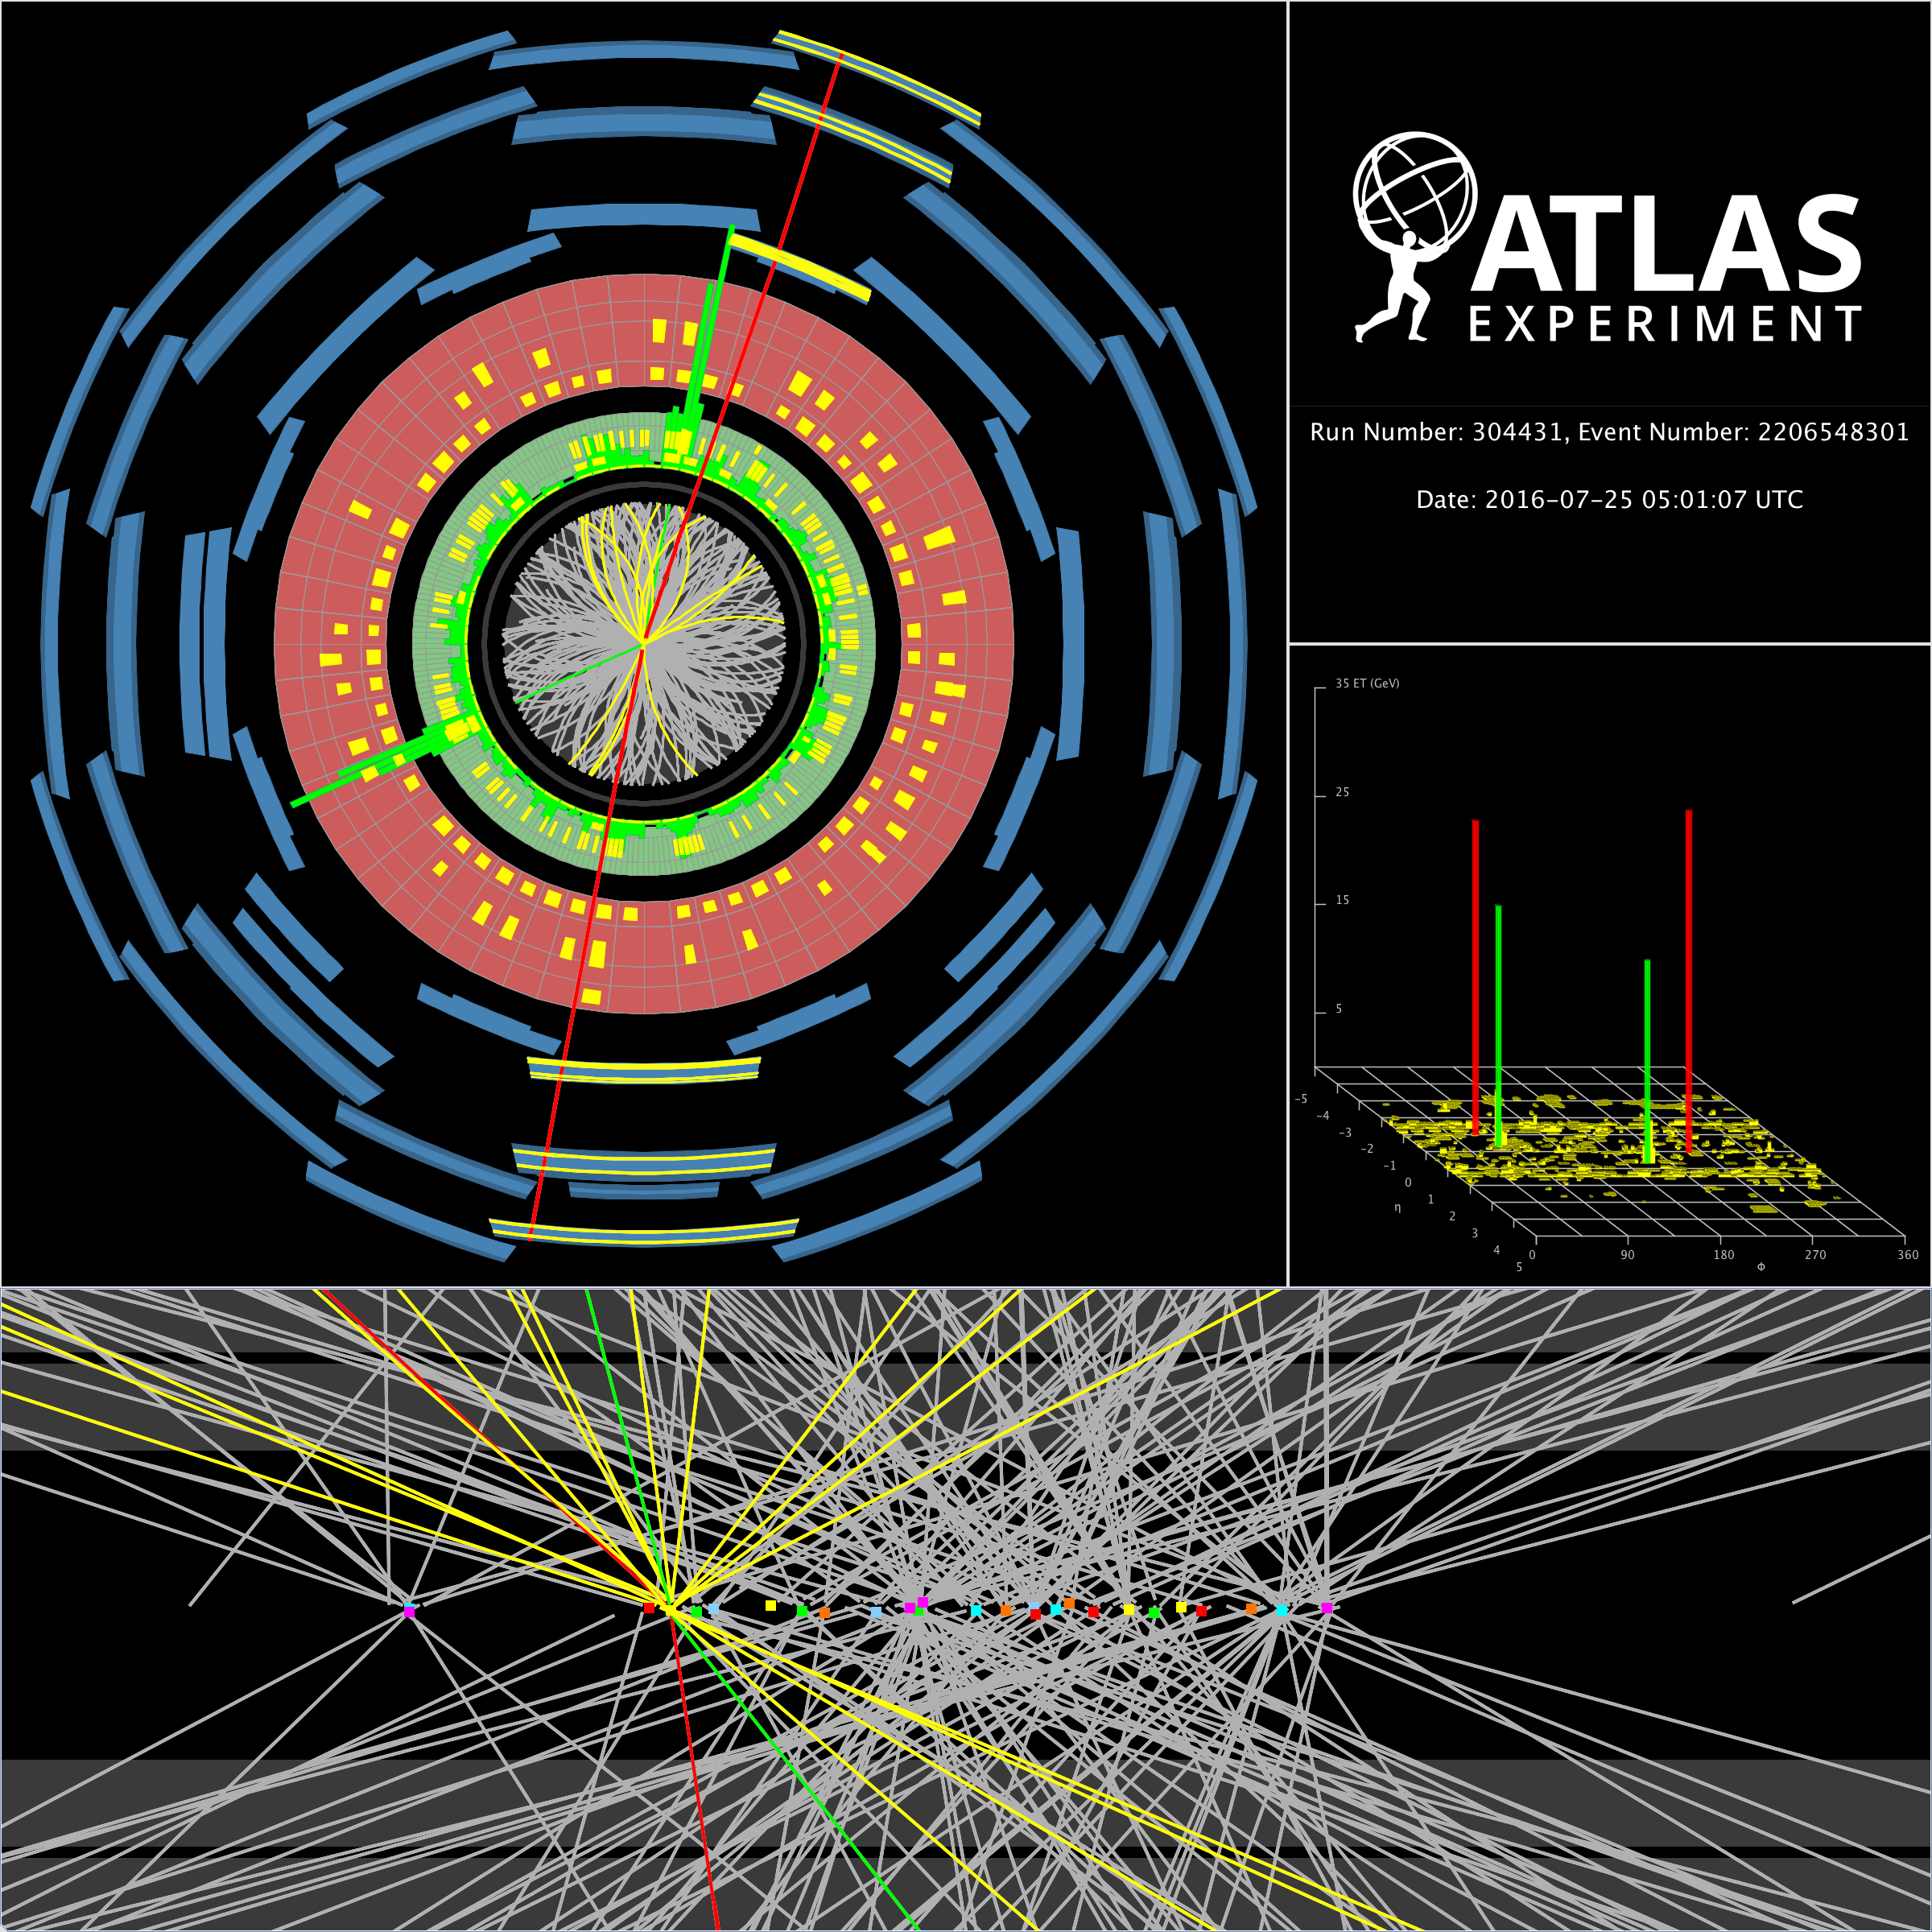
Status of the ATLAS Experiment
Karl Jakobs
University of Freiburg / Germany
44th Meeting of the ATLAS RRB, 25th April 2017

Slide 2
Status of the ATLAS Experiment
Collaboration and Management matters
Physics Highlights (short summary)
Towards Running in 2017 (Offline)
Phase-II Upgrade
Status of TDRs, Approval process
Karl Jakobs
University of Freiburg / Germany
44th Meeting of the ATLAS RRB, 25th April 2017

Slide 3

Collaboration
and
Management Matters

Slide 4
No major changes in the collaboration composition w.r.t. previous RRB meeting:
National Center for Scientific Research “Demokritos” Athens joined as an
Associate Institute, affiliated to NTU Athens
(Expression of Interest to join ATLAS as a full member institution expected)
ZiTi Heidelberg (Zentrum für Technische Informatik) withdrew from the
Heidelberg cluster (two institutes remain in the cluster)
→ No change in the Collaboration Board Composition

Slide 5
182 Institutions in 38 Countries
~ 2.900 Scientific Authors
~ 1.900 with PhD, contributing to M&O share
~ 1.000 Students

Slide 6




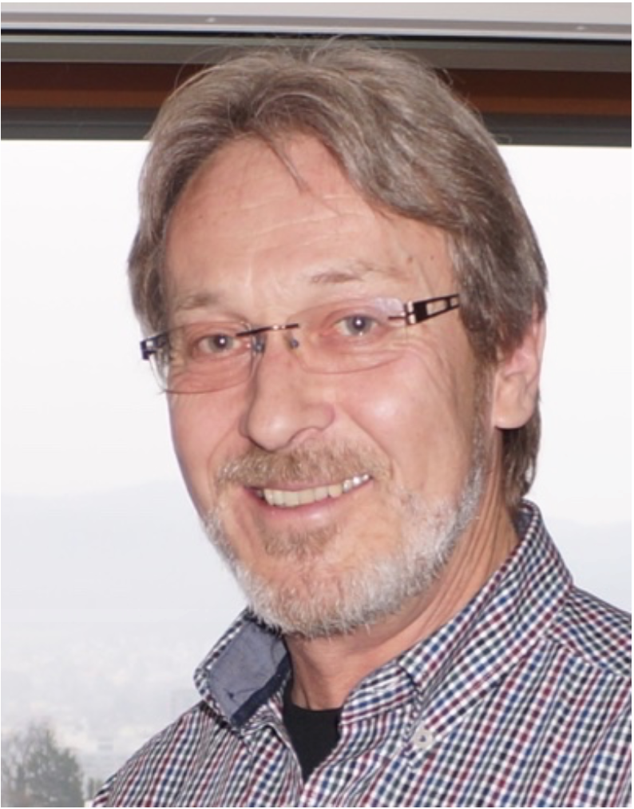
ATLAS Management Team
March 2017 – February 2019
Spokesperson: Karl Jakobs (Freiburg)
Deputy Spokespersons:
- Andreas Hoecker (CERN)
- Isabelle Wingerter-Seez (Annecy LAPP)
Technical Coordinator: Ludovico Pontecorvo (CERN / INFN)
Resources Coordinator: Fido Dittus (CERN)
Upgrade Coordinator: Kevin Einsweiler (Berkeley LBNL)

Slide 8
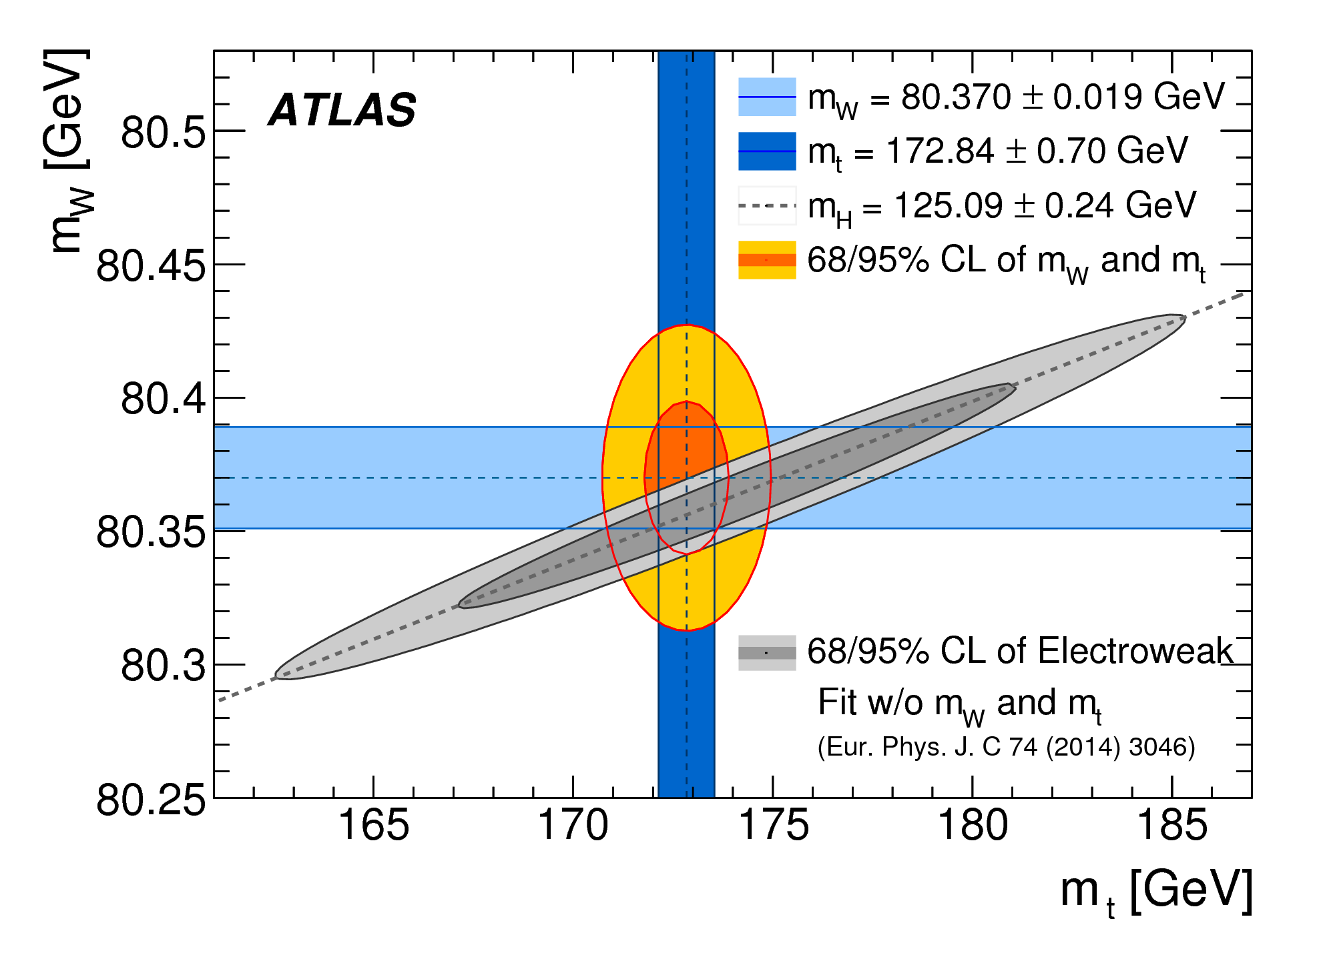
A few Highlights from Physics Analysis
Precision measurements
(based on Run-1 data)
Searches for BSM Physics
(based on complete Run-2 dataset,
2015/16 data)

Slide 9
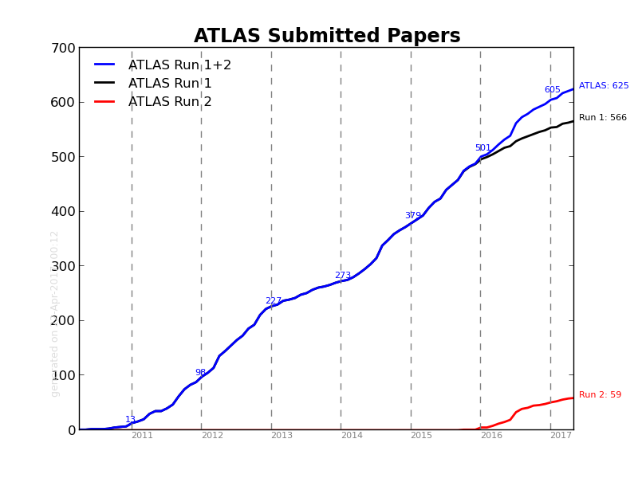
ATLAS Publication Statistics
- 625 Journal publications
submitted or published
- 17 Conference notes
based on complete
2015/16 dataset
Run-1 papers: publications continue, now focus on precision measurements
(well calibrated and understood dataset)
Run-2 papers: focus is now on the publication of searches and measurements
(e.g. in the Higgs area) based on the full 2015 + 2016 dataset
so far: 2 papers published and 17 CONF notes (Winter conferences)
released on the full Run-2 dataset

Slide 10
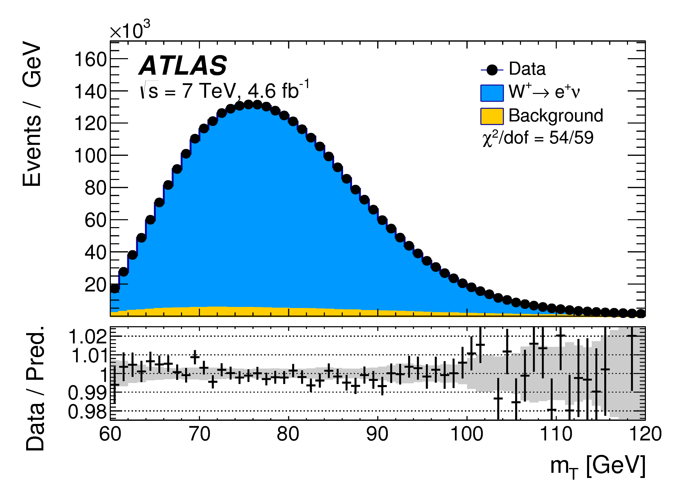
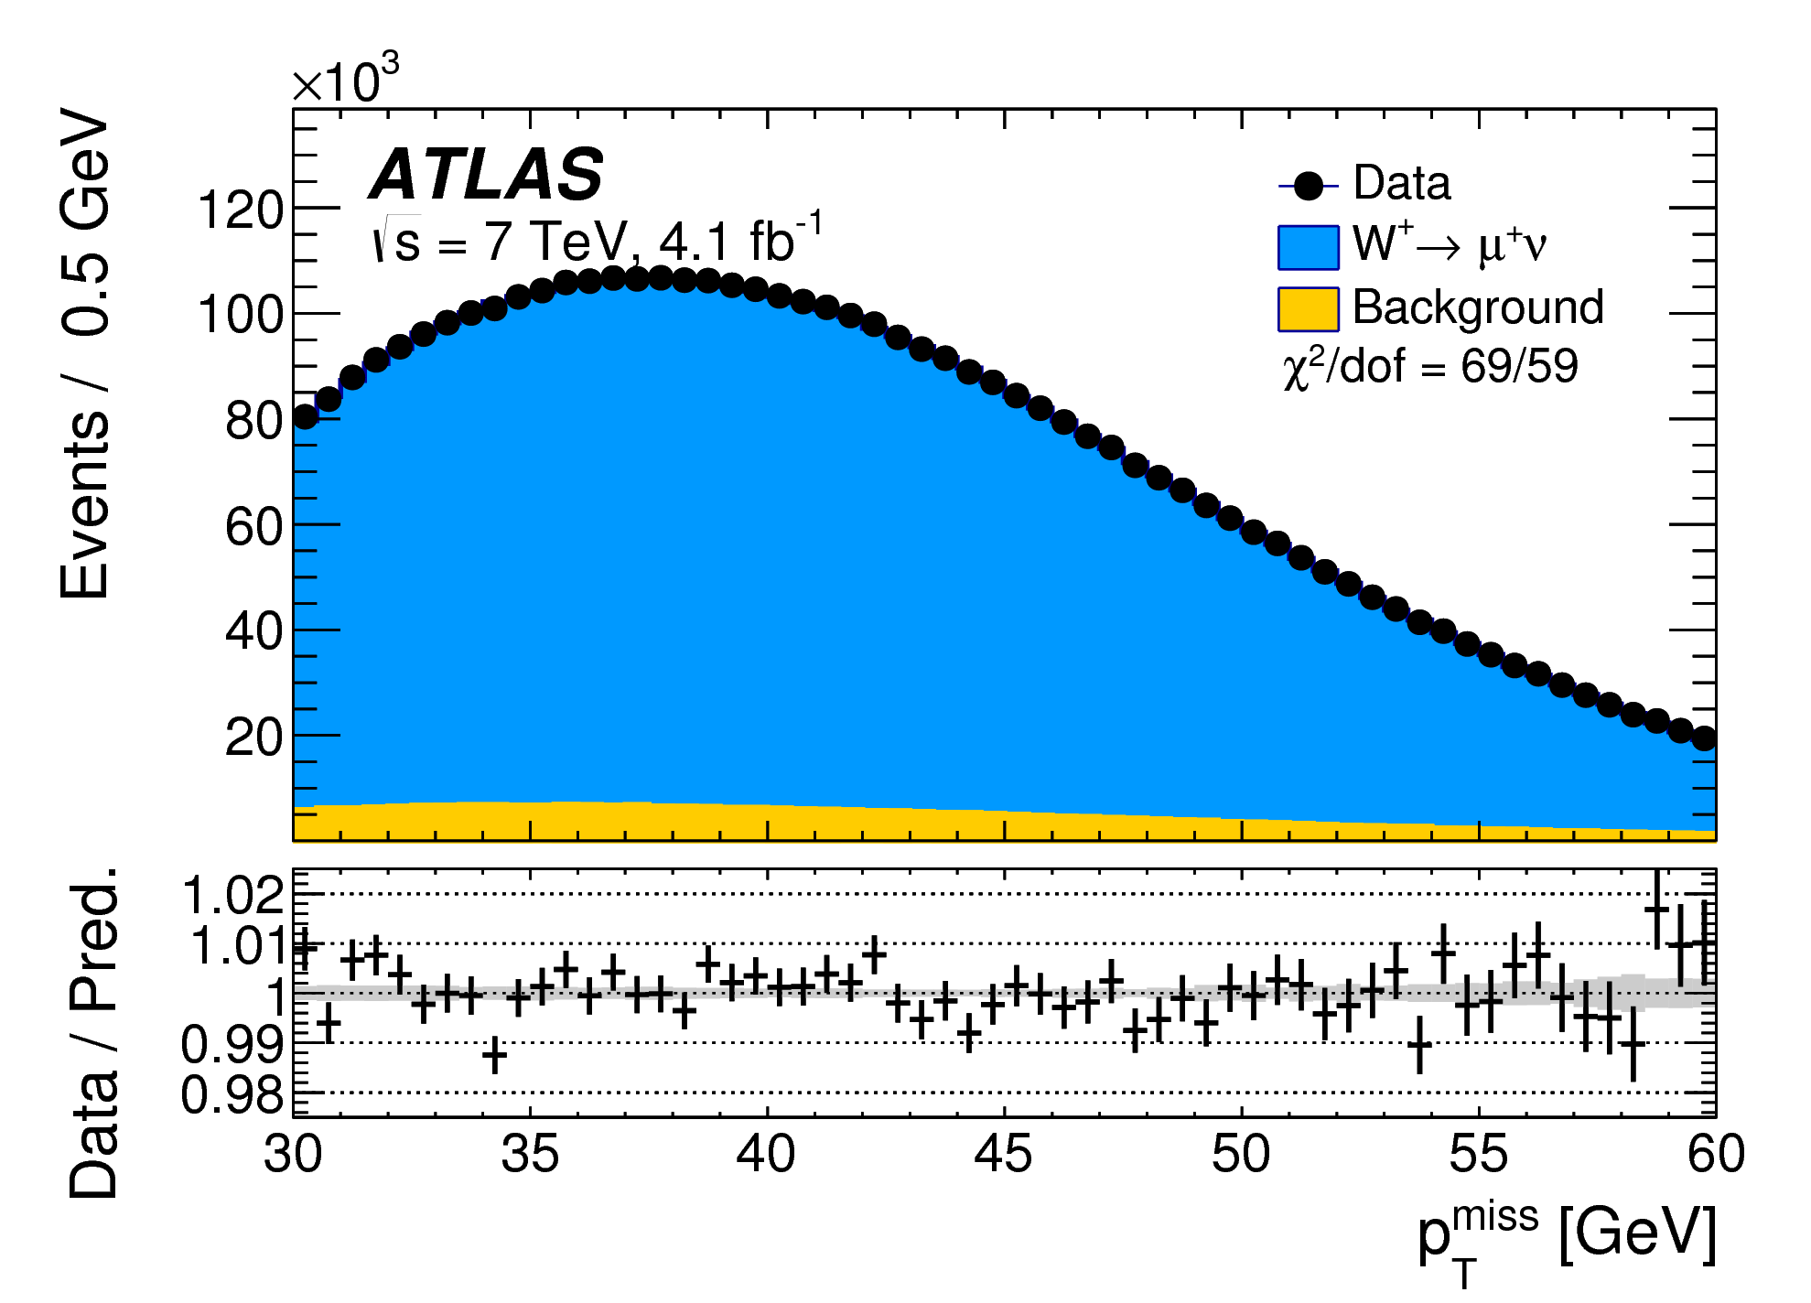
Measurement of the W-boson mass
Based on early data (2011) at √s = 7 TeV (4.6 fb⁻¹)
Huge amount of work to understand detector response and the modelling of
kinematic quantities (relies on large Z → ℓℓ sample)
High quality analysis in W → eν and W → μν channels
arXiv:1701.07240

Slide 11
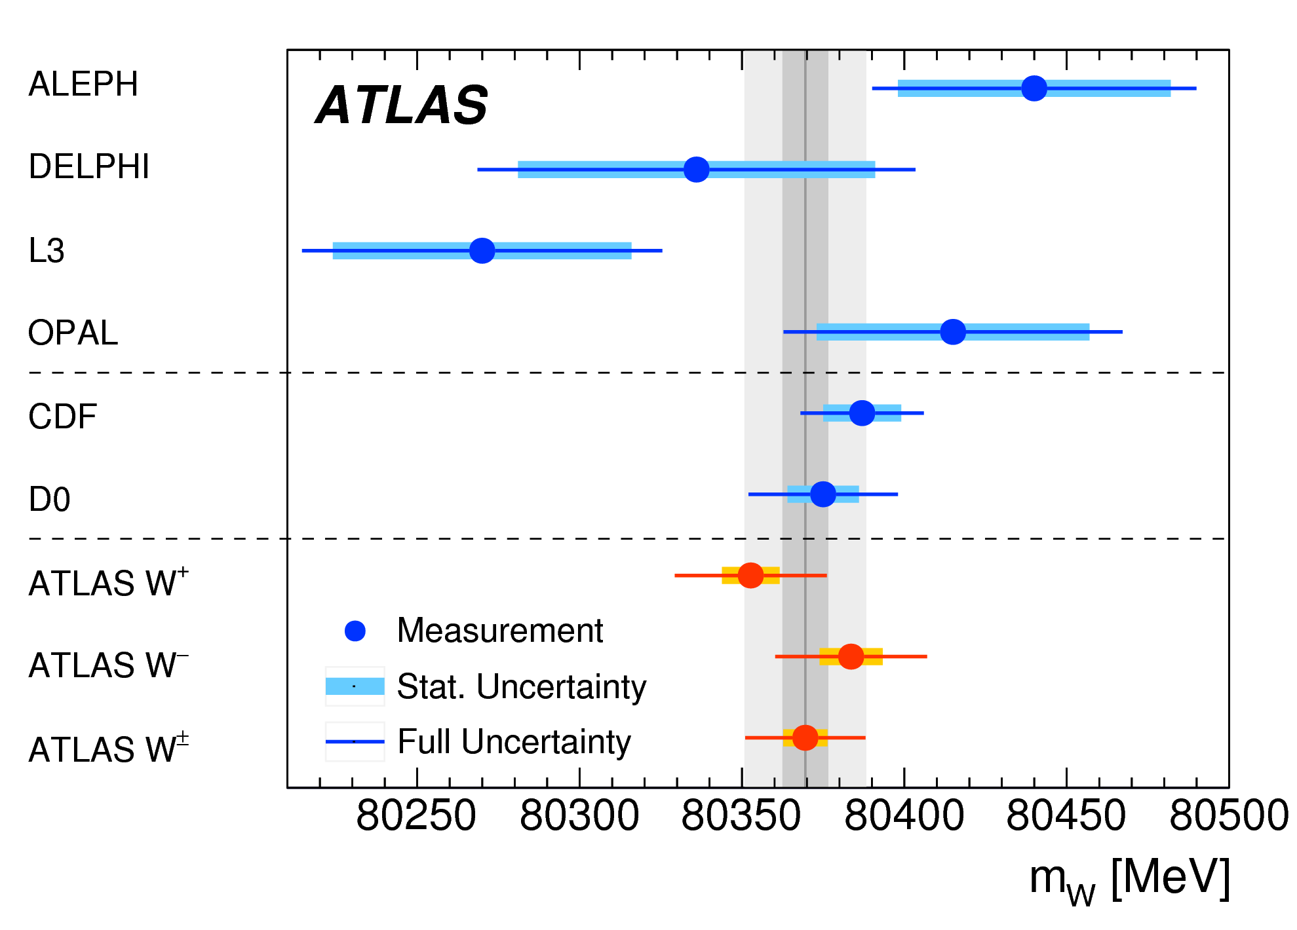
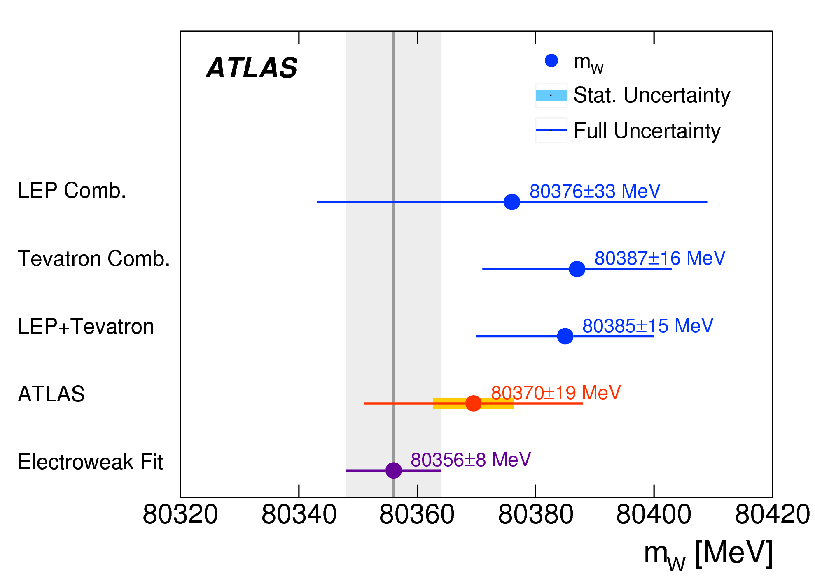
Measurement of the W-boson mass (cont.)
arXiv:1701.07240
Same precision reached as for current best measurement
from the CDF experiment
m_{W} = 80.370 ± 0.019 GeV
± 7 MeV statistical
± 11 MeV systematic
± 14 MeV modeling

Slide 12
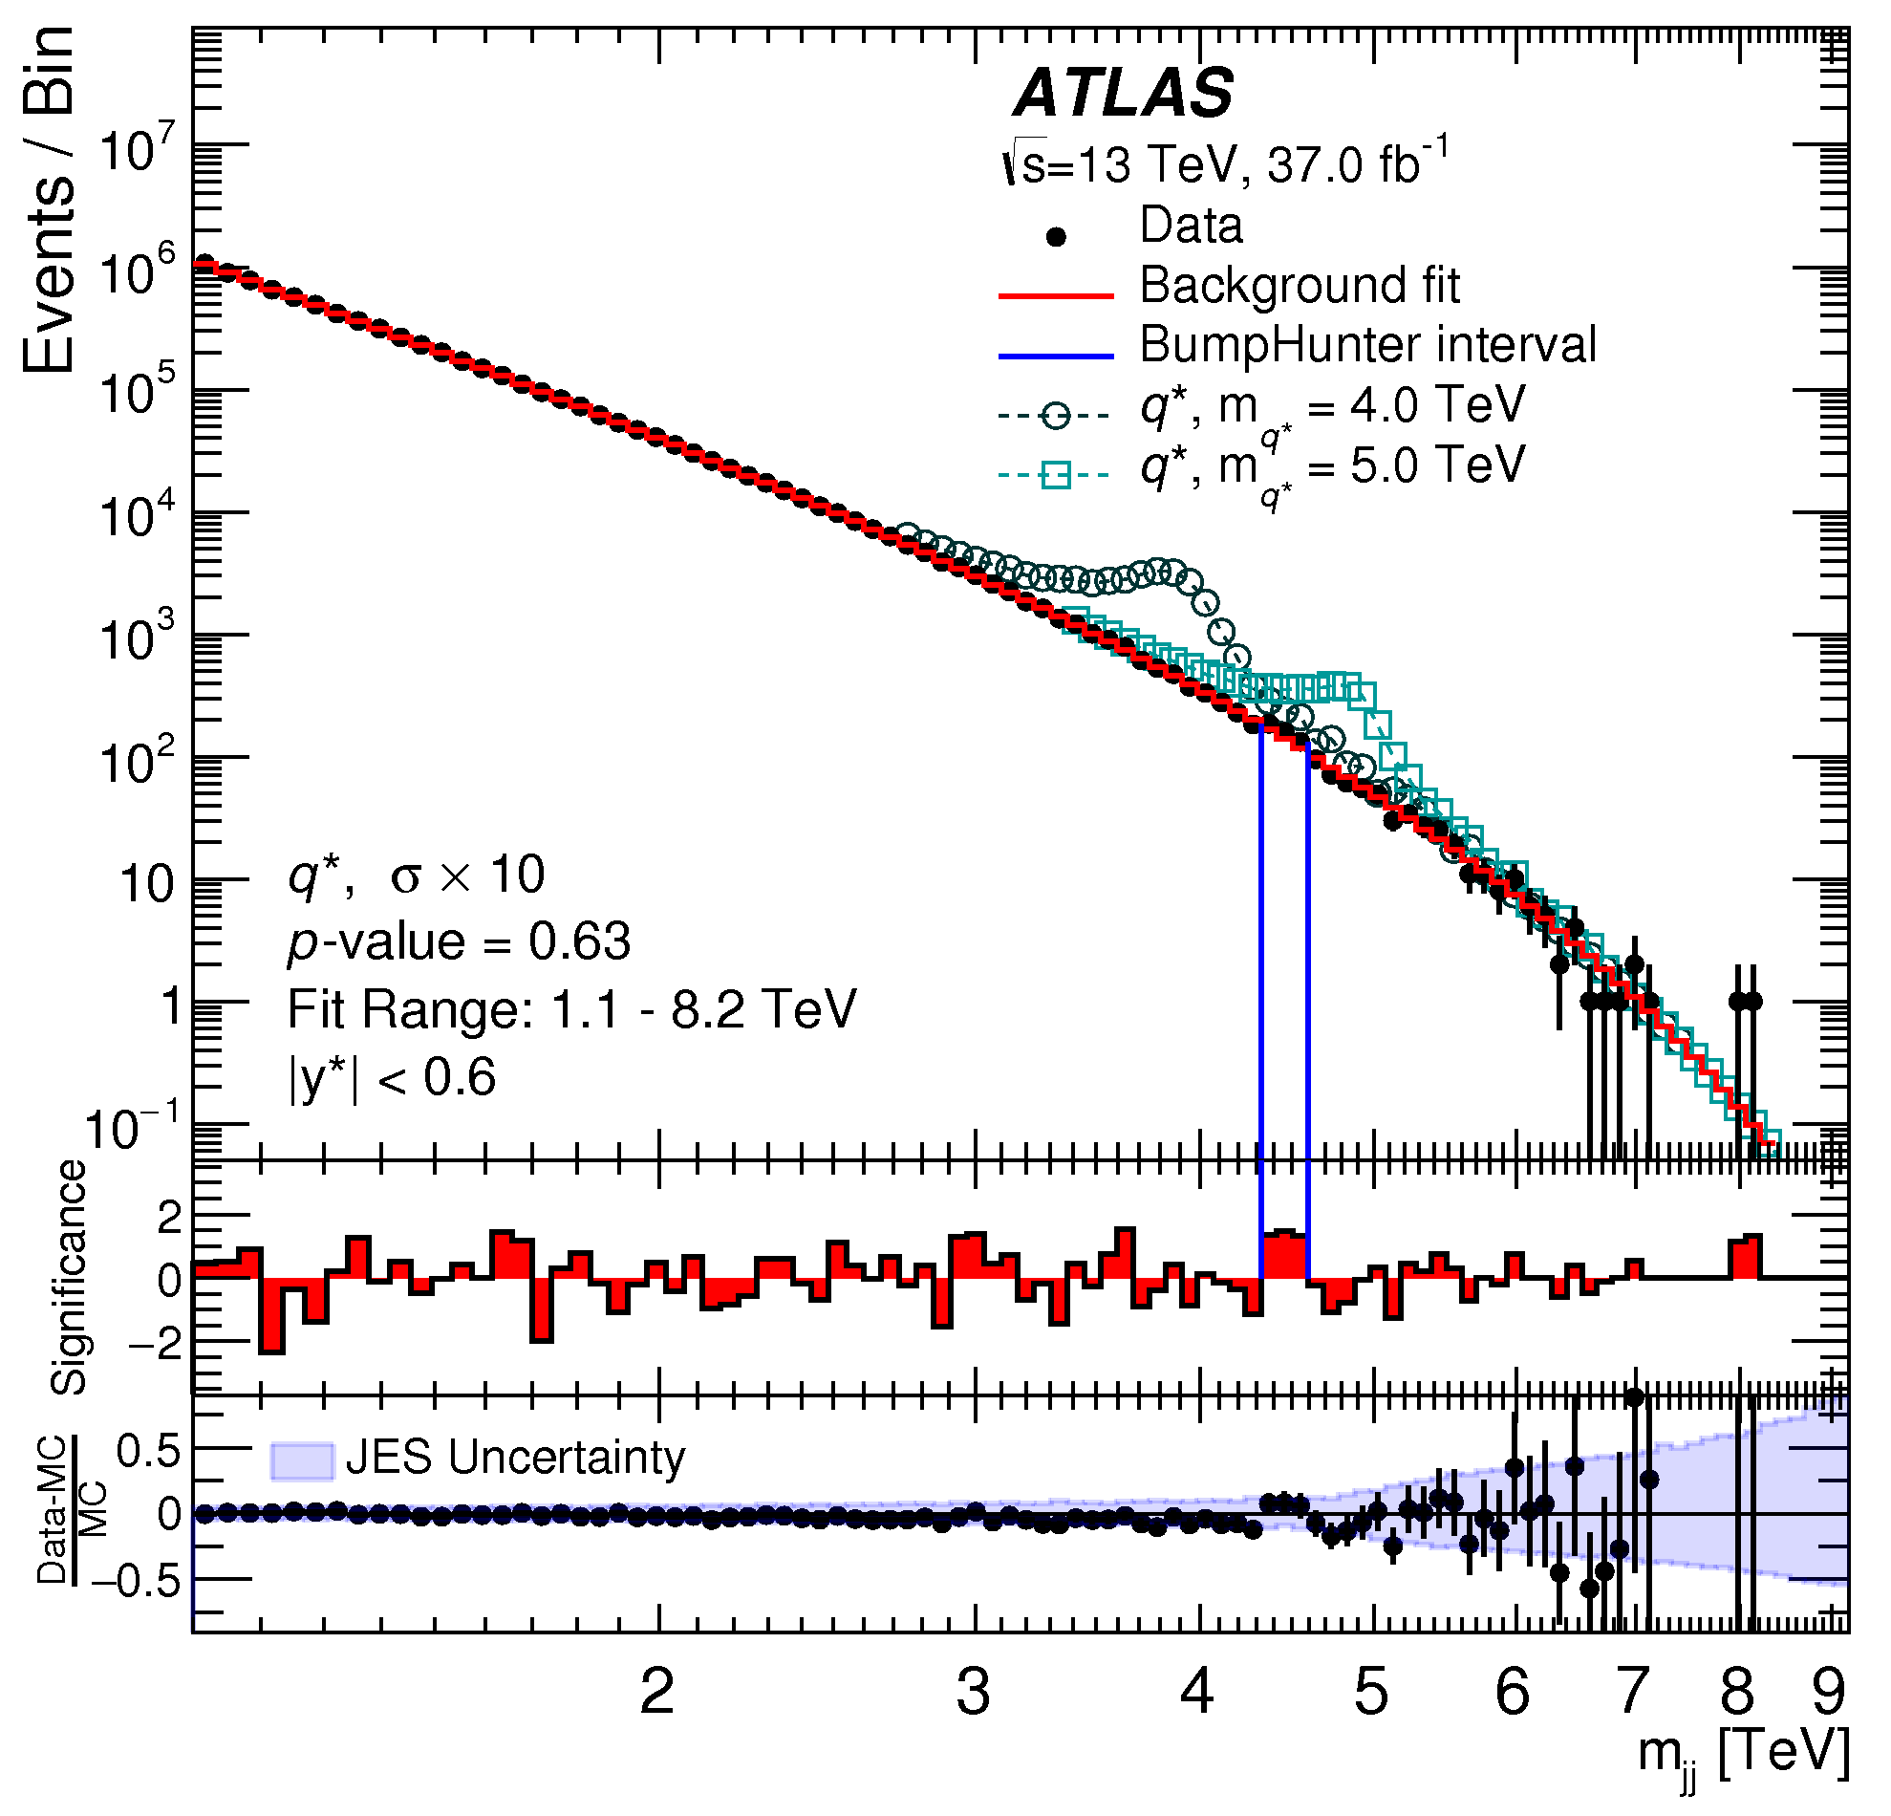
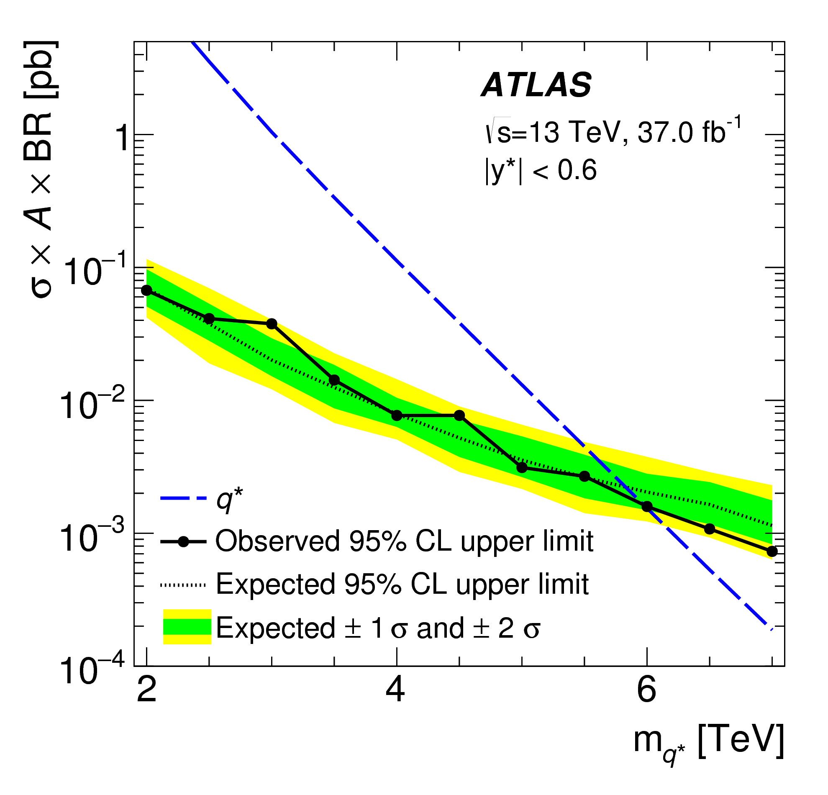
Search for new phenomena in di-jet events
First publication on complete Run-2 (2015+2016) dataset: 37.0 fb⁻¹ at √s = 13 TeV
arXiv:1703.09127
95% CL exclusion limits: Excited quarks m_{q*} > 6.0 TeV (5.8 TeV exp.)
Add. gauge bosons: m_{W’} > 3.6 TeV (3.7 TeV exp.)
Quantum Black Holes: m_{BH} > 8.9 TeV (8.9 TeV exp.)
Contact Interactions: Λ > 13.1 TeV (η_{LL} = +1)
Λ > 21.8 TeV (η_{LL} = -1)

Slide 13
Search for di-lepton resonances
Search is based on complete Run-2 (2015+2016) dataset: 36.1 fb⁻¹ at √s = 13 TeV
ATLAS-CONF-2017-027
No significant deviations from the Standard Model expectations observed
→ resulting lower mass limits, e.g. m(Z’_{SSM}) > 4.5 TeV (95% C.L.)
significant improvement w.r.t. Run 1 (due to higher energy)
In addition: no indication of contact interactions, energy scale Λ_{ℓℓqq} > 23.5 - 40.1 TeV

Slide 14
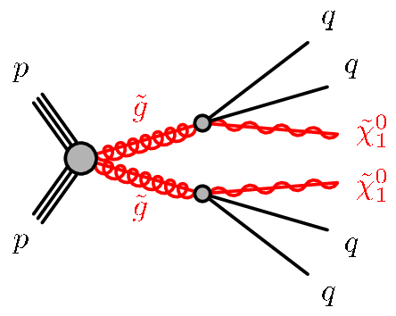
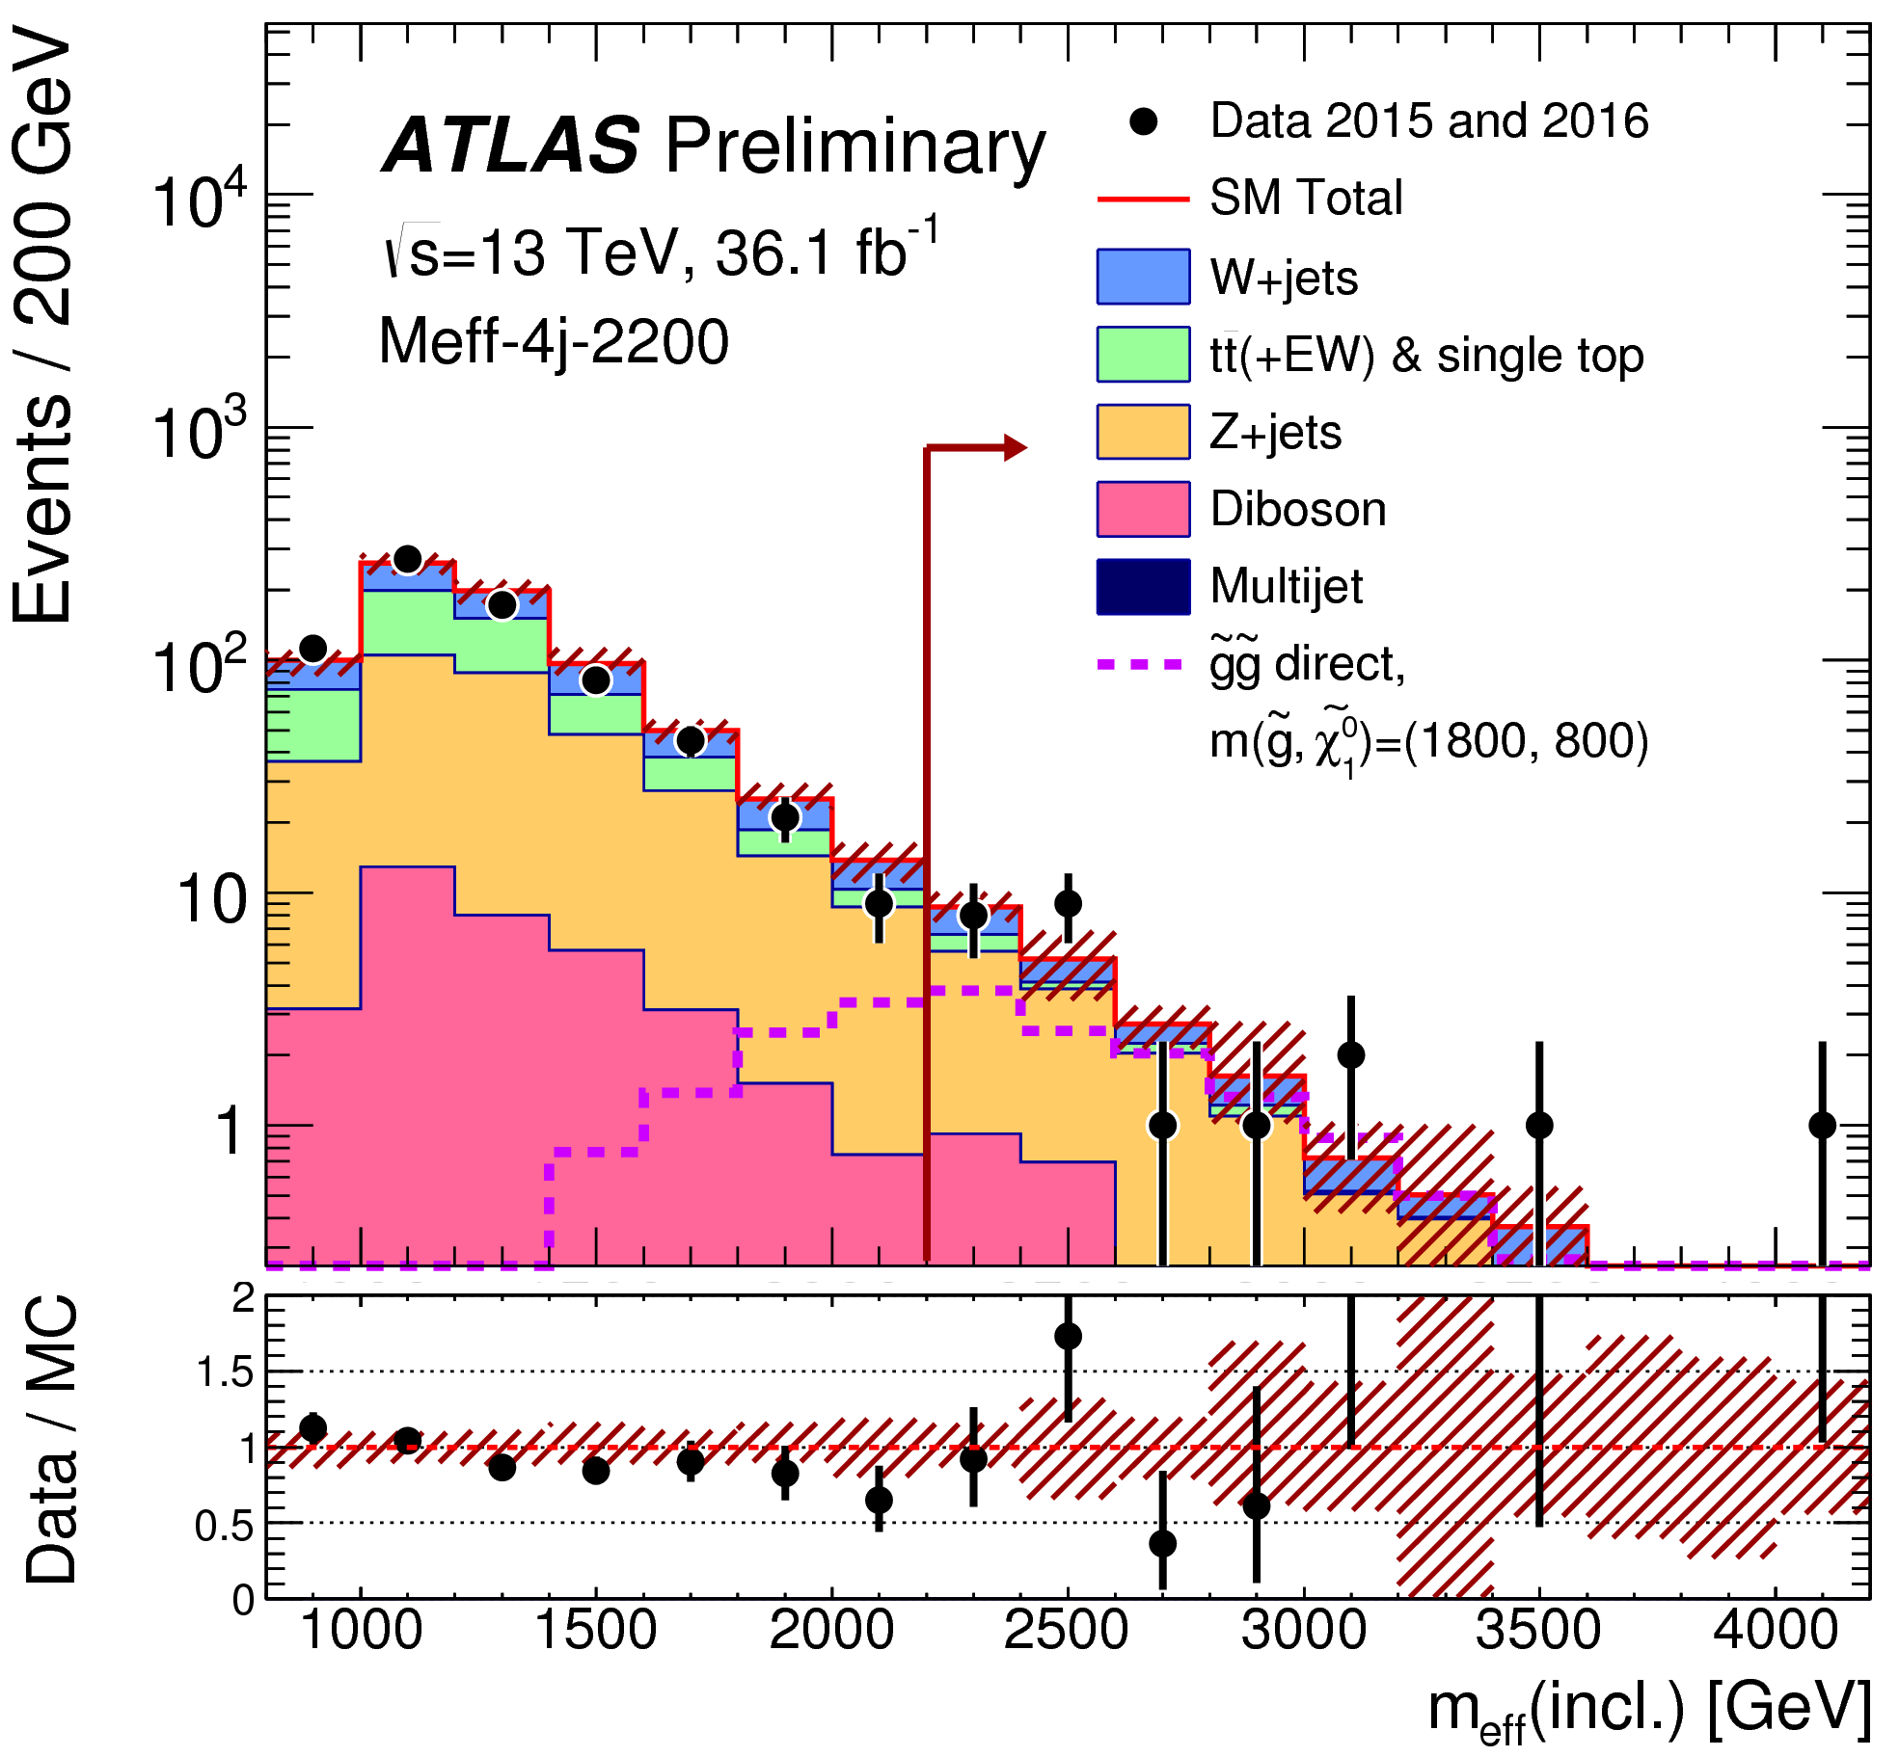
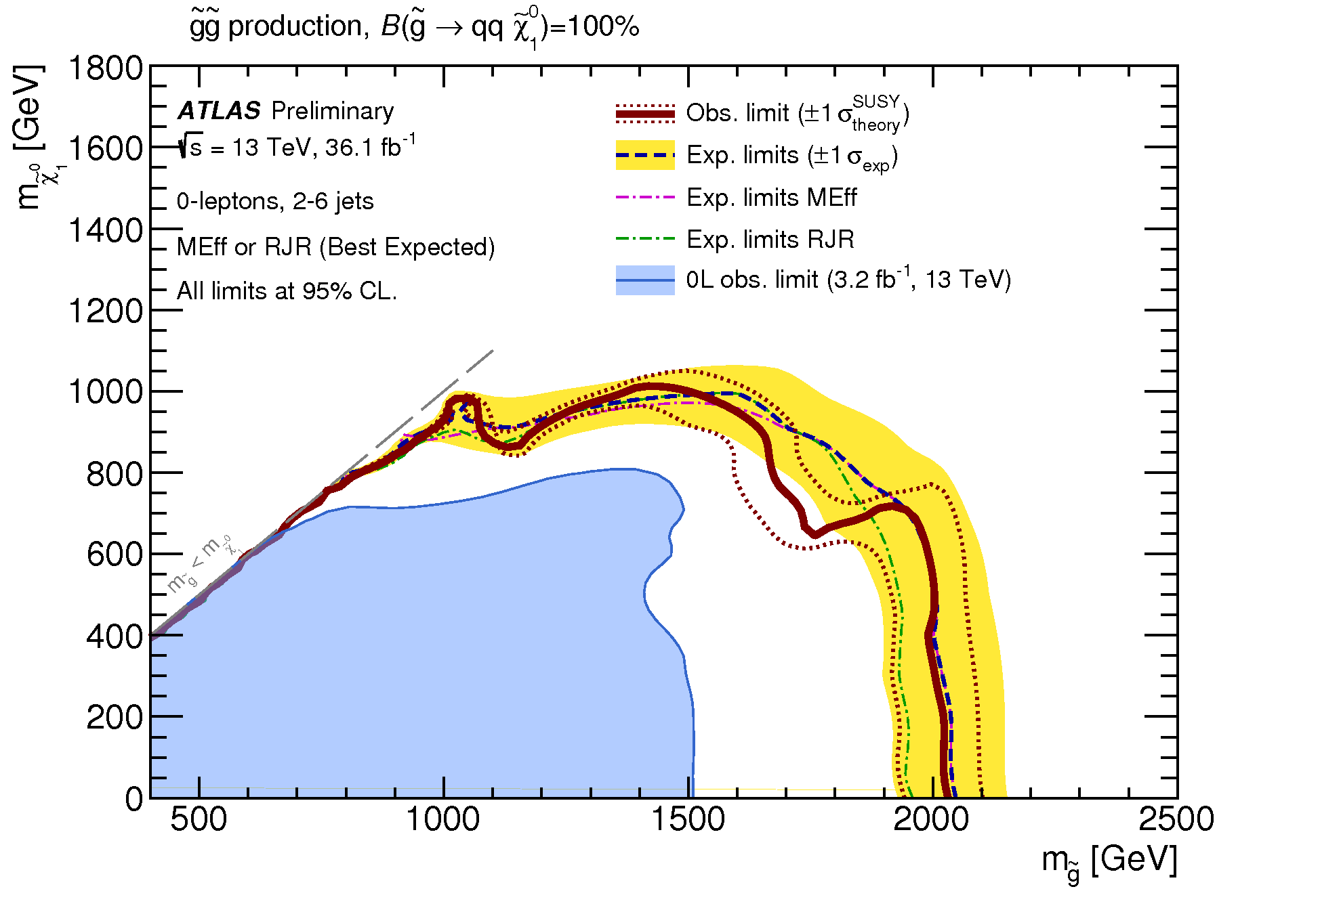
Search for Supersymmetry
-Important new results with complete Run-2 dataset-
ATLAS-CONF-2017-022
Data well described by expectations
from SM processes
Gluino mass limit beyond 2 TeV, m(χ⁰) = 0

Slide 15
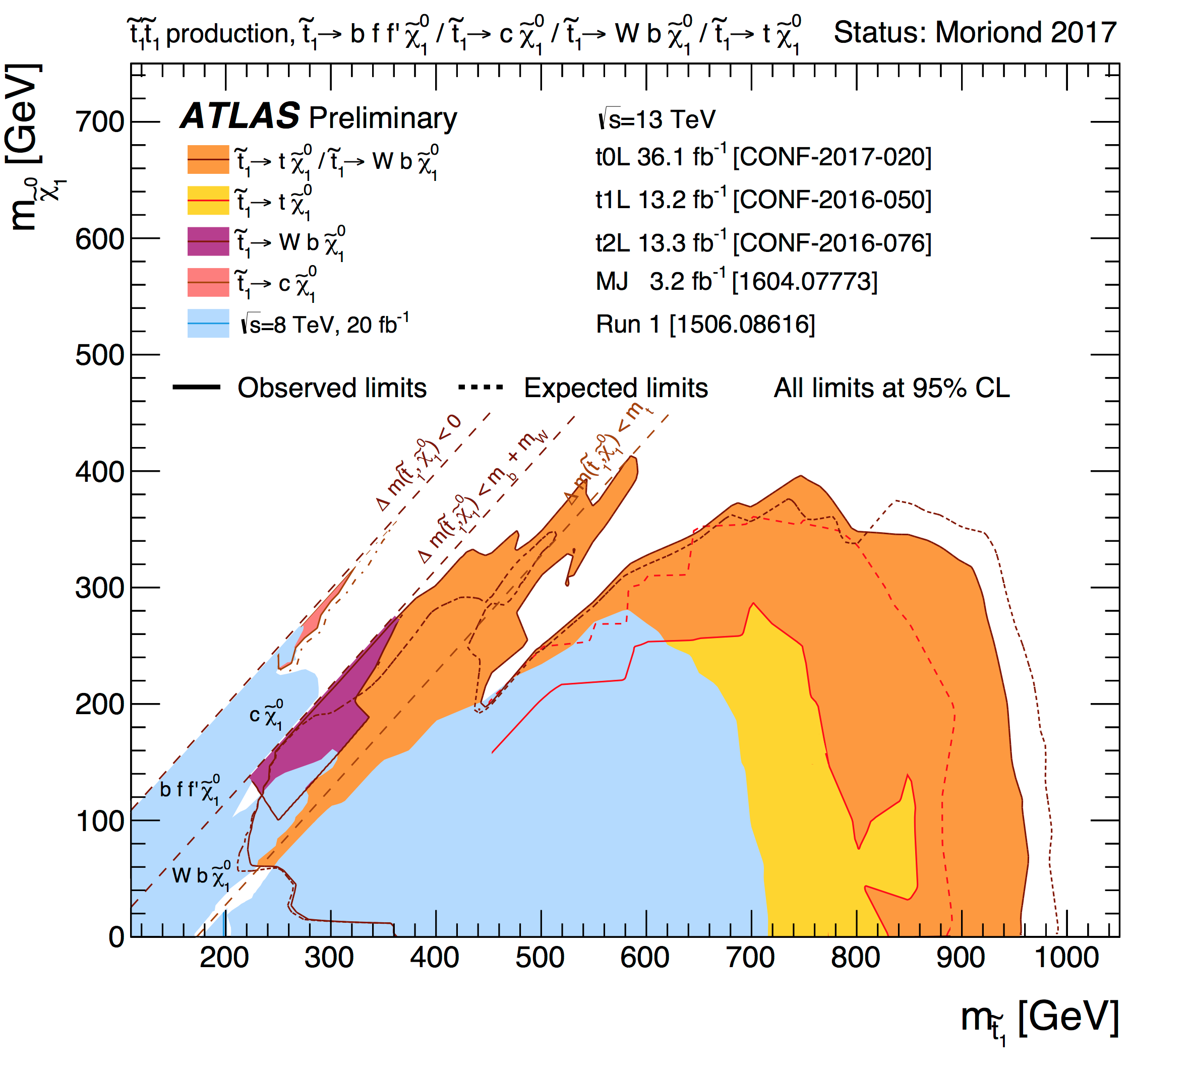
Search for Supersymmetry
-update on searches for the top squark (stop)-
more difficult regions
addressed
significant extension
at high mass
Stop mass limit beyond 0.9 TeV, m(χ⁰) = 0
Some difficult parameter regions at low mass still uncovered

Slide 16
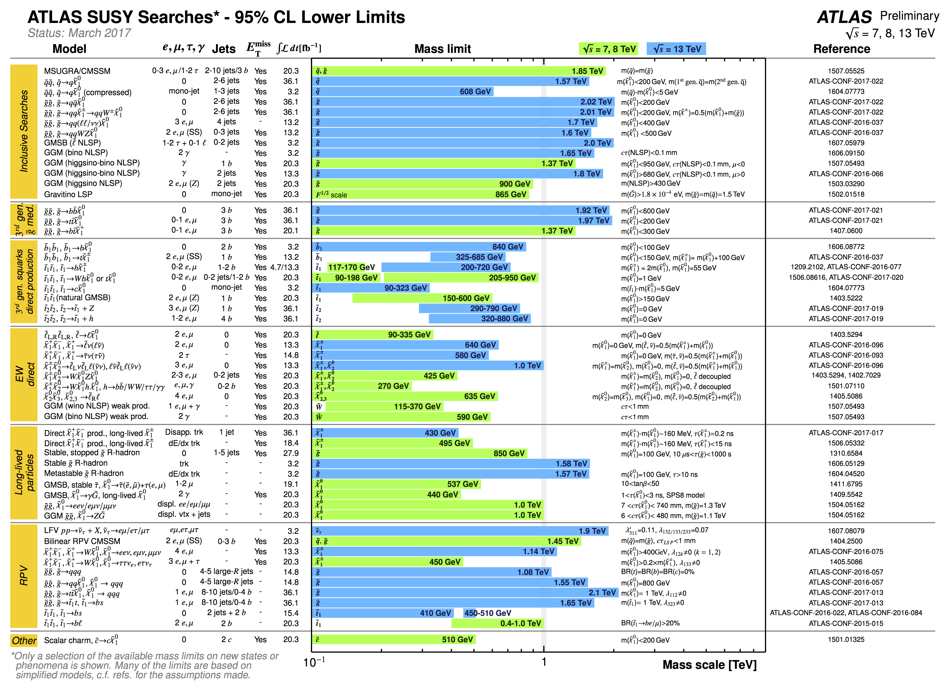
“The 2 TeV line has been reached for some scenarios”

Slide 17
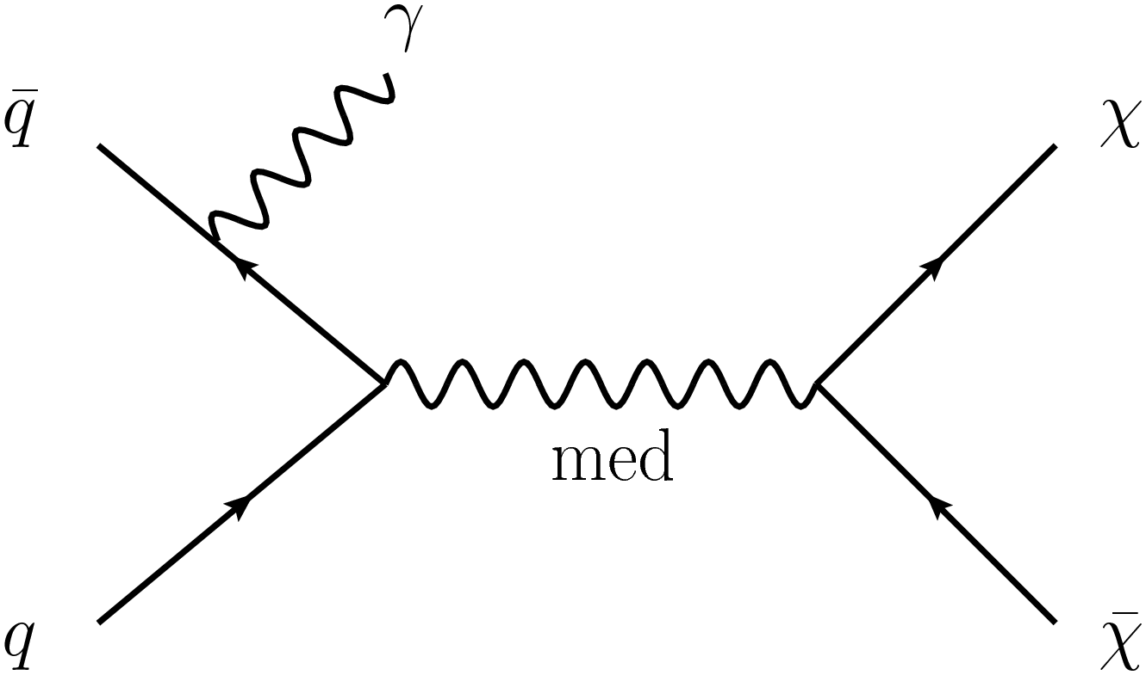
Search for Dark Matter
Search in final states containing an energetic photon and large E_{T}^{miss}
(2015+2016) dataset: 36.1 fb⁻¹ at √s = 13 TeV
No excess above expectations from Standard model processes observed
→ Interpretation in Simplified Dark Matter models (Dirac fermion DM, s-channel
mediator with vector / axial-vector couplings) → Excluded regions (m_{med} versus m_{χ} )
→ Interpretation in excluded χ-proton spin-dependent and spin-independent scattering
cross sections for different mediator models → link to direct DM search experiments
Interesting limits obtained, extend to low masses of Dark matter particles

Slide 18
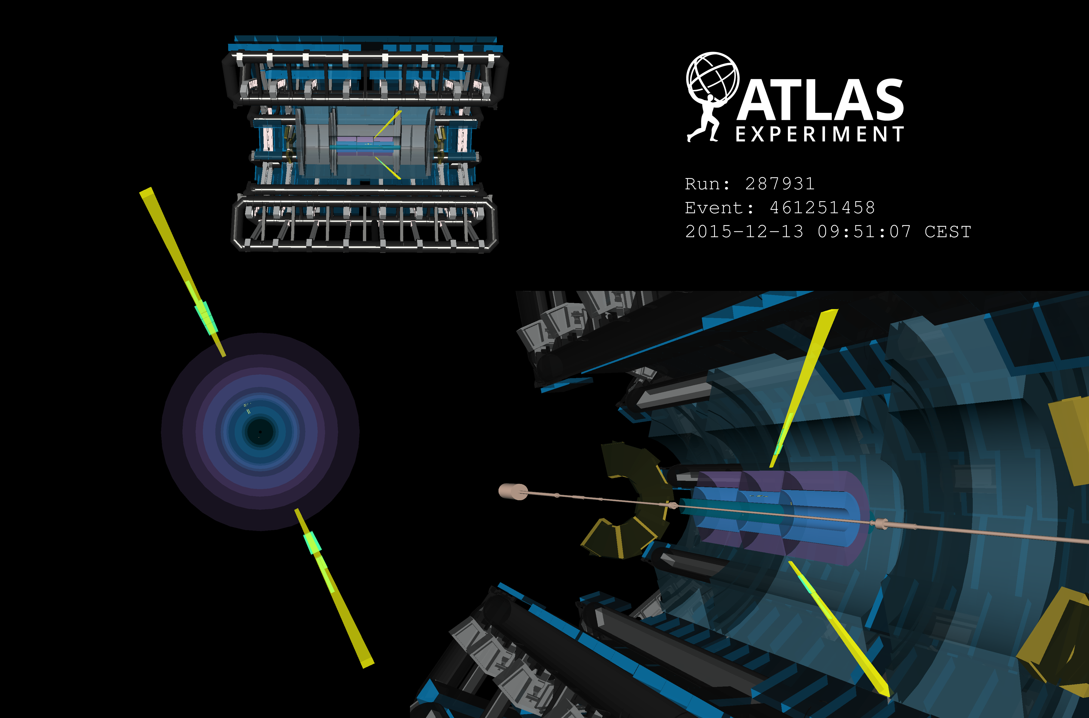
Heavy Ion Physics in ATLAS
Evidence for light-by-light scattering γγ → γγ in 5 TeV Pb-Pb collision data (2015)
(submitted to Nature Physics, arXiv:1702.01625)
At Quark Matter 2017: − 11 preliminary results (conference notes),
including 8 TeV p-Pb collision data
− 2 journal papers
Main highlights: Jet production, flow in small system

Slide 19
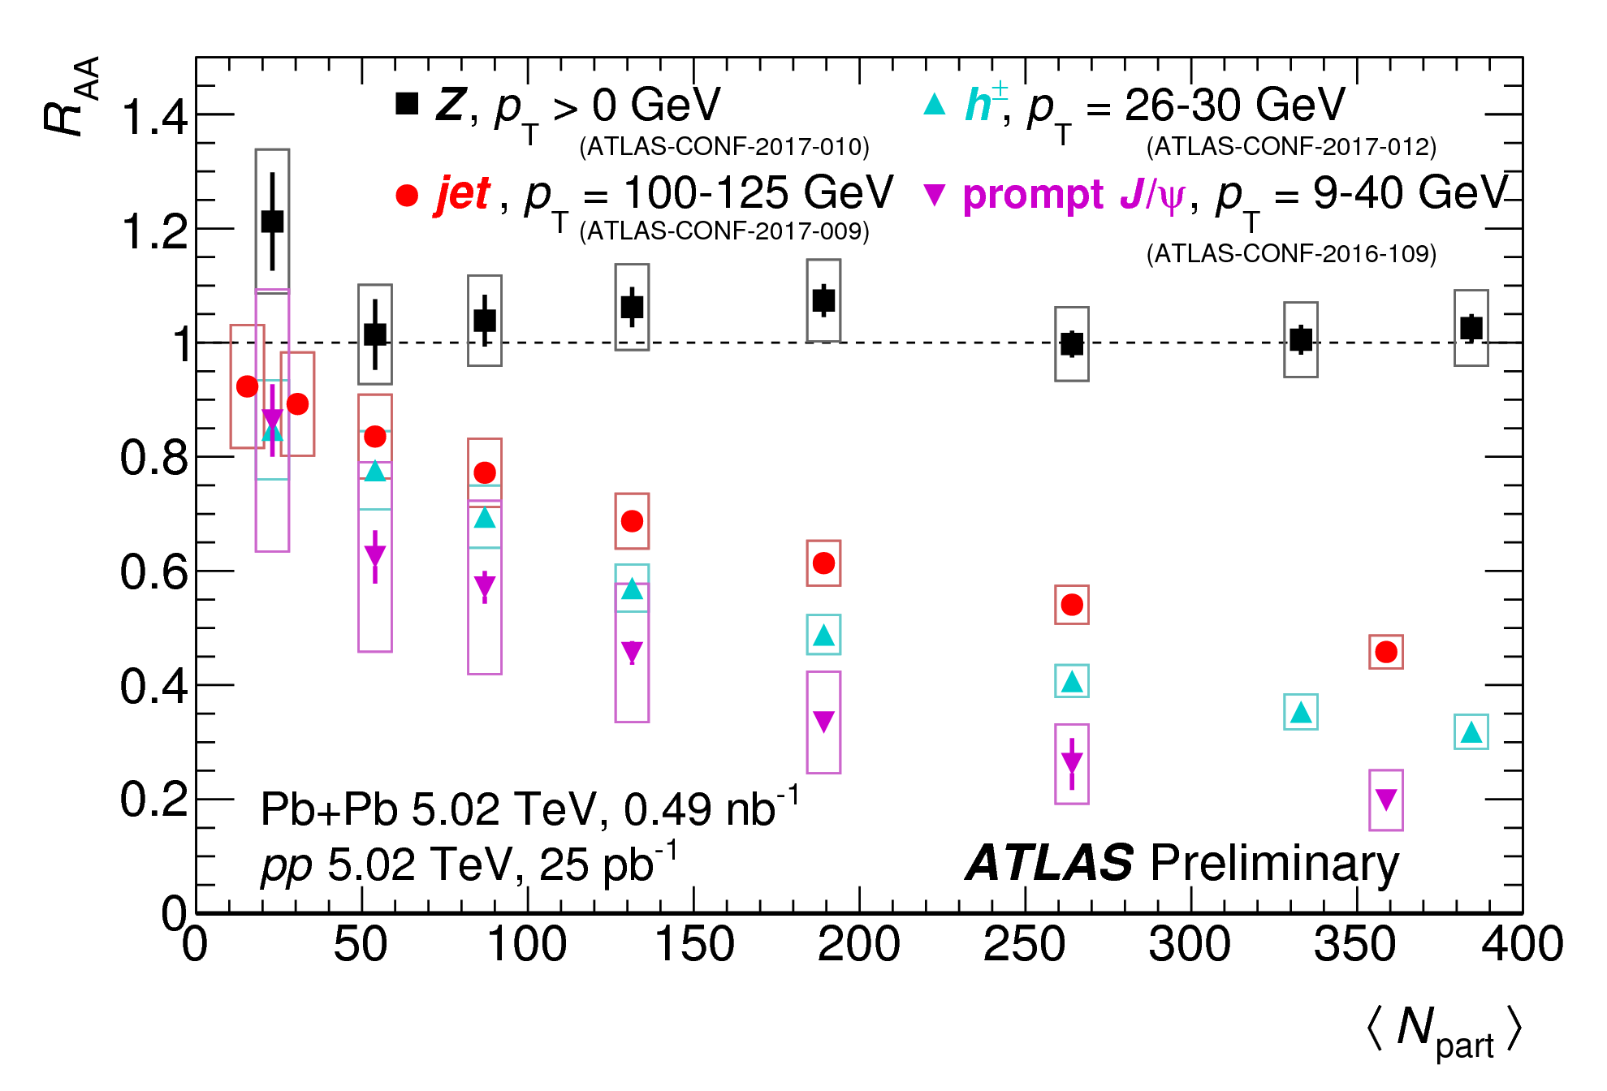
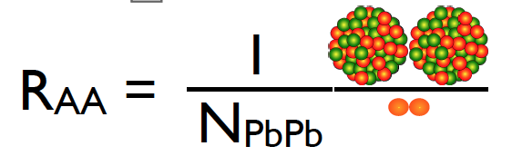
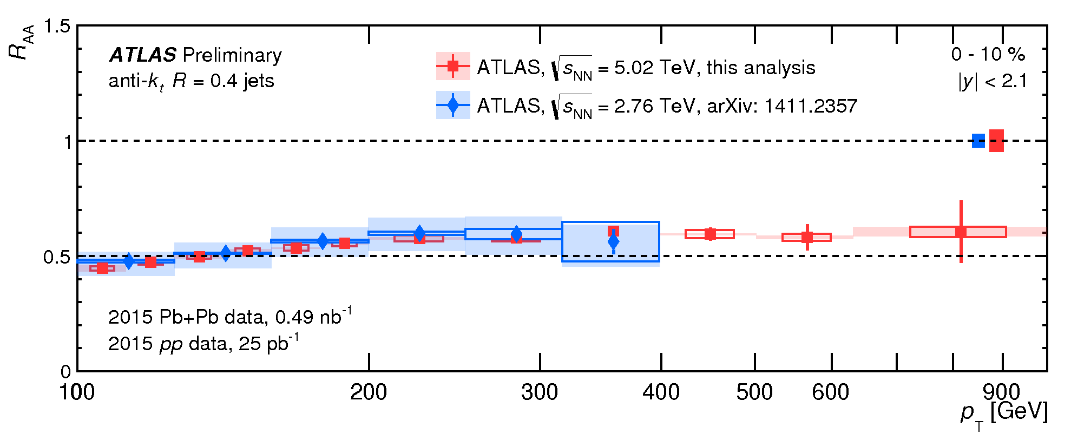
Results on Heavy Ion Physics in ATLAS
Strongly interacting particles
are increasingly suppressed
as the density of the nuclear
medium increases
With Run-2 data, jets up to
p_{T}~1 TeV can be assessed

Slide 20
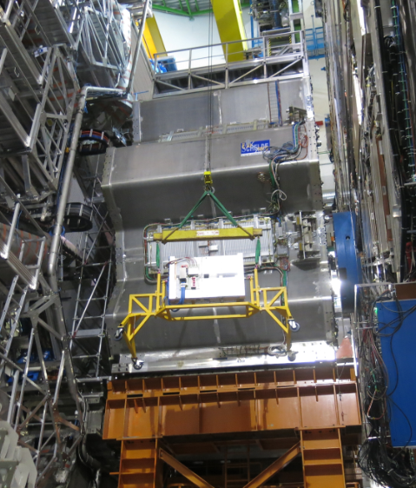
Work during
Extended Year End Technical Stop
(EYETS)

Slide 21
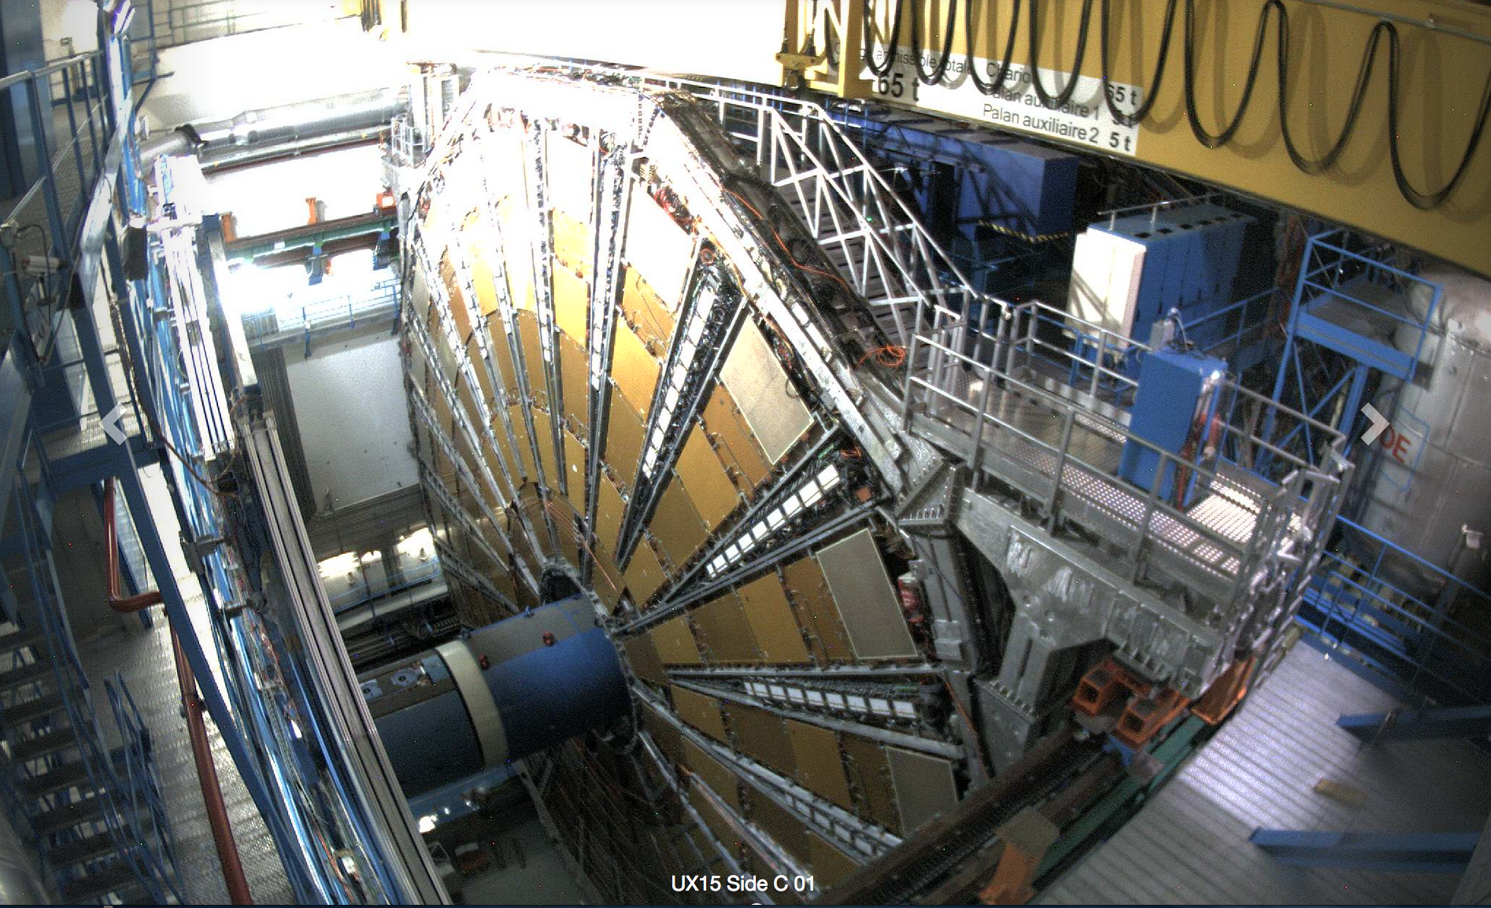
Side C
4th April 2017
The 2017 EYETS programme has been successfully completed;
ATLAS is ready for data taking in 2017
(more details in the talk by Ludovico Pontecorvo)

Slide 22
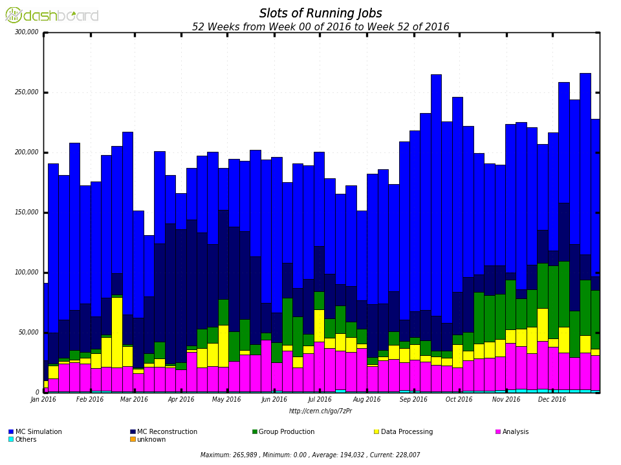
Computing
As always, the WLCG has been fundamental to ATLAS physics analysis
Fully leverage all pledged resources
Aggressively use non-pledged CPU resources
MC Simulation
MC Reconstruction
Group production
Data Processing
Analysis

Slide 23
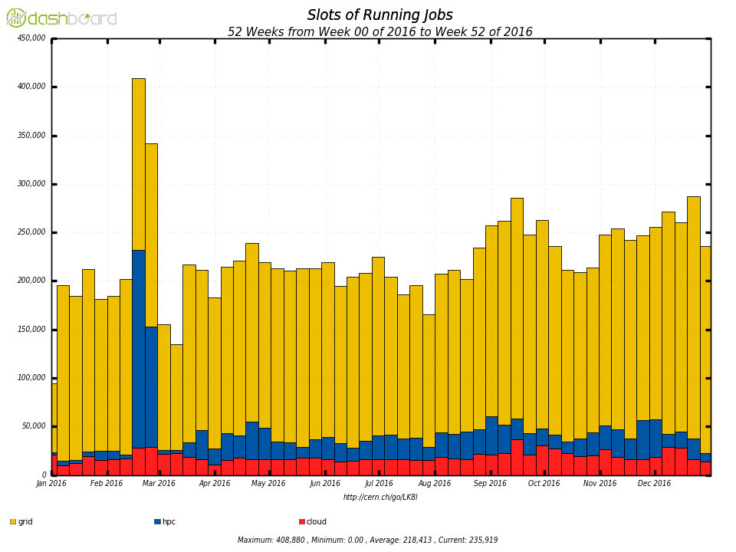
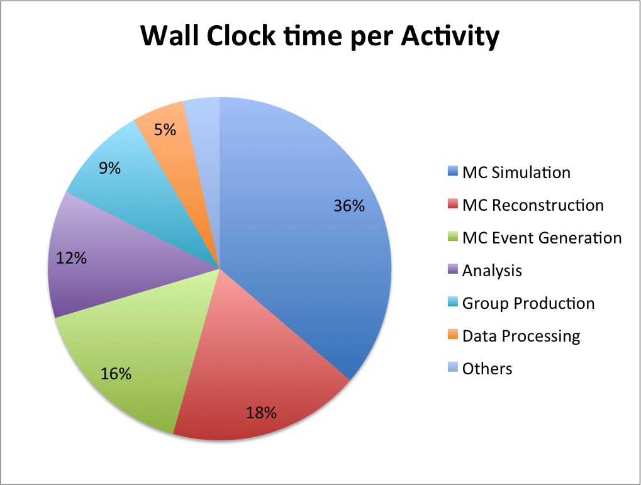
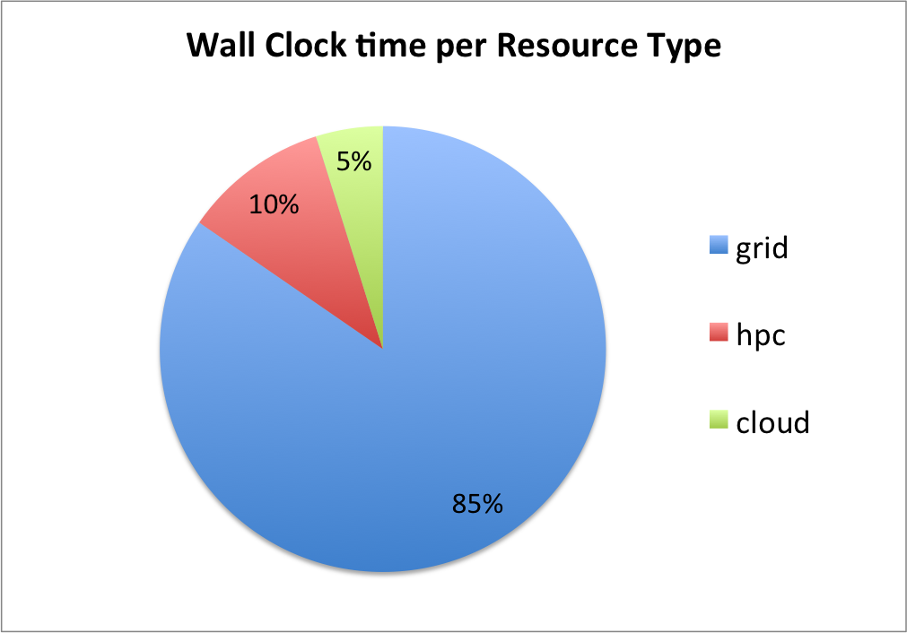
Computing (cont.)
Increasing opportunistic use of clouds and HPCs
(~15%); HPCs especially for event generators and
Monte Carlo production;
Integration of non-Grid resources in ATLAS is a
big investment with a big return

Slide 24
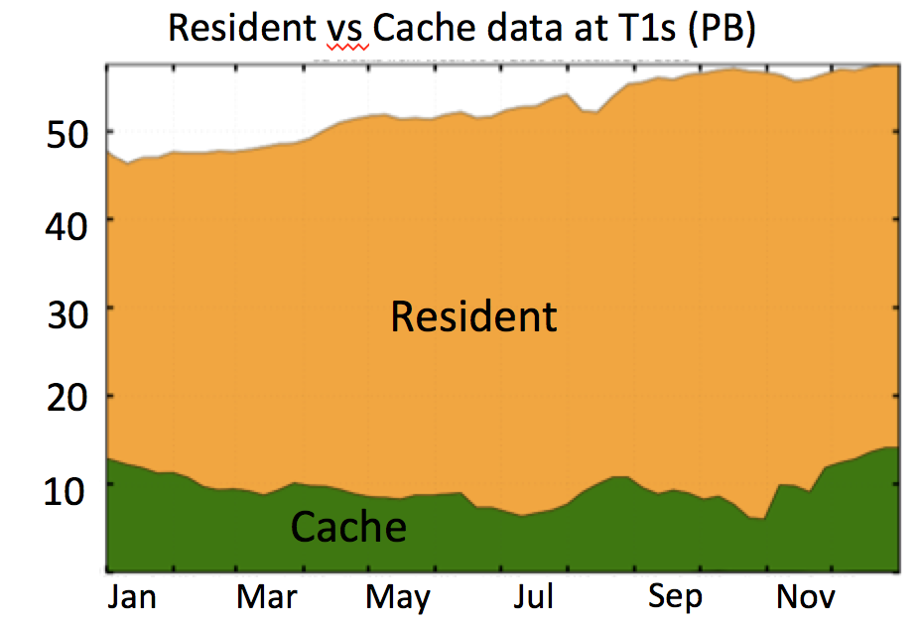
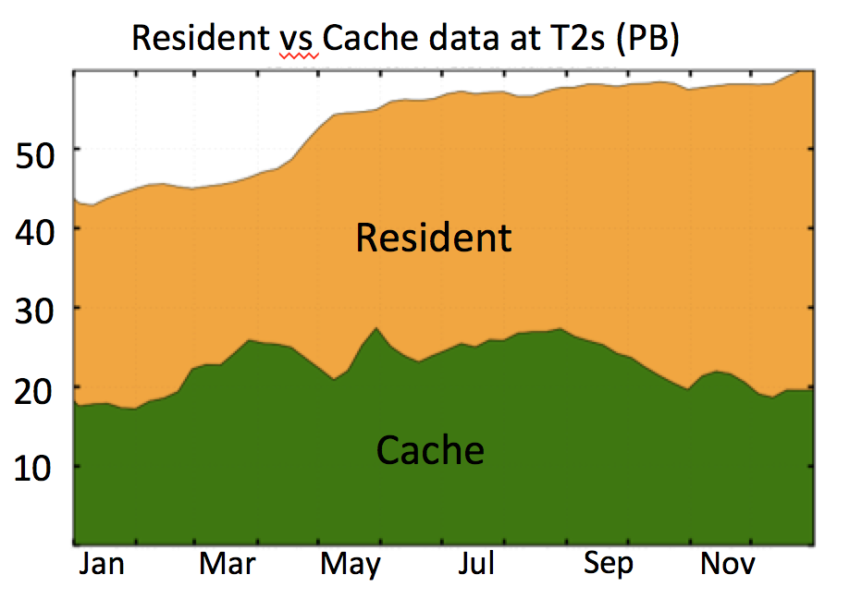
Resources are needed in Run 2 to exploit the excellent
LHC performance, which is expected to continue
Tier-1 and Tier-2 CPU fully used,
supplemented by opportunistic resources
Tier-1 and Tier-2 disks are full
Aggressive use of “lifetime” deletion model
Reprocessing of 2015+2016 data with new release
In addition: more Monte Carlo events are needed
ATLAS has taken measures to optimize resources,
e.g. reduce AOD, DAOD file sizes, or speed-up of
simulation (→ next slides)
ATLAS relies on development of tools to
exploit new computing resources
Thanks to the continuous strong Computing support;
ATLAS’ success relies heavily on it !

Slide 25
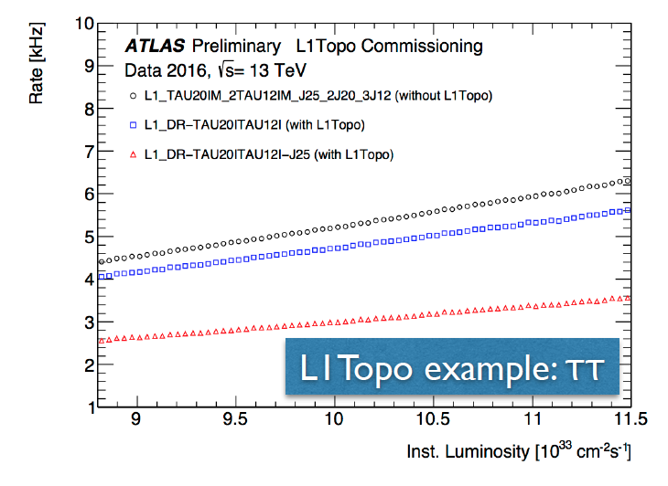
Trigger and DAQ: getting ready for 2 •10³⁴ cm⁻² s⁻¹
Level 1: Topological Trigger
- Apply real-time kinematic and angular cuts
at L1 → reduction of L1 rate, critical for
high-luminosity running
- Hardware stable for a year, expanded menu
and firmware for 2017 ready
High-Level Trigger
- Keep thresholds as low as possible
- Work done to reduce HLT CPU use by 15-20%
Operation of the Inner Detector
(Tracking) at high luminosity
- Significant upgrade of readout hardware
(Pixel DAQ)
- Inner Detector can run at 100 kHz and
pile-up level up to μ ~ 60 (~ 2 10³⁴ cm⁻² s⁻¹)

Slide 26
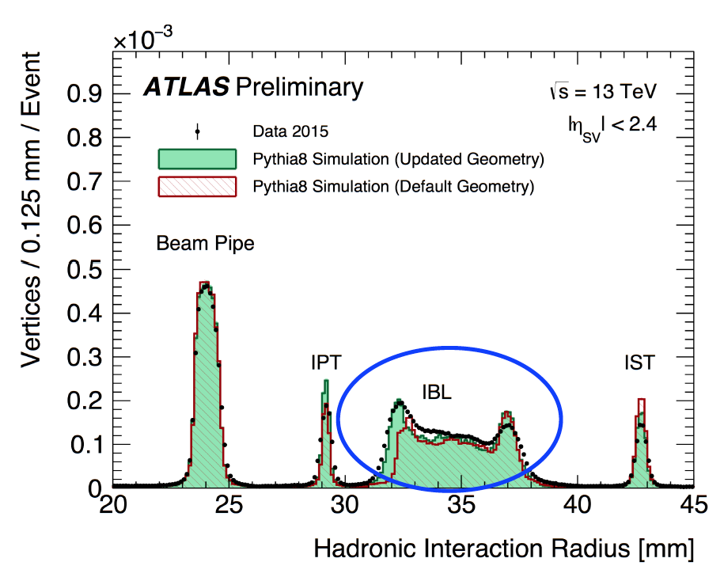
Simulation and Reconstruction
Software for Run 2: Release 21
- Release 21 commissioned and validated
Stable release for Run 2 → reprocessing of earlier Run-2 data
Simulation
- 15% speed-up w.r.t. previous release
for full detector simulation
(incl. new Geant4 version, updated
geometry, ... )
- Further development of Fast Simulation
is a high-priority item
Reconstruction
- Numerous changes and improvements
to the software, calibration and alignment
- Content of reconstruction output (AOD) carefully optimized to reduce the size (20% for data)
→ helps to mitigate 2018 storage requests by moving some CPU-light reconstruction
into the analysis-format building step (DAODs)

Slide 27

Phase-II
Detector Upgrade
-From the Scoping Document to the Technical Design Reports-

Slide 28
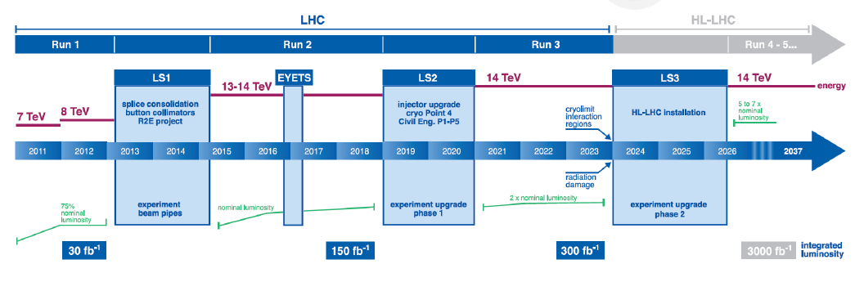
LHC Schedule
Phase-I upgrades to be installed by end of LS2, i.e. end of 2020
Parts already installed (LS1) or coming during Run 2 (FTK)
Larger parts to come in LS2 (NSW, LAr electronics, L1 Calo, L1 Muon, and FELIX)
14 TeV running after LS2 (in Run 3)
Phase-II upgrades for installation in LS3 in 2024-2026
TDR preparation in full swing
R&D activities in all Phase-II areas

Slide 29
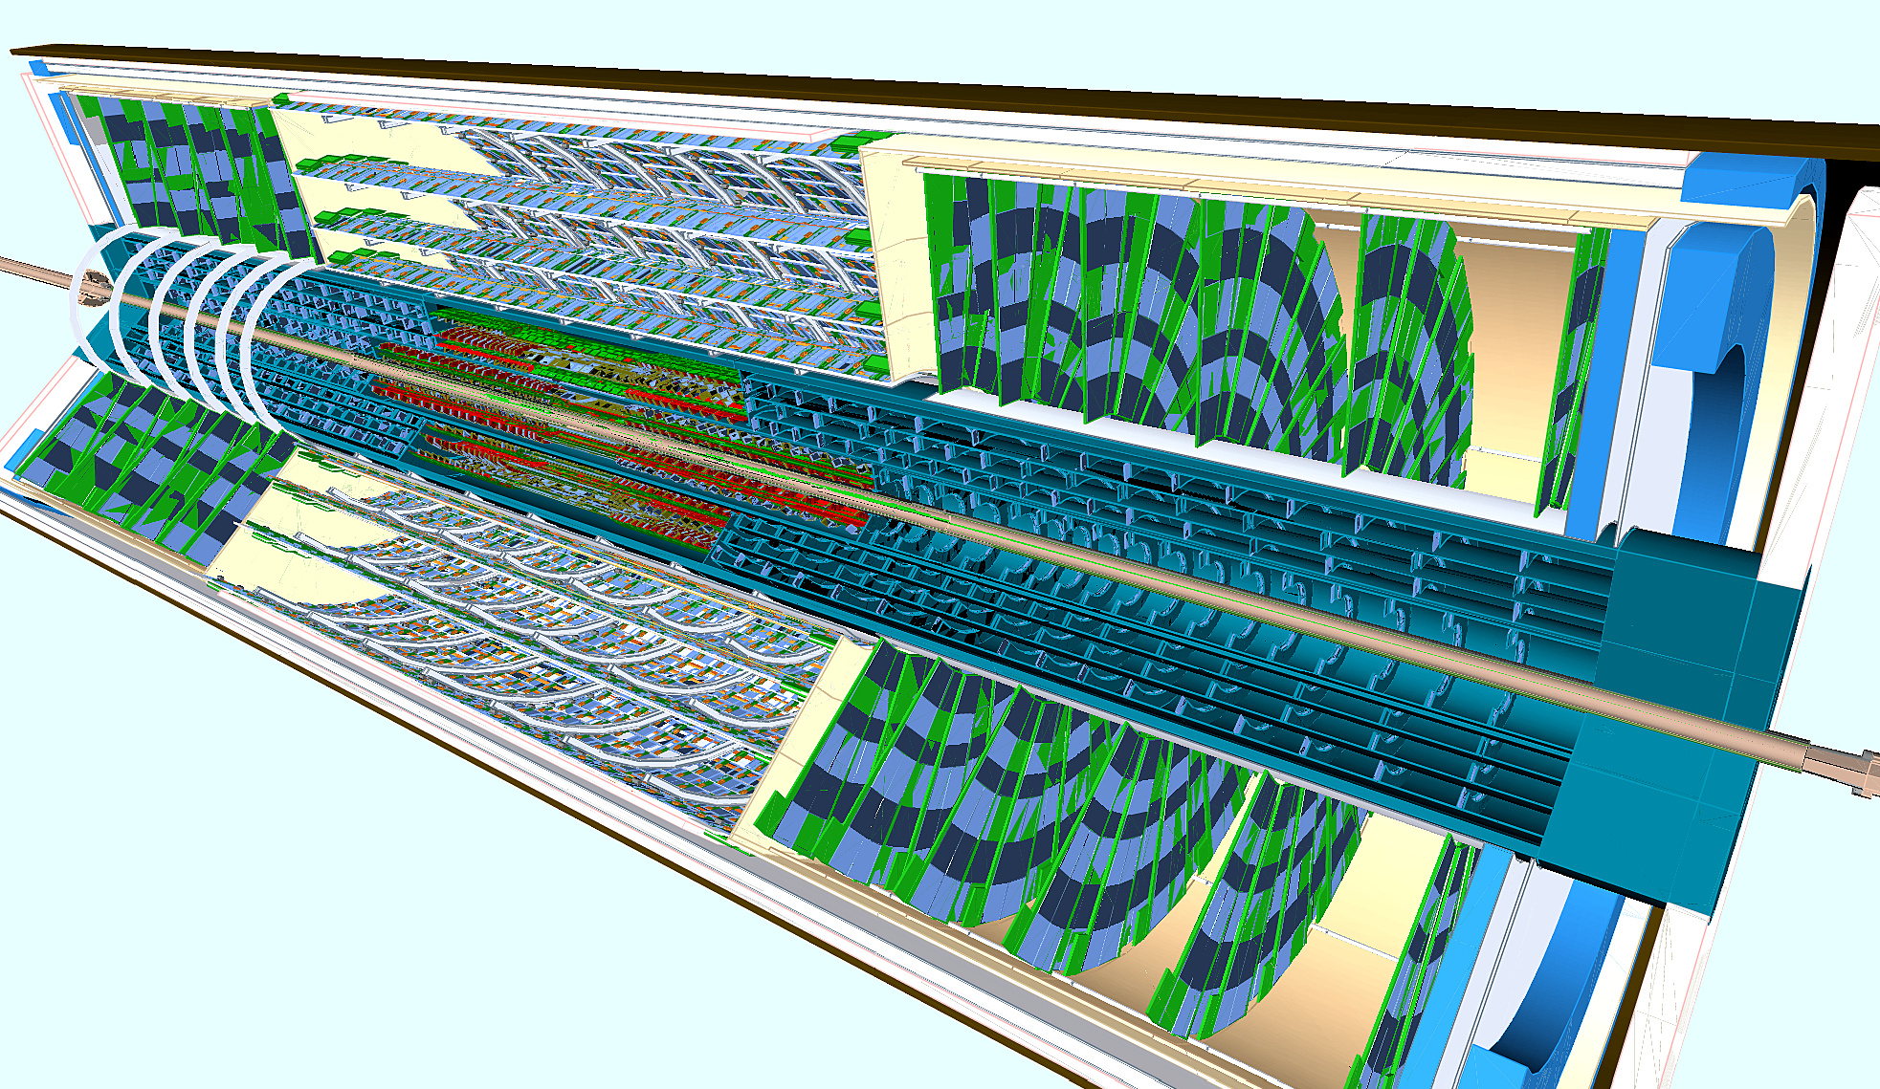
ITk: The new ATLAS Inner Tracker
Motivation:
Replacement of the central tracking detector in ATLAS;
Major component of the Phase-II upgrade, ~50% of the total cost
Essential to manage radiation damage and instantaneous luminosity at HL-LHC
Layout Task Force has converged on a silicon pixel (5 layers in the barrel) +
silicon strip (4 outer layers in the barrel) system;
Pixel system is confined to a cylinder around the beam pipe, R = 34.5 cm
Pixel Tracker
Strip Tracker (Barrel and Endcaps)

Slide 30
ITk: The new ATLAS Inner Tracker (cont.)
Status of the ITk Strip Detector TDR:
The first Phase-II TDR, covering the outer part of the tracker (based on Silicon Strips)
has been submitted to the LHCC
550 pages, printed copies available for RRB
LHCC has given preliminary approval at its meeting
in February 2017
“ITk strip tracker as proposed is a sound design and, with
the pixels system being considered, addresses the tracker
performance required for HL-LHC. No show stoppers were
identified.”
Next step: Approval by Upgrade Cost Group (UCG)
Separate UCG material for cost, schedule, risk and
resources was submitted in Jan 2017;
Updated version submitted on 9th April 2017

Slide 31
ITk: The new ATLAS Inner Tracker (cont.)
In-depth UCG review (chaired by Stewart Smith) planned for 8th/9th May 2017 (beginning of next LHCC week)
Very detailed review, on costs (uncertainties, quality factors), schedule,
sharing of work, resources (at institutes), and risk analysis
Present cost estimates: 60 MCHF in Strip Tracker, 40 MCHF in Pixel Tracker,
20 MCHF in Common ITk Items.
(total in agreement with estimates given in the Scoping Document for the inner
tracker system in the reference scenario)
ITk is a central and essential part of the Upgraded ATLAS detector
→ no large cost saving or down-scoping possible (especially not for strip detector)
Hope to get approval by UCG and LHCC, followed by approval of CERN
Research Board on 9th June 2017
Prepare iMoU for final ASIC and sensor prototypes in 2017/18 for ITk Strip detector
Second part of the ITk TDR (Pixel detector system) will be finalized in Dec 2017

Slide 32
Remaining Elements of ATLAS Phase-II upgrade
Every major system in ATLAS requires significant upgrades for HL-LHC
The Phase-I upgrades form the foundation for Phase-II upgrades
The TDRs will be finalized throughout this year
Muon Spectrometer
Electronics replacements, plus upgrade of chambers in the inner barrel layer
TDR submission: 30th June 2017
Calorimeters
- Electronics replacements for LAr and Tile calorimeters;
- ATLAS decided not to upgrade the forward calorimeter (sFCAL);
(-10 MCHF w.r.t reference scenario in Scoping Document)
- High Granularity Timing Detector (HGTD) in forward region seriously considered;
R&D progressing well;
Internal review to decide whether to proceed to TDR planned for Sept 2017;
If agreed, HGTD will be presented in preliminary form in the LAr TDR and followed up with a
separate TDR in 2018
TDR submission: 30th September 2017

Slide 33
Remaining Elements of ATLAS Phase-II upgrade
Trigger and DAQ
Major upgrade of Trigger and DAQ systems to provide more than a factor of ten
increase in trigger rate capability
TDR submission: 15th December 2017
(together with ITk Pixel detector TDR)

Slide 34
Update on Phase-II TDR Approval Process
We are planning for convergence of the scientific/technical reviews of all Phase-II
projects (complete program) in the first half of 2018
Target date: RRB in April 2018
→ ATLAS clearly prefers the “Fast Forward” review schedule
(however, we are not suggesting to reduce the level of scrutiny;
this probably calls for an optimization of the review process and more reviewers)
- We consider this critical to achieve readiness for LS3 installation
- First CORE money has to be spent during 2017/18 and this will
require (i)MoUs

Slide 35
Summary
ATLAS continues to produce high-quality physics results
- Precision phase entered on some measurements, e.g m_{W}
- Results for many searches for BSM physics are based on complete Run-2 dataset
- Aim for updates on Higgs boson studies and parameter measurements for Summer 2017
Detector Consolidation successfully mastered during Extended Year End
Technical Stop
→ ATLAS is ready for Data Taking in 2017
First Technical Design Report (ITk Strip detector) presented and first approval
steps taken;
They will be followed by the submission of the remaining Phase-II TDRs
throughout 2017
We have an intense year ahead of us!

Slide 36
The strong support of the ATLAS Funding Agencies over the last decades has been, and continues to be, fundamental to the success of the experiment
Thank you!

Slide 37
Backup Slides

Slide 38
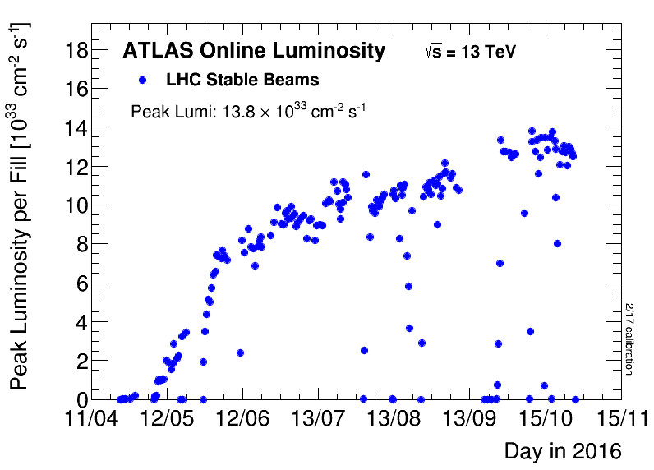
Recall of the excellent 2016 LHC performance
nominal
Excellent LHC performance in 2016 at √s = 13 TeV
Peak luminosities ~ 1.4 10³⁴ cm⁻² s⁻¹
High level of pileup: mean of ~25 interactions / beam crossing in 2016

Slide 39
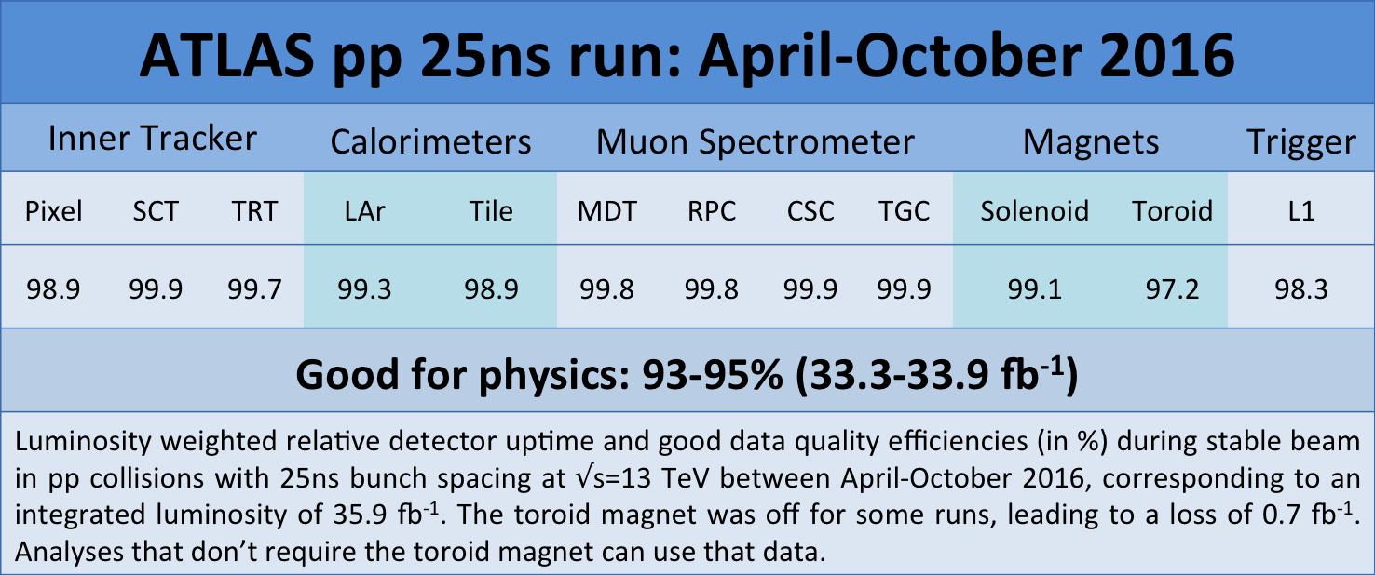
Recall of the excellent 2016 ATLAS performance
Data taking efficiency: 92.4 %
(even with peak luminosity well above LHC design)
High operational fractions for all detector systems
High data quality: Integrated luminosity good for physics: 33.3 – 33.9 fb⁻¹

Slide 40
First collisions may come in week 22, i.e. 29th May 2017

Slide 42

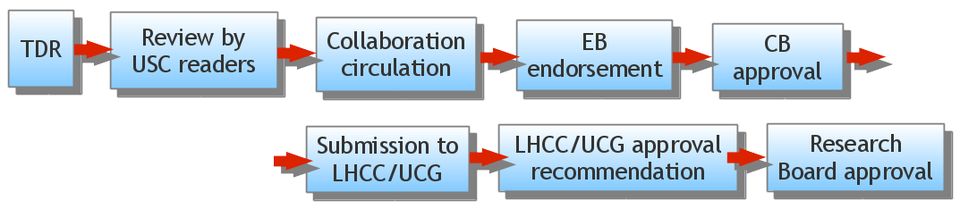
Remaining Elements of ATLAS Phase-II upgrade (cont.)
Present Status:
Internal process (IDR = Initial Design Reviews) and Kick-off meetings for all Phase-II
projects have been completed
→ ATLAS formal approval of scope and status of projects to proceed to complete
and submit their TDRs.
Remaining projects (Pixel part of ITk, LAr and Tile calorimeters, Muon spectrometer,
and TDAQ system) working on TDRs, with submissions targeting the LHCC weeks
in Sept. 2017, Nov. 2017 and Feb. 2018.

Slide 43
ITk: The new ATLAS Inner Tracker (cont.)
Details on UCG review (chaired by Stewart Smith, Princeton),
planned for 8./9. May 2017:
0845 (15 +5) Overall ITk Project Overview and Organization
0905 (15 +5) Strip Project Organization
0925 (10 +5) Common Mechanics: WBS and current best estimate of sub-project cost
0940 (10 +5) Common Electronics: WBS and current best estimate of sub-project cost
0955 (15 +10) Pixel Detector: WBS and current best estimate of sub-project cost
1020 (15 +10) Strip Sensors (2.2.1)
1045 (15) Break
1100 (10 +10) Strip ASICs (2.2.2)
1120 (15 +10) Strip Modules (2.2.3)
1145 (10 +10) Strip Local Support Electronics and Off-Detector Electronics (2.2.4 + 2.2.9)
1205 (10 +10) Strip Local Supports (2.2.5)
1225 (10 +10) Strip Global Mechanics, Services, and Integration (2.2.6-2.2.8)
(20) Discussion
Breakout sessions
Session 1: (1400 – 1700) Drilldown of costs, etc. for the strip modules and sensors
Session II a. (1400 – 1530) ASICS
Session II b. (1530 – 1700) Local Supports, Off-Detector Electronics
Session III a. (1400 – 1600) Local Support Mechanics, Global Mechanics, Services and Integration
Session III b. (1600 – 1700) Common Electronics, Common Mechanics and Pixels)

