Slide 1
Scope of the design review
Ray Veness

Slide 2
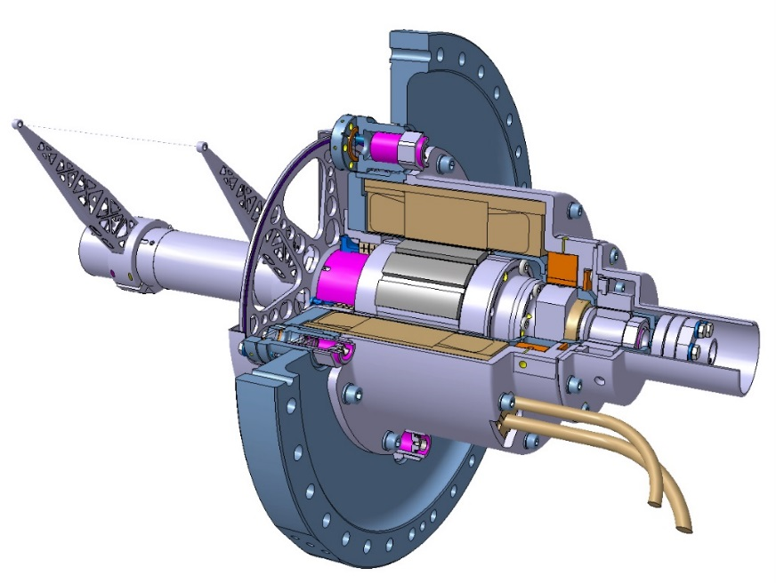
Brief Status
SPS Prototype
  Design review in 2013 led to installation in LS1
  First operational tests in 2015, additional operational tests, late 2016
  Demonstrated:
    Confirmation of extensive vacuum testing [See talk by J.Somoza]
    Confirmation of simulation and tests for beam impedance [See talk by C.Vollinger]
    No discernible impedance heating of the wire [See talk by C.Vollinger]
    Nominal (20 ms-1) operating cycles, trigger and signal acquisition, tests with beam [See talk by F.Roncarolo]
  2nd prototype hardware used for parallel development of control system, lifetime testing, impedance testing, vacuum qualification
PSB Prototype
  Instrument re-designed for integration into the Booster, along with ‘industrialisation’ of mechanics, acquisition and control electronics [See talk by D.Gudkov]
    This design will now be used for all 3 machines
    Calibration with prototype laser system [See talk by F.Roncarolo]
    Successfully installed during EYETS16-17
  2nd prototype used in parallel for development of control system, lifetime and impedance testing
SPS Prototype instrument
PSB Prototype instrument

Slide 3
Why have a review now?
New project management and structure in BI
Recently revised budget based on:
  Final mechanical design, with well-developed cost analysis
  Working prototype for control and acquisition systems
  Cabling figures extrapolated from the PSB prototype
Extensive testing and simulation has been made on both SPS and PSB prototypes for impedance and vacuum
We have some operational experience, but not in the PSB or PS
We need to launch the mechanics production now if we are to be ready for installation at the start of LS2

Slide 4
LIU Wire Scanner Upgrade Organigram
(as of 1/2/17)
LIU Wire Scanner Upgrade Project Leader
[R.Veness]
MME design and manufacture
[A.Dallocchio, N.Chritin, E.Rigutto]
Instrument Mechanics and project management
[R.Veness]
Control and Acquisition Electronics. Operational testing.
[F.Roncarolo, J.Emery]
P.Anderssen
W.Andreazza
A.Goldblatt
D.Gudkov (F)
J.L. Sirvent (F)
A.Mariet (F)
J.Tassan-Viol
C.Vulliez (TS)

Slide 5
Questions to be addressed in this review
Is the mechanical design satisfactory and ready to proceed for series production?
Do we have confidence that this instrument will fulfil the specification for LIU?
Do we have confidence that the instrument:
  will be qualified for vacuum acceptance,
  will not have a major impact on machine operation due to impedance
  should not suffer wire breakage due to impedance heating
The series budget and schedule are understood and that the costs are justified

