Slide 1
LIU WS procurement process

Slide 2
Schedule summary

Slide 3
Procurement overview
Procurement strategy for key mechanical components formally agreed between EN/MME and BE/BI to optimise the process
Most of the documentation(MS+IT documents, specification, manufacturing drawings,…)ready to start the procurement as soon as possible
Critical raw material ordered, some already in house, the rest ready waiting for shipment
Targeting 2nd quarter 2018 to have all the parts available to start the WS preparation

Slide 4
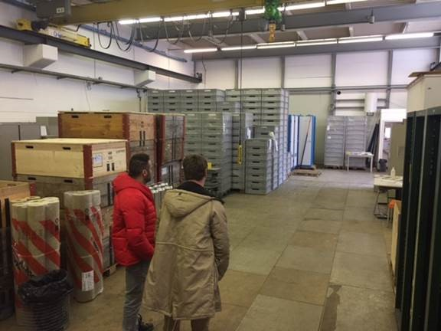
Assembly area:
100 mt² asked to LIU in 2015 but not allocated
Bldg.283(former ISR) but will need a lot of work
Other options are being considered

Slide 5
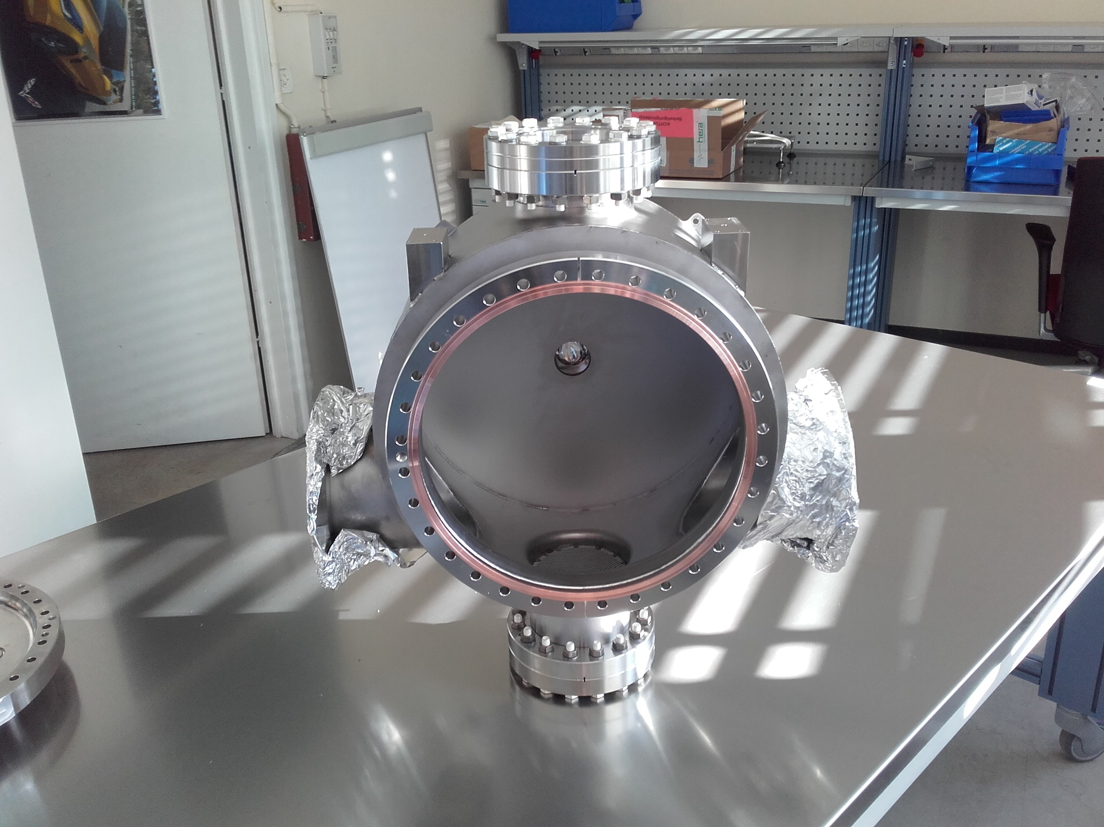
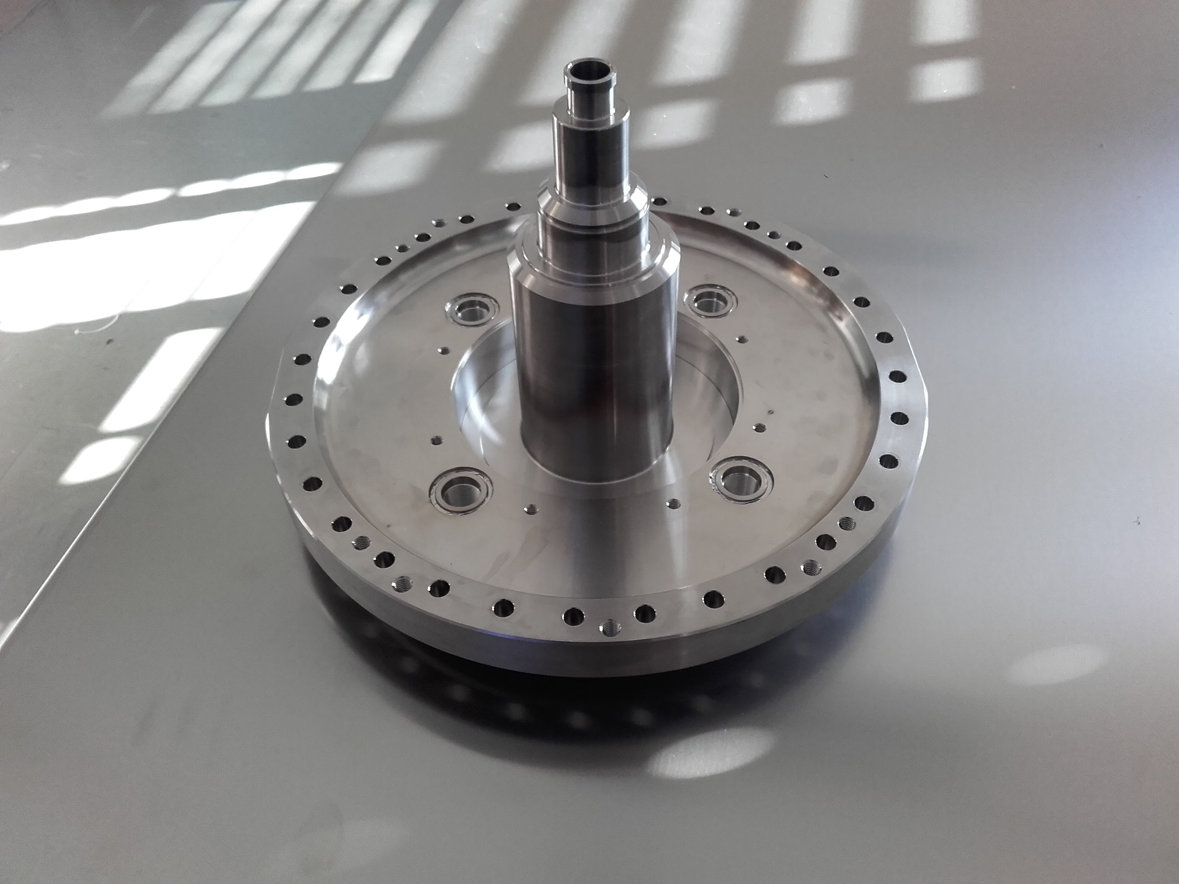
Tanks
Market survey + invitation to tender
BE/BI in collaboration with EN/MME
Expected contract notification beginning of the 3rd quarter 2018
Tanks delivery end of 1st quarter 2018
Stepped chamber
Price inquiry for machining and in house EB welding(EN/MME)
Delivery foreseen for 1st quarter 2018

Slide 6
Mechanical components
Price inquiries managed by EN/MME
~2500 parts in total
Delivery foreseen for 1st quarter 2018
Supports
Design on going, will be completed soon
Price inquiries managed by EN/MME
Delivery foreseen for 3rd quarter 2018

Slide 7
Motors
Single tender option with CERN qualified supplier(ALXIOM)
Price request submitted
Delivery expected 4th quarter 2017

Slide 8
Documentation overview
 | WS design | Support design | WS Manufactur. drawings | Support Manufact. drawings | Integration | ECR
PS | 100% completed | 100% completed | 70% completed | on going | On going, 90% completed | ECR in preparation
PSB | 100% completed | 100% completed | 60% completed | on going | On going, 60% completed | Space reservation done, ECR in preparation
SPS | 100% completed | 100% completed | 70% completed | on going | On going, 80% completed | Space reservation submitted, ECR in preparation

