Slide 2
LIU BWS expected performances
LIU BWS Mechanics Production Readiness Review – 29-03-2017
F.Roncarolo
Lots of input, figures and plots from
J.Emery, J.Sirvent Blasco, L.Garcia
Input from G.Trad, E.Piselli, the BI management,
including Bernd’s documentation and inspiring discussions in the last two years

Slide 3
Contents
Motivations
Expected performances
Results of tests to-date
Planned tests with the SPS, PSB and PS prototypes

Slide 4
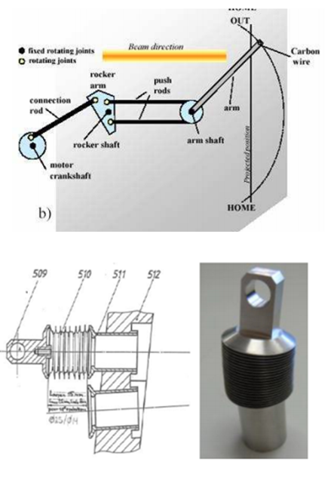
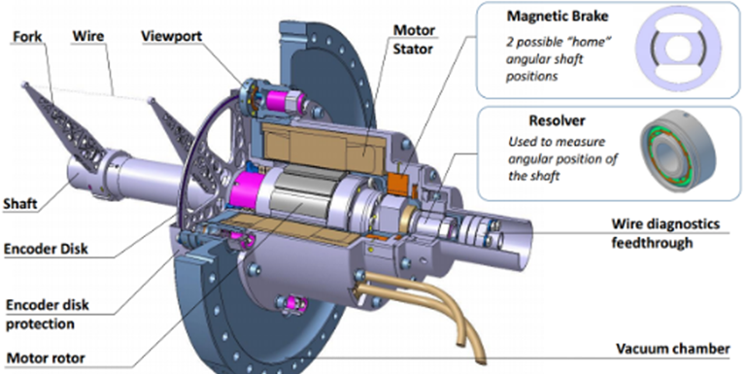
From present ‘OP’ to ‘LIU’ BWS (I)
Present PSB mechanism
Multiple rotating joints
Bellows
New LIU design
All movable pieces on same shaft
No bellows

Slide 5
From present ‘OP’ to ‘LIU’ BWS (II)
Supervision & Acquisition
Control & Feedback
Present electronics
WS supervision, acquisition system, motor control electronics:
All managed by the same CPU in a VME crate
New LIU design
Intelligent Drive for control and feedbacks separated from supervision and acquisition VME crate

Slide 6
Limitations of Present Fast BWS
Wire position determination
Mechanical plays, vibrations
Outside vacuum (noisy) potentiometers
Reproducibility, resolution and accuracy
Motor control electronics
Feedbacks difficult to tune/optimize with present electronics and FW
Reliability
Power electronics
Power Supplies featuring relatively high failure rate
Linear Power Amplifier, high power, heating
Secondary shower detectors and electronics
Working point (WP) via PM gain + OD filters
Single WP Low dynamic range (10e2 – 10e3)
Electronics + cables bandwidth
Low frequency noise, EMI
To be found for each beam type
Difficult tails measurements
Bunch-by-bunch (25ns) bunch pile-up, profile cross-talk
Availability
Resolution and Accuracy

Slide 7
New Fast BWS
Wire position determination
Lower mechanical plays
In vacuum optical disk incremental encoding
Resolver for control loops (better than present potentiometers)
‘Simple’ angle → transverse plane projection
Motor Control
New electronics generation
High performance control loops
Power Electronics
New generation HW, compact
Switched mode drive, less power, less heating
Secondary shower detectors and electronics
Aim at high dynamic range and fewer WP for different beams
Multiple PM stations, Hybryd PM, (Diamonds for SPS / LHC?)
New electronics generation (VFC, GEFE, GBT link, optical fiber communication)
Higher bandwidth

Slide 8
Wire Position determination
Present OP scanners (PS – PSB)
  Rotor measurement via potentiometer
  Projected wire position from laser test bench → calibration tables
  Uncertainty of the order of 100um comparing different calibration sets
  Differences of the order of few mm (offset on measured beam position) between different devices of the same family

Slide 9
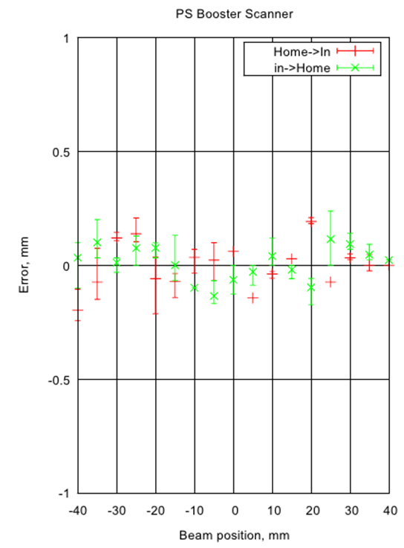
Wire Position determination
Old scanners (PS – PSB)
  Uncertainty of the order of 50-100um comparing different calibration sets

Slide 10
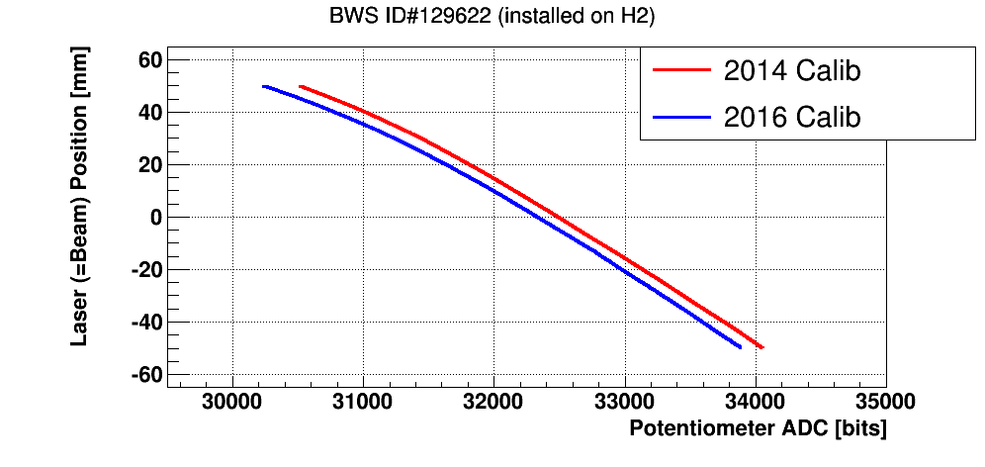
Wire Position determination
Present OP scanners (PS – PSB)
  Differences of the order of few mm between different devices of the same family

Slide 11
Wire Position determination
Present OP scanners (SPS)
Rotational scanners
  Motor position via potentiometer
  Projected wire position via geometrical transformation
Linear Scanners
  Fork position via potentiometer
Both systems affected by potentiometer noise

Slide 12

Wire Position Determination
New LIU BWS
In-Vacuum optical disk

Slide 13
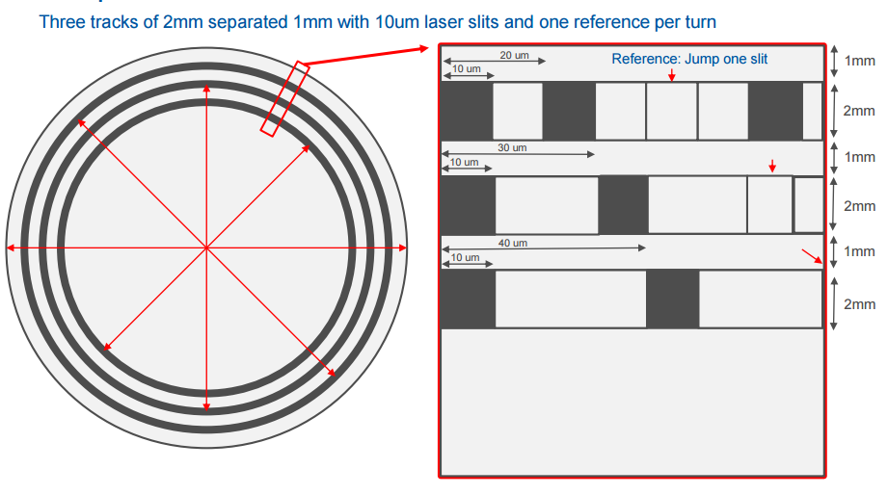
Optical disk concept
Tracks with alternating reflective and anti-reflective ‘slits’
This is only one of the disk we tested

Slide 14
Accuracy on beam size measurement
Sources of uncertainty
Observable
Optical disk angular position
Fork angular position
Fork projected position
Wire projected position
Beam size after a full scan
Mechanical design/geometry →
Optical disk fabrication →
Optical disk encoding →
Mechanical plays →
Dynamic deformations
Fork vibrations →
Alignment →
Test bench calibration →
Wire vibrations →
Secondary shower detector →
Acquisition system →
Optimal working point →
Fitting routines →

Slide 15
Optical Disk and Wire Position Determination
Optical disk angular position measurement accuracy and resolution depend on:
Traces pitch
traces manufacturing tolerances
Data encoding errors (optics, reflections, interference, algorithms)
Wire position (projected on transverse plane) measurement accuracy and resolution depend on:
Geometry (fork length, analytical projection)
Disk eccentricity
Vibrations (mechanics + control system)
…
…
Mechanical assembly
Mech Play → statistical error
Aligment → systematic error
DESIGN
IMPLEMENTATION

Slide 16
Optical Disk Position Determination
Optical disk with pattern of reflective slits, including ref. traces
Laser diode firing on disk continuously via optical fiber
Pseudo-sinusoidal signal read back by photodiode
  20 MHz sampling → a sample every 0.8um on projected plane, distances between slits = 26 um
Signal encoding provides disk angular position
PSB prototype already equipped with 2 laser diode systems (redundancy + on-line compensation of eccentricity

Slide 17
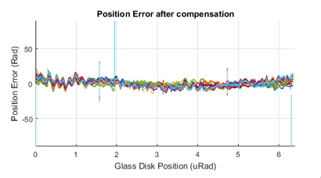
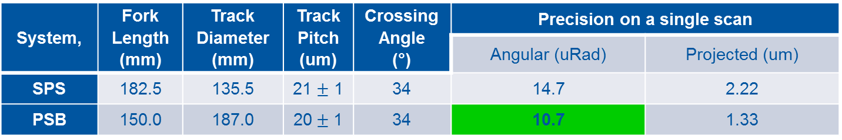
Optical Disk Position Determination
Expected precision, accounting for design parameters and optical disk manufacturing tolerances
System, | Fork Length (mm) | Track Diameter (mm) | Track Pitch (um) | Crossing Angle (°) | Precision on a single scan
 |  |  |  |  | Angular (uRad) | Projected (um)
SPS | 182.5 | 135.5 | 21 $±$ 1 | 34 | 14.7 | 2.22
PSB | 150.0 | 187.0 | 20$±$ 1 | 34 | 10.7 | 1.33
PSB Prototype laboratory tests
Position error w.r.t. reference trace
(15 scans, eccentricity corrected)
Both single scan jitters and scan per scan reproducibility of the order of 10 uRad peak to peak
→ < 1.5 um on projected position
~10 uRad

Slide 18
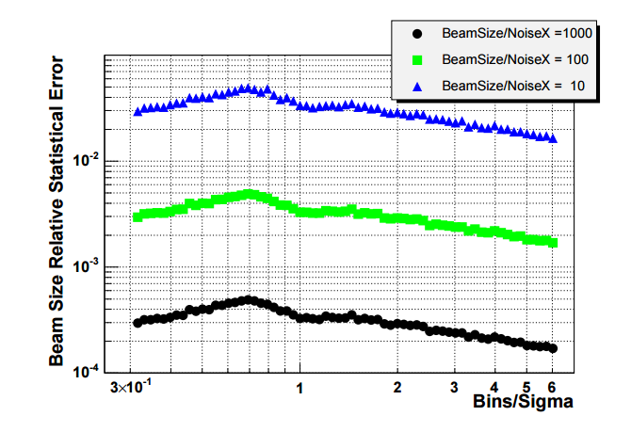
Expected accuracy on beam size measurement
NoiseX = Uncertainty on wire position
Considered examples of 100 um and 20 um
Possible Scenarios
PSB 20m/s, sigma 1mm → error on beam size < 2%
SPS 10 m/s, sigma 0.5mm, error < 5%
Other cases in table below
SPS
PSB
(Not considering errors on amplitude signal)
 | Beam Size [mm] | Wire Speed [m/s] | Points per sigma | NoiseX [um] | Sigma/NoiseX
PSB | 1.0 | 20.0 | 50.0 | 100 | 10
PSB | 1.0 | 20.0 | 50.0 | 20 | 50
SPS | 1.0 | 10.0 | 4.3 | 100 | 10
SPS | 1.0 | 10.0 | 4.3 | 20 | 50
SPS | 0.5 | 10.0 | 2.2 | 100 | 5
SPS | 0.5 | 10.0 | 2.2 | 20 | 25

Slide 19
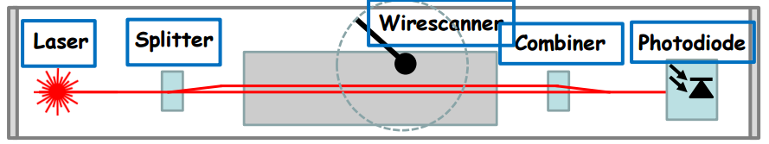
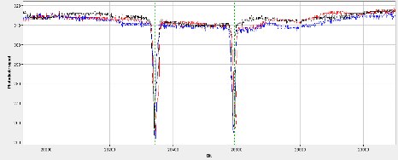
Laser based calibration benches
Laser and diode on translation stages and scanned in steps on the WS meas. transverse plane
For each laser position:
Wire scan
Photodiode signal correlated to wire position (potentiometer or optical disk)
Photodiode signal with two deeps == wire crossing
Middle point between deeps used as laser (beam) vs wire position calibration point

Slide 20
Old vs new control and calibration
Present systems based on look up tables built after laser based calibration in the lab
  For motor control
    Voltage vs Potentiometer: check position during scan to adjust voltage
  For projected wire position during a scan
New systems based on the same method but:
  For motor control
    Voltage vs Resolver: check position, speed and acceleration
  For beam size measurement accuracy → expected to be just a redundant system on top of optical disk encoding if disk mechanical alignment is precise
  For beam centroid position → laser based calibration still needed to infer offset w.r.t. beam axis

Slide 21
TESTS WITH BEAM (SPS)

Slide 22
SPS Prototype Measurements
Prototype installed in 2015 (MDs to test diamond detectors)
MDs and parasitic measurements in 2016
  Secondary shower detection via Diamond and Scintilator+PMT
  Validate system functionality, reproducibility, noise levels
  Compare to operational scanners (rotational and linear)
  Results examples in next slides

Slide 23
SPS Prototype Measurements
2016_09_07, 16:00-17:14 (Parasitic measurements):
MD: MD1641 Wideband Feedback on Bunch train - Beam: 3-4 Batches high intensity 25ns bunch train @ 26GeV
Objective: Study mechanics of the BWS, test and set-up acquisition system and optical position sensors
2016_11_25, 14:00-20:00 (Dedicated BWS MD):
MD: MD1960 LIU FWS prototytpe tests, Beam: Single bunch, nominal intensity 1.1e11p @ 26GeV
Objective: Measurements at injection energy synchronicing BWS control & acquisition electronics. Cross-check profiles with BWS517 (recorded on the same scope trace as prototype profiles).
2016_12_02, 14:00-20:00 (Dedicated BWS MD):
MD: MD1960 LIU FWS Prototype test
Beam: Single bunch 0.9e11p @26GeV
Objective: Same as 2016_11_25
2016_12_07, 10:00-18:00 (Parasitic measurements COAST)
MD: MD592 Emittance Growth during a COAST at 270GeV
Beam: Single bunch 0.2e11p @ 270GeV
Objective: Asses the accuracy of the BWS with a stable beam and compare with linear and rotational BWS on SPS. Record a relevant number of measurements for statistics study.
2016_12_09, 12:00-13:30 (Parasitic measurements AWAKE Beam)
MD: Officially MD1648 Test of new electro optical pick-up
Beam: Single bunch 1.1e11p @ 400GeV.
Setup, functionality tests, synchronization
Profile meas., compare to OP scanners, start assessing performances

Slide 24
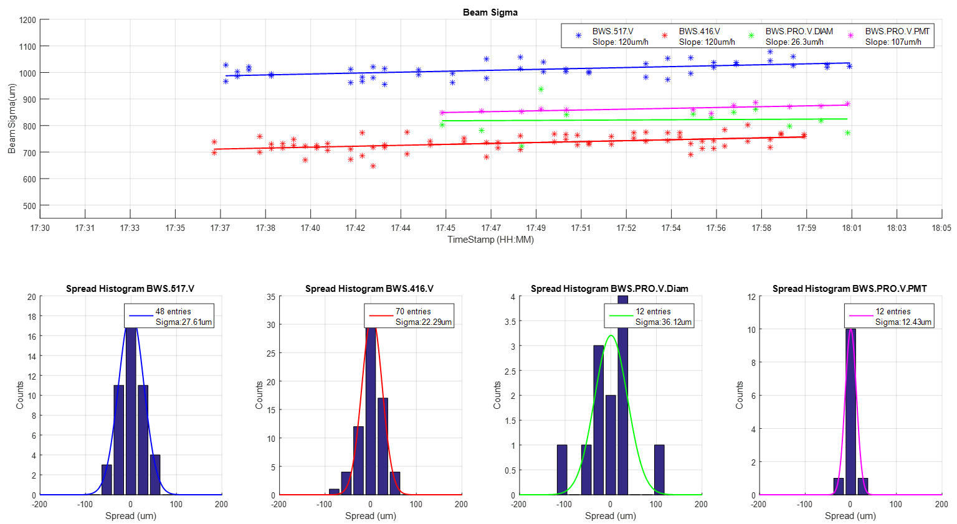
SPS Prototype Measurements
Coasting beam, 270 GeV – Beam Sizes
~1.5 %
~4.5 %

Slide 25
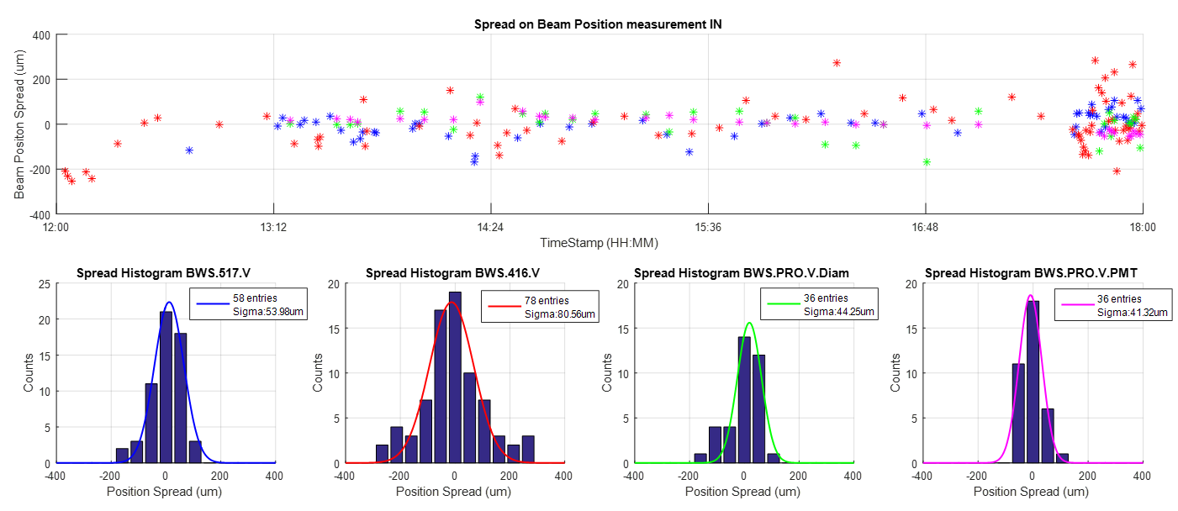
SPS Prototype Measurements
Coasting beam, 270 GeV – Beam Centroid

Slide 26
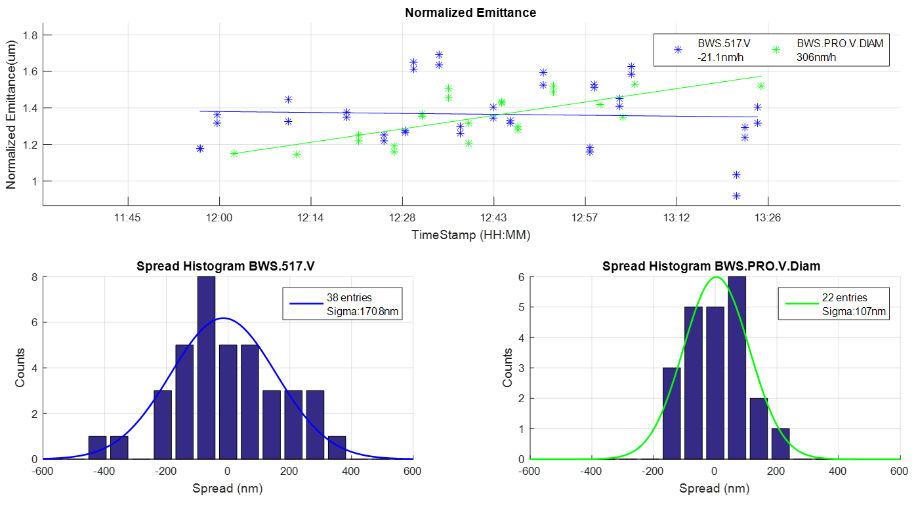
SPS Prototype Measurements
Coasting beam, 400 GeV, Beam emittance

Slide 27
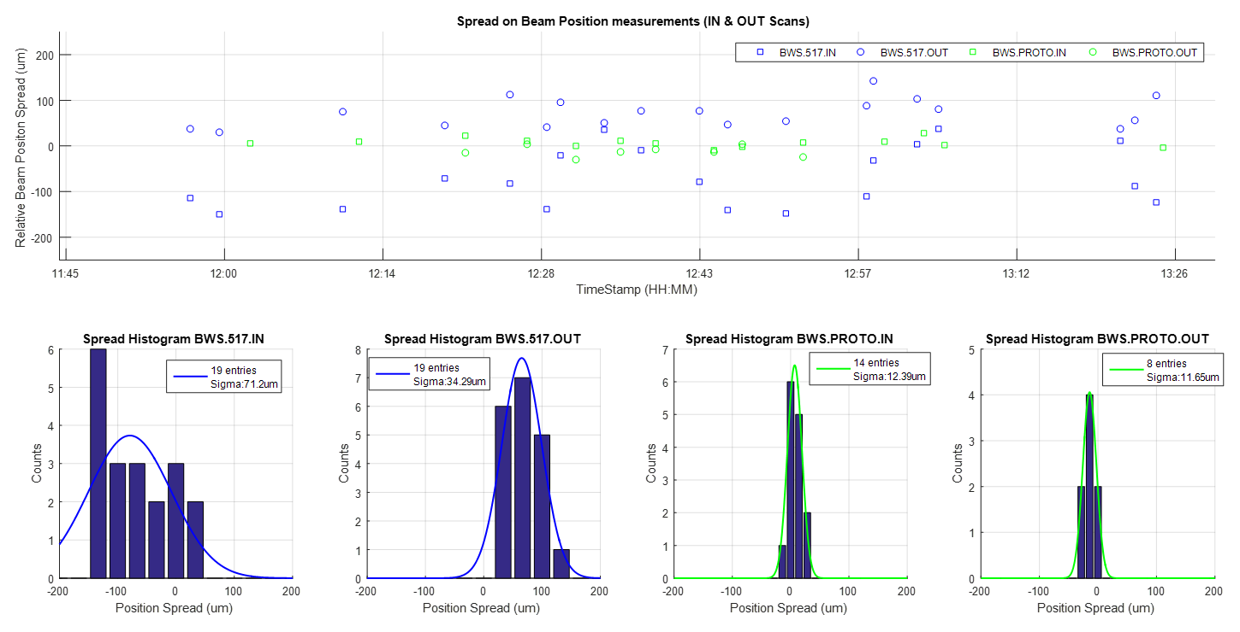
SPS Prototype Measurements
Coasting beam, 400 GeV, Beam Centroid

Slide 28
Performance tests 2017 → LS2
SPS prototype
  PM + scintillator now refurbished with optical filters
  Compare to operational scanners
PSB prototype
  Compare to OP scanners for various beam types
  Test a multi-PM configuration to increase dynamic range
PS prototype (2018)
  Test final control system → launch series production
  Compare to OP scanners
  Upgraded secondary shower detectors
Laboratory
  Fatigue
  Reproducibility
  Optical disk types (metallic, glass)
  Optical disk encoding optimization (optics + algorithms)
  Fork and wire vibration studies

Slide 29
Summary
LIU BWS designed to improve (w.r.t. present systems)
  reliability and availability (mechanics and electronics)
  resolution, precision (reproducibility), accuracy
Design studies + laboratory tests + SPS MDs very promising, e.g.:
  Conceptual design + mechanical tolerances → less mechanical plays
  Optical disk position measurement at the um level precision
  Beam size measurements with 1.5% reproducibility
  More stable control loops

Slide 30
Spares

Slide 31
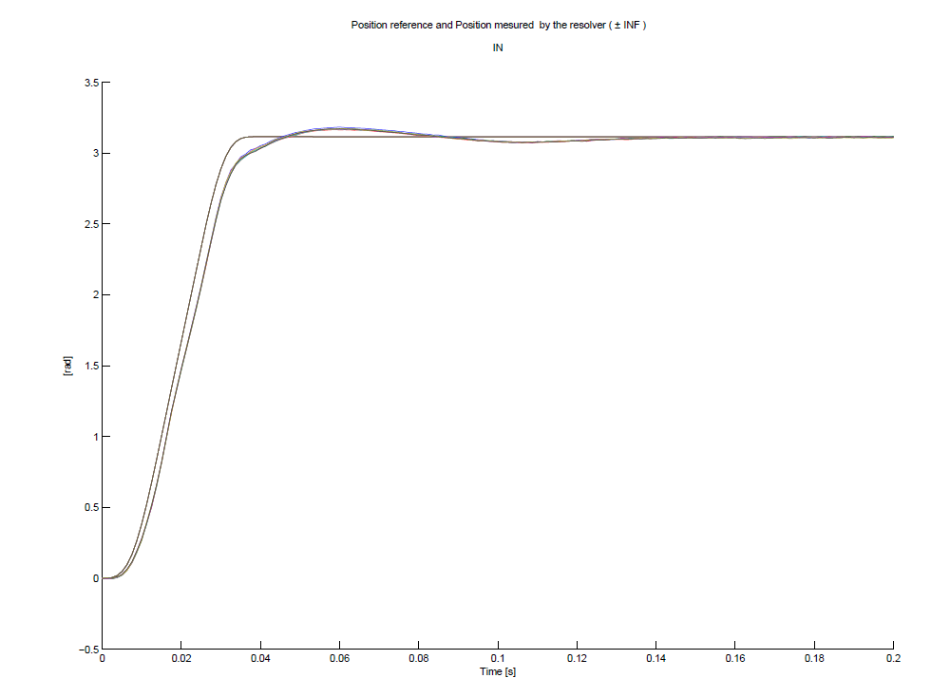

Slide 32
CERN Beam Wire Scanner Upgrade
Glass Disk for PSB BWS (3mm Tracks)
J.L. Sirvent 30/09/2016
(PSBBWSRA0056)
Tracks Detail and References
Soda Lime Glass
20 um
High Reflectivity Cr.
1 mm
50 um
10 um
3 mm
30 mm
0.5 mm
20 mm
20 mm
3 mm
15 mm
α = 34.52°
α = 34.52°
15 mm
20 um
100 um
20 mm
20 mm
0.5 mm
Track References
40 um
α = 34.52°
α = 34.52°
1mm
30 mm
30mm
PSB Resolution 20 +-1 um pitch:
187mm*pi/20um = 29374 slits
2*pi / 29374 = 214 +- 10.7 uRad
214 uRad * 150mm (fork) = 32 +- 1.6 um
PSB Resolution 40 +-1 um pitch:
180mm*pi/40um = 14137 slits
2*pi / 14137 = 444 +- 11 uRad
444 uRad * 150mm (fork) = 66.7 +- 1.7um
α = 34.52°
α = 34.52°
30 mm
20 mm
20 mm
15 mm
α = 34.52°
α = 34.52°
15 mm
20 mm
20 mm
* Drawing not in scale
30 mm
Requirements:
2 High Reflectivity Cr. tacks: 20um & 40um pitch (50% Cr., 50% transparent)
4 References in each track: Centred respect each other, separated 90 degrees.
Mechanical Alignment References:
  4 : 1mm x 30mm aligned with track references.
  4 : 1mm x 15mm 45 degrees from track references.
  8 : 1mm x 20mm placed + 34.52° and -34.52° from track references
Glass Disk :
Material → Soda Lime Glass
External Glass Diameter → 192mm
Internal Hole Diameter → 70.2mm
Glass Thickness → 1.5mm

