Slide 1
Status and Summary of the Impedance Results for the LIU Wire Scanners
Christine Vollinger with help and support from:
T. Kaltenbacher, P. Kramer, A. Lasheen, M. Migliorati, J. Repond, B. Salvant and input from:
D. Amorim, T. Rijoff

Slide 2
LIU WS: Machine Element Impedances
  Status of qualification for installation in the PSB, PS, SPS.
  Status of simulations of mode-induced wire heating.
  Work plan up to LS2.

Slide 3
1- Beam Impedance Evaluation

Slide 4
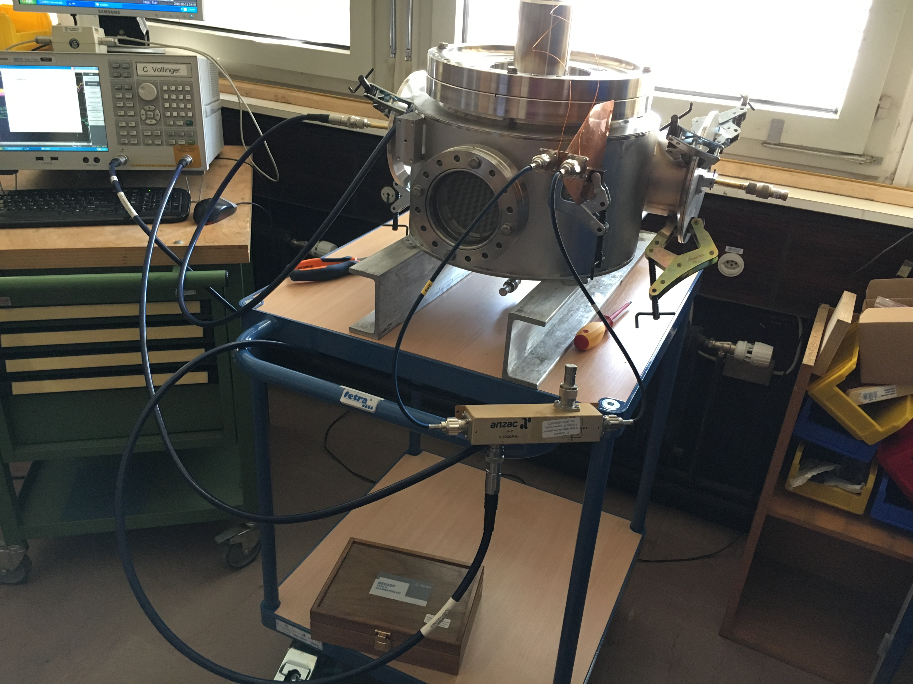
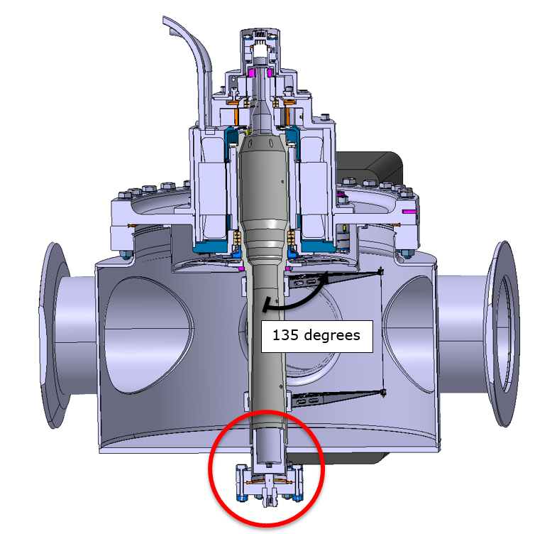
Evaluation of PSB Wire Scanner
RF- measurements were carried out on the PSB WS.
Probe-to-Probe measurements
Feed-through
Probe-to-Feedthrough measurements
(to see additional modes).
Probe-to-Wire measurements
via Hybrid to distinguish magnetic and
electric mode coupling to the wire.

Slide 5
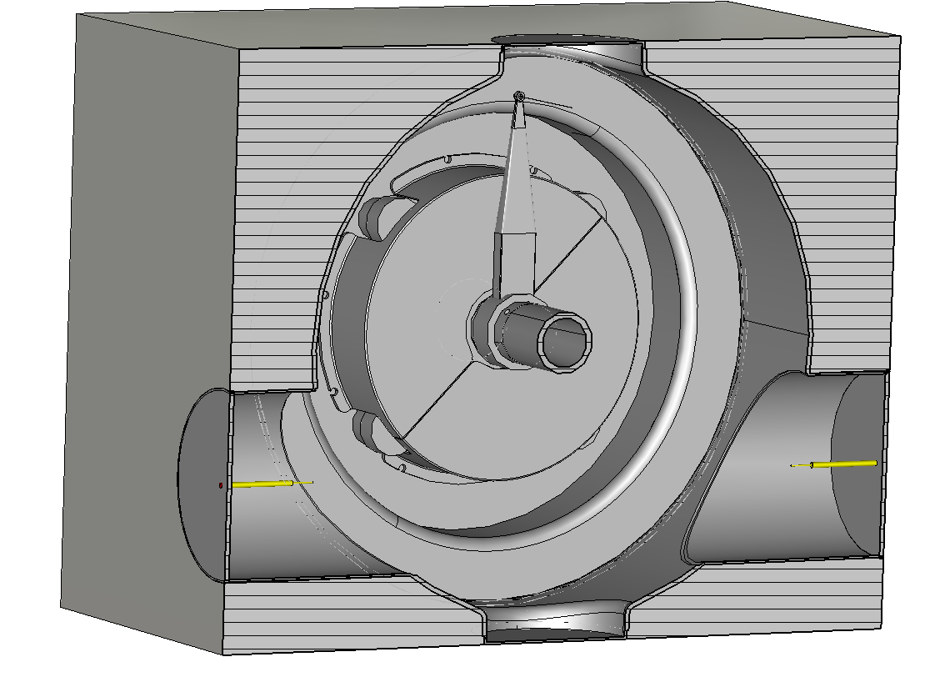
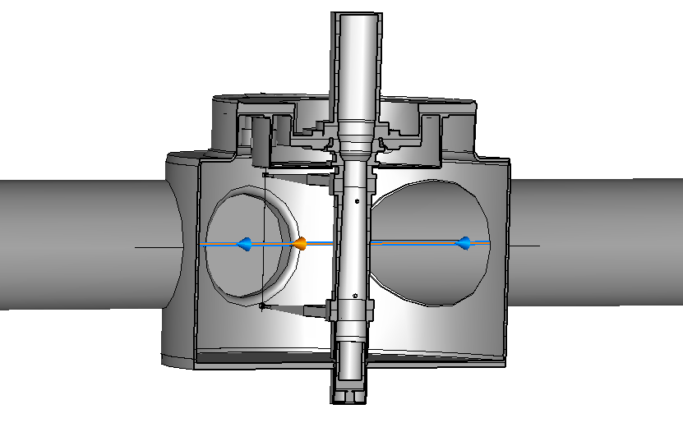
Evaluation of all Wire Scanners
EM-model for the PSB WS
EM-simulations were carried out on the PSB WS, PS WS, SPS WS.
“Cover” of the rotating mechanism helped reducing EM-disturbances;
Model is asymmetric w.r.t. beam axis

Slide 6
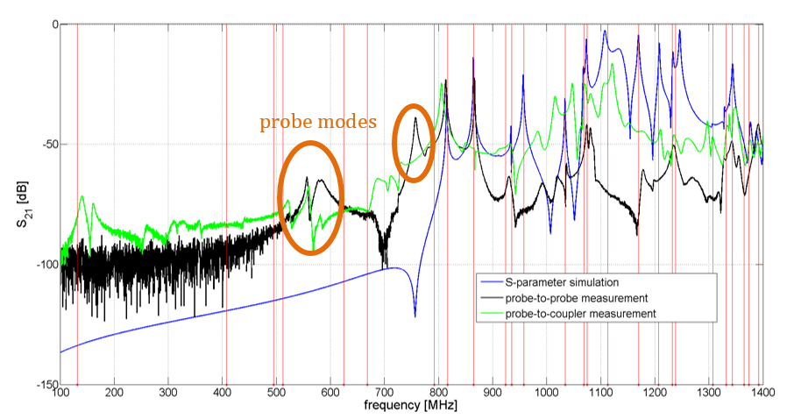
PSBooster WS: S-parameter vs. Eigenmode
Rather strong resonances
at 812 MHz and 867 MHz.
Courtesy: T. Kaltenbacher

Slide 7
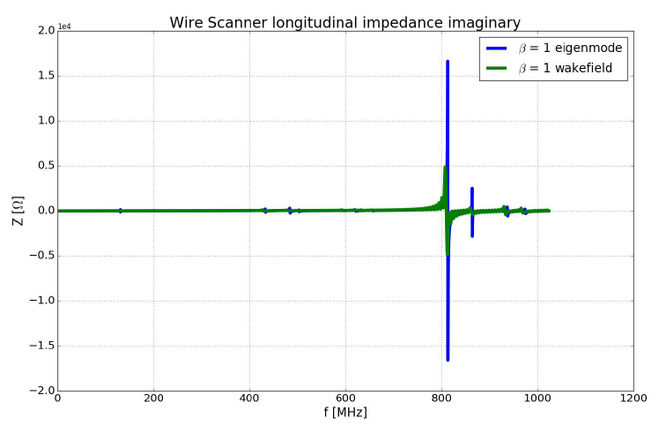
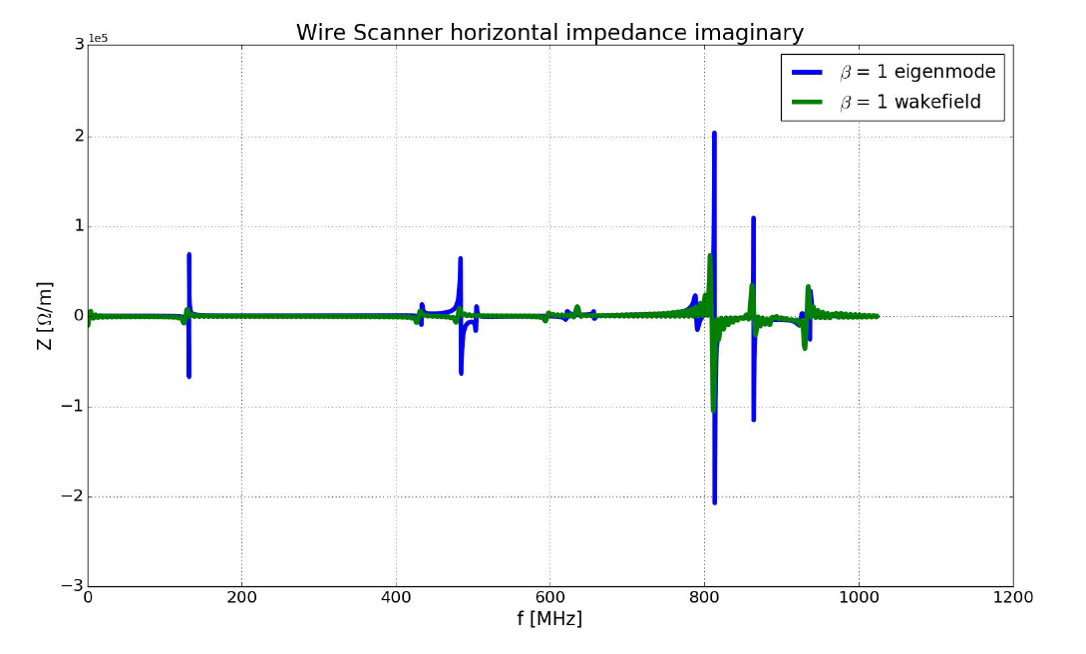
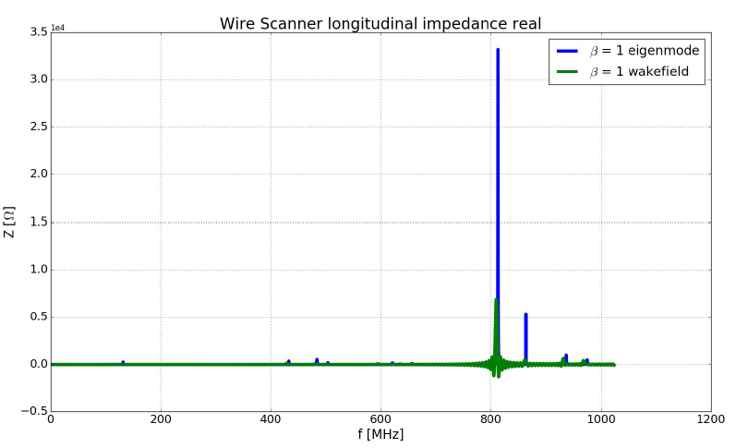
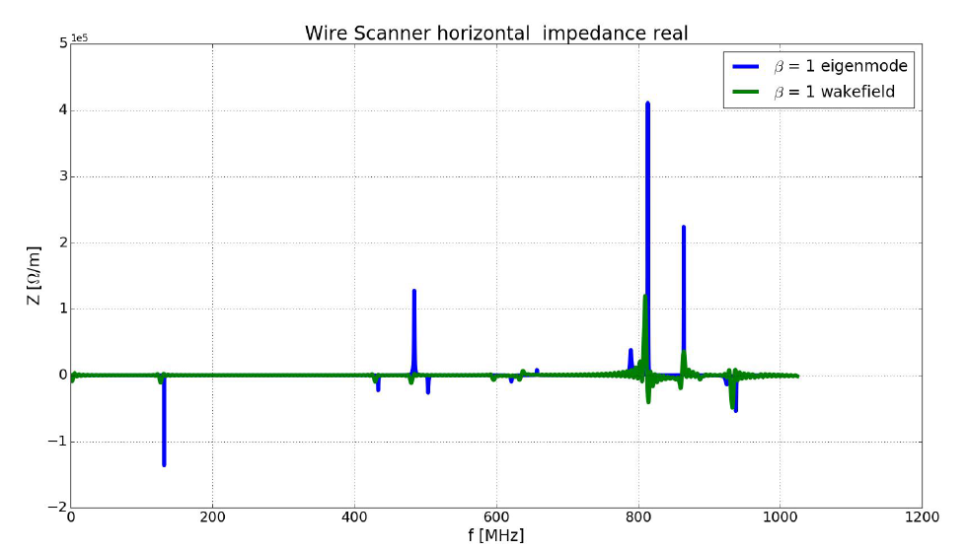
Beam Impedance Results PSBooster WS
Courtesy: T. Rijoff

Slide 8
Transverse Beam Impedance Results PSB, PS & SPS WS
PSB:
  Effective impedance is ~ 1kOhm/m per wirescanner in both transverse planes.
  → negligible
  Modes sit 1 to 2 orders of magnitude higher in frequency compared to the beam spectrum (well beyond 100 MHz compared to ~10 MHz).
  → would not be considered in the current way of analysing instabilities.
  Furthermore, computed modes are in the kOhm/m to 100 kOhm/m range, which is reasonable for such a device, and not expected to change stability thresholds.
PS:
  Effective impedance is ~ 1kOhm/m per wirescanner in both transverse planes.
  → negligible impact on global impedance.
  DELPHI beam dynamics simulations expect no impact from modes on transverse stability.
SPS:
  Effective impedance is ~ 1kOhm/m per Wirescanner in both transverse planes.
  → negligible impact on global impedance
  DELPHI beam dynamics simulations expect no impact from modes on transverse stability
→ No visible showstopper expected from transverse plane

Slide 9
Longitudinal Beam Impedance Results PSB, PS & SPS WS
  PSB:
  Modes sit 1 to 2 orders of magnitude higher in frequency compared to the beam spectrum (well beyond 100 MHz compared to ~10 MHz).
  → to give a more detailed evaluation of MW-instabilities, model is in development.
PS:
  Impedance impact was estimated from analytical formulae.
  → Preliminary results show only small contributions that are considered not critical.
SPS:
  Beam dynamics simulations are carried out showing no significant impact on intensity threshold. → negligible impact on global impedance.
→ No visible showstopper expected from longitudinal plane
These conclusions are a team effort; beam dynamics evaluations from:
PSB transverse impedance →T. Rijoff, B. Salvant.
PS and SPS transverse impedance → D. Amorim, B. Salvant.
PSB longitudinal impedance → D. Quartullo.
PS longitudinal impedance → A. Lasheen, M. Migliorati.
SPS longitudinal impedance → J. Repond, A. Lasheen.
Note that for PSB and PS, longitudinal impedance models are in development stage and hence these results are preliminary!

Slide 10
2- Evaluation for Wire Heating

Slide 11
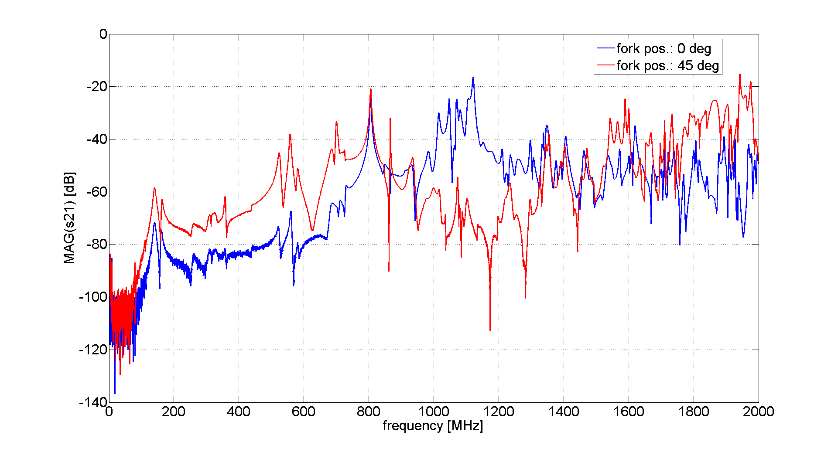
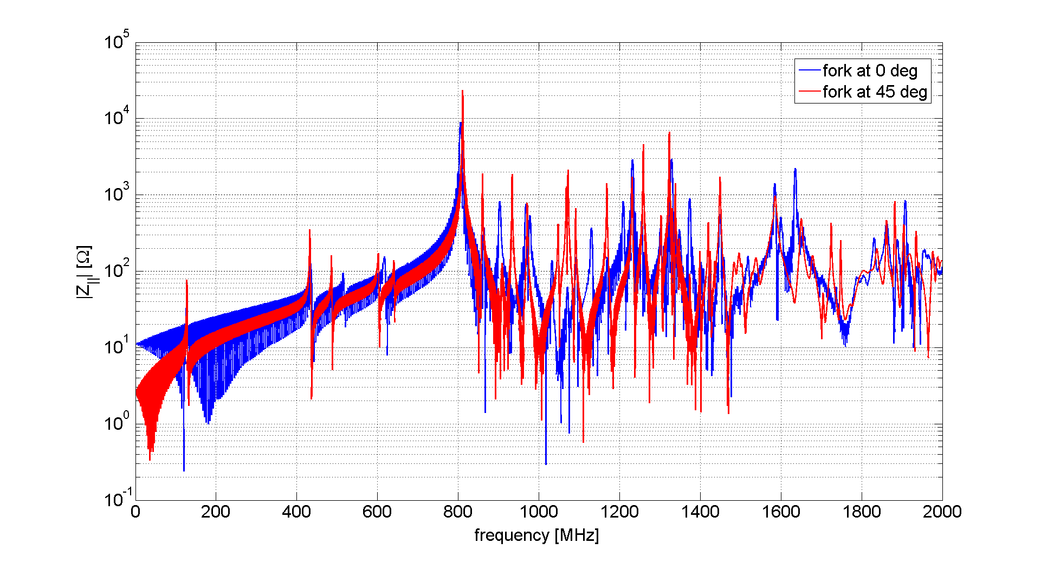
PSBooster WS: RF-meas vs. Simulation for 2 Fork Positions
Measurement
Dependence on fork position,
But 812 MHz resonance stays.
Simulation

Slide 12
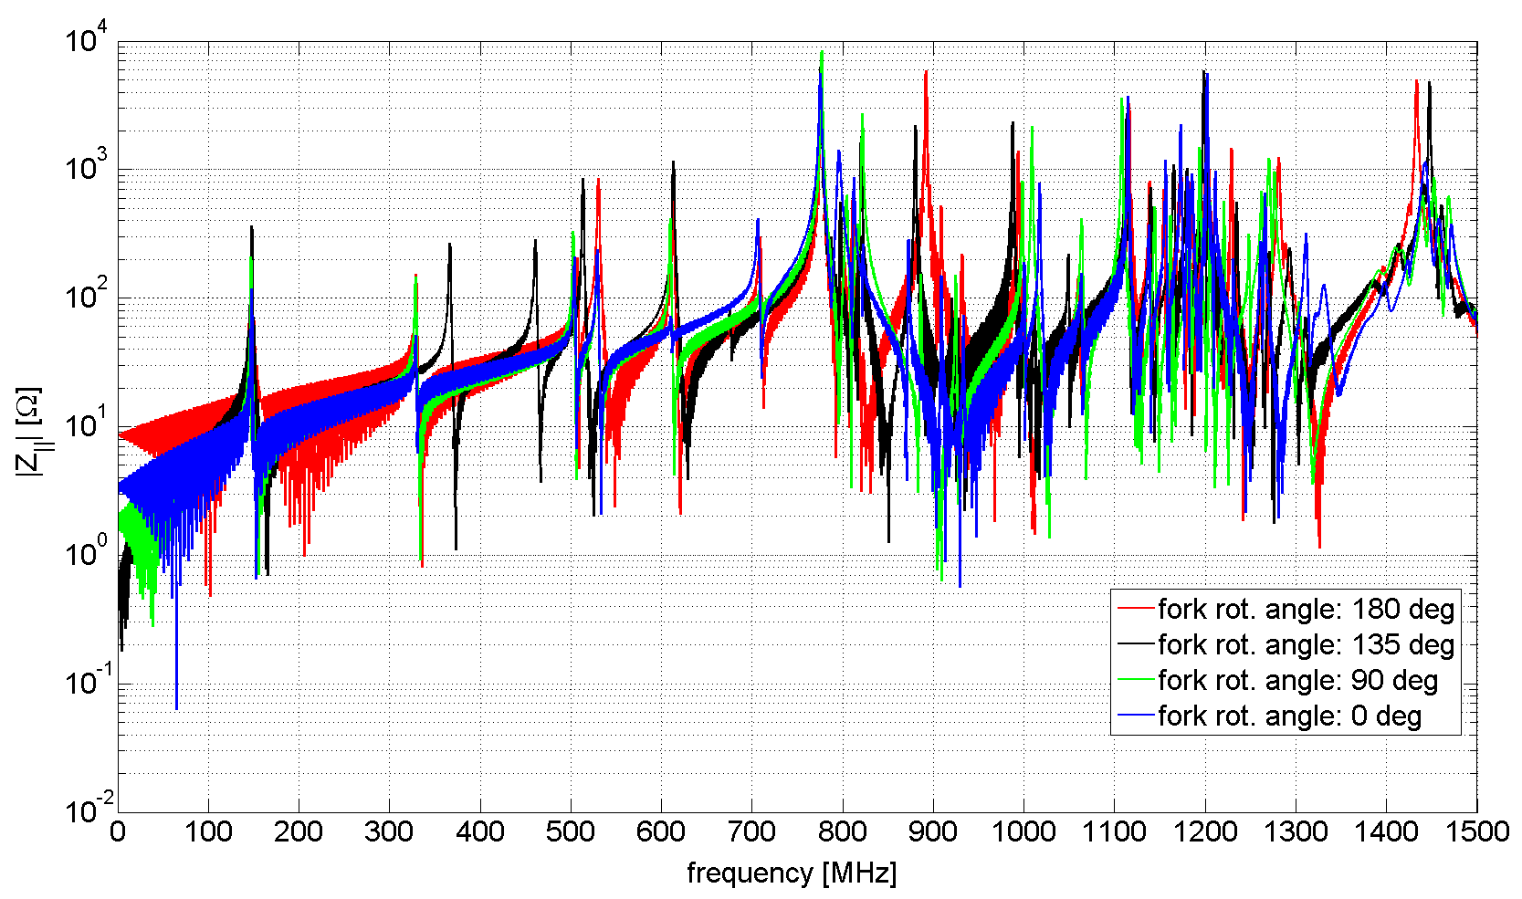
PS, SPS WS: Simulation for Different Fork Positions
882 MHz
Simulation
523 MHz
known eigenmode
Courtesy: T. Kaltenbacher

Slide 13
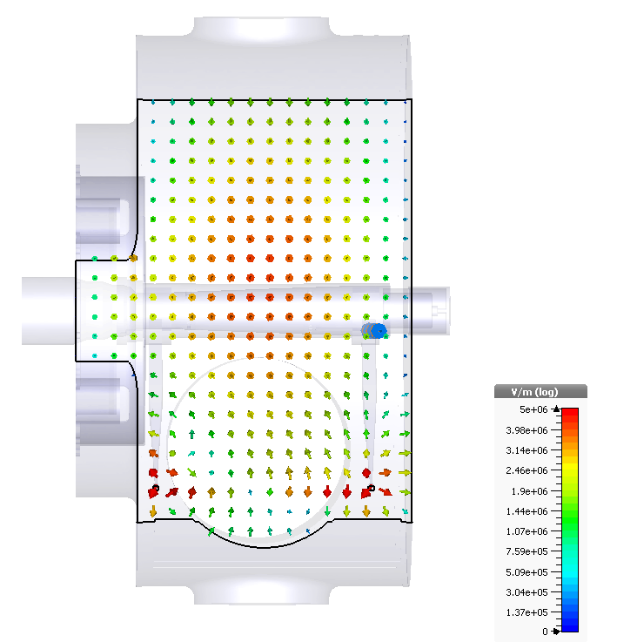
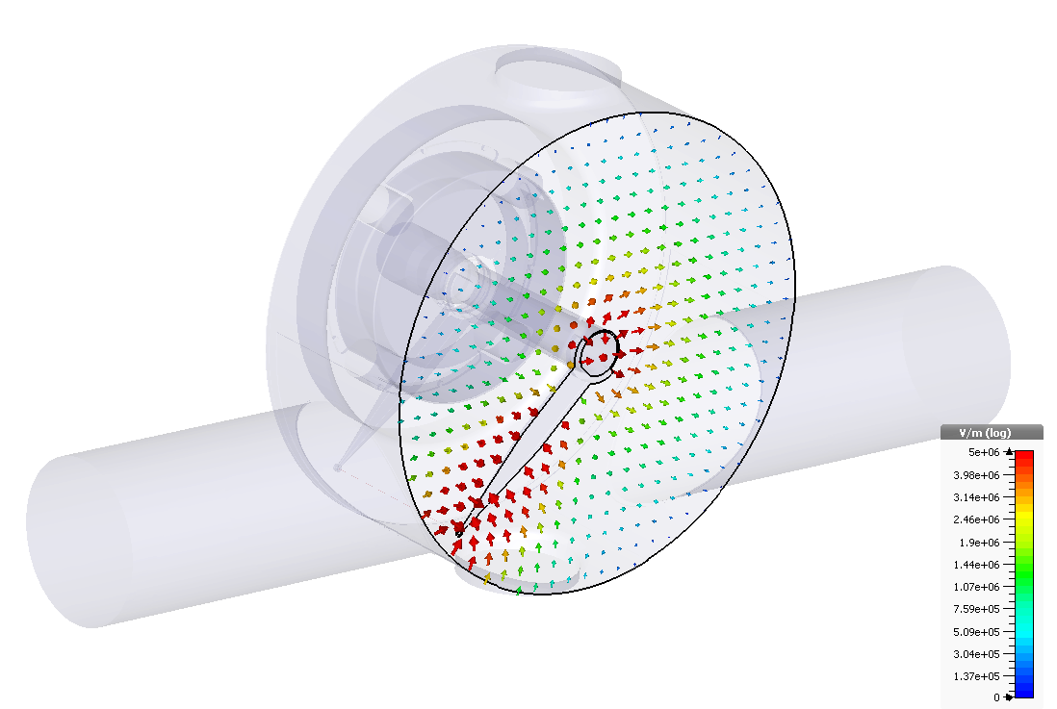
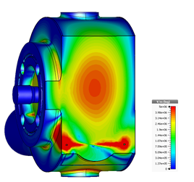
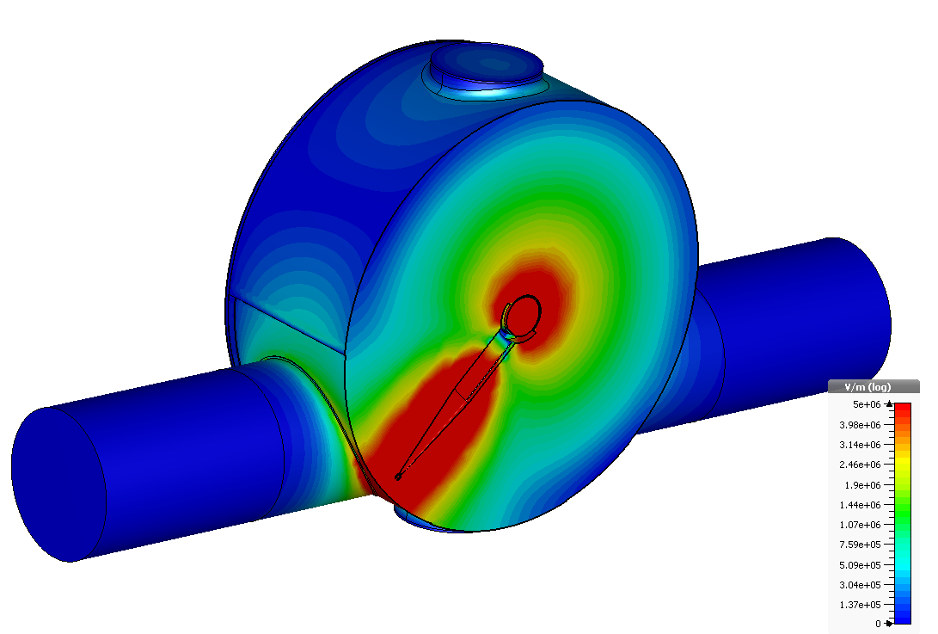
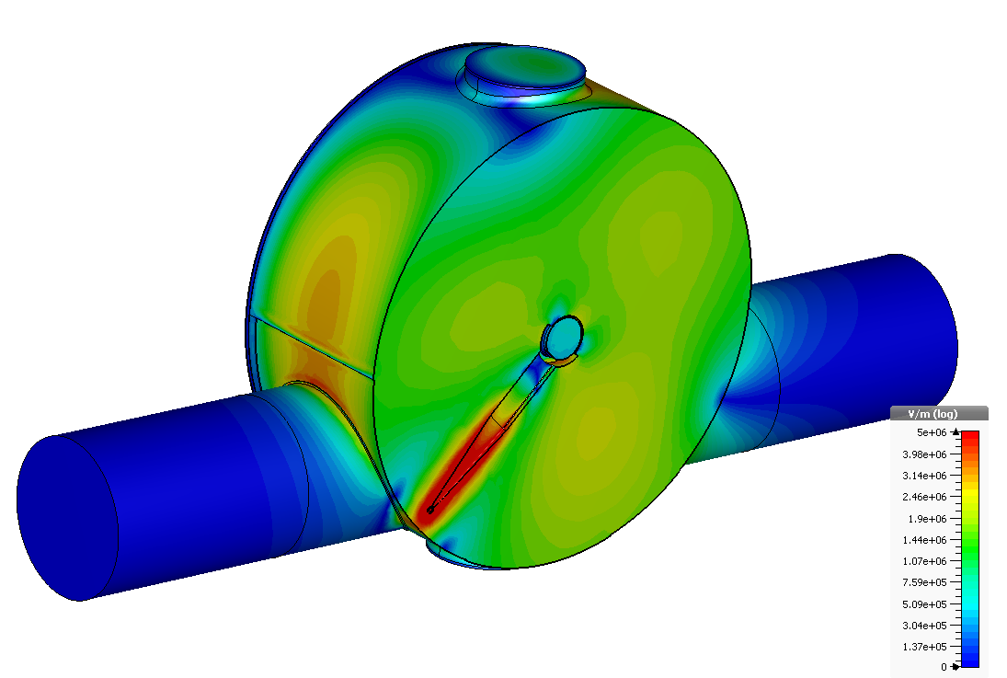
EM-Field Configuration – 135 deg for PS/SPS WS
523 MHz
882 MHz
Highest induced power observed at 523 MHz and 882 MHz at 135 deg position.

Slide 14
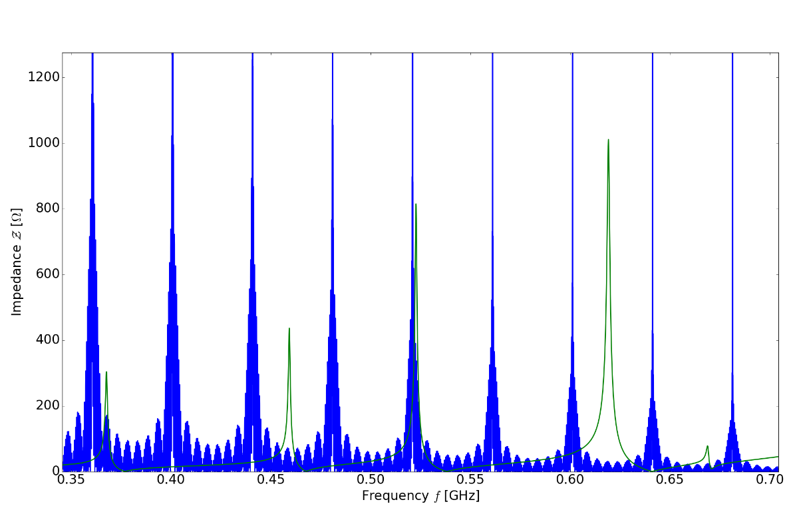
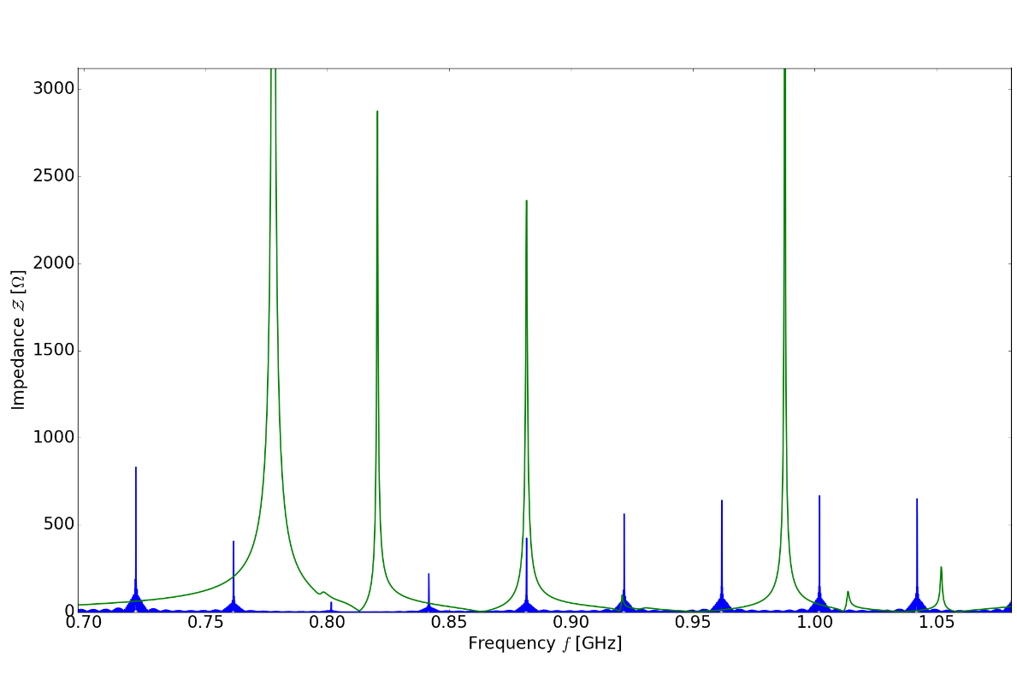
Beam Induced Power Estimation
PS/SPS WS
Wire conductivity: s≈ 7.46 x 10⁴ S/m.
Coupling extracted from eigenmode
simulation.
LIU beam specification used.
Values for 0 deg fork position (parking pos.)
machine | tot. loss in wire [W/turn] | e.g. [W/turn]
PS | 0.01 | 0.01 @ 874 MHz
SPS | 0.11 | 0.11 @ 523 MHz
SPS beam (blue); WS long. Impedance
for 135 deg (green)
Values for 135 deg fork position
machine | tot. loss in wire [W/turn] | e.g. [W/turn]
PS | 0.03 | 0.02 @ 882 MHz
SPS | 1.98 | 1.36 @ 523 MHz 0.51 @ 882 MHz

Slide 15
3- Work Plan until LS2 (tentative)

Slide 16
Work Plan (to be discussed!)
Bench measurements on PS and SPS prototypes
  Measurements with a real wire might give more insight (?).
Measurements with CLEAR beam:
  on simple tank;
  on wire scanner equipment in that tank;
  on the PSB/PS/SPS prototypes (when available).
Potential for measurements with PSB/PS/SPS beam?
  Can we instrument some wirescanners temporarily to measure also the high frequency content of what is coming out of the wires with PSB and SPS beam?

Slide 17
Thank you!

Slide 18
More details to be found here:
https://indico.cern.ch/event/625631/contributions/2526500/attachments/1434087/2204420/WS_Impedance.pdf
http://paf-spsu.web.cern.ch/paf-spsu/
https://indico.cern.ch/event/616762/

