Slide 1
Vacuum qualification PSBBWSRA
Jose A. Ferreira
Tests: Alice Michet & Nicolas Thaus
Installation: Guillermo Merino & Paul Demarest

Slide 2
Why vacuum qualification?
Mandate of TE-VSC is to guarantee the quality of the vacuum in CERN’s accelerators
Leak Tightness
Contamination
Outgassing rate (and time dependency)
Virtual Leaks
Leak detection
RGA
Pumpdown curve
Accumulation tests

Slide 3
Which criteria?
New document to be circulated soon (15th of April)
Leak tightness does not change
Outgassing values will refer to 24h (instead of 10h), but equivalent values → PSB 5∙10⁻⁶ mbar∙l∙s⁻¹ (24h) [4 m² of SS]
Same RGA limits. Components with low outgassing → correction to request same partial pressure (more flexible)

Slide 4
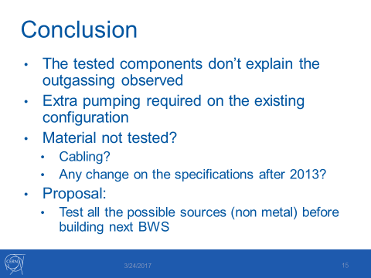
SPS experience
https://indico.cern.ch/event/393525/

Slide 5
SPS experience
https://indico.cern.ch/event/393525/

Slide 6
BWSRE-Materials
Item | SPSBWSRE0003 | Drawing | Material | To be checked
1 | Drum | SPSBWSRE0005 | 316L/316LN
2 | Optical disc | SPSBWSRE0009 | Steel, Glass, Inconel, Aluminium
3 | Optical sensor holder | SPSBWSRE0065 | Aluminium, stainless steel | Optical sensor
 |  |  |  | Optical sensor
4 | Shaft | SPSBWSRE0011 | 304L
5 | Shaft end | SPSBWSRE0013 | Alu EN AW6082
6 | Washer | SPSBWSRE0007 | 304L
7 | Optical fibre cover | ? | ?
8 | Spring washer | SPSBWSRE0004 | Steel
9 | Round tube for optical fibre | ? | ?
10 | Stepped vacuum chamber assembly | SPSBWSRE0014 | 316LN
11 | RF screen | SPSBWSRE0012 | 304L, CuBe
12 | Fork | SPSBWSRE0028 | Ti
13 | Thin RF shield assembly | SPSBWSRE0027 | ? | X
14 | Bearing O32-O20-7 | ? | ? | XXX
15 | Bearing O47-O35-7 | ? | ? | XXX
16 | RF screen internal support | ? | ? | X
17 | RF screen hinge | ? | ? | XX
18 | Small RF screen support | SPSBWSRE0038 | 316L
19 | Small RF screen support | SPSBWSRE0039 | 316L
20 | Ring 10-13-1.35 | SPSBWSRE0051 | 304L
21 | Ring 25-28-2.4 | SPSBWSRE0052 | 304L
22 | Encoder stop ring | SPSBWSRE0053 | 304L
23 | Fork | SPSBWSRE0006 | Ti
24 | Optical feedthrough | ? | ? | XX
25 | Break | ? | ? | Outside vacuum
26 | Optical fibre | ? | ? | XX
27 | Encoder | ? | ADMOTEC: R03620 = 036 - 000(036-030A+036-020C) | Outside vacuum
28 | Brushless motor | ? | ? | Outside vacuum
29 | Wire | ? | ? | X
30-40 | nuts and bolts |  | steel
41 | Dome | SPSBWSRE0040 | Alu EN AW6082 | Outside vacuum
42 | Resolver and break support | SPSBWSRE0037 | Alu EN AW6082 | Outside vacuum
43 | Resolver stop | ? | Alu EN AW6082 | Outside vacuum
44 | Stator fitting tube | ? | Alu EN AW6082 | ?

Slide 7
BWSRE-Materials
Item | SPSBWSRE0003 | Drawing | Material | To be checked
1 | Drum | SPSBWSRE0005 | 316L/316LN
2 | Optical disc | SPSBWSRE0009 | Steel, Glass, Inconel, Aluminium
3 | Optical sensor holder | SPSBWSRE0065 | Aluminium, stainless steel | Optical sensor
 |  |  |  | Optical sensor
4 | Shaft | SPSBWSRE0011 | 304L
5 | Shaft end | SPSBWSRE0013 | Alu EN AW6082
6 | Washer | SPSBWSRE0007 | 304L
7 | Optical fibre cover | ? | ?
8 | Spring washer | SPSBWSRE0004 | Steel
9 | Round tube for optical fibre | ? | ?
10 | Stepped vacuum chamber assembly | SPSBWSRE0014 | 316LN
11 | RF screen | SPSBWSRE0012 | 304L, CuBe
12 | Fork | SPSBWSRE0028 | Ti
13 | Thin RF shield assembly | SPSBWSRE0027 | ? | X
14 | Bearing O32-O20-7 | ? | ? | XXX
15 | Bearing O47-O35-7 | ? | ? | XXX
16 | RF screen internal support | ? | ? | X
17 | RF screen hinge | ? | ? | XX
18 | Small RF screen support | SPSBWSRE0038 | 316L
19 | Small RF screen support | SPSBWSRE0039 | 316L
20 | Ring 10-13-1.35 | SPSBWSRE0051 | 304L
21 | Ring 25-28-2.4 | SPSBWSRE0052 | 304L
22 | Encoder stop ring | SPSBWSRE0053 | 304L
23 | Fork | SPSBWSRE0006 | Ti
24 | Optical feedthrough | ? | ? | XX
25 | Break | ? | ? | Outside vacuum
26 | Optical fibre | ? | ? | XX
27 | Encoder | ? | ADMOTEC: R03620 = 036 - 000(036-030A+036-020C) | Outside vacuum
28 | Brushless motor | ? | ? | Outside vacuum
29 | Wire | ? | ? | X
30-40 | nuts and bolts |  | steel
41 | Dome | SPSBWSRE0040 | Alu EN AW6082 | Outside vacuum
42 | Resolver and break support | SPSBWSRE0037 | Alu EN AW6082 | Outside vacuum
43 | Resolver stop | ? | Alu EN AW6082 | Outside vacuum
44 | Stator fitting tube | ? | Alu EN AW6082 | ?
Stainless steel, CuBe and Al series 6000

Slide 8
BWSRE-Materials
Item | SPSBWSRE0003 | Drawing | Material | To be checked
1 | Drum | SPSBWSRE0005 | 316L/316LN
2 | Optical disc | SPSBWSRE0009 | Steel, Glass, Inconel, Aluminium
3 | Optical sensor holder | SPSBWSRE0065 | Aluminium, stainless steel | Optical sensor
 |  |  |  | Optical sensor
4 | Shaft | SPSBWSRE0011 | 304L
5 | Shaft end | SPSBWSRE0013 | Alu EN AW6082
6 | Washer | SPSBWSRE0007 | 304L
7 | Optical fibre cover | ? | ?
8 | Spring washer | SPSBWSRE0004 | Steel
9 | Round tube for optical fibre | ? | ?
10 | Stepped vacuum chamber assembly | SPSBWSRE0014 | 316LN
11 | RF screen | SPSBWSRE0012 | 304L, CuBe
12 | Fork | SPSBWSRE0028 | Ti
13 | Thin RF shield assembly | SPSBWSRE0027 | ? | X
14 | Bearing O32-O20-7 | ? | ? | XXX
15 | Bearing O47-O35-7 | ? | ? | XXX
16 | RF screen internal support | ? | ? | X
17 | RF screen hinge | ? | ? | XX
18 | Small RF screen support | SPSBWSRE0038 | 316L
19 | Small RF screen support | SPSBWSRE0039 | 316L
20 | Ring 10-13-1.35 | SPSBWSRE0051 | 304L
21 | Ring 25-28-2.4 | SPSBWSRE0052 | 304L
22 | Encoder stop ring | SPSBWSRE0053 | 304L
23 | Fork | SPSBWSRE0006 | Ti
24 | Optical feedthrough | ? | ? | XX
25 | Break | ? | ? | Outside vacuum
26 | Optical fibre | ? | ? | XX
27 | Encoder | ? | ADMOTEC: R03620 = 036 - 000(036-030A+036-020C) | Outside vacuum
28 | Brushless motor | ? | ? | Outside vacuum
29 | Wire | ? | ? | X
30-40 | nuts and bolts |  | steel
41 | Dome | SPSBWSRE0040 | Alu EN AW6082 | Outside vacuum
42 | Resolver and break support | SPSBWSRE0037 | Alu EN AW6082 | Outside vacuum
43 | Resolver stop | ? | Alu EN AW6082 | Outside vacuum
44 | Stator fitting tube | ? | Alu EN AW6082 | ?
Stainless steel, CuBe and Al series 6000
Outside vacuum

Slide 9
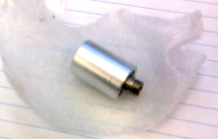
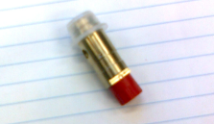
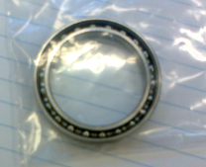
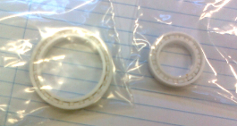
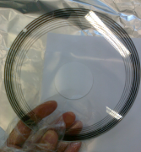
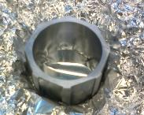
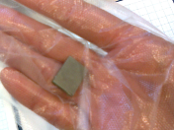
BWSRE potential OG sources
Item | SPSBWSRE0003 | Drawing | Material | To be checked
2 | Optical disc | SPSBWSRE0009 | Steel, Glass, Inconel, Aluminium
3 | Optical sensor holder | SPSBWSRE0065 | Aluminium, stainless steel | Optical sensor
 |  |  |  | Optical sensor
7 | Optical fibre cover | ? | ?
9 | Round tube for optical fibre | ? | ?
13 | Thin RF shield assembly | SPSBWSRE0027 | ? | X
14 | Bearing O32-O20-7 | ? | ? | XXX
15 | Bearing O47-O35-7 | ? | ? | XXX
16 | RF screen internal support | ? | ? | X
17 | RF screen hinge | ? | ? | XX
24 | Optical feedthrough | ? | ? | XX
26 | Optical fibre | ? | ? | XX
29 | Wire | ? | ? | X
44 | Stator fitting tube | ? | Alu EN AW6082 | ?
Q_{10h}< 1.7 10⁻⁷ mbar∙l∙s⁻¹
Measurement of all the components
Q_{10h}= 6.7 10⁻⁷ mbar∙l∙s⁻¹
P∝1/t
No sign of contamination
Q_{10h}< 4.9 10⁻⁷ mbar∙l∙s⁻¹
Q_{10h}< 1.1 10⁻⁶ mbar∙l∙s⁻¹
Q_{10h}< 4.9 10⁻⁷ mbar∙l∙s⁻¹
Q_{10h}< 6.5 10⁻⁷ mbar∙l∙s⁻¹
Q_{10h}< 8.3 10⁻⁷ mbar∙l∙s⁻¹
Q_{10h}< 1.7 10⁻⁷ mbar∙l∙s⁻¹
EDMS 1335217. Tests October 2013

Slide 10
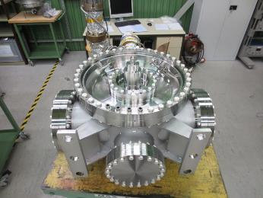
Acceptance test
  Q_{10h}= 8.1∙10⁻⁵ mbar∙l∙s⁻¹
P∝1/t^{0.5}!
No contamination observed
2 fibres B + 2 feedthroughs + 2 focusers (1st type) + 1 disk | 2.55∙10⁻⁶ mbar∙l∙s⁻¹
2 fibres B + 2 feedthroughs + 2 focusers (2nd type) + 1 disk | 3.19∙10⁻⁶ mbar∙l∙s⁻¹
2 fibres A + 2 feedthroughs + 2 focusers (1st type) + 1 disk | 1.28∙10⁻⁵ mbar∙l∙s⁻¹
2 fibres A + 2 feedthroughs + 2 focusers (2nd type) + 1 disk | 1.34∙10⁻⁵ mbar∙l∙s⁻¹
Test December 2014

Slide 11
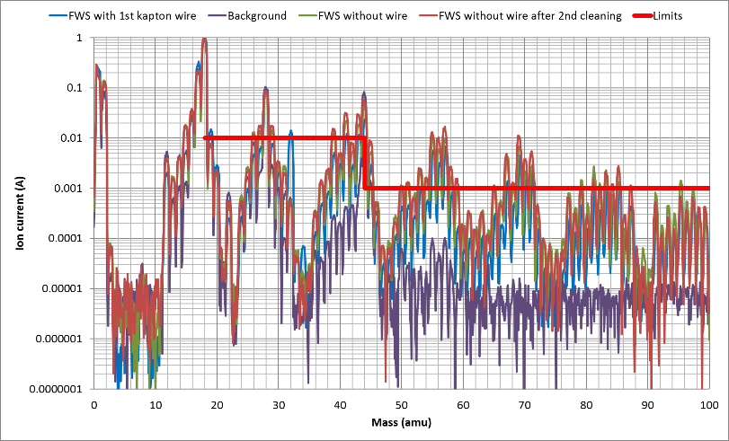
Residual Gas Analysis PSB FWS

Slide 12
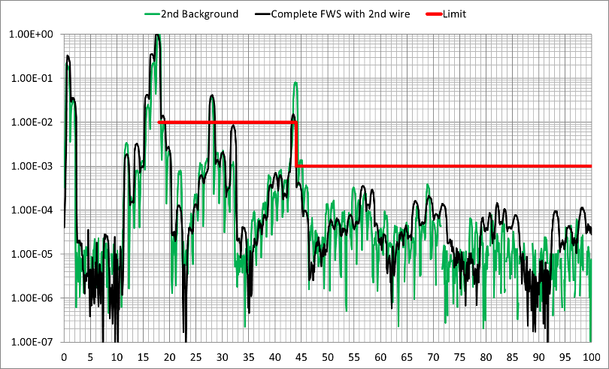
Residual Gas Analysis PSB FWS

Slide 13
Residual Gas Analysis PSB FWS
Peak 32 linked to coaxial cable. Virtual leak

Slide 14
Residual Gas Analysis PSB FWS
Issues after cleaning/assembly required to repeat the process to get here
Origin of contamination not fully understood
Cleaning and assembly of different components is critical

Slide 15
Tests PSB wire scanner
Full BWSRA
4.7∙10⁻⁵ mbar∙l∙s⁻¹ (24h)
1.1∙10⁻⁴ mbar∙l∙s⁻¹ (10h)
Several tests without Kapton coaxial cable
From 2 to 7∙10⁻⁶ mbar∙l∙s⁻¹ (24h)
PSB requirement 5∙10⁻⁶ mbar∙l∙s⁻¹ (24h)

Slide 16
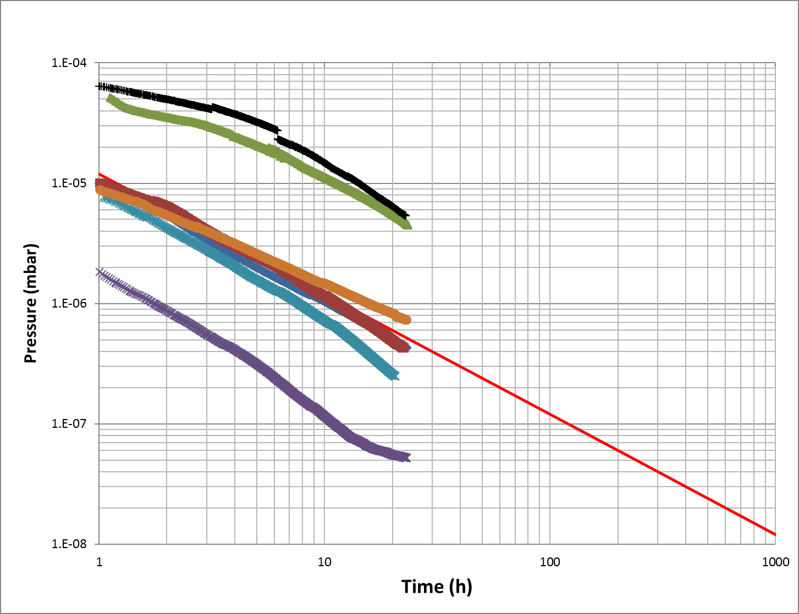
Tests PSB wire scanner
Complete FWS
Without coaxial cable
PSB limit
Background

Slide 17
Tests PSB wire scanner
Without coaxial cable in acceptable values
Discrepancy of SPS results finally explained!
Complete FWS
Without coaxial cable
PSB limit
Background

Slide 18
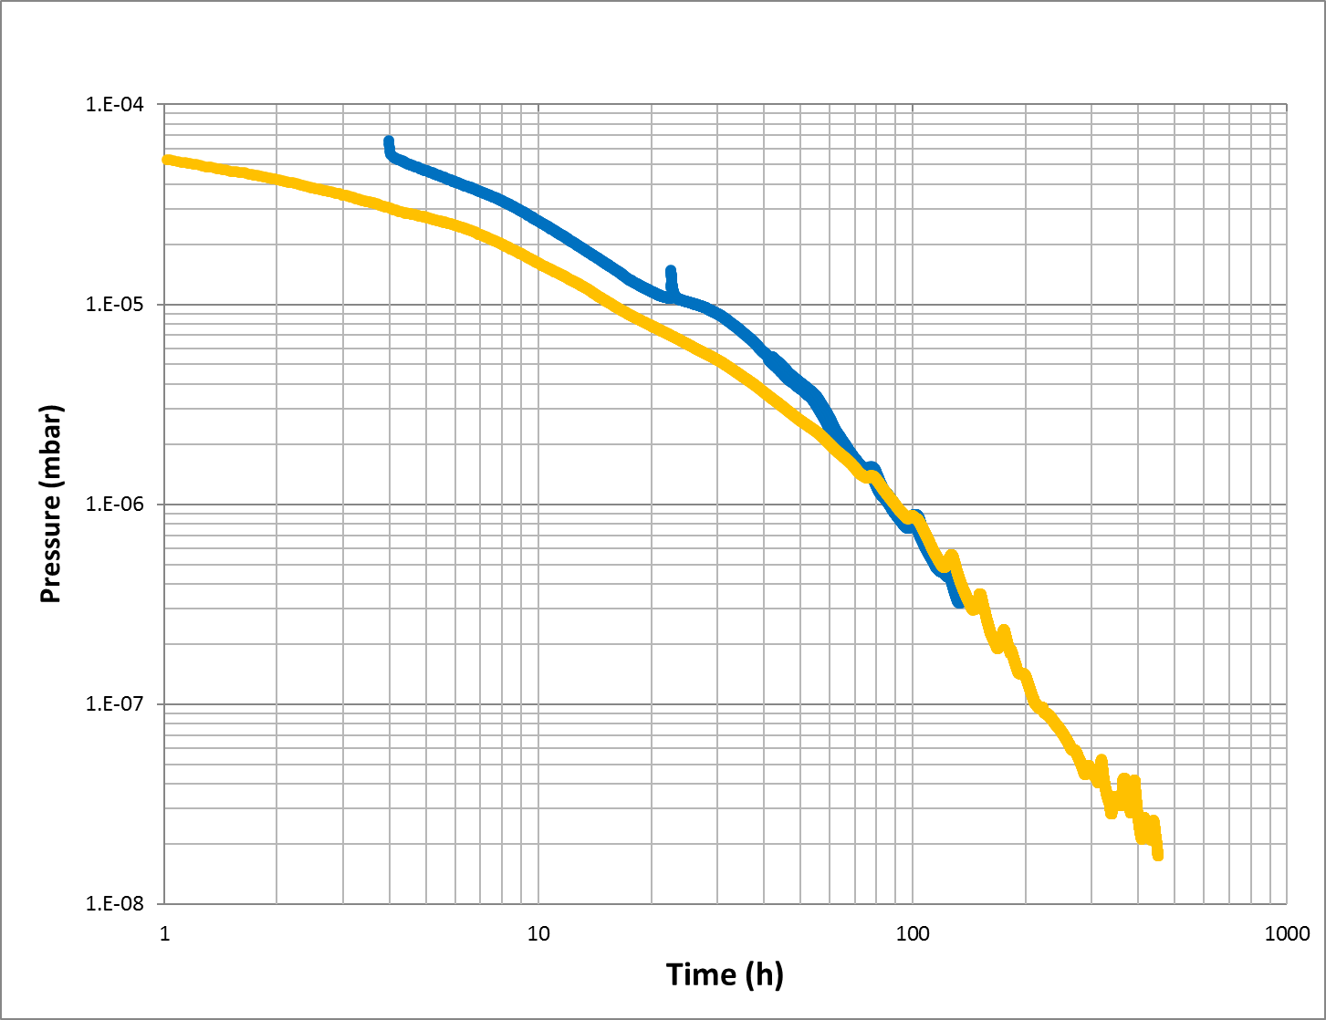
Outgassing cable #2
1st Pumpdown
2nd Pumpdown after bakeout 150C@24h and 24h in air

Slide 19
Outgassing cable #2
1st Pumpdown
Approx. same outgassing as cable #1
2nd Pumpdown after bakeout 150C@24h and 24h in air

Slide 20
Outgassing cable #2
1st Pumpdown
Some improvement (factor ~2) on the short term t<100h
2nd Pumpdown after bakeout and 24h in air

Slide 21
Outgassing cable #2
1st Pumpdown
No improvement on the long term t<100h
2nd Pumpdown after bakeout 150C@24h and 24h in air

Slide 22
Outgassing cable #2
1st Pumpdown
Pre-degassing is not effective reducing outgassing!
No improvement on the long term t<100h
2nd Pumpdown after bakeout 150C@24h and 24h in air

Slide 23
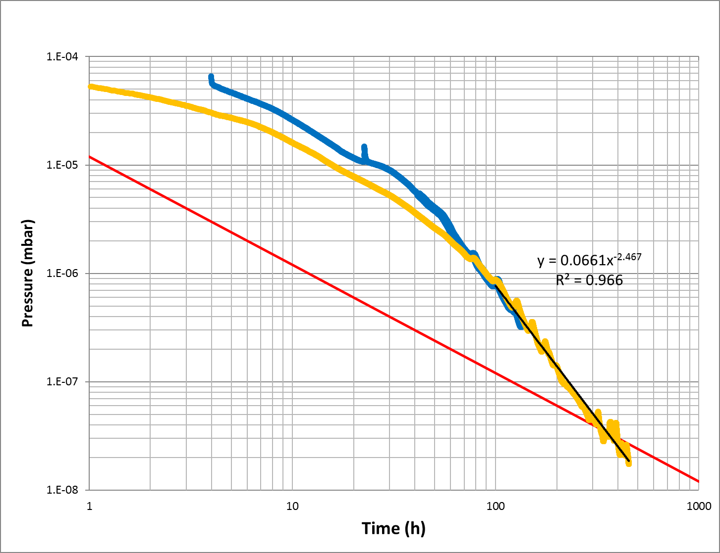
Outgassing cable #2
After 400h pumpdown in spec
PSB limit

Slide 24
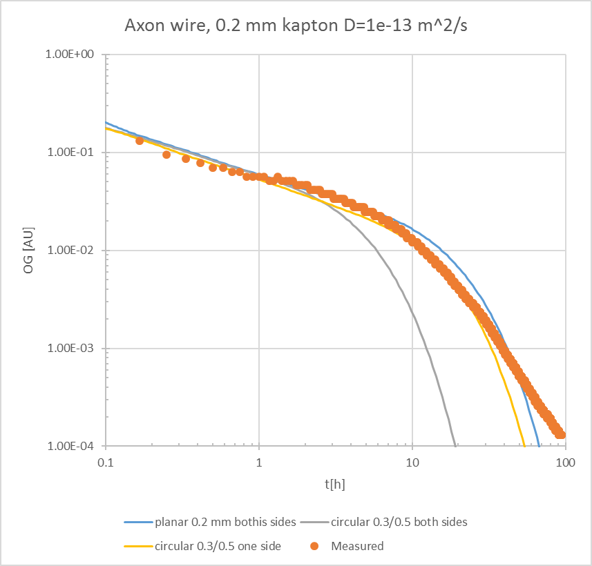
Interpretation
Diffusion of water in very thin Kapton® layer
Model validated against an extruded wire 0,2 mm (Axon HT3007SCA)
Only observable if <0,5 mm thickness
1 mm layer >1000h!

Slide 25
Outgassing full wire scanner
During the final test → Observe same behavior?
If same behavior → FWS out of spec at 24h but in spec at >300h

Slide 26
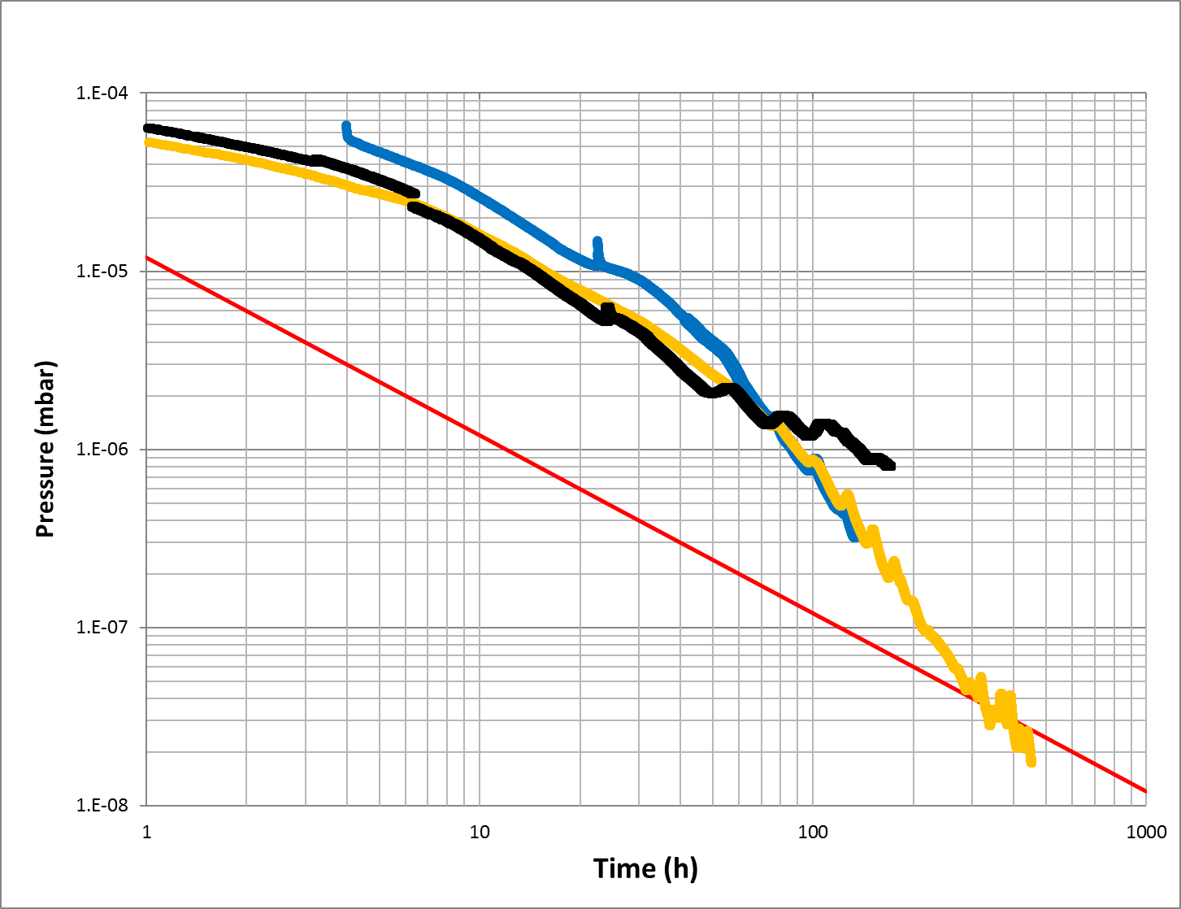
Outgassing fast wire scanner
FWS does not follow same trend! >10 times higher after 100 h
PSB limit

Slide 27
Outgassing full wire scanner
During the final test → Observe same behavior?
If same behavior → FWS out of spec at 24h but in spec at >300h
Effective pumping speed 100 l/s. Ion pump 75 l/s added to the FWS → Gain factor of 2 but still out of spec
Vacuum recommendation → Installation but find a replacement for coax. cable in future units

Slide 28
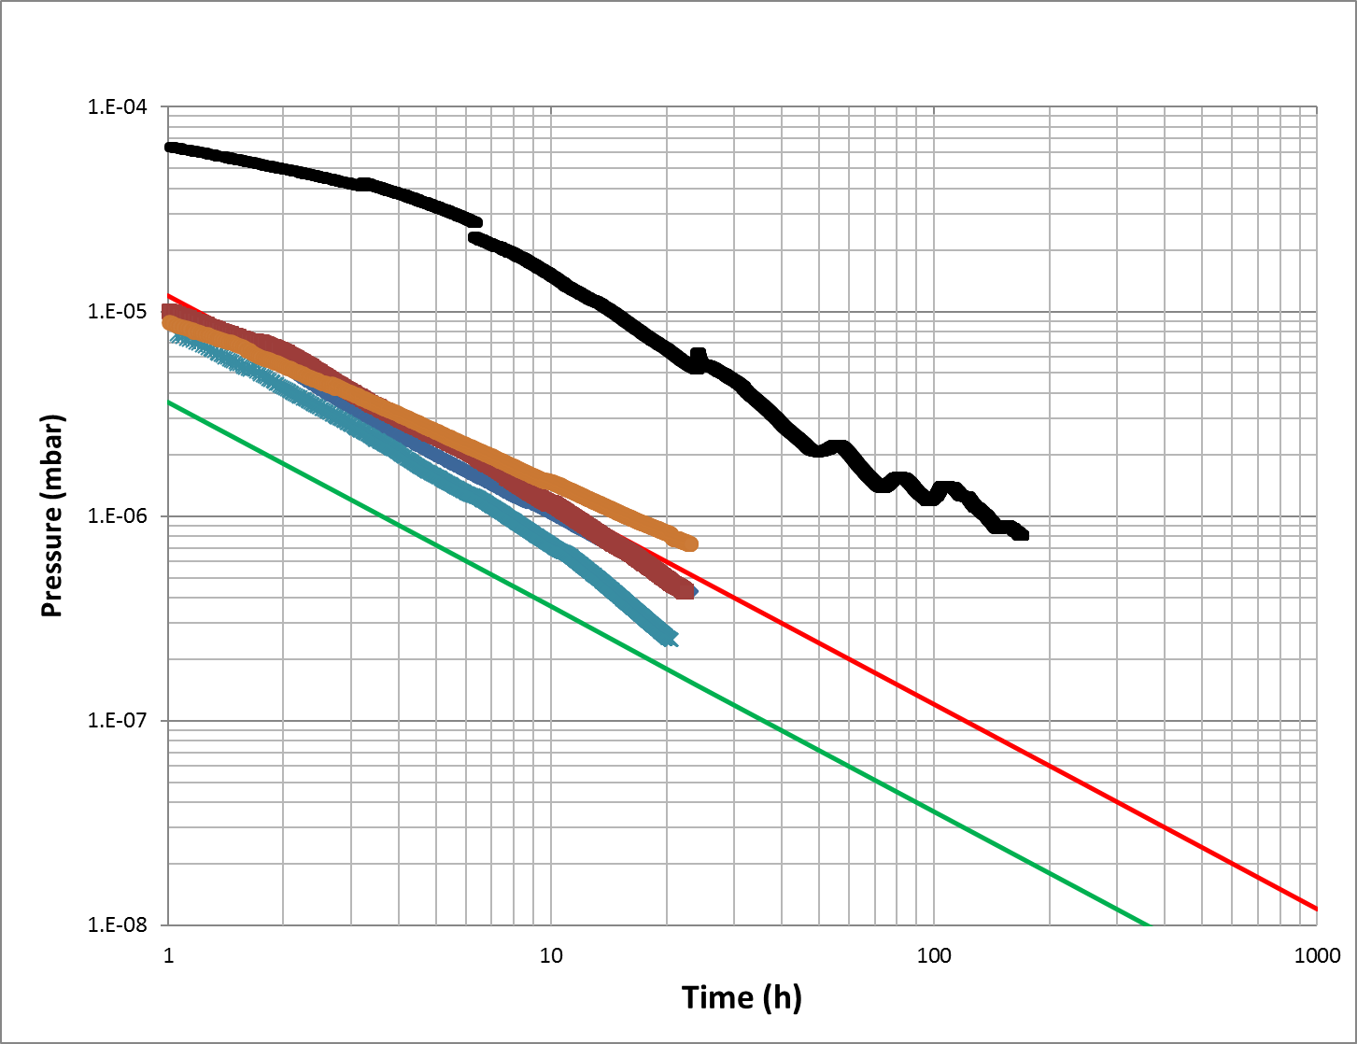
PS ring
Ion run have stringent pressure requirement
Removing coaxial needed to reach the spec, but not enough
Highly recommended to add ion pump 200 – 150 l/s to keep it as an unbaked component
Simulation final location to refine this first estimation
PSB limit
PS limit

Slide 29
Conclusions
The coaxial wire is responsible of >90% of the gas load
Highly recommended to explore better alternatives
Retrofit the alternative to PSB and SPS wire scanners
To avoid in situ bake-out in PS→ Add ion pump. Detailed evaluation required. Position?
1 staff FTE∙month in acceptance tests only for this component until now. Compensation associated cost requested.

Slide 30
Thank you for your attention

