Slide 1
LIU BWS UPGRADE
Series production: budget, schedule and risk
Ray Veness
With material from:
Rhodri Jones, Lars Jensen, Federico Roncarolo, Dmitry Gudkov, Jonathan Emery

Slide 2
Contents
Cost breakdown for both mechanics and electronics
  These figures cover design, production, assembly, test and installation for mechanical, control and acquisition systems up to the racks.
Summary of total cost and situation with respect to existing EVM
Overview milestones and schedule for the project
Cost and schedule risks and mitigation
Summary

Slide 3
BWS series mechanics cost estimate breakdown
Hardware
Hardware Cost (17 tanks+17 instruments, no spares) | Hardware Cost (21 tanks + 22 instruments)
CHF 984,514.00 | CHF 1,139,664.00
 | Hardware Cost (17 tanks+17 instruments, no spares) | Hardware Cost (21 tanks + 22 instruments)
Critical raw material purchase | CHF 95,000.00 | CHF 95,000.00
Production Group 1 - Vacuum tanks | CHF 238,000.00 | CHF 294,000.00
Production Group 2 - Stepped chamber + shaft | CHF 172,900.00 | CHF 220,400.00
Production Group 3 - Conventional machining | CHF 69,200.00 | CHF 89,200.00
Special Components | CHF 61,352.00 | CHF 71,352.00
Commercial components purchase | CHF 152,350.00 | CHF 174,000.00
Auxiliary vacuum pipes | CHF 106,632.00 | CHF 106,632.00
Supporting systems + fixation | CHF 89,080.00 | CHF 89,080.00
BWS Common cost for design, assembly and spares
*1 x Vacuum tank = 14000 CHF
**1 x Stepped chamber + shaft = 9500 CHF
 | Cost
Design of BWS for PS, SPS, PSB | CHF 18,360.00
Assembly and installation | CHF 31,215.00
Calibration Bench Procurement | CHF 53,000.00
Courtesy: D.Gudkov

Slide 4
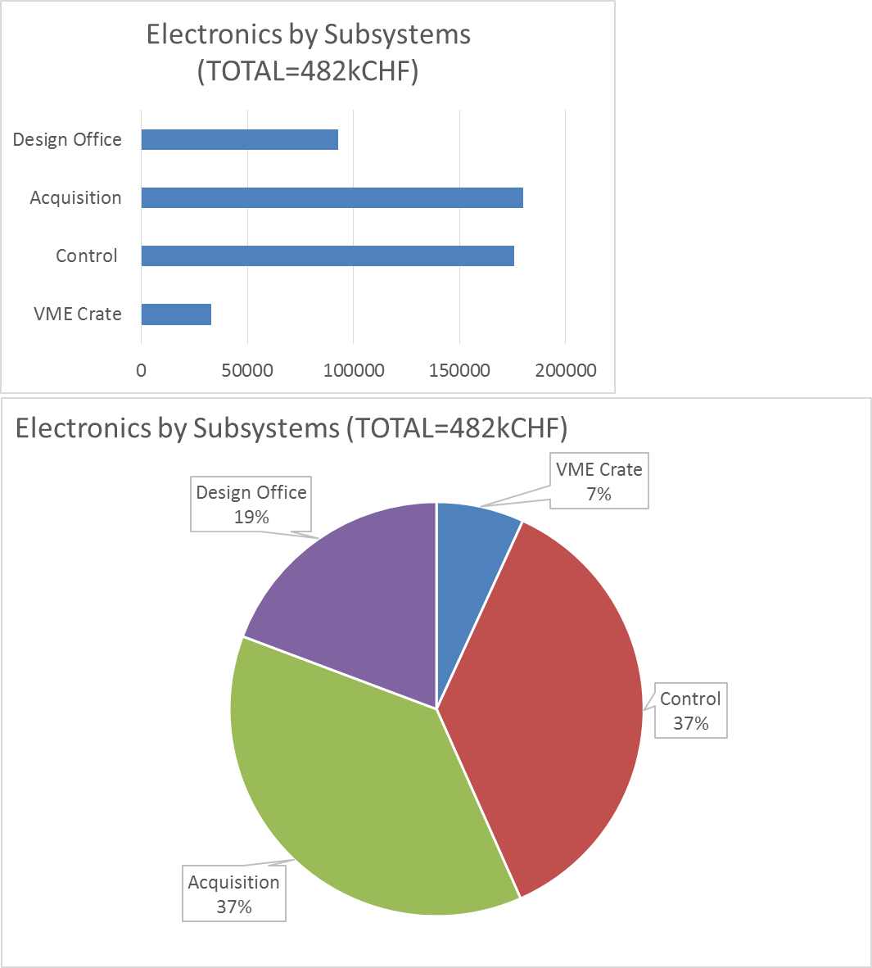
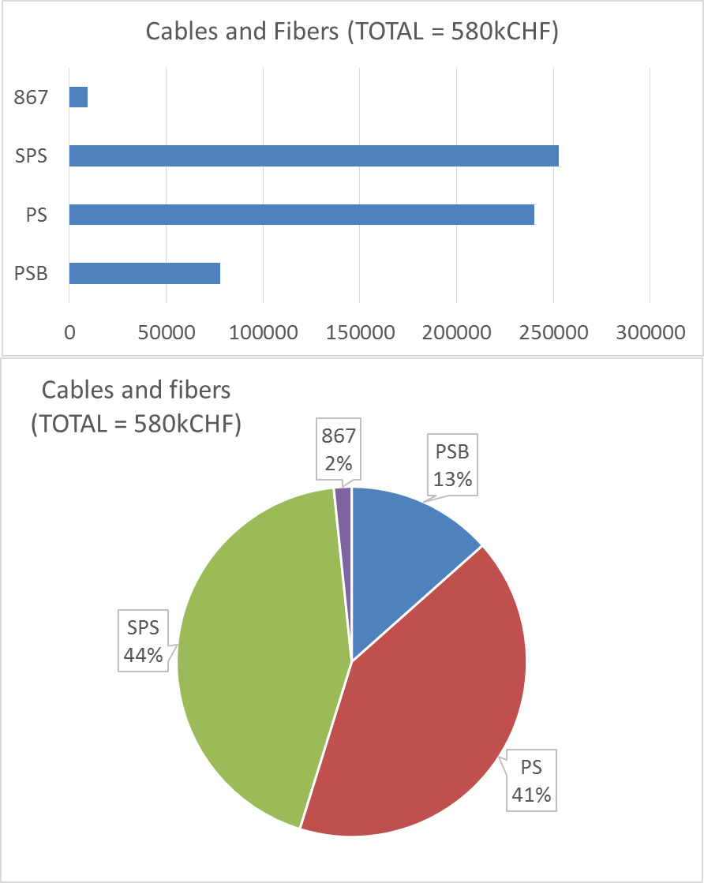
Electronics cost breakdown
Data: Courtesy J.Emery

Slide 5
Unit costs
Material + vacuum tank + instrument + support
  51 kCHF / instrument
  6 kCHF / instrument for the 2 connecting vacuum chambers
Control Electronics + Acquisition system
  23.5 kCHF / instrument
  Cabling varies by machine, and some already paid, but average/instrument is 33.4 kCHF / instrument

Slide 6
Remaining development costs
Common project costs (244 kCHF)
  Design and integration, calibration bench procurement, additional FSU for assembly
Additional costs (options)
Clean assembly area (100 kCHF)
  100 m² originally requested to LIU in 2015 as part of the LS2 project
  Essential to minimise vacuum acceptance issue risk
Spares (280 kCHF)
  1 spare tank/different design (4 total), 1 ‘hot spare’ instrument per configuration (H+V) ready to install (5 total)
  YETS 2017-18 PS prototype is assumed to be ‘final’ so will be used as a spare
Vacuum pumps (130 kCHF)
  VSC request a baseline of 1 additional ion pump per new instrument
Oasis electronics (76 kCHF)
  OP request for operational analysis

Slide 7
Cost Summary
Series hardware production cost estimate (1258 kCHF)
  17 Instrument units, (instrument, vacuum tank, supports), 867 kCHF = 51 kCHF/unit
  17 Control + acquisition system units 391 kCHF = 23 kCHF/unit
  Total production cost estimate = 1258 kCHF = 74 kCHF/unit
Remaining LIU EVM Budget ~1.3 MCHF covers instrument hardware costs
Necessary additional estimated costs (780 kCHF)
  Cabling (568 kCHF), interface vacuum chambers (101 kCHF), remaining design (18 kCHF mec + 93 kCHF elec),
Costs for assembly & test (133 kCHF)
  1 MY FSU (80 kCHF), calibration bench (53 kCHF)
Missing LIU Funding for series production, assembly & installation ~900 kCHF
Spares (280 kCHF)
  Mechanics (175 kCHF) + electronics (105 kCHF)
Optional additional costs (308 kCHF)
  Additional vacuum pumps (132 kCHF), Oasis systems (76 kCHF), Renovation of assembly hall (100 kCHF)
LIU manpower
  LIU-GET for acquisition system (50% LIU: J.Sirvent), LIU-GET for series production (Funded: A.Mariet), LIU-TS for WS analysis (Funded: L.Garcia), LIU-PJAS or TS for software (to be requested)
Historical costs for LIU (772 kCHF) & CONS (412 kCHF) already spent on EVM allocation
  Conceptual design, technology development, SPS prototype design and manufacture, PSB prototype design and production, integration

Slide 8
Production Schedule Overview
(Consistent with EVM)
Electronics – all electronics delivered
Electronics – Test final acquisition prototype
Electronics – Test final controls prototype
Mechanics – ready for installation
Mechanics – components at CERN
2017
2018
2019
2020
Mechanics - design
Material procurement
Mechanics – procurement and assembly
Mechanics – installation
Electronics – design
Electronics – procurement
Cables – procurement and installation
Electronics – installation and commissioning
Procure optional pumps and Oasis electronics

Slide 9
Cost & Schedule Risks and Mitigation
Equipment / Systems | Level Defined | Risk level class | Uncertainty & Mitigation
Mechanics | 95% | Class 1 (+10% -10%) | Cost Estimates v tendered costs Schedule Unforeseen technical problems – continued laboratory & machine testing essential to spot these early Production, assembly or qualification issues – baseline to be ready for installation at start of LS2 so some schedule margin exists
Control Electronics | 80% | Class 1 (+15% -10%) | Final prototype under construction Baseline is to be ready to start series production in 2018
Acquisition Electronics | 70% | Class 2 (+20% -15%) | Type & number of photomultipliers still to be defined in order to cover necessary dynamic range
Cabling | 90% | Class 1 (+10% -10%) | Cost based on EYETS experience Final cable layout can still be slightly optimised
Infrastructure | 30% | Class 3 (+30% -15%) | Clean assembly area in BI has not been costed by SMB Need to advance quickly with detailed planning

Slide 10
Summary
The project considers it is ready to advance to the series production phase:
  A decision to launch production now is consistent with installation from the start of LS2
A detailed cost estimate has been made:
  The full project with all options would require 1.42 MCHF in addition to existing EVM provisions
A risk analysis has been performed, based on the model for HL-LHC

Slide 11
Particular thanks to:
Vacuum team: For design input, qualification of components and assembles
Impedance team: For design input, simulation and tests
MME: for design, consultancy for materials selection, production engineering, cost engineering, production

Slide 12
Additional Material

Slide 13
Cables
Position | Scanner name | estimated length |  | estimated price based on length | Copper TID | Optical TID | line total | Machine total
PSB
4x | 4L1 | 65 |  | - | 58200 | 9773 | 67973
4x | 11L1 | ? |  | - | 0 | 10000 | 10000 | 77973
PS |  |  |  | Estimation based on PS54
PS54 | 54 | 150 |  | - | 19100 | 13639 | 32739
PS64 | 64 | 250 |  | 54565 |  |  | 54565
PS65 | 65 | 250 |  | 54565 |  |  | 54565
PS68 | 68 | 230 |  | 50199.8 |  |  | 50199.8
PS85 | 85 | 220 |  | 48017.2 |  |  | 48017.2 | 240086
SPS |  |  |  | Estimation based on SPS517 / 1.5 (less cables)
51740 | 517 | 88 |  | - | 22420 | 13000 | 35420
41677 | 416H | 190 |  | 50983.3 |  |  | 50983.33
41677 | 416V | 190 |  | 50983.3 |  |  | 50983.33
51995 | 519H | 215 |  | 57691.6 |  |  | 57691.67
51995 | 519H | 215 |  | 57691.6 |  |  | 57691.67 | 252770
867 | Calibration and test bench |  |  | Estimation (half the cables of PS installation)
 |  |  | 220 | 9550 |  |  | 9550 | 9550
 |  |  |  |  |  | Total injectors | 580379
4 scanners in 11L1 included?
Estimated cost based on prototype and scaling on cable length
Estimated cost based on prototype and scaling on cable length / 1.5

Slide 14
HL-LHC procedure for evaluating risk
(as adopted here)

