Slide 1
PC Overview
Video CM, 21-22/Mar./2017
M. Komatsu
1
1
1
1

Slide 2
PC meetings since October
We had four PC meetings since October CM @ Naples
PC meeting 7/12/2016
  https://indico.cern.ch/event/591841/
  Final statistics for data analysis : Sato
  Nue oscillation analysis : Matteo
  Nue paper preparation status : Svetlana
  Marginal event analysis : Giuliana
  Multiplicity internal note status : Cagin
PC meeting 13/1/2017
  https://indico.cern.ch/event/597066/
  Electron energy reconstruction : Frank
  Nue oscillation analysis : Matteo
  Nue paper preparation status : Svetlana
  Numu disappearance analysis : Budimir
  Marginal event analysis : Giuliana
  Cosmic ray annual modulation : Nicoletta
  Open data event set : Cagin

Slide 3
PC meetings since October
PC meeting 17/2/2017
  https://indico.cern.ch/event/612325/
  Nue oscillation analysis : Matteo
  Nue paper preparation status : Svetlana
  Marginal event analysis : Giuliana
  Cosmic ray annual modulation : Nicoletta
  Materials provided offline
    Double vertex event : Chiara
    Multiplicity study : Cagin
PC meeting 15/3/2017
  https://indico.cern.ch/event/618894/
  Nue analysis and paper status : Svetlana, Matteo
  Marginal event analysis : Giuliana
  numu disappearance analysis : Budimir
  Cosmic ray annual modulation : Alessandro on behalf of Nicoletta
  Event display for open data : Sergey

Slide 4
Scanning Coordination
Final statistics for nue and marginal event analysis
  Statistics frozen by the end of November 2016

Slide 5
Statistics at 5th Dec same definition with 5th tau paper
Sato @ PC 7 Dec
Run year | 0mu DS | 1mu DS | 0mu loc | 1mu loc
2008 | 150 | 543 | 156 | 556
2009 | 255 | 1024 | 268 | 1042
2010 | 278 | 1001 | 296 | 1029
2011 | 291 | 1031 | 315 | 1093
2012 | 223 | 807 | 246 | 867
TOTAL | 1197 | 4406 | 1281 | 4587
15 GeV cut for 1mu
1st and 2nd bricks
5603 TcauDecaySearched
5868 Located

Slide 6
Comparison with 5th tau paper
Sato @ PC 7 Dec
Run year | 0mu DS | 1mu DS | 0mu loc | 1mu loc
2008 | 149 +1 | 542 +1 | 155 +1 | 555 +1
2009 | 253 +2 | 1020 +4 | 266 +2 | 1036 +6
2010 | 268 +10 | 968 +33 | 281 +15 | 989 +40
2011 | 270 +21 | 966 +65 | 293 +22 | 1016 +77
2012 | 204 +19 | 768 +39 | 228 +18 | 818 +49
TOTAL | 1144 +53 | 4264 +142 | 1223 +58 | 4414 +173
DS done 5408(5th paper) + 195 → 3.6% increased.
Loc done 5637 + 231

Slide 7
Nue analysis
Svetlana and Matteo
Updated in all PC meetings

Slide 8
Key items for nue analysis
3+1 model with shape analysis (multi bin analysis) is baseline.
  Big discussions and cross checks on “energy cut” or “no cut”
  Concluded as “no cut” by February PC meeting and finalized
Normalization
  With a help of SC, normalization become more and more solid
  Many cross checks been done.
Model (mostly) independent P_{μe} evaluation
  Any interpretation can be applied on this P_{μe} value
  Counting method with energy cut (Best sensitivity)

Slide 9
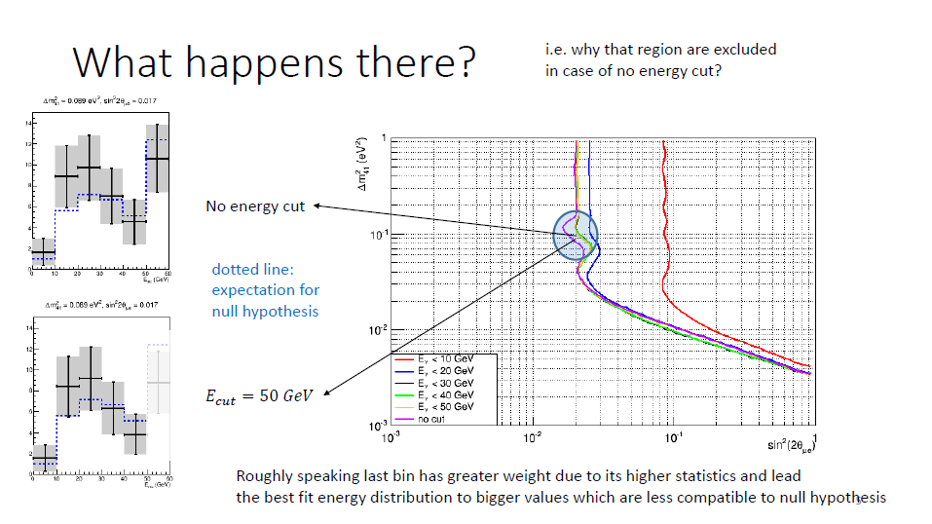
Matteo @ PC 17 Feb

Slide 10
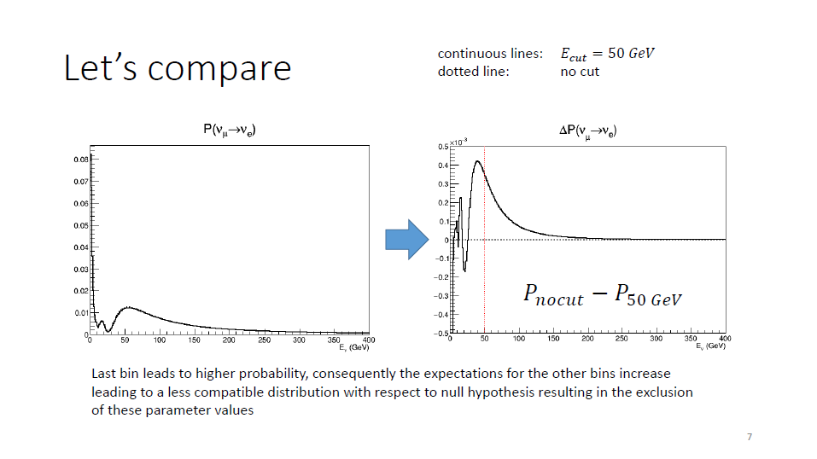
Matteo @ PC 17 Feb

Slide 11
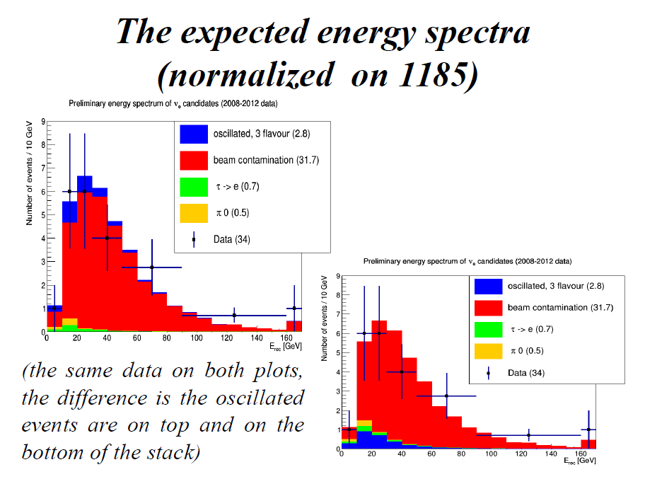
Svetlana @ PC 15 Mar

Slide 12
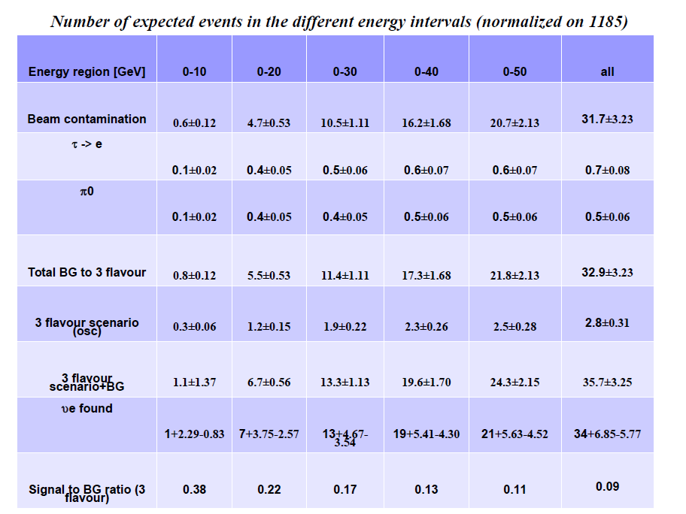
Svetlana @ PC 15 Mar

Slide 13
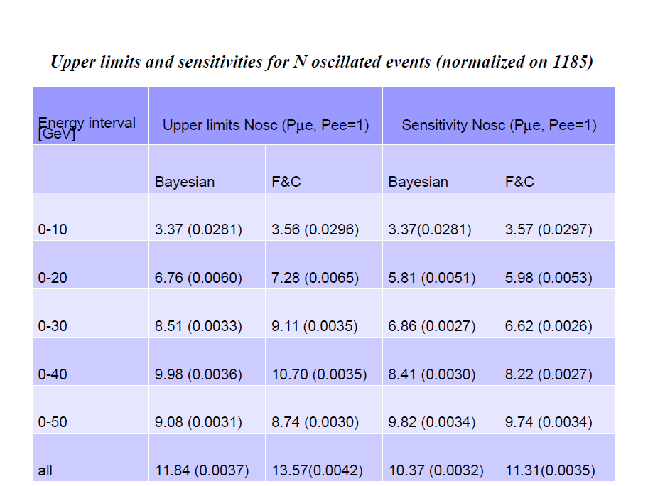
Svetlana @ PC 15 Mar

Slide 14
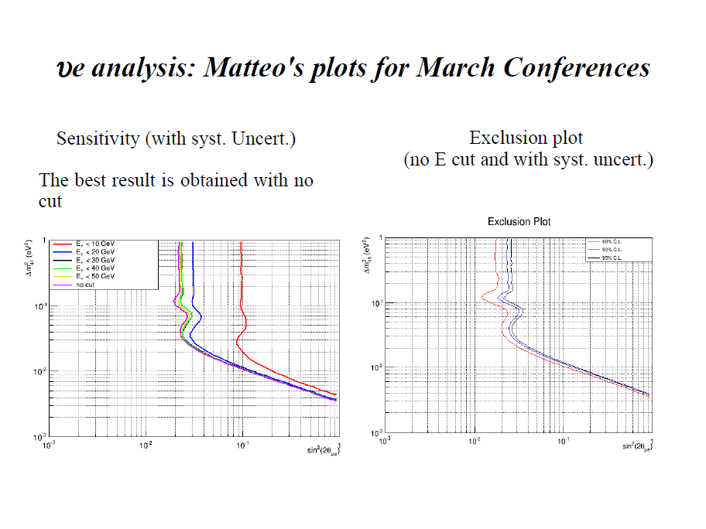
Svetlana @ PC 15 Mar

Slide 15
marginal events
Giuliana
Updated in all PC meetings

Slide 16
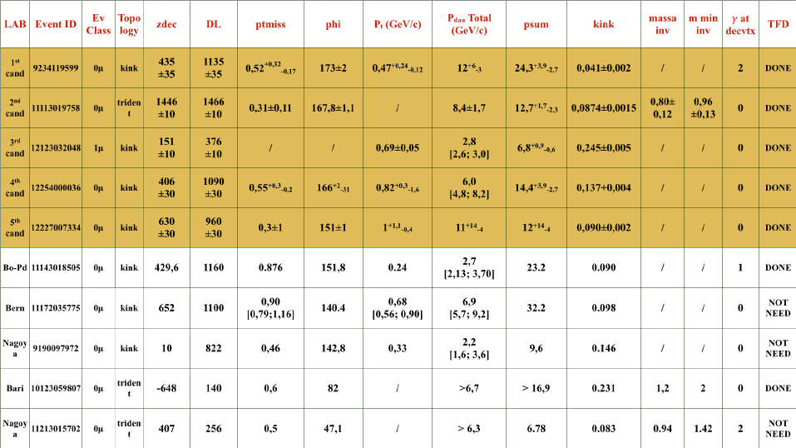
Giuliana @ PC 17 Feb

Slide 17
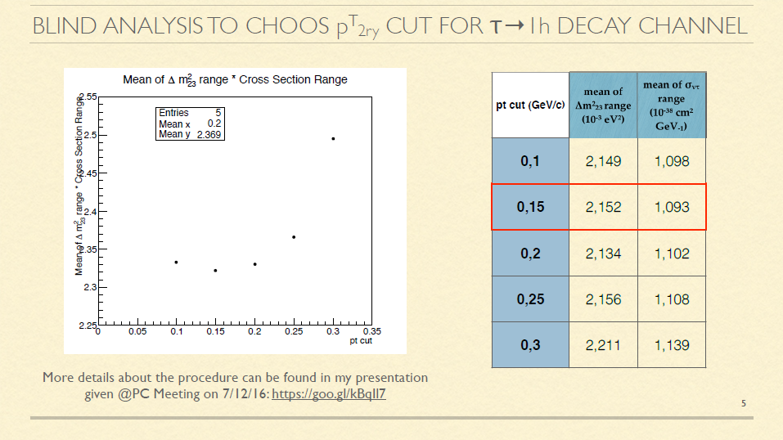
Giuliana @ PC 13 Jan
Minimum bias requirement optimization

Slide 18
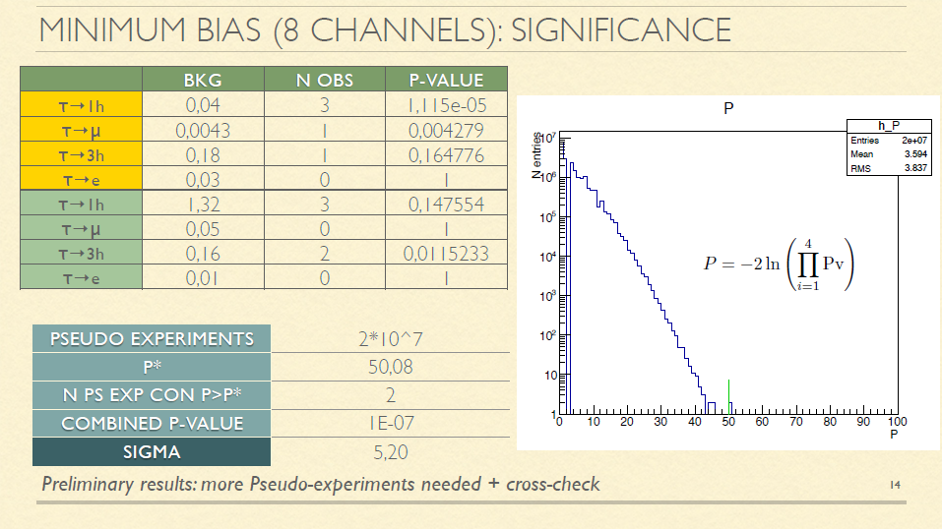
Giuliana @ PC 13 Jan

Slide 19
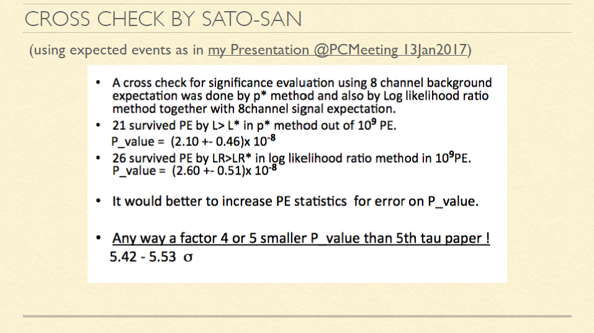
Giuliana @ PC 17 Feb

Slide 20
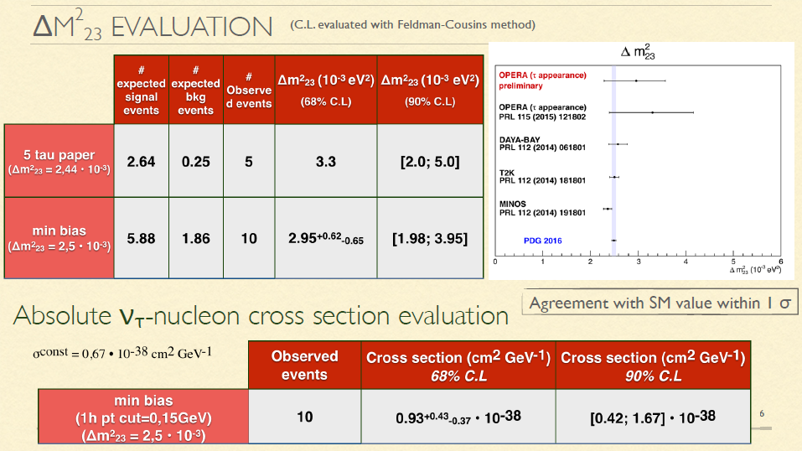
Giuliana @ PC 17 Feb
We are sensitive to a product of oscillation probability and cross-section

Slide 21
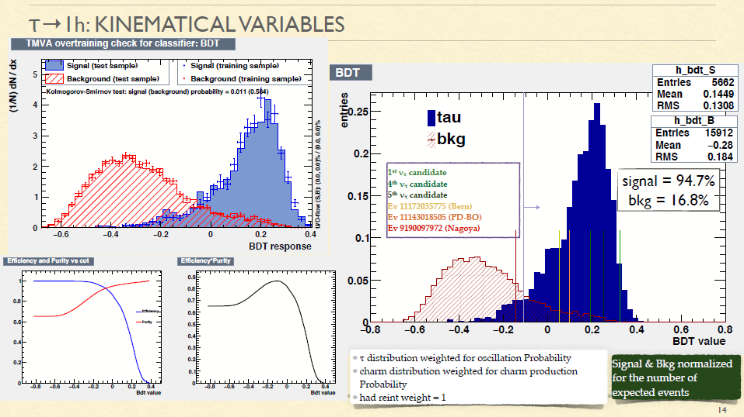
Giuliana @ PC 17 Feb

Slide 22
Numu disappearance
Budimir

Slide 23
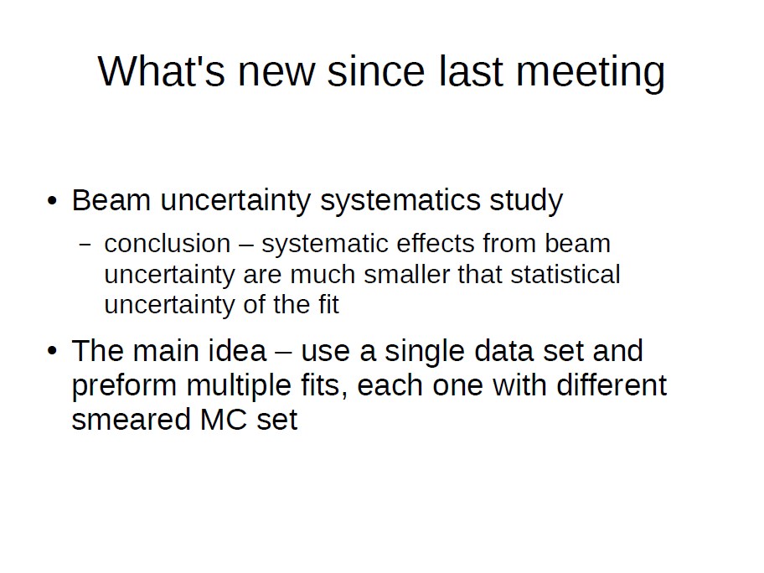
Budimir @ PC 13 Jan

Slide 24
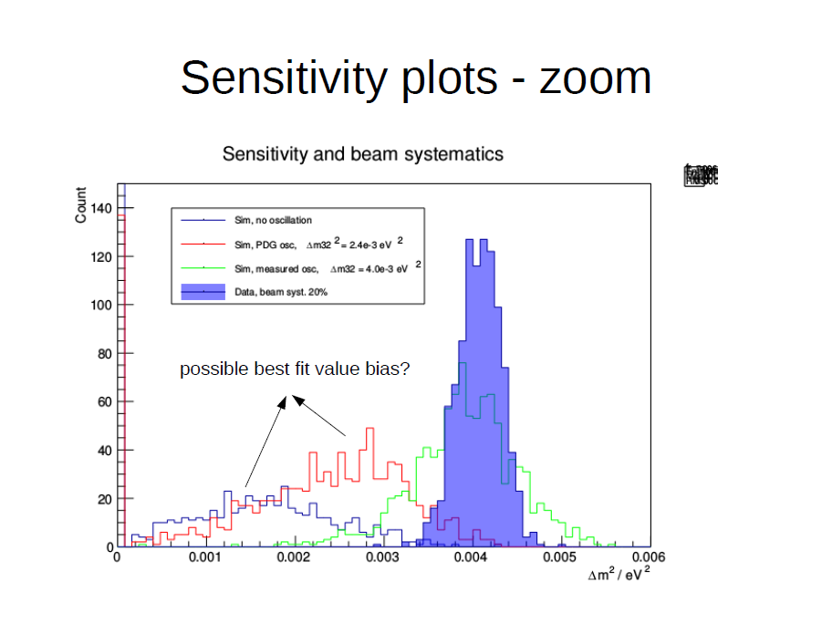
Budimir @ PC 15 Mar

Slide 25
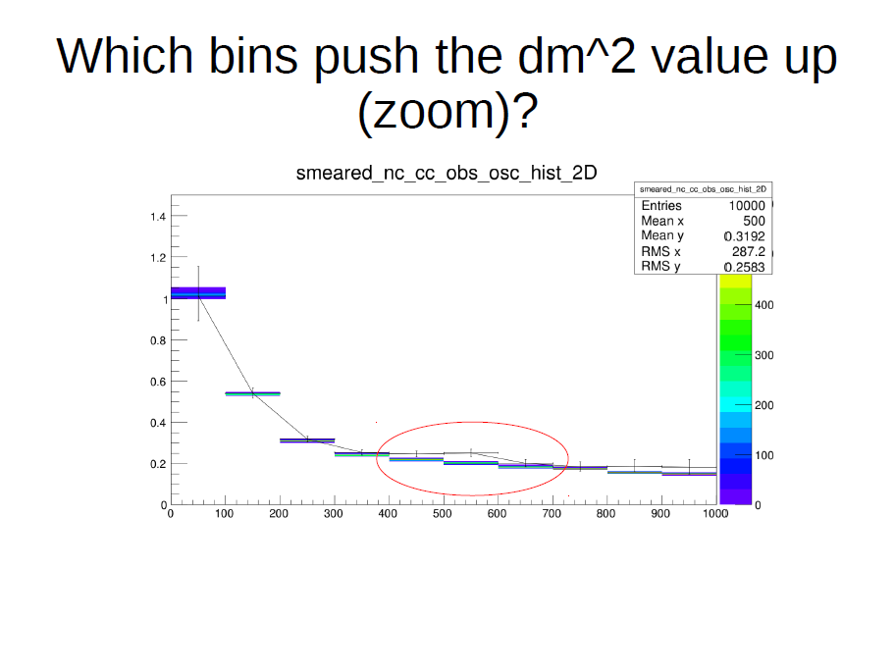
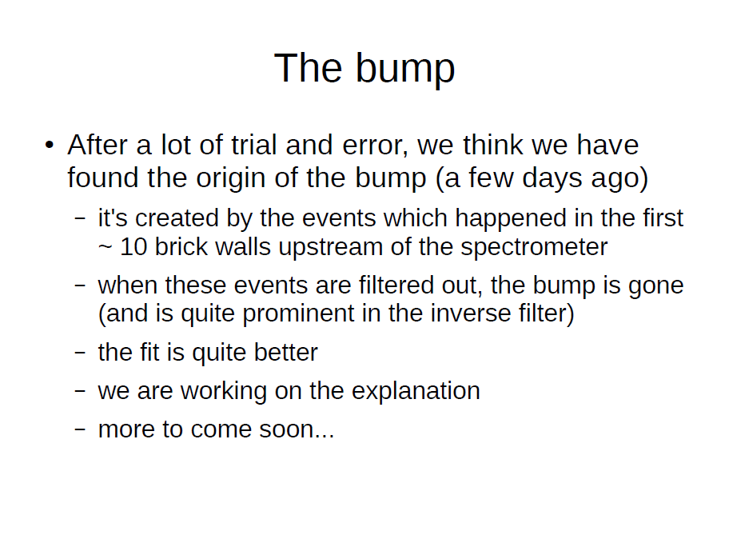
Budimir @ PC 15 Mar

Slide 26
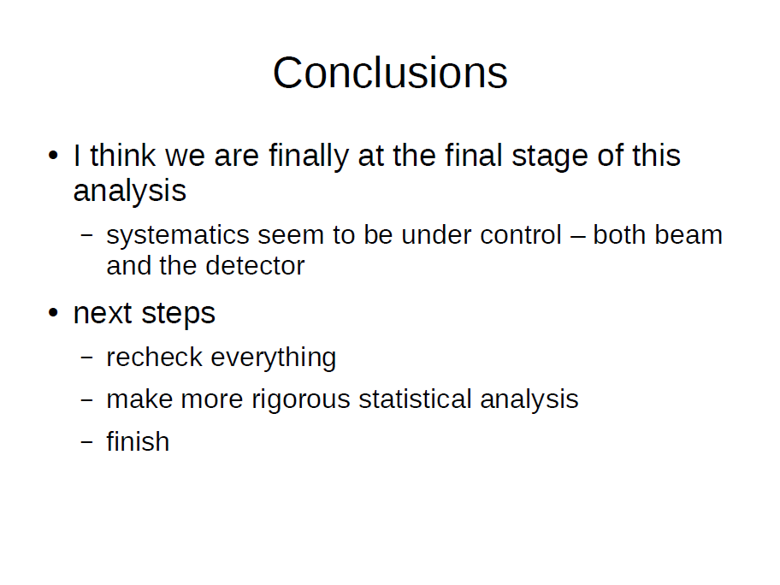
Budimir @ PC 15 Mar

Slide 27
Other activities
Updates on annual modulation : Nicoletta, Andrea, Alessandro
Multiplicity Distributions in CC Interactions : Cagin
Open data event sample : Cagin, Sergey
Test of Lorentz violation : offline

Slide 28
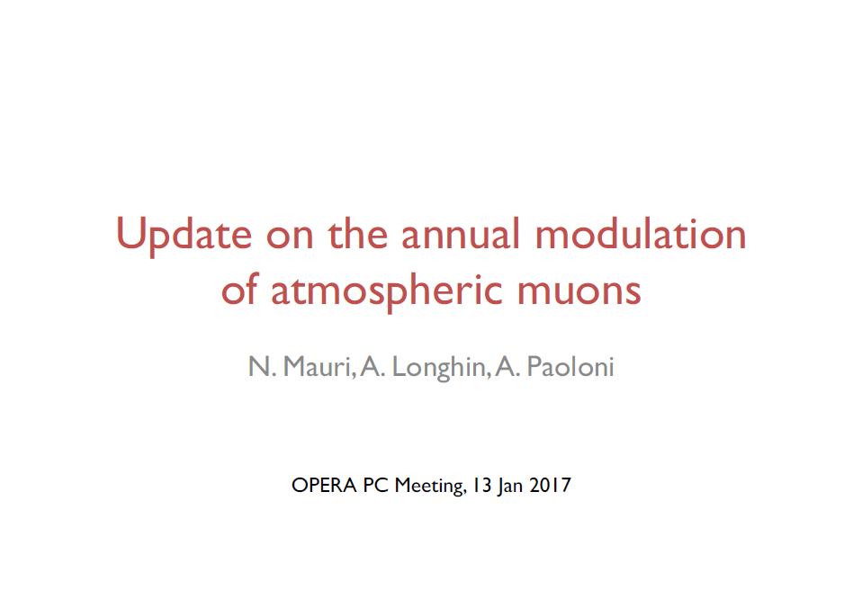
Nicoletta @ PC 13 Jan

Slide 29
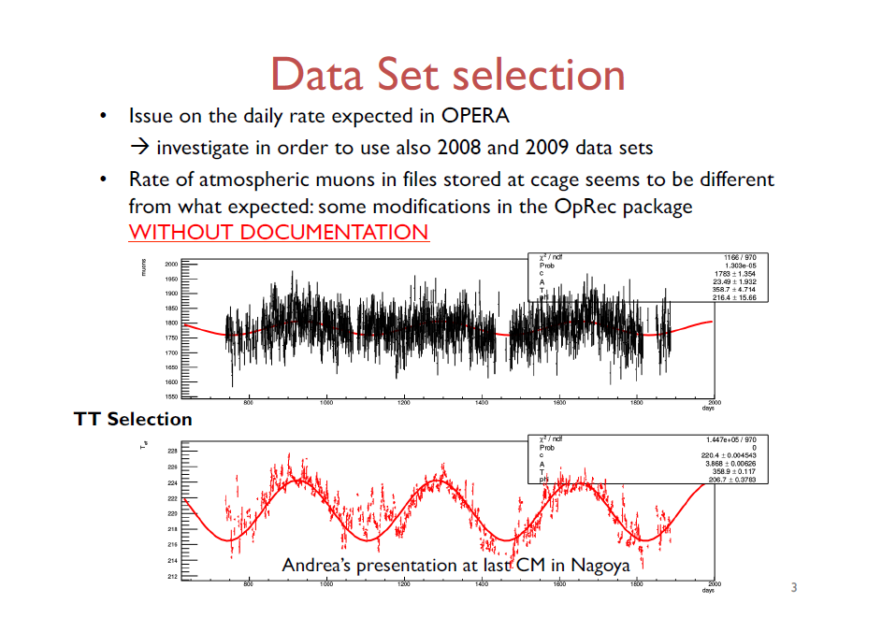
Nicoletta @ PC 13 Jan

Slide 30
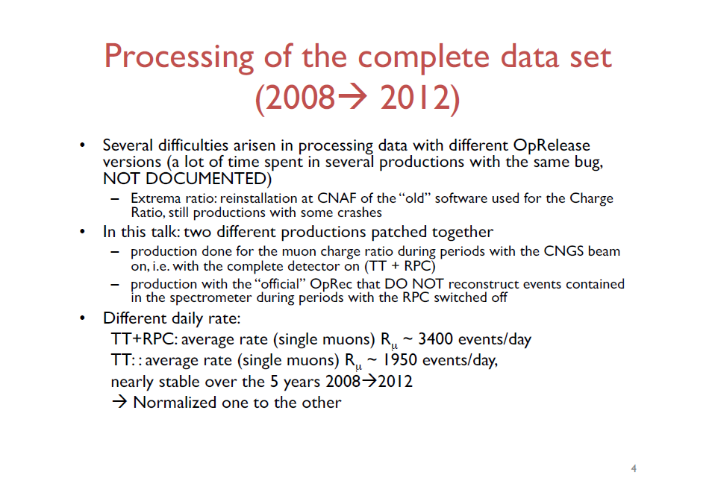
Nicoletta @ PC 13 Jan

Slide 31
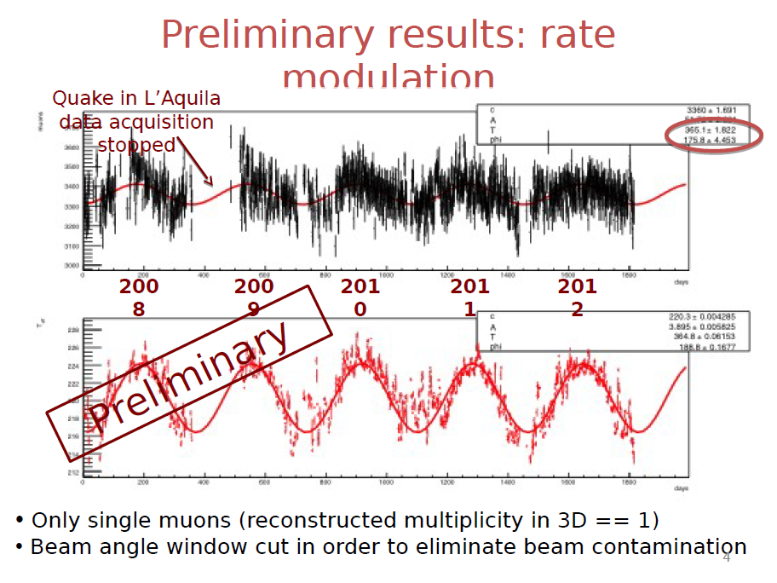
Nicoletta @ PC 15 Mar

Slide 32
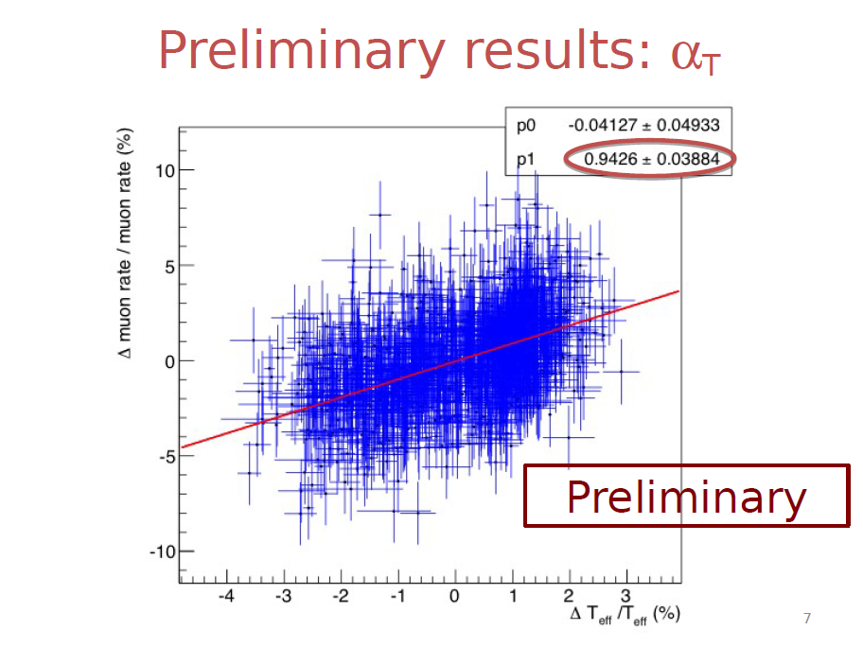
Nicoletta @ PC 15 Mar

Slide 33
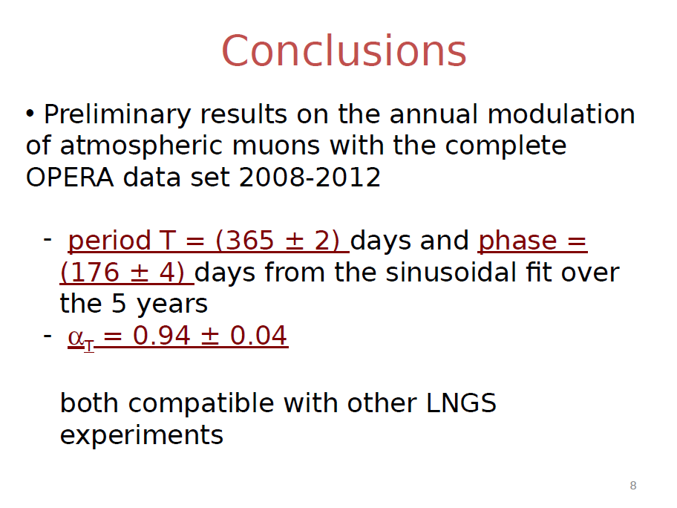
Nicoletta @ PC 15 Mar

Slide 34
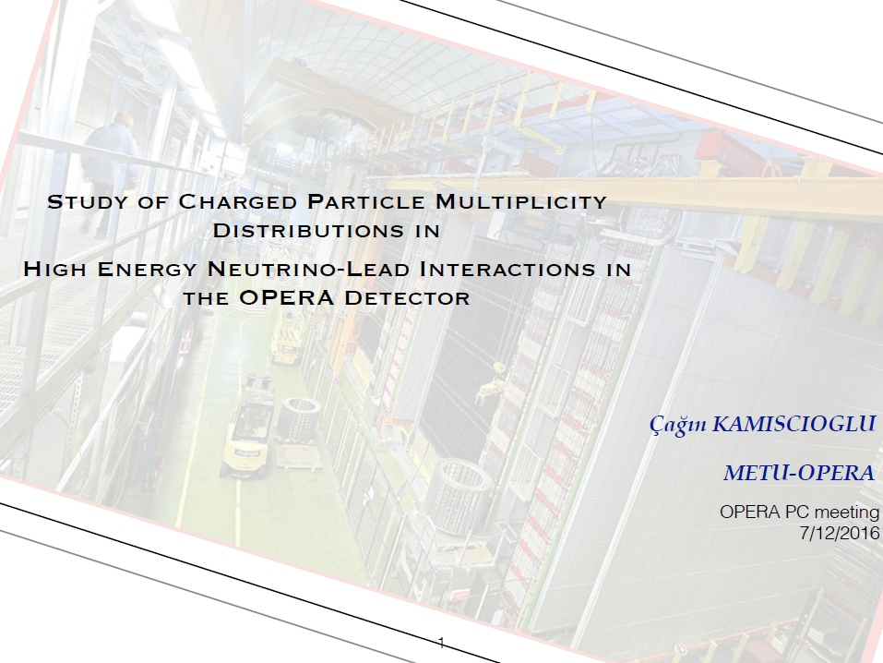
Cagin @ PC 7 Dec

Slide 35
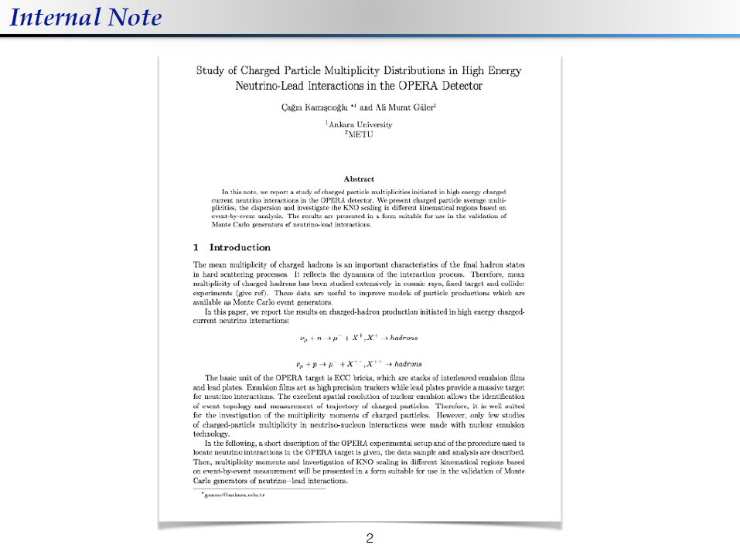
Cagin @ PC 7 Dec

Slide 36

Cagin @ PC 13 Jan

Slide 37
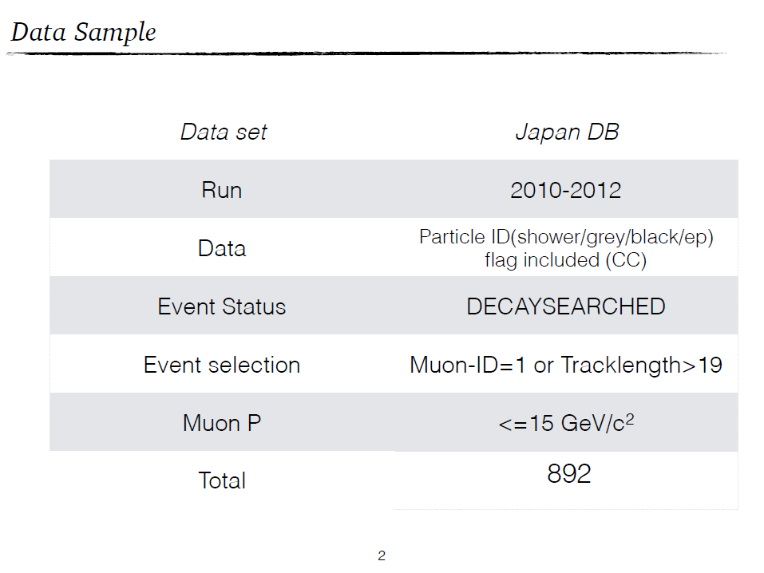
Cagin @ PC 13 Jan

Slide 38
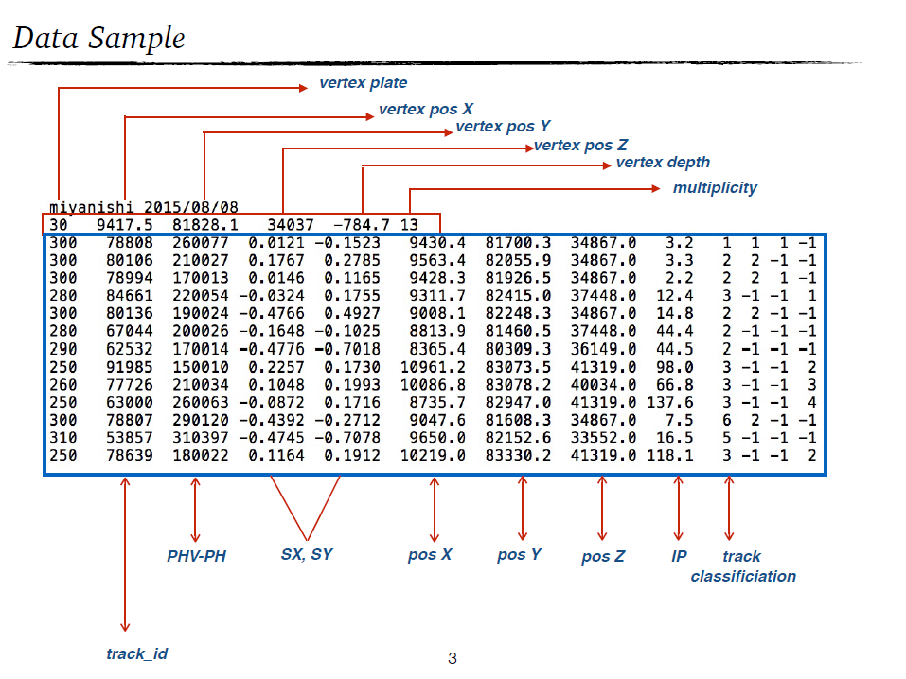
Cagin @ PC 13 Jan

Slide 39
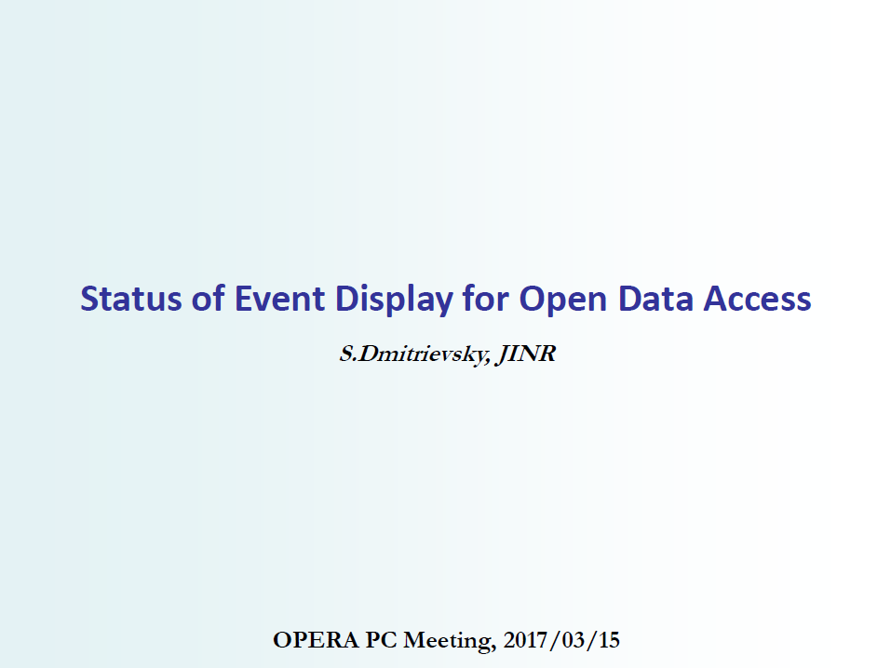
Sergey @ PC 15 Mar

Slide 40
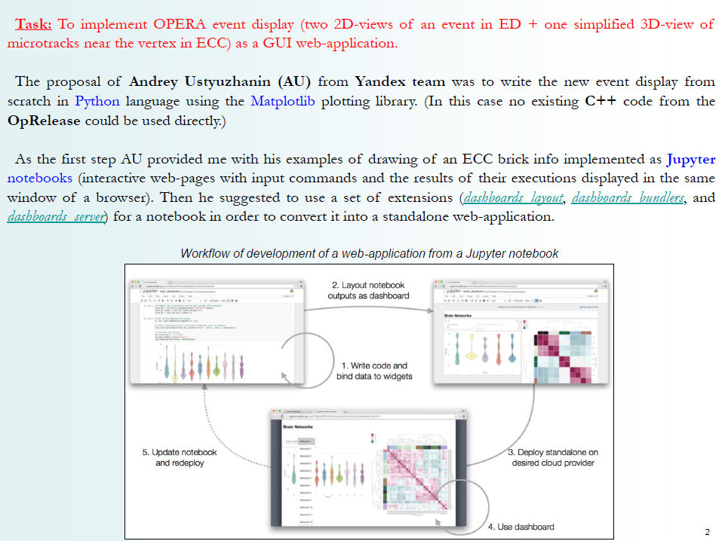
Sergey @ PC 15 Mar

Slide 41
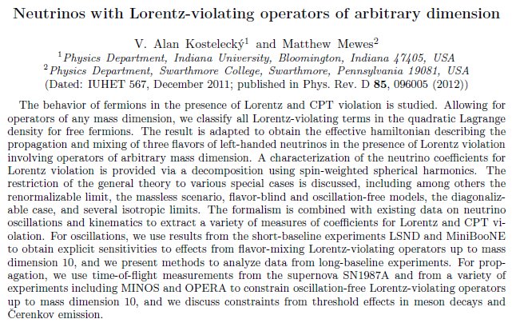
Test of Lorentz violation
Giovanni is contacted to improve analysis by T. Katori.
  http://arxiv.org/abs/1112.6395
  direction dependent neutrino TOF

Slide 42
Test of Lorentz violation
I made contact to peoples who has worked for neutirno TOF in past.
  Namely Stefano, Alessandro B., Alessandro P., Gabriele and Sergey.
Only partial or faulty data available
  Gabriele has old faulty (A1 and CTRI) data. Not the final one.
  Alessandro Bertlin told that seems it is not possible to recover old data.
  Alessandro P. and Sergay only has arrival time information for bunched beam run in 2012
In conclusion
  It seems difficult to perform another analysis for neutrino TOF without main contributor on this subject.

Slide 43
Outlook
Papers in line
  Double vertex event and multiplicity paper will be distributed very soon.
Papers to be sent to internal referee
  Nue and marginal event soon April to June
Should be finalized and added
  Numu disappearance
  Combined analysis for all flavors
    nutau, nue appearance and numu disappearance
    Update of exotic oscillation in tau appearance
  AoB

Slide 44
Agenda
nue oscillation analysis : Matteo
nue analysis statistics and paper status : Svetlana
marginal event analysis : Giuliana
numu disappearance analysis : Budimir
cosmic ray annual modulation : Nicoletta
Report from PTB
Paper status report for double vertex event : Chiara
Paper status report for multiplicity : Cagin
Hadron BG study : Mizusawa
Short decay search : Mustafa
Open data event display

