Slide 1
Update of hadron interaction analysis
H. Mizusawa, M. Okubo, J. Ohira, M. Hatakeyama,
T. Fukuda, T. Matsuo, S. Nishimura, T. Suzuki,
H. Ishida, H. Shibuya, S. Ogawa, et al.
Toho University
OPERA collaboration meeting on 22 March 2017

Slide 2
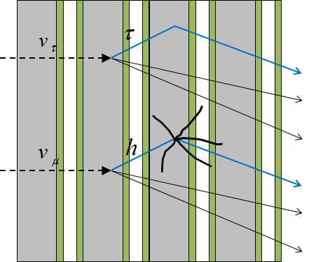
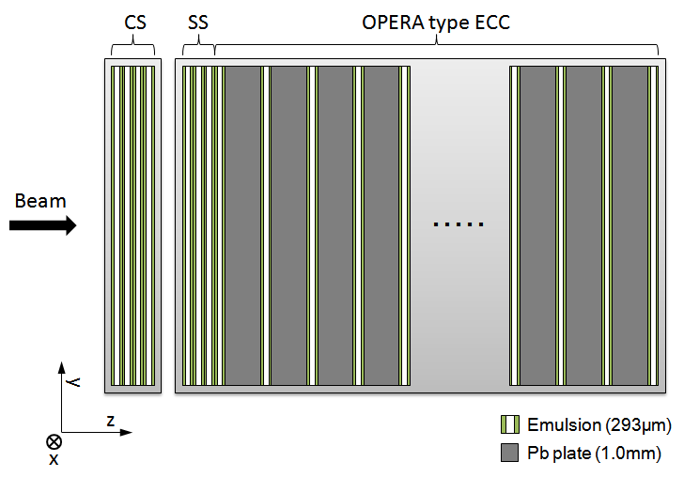
Introduction
Hadron interaction is one of the main background source of tau decay in OPERA.
In previous study, we analyzed 2, 4, 10 GeV/c π⁻ interaction in OPERA ECC and compared with a FLUKA based MC simulation.
We concluded the agreement between the experimental data has been confirmed at the 30% level.
In 2012, we took a new data set for hadron interaction analysis to increase statistics and confirm the agreement with better precision.
Signal
Event
Hadron
Background

Slide 3
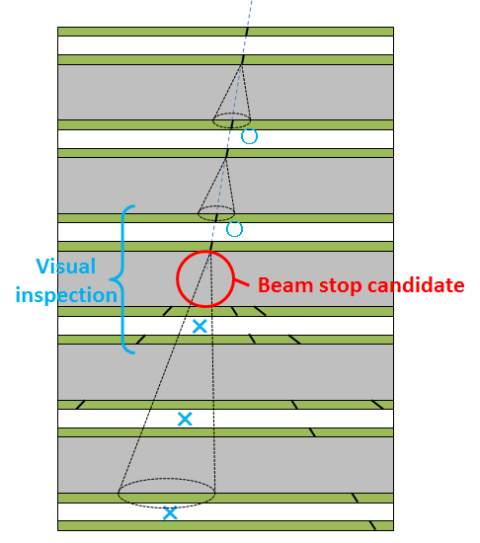
Interaction search
Beam tracks are followed down from the upstream in the ECC.
We defined beam stop candidates as follows:
Beam stop candidate
No track found in 3 consecutive films.
(angle difference for connection < 20mrad)
If the beam-stop candidate found, the last beam track and predicted position in a downstream film are visually inspected.

Slide 4
Interaction search
Interaction search status
Beam momentum | 2 GeV/c | 3 GeV/c | 4 GeV/c | 5 GeV/c | 6 GeV/c
Number of reconstructed tracks | 538 /4cm² | 899 /4cm² | 547 /4cm² | 864 /1cm² | 239 /1cm²
Number of manual checked films | 51 films | 51 films | 51 films | 51 films | 51 films
Number of found interactions | 213 events | 239 events | 127 events | 233 events | 61 events
Interaction search has been finished in all momentum area.

Slide 5
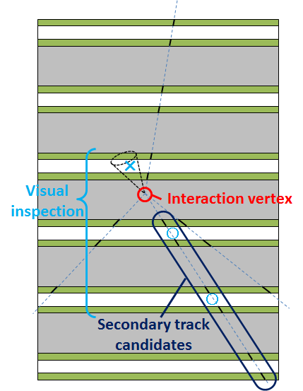
Secondary particle search
Each confirmed interaction is subject to the secondary particle track search.
When a secondary particle candidate is found in at least 1 of the 3 downstream films from the vertex, we required the follow conditions:
Selecting condition
IP < 10 + 0.01 x depth (μm)
|tanθ| < 0.6
Same as those in OPERA
At least 3 tracks in 6 downstream films from the vertex.
Once a secondary track candidate found, it is checked by visual inspection
Visual inspection
Passing-through track check in 1 upstream film from the interaction vertex.
2 downstream films from the interaction vertex.

Slide 6
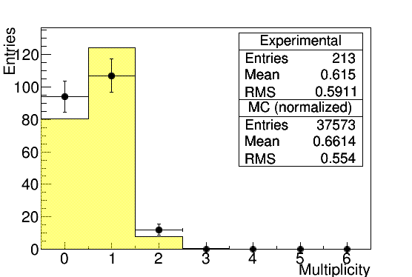

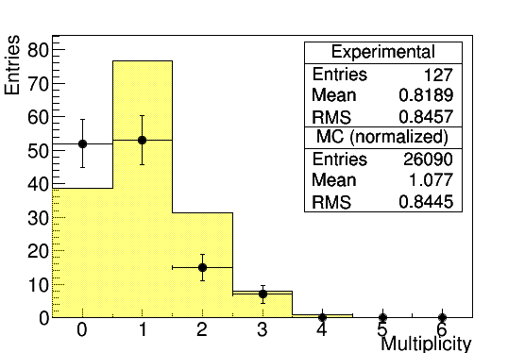
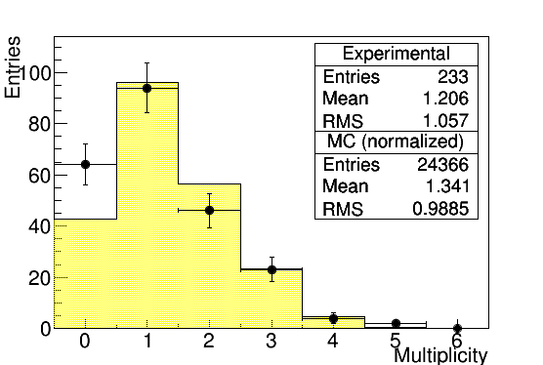
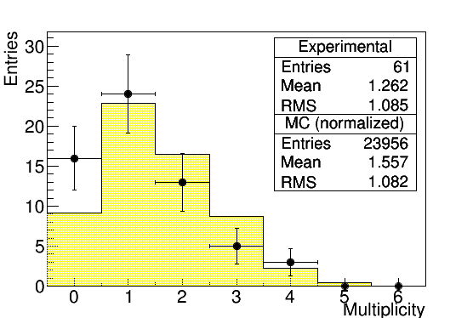
Secondary particle multiplicity
2 GeV/c
3 GeV/c
4 GeV/c
Plots : Experimental data
Histogram : Simulated data
5 GeV/c
6 GeV/c

Slide 7
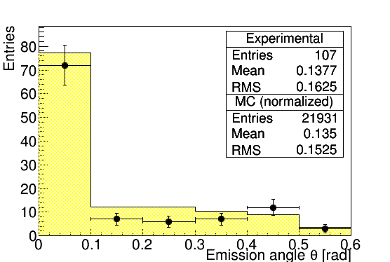
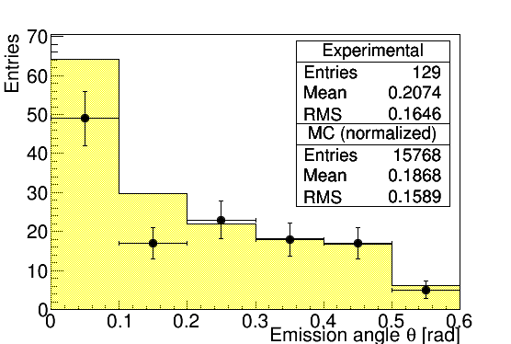
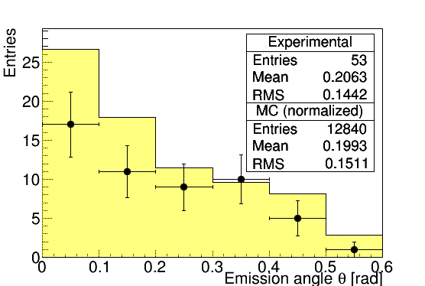
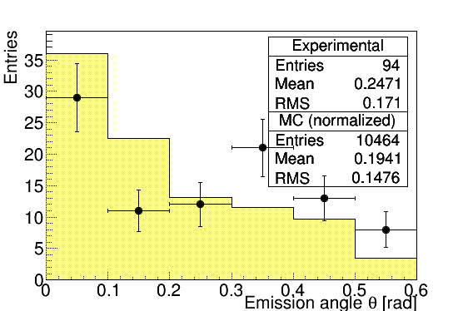
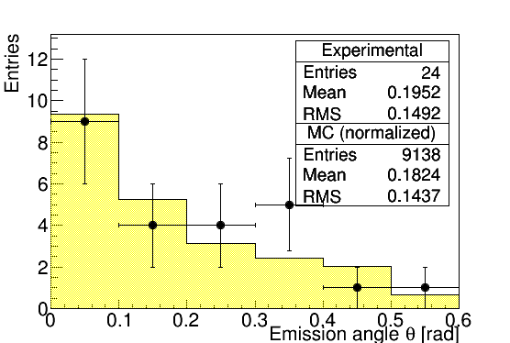
Secondary particle emission angle
2 GeV/c
3 GeV/c
4 GeV/c
5 GeV/c
6 GeV/c
Plots : Experimental data
Histogram : Simulated data

Slide 8
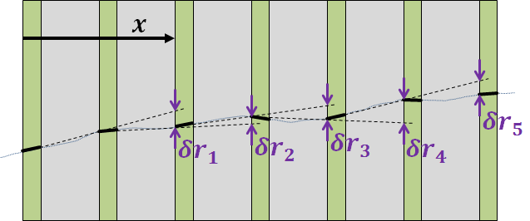
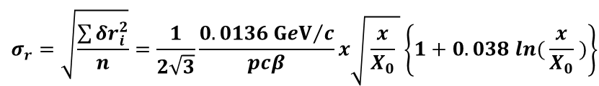
Measurement of secondary particle momentum
The momenta of secondary tracks are estimated by measuring their multiple Coulomb scattering in the brick.
We use the coordinate method because it is more accurate when a small multiple scattering signal is expected.
Momentum measurable tracks
At least 14 emulsion films are available for the position measurements.
$$σ_{r}=\sqrt{\frac{\sum{{δr}_{i}^{2}}}{n}}=\frac{1}{2\sqrt{3}}\frac{0.0136{GeV}/c}{pcβ}x\sqrt{ \frac{x}{X_{0}} }\left\{1+0.038 ln⁡( \frac{x}{X_{0}} )\right\}$$

Slide 9
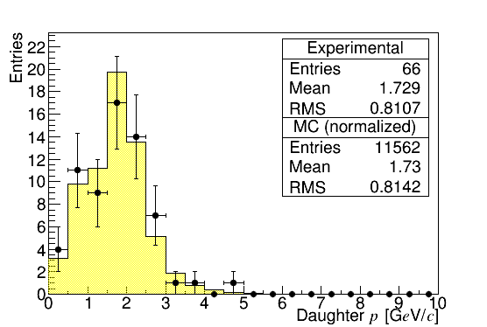
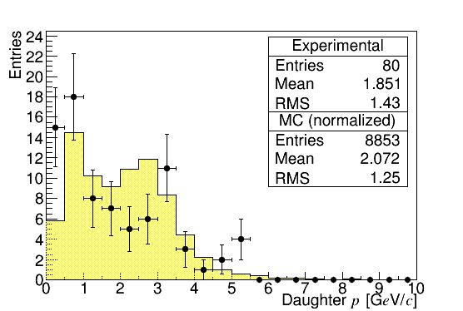
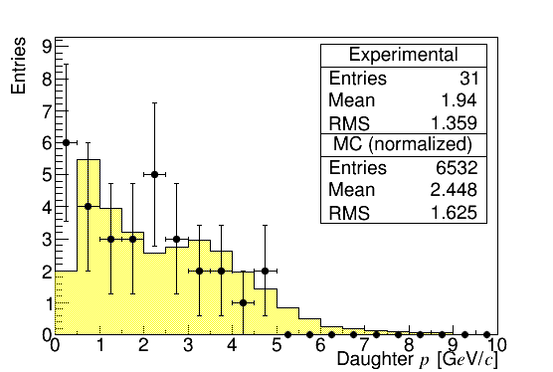
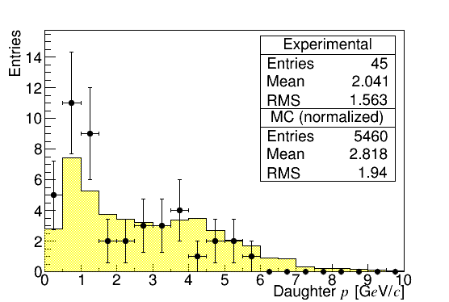
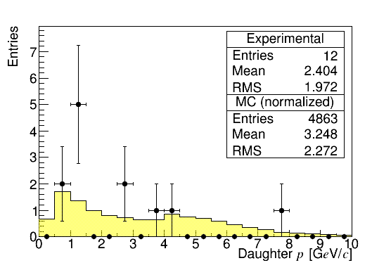
Secondary particle p
2 GeV/c
3 GeV/c
4 GeV/c
Plots : Experimental data
Histogram : Simulated data
5 GeV/c
6 GeV/c

Slide 10
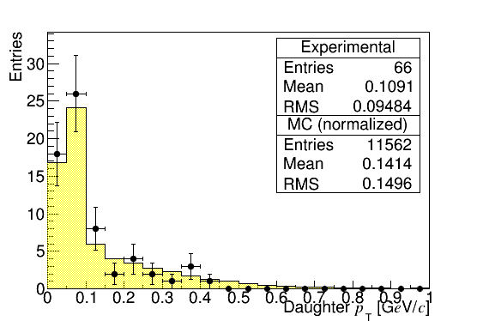
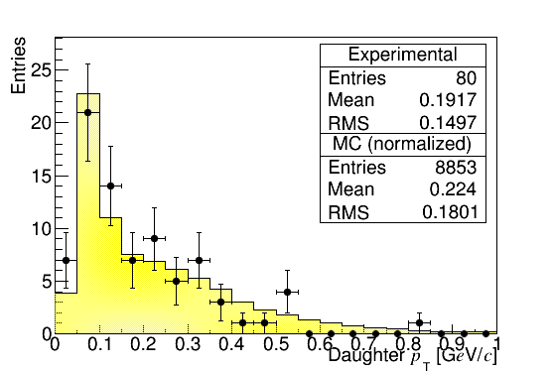
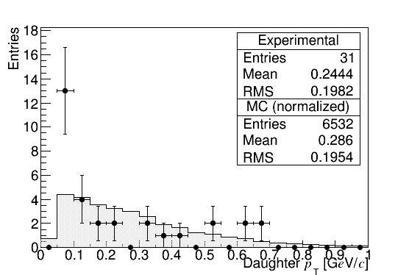
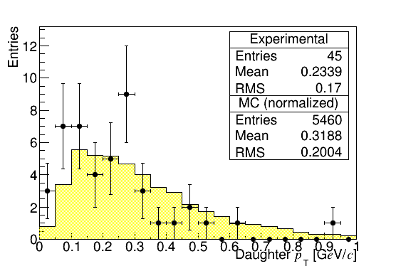
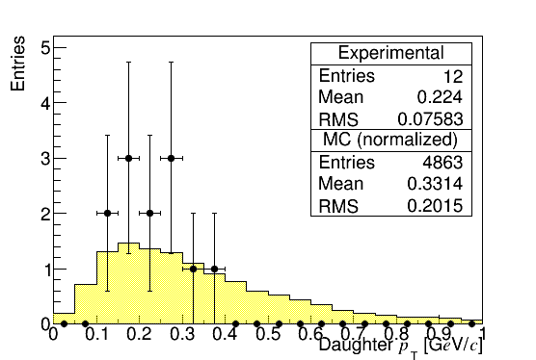
Secondary particle p_{T}
2 GeV/c
3 GeV/c
4 GeV/c
Plots : Experimental data
Histogram : Simulated data
5 GeV/c
6 GeV/c

Slide 11
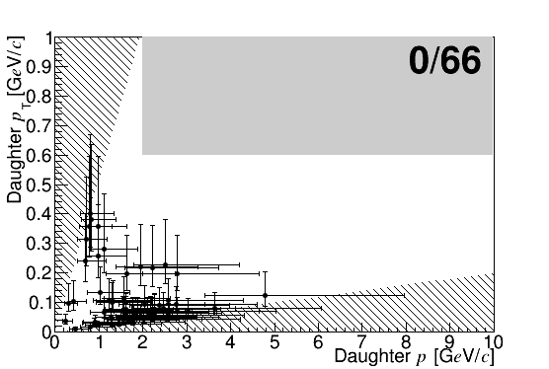
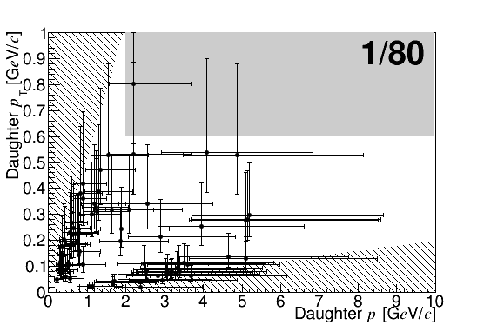
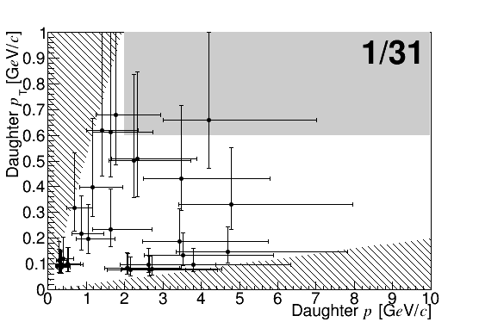
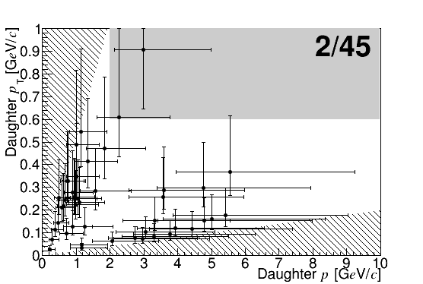
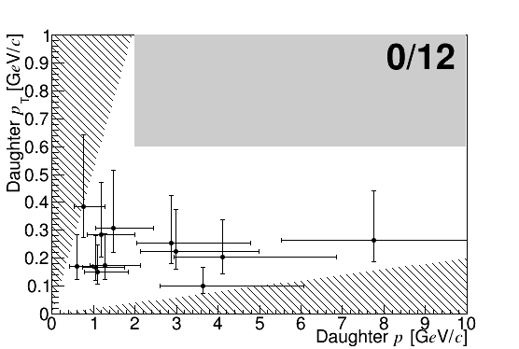
p_{T} vs. p plot
2 GeV/c
3 GeV/c
4 GeV/c
5 GeV/c
6 GeV/c
Plots : Experimental data
Histogram : Simulated data

Slide 12
Statistics of kinematical analysis
Numbers of secondary tracks for which the momentum is measurable
Momentum | 2 | 3 | 4 | 5 | 6 | 10 | Analyzed events
Previous study | 12 | - | 7 | - | - | 10 | 29
This study | 66 | 80 | 31 | 45 | 12 | - | ~234 (~8.1x)
More than 8 times the previous data were obtained .

Slide 13
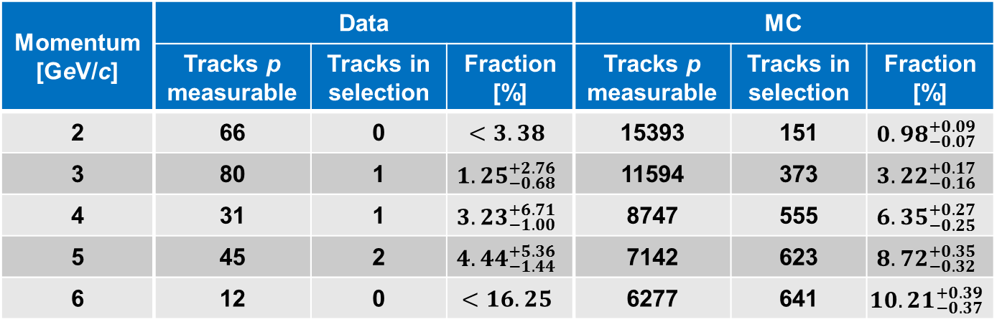
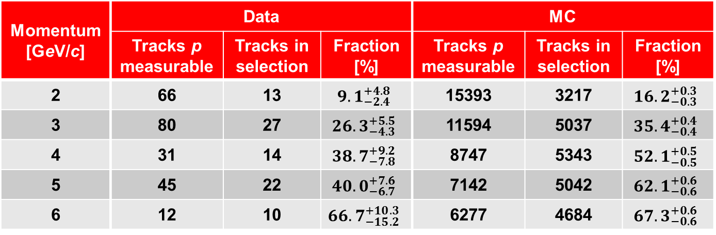
p > 2 GeV/c, p_{T} > 0.6 GeV/c (“Golden analysis”)
Upper limits are at 90% C.L.
Momentum [GeV/c] | Data |  |  | MC
 | Tracks p measurable | Tracks in selection | Fraction [%] | Tracks p measurable | Tracks in selection | Fraction [%]
2 | 66 | 0 | $$<3.38$$ | 15393 | 151 | $${0.98}_{−0.07}^{+0.09}$$
3 | 80 | 1 | $${1.25}_{−0.68}^{+2.76}$$ | 11594 | 373 | $${3.22}_{−0.16}^{+0.17}$$
4 | 31 | 1 | $${3.23}_{−1.00}^{+6.71}$$ | 8747 | 555 | $${6.35}_{−0.25}^{+0.27}$$
5 | 45 | 2 | $${4.44}_{−1.44}^{+5.36}$$ | 7142 | 623 | $${8.72}_{−0.32}^{+0.35}$$
6 | 12 | 0 | $$<16.25$$ | 6277 | 641 | $${10.21}_{−0.37}^{+0.39}$$
p > 1 GeV/c, p_{T} > 0.15 GeV/c (“Minimum bias analysis”)
Momentum [GeV/c] | Data |  |  | MC
 | Tracks p measurable | Tracks in selection | Fraction [%] | Tracks p measurable | Tracks in selection | Fraction [%]
2 | 66 | 13 | $${9.1}_{−2.4}^{+4.8}$$ | 15393 | 3217 | $${16.2}_{−0.3}^{+0.3}$$
3 | 80 | 27 | $${26.3}_{−4.3}^{+5.5}$$ | 11594 | 5037 | $${35.4}_{−0.4}^{+0.4}$$
4 | 31 | 14 | $${38.7}_{−7.8}^{+9.2}$$ | 8747 | 5343 | $${52.1}_{−0.5}^{+0.5}$$
5 | 45 | 22 | $${40.0}_{−6.7}^{+7.6}$$ | 7142 | 5042 | $${62.1}_{−0.6}^{+0.6}$$
6 | 12 | 10 | $${66.7}_{−15.2}^{+10.3}$$ | 6277 | 4684 | $${67.3}_{−0.6}^{+0.6}$$

Slide 14
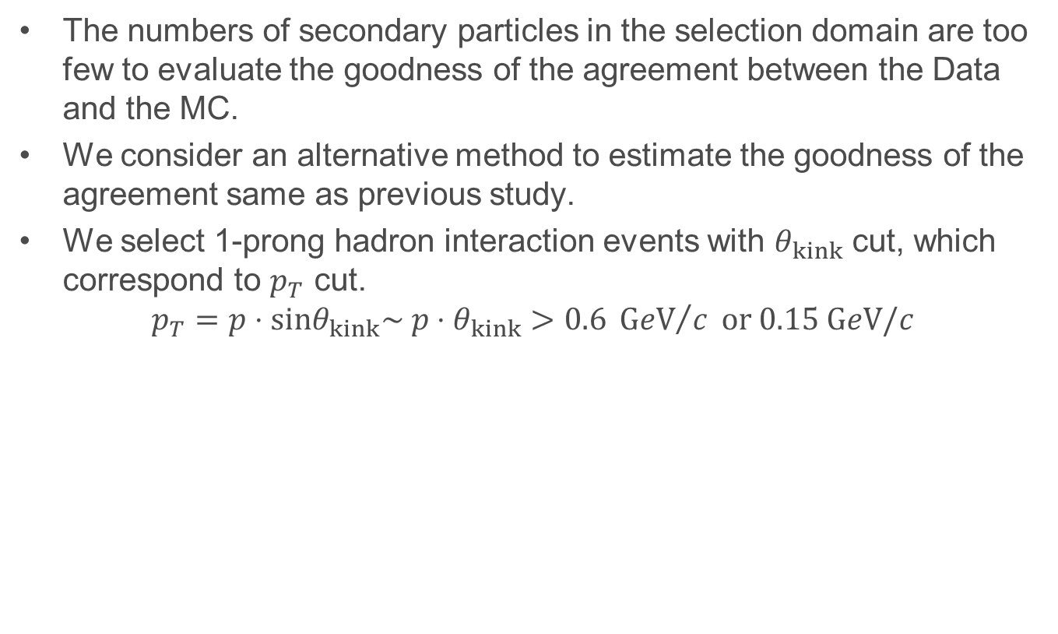
Goodness of agreement between Data and MC
The numbers of secondary particles in the selection domain are too few to evaluate the goodness of the agreement between the Data and the MC.
We consider an alternative method to estimate the goodness of the agreement same as previous study.
We select 1-prong hadron interaction events with $θ_{kink}$ cut, which correspond to $p_{T}$ cut.
$$p_{T}=p⋅sinθ_{kink}\sim p⋅θ_{kink}>0.6 {GeV}/c or 0.15 GeV/c$$

Slide 15
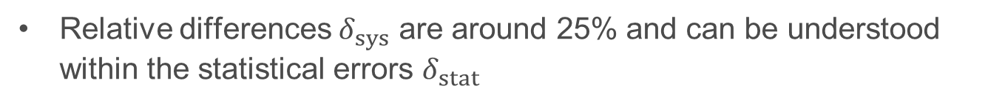
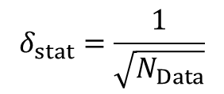

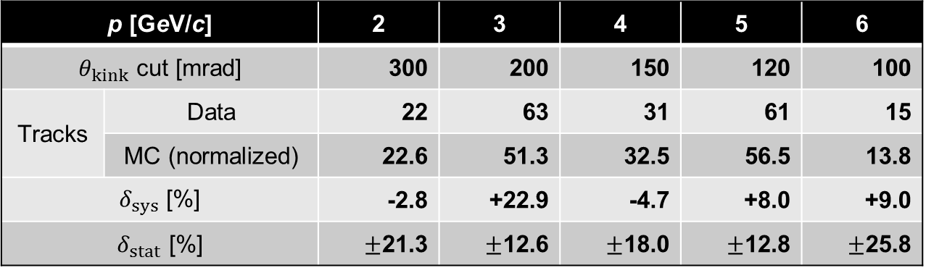
Goodness of agreement between Data and MC
p > 2 GeV/c, p_{T} > 0.6 GeV/c (“Golden analysis”)
p [GeV/c] |  | 2 | 3 | 4 | 5 | 6
$θ_{kink}$ cut [mrad] |  | 300 | 200 | 150 | 120 | 100
Tracks | Data | 22 | 63 | 31 | 61 | 15
 | MC (normalized) | 22.6 | 51.3 | 32.5 | 56.5 | 13.8
$δ_{sys}$ [%] |  | -2.8 | +22.9 | -4.7 | +8.0 | +9.0
$δ_{stat}$ [%] |  | $±$21.3 | $±$12.6 | $±$18.0 | $±$12.8 | $±$25.8
$$δ_{sys}=\frac{N_{Data}−N_{MC}}{N_{MC}}$$
$$δ_{stat}=\frac{1}{\sqrt{N_{Data}}}$$
Relative differences $δ_{sys}$ are around 25% and can be understood within the statistical errors $δ_{stat}$

Slide 16
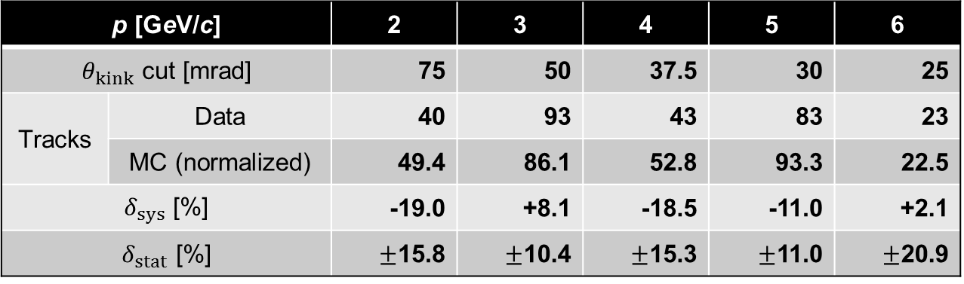

Goodness of agreement between Data and MC
p > 1 GeV/c, p_{T} > 0.15 GeV/c (“Minimum bias analysis”)
p [GeV/c] |  | 2 | 3 | 4 | 5 | 6
$θ_{kink}$ cut [mrad] |  | 75 | 50 | 37.5 | 30 | 25
Tracks | Data | 40 | 93 | 43 | 83 | 23
 | MC (normalized) | 49.4 | 86.1 | 52.8 | 93.3 | 22.5
$δ_{sys}$ [%] |  | -19.0 | +8.1 | -18.5 | -11.0 | +2.1
$δ_{stat}$ [%] |  | $±$15.8 | $±$10.4 | $±$15.3 | $±$11.0 | $±$20.9
$$δ_{sys}=\frac{N_{Data}−N_{MC}}{N_{MC}}$$
$$δ_{stat}=\frac{1}{\sqrt{N_{Data}}}$$
Relative differences $δ_{sys}$ are around 20% and can be understood within the statistical errors $δ_{stat}$

Slide 17
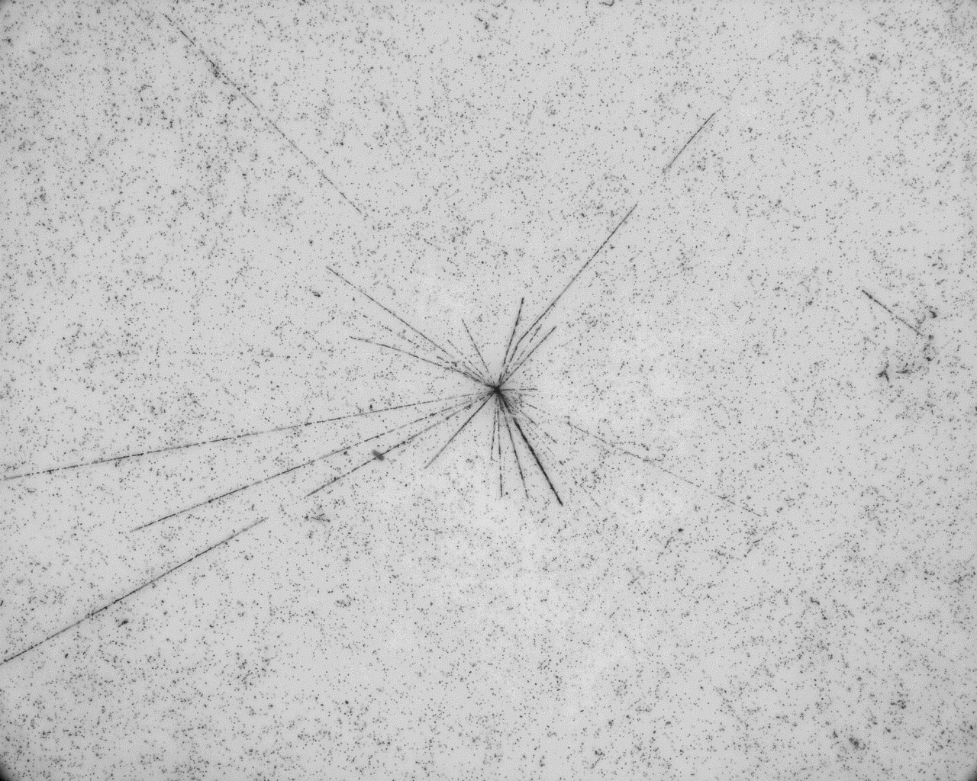

Nuclear Fragments
If a secondary particle has a value of $β$ < 0.7, the particle is observed as a heavily ionizing track or a nuclear fragment.
Nuclear fragments emitted from hadron interactions were also sought by a newly developed automatic emulsion scanning system with wider angular acceptance, FTS.
Signal
BG

Slide 18
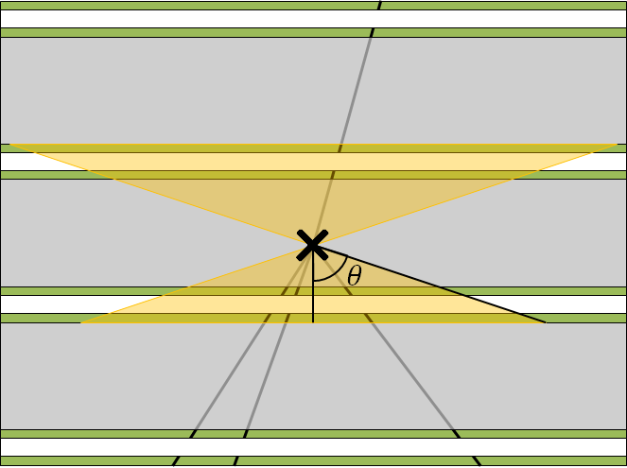
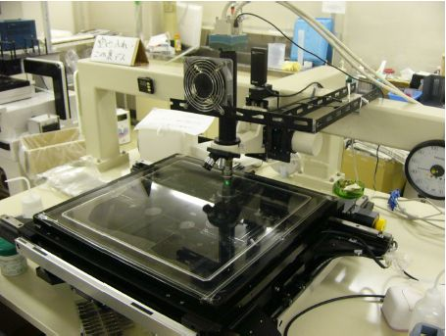
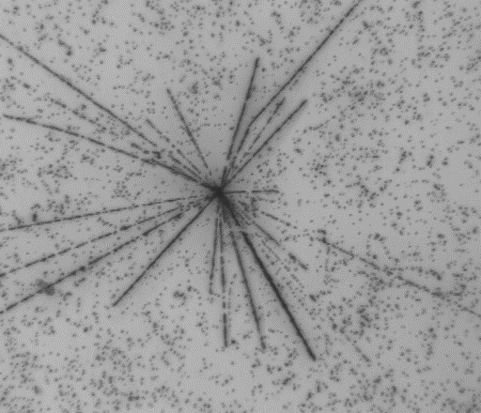
Nuclear fragments search
We scanned upstream and downstream films of the 1 or 3 prong vertex.
Since most of nuclear fragments are emitted at large angle, scanning was performed by using FTS at Toho University.
  Angle acceptance : |tanθ| < 3.0
Since nuclear fragments are expected to suffer from large multiple scattering, therefore, a loose condition was imposed.
  IP < 100 μm + 0.01×depth
Confirmation of candidates by visual inspection.

Slide 19
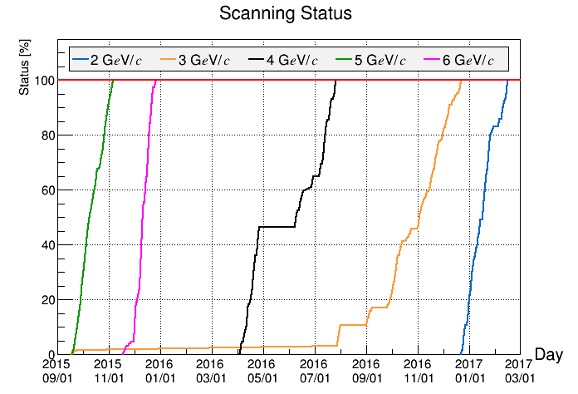
Scanning status
We finished large angle track scan of all hadron interactions.

Slide 20
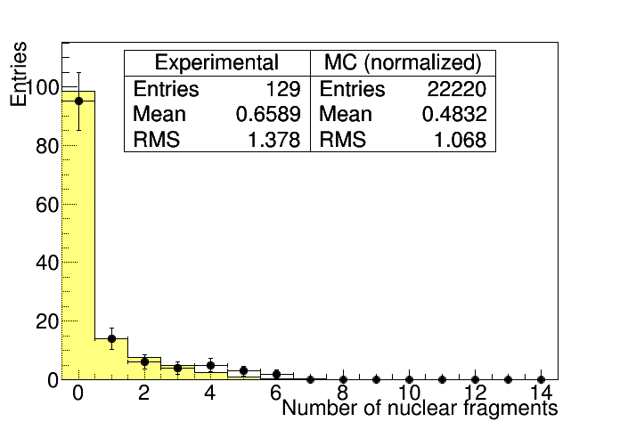
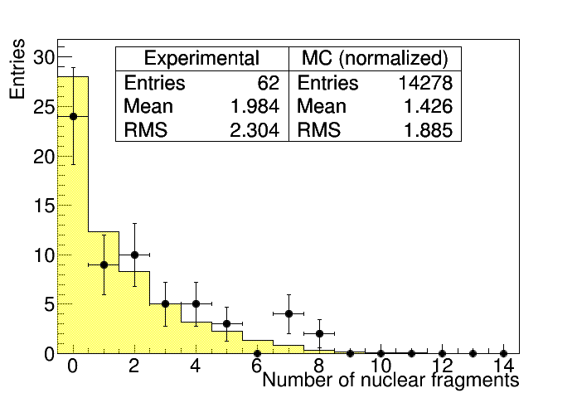
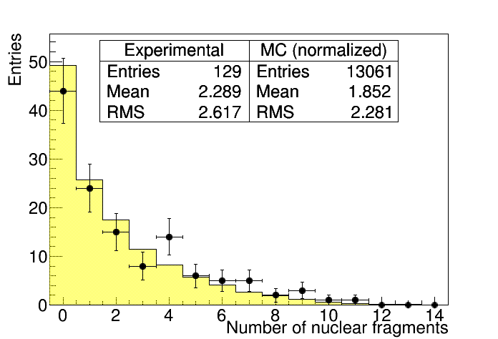
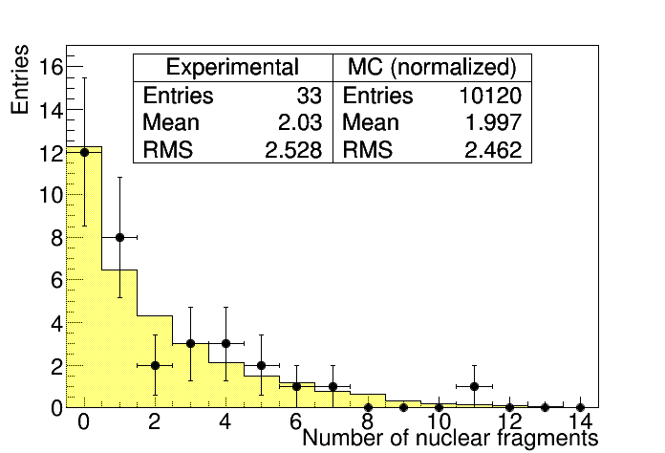
Results (Multiplicity distribution)
2 GeV/c
4 GeV/c
Plots : Experimental data
Histogram : MC data (FLUKA)
5 GeV/c
6 GeV/c

Slide 21
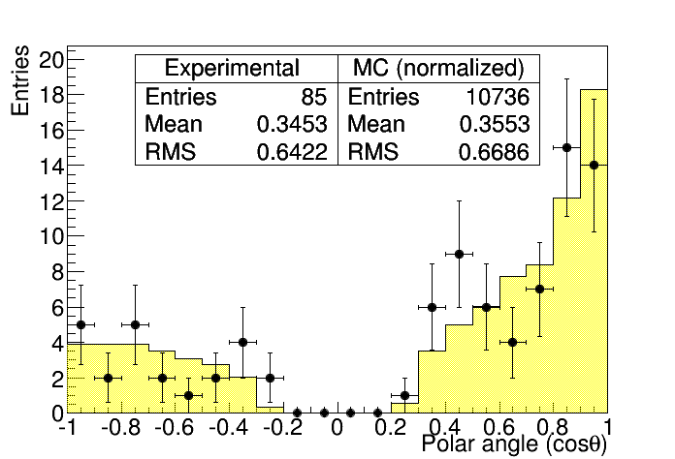
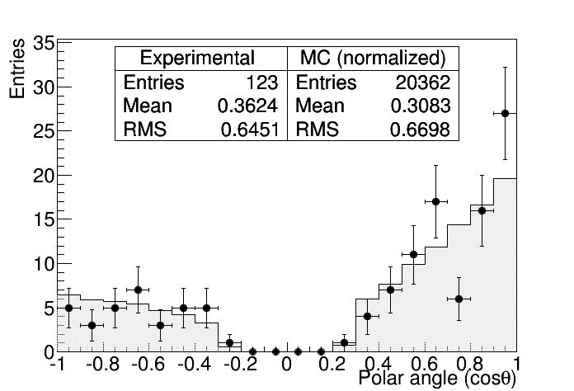
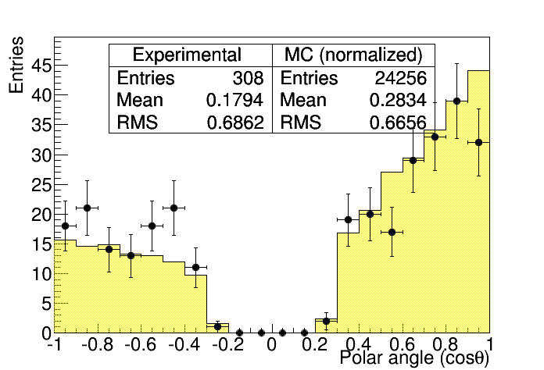

Results (Emission angle distribution)
2 GeV/c
4 GeV/c ^{[1]}
Plots : Experimental data
Histogram : MC data (FLUKA)
5 GeV/c ^{[2]}
6 GeV/c ^{[2]}
backward
forward

Slide 22

Results (Association probability)
0.5
We obtained new beam momentum data of nuclear fragments.
The MC data agree reasonably well with the experimental data.

Slide 23

Summary
Interaction & Secondary particle search
We finished the analysis of interaction & secondary particle search for all hadron beam interaction.
MC data agree roughly well with the experimental data.
Nuclear fragments search
Except for 3 GeV/c, manual check of nuclear fragments candidate have been done.
These results agree reasonably well.
Momentum measurement and agreement between Data and MC
We started the measurement of secondary particle momenta.
We obtained more than 8 times the previous data.
Relative differences $δ_{sys}$ are around 20% and can be understood within the statistical errors $δ_{stat}$.

