Slide 1


Thermosiphon pre-design
J. Direito (EN/CV/DC)

Slide 2
Gravity-driven Cooling Concept
Natural circulation of the fluid:
  Condensation temperature/pressure must lower than evaporation temperature/pressure
No working components in the main circuit
  Less probability of occurrence of leaks
  No significant vibrations on the system
  Low maintenance operations
Access to refrigeration units at the surface
No limit for the Evaporation Temperature:
  Suction pressure of the compressors is not a limit anymore -> possibility of reaching lower evaporation temperatures

Slide 3
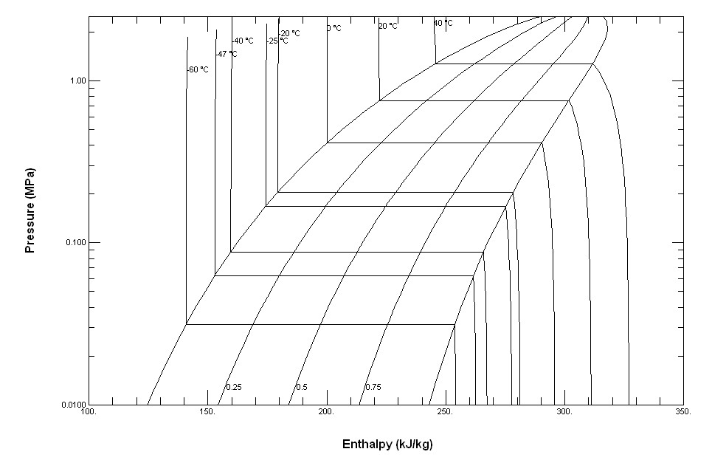
Preliminary design and parameters
Thermodynamic Cycle Example for C3F8 with Sub-Cooling
C
D
A-B : Condensation
B-C : Hydrostatic dP
C-D : Heat Exchanger
D-E : Pressure Regulation
E-F : Sub-Cooling
F-G : Capillary Expansion
G-H : Evaporation
H-I : Heater
I-A : Back-Pressure regulation
F
E
H
G
I
B
A

Slide 4
Preliminary design and parameters
SURFACE
100 m
CAVERN
Design by A. Moraux

Slide 5
Preliminary design and parameters
A-B : Condensation – dh = h (at T_{condensation}) – h (at T_{return lines})
  Definition of the Condensation Power
B-C : Hydrostatic – dP > P_{transfer} _{lines} (T_{transfer} _{lines}) – P_{return lines} (T_{return lines})
  Definition of minimum height
C-D : Heat Exchanger – dh = h (at T_{in}) – h (T_{supply lines})
  Definition of HX power
D-E : Pressure Regulation – Pressure Regulator Cv
  Regulation of mass flow
E-F : Sub-Cooling – dh = h (T_{evap} at T_{cond}) – h (X_{in})
  Definition of HX Power for sub-cooling
F-G : Capillary pressure drop – dP = P_{pressure regulator} – P_{evaporation}
  Definition of capillary length
G-H : Evaporation – dP _{stave}
  Definition of dP at the stave
H-I : Heater – dh = h (X_{out}) – h (T_{transfer lines})
  Definition of Heater power
I-A : Back-Pressure regulation – Pressure Regulator Cv
  Regulation of Evaporation Temperature
C
D
F
E
G
H
I
B
A

Slide 6
Preliminary design and parameters
Application example for the IBL detector and Distribution Racks at USA 15:
  Required mass flow = 36g/s
  Evaporation temperature = -40C
  Supply and return lines Temperature = 20C
  Altitude difference ≈ 100m
Definition of the main components:
  Minimum height O.K.: 16 bar > dP (P_{cond} = 7.57 bar ; P_{evap} = 0.87 bar)
  liquid line = DN25 -> dP= 16 bar ; Vapor line = DN50 -> dP = 90 mbar
  Condensation Temperature < -42.5 C (P_{cond} < 0.87 bar – 90mbar)
  Condenser Power > 5.94kW (dh = 165kJ/kg; m = 36g/s)
  Heat Exchanger Power > 1.44kW (dh = 40kJ/kg; m = 36 g/s)

