Slide 1
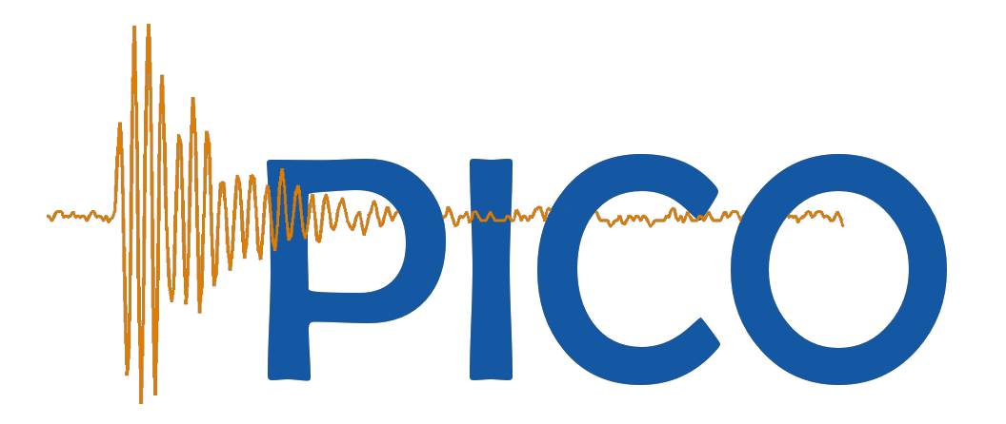
Tiny Bubbles in the Mine:
Results from PICO-60
Eric Dahl, Northwestern U.
SLAC Summer Institute

Slide 2
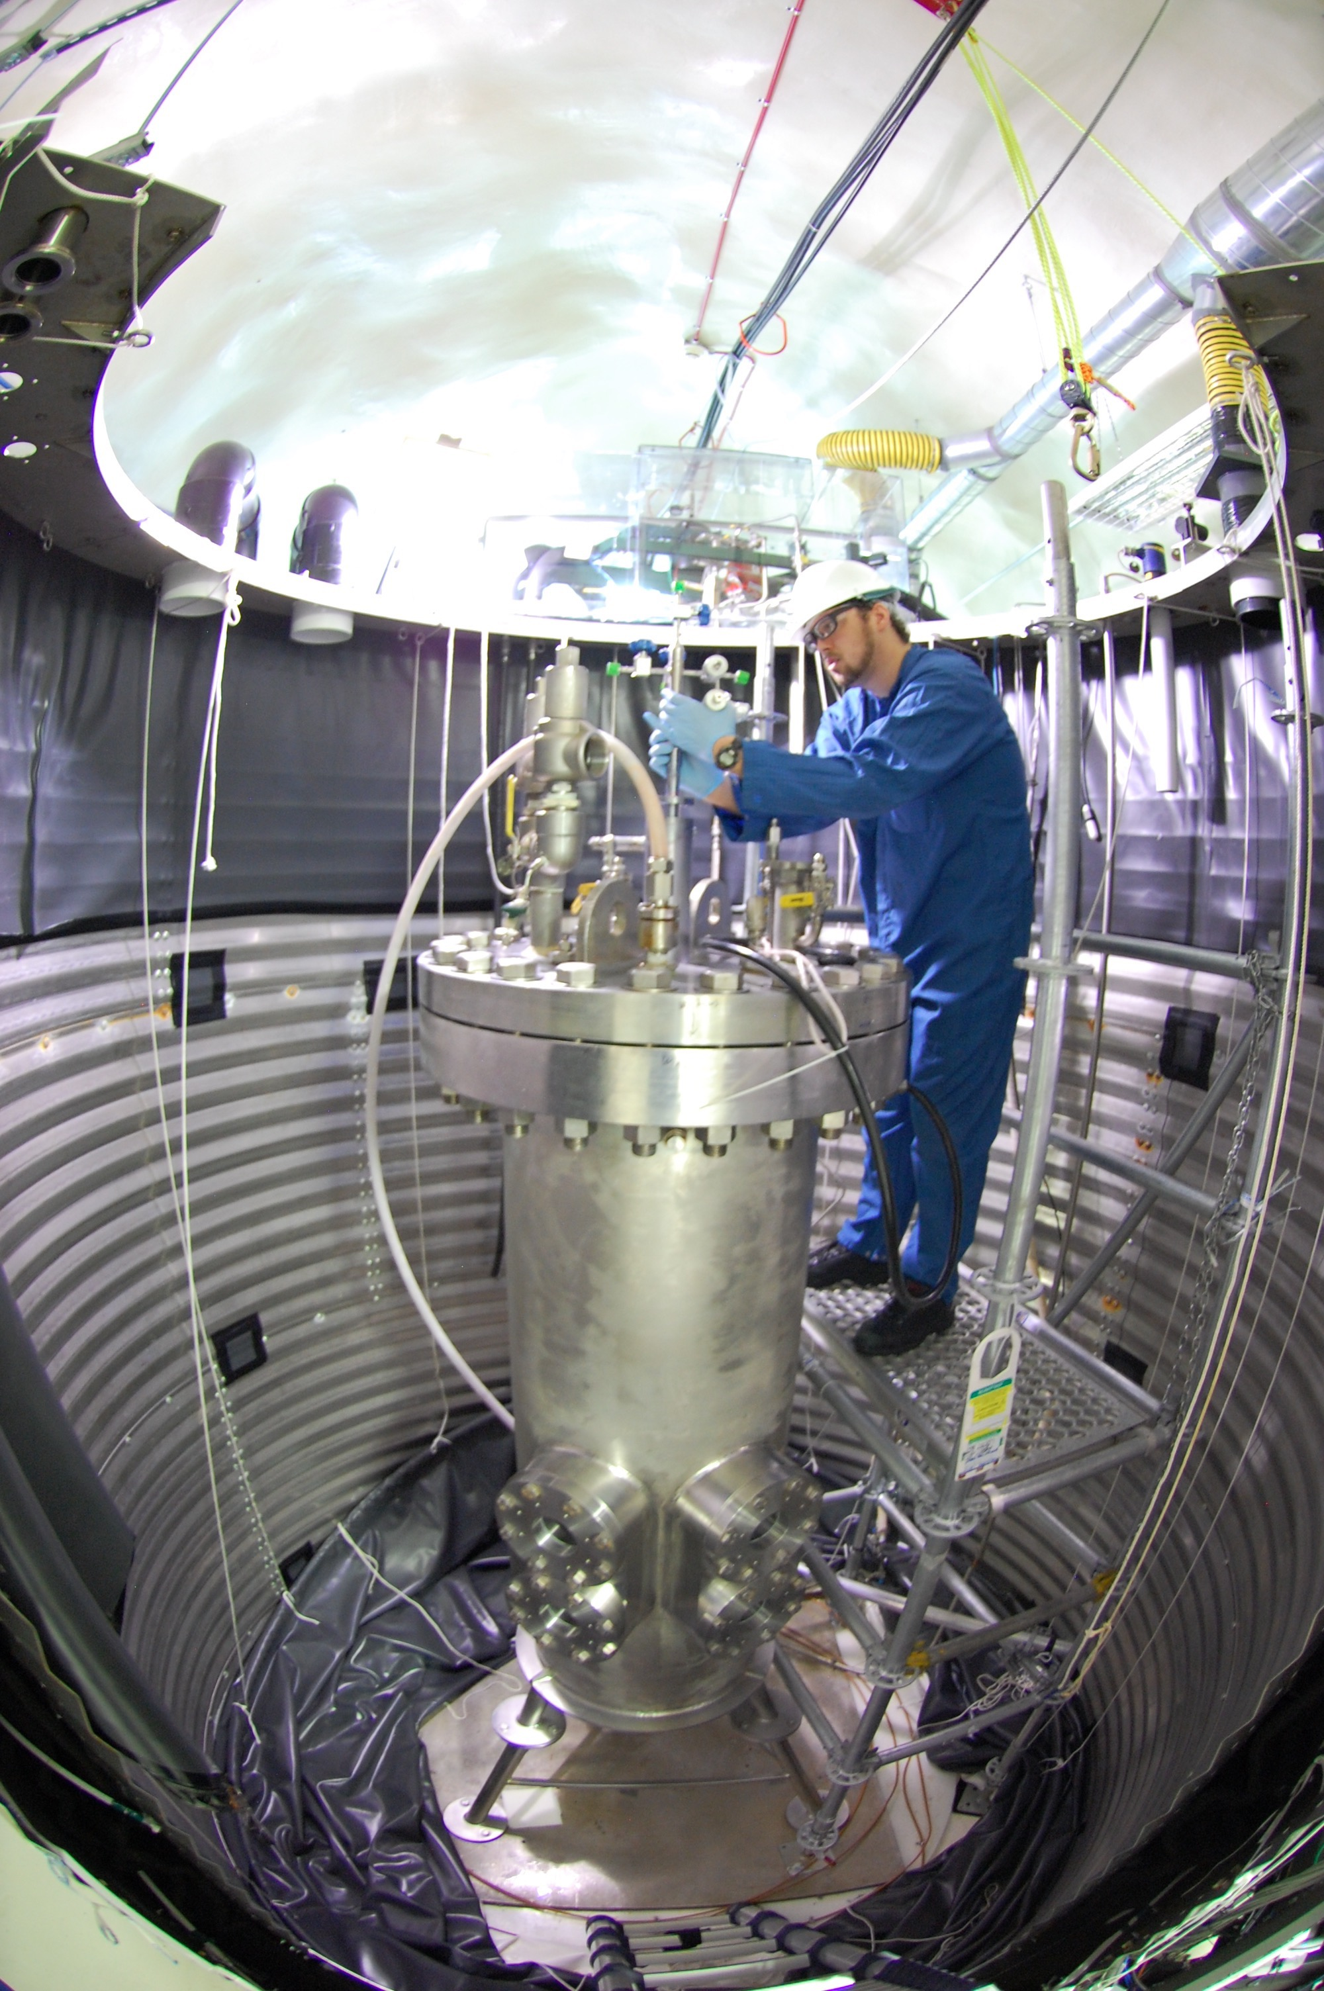
Roadmap
Motivation – Why Bubble Chambers?
  Spin-Independent vs Spin-Dependent WIMP interactions
  Backgrounds and Discovery
Bubble Chamber Overview
The PICO-60 Experiment
  arXiv:1702.07666 [PRL 118, 251301 (2017)]
The road forward
  Right-side-up Bubble Chambers
  Scintillating Bubble Chambers

Slide 3
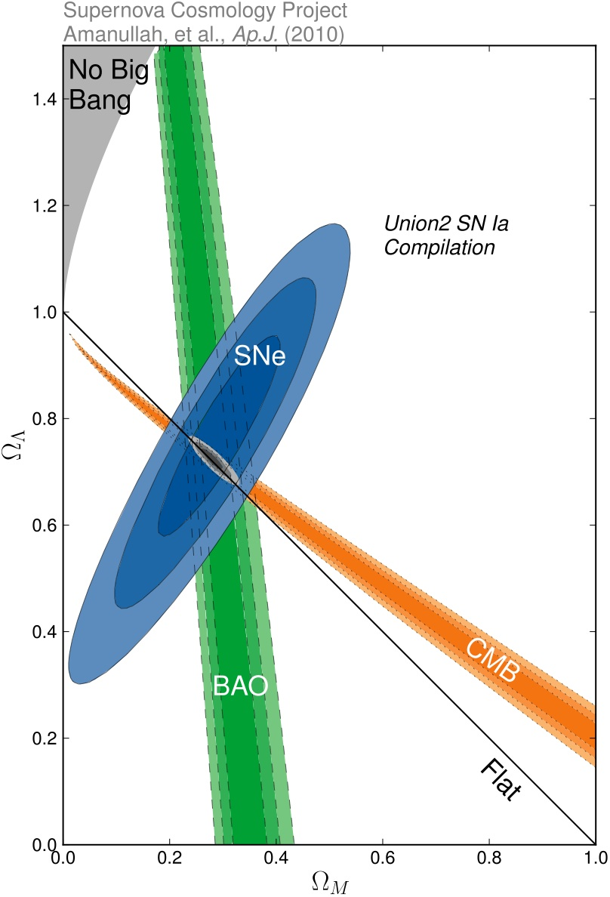
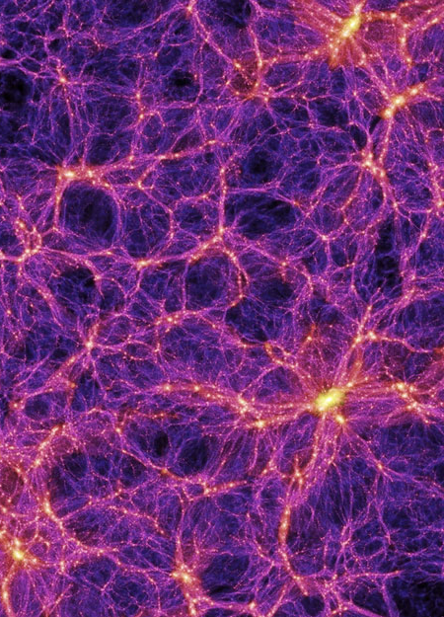
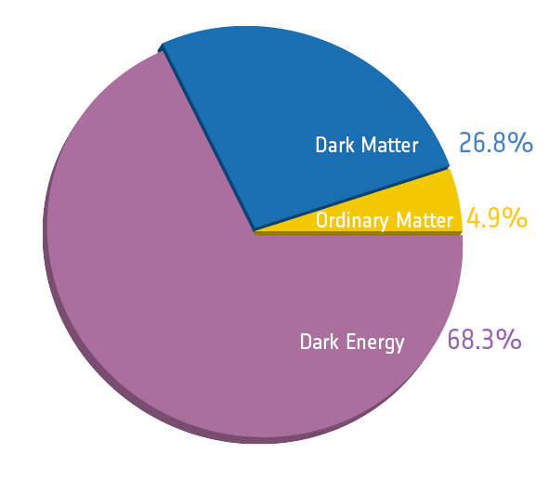

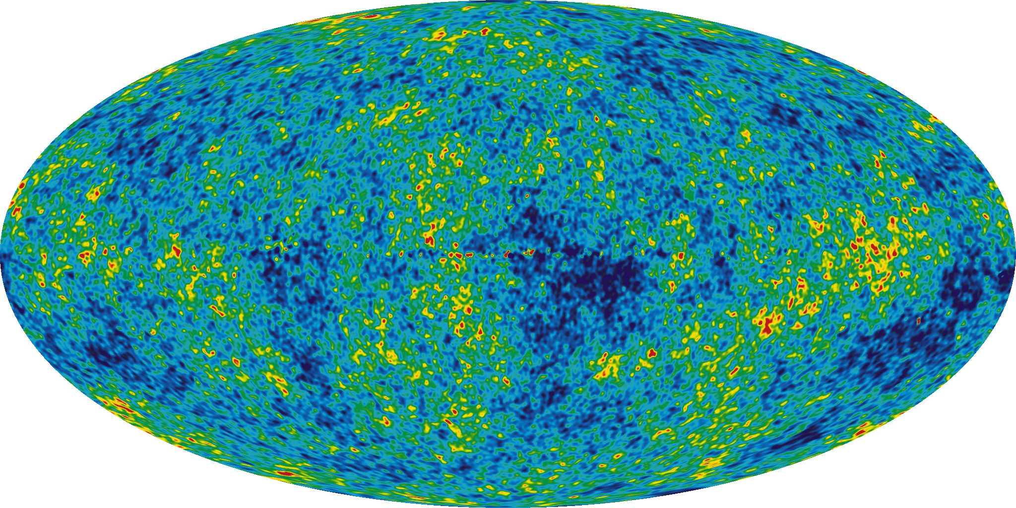
Evidence for
Dark Matter

Slide 4
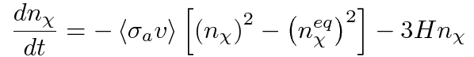
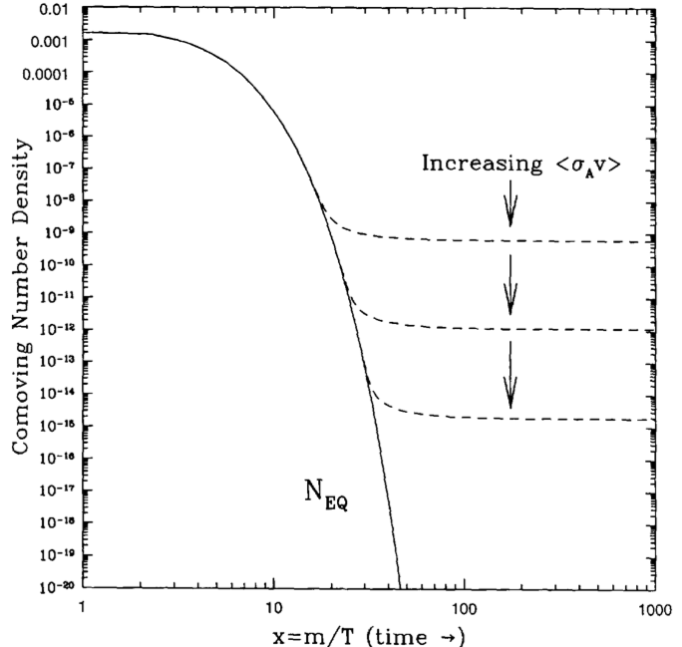
Relics and Miracles
Suppose Dark Matter is:
  Stable Particle (LSP…)
  Thermal Relic of Big Bang
Weak-scale interaction gives required density for dark matter
E. Kolb and M. Turner, The Early Universe.
Redwood City: Addison-Wesley, 1989.

Slide 5
WIMP Direct Detection
M_{χ} ≈ GeV – TeV
χ
χ
v_{χ} ≈ 220 km/sec (rms) +
232 km/sec (earth)
WIMP signal:
Coherent elastic scattering on nucleus
E_{r} ≈ 10 keV

Slide 6
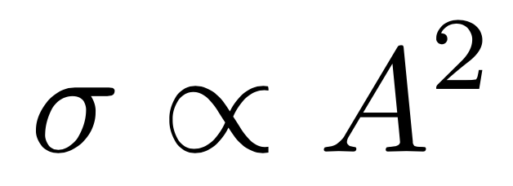
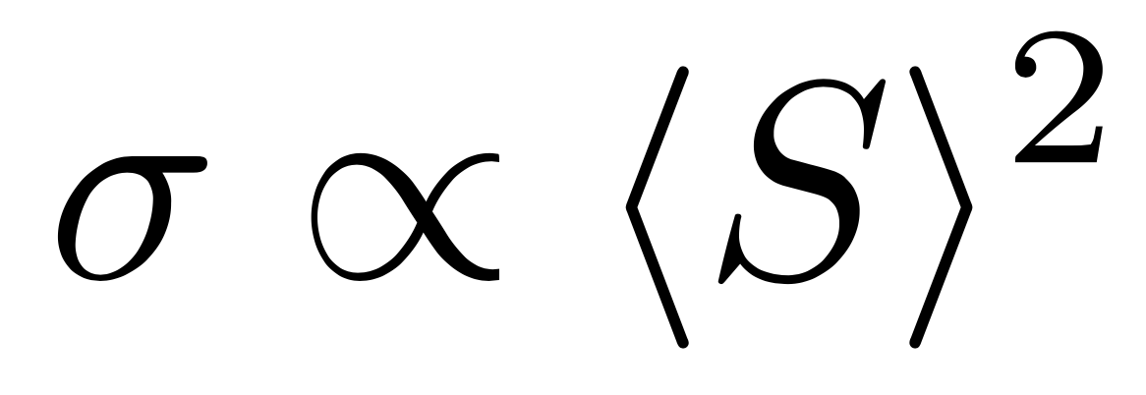
WIMP Direct Detection
M_{χ} ≈ GeV – TeV
χ
χ
v_{χ} ≈ 220 km/sec (rms) +
232 km/sec (earth)
Spin-Independent:
  Prefer Big nuclei
Spin-Dependent:
  Prefer Lots of nuclei (with spin)
E_{r} ≈ 10 keV

Slide 7
WIMP Detection – Interactions
A. Liam Fitzpatrick
Proton Coupling
Barger et al., PRD 78, 056007 (2008)
Even for xenon (A=128–136), detection may come via SD interaction
Xenon alone cannot
distinguish SD from SI
Neutron Coupling
SI
SD

Slide 8
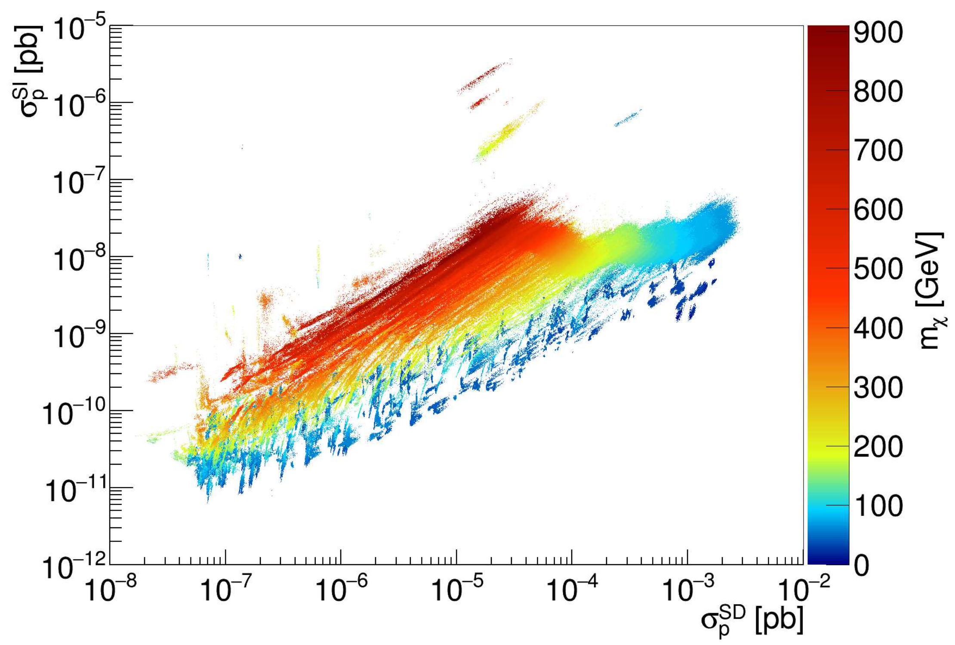
WIMP Detection – Interactions
A. Liam Fitzpatrick
(Scan of MSSM)
Proton Coupling
Riffard et al., PRD 93, 035022 (2016)
Even for xenon (A=128–136), detection may come via SD interaction
Xenon alone cannot
distinguish SD from SI
Neutron Coupling
SI
SD

Slide 9
WIMP Detection – Neutrino Floor
Elastic neutrino-nucleus scattering is an SI process
Can suppress neutrino floor using targets with low SI sensitivity

Slide 10
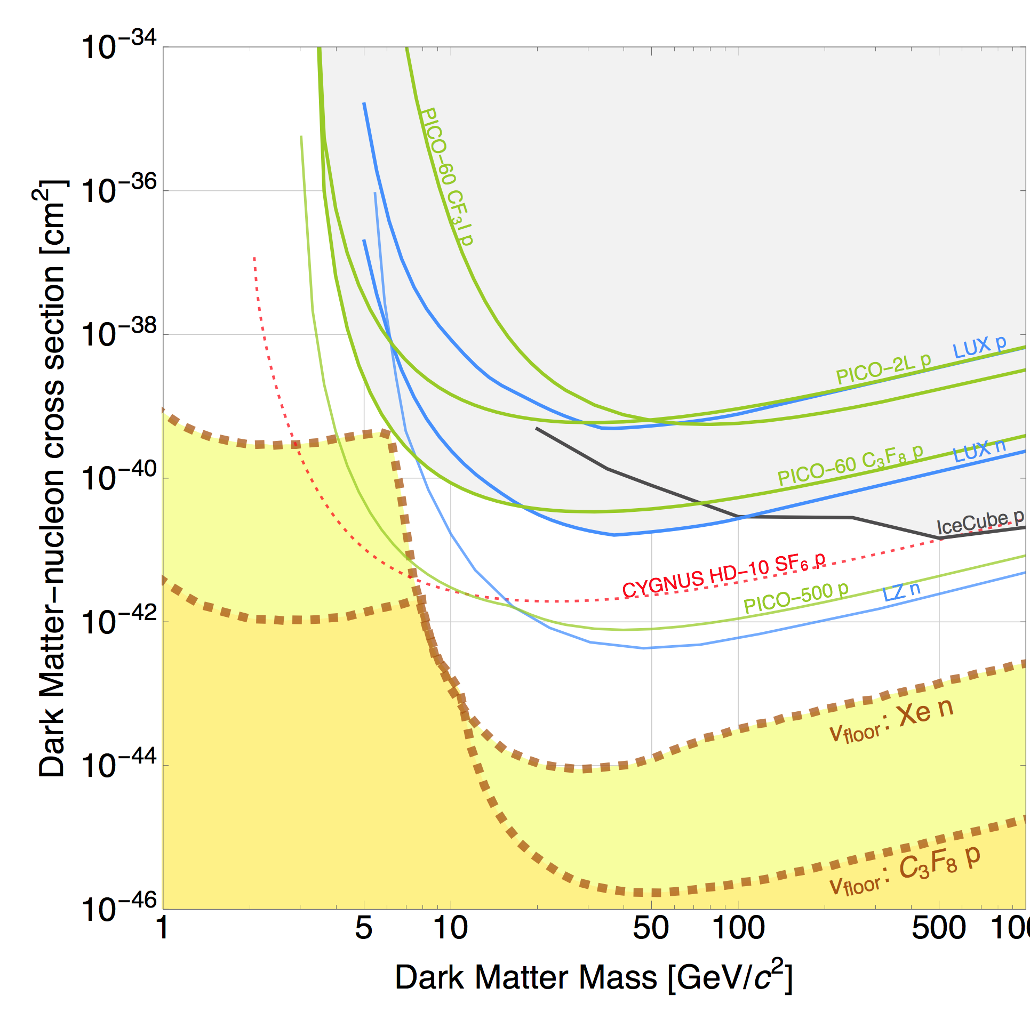
WIMP Detection – Neutrino Floor
Battaglieri, et al. arXiv:1707.04591
Proton Coupling
SI
SD
Elastic neutrino-nucleus scattering is an SI process
Can suppress neutrino floor using targets with low SI sensitivity

Slide 11
WIMP Detection – Backgrounds
– Backgrounds
χ
χ
Basic low-background practices are necessary …
Go underground
Shield external gammas and neutrons
Screen and purify detector elements
… but not sufficient
γ
γ
γ

Slide 12
WIMP Detection – Backgrounds
– Backgrounds
χ
χ
Must be able to discriminate against all of these backgrounds…
…as well as against backgrounds we haven’t run into yet…
γ
γ
γ

Slide 13
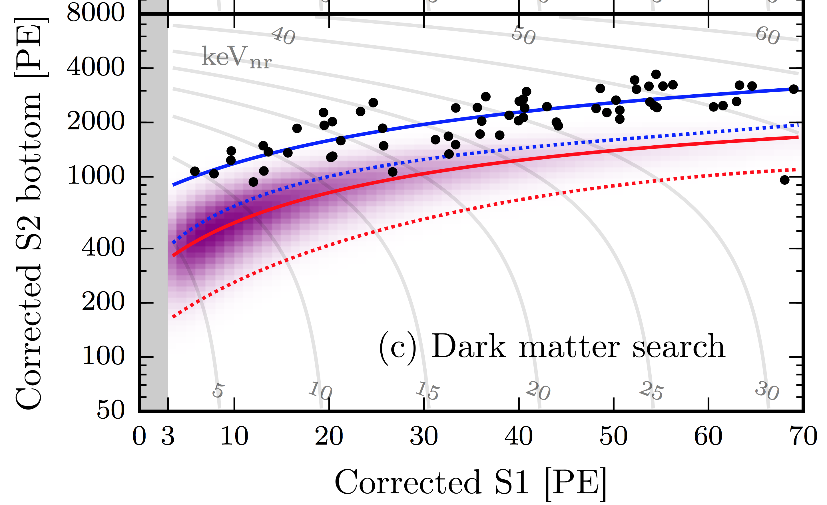
Background? Or Signal?
Electron recoil?
Dust?
Inelastic dark matter?
Something else?
XENON1T, arXiv:1705.06655
Every detection technique has the potential for anomalous backgrounds:
  Ways discrimination may be systematically fooled
  Backgrounds we weren’t creative enough to think of a priori…
The dark matter signal might not be what we expect!
Confirmation from a different technology, with different anomalous backgrounds, will be crucial

Slide 14
Bubble Chambers
Superheated Target
  CF₃I, C₃F₈, …
Particle interactions
nucleate bubbles
Cameras and acoustic
sensors capture
bubbles
Chamber recompresses
after each event

Slide 15
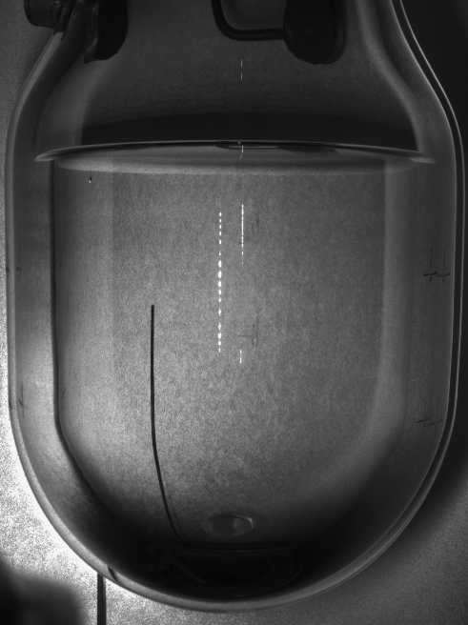










Bubble Chambers
Superheated Target
  CF₃I, C₃F₈, …
Particle interactions
nucleate bubbles
Cameras and acoustic
sensors capture
bubbles
Chamber recompresses
after each event

Slide 16
Bubble Chamber Thermodynamics
What is a meta-stable state?
Superheated Liquid

Slide 17
Bubble Chamber Thermodynamics
Consider a bubble with
  T_{l} = T_{b} (thermal equilibrium)
  μ_{l} = μ_{b} (chemical equilibrium)
Then P_{b} is (approx) the vapor
pressure at temperature T
P_{b} > P_{l} , so bubble should
grow… until we consider surface tension
P_{l}, T_{l}
P_{s}
P_{b}, T_{b}

Slide 18
Bubble Chamber Thermodynamics
Inward pressure from surface tension!
  P_{s} = 2σ/r
Bubble will grow if
  P_{b} > P_{l} + P_{s}
  r > r_{c} = 2σ / (P_{b} – P_{l})
Bubbles with r < r_{c}
collapse and re-condense
P_{l}, T_{l}
P_{s}
P_{b}, T_{b}

Slide 19
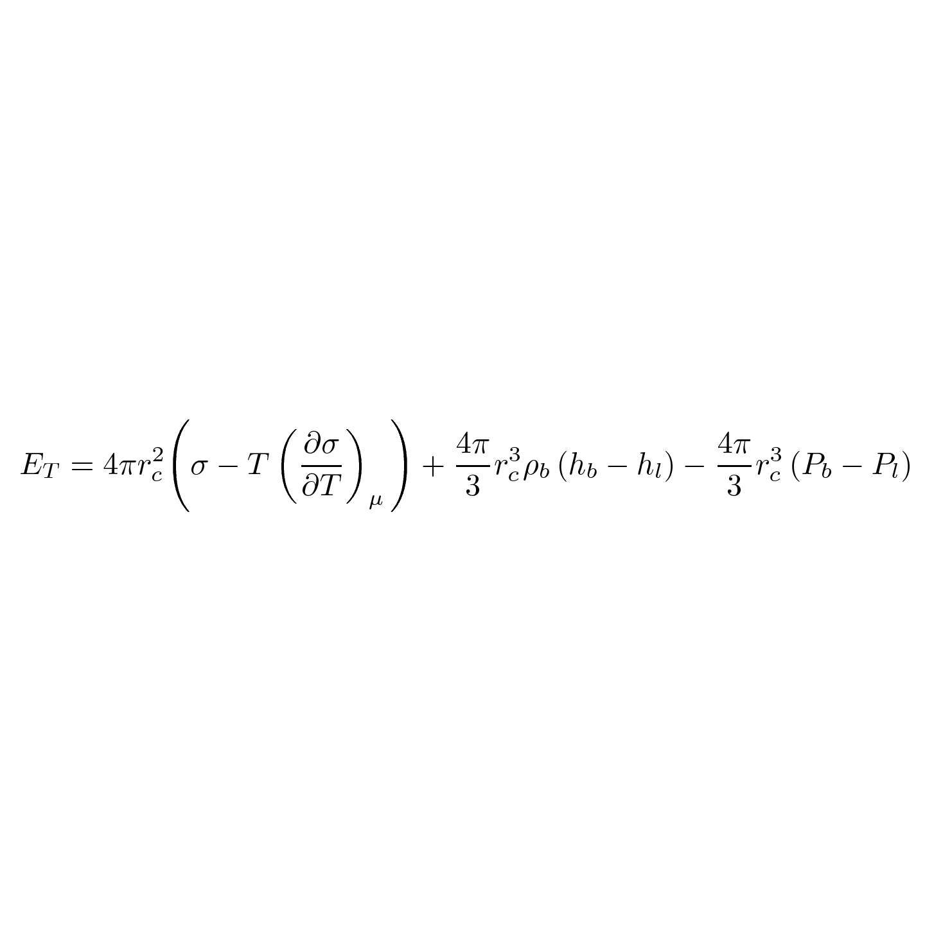
Bubble Chamber Thermodynamics
What does it take to produce critical bubble?
1.53 keV
P_{l}=30 psia, T_{l}=14ºC
1.81 keV
P_{b}= 89.7
psia
-0.15 keV
r_{c}=23.7nm
C₃F₈
= 3.19 keV total
Surface energy, Bulk energy, Reversible Work

Slide 20
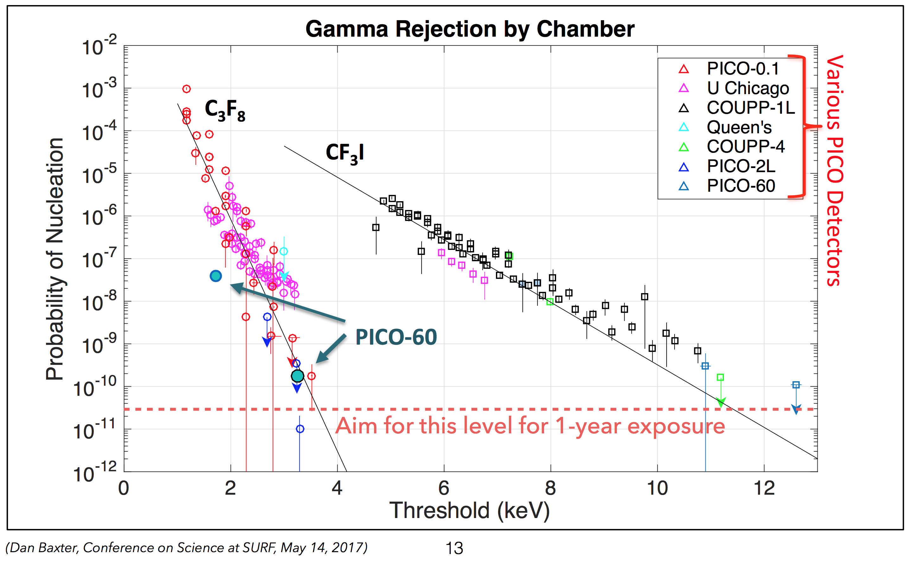
Bubble Chamber Discrimination

Slide 21
Nuclear Recoil Threshold
Neutron Calibrations in C₃F₈ @ E_{T} = 3.2 keV

Slide 22
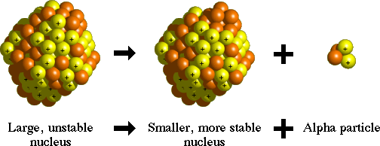
Alpha-Decay Discrimination
All bubbles look the same!
  1-mm diameter bubble has drawn
  10 PeV from superheated fluid
  Nuclear recoil visually indistinguishable from alpha-decay
10 keV
6 MeV
Nuclear
Recoils
(3-500 keV)
~1-MeV energy resolution in acoustic channel
²²²Rn, ²¹⁸Po
(5.5, 6.0 MeV)
C. Amole et al. Phys. Rev. D 93, 061101(R) (2016) [arXiv:1601.03729]
²¹⁴Po
(7.7 MeV)

Slide 23
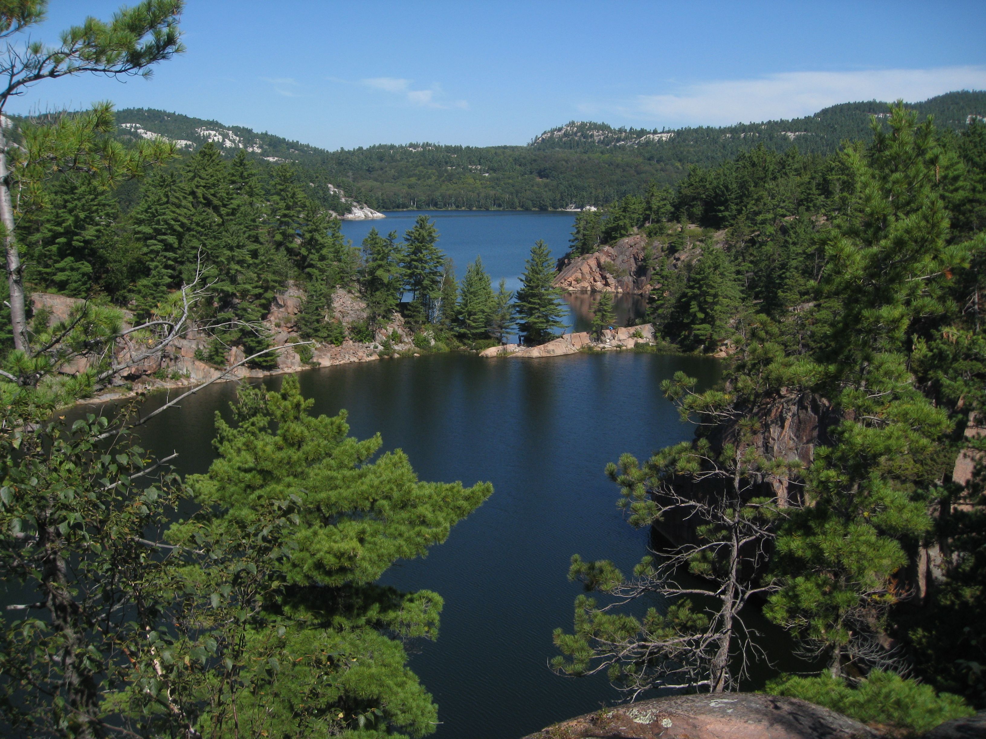
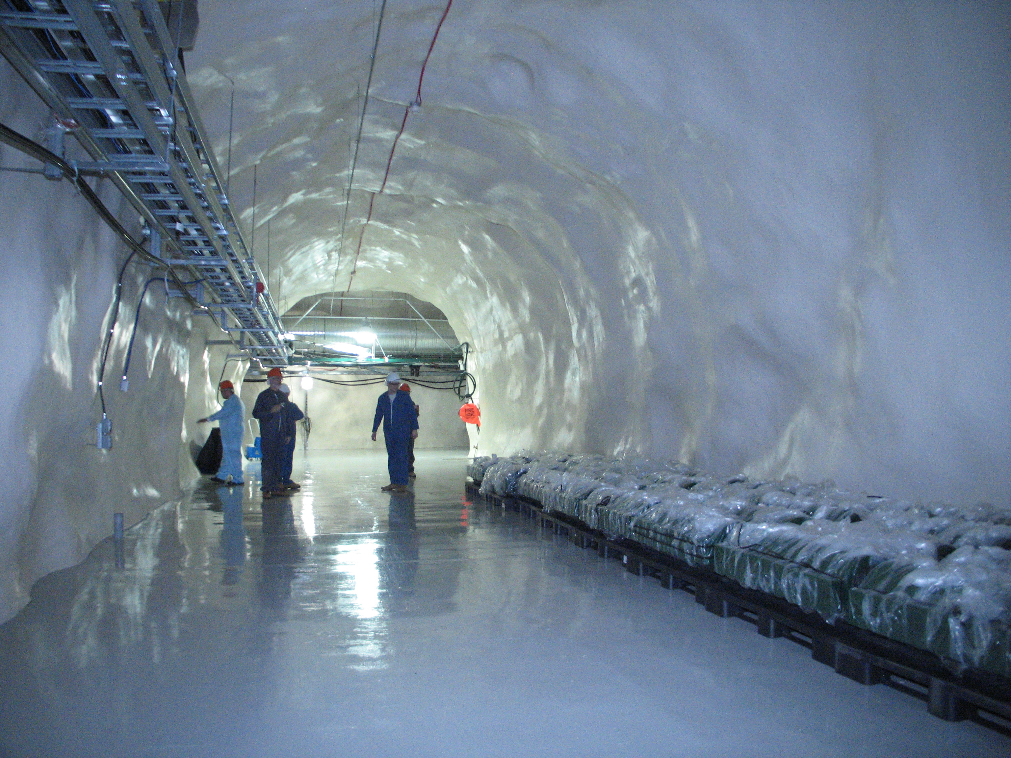
Sudbury, Ontario
6800 Feet Down
SNOLAB

Slide 24
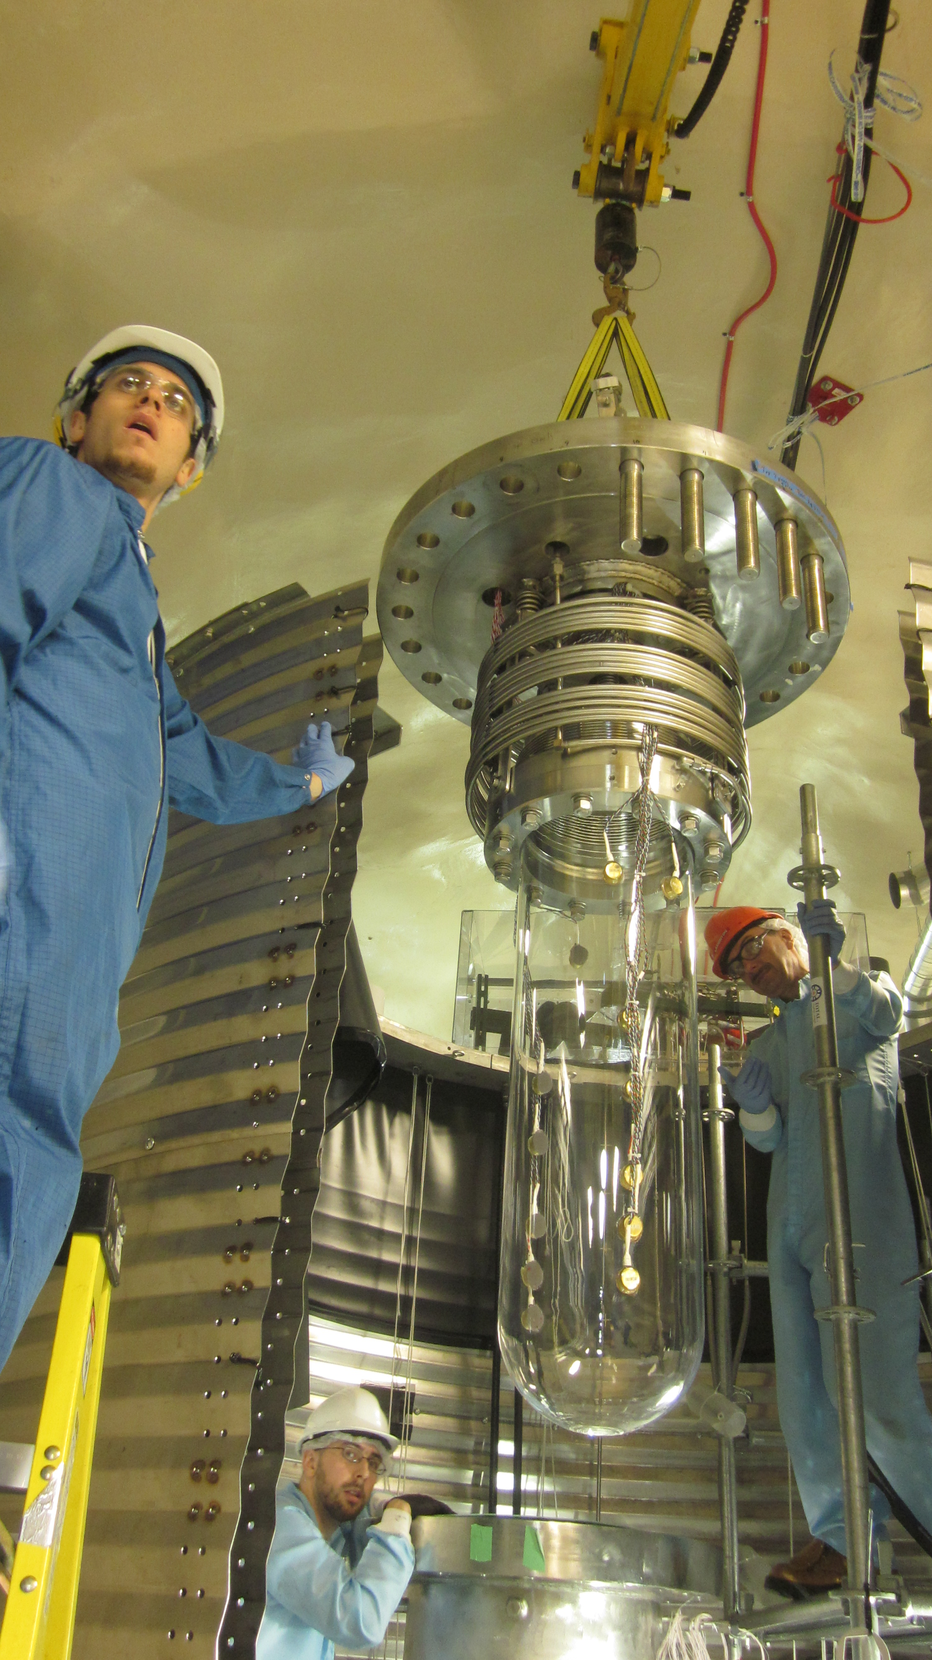
PICO-60
SNOLAB Run 1 completed
(June 2013 – May 2014)
35-kg CF₃I, upgradable to 80-kg
>80% livetime (>90% by end of run)
3,415 kg-days exposure
at 7—20 keV thresholds
One multi-bubble event
(consistent with expected
neutron rate)
Acoustic discrimination in
large chamber confirmed
2,111 WIMP-like events
NOT WIMPS

Slide 25
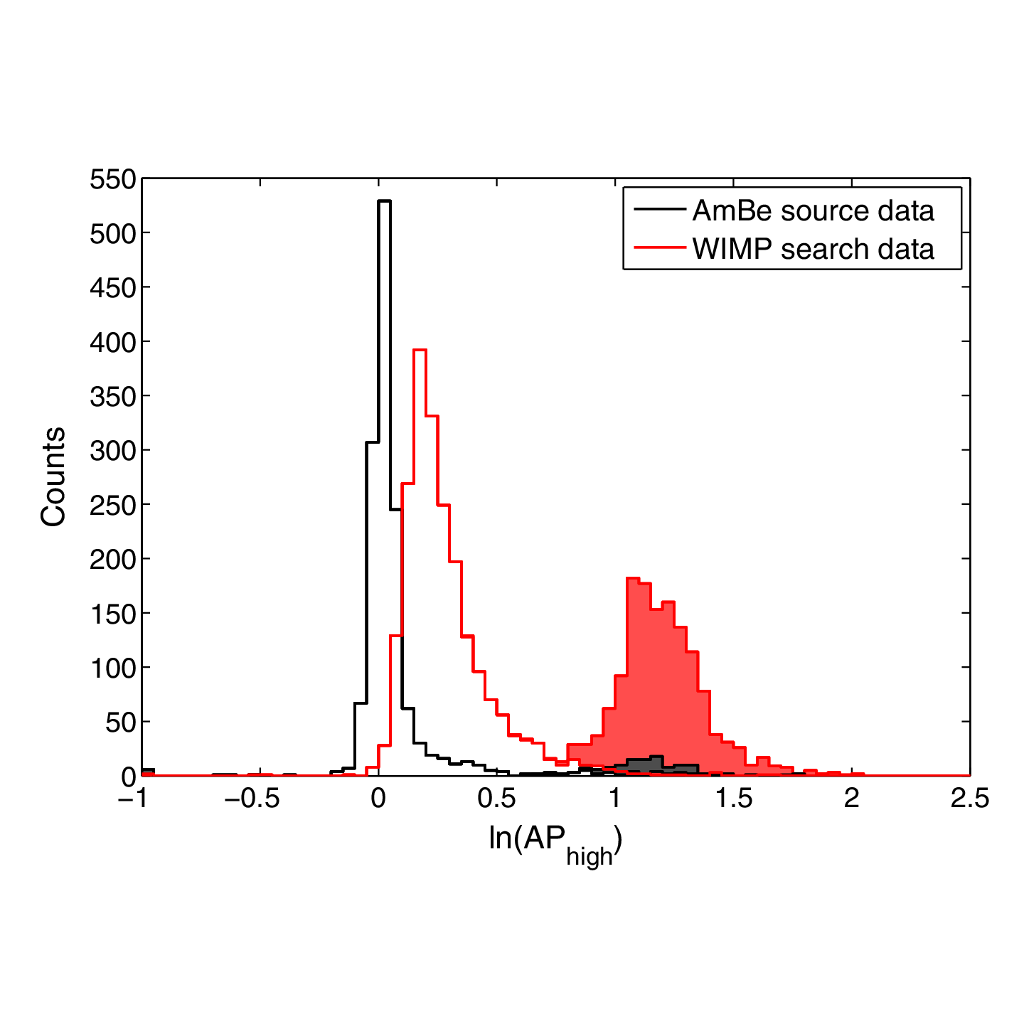
PICO-60 Background Characteristics
Mostly at top, edges of detector
Higher AP than nuclear recoils
Not uniform in time
# of events
C. Amole et al. Phys. Rev. D 93, 052014 (2016) [arXiv:1510.07754]

Slide 26
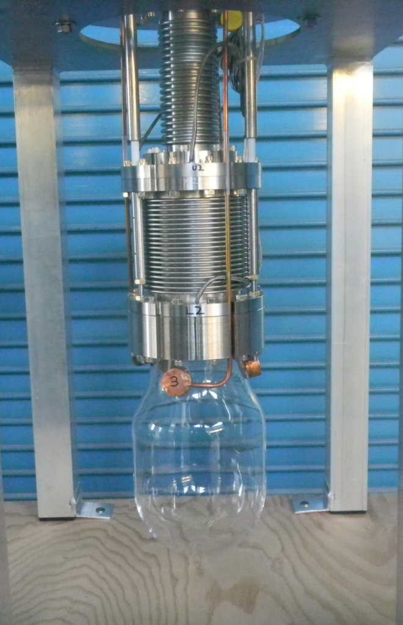
PICO-2L
Run 1 complete:
Sept 2013 – May 2014
3-kg C₃F₈,
3—8 keV thresholds
211.6 kg-day exposure
No multi-bubble events
12 WIMP-like events
ALSO NOT WIMPS

Slide 27
The Culprit: Particulate
Silica
Stainless Steel
Particulate mostly from wetted materials
Rebuilt PICO-2L in 2015 with new cleanliness, assembly, and operating procedures designed to minimize particulate production

Slide 28
Particulate Mitigation in PICO-2L
Before (Run 1)
After (Run 2)
C. Amole et al. Phys. Rev. D 93, 061101(R) (2016) [arXiv:1601.03729]
Alpha-decay
WIMP candidate

Slide 29
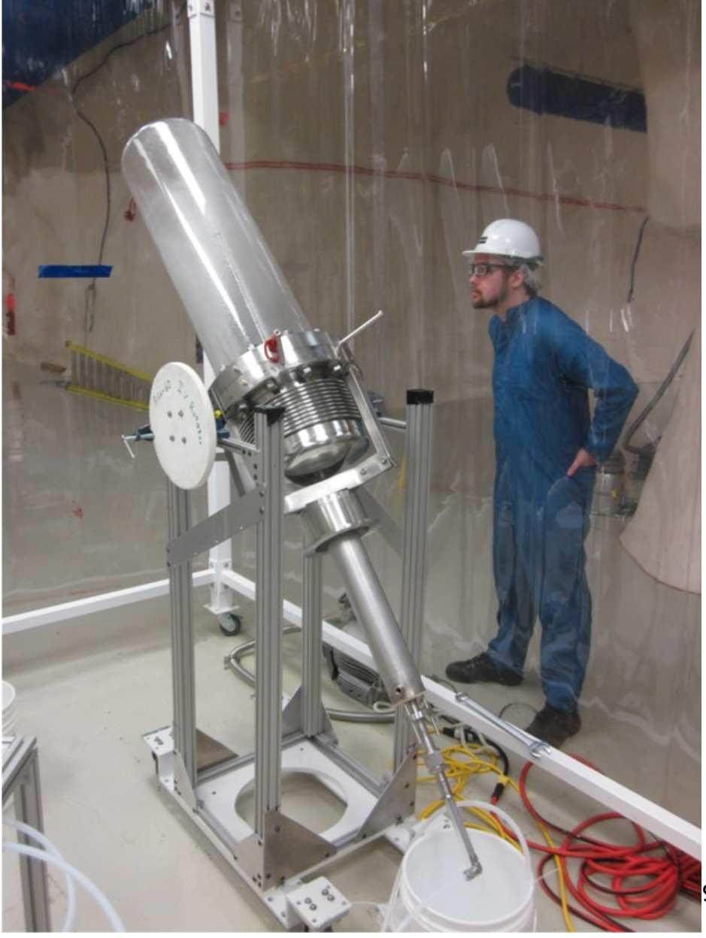
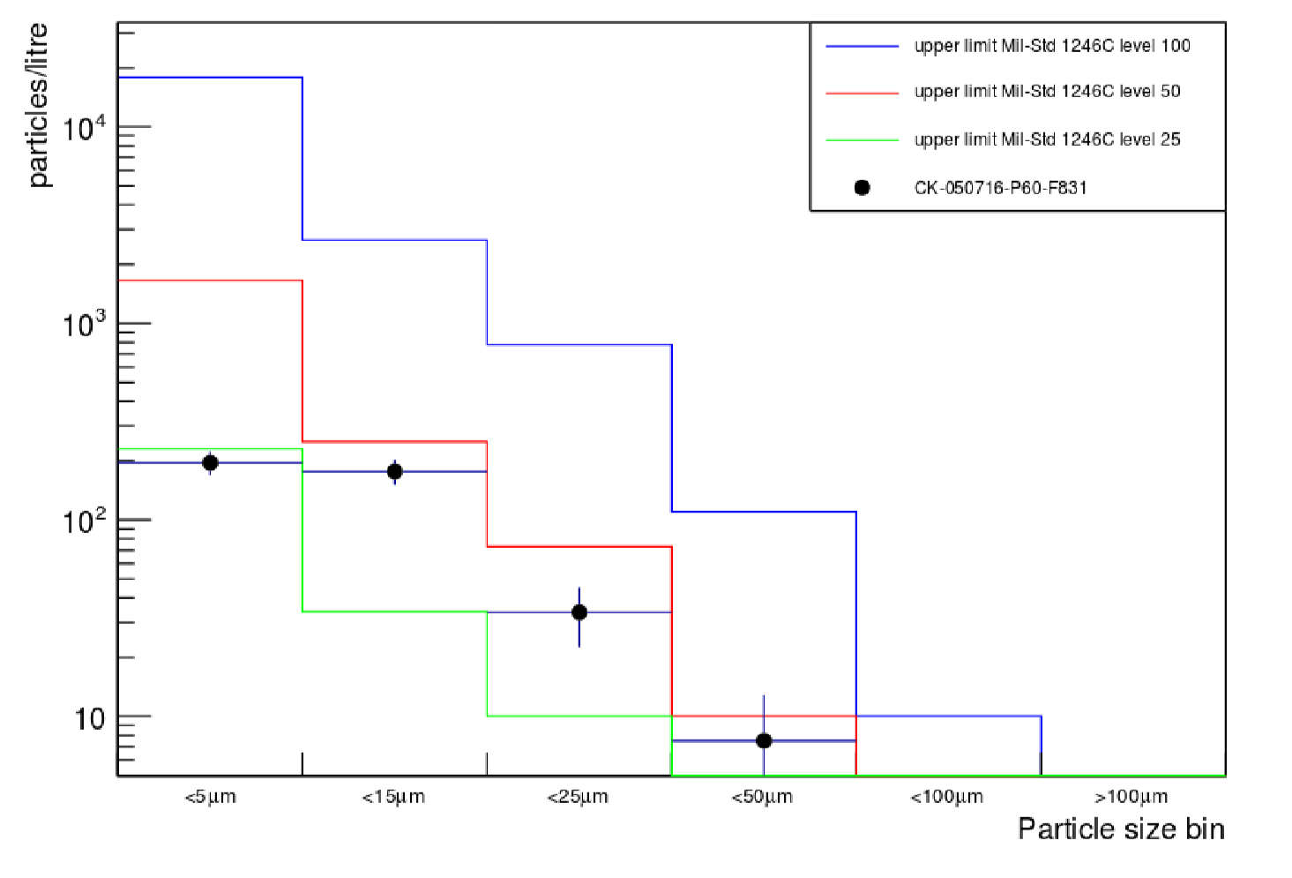
PICO-60 C₃F₈
Goal: Eliminate particulate backgrounds in 40-liters C₃F₈
  Cleaning/assaying to MIL-STD1246C Level 50
  Softer metal-quartz seal design
  In-situ buffer filtration

Slide 30
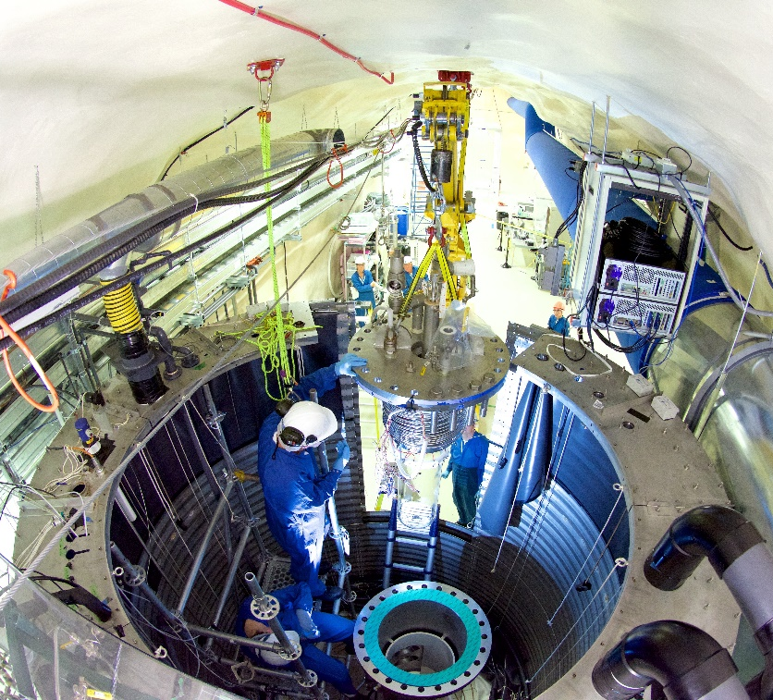

Commissioning
Filled with 40L C₃F₈ on June 30, 2016
First physics run began Nov 28, 2016

Slide 31
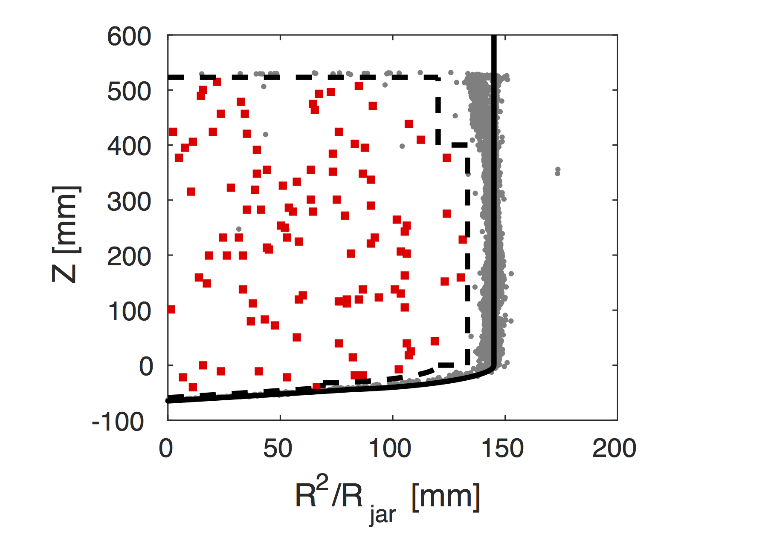
Before Opening the Box
30.0 live-day Blinded Dataset
  “Blind” for PICO means deaf,
  i.e. no acoustic information
  Effectively salts data with 3 bulk singles per day (alpha-decays)
  106 bulk-single bubbles observed
Neutron Background
  Not blinded to images
  3 multiple-bubble events
  in the physics data
  Multiples to singles ratio is approximately 3:1 from calibration and simulation
Conclusion: 0-3 bulk singles would be consistent with neutrons and no anomalous background
C. Amole et al., PRL 118, 251301 (2017)

Slide 32
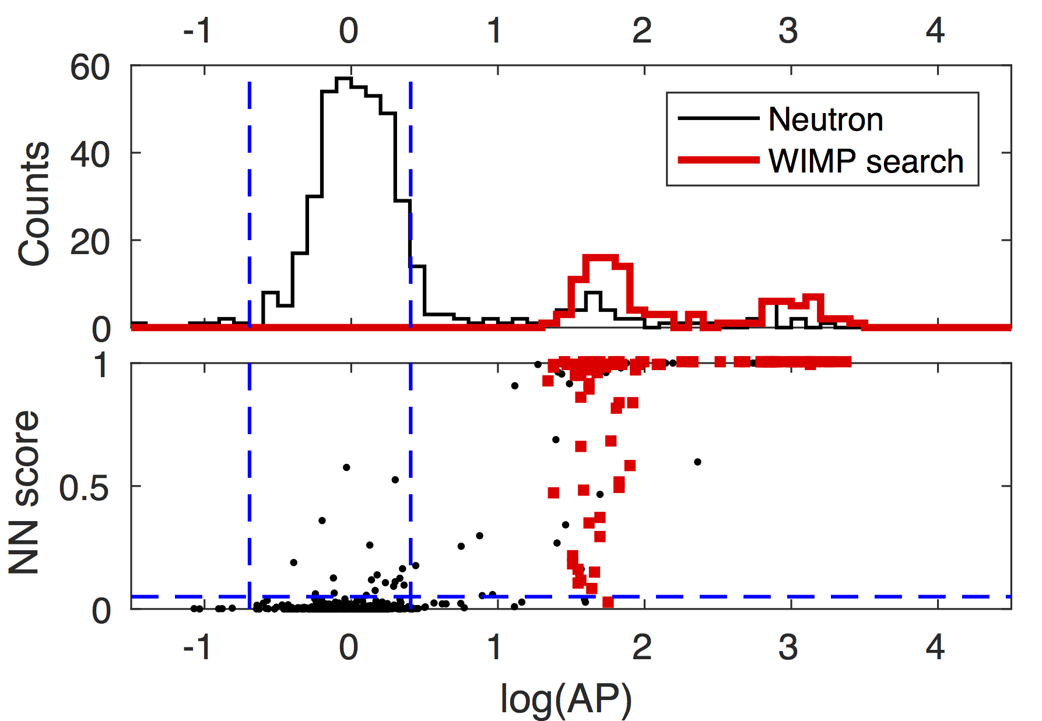
After Opening the Box
No events in signal region!
C. Amole et al., arXiv:1702.07666
( ~ Acoustic Power)

Slide 33
Spin-dependent Limits
C. Amole et al., PRL 118, 251301 (2017)
PICASSO
SIMPLE
PICO-2L C₃F₈
PandaX-II
PICO-60 CF₃I
IceCube
Factor of 17 improvement!
SuperK

Slide 34
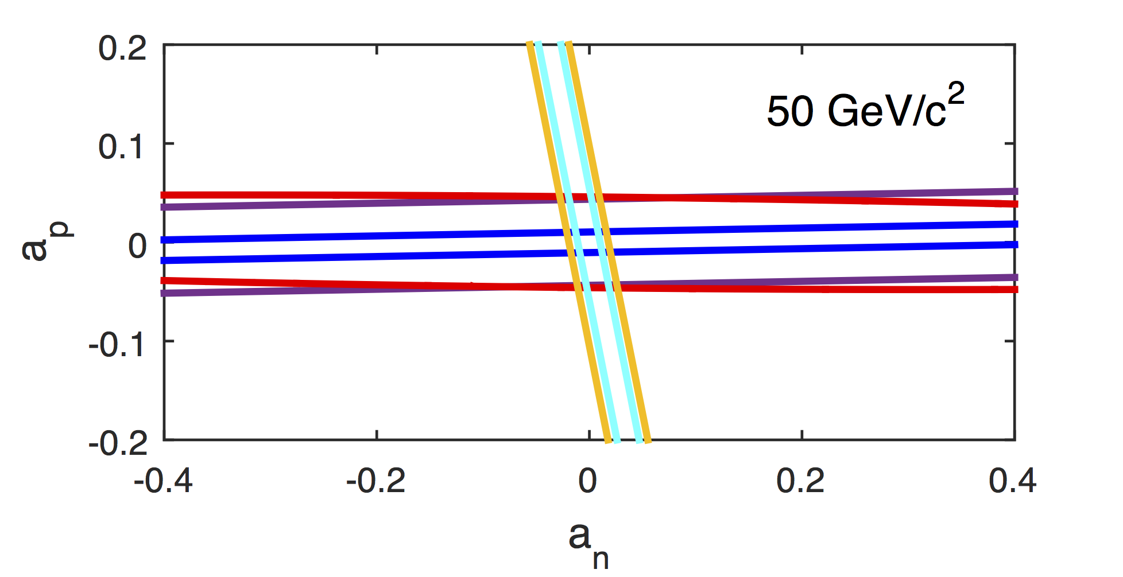
Nucleon Coupling Limits
Consider spin-dependent coupling to proton and neutron
C. Amole et al., PRL 118, 251301 (2017)
LUX
PandaX-II
PICO-60 C₃F₈
PICO-2L C₃F₈
PICO-60 CF₃I
See Tovey for details:
D.R. Tovey, et al., Phys. Lett. B 488, 17 (2000)

Slide 35
Spin-independent Limits
Light nuclear targets give sensitivity to low-mass WIMPs
A second live-month exposure at 2.4 keV in hand (still blinded) aiming at ~GeV WIMPs
C. Amole et al., PRL 118, 251301 (2017)
PICO-2L C₃F₈
PICO-60 CF₃I
CDMSlite
CRESST-II
PandaX-II
LUX

Slide 36
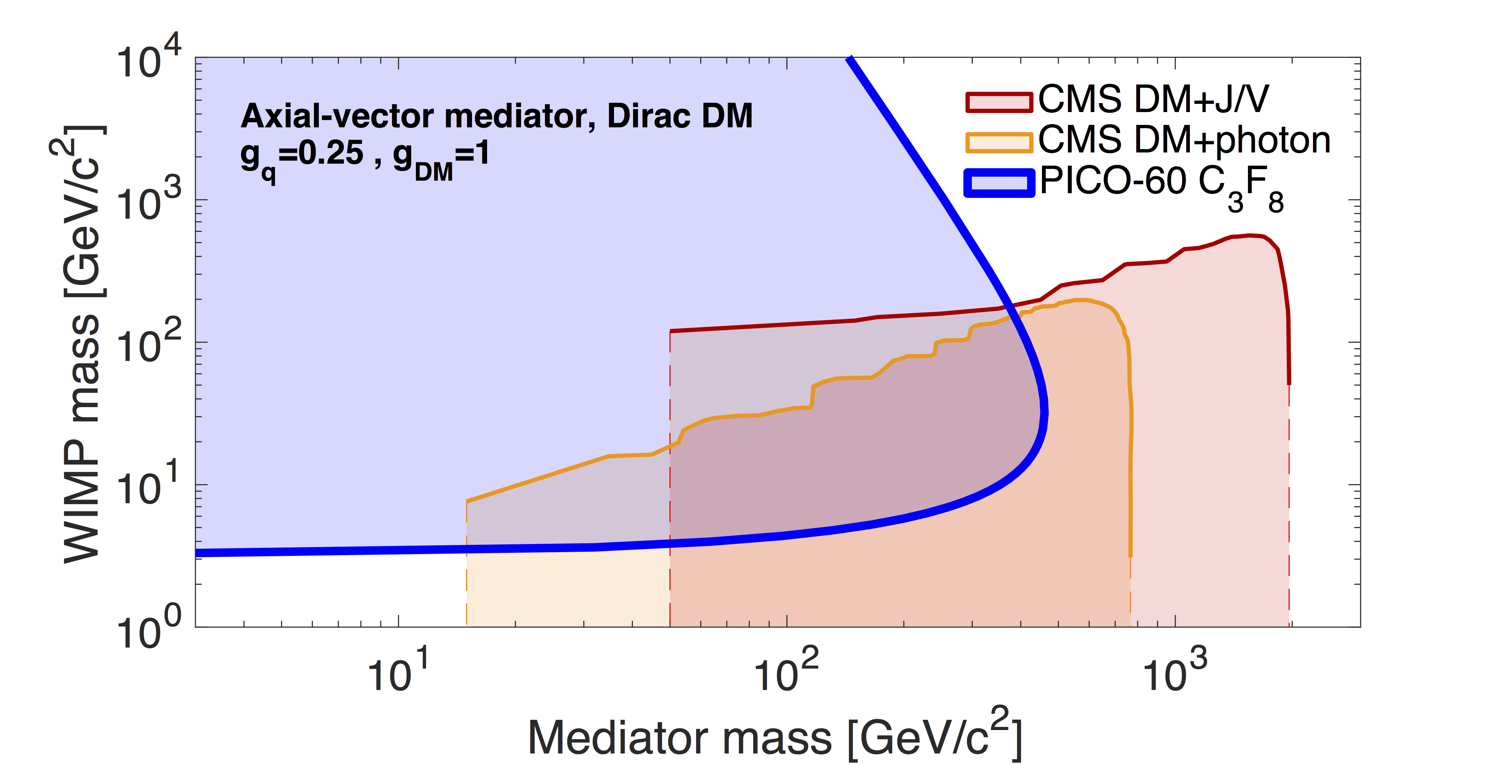
Comparison to Collider
C. Amole et al., arXiv:1702.07666
For direct detection, this simplified model boils down to EFT at all mediator masses (trivial scaling with g’s)

Slide 37
The Future of PICO
We’ve shown we can mitigate our background and set new limits…
But this is not yet a discovery machine
We must either discriminate against this background, or prove that we have eliminated it entirely. (Or both…)

Slide 38
How to get Bubbles from Particulate
Alpha decays from particulate, failed acoustics
Merging buffer fluid droplets, cavitation

Slide 39
Particulate Mitigation in PICO-2L
Before (Run 1)
After (Run 2)
C. Amole et al. Phys. Rev. D 93, 061101(R) (2016) [arXiv:1601.03729]
Alpha-decay
WIMP candidate

Slide 40
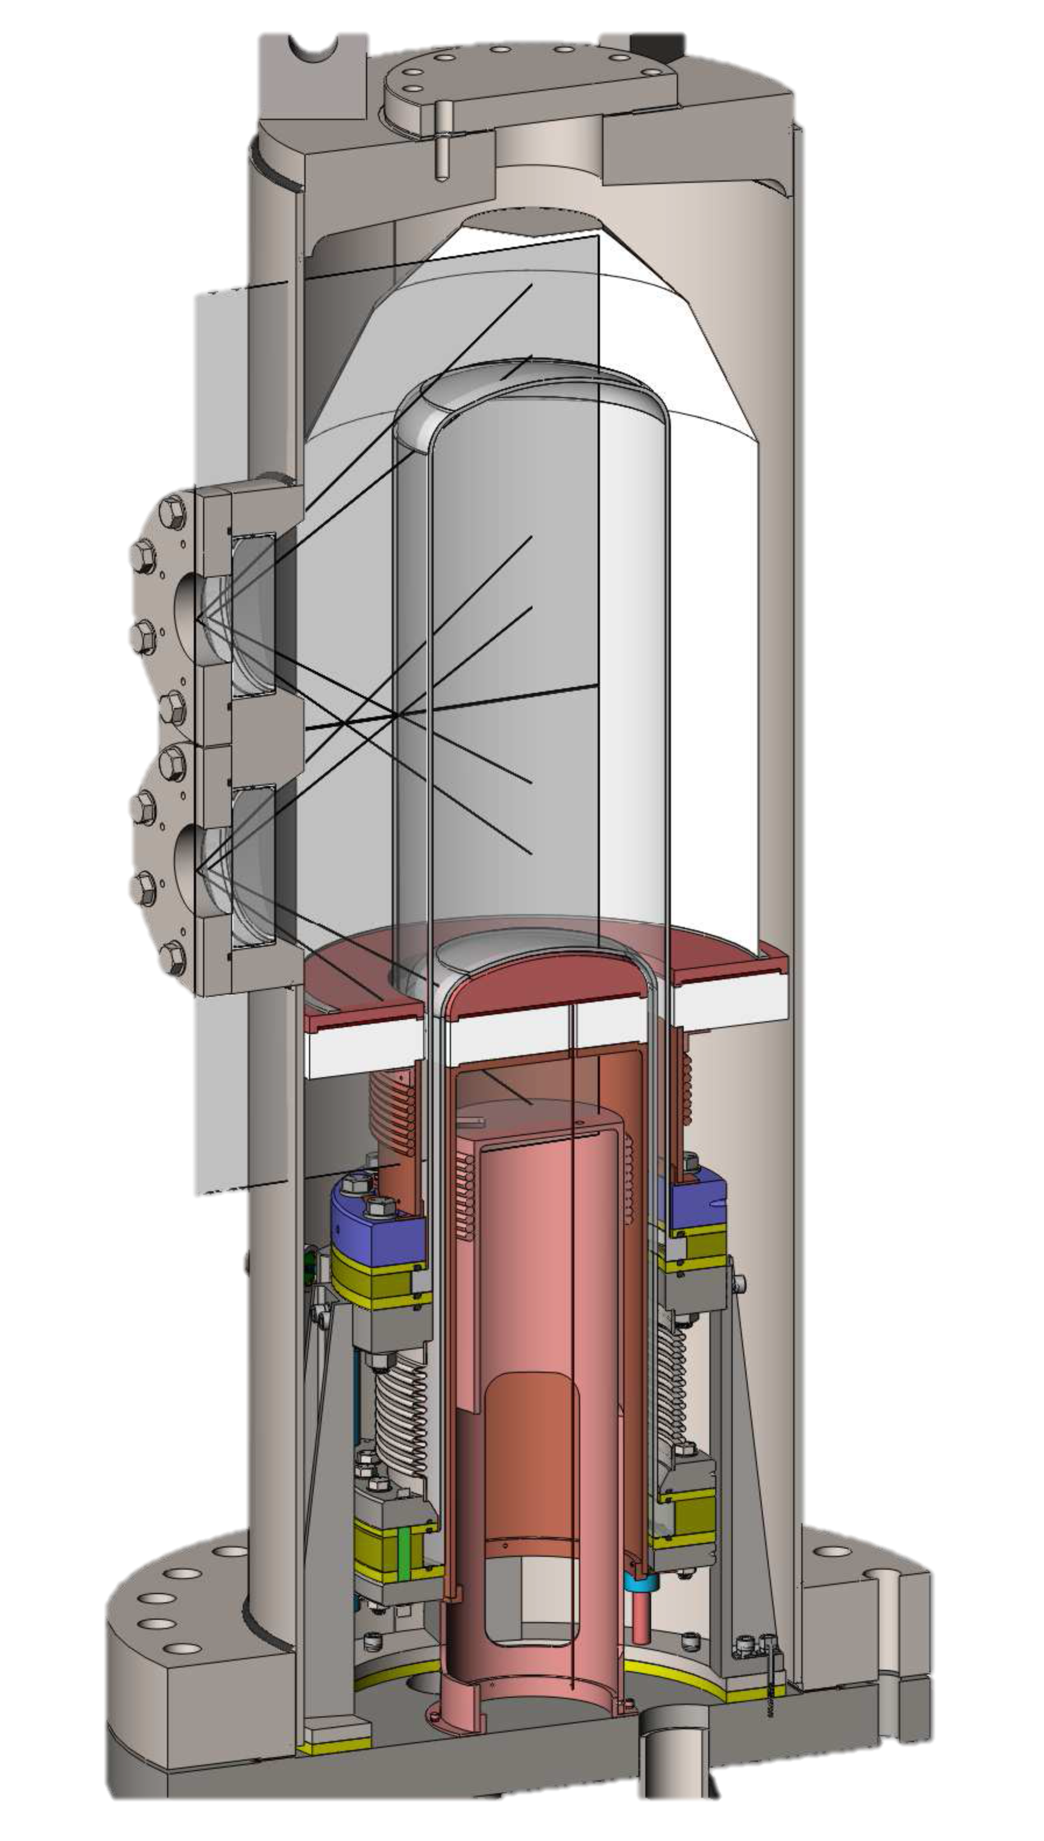
Solution: PICO-40L no-buffer-fluid bubble chamber
Thermal Gradient
FLIP IT

Slide 41
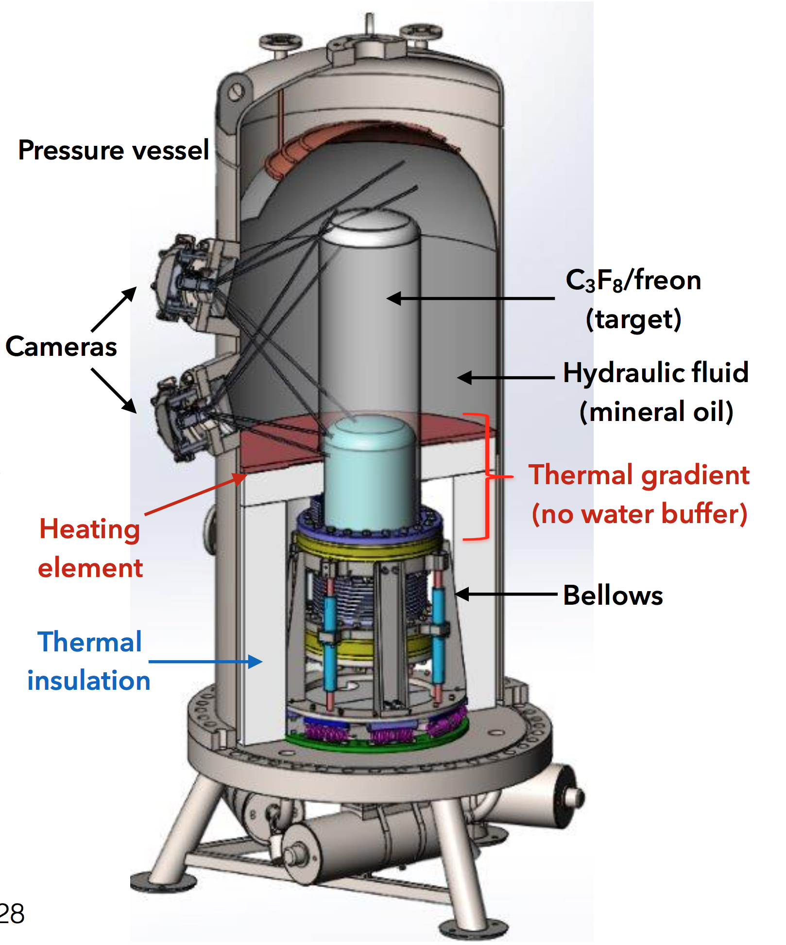
PICO-40L: “Right-side-up”
Replace buffer fluid with thermal gradient
Larger diameter pressure vessel to reduce neutron background
Parts now arriving at SNOLAB, physics in 2018

Slide 42
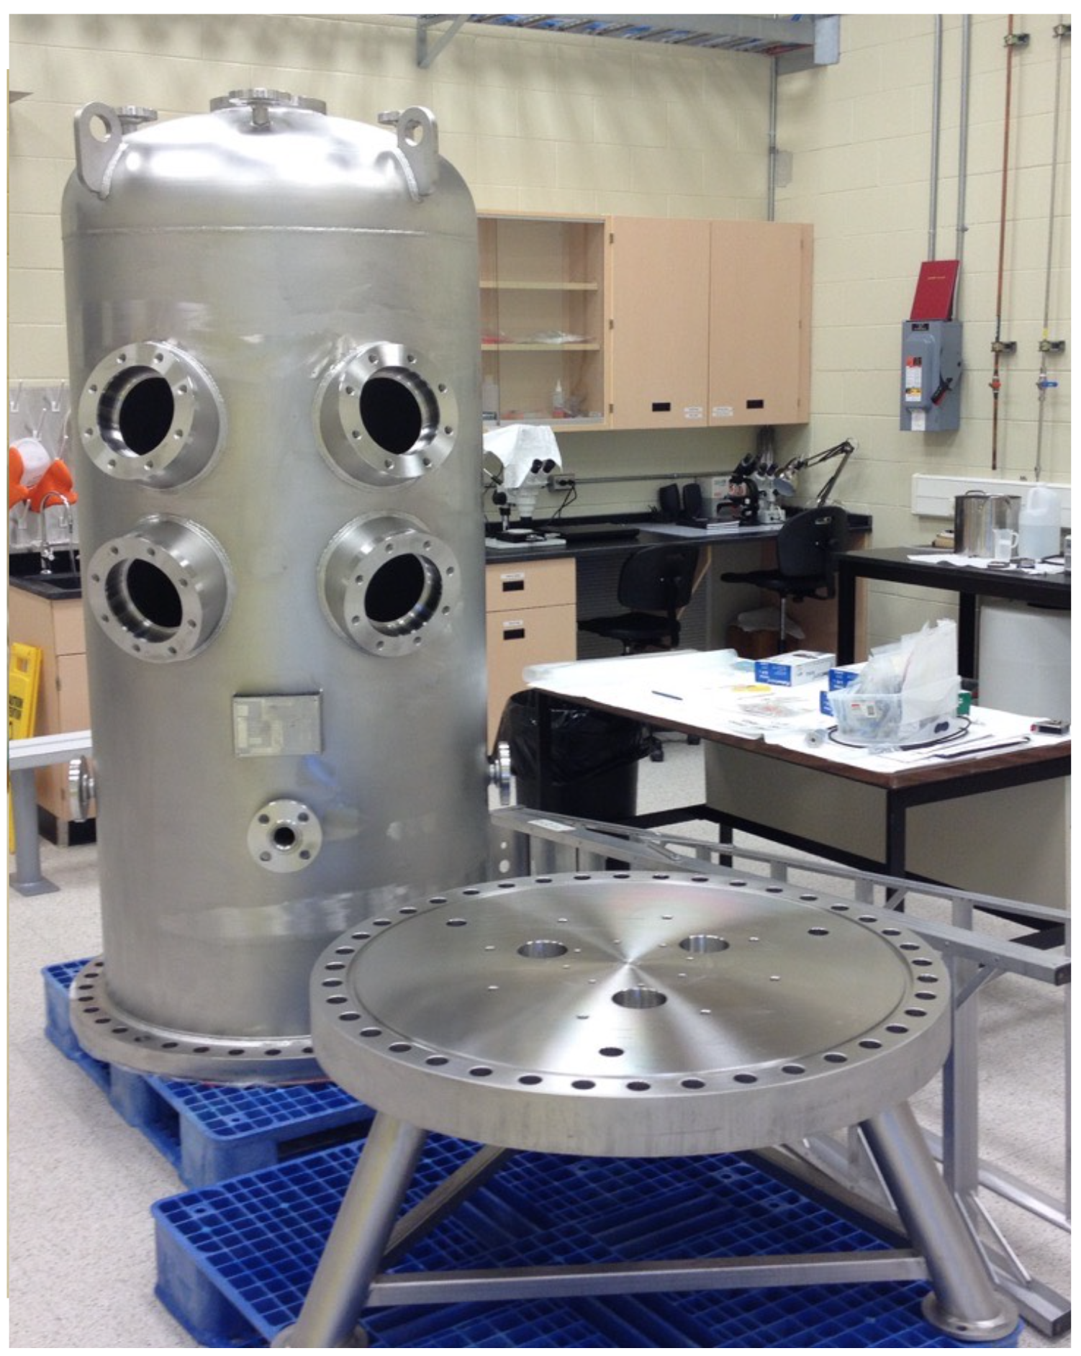
PICO-40L: “Right-side-up”
Replace buffer fluid with thermal gradient
Larger diameter pressure vessel to reduce neutron background
Parts now arriving at SNOLAB, physics in 2018

Slide 43
Bubble Chambers
Superheated Target
  CF₃I, C₃F₈, …
Particle interactions
nucleate bubbles
Cameras and acoustic
sensors capture
bubbles
Chamber recompresses
after each event

Slide 44
Scintillating Bubble Chambers
Superheated Scintillator
  Xe, Ar, CF₄, …
Particle interactions
nucleate bubbles
and produce scintillation
Cameras and acoustic
sensors capture bubbles
and photodetectors collect
scintillation light
Chamber recompresses
after each event
PMT
PMT
PMT
PMT

Slide 45
Bubble Chamber Backgrounds
6 MeV
1 MeV
100 eV
ALL of these are trivially identified with scintillation signal
More information always key to background discrimination

Slide 46
Scintillating
Bubble Chamber
Now demonstrated in superheated xenon
  30-gram right-side-up prototype at Northwestern
  arXiv:1702.08861 [PRL 118, 231301]
Potential for sub-keV thresholds and multiple targets (Xe, Ar, CF₄, …)
  Better low-threshold electron discrimination than freon chambers
  Low-energy NR
  calibrations underway
Acoustic Signal
Scintillation Signal

Slide 47
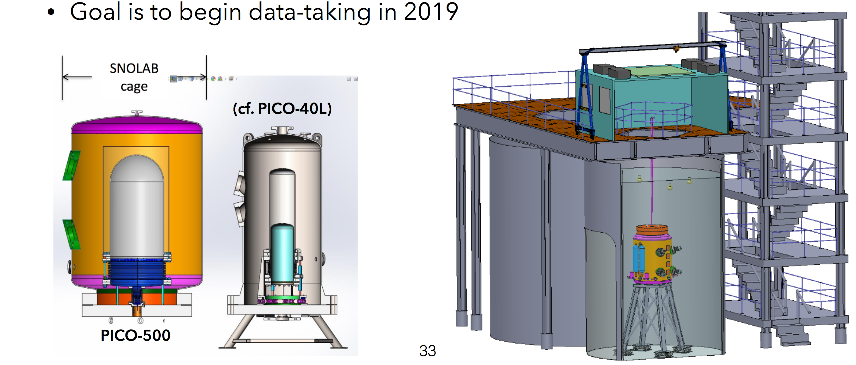
PICO-500
Ton-scale detector, $3M proposal to CFI (Canadian Foundation for Innovation)
Right-side-up design, straight-forward scale-up of PICO-40L
On track to turn on in 2019

Slide 49
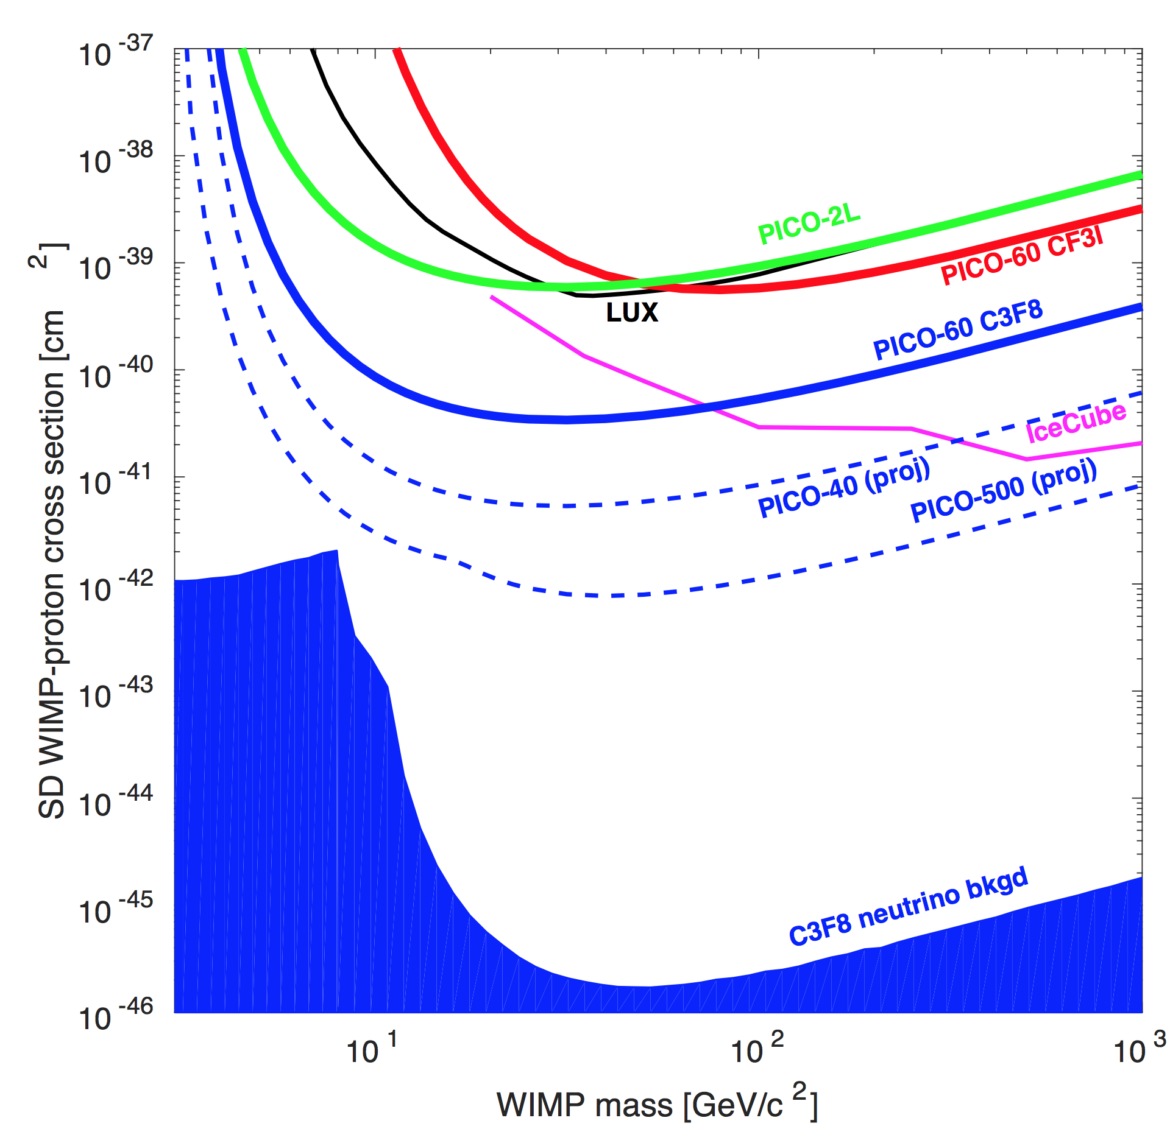
Summary
PICO-60 result:
Background-free
PICO technology still getting better
  PICO-40L (right-side-up)
  Scintillating Bubble Chambers
PICO-500 underway, could make WIMP discovery
Bubble chambers are key exploring SD space…
…and to characterizing a future WIMP signal!

Slide 50
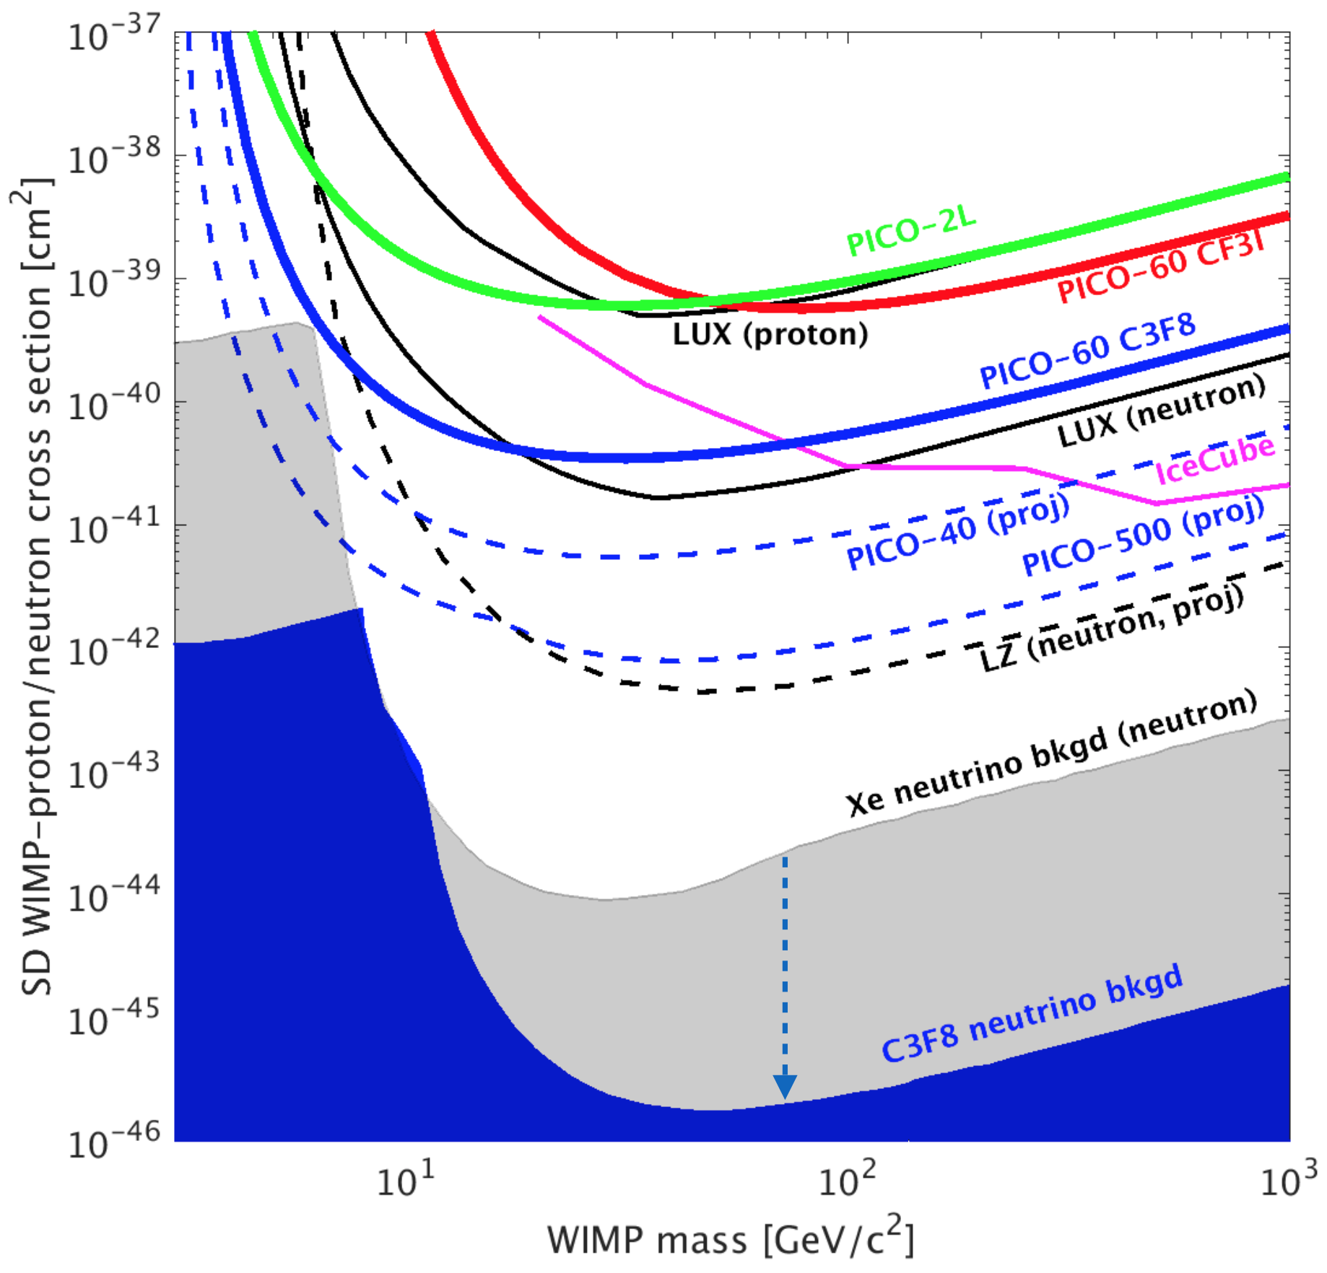
Summary
PICO-60 result:
Background-free
PICO technology still getting better
  PICO-40L (right-side-up)
  Scintillating Bubble Chambers
PICO-500 underway, could make WIMP discovery
Bubble chambers are key exploring SD space…
…and to characterizing a future WIMP signal!

Slide 51
Backup

Slide 52
Scintillating
Bubble Chamber
Xenon Bubble Chamber Prototype
(Northwestern University)
Concept:
Coincident scintillation and bubble nucleation by nuclear recoils
  Extreme electron recoil discrimination as in freon bubble chambers
  Event-by-event energy from scintillation signal
  Now demonstrated in liquid xenon
  arXiv:1702.08861
  [PRL 118, 231301]
43

Slide 53
Sample Nuclear Recoil Event
z
z
Δt

Slide 54
Acoustic – Scintillation Coincidence
< 1% accidental coincidence rate in calibration data
Slope = speed of sound in xenon (to 20%)

Slide 55
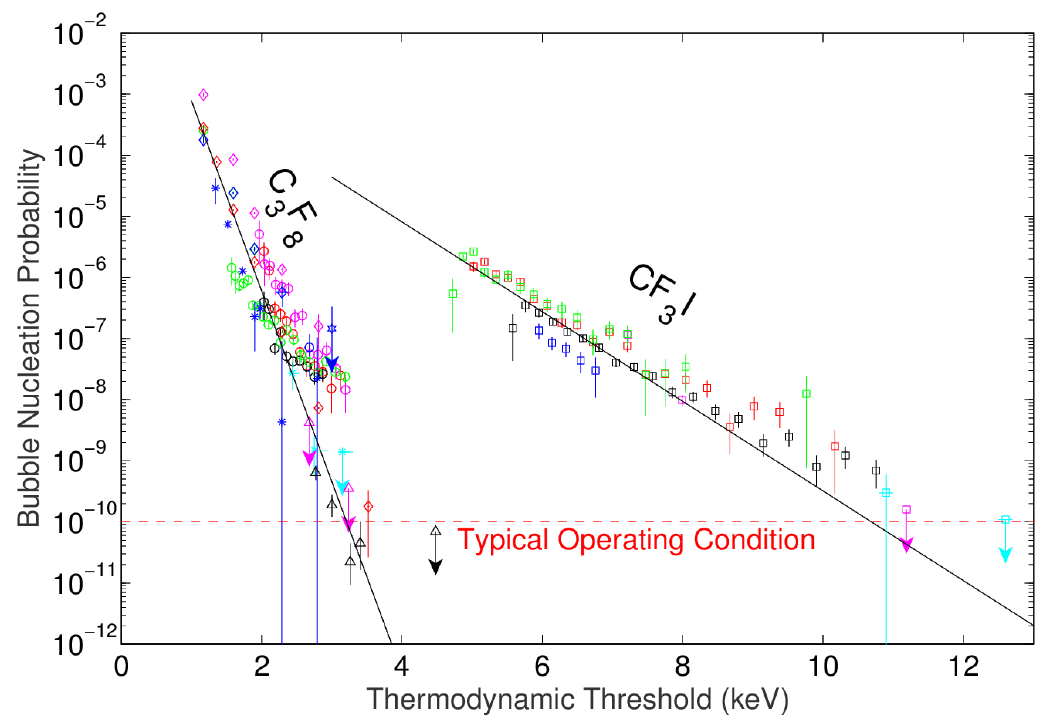
Gamma Discrimination
Xenon (90% CL, no bubbles from gammas so far)
Without scintillation, we would expect poorer discrimination in xenon than CF₃I

Slide 56
Scintillation Spectrum for Bubble Events
E_{T} = 8.2 – 8.6 keV
E_{T} = 8.6 – 15 keV
No E_{T} dependence
observed in
other bins
*
*Simulation assumes
15-keV threshold for bubble nucleation
Bubbles with no PMT Trigger

