Slide 1
A Possible Scenario about Neutrino mass
Gongjun Choi (YITP, Stony Brook Univ. )
Rahulkumar Solanki (Univ. of Texas at Dallas)

Slide 2
Outline
About sterile neutrino
Relevant neutrino future experiments
Information on neutrino mass from each experiment
A scenario on neutrino mass
Conclusion

Slide 3
Q. Examine one or more “interesting” scenarios (i.e. non-trivial) for combining
DUNE, CMB S4, KATRIN, and future neutrino-less double beta decay experiment results from the perspective of understanding (and precisely measuring) the neutrino masses.

Slide 4
About sterile neutrino

Slide 5
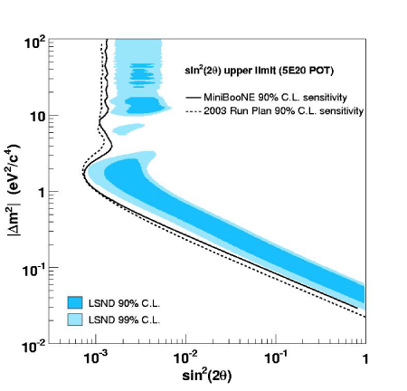
Even the lowest allowed
region of LSND result
=> Violate the summation law
Δ(m13^2) = Δ (m12^2) + Δ(m23^2)
Other reactor anti-ν anomaly
=> GALLEX and SAGE
3+1 scenario
An additional massive ν with mass at the eV scale and mass of other 3 much smaller

Slide 6
Some Future ν-Exp

Slide 7
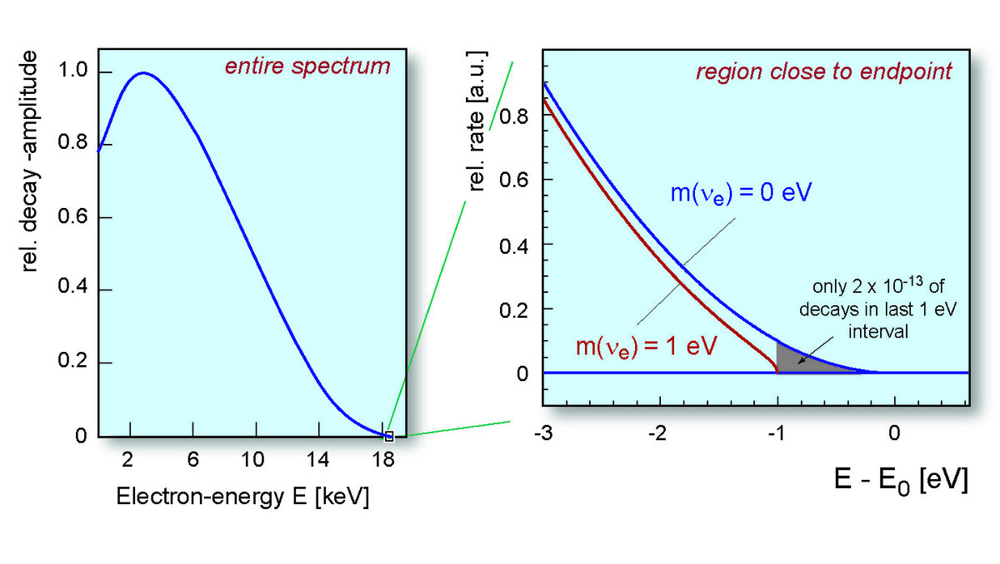
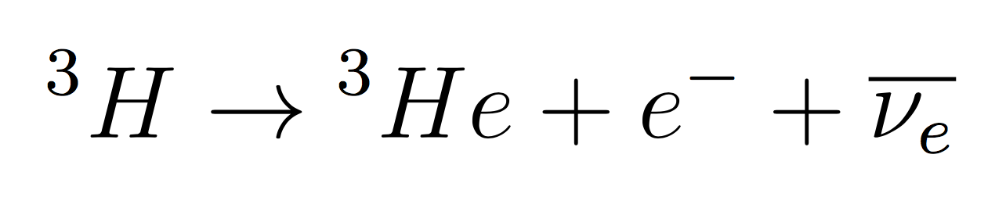
KATRIN(KArlsruhe TRItium Neutrino exp)
End point of E – spectrum
=> quantifies mβ
-

Slide 8
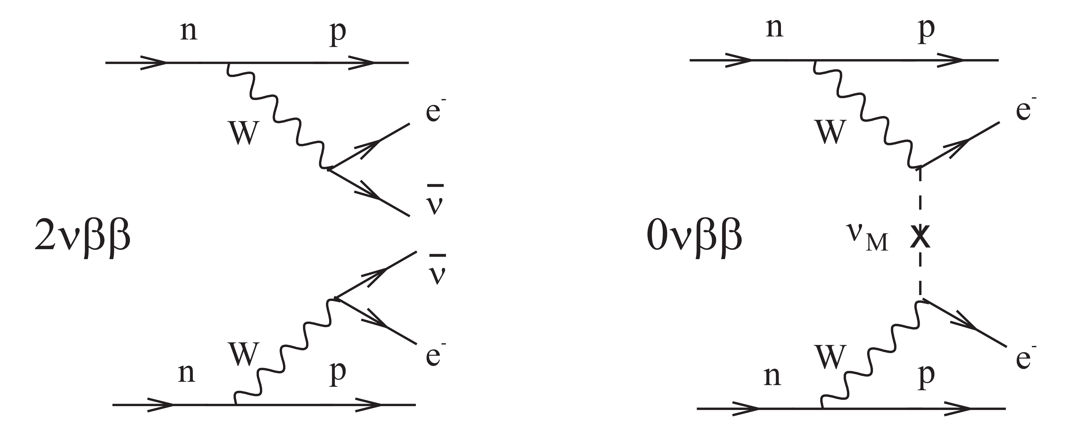
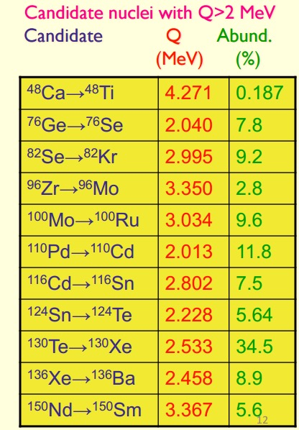




$ν$-less $ββ$ decay
GERDA
SNO+
KamLAND-ZEN
EXO-200, nEXO

Slide 9
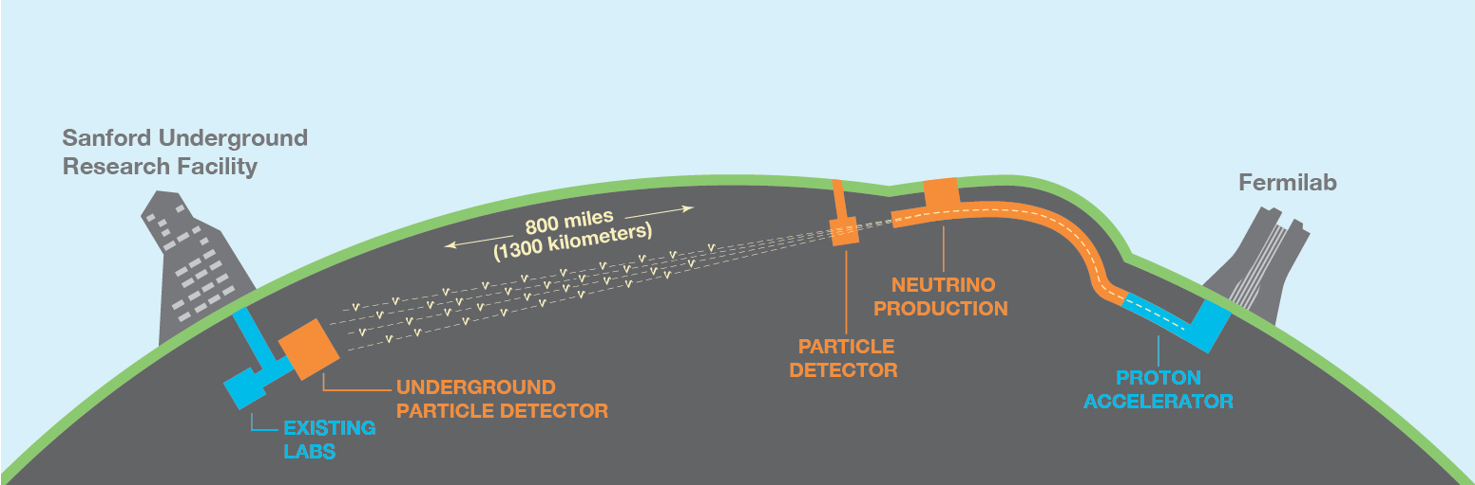
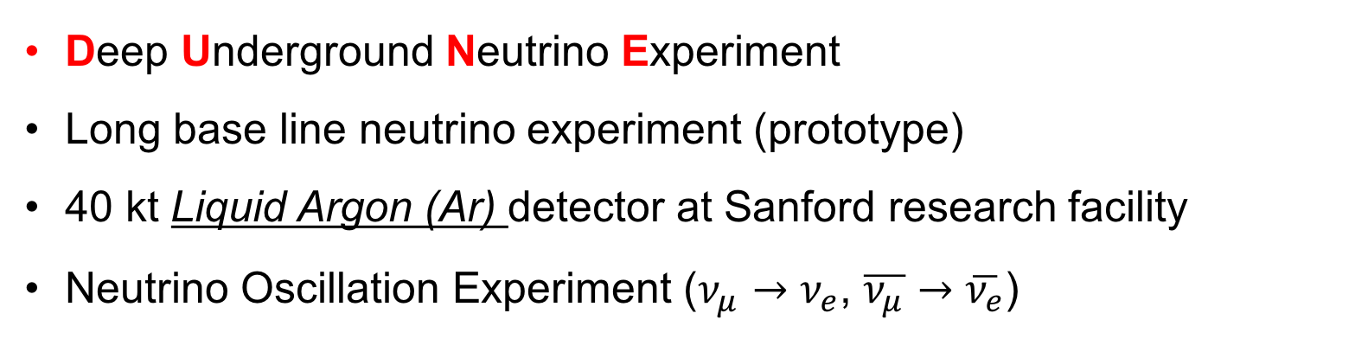
DUNE
Deep Underground Neutrino Experiment
Long base line neutrino experiment (prototype)
40 kt Liquid Argon (Ar) detector at Sanford research facility
Neutrino Oscillation Experiment ($ν_{μ}→ν_{e}$, $\overline{ν_{μ}}→\overline{ν_{e}}$)

Slide 10
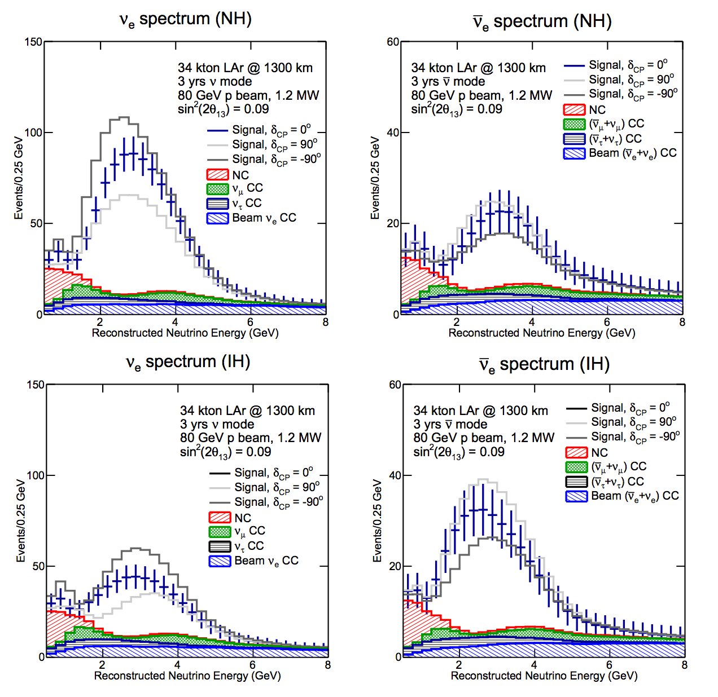

Slide 11
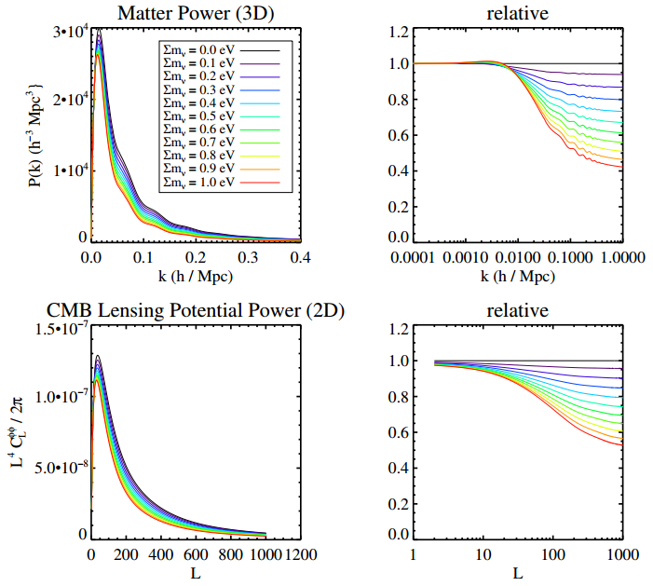
CMB-Stage 4
The greater neutrino mass
the small scale of matter power spectrum ↓
the small scale of CMB lensing potential power spectrum ↓

Slide 12
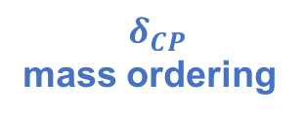
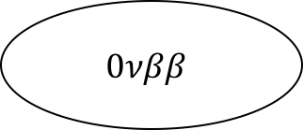

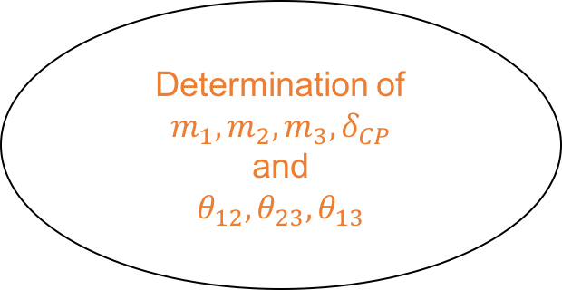


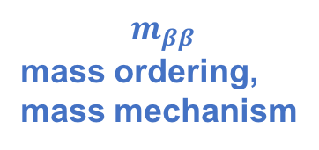
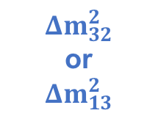
Solar neutrino oscillations
$$0νββ$$
$$m_{ββ}$$
mass ordering, mass mechanism
$$Δm_{12}^{2}$$
Determination of
$$m_{1},m_{2}, m_{3}, δ_{CP}$$
and
$$θ_{12}, θ_{23}, θ_{13}$$
$$m_{β}$$
KATRIN
Atmospheric neutrinos
$$Δm_{32}^{2}$$
or
$$Δm_{13}^{2}$$
$$δ_{CP}$$
mass ordering
$$Σm_{ν}$$
DUNE
CMB S4

Slide 13



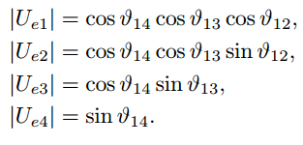

In 3+1 scenario..with sterile ν
Effective νe mass(absolute scale of ν mass)
Mass sum
Sterile ν is already non-relativistic after mat-rad equality (T=0.75eV)
If ν is Majorana, then Effective Majorana ν mass
with and

Slide 14
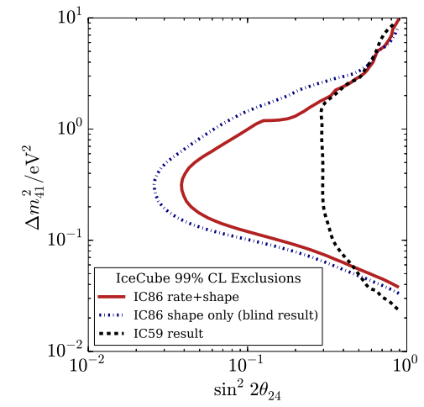
Appealing mass scenario
Q. Mass Parameter Space for consistency of all mentioned exp?
Ice Cube excluded only part of LSND anomaly
Still possible !

Slide 15
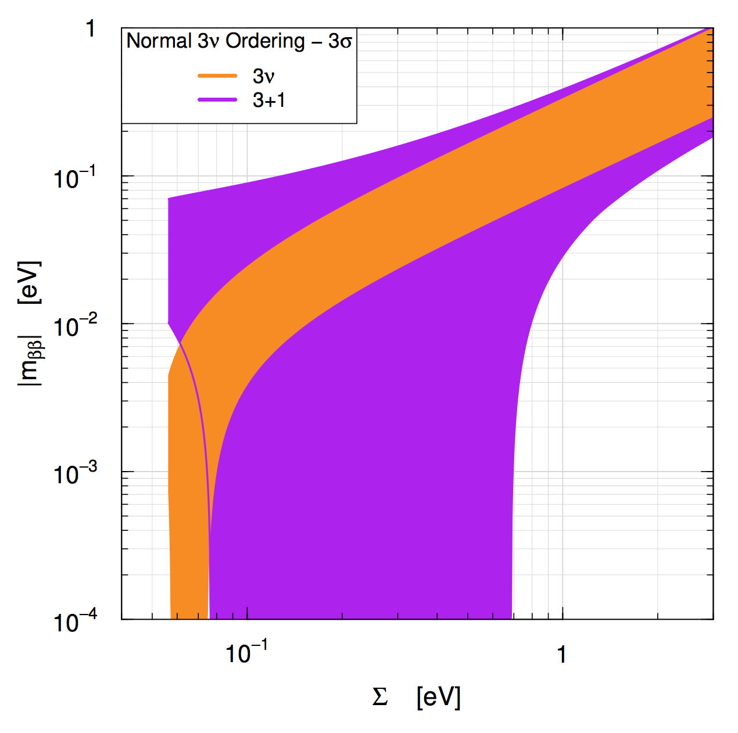
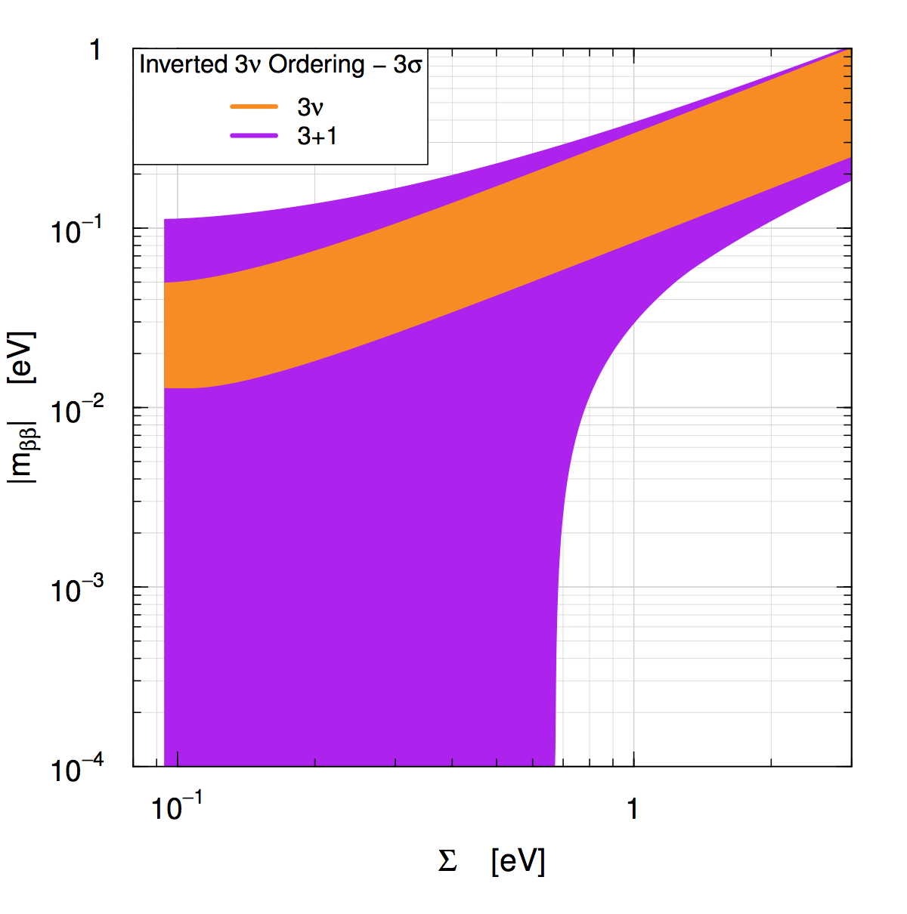

CMB S4 and $0νββ$
PLANCK 2015
∑mν < 0.194 eV

Slide 16
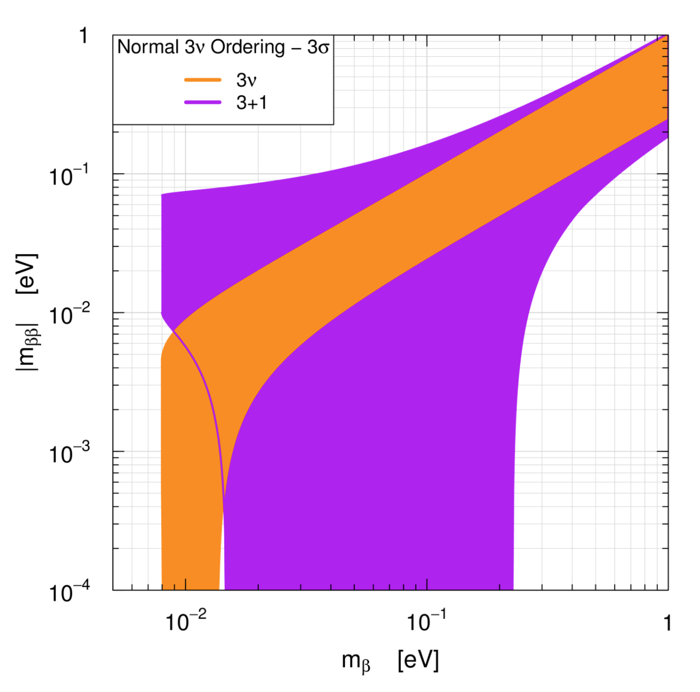
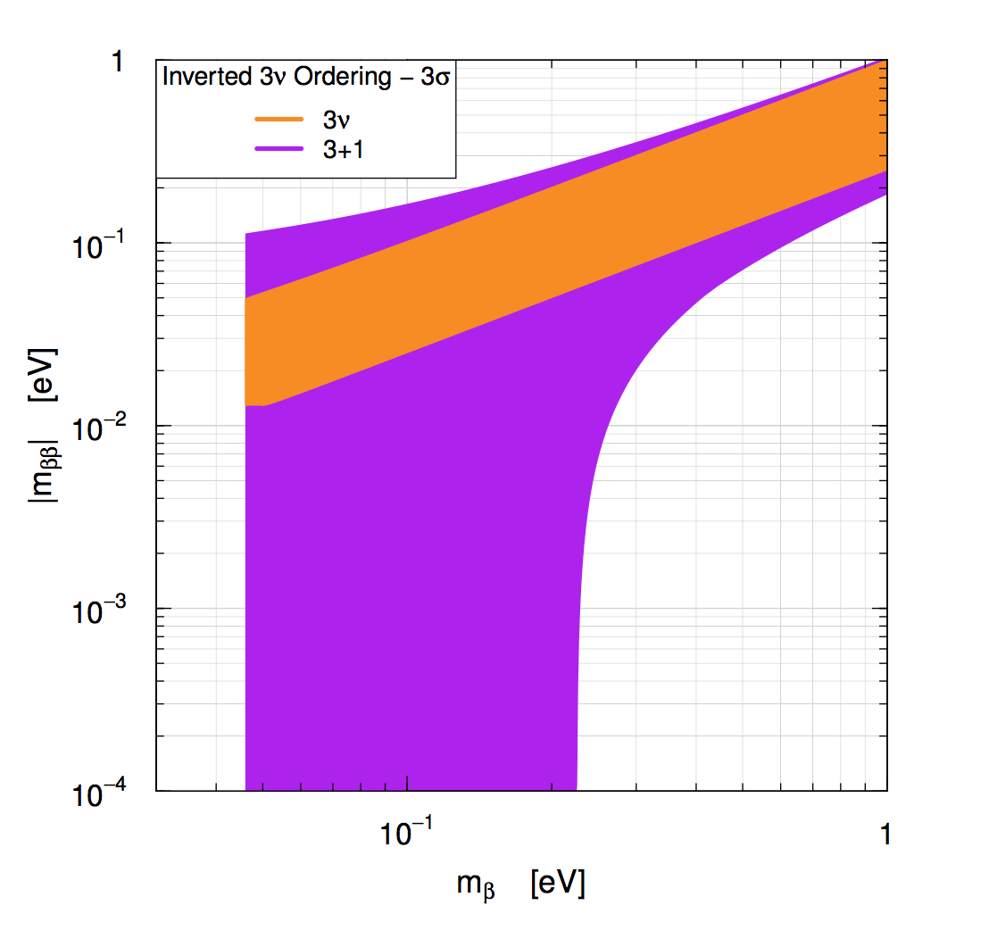

KATRIN and $0νββ$
sensitive

Slide 17
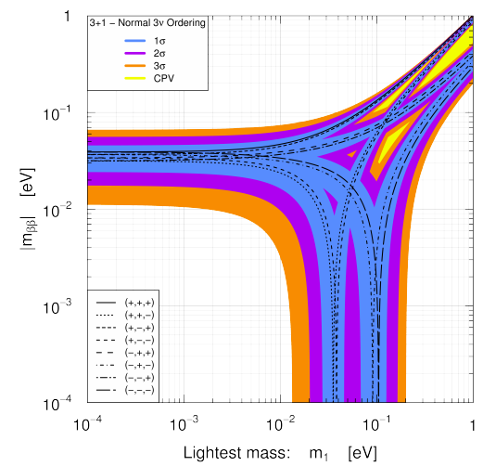
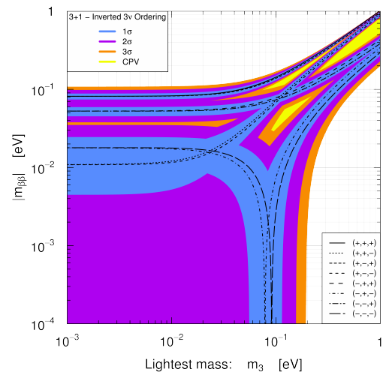
The lightest ν mass ?

Slide 18
CMB S4 and $0νββ$
PLANCK 2015
∑mν < 0.194 eV

Slide 19
KATRIN and $0νββ$
sensitive

Slide 20
The lightest neutrino mass in tension with Ωm
If 3+1 scenario holds and ν is Majorana,
In NO, for mββ ≈ 2X10^(-2) eV ~ 6X10^(-2) eV,
m1 ~ 0.001 eV m2 ~ 0.0087 eV and m3 ~ 0.0497eV
∑ mν ≈ 0.059eV (in tension with the lower bound from Ωm=0.058eV)
In IO, for for mββ ≈ 2X10^(-2) eV ~ 6X10^(-2) eV,
m3 ~ 0.001eV
m1 ~ 0.049eV, m2~ 0.0497eV
∑ mν ≈ 0.0997eV (exceed the lower bound from Ωm)
We can set the upper bound on the mlightest < O(10^(-3))

Slide 21
Conclusion
Still need to consider 3+1 scenario
Within 3+1, there is a scenario of ν masses satisfying
(1) oscillation exp result (DUNE) (2) lower bound of ∑mν from Ωm
(3) upper bound of ∑mν from CMB-S4
(4) sensitive to next generation of KATRIN
(5) ν is Majorana (success of 0 νββ)
mlightest ~ or < O(10^(-4))

Slide 22
References
C. Giunti and E. Zavanin, arXiv:1505.00978
CMB S4 science book, arXiv:1610.02743
Long Baseline Neutrino Experiment , arXiv:1307.7335
Neutrinoless double beta decay review , arXiv:1601.07512
Searches for Sterile Neutrinos with the IceCube Detector, arXiv:1605.01990
https://www.katrin.kit.edu/
http://www.dunescience.org/
Talks by L Kaufman, H Tanaka, A Friedland

Slide 23
