Slide 1
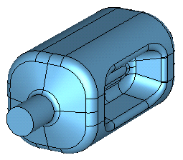
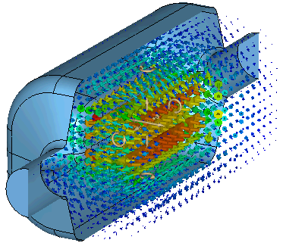
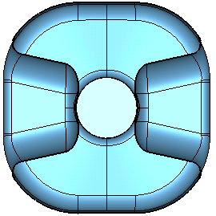
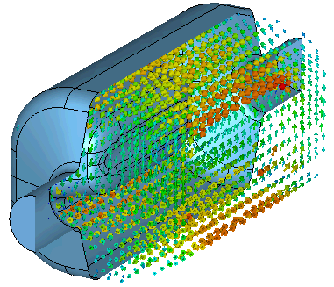
Current RFD Design
Frequency – 400.79 MHz
Transverse voltage – 3.4 MV
Fixed parameters – 84 mm aperture
Cavity size – < 281 mm
Frequency | 400 | MHz
Aperture | 84 | mm
Nearest HOM | 633.5 | MHz
E_{p}/E_{t} | 3.6 | MV/m
B_{p}/E_{t} | 6.2 | mT
[R/Q]_{t} | 429.7 | Ω
Geometrical Factor (G) | 106.7 | Ω
R_{t}R_{s} | 4.6×10⁵ | Ω²
V_{t} | 3.4 | MV
E_{p} | 33 | MV/m
B_{p} | 56 | mT
E Field
281 mm
194 mm
H Field
281 mm

Slide 2
RFD Design Optimization Steps
Modify shape of the poles
  Increase slope of the poles to facilitate proper rinsing during high pressure rinsing
  Check HOM modes and impedances
  Check multipoles
Increase pickup port diameter → 40 mm diameter
  Increase pick up port size to 40 mm and optimize coupling of probe to extract 1 W
Revisit Lorentz detuning compensation → 10 kHz at 3.4 MV
Adjust height of the ports
  Increase height of the ports between end and NbTi plate for convenience during cavity assembly

Slide 3
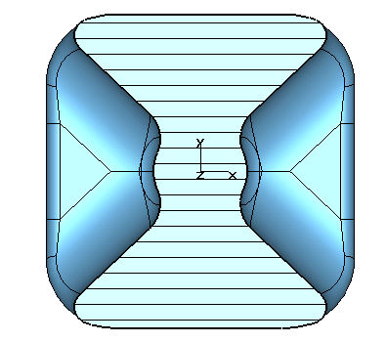
Modification to RFD Designs
Increase angle – same as PoP
Aperture is the same – 84 mm
Cavity frequency is dependent on the curvature of the edges
This shape complicates the welding of poles to the outer body
Also hard to achieve target frequency of 400.79 MHz
Needs to revisit HOM spectrum and multipoles and mechanical analysis
281 mm
281 mm

