Slide 1
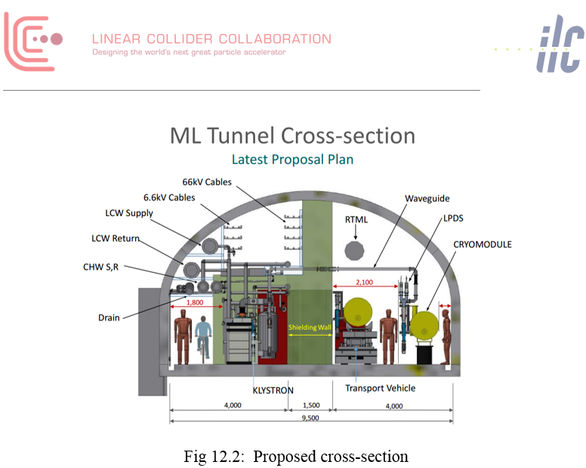
Latest ILC tunnel cross section May 2017
The defining issue in determining the ILC tunnel wall thickness is field-emission induced radiation from the cavities (dark current) when the RF power is on since it is proposed that personnel access will be permitted during these times.

Slide 2
ILC tunnel cross section in RDR (2007) for CERN site with double tunnel

Slide 3
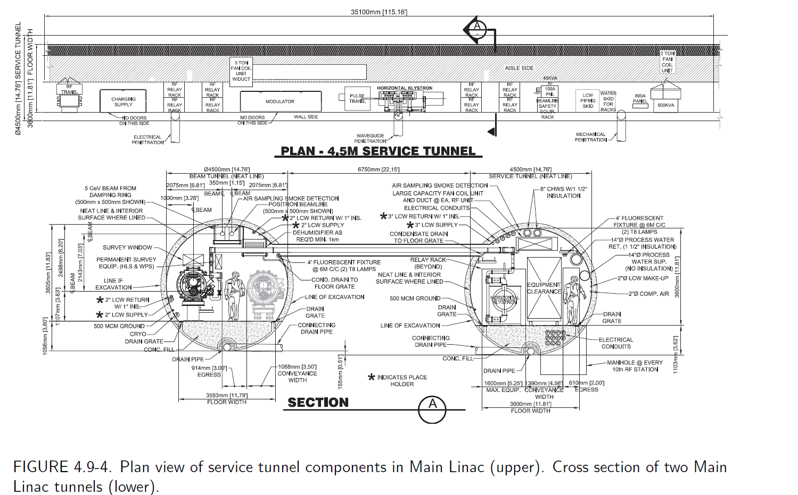
ILC tunnel cross section in RDR (2007) with double tunnel

Slide 4
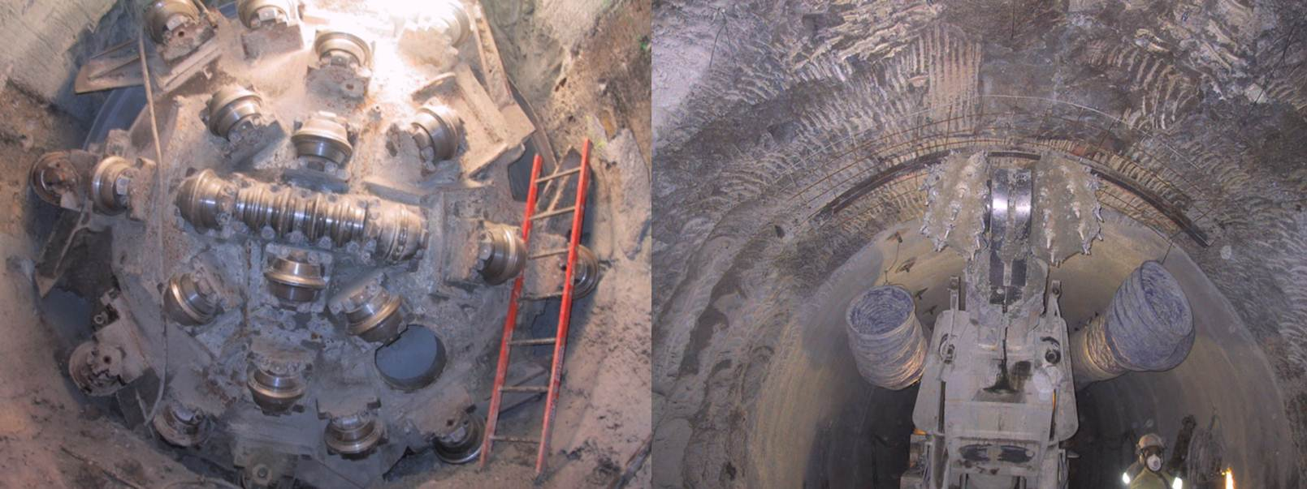
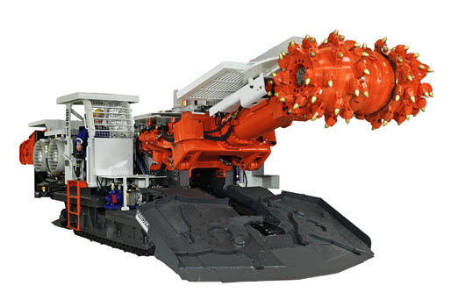
A few thoughts about CLIC civil engineering for Klystron option
FCC and ILC studies have shown that generally one larger single tunnel is normally cheaper/faster than two smaller tunnels
From LHC experience we know if a tunnel is longer than about 2km (CLIC will be 5km each side of IP), generally ‘circular’ tunnel boring machines provide the quickest and cheapest option in Molasse rock
Typical TBM diameter is 6m, but can increase up to about 10m
Other option would be to use a “roadheader” type excavation to make the cross section similar to ILC Japan “kamaboko” shaped tunnel
How do the BDS v Klystron tunnel cross sections vary ?
These three options will be briefly investigated (Double tunnel, Large circular single tunnel or ‘Roadheader’ tunnel
John Osborne SMB/SE/FAS 5 May 2017
TBM
Roadheader

