Slide 1


Considerations on a klystron module layout
C. Rossi

Slide 2
Considerations on a Klystron-based Option at 380 GeV
With the increase of the klystron and modulator efficiencies, the interest for the option is growing
Two tunnels or one large tunnel (with shielded separation between the modulator area and the beam) ?
  Solutions exist to keep attenuation low in long waveguides
  Access to modulators is required during operation
In principle, k-modules do not need to be moved if CLIC is upgraded, however different BDS length for the 380 GeV and the 3 TeV options.

Slide 3
380 GeV Module Sequence - Klystron Option
Areas of possible improvement
Sectors of the MB FODO lattice for one Linac
FODO Sector | T0 | Q1 | Q2 | Totals |  | AS with 28 cells
1 | 148 | 148 |  |  |  | sequence: 148 x T0Q1
2 | 276 | 138 |  |  |  | sequence: 138 x T0T0Q1
3 | 228 | 76 |  |  |  | sequence: 76 x T0T0T0Q1
4 | 300 |  | 100 |  |  | sequence: 100 x T0T0T0Q2
5 | 504 |  | 126 |  |  | sequence: 126 x T0T0T0T0Q2
Totals | 1456 | 362 | 226
Quads | 0 | 362 | 226 | 588 |  | 362 x 0.4 + 226 x 0.65
AS | 11648 |  |  | 11648
T0 Module is made of 8 x AS
One Linac length = 3334 m

Slide 4
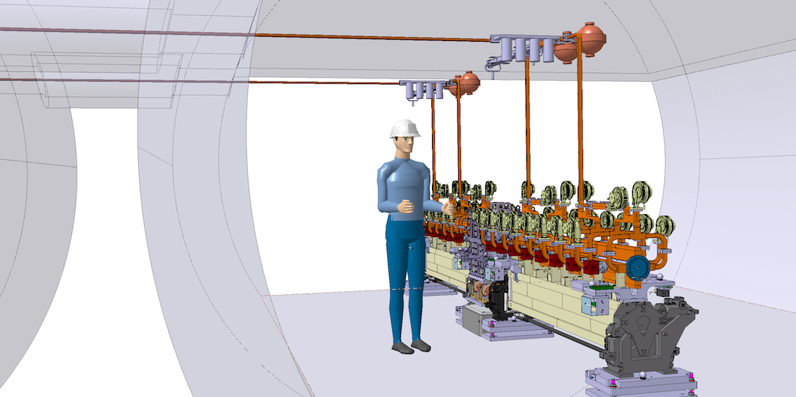
380 GeV Klystron Tunnel View
The module layout is still at a draft stage
3D Integration and Design Y. Cuvet

Slide 5
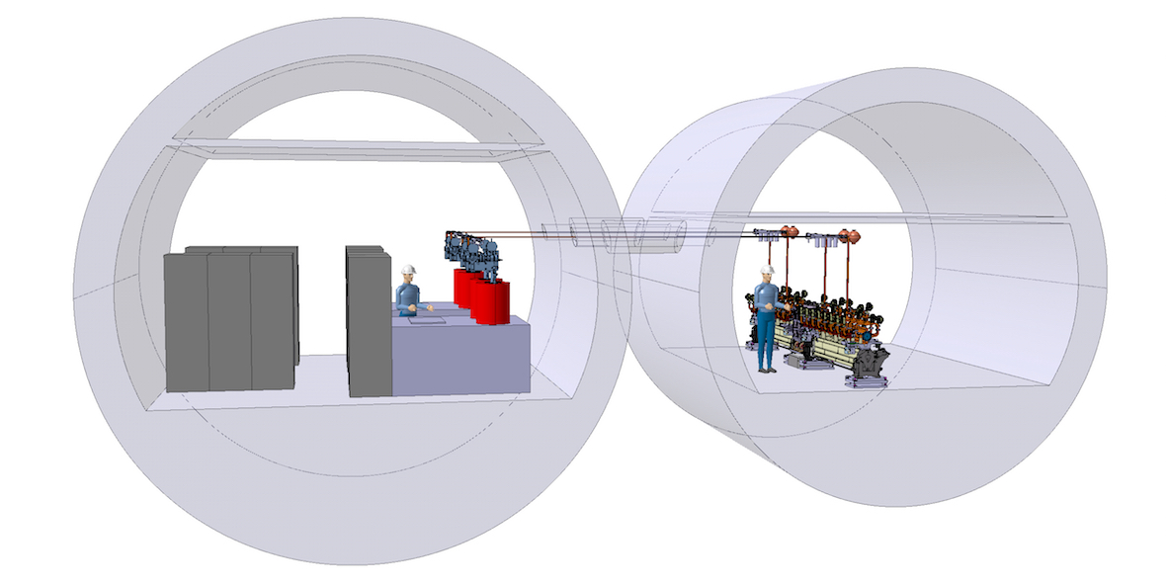
380 GeV Klystron Tunnel View
The modulator layout comes from the revisiting of a Scandinova draft proposal.
The distance between tunnels remains to be defined and the number of interconnections as well.

Slide 6
380 GeV Klystron Tunnel Cross-sections
h
Klystron replacement needs space under the ceiling and a crane

Slide 7
380 GeV Klystron Tunnel Plan View

Slide 8
380 GeV Klystron Tunnel Plan View

Slide 9
380 GeV choice of RF Strcuture
Areas of possible improvement
Optimization of RF structure design – D. Schulte 21/01

Slide 10
RF Power Dissipation
Areas of possible improvement
Structure | CLIC-G | CLIC-G* | CLIC380 | Klystron (K)
f_{rep} [Hz] | 50 | 50 | 50 | 50
Efficiency: η [%] | 27.7 | 28.5 | 39.8 | 38.7
Rise time: tr [ns] | 22.4 | 22 | 13.1 | 20.3
Filling time: tf [ns] | 62.9 | 65.5 | 55.4 | 62.7
Efficient beam loading time: tb [ns] | 155.5 | 155.5 | 175.5 | 242
Pulse length: tp [ns] | 240.8 | 243 | 244 | 325
P_{in} [MW] | 63.8 | 62.3 | 59.7 | 41.7
P_{out}^{unloaded} [MW] | 29.7 | 26.5 | 27.6 | 17.9
P_{out}^{loaded} [MW] | 11.9 | 9.76 | 6.2 | 4.5
P_{beam} [MW] | 27.367 | 27.747 | 33.035 | 21.673
Thermal dissipation [W]: <P_{dissipated}^{unloaded}>, <P_{dissipated}^{loaded}> | 410.564, 336.181 | 434.970, 349.394 | 391.620, 289.526 | 386.750, 286.649
Mean power in the load [W]: <P_{load}^{unloaded}>, <P_{load}^{loaded}> | 357.588, 219.193 | 321.975, 191.822 | 336.720, 148.935 | 290.875, 128.735
Mean power to the beam: <P_{beam}> [W] | 212.778 | 215.729 | 289.879 | 262.241
X. X. Huang 5/04/17

Slide 11
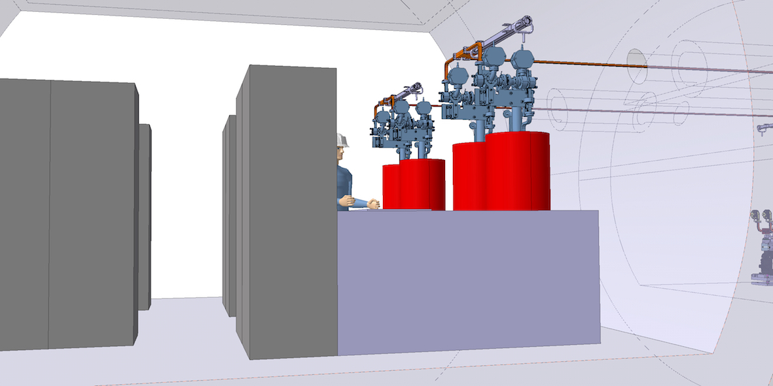
380 GeV Klystron option – Power Dissipations in Main Tunnel
Areas of possible improvement
The following power levels and efficiencies have been considered for the evaluation of the power dissipation:
AS input 42.5 MW with 325 10⁻⁹ s @ 50 Hz
Klystron output 57 MW peak with 1.625 10⁻⁶ s @ 50 Hz
Efficiencies modulator 95%, klystron 70%, RF network (including
the pulse compression) 60%

Slide 12
380 GeV – Power Dissipations in the Main Tunnel
Areas of possible improvement
Component | unit | 3 TeV DB | 380 GeV DB | 380 GeV K
Alignment | W/m | 1.9 | 1.8 | 0.8
BPM | W/m | 13.9 | 13.0 | 2.3
Vacuum | W/m | 51.1 | 43.9 | 31.7
Magnets (air) | W/m | 46.1 | 45.7 | 17.5
Magnets (water) | MW | 16.8 | 2.7 | 1.4
MBQ stab ilization | W/m | 8.7 | 14.3 | 15.7
RF System_{unloaded} (air) | W/m | 195 | 167 | 255
RF System_{unloaded} (water) | MW | 107 | 15 | 25
RF System_{loaded} (air) | W/m | 137 | 98 | 181
RF System_{loaded} (water) | MW | 79 | 9 | 19
To be checked
M. Aicheler

Slide 13
380 GeV – Power Dissipations in the Main Tunnel
Areas of possible improvement
Totals | unit | 3 TeV DB | 380 GeV DB | 380 GeV K
Unloaded case (air) | W/m | 307 | 1.8 | 0.8
Unloaded case (water) | MW | 124 | 13.0 | 2.3
Loaded case (air) | W/m | 249 | 42.3 | 17.5
Loaded case (water) | MW | 96 | 1.1 | 0.7
Klystron (air) | W/m | - | - | 87
Klystron (water) | MW | - | - | 11
Estimates assume 95% power dissipated in water and 5% in air.
M. Aicheler

Slide 14
380 GeV – Concluding remarks
A refinement of the information concerning klystron efficiency and modulator topology can produce relevant changes in this preliminary proposal.
The Klystron 3D layout can rapidly progress, as soon as feedback on the draft proposal becomes available.
We will work to refine the RF design and the layout in parallel.
At this moment what looks as a useful input to the CEIS WG is:
  Deliver a realistic layout of the klystron-based machine
  Identify the operational conditions (and transitions)
  Evaluate the interfacing to the infrastructure and services
    Power consumption
    Power dissipation and heat load on air and water
    Needs for specific ancillary systems (BOC temp control, for ex.)

