Slide 1
The new CLIC detector
and
(some of) the interaction region

Slide 2
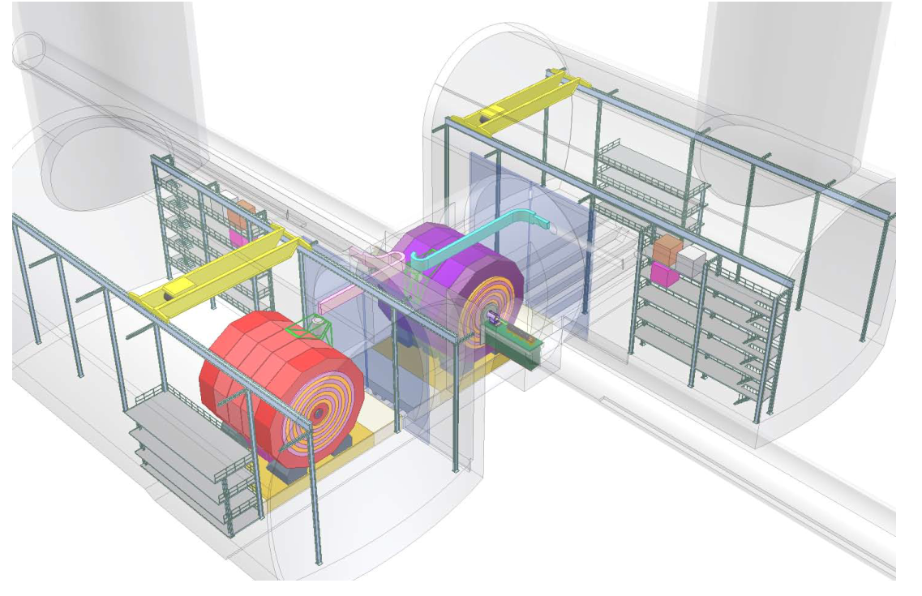
Reminder: the “old” layout – for the CDR
(CDR Volume 2, Fig. 11.10)
5 May 2017

Slide 3
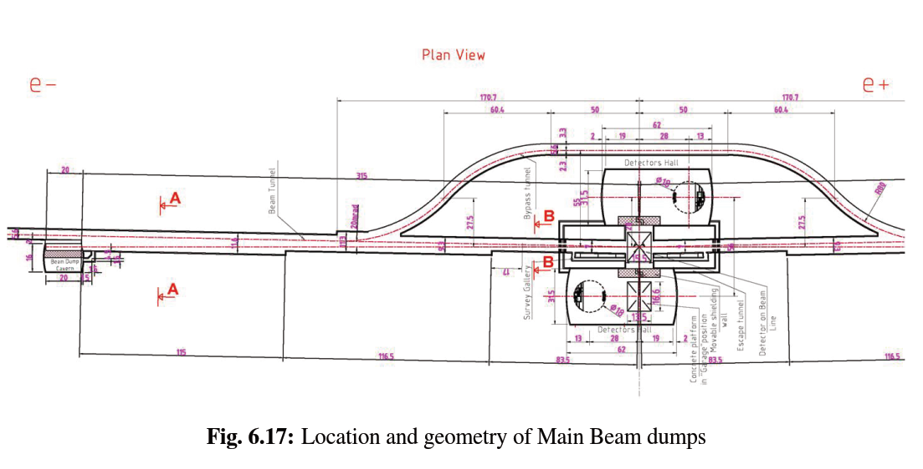
Reminder: the “old” layout – for the CDR
(CDR Volume 1)
5 May 2017

Slide 4
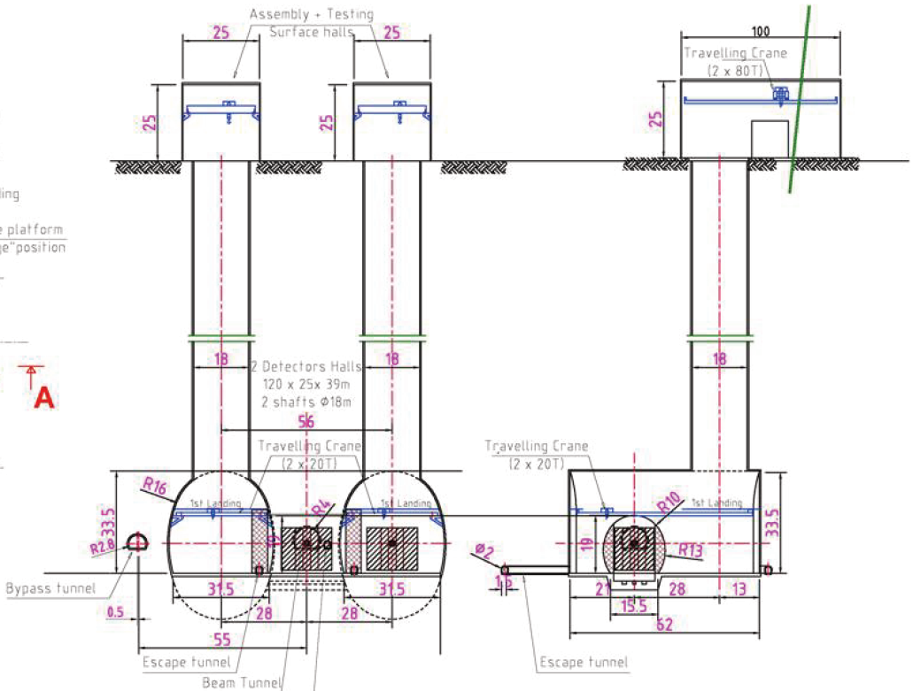
Reminder: the “old” layout – for the CDR
(CDR Volume 1, Fig. 6.19))
5 May 2017

Slide 5
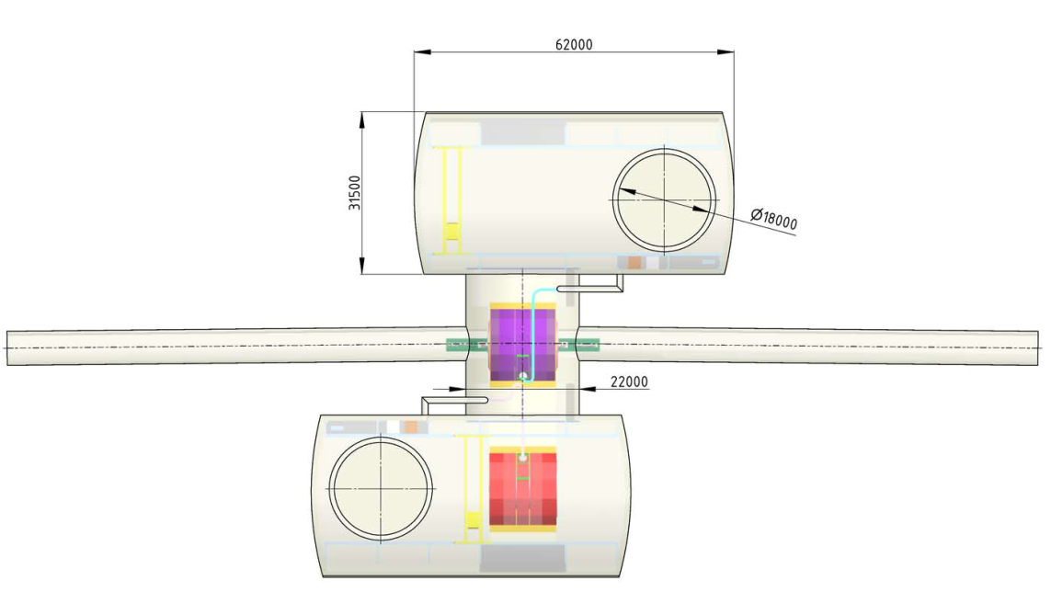
Reminder: the “old” layout – for the CDR
(CDR Volume 2, Fig. 11.11)
5 May 2017

Slide 6
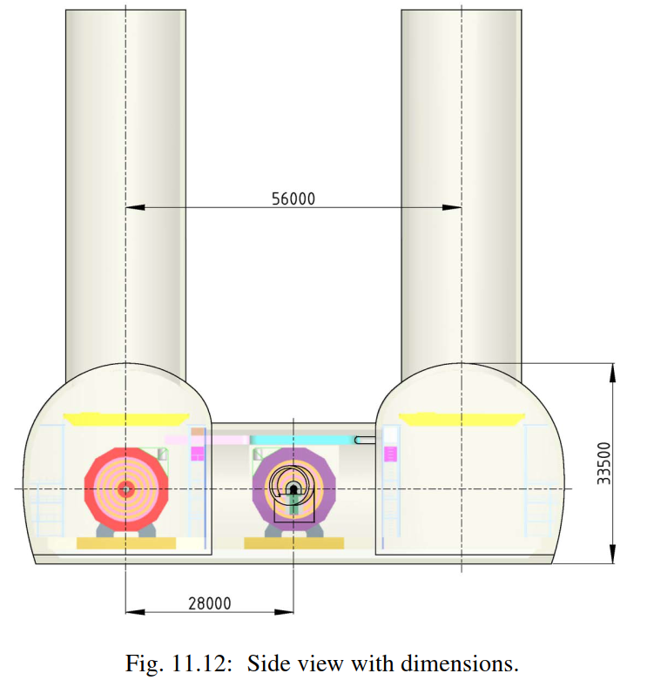
Reminder: the “old” layout – for the CDR
(CDR Volume 2)
5 May 2017

Slide 7
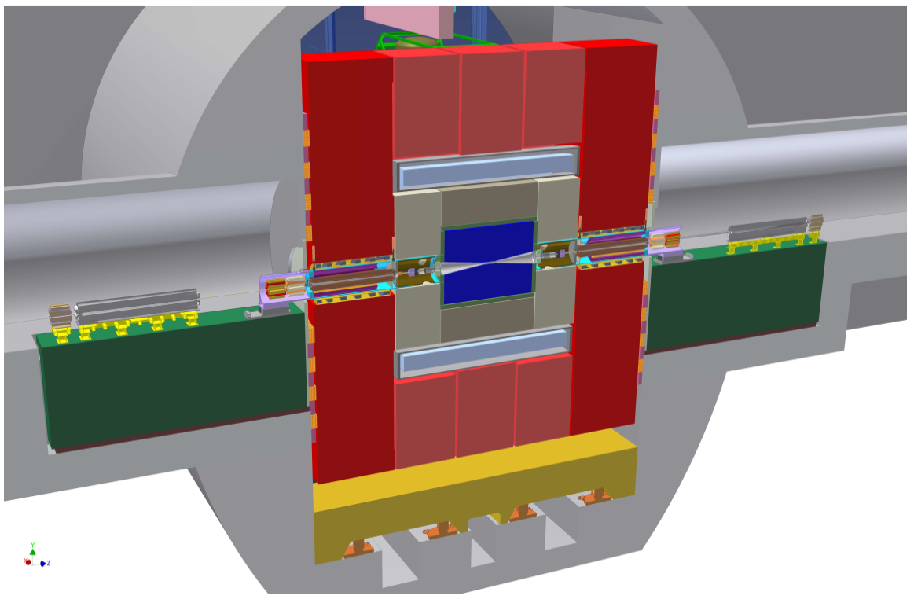
Reminder: the “old” layout – for the CDR
12.8 m
QD0
(vertical cut
through the cavern
and the detector on IP)
(CDR Volume 2, Fig. 11.9)
5 May 2017

Slide 8
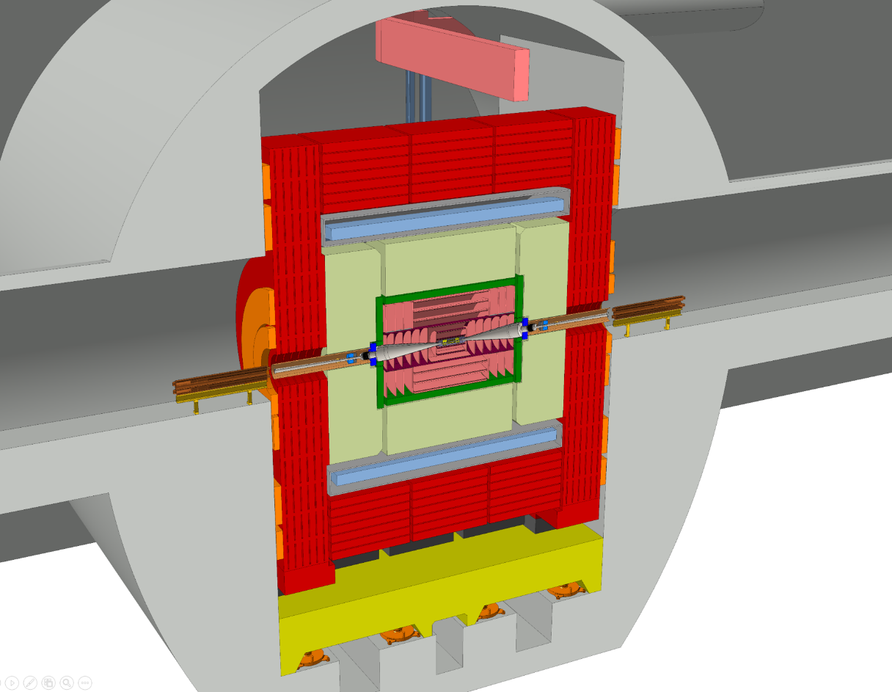
“Working Hypothesis”: QD0 outside of detector
11.4 m
QD0
QD0
(vertical cut
through the cavern
and the detector on IP)
5 May 2017

Slide 9
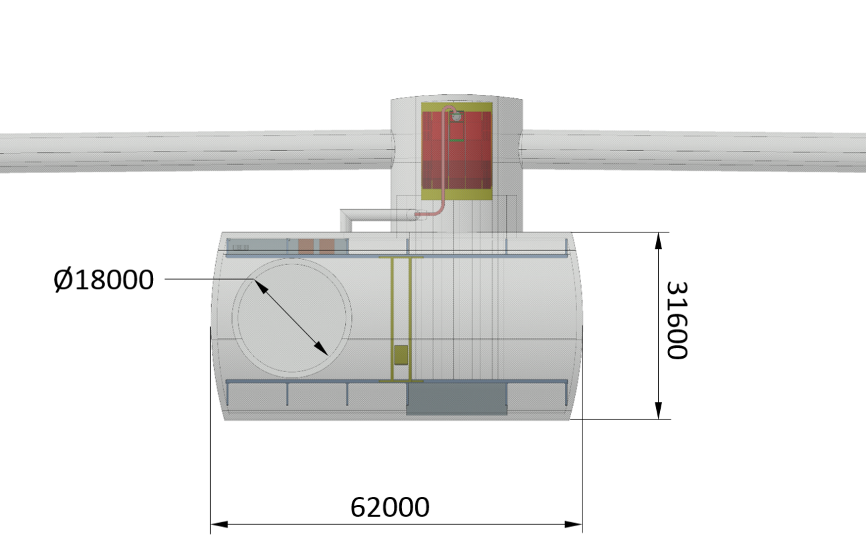
New (simplified) CE layout
(Top View of Expt. Area – dimensions in [mm] – CLICdet 2017)
5 May 2017

Slide 10
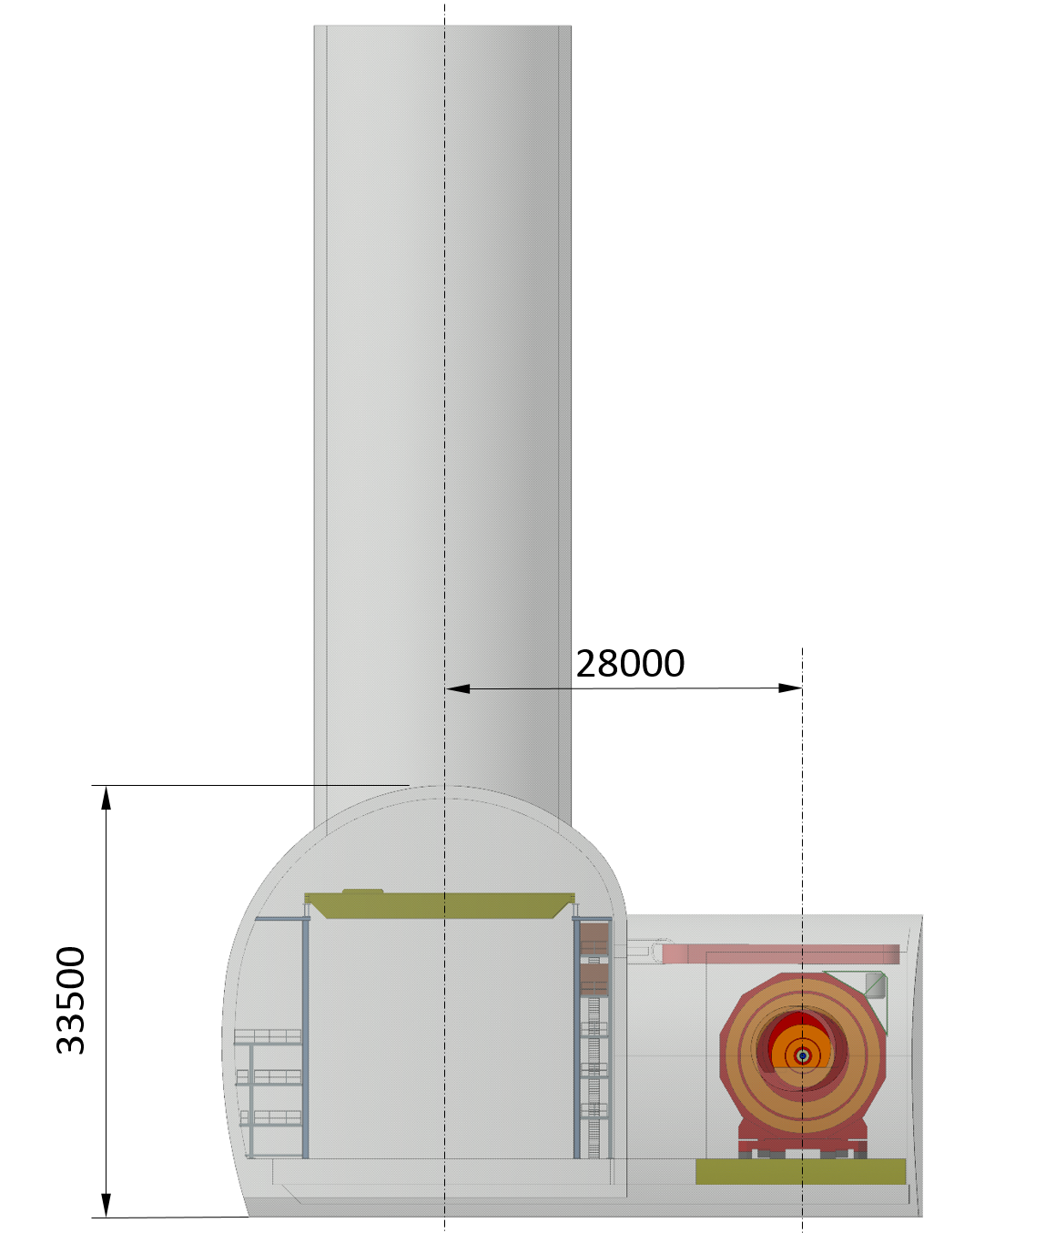
New (simplified) CE layout
(Beam View of Expt. Area – dimensions in [mm] – CLICdet 2017)
5 May 2017

Slide 11
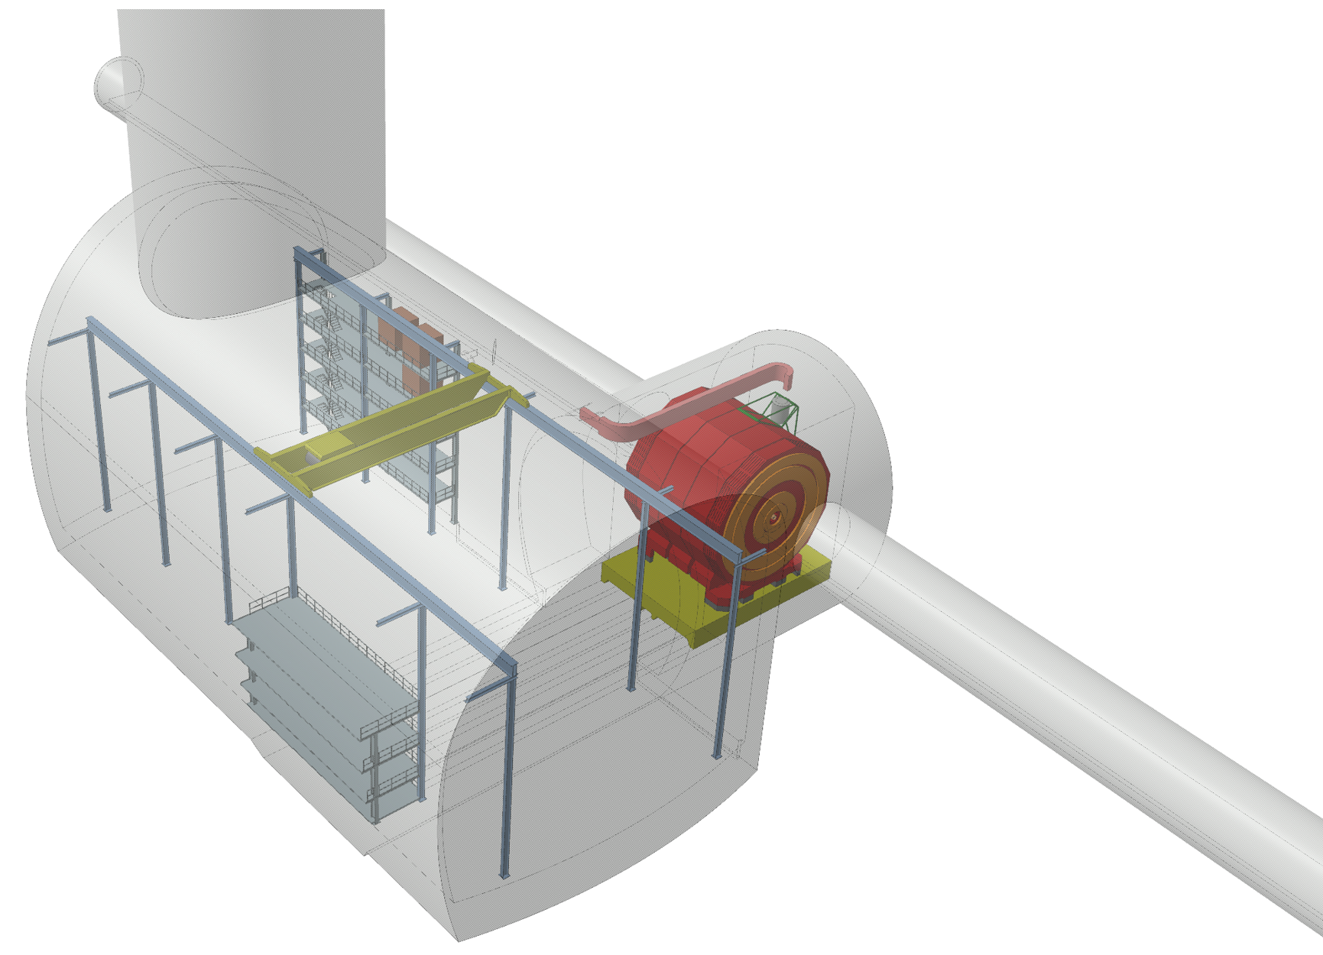
New (simplified) CE layout
5 May 2017

Slide 12
Summary
Simplified layout (w.r.t. CDR) – still using the “CMS principles”
One detector -> one service cavern, one shaft; space needs “as in CDR” (1/2)
QD0 outside of the detector -> layout as compact as possible
(to avoid luminosity loss to the extent possible)
Detector on platform (to move onto / away from IP – maintenance !)
Platform moves above large trenches (for cables) – as in the CDR
Combination of fixed + flexible cryo-lines (as in the CDR)
5 May 2017

Slide 13
N. Alipour-Tehrani et al., CLICdet: the post-CDR CLIC detector model, http://cds.cern.ch/record/2254048/files/CLICdp-Note-2017-001.pdf
A. Gaddi and D. Dannheim, CLIC detector power requirements, https://cds.cern.ch/record/1602917/files/LCD-Note-2013-011.pdf
THANK YOU
5 May 2017

Slide 14
back-up
5 May 2017

Slide 15
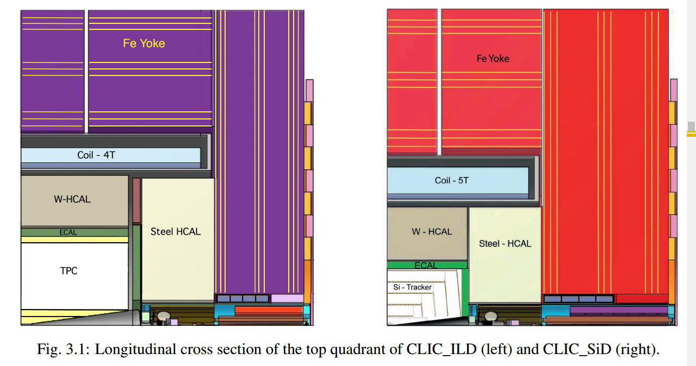
Quarter view of the two CDR detectors
5 May 2017

Slide 16
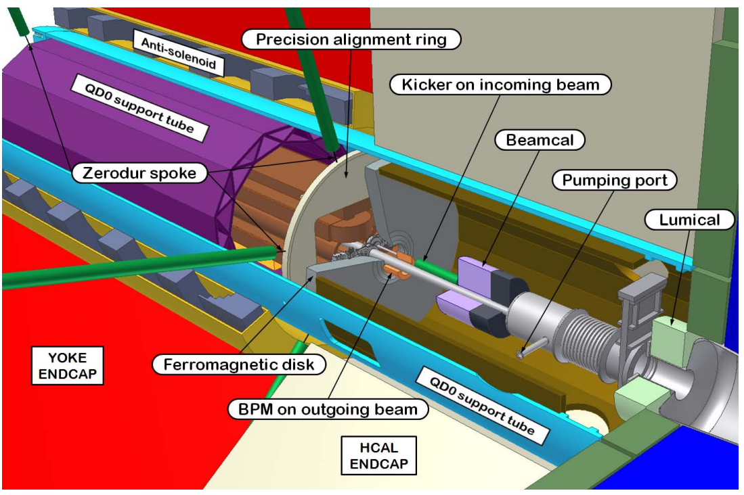
OLD layout of the forward region (CDR)
5 May 2017

Slide 17
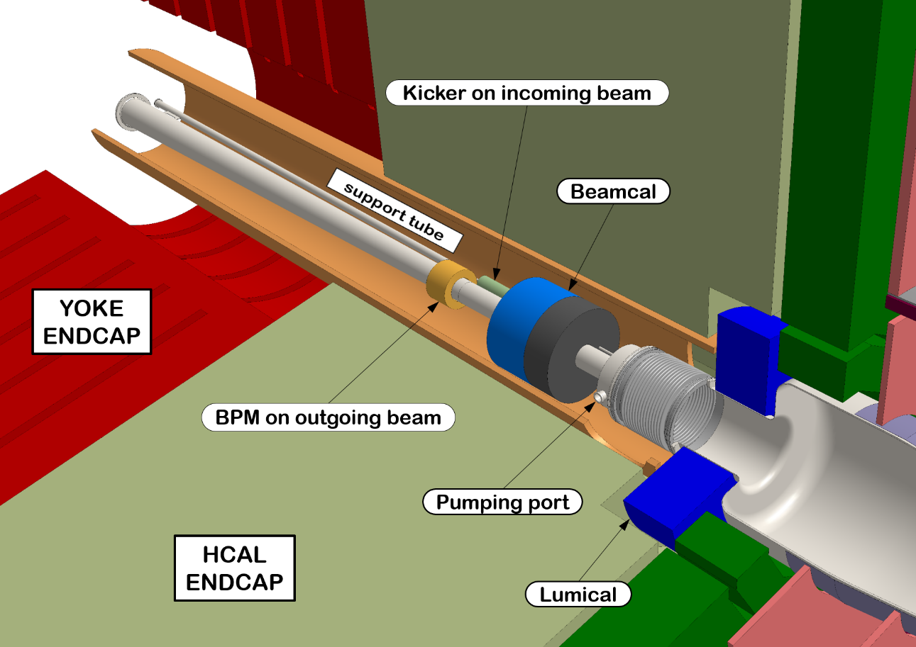
layout of the forward region in CLICdet - 2017
ECAL
ENDCAP
5 May 2017

Slide 18
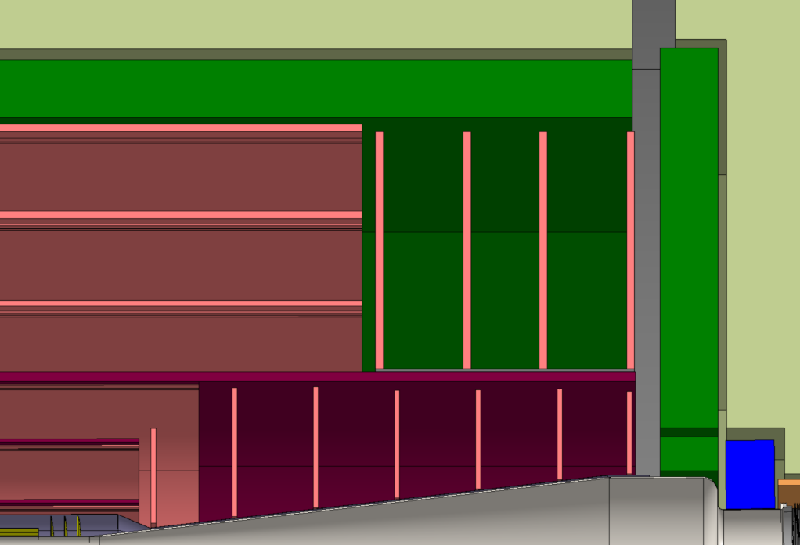
latest developments: ECAL layout
ECAL
CLICdet ECAL:
Silicon-Tungsten
40 layers
22 X_{o}
ECAL
N.B.: maybe this is not the ECAL we would build
5 May 2017

