Slide 1
CLIC Civil Engineering Update
Matthew Stuart – John Osborne SMB-SE-FAS

Slide 2
Reminder – Summary From 31/03/2017
380GeV, 1.5TeV and 3TeV machine layouts to be created
Develop new engineering layout for 380GeV machine using Klystron technology
Develop a layout for the interaction region
CLIC-TOT to be produced to allowed optimisation of tunnel location.
A detailed cost estimate for infrastructure to be produced and work together with ILC on areas of synergy

Slide 3
380 GeV
4 turnarounds and accelerator sections either side of the Interaction Region
1.9 km Beam Delivery System
Total length of 10km
Shafts every 5km
Central Injector Complex, one drive beam – Located on CERN land
Drive Beam
Main Beam
Notes:
First look at the proposed 380 GeV layout.

Slide 4
380 GeV
4 turnarounds and accelerator sections either side of the Interaction Region
1.9 km Beam Delivery System
Total length of 10km
Shafts every 5km
Central Injector Complex, one drive beam – Located on CERN land
Drive Beam
1.9km
Main Beam

Slide 5
380 GeV
4 turnarounds and accelerator sections either side of the Interaction Region
1.9 km Beam Delivery System
Total length of 10km
Shafts every 5km
Central Injector Complex, one drive beam – Located on CERN land
5km (x2)
Drive Beam
1.9km
Main Beam

Slide 6
380 GeV
4 turnarounds and accelerator sections either side of the Interaction Region
1.9 km Beam Delivery System
Total length of 10km
Shafts every 5km
Central Injector Complex, one drive beam – Located on CERN land
5km (x2)
Drive Beam
1.9km
Main Beam
Notes:
Actual length of tunnel for 380GEV only required to be 4.5km.

Slide 7
380 GeV
4 turnarounds and accelerator sections either side of the Interaction Region
1.9 km Beam Delivery System
Total length of 10km
Shafts every 5km
Central Injector Complex, one drive beam – Located on CERN land
2140m
Drive beam injector
Experimental buildings
Main beam injector
880m
420m
Notes:
Central injection complex, located on CERN land in Prévessin, consisting of surface buildings and shallow underground galleries. This complex will be divided into several parts:
The Main Beam injector complex:
10 x surface buildings, largest of which is approximately 400m x 7m x 3m.
11 x shallow cut and cover type tunnels of varying sizes.
The Drive Beam injector complex:
3 x surface buildings, the largest of which will be approximately 2560m x 30m x 9m.
7 x shallow cut and cover type tunnels of varying sizes.
Common transfer tunnel from junction point to separation point 277m x 6m x 3m and surface building 30m x 30m x 5m
2 x Final Transfer tunnels (from separation point).
Experimental area surface buildings consisting of:
19 x surface buildings.
2 x gas storage areas.
1 x transformer switching yard.
Access roads and a car park.
RF Tunnel lengths/layout – to be discussed with Daniel – is the required for TOT

Slide 8
380 GeV
4 turnarounds and accelerator sections either side of the Interaction Region
1.9 km Beam Delivery System
Total length of 10km
Shafts every 5km
Central Injector Complex, one drive beam – Located on CERN land
2140m
Drive beam injector
Experimental buildings
Main beam injector
880m
420m
Notes:
Central injection complex, located on CERN land in Prévessin, consisting of surface buildings and shallow underground galleries. This complex will be divided into several parts:
The Main Beam injector complex:
10 x surface buildings, largest of which is approximately 400m x 7m x 3m.
11 x shallow cut and cover type tunnels of varying sizes.
The Drive Beam injector complex:
3 x surface buildings, the largest of which will be approximately 2560m x 30m x 9m.
7 x shallow cut and cover type tunnels of varying sizes.
Common transfer tunnel from junction point to separation point 277m x 6m x 3m and surface building 30m x 30m x 5m
2 x Final Transfer tunnels (from separation point).
Experimental area surface buildings consisting of:
19 x surface buildings.
2 x gas storage areas.
1 x transformer switching yard.
Access roads and a car park.
RF Tunnel lengths/layout – to be discussed with Daniel – is the required for TOT

Slide 9
1.5 TeV
13 turnarounds and accelerator sections either side of the Interaction Region – 1 redundant turnaround.
2.75 km Beam Delivery System
Total length of 27km
Shafts every 5km
Central Injector Complex, one drive beam – Located on CERN land
Drive Beam
Main Beam
Notes:
Potential to not construct the first turnaround and start from the second – therefore initial 380 GEV stage to have 2.75 BDS

Slide 10
1.5 TeV
13 turnarounds and accelerator sections either side of the Interaction Region – 1 redundant turnaround
2.75 km Beam Delivery System
Total length of 27km
Shafts every 5km
Central Injector Complex, one drive beam – Located on CERN land
Drive Beam
2.75km
Main Beam

Slide 11
1.5 TeV
13 turnarounds and accelerator sections either side of the Interaction Region – 1 redundant turnaround
2.75 km Beam Delivery System
Total length of 27km
Shafts every 5km
Central Injector Complex, one drive beam – Located on CERN land
13.5km (x2)
Drive Beam
2.75km
Main Beam

Slide 12
1.5 TeV
13 turnarounds and accelerator sections either side of the Interaction Region – 1 redundant turnaround
2.75 km Beam Delivery System
Total length of 27km
Shafts every 5km
Central Injector Complex, one drive beam – Located on CERN land
13.5km (x2)
Drive Beam
`
`
2.75km
Main Beam
Potentially construct tunnel to shaft 7 and approx. 100m past at second stage.
Notes:
Tunnel to be constructed to shaft 7 to ensure it is not a dead end tunnel.
Third stage to be bored from shaft 9 back to shaft 7.

Slide 13
1.5 TeV
13 turnarounds and accelerator sections either side of the Interaction Region – 1 redundant turnaround
2.75 km Beam Delivery System
Total length of 27km
Shafts every 5km
Central Injector Complex, one drive beam – Located on CERN land
2140m
2140m
Drive beam injector
Drive beam injector
Experimental buildings
Experimental buildings
Main beam injector
Main beam injector
880m
880m
420m
420m
Notes:
Central injection complex, located on CERN land in Prévessin, consisting of surface buildings and shallow underground galleries. This complex will be divided into several parts:
The Main Beam injector complex:
10 x surface buildings, largest of which is approximately 400m x 7m x 3m.
11 x shallow cut and cover type tunnels of varying sizes.
The Drive Beam injector complex:
3 x surface buildings, the largest of which will be approximately 2560m x 30m x 9m.
7 x shallow cut and cover type tunnels of varying sizes.
Common transfer tunnel from junction point to separation point 277m x 6m x 3m and surface building 30m x 30m x 5m
2 x Final Transfer tunnels (from separation point).
Experimental area surface buildings consisting of:
19 x surface buildings.
2 x gas storage areas.
1 x transformer switching yard.
Access roads and a car park.
RF Tunnel lengths/layout – to be discussed with Daniel – is the required for TOT

Slide 14
1.5 TeV
13 turnarounds and accelerator sections either side of the Interaction Region – 1 redundant turnaround
2.75 km Beam Delivery System
Total length of 27km
Shafts every 5km
Central Injector Complex, one drive beam – Located on CERN land
2140m
2140m
Drive beam injector
Drive beam injector
Experimental buildings
Experimental buildings
Main beam injector
Main beam injector
880m
880m
420m
420m
Notes:
Central injection complex, located on CERN land in Prévessin, consisting of surface buildings and shallow underground galleries. This complex will be divided into several parts:
The Main Beam injector complex:
10 x surface buildings, largest of which is approximately 400m x 7m x 3m.
11 x shallow cut and cover type tunnels of varying sizes.
The Drive Beam injector complex:
3 x surface buildings, the largest of which will be approximately 2560m x 30m x 9m.
7 x shallow cut and cover type tunnels of varying sizes.
Common transfer tunnel from junction point to separation point 277m x 6m x 3m and surface building 30m x 30m x 5m
2 x Final Transfer tunnels (from separation point).
Experimental area surface buildings consisting of:
19 x surface buildings.
2 x gas storage areas.
1 x transformer switching yard.
Access roads and a car park.
RF Tunnel lengths/layout – to be discussed with Daniel – is the required for TOT

Slide 15
3 TeV
25 turnarounds and accelerator sections either side of the Interaction Region – 1 redundant turnaround.
2.75 km Beam Delivery System
Total length of 48km
Shafts every 5km
Central Injector Complex – Located on CERN land two drive beam injectors.
Drive Beam
Main Beam

Slide 16
3 TeV
25 turnarounds and accelerator sections either side of the Interaction Region – 1 redundant turnaround.
2.75 km Beam Delivery System
Total length of 48km
Shafts every 5km
Central Injector Complex – Located on CERN land two drive beam injectors.
Drive Beam
2.75km
Main Beam

Slide 17
3 TeV
25 turnarounds and accelerator sections either side of the Interaction Region – 1 redundant turnaround.
2.75 km Beam Delivery System
Total length of 48km
Shafts every 5km
Central Injector Complex – Located on CERN land two drive beam injectors.
24km (x2)
Drive Beam
2.75km
Main Beam

Slide 18
3 TeV
25 turnarounds and accelerator sections either side of the Interaction Region – 1 redundant turnaround.
2.75 km Beam Delivery System
Total length of 48km
Shafts every 5km
Central Injector Complex – Located on CERN land two drive beam injectors.
24km (x2)
Drive Beam
2.75km
Main Beam

Slide 19
3 TeV
25 turnarounds and accelerator sections either side of the Interaction Region – 1 redundant turnaround.
2.75 km Beam Delivery System
Total length of 48km
Shafts every 5km
Central Injector Complex – Located on CERN land two drive beam injectors.
2140m
Drive beam injector
Experimental buildings
Main beam injector
880m
420m
Notes:
Central injection complex, located on CERN land in Prévessin, consisting of surface buildings and shallow underground galleries. This complex will be divided into several parts:
The Main Beam injector complex:
10 x surface buildings, largest of which is approximately 400m x 7m x 3m.
11 x shallow cut and cover type tunnels of varying sizes.
The Drive Beam injector complex:
3 x surface buildings, the largest of which will be approximately 2560m x 30m x 9m.
7 x shallow cut and cover type tunnels of varying sizes.
Common transfer tunnel from junction point to separation point 277m x 6m x 3m and surface building 30m x 30m x 5m
2 x Final Transfer tunnels (from separation point).
Experimental area surface buildings consisting of:
19 x surface buildings.
2 x gas storage areas.
1 x transformer switching yard.
Access roads and a car park.
RF Tunnel lengths/layout – to be discussed with Daniel – is the required for TOT

Slide 20
3 TeV
25 turnarounds and accelerator sections either side of the Interaction Region – 1 redundant turnaround.
2.75 km Beam Delivery System
Total length of 48km
Shafts every 5km
Central Injector Complex – Located on CERN land two drive beam injectors.
2140m
Drive beam injector
Experimental buildings
Main beam injector
880m
420m
Notes:
Central injection complex, located on CERN land in Prévessin, consisting of surface buildings and shallow underground galleries. This complex will be divided into several parts:
The Main Beam injector complex:
10 x surface buildings, largest of which is approximately 400m x 7m x 3m.
11 x shallow cut and cover type tunnels of varying sizes.
The Drive Beam injector complex:
3 x surface buildings, the largest of which will be approximately 2560m x 30m x 9m.
7 x shallow cut and cover type tunnels of varying sizes.
Common transfer tunnel from junction point to separation point 277m x 6m x 3m and surface building 30m x 30m x 5m
2 x Final Transfer tunnels (from separation point).
Experimental area surface buildings consisting of:
19 x surface buildings.
2 x gas storage areas.
1 x transformer switching yard.
Access roads and a car park.
RF Tunnel lengths/layout – to be discussed with Daniel – is the required for TOT

Slide 21
Central Injector Complex
Consists of 3 main parts – Drive beam injector, main beam injector and experimental buildings.
Section A-A: Cross sectional geometry of the drive beam injector
Section B-B: Cross sectional geometry of the main beam injector
Road
2140m
Drive beam injector
A
Experimental buildings
A
B
Main beam injector
B
880m
420m
Notes:
Central injection complex, located on CERN land in Prévessin, consisting of surface buildings and shallow underground galleries. This complex will be divided into several parts:
The Main Beam injector complex:
10 x surface buildings, largest of which is approximately 400m x 7m x 3m.
11 x shallow cut and cover type tunnels of varying sizes.
The Drive Beam injector complex:
3 x surface buildings, the largest of which will be approximately 2560m x 30m x 9m.
7 x shallow cut and cover type tunnels of varying sizes.
Common transfer tunnel from junction point to separation point 277m x 6m x 3m and surface building 30m x 30m x 5m
2 x Final Transfer tunnels (from separation point).
Experimental area surface buildings consisting of:
19 x surface buildings.
2 x gas storage areas.
1 x transformer switching yard.
Access roads and a car park.
RF Tunnel lengths/layout – to be discussed with Daniel – is the required for TOT

Slide 22
Central Injector Complex
Consist of 3 main parts – Drive beam injector, main beam injector and experimental buildings.
Section A-A: Cross sectional geometry of the drive beam injector
Section B-B: Cross sectional geometry of the main beam injector
30m
9m
GL
5m
10m
3m
6m
12m
5m
Section A-A Drive beam tunnel
Notes:
Central injection complex, located on CERN land in Prévessin, consisting of surface buildings and shallow underground galleries. This complex will be divided into several parts:
The Main Beam injector complex:
10 x surface buildings, largest of which is approximately 400m x 7m x 3m.
11 x shallow cut and cover type tunnels of varying sizes.
The Drive Beam injector complex:
3 x surface buildings, the largest of which will be approximately 2560m x 30m x 9m.
7 x shallow cut and cover type tunnels of varying sizes.
Common transfer tunnel from junction point to separation point 277m x 6m x 3m and surface building 30m x 30m x 5m
2 x Final Transfer tunnels (from separation point).
Experimental area surface buildings consisting of:
19 x surface buildings.
2 x gas storage areas.
1 x transformer switching yard.
Access roads and a car park.
RF Tunnel lengths/layout – to be discussed with Daniel – is the required for TOT

Slide 23
Central Injector Complex
Consist of 3 main parts – Drive beam injector, main beam injector and experimental buildings.
Section A-A: Cross sectional geometry of the drive beam injector
Section B-B: Cross sectional geometry of the main beam injector
7m
GL
3m
5m
10m
3m
5m
5m
1.1m
Section B-B Main beam tunnel
Notes:
Central injection complex, located on CERN land in Prévessin, consisting of surface buildings and shallow underground galleries. This complex will be divided into several parts:
The Main Beam injector complex:
10 x surface buildings, largest of which is approximately 400m x 7m x 3m.
11 x shallow cut and cover type tunnels of varying sizes.
The Drive Beam injector complex:
3 x surface buildings, the largest of which will be approximately 2560m x 30m x 9m.
7 x shallow cut and cover type tunnels of varying sizes.
Common transfer tunnel from junction point to separation point 277m x 6m x 3m and surface building 30m x 30m x 5m
2 x Final Transfer tunnels (from separation point).
Experimental area surface buildings consisting of:
19 x surface buildings.
2 x gas storage areas.
1 x transformer switching yard.
Access roads and a car park.
RF Tunnel lengths/layout – to be discussed with Daniel – is the required for TOT

Slide 24
Interaction Region
Access shaft for detector and machine ?
What to do with the proposed escape tunnel?
Thickness of shielding wall?
Moveable detector – garage position available.

Slide 25
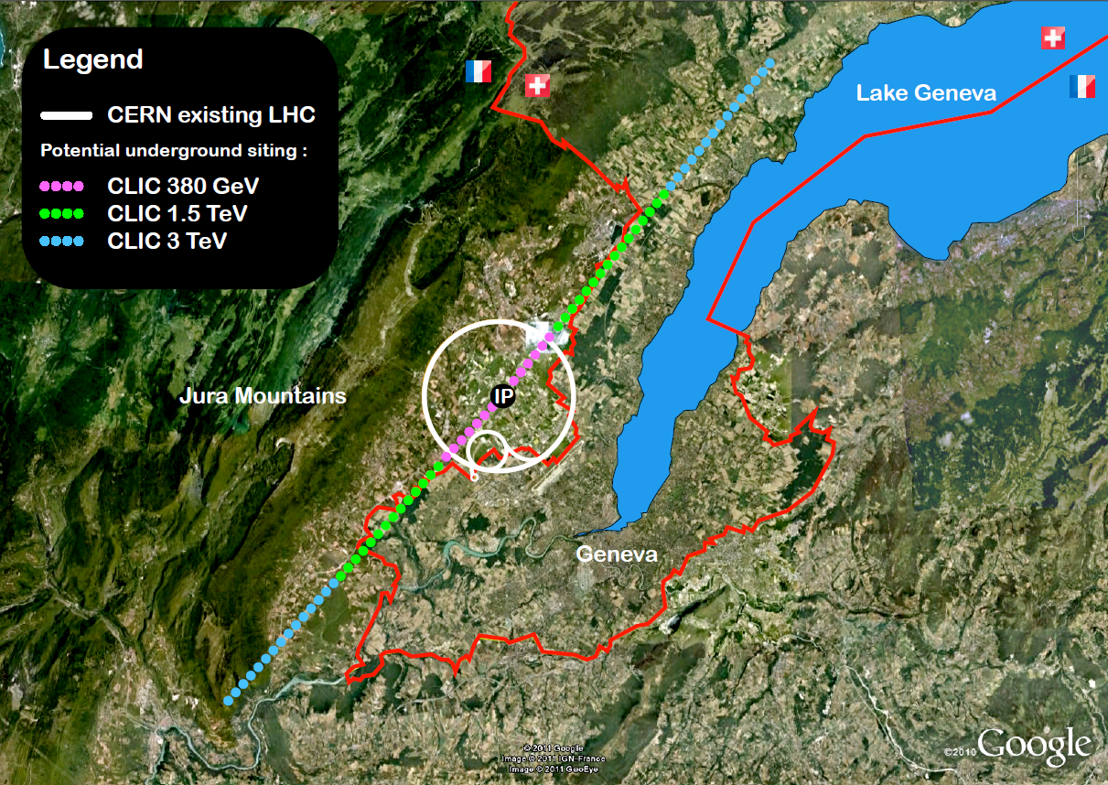
CLIC-TOT
Optimise the Position of the CLIC for the three energy stages.
Optimise the depth
Optimise the angle of the tunnels
Optimise the position of the IR
Production of Tool including user inputs and outputs has been agreed
Geological data required outside of the FCC study area. (Meeting with local geologists 22 May).

Slide 26
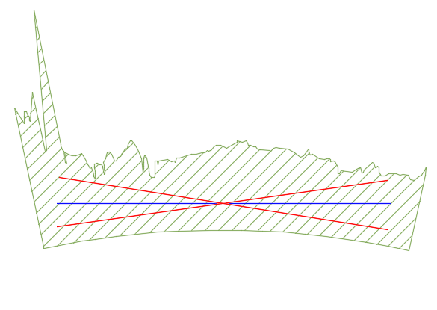
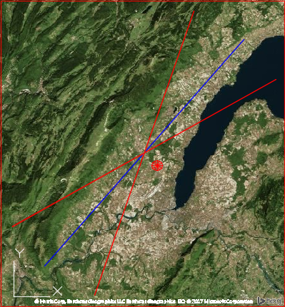

Tool Functionality
Allows rotation of the tunnel in the vertical plane shown here.
Gives an optimised depth and most suitable shaft positions.
Reduce average depth of tunnel to decrease cost and schedule.
Rotation of the Tunnel in the horizontal plane shown here.
Provide a Geological cross section of the tunnel.
Allow positioning of inclined tunnel access and provide geological data for the inclined tunnels.
11
7
5
3
1
2
4
9
6
8
10
Approximate shaft locations

Slide 27
TOT Timeline
The proposed programme task completion dates are as follows, assuming a project commencement at the end of April 2017:
Task 1 | Establish Project Setup and Technical Basis | June (mid)
Task 2 | Data and Functionality Prioritisation | June (end)
Task 3 | Specifications and TOT-CLIC architecting/wireframing (Concept Stage) | July (mid)
Task 4 | Data Integration and TOT-CLIC (beta) development | July (mid)
Task 5 | Finalised TOT-CLIC Development | Sept (end)
Task 6 | Troubleshooting and Technical Support | -

Slide 28
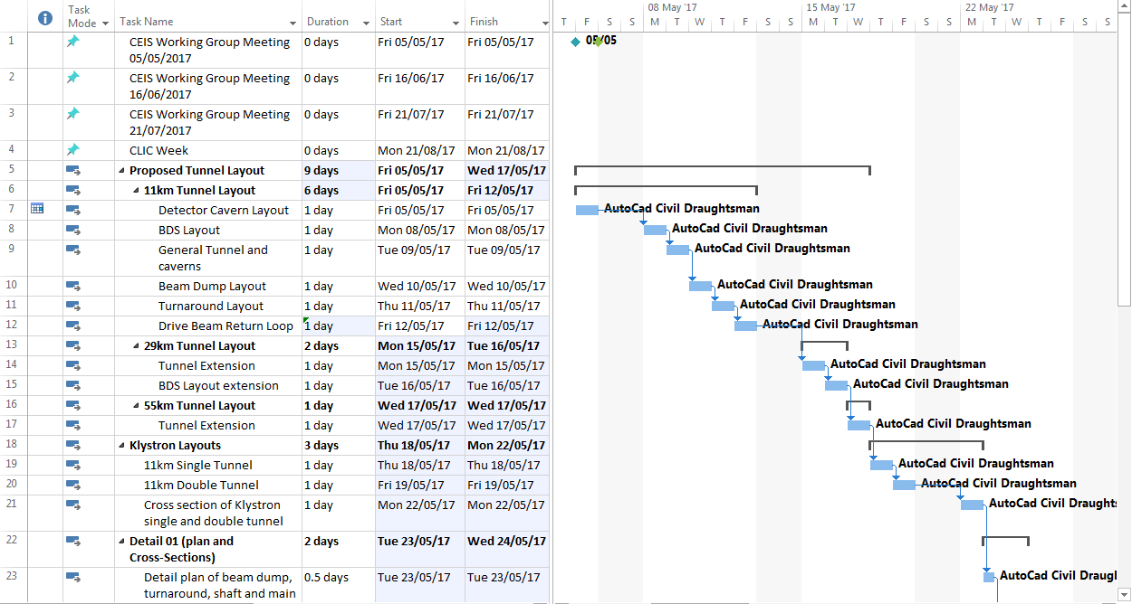
Civil Engineering Drawings
Existing Civil Drawings to be updated where required.
New drawings for Klystron Design will be required.
Full 3D schematic required for entire length.
3D schematic required for IR.
Schedule for Drawings to be agreed with Civil Draughtsmen.

Slide 29
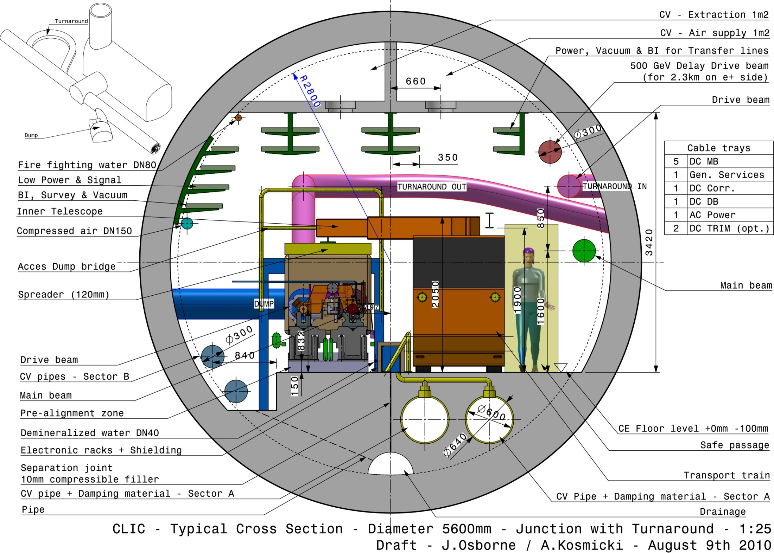
Drive Beam Tunnel
5.6m Internal Diameter
Turnaround with 10m turning radius to exit and enter main tunnel.
Beam dump cavern required at each turnaround.
Notes:
10m Turning radius may need to be increased.

Slide 30
Low energy Klystron
The ideal scenario would be to have the same tunnel design for the drive beam and for the klystron accelerator.
The first energy stage design should be consistent with the previously proposed drive beam design allowing consideration for an upgrade
Ensure that it is compatible with an energy upgrade if it is decided that energy upgrades will be powered by klystrons.
Notes:
Same structure design?
Consistent layout with drive beam proposed layout
Compatible for both klystron and drive beam upgrades

Slide 31
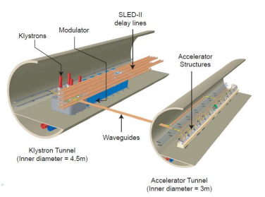
Low energy Klystron
Klystron Layout
Double tunnel – one for the accelerator and one for the klystrons.
Accelerator tunnel – How does this change?
Are the connections between the tunnels compatible with the current design?
ID of the accelerator to be 5.6m not 3m
Klystron tunnel – 4.5m ID
Section through tunnels
Which Caverns will be required?
Accelerator tunnel – How has the layout changed
Accelerator tunnel – 5.6m ID
Waveguide connections
Klystron Tunnel
Notes:
Waveguides every 1m or 2m!
Second tunnel to be located slightly above the Accelerator tunnel to avoid beam dumps with waveguide connections.

Slide 32
Low energy Klystron
Klystron Layout
Double tunnel – one for the accelerator and one for the klystrons.
Accelerator tunnel How does this change?
Are the connections between the tunnels compatible with the current design?
ID of the accelerator to be 5.6m not 3m
Klystron tunnel – 4.5m ID
Section through tunnels
Which Caverns will be required?
Accelerator tunnel – How has the layout changed
Accelerator tunnel – 5.6m ID
Waveguide connections
Klystron Tunnel
Notes:
No Drive beam required and no turnarounds required - this will depend on future upgrades proposed:
If Drive beam is to be used for higher energy stage then this will be required.
If Klystrons are to be moved along the length of the tunnel for upgrade then turnarounds will be required

Slide 33
Low energy Klystron
Klystron Layout
Double tunnel – one for the accelerator and one for the klystrons.
Accelerator tunnel How does this change?
Are the connections between the tunnels compatible with the current design?
ID of the accelerator to be 5.6m not 3m
Klystron tunnel – 4.5m ID
Section through tunnels
Which Caverns will be required?
Accelerator tunnel – How has the layout changed
Accelerator tunnel – 5.6m ID
Waveguide connections
Klystron Tunnel
Notes:
Distance between connections? Diameter of bores required for connection tunnels?
Shaft Locations
TOT for double tunnel?

Slide 34
Low energy Klystron
Klystron Layout
Double tunnel – one for the accelerator and one for the klystrons.
Accelerator tunnel How does this change?
Are the connections between the tunnels compatible with the current design?
ID of the accelerator to be 5.6m not 3m
Klystron tunnel – 4.5m ID
Section through tunnels
Which Caverns will be required?
Accelerator tunnel – How has the layout changed
Accelerator tunnel – 5.6m ID
Waveguide connections
Klystron Tunnel
Notes:
Access for second tunnel?
TOT for double tunnel?
Surface buildings for Klystron machine remain the same except no drive beam requires
No turnarounds for initial stage?

Slide 35
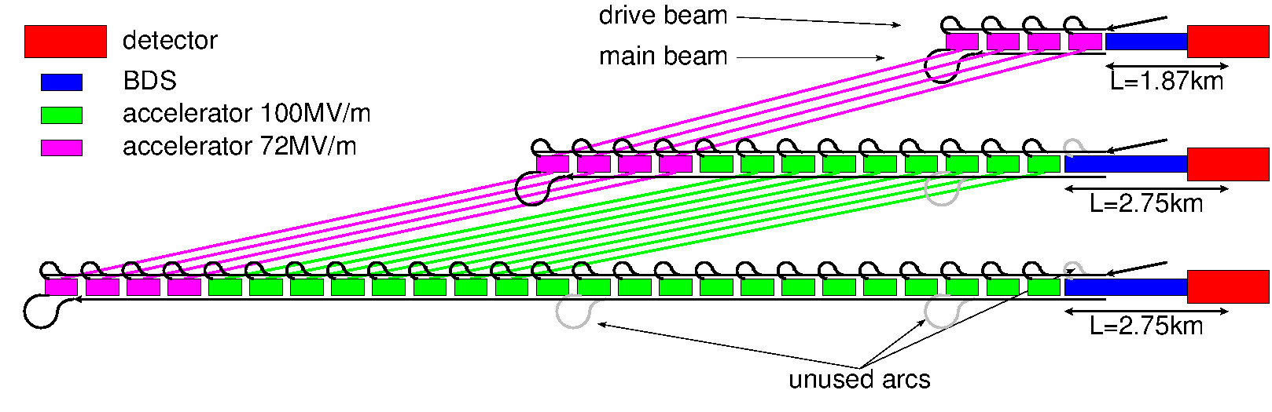
Summary
3 different energy stages: 10km, 27km and 48km
380 GeV Klystron design compatible with upgrades. Double tunnel or single tunnel required.
Tunnel Optimisation Tool kick off meeting to be held on the 22nd of May
Civil Drawings are to be produced by Civil Draughtsmen - new drawings to be produced for the Klystron design and existing drive beam design drawings to be changed.
Next meeting on the 16th of June.
Notes:
TO BE CONFIRMED WITH DANIEL

Slide 36
Thank You For Your Attention
Thank you to all contributors
(John Osborne, Daniel Schulte, Steinar Stapnes etc…)

Slide 37
Extra Slides

Slide 38
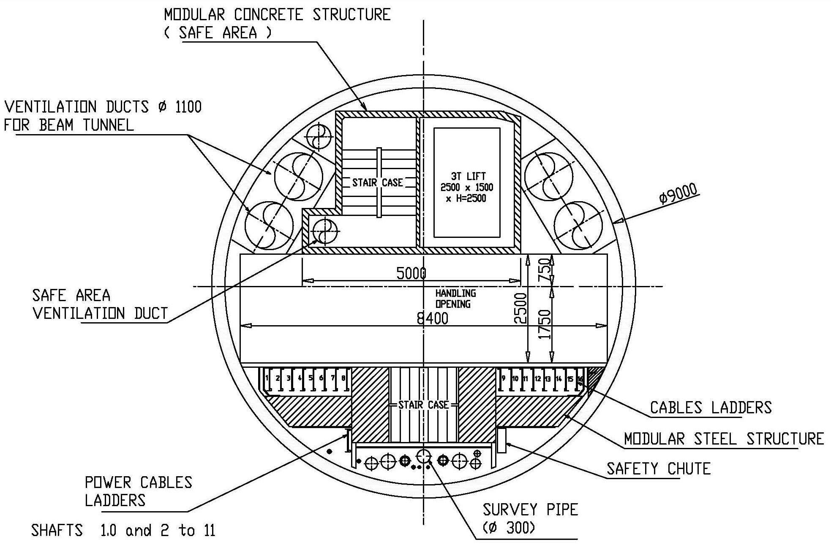
Shaft Layout

Slide 39
Original CLIC
13 turnarounds and accelerator sections either side of the Interaction Region – 1 redundant turnaround
2.75 km Beam Delivery System
Total length of 29km
Shafts every 5km
Central Injector Complex, one drive beam – Located on CERN land
2140m
Drive beam injector
Experimental buildings
Main beam injector
880m
420m
Notes:
Central injection complex, located on CERN land in Prévessin, consisting of surface buildings and shallow underground galleries. This complex will be divided into several parts:
The Main Beam injector complex:
10 x surface buildings, largest of which is approximately 400m x 7m x 3m.
11 x shallow cut and cover type tunnels of varying sizes.
The Drive Beam injector complex:
3 x surface buildings, the largest of which will be approximately 2560m x 30m x 9m.
7 x shallow cut and cover type tunnels of varying sizes.
Common transfer tunnel from junction point to separation point 277m x 6m x 3m and surface building 30m x 30m x 5m
2 x Final Transfer tunnels (from separation point).
Experimental area surface buildings consisting of:
19 x surface buildings.
2 x gas storage areas.
1 x transformer switching yard.
Access roads and a car park.
RF Tunnel lengths/layout – to be discussed with Daniel – is the required for TOT

