Slide 1
CM and Cryo meeting #1
S. Feher
3/6/2017

Slide 2
Agenda
Cold Mass design work progress and plans H. Prin
Cryostat design work progress and plans D. Ramos Duarte
Cold Mass & Cryostat requirements document status S. Feher
Welding equipment and procedures T. Vouris
Parts to be procured by CERN and FNAL All
Safety doc status All
Schedule A

Slide 3
Preparation for CD1 DOE Review
Couple of Reviews:
  CD1 director’s Review in June 13th
  CD1 DOE Review August 1st
We need to prepare:
  Functional Requirements documents for both CM and Cryostat
    CM has a draft version no even a draft for the Cryostat work
  CDR for the US built magnets – CM&Cryo included
    Conceptual Design – Fabrication plan, Interfaces, tooling
    Safety docs and agreements to make sure that the product will meet all the standards
  Basis of Estimates – CM (Labor and M&S) Cryostat (Labor)
    Part list procurement plan between CERN and FNAL
  Risk registry – risk needs to show up as a cost to the project
  Schedule – for prototype and for production

Slide 4
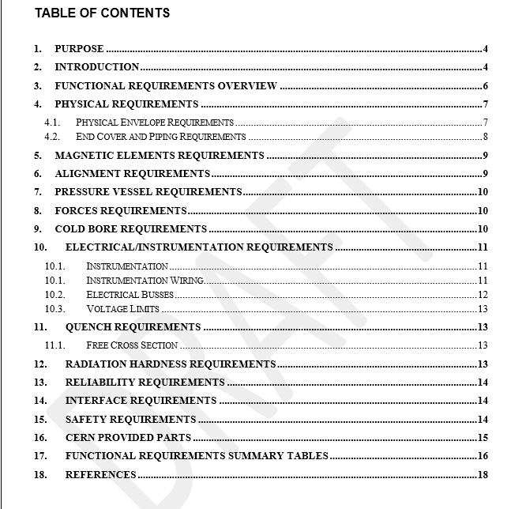
Cold Mass Functional Requirement Specifications
Written by Ruben so far has not been reviewed
Needs to be signed of by CERN and FNAL
Alignment is not consistent:
  “The two MQXFA axis with respect to the common axes must be within ±0.5 mm, for the center and ±2 mrad for the axis direction”
No electrical agreement
Radiation hardness:
  Low cobalt 304LN
What are the next steps in Safety?
Who signs the partlists?

Slide 5
Schedule
Prototype Cryo-assembly (Full magnet) ready for testing: June 16, 2019
Prototype Cryo assembly Fabrication start date: October 23, 2018
Important Milestones for CM prototype:
  Interface specifications need to be completed ~ January, 2018
  Parts need to be received by Fermilab: some of them June, 2018
Important Milestones for Cryostat prototype:
  Tooling design – to prepare the tables and floor space: September, 2018
  Start of the Cryostat work at FNAL: April 16th, 2019
Important Milestones for Stand for Test facility:
  Interface specifications – to be able to make the relevant shuffling unit: January, 2018

Slide 6
Parts list to be provided by CERN
316LN Plates (low cobalt content) or shells (shaped plates)
  Is there any 304L low cobalt content material?
End domes (a.k.a end covers)
Cold bore tube
‪Heat exchanger tube
‪18kA Busbars (+others if the integration study is not retained by CRG)
‪External busbar lines
Temperature sensors?
Instrumentation wires?
Any parts US to provide?

