Slide 1

LMQXF DESIGN & Prototype Fabrication/Testing
Author
Antonios Vouris
LMQXF Design, March 6th, 2017

Slide 2
Weld Equipment
Bug-O Systems –
Automated Cutting &
Welding System:
Modular Drive System

Slide 3
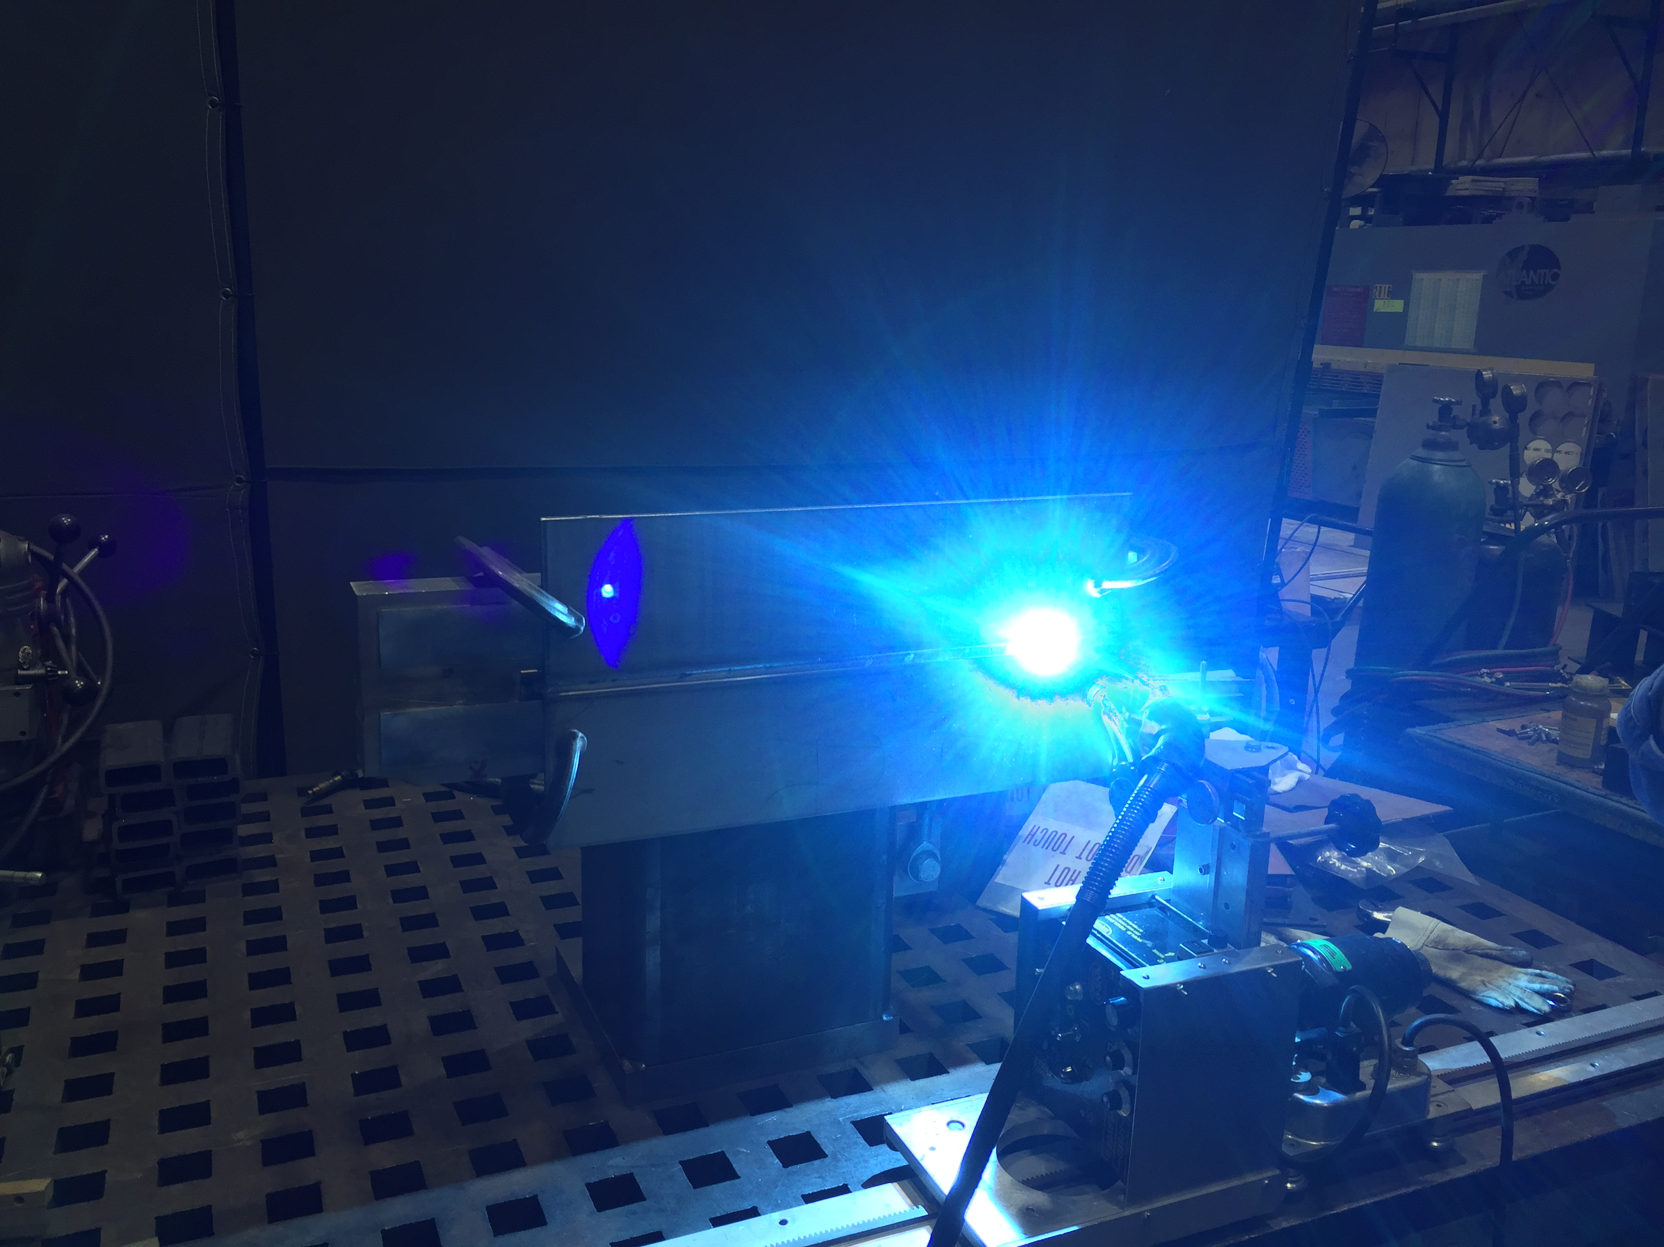
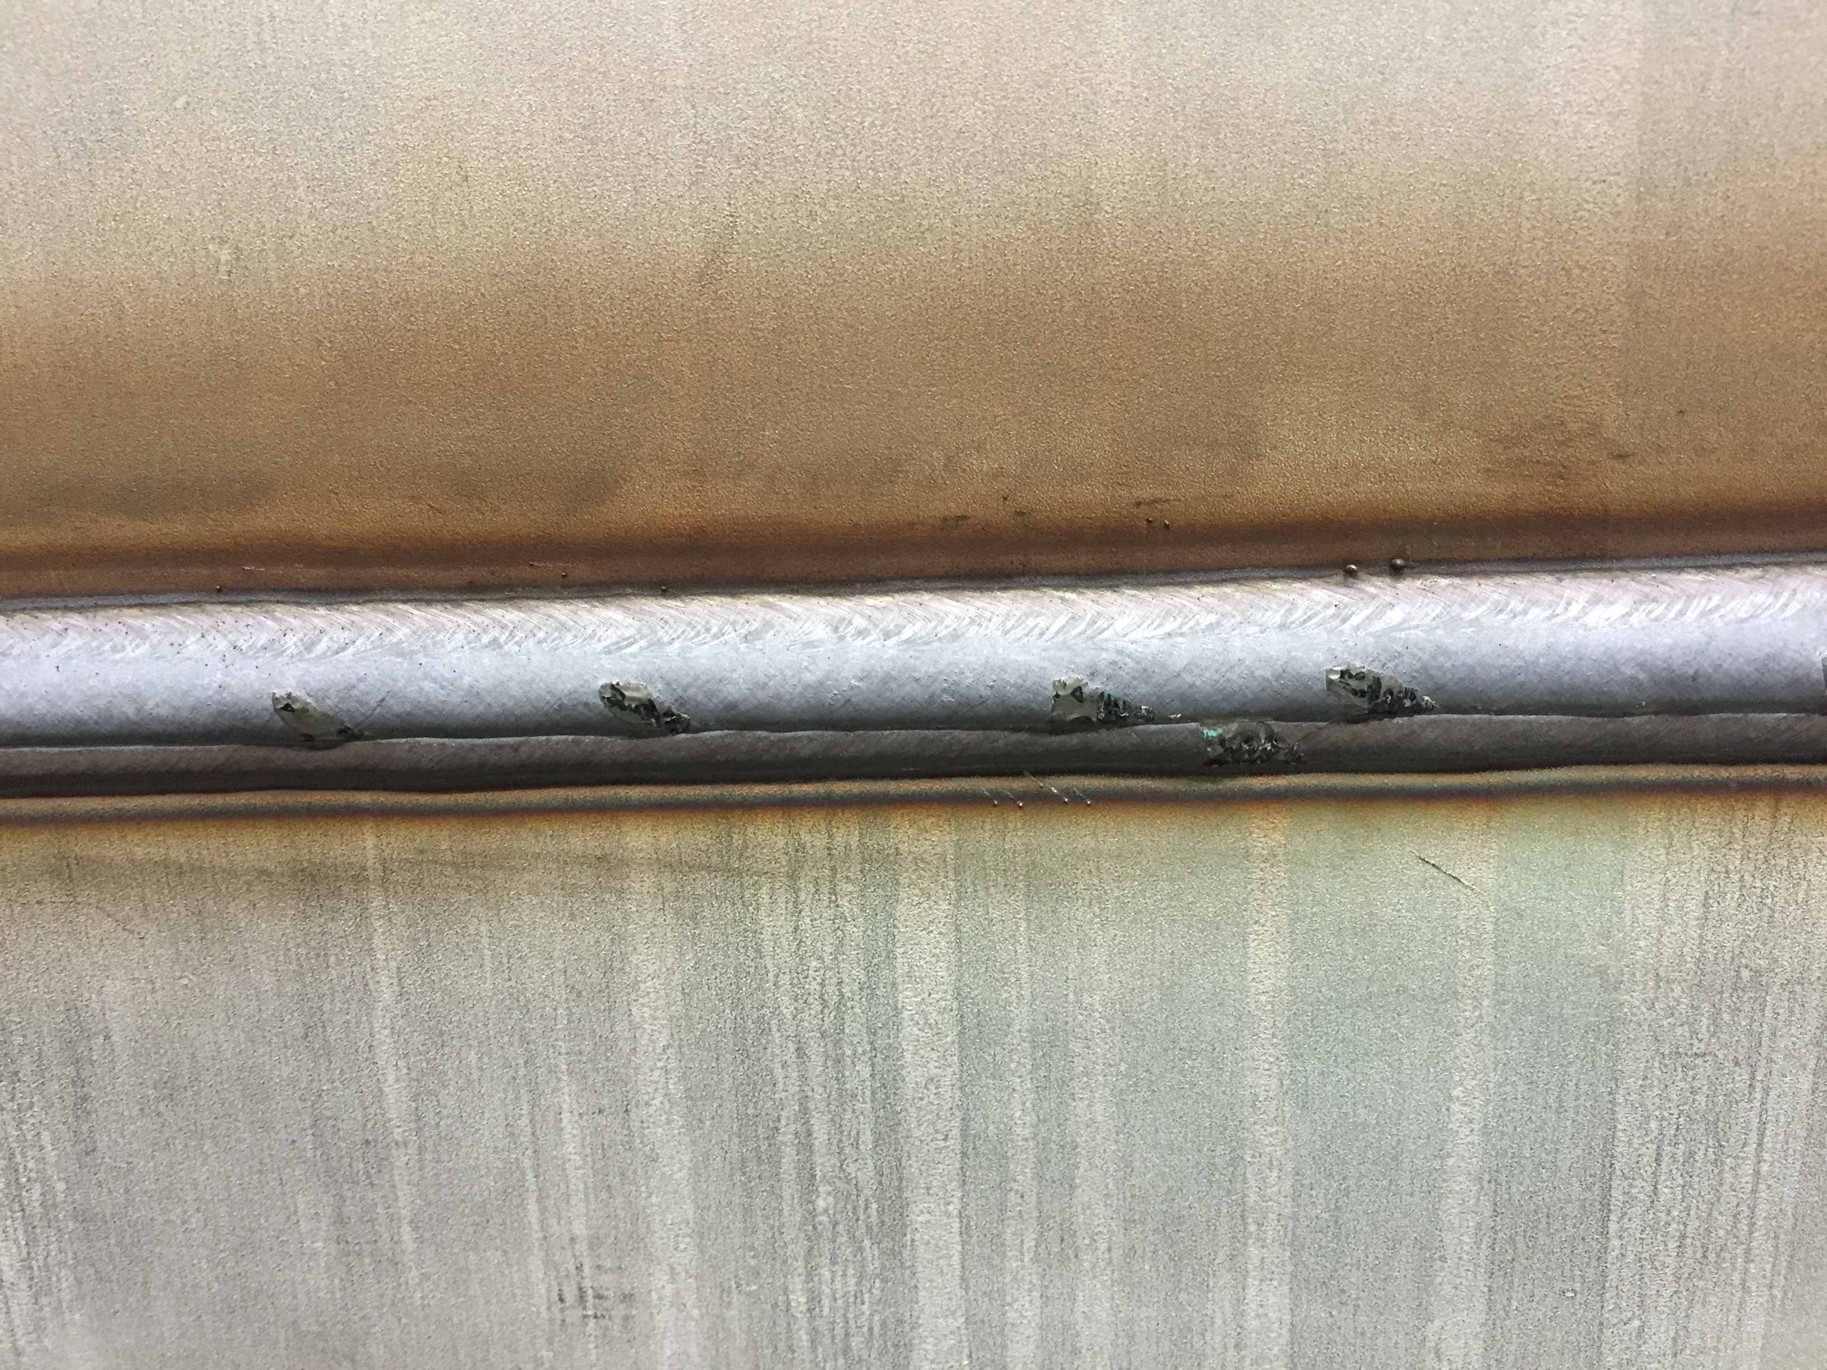
Weld procedure Parameters
Weld procedure development at moment:
  Millermatic 350P
  Pulse mode
  Wire - .035” (.89 mm) 308L Si
  Gas – 90%Ar/10%CO2
  22.6 Volts
  3 Passes:
    1..10 IPM (254 mm/m), 2.. 10.75 IPM (273 mm/m), 3.. 14.25 IPM (362 mm/m)
Still tweaking to decrease weld shrinkage from 0.1” (2.54mm).

Slide 4
Cold Mass Design
Design/Fab per ASME BPVC Section VIII-1?
Material requirements:
  304/304L, 316/316L, 316LN?
  Low Co?
  Shell Forming & End Domes
NDE:
  Spot RT – 6” spot /300 ft. of weld
  Liquide penetrant test (PT) - nozzles
Pressure Test/HMS Leak Test?
Interface/End Domes design and material?
Mounting brackets and fiducials?

Slide 5
Milestones & Questions
Coldmass specifications –
Low Co?
NDE:
  Spot RT – 6” spot /300 ft. of weld
  Liquide penetrant test (PT) - nozzles
Pressure Test/HMS Leak Test?
Interface/End Domes design and material?
Mounting brackets and fiducials?
CERN Supplied Materials:
  Shell material (Feb 2018)
  Beam Tube (April 2018)
  Ht Exchangers (April 2018)
  Bus Bar (March/April 2018)
  Temp Sensors (March/April 2018)
  Instrumentation wires (March/April 2018)
  Cryostat kit (August 2018)

Slide 6
THANK YOU!

