Slide 2
The CERN Linac4 history, performance, perspectives
Maurizio Vretenar, CERN
TIARA Meeting19 June 2017

Slide 3

Linac4 Inauguration, 9th May 2017

Slide 4
Linac4 layout
Normal-conducting linear accelerator, made of:
Pre-injector (source, magnetic LEBT, 3 MeV RFQ, chopper line)
Three types of accelerating structures, all at 352 MHz (standardization of components).
Beam dump at linac end, switching magnet towards transfer line to PSB.
No superconductivity (not economically justified in this range of β and duty cycles);
Single RF frequency 352 MHz (no sections at 704 MHz, standardised RF allows considerable cost savings) ;
High efficiency, high reliability, flexible operation → 3 types of accelerating structures, combination of PMQ and EMQ focusing.
 | Energy [MeV] | Length [m] | RF Power [MW] | Focusing
RFQ | 0.045 - 3 | 3 | 0.6 | RF
DTL | 3 - 50 | 19 | 5 | 112 PMQs
CCDTL | 50 - 102 | 25 | 7 | 14 PMQ, 7 EMQs
PIMS | 102- 160 | 22 | 6 | 12 EMQs

Slide 5

Linac4: a team work

Slide 6
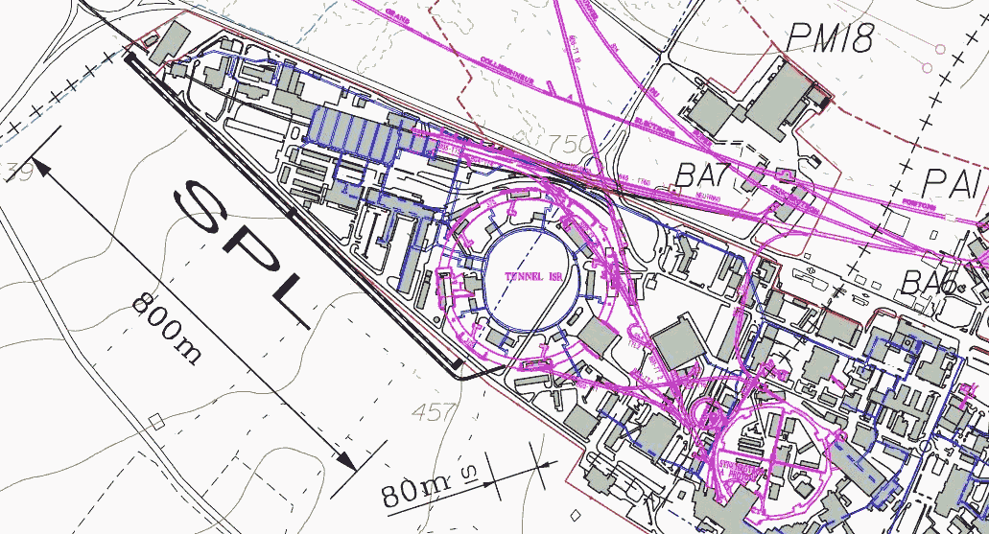

20 years of Linac4 – early work
October 1996: first proposal (Garoby, Vretenar) of a new 2 GeV linac injector for the PS using decommissioned LEP hardware (what became the SPL, Superconducting Proton Linac)
2004: start R&D and prototyping for the new linac (small CERN budget and support from CARE, the first EU Integrating Activity for accelerators (2004-08).
2001: idea to build in a first stage only the room temperature part (120 MeV) of the SPL to inject into the PSB.
Called «Linac4» and energy to 160 MeV from 2003.
1996 2001 2005

Slide 7

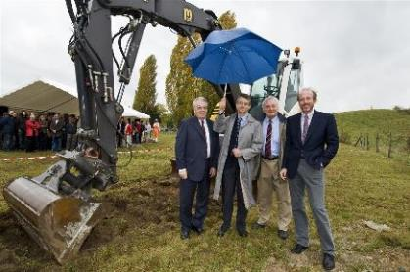
20 years of Linac4 - approval
21 June 2007: at its 142nd session, the CERN Council approves a White Paper presented by the DG R. Aymar including construction of Linac4 and study of the SPL
1 January 2008: the project officially starts (first project budget)
16 October 2008: Groundbreaking ceremony at the location of «Mount Citron»
December 2006: published the Linac4 Technical Design Report
2006 2007 2008 2009

Slide 8
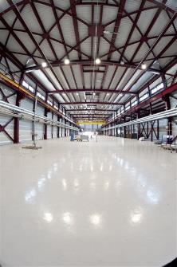
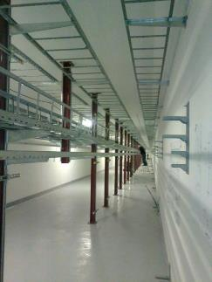
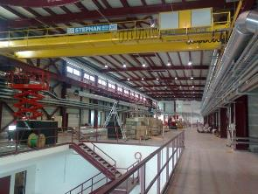
20 years of Linac4 - infrastructure
December 2012: infrastructure (electricity, cooling, ventilation, racks, cabling) complete, start installation of machine equipment and components.
December 2010: delivery of the civil engineering works (on budget and schedule)
2013: preparing for beam
2010 2011 2012 2013

Slide 9
20 years of Linac4 - commissioning
RFQ in final location (3 MeV): 6 December 2013
Drift Tube Linac tank 1 (12 MeV): 6 August 2014
Drift Tube Linac tanks 2 & 3 (50 MeV): 24 November 2015
CCDTL (104 MeV): June 2016
PIMS (160 MeV final energy): 25 October 2016
2014 2015 2016 2017

Slide 10
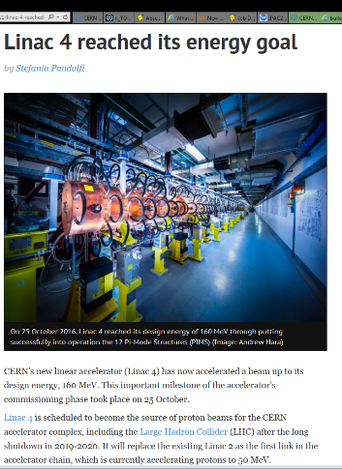
(exactly) 20 years from first idea to first beam

Slide 11

Evolution of Linac4 design
Although the basic principles remained the same (basic frequency 352 MHz, only NC, current 30/40 mA) design and parameters have changed several times.
The most important milestone is the transition between R&D and construction: the impact on Linac4 was the replacement of a Side Coupled Linac (SCL) at 704 MHz by a Pi-Mode Structure (PIMS) at 352 MHz, when SCL design and protypying were well advanced.
1: 2002, 30 mA, 120 MeV, 352 MHz
2: 2004, 30 mA, 160 MeV, 352/704 MHz
3: 2006, 40 mA, 160 MeV, 352/704 MHz
Motivations for the change SCL/PIMS:
Standardisation of the RF system on a single frequency and one type of klystron (but some reduction in RF efficiency ZT^2).
Less manpower required for tuning and construction (5 times less cells!)
Easier to attract internal and external interest for a new type of structure
2006, 40 mA, 160 MeV, 352/704 MHz
4: 2007, 40 mA, 160 MeV, 352 MHz

Slide 12


EC support in a critical phase
HIPPI: High Intensity Pulsed Proton Injectors (2004-2008)
Joint research Activity in CARE, the first IA for accelerator R&D
Main objective: Research and development of the technology for high intensity pulsed proton linear accelerators up to an energy of 200 MeV.
Applications of the HIPPI results: Upgrade of the linac injectors for GSI, CERN and RAL.
10 participating laboratories: RAL, CEA, CERN, FZJ, GSI, IAP-FU, INFN-MI, INFN-NA, LPSC, IPNO
Budget: 14.7 M€, EU contribution 3.6 M€ (~25%)
Goal: advance jointly linac technologies in Europe, beyond SNS and JPARC
HIPPI has built in 5 years a total of 12 prototypes of accelerating structures and has developed and validated the linac beam optics codes.

Slide 13
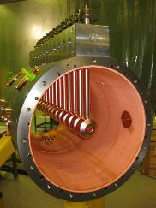
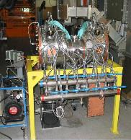
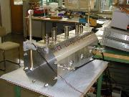
HIPPI Workplan (from proposal, 2003)

Slide 14
The contribution of CARE/HIPPI
Developing some of the technologies for Linac4 within a European project has provided:
An environment for collaboration and exchange of information with the different European actors (synergies and network of competences).
A clear vision of the advantages/disadvantages of different technical options that has allowed converging on an optimised design.
A welcome support for R&D (budget and recognition) in the critical time before project approval.
During the HIPPI lifetime, the Linac4 proposal was submitted and approved, and the proposal for the FAIR proton linac was submitted.
One additional comment: when Linac4 had a problem with the ion source (2010), the crash programme to develop and build a new ion source started from the high-duty H- ion source that had been developed within the sLHC-PP project.

Slide 15
Linac4 main innovations
2 types of accelerating structures (CCDTL and PIMS) used for the first time in the world.
New original Drift Tube Linac mechanical design (patented) and tuning scheme.
Extensive use of permanent magnet quadrupoles (127/158)
Innovative scheme for chopping of the beam at low energy
New CERN-made H- ion source design.
(Touching wood…) one of the most reliable RFQs in accelerator history.
A special RF distribution scheme that allows re-using the LEP klystrons.
An upgradable design in duty cycle and current (and a tunnel that can be extended to higher energies…)

Slide 16
A few lessons learned
Problems always appear where you don’t expect them: the ion source was considered so critical that we copied an existing (working) design, which did not work at CERN. We have chosen a proven type of vacuum joints, but the manufacturer changed the parameters and we have lost 6 months chasing the problem…
Collaborations are of paramount importance to share the workload and to have access to a network of competences.
It is essential to have available as soon as possible a test stand to get experience on real components and real beams.
For a smooth commissioning, it is vital to have offhand a set of simulation codes with an accurate modeling of the machine (and a reliable diagnostics!).

Slide 17
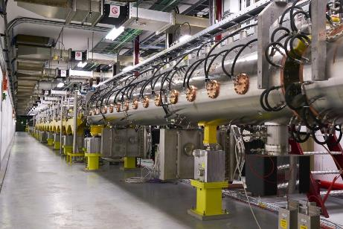
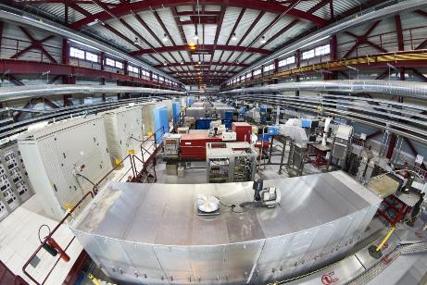
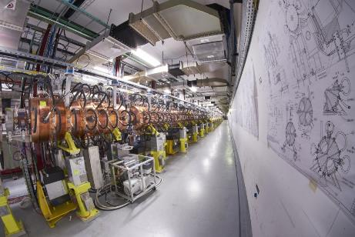
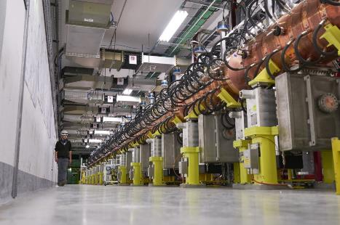
Linac4 today

Slide 18
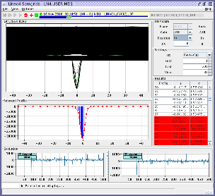
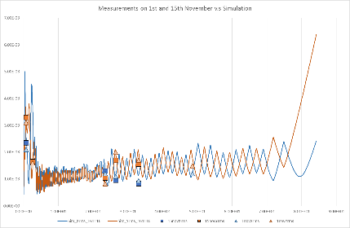
Beam measurements – 160 MeV
Commissioning with beam current 15 mA, emittance well within specifications
Excellent agreement between beam simulations and measurements
October 2016 - March 2017: beam optimisation at 160 MeV and test of the PS Booster injection equipment (temporary installation in Linac4 line).
Transverse beam profile at 160 MeV
Transverse beam size along Linac4 – simulations (lines) and measurements (points)

Slide 19
Ion source

Slide 20
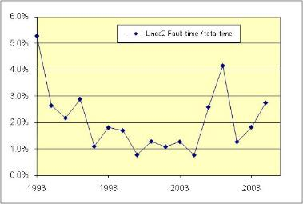
Next step: reliability run
Reliability is one of the main challenges of Linac4
Goal of Linac4 is availability > 95%. Will be necessarily lower in the initial phase
Reliability Run:
Debugging off-line for the initial problems
Objective for the Reliability Run:
reaching 90 – 95 % availability at the end of the RR.
Example:
Linac2 fault rate after the installation of the new RFQ2 in 1993.
Connection to the PS Booster during LS2 (2019-20)

Slide 21
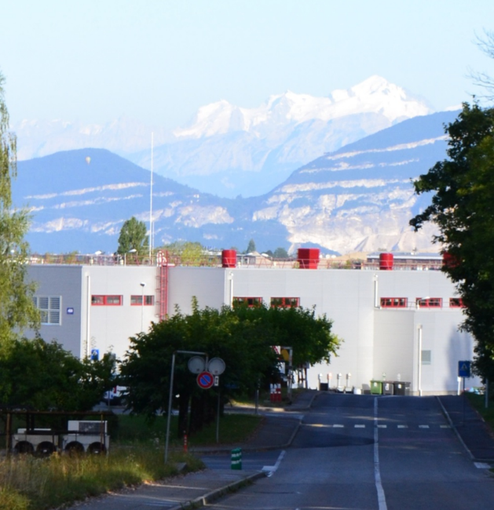
Thank you for your attention

