Slide 1

Comparison of CERN data in the EGI portal with experiment specific systems
Meeting 09.03.2017
Julia Andreeva CERN IT

Slide 2
Validation
Some fixes were introduced in CERN generation of the accounting report in order to cover all resources
Data was re-fed for January, February
Comparison for ATLAS and CMS is available in the accounting validation view in SSB
For ALICE and LHCb need to re-fill data into SSB, since currently there is no automatic collector in place
Pretty good agreement for wallclock time on the level of 10-13%. For wallclock work agreement is not good.(1.45 ATLAS, 2.55 CMS) Need to investigate more, most probably the factor used for normalization and published in REBUS needs to be fixed.

Slide 3
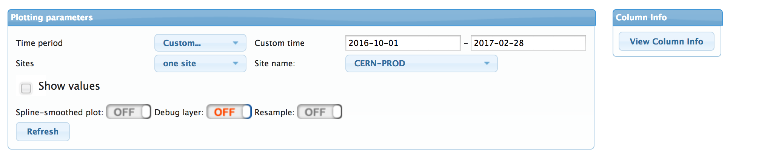
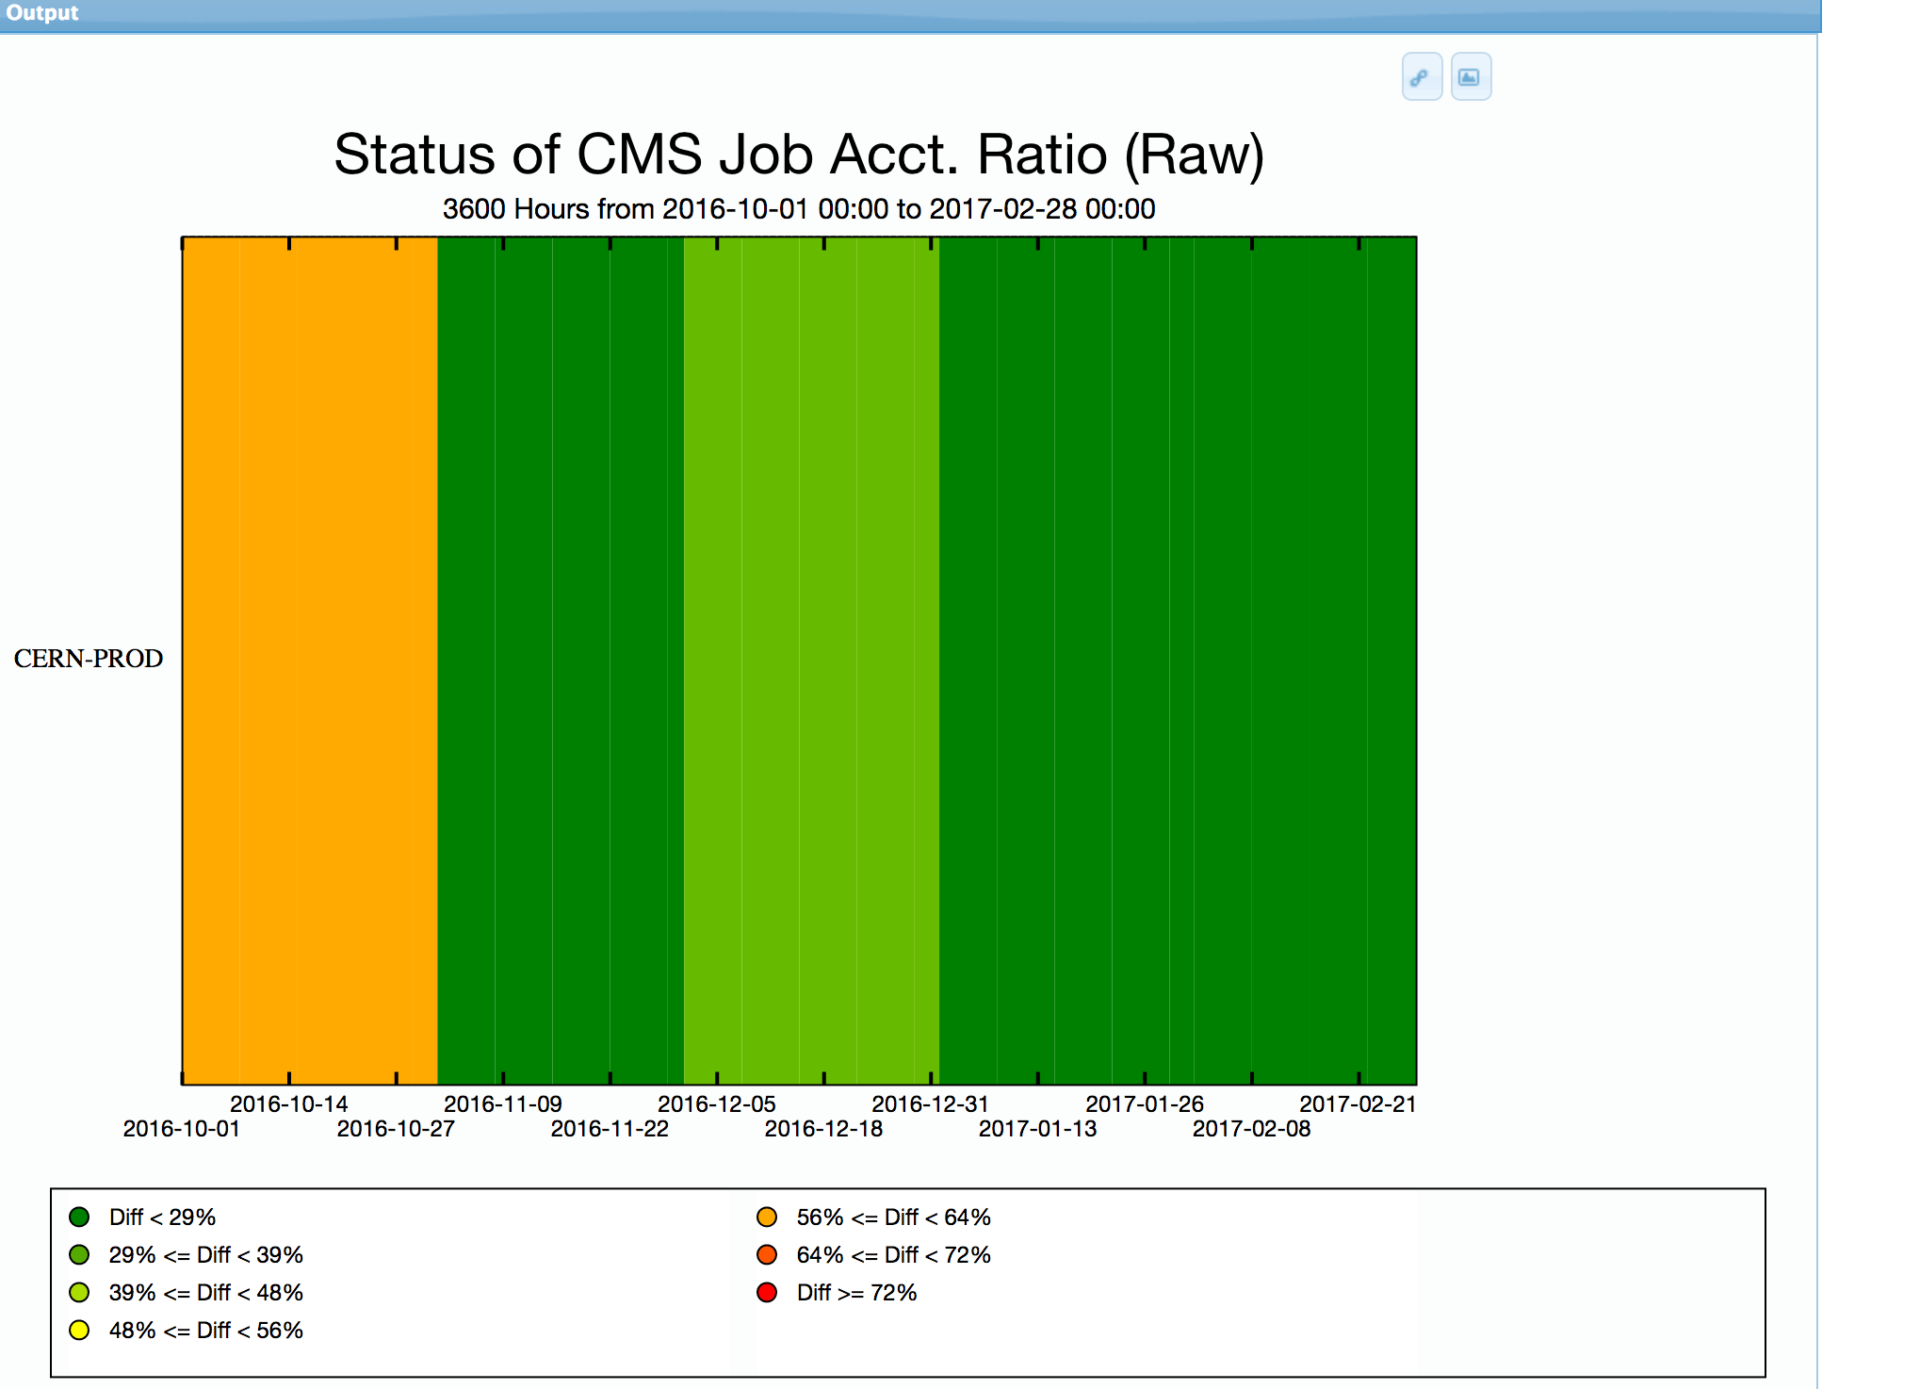

Comparison with CMS dashboard data
CMS Dashboard EGI Portal

Slide 4
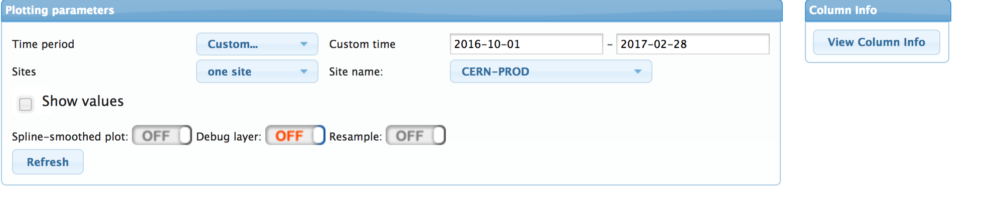
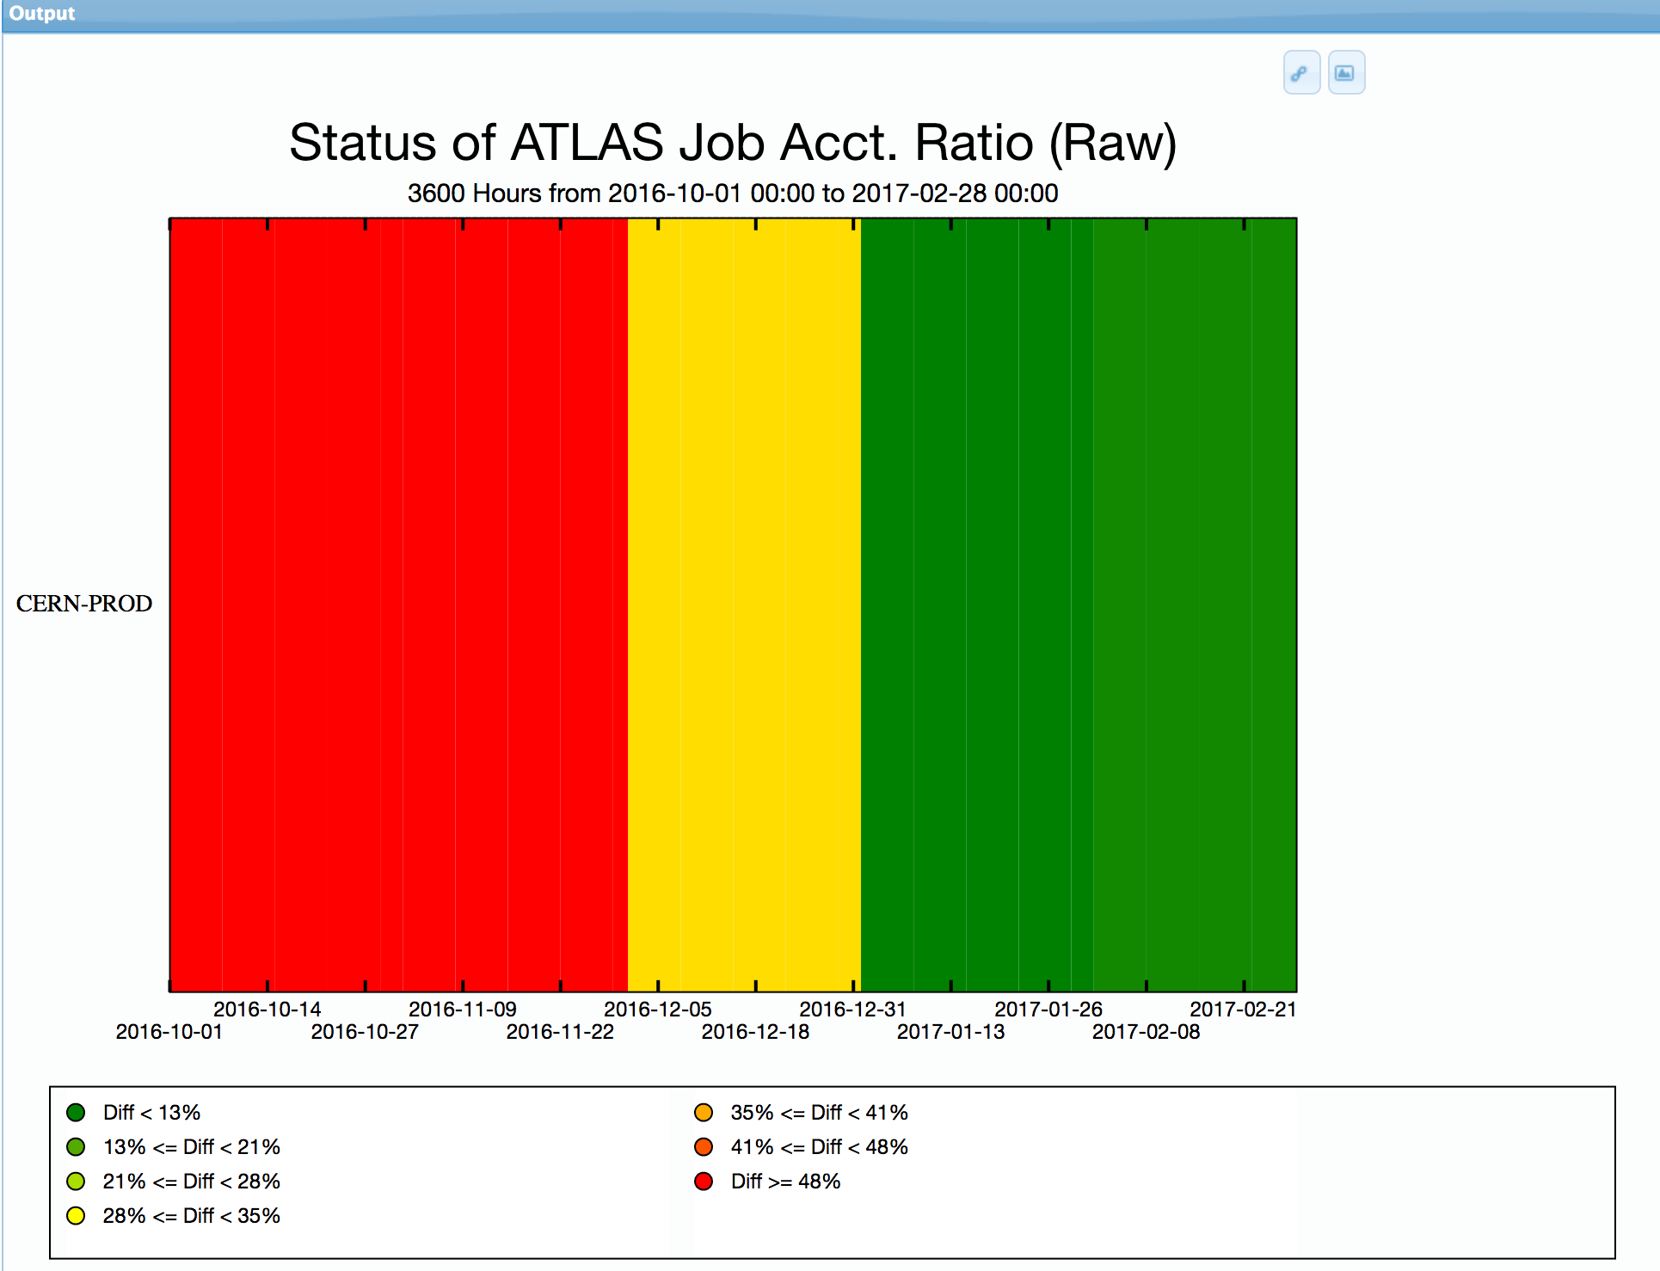

Comparison with ATLAS Dashboard data
ATLAS Dashboard EGI Portal

Slide 5
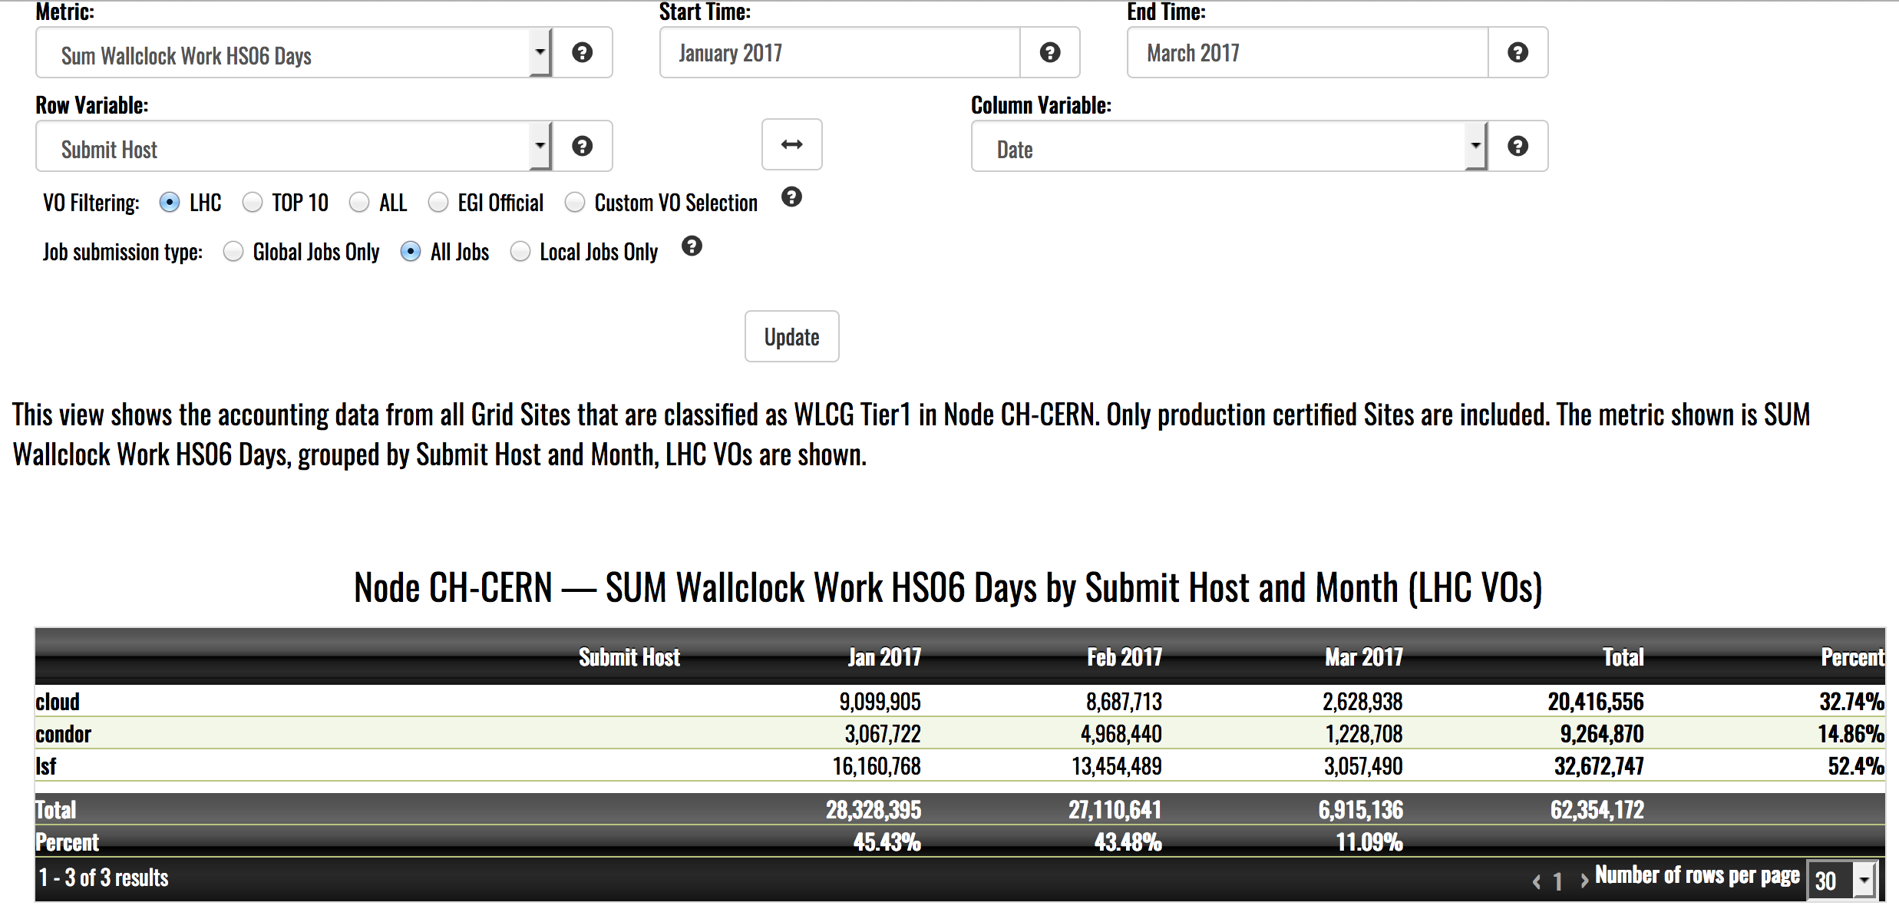
Manual update of CPU in REBUS is no longer needed
Accounting portal does not use CPU data manually updated in REBUS any more for generation of the accounting reports
There is an additional nice feature available in the EGI portal for CERN – possibility to classify by different type of CERN resources using ‘Submit node’ attribute:

