Slide 1
IPPOG Collaboration Meeting, Lisbon, Portugal
Public Web Pages & External Communication
B. Gulejova, S. Goldfarb

Slide 2
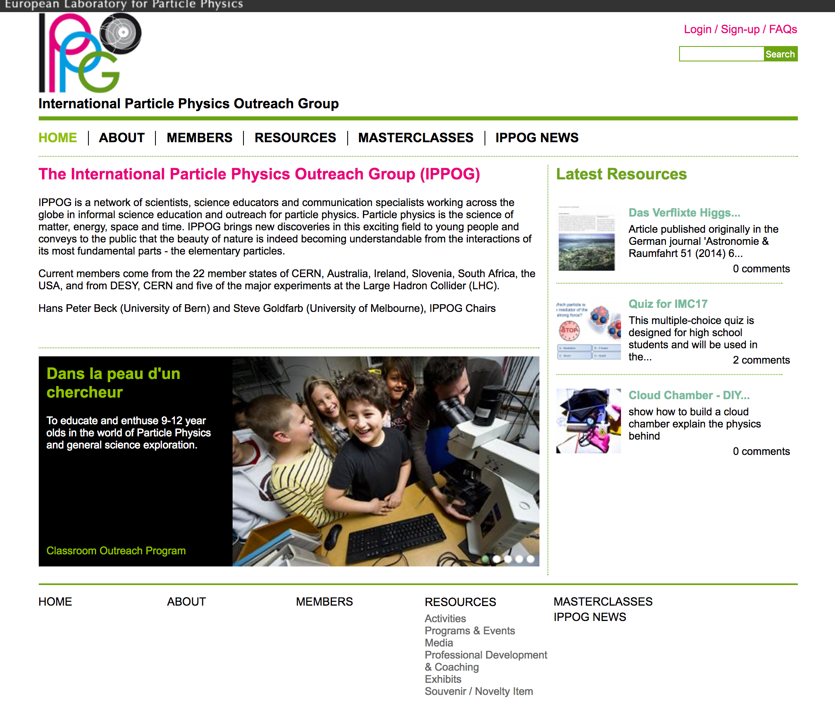

Slide 3
Findings: Web & DB
Until Now
  2014 Working Group on Resource DB
  2015 Working Group on Web Pages
  2016 Panel on Resource DB and Web Pages
Proposed New Structure and Layout of DB
  Curated categories (17 from 44 topics, 9 from 41 item types, 4 from 6 filtering options, etc.)
  Searching by filter on the left & 4 big topic categories in the middle
  Evaluation by visitors
TODO
  Curation Committee
  Select Resources to be transferred to new DB
  Assign new tags and categories

Slide 4
Findings: Web & DB
Website Requirements
  Sustainable
    Theme we can develop and maintain
  Professionally Designed
    Proposed Organisational Structure
      Main menu bar: Home, Members, Resources, Masterclasses, Cosmic Rays, National Resources, Publications, …
      Sidebar: New DB resources, Events calendar, Upcoming conferences, Newsletter, Social media links
  Appealing
    Professional Graphics
TODO
  Develop Design Guidelines, Theme, and Graphic Elements

Slide 5
Development Strategy
Development Steering Group
  Goal
    Oversee new design and implementation
  Members
    B. Gulejova (principle developer), S. Boutas (CERN webmaster), M. Lapka, P. Watkins, S. Goldfarb, H.P. Beck
External Web Design Expertise
  Prepare Design Guidelines
    Clarified Goals, Messages, Target Audiences
    Layout that enforces organisational structure
  Develop Drupal Theme
    CERN approved (for maintenance)
    Drupal 8
  Provide Graphic Elements

Slide 6
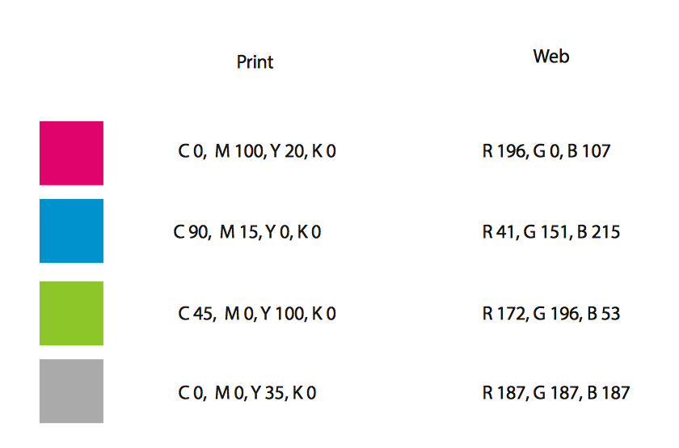
Progress So Far
Steering Group
  In place, ready to work
  Iterating on Technical Specifications for Design Experts
  Preliminary budget proposed
We are now ippog.org
  Login: ippog.web.cern.ch
Graphical Elements
  INFN (Catia)
    provided original logo design
  CERN Design Team
    developed vectorised files
    defined colours and font (Arial)

Slide 7
Findings: External Communication
Discussion Group on IPPOG Advertising and External Communication (Nov. 2015)
Audiences
  Particle Physics community
  Teachers
  Schools / Students
  Broad Public
  Politicians, decision makers, public opinion makers
Messages
  we exist
  what we do
  how to contact us
  how they can get involved

Slide 8
Findings: External Communication
Communication Channels
  Delegates - it should be stated in the MoU Addenda
  Conferences - limited audience
  Meetings
    Experiments: weekly meetings, collaboration weeks
    Labs, Boards,…
  Keen young students
  E-Mail
  Screens at Labs and Institutes
  Articles in PP community journals
  Newsletters of other communities / professional societies
  IPPOG newsletter
  Social Media
  Wikipedia (https://en.wikipedia.org/wiki/Physics_outreach)

Slide 9
Progress So Far
Social Media Set Up
  Facebook: @ippog
  Twitter: @ippogorg (working on getting @ippog)
External Communication Coordination
  Develop strategy for posting material to home, social media
  Coordinate content development
  Encourage activity from IPPOG members:
  Sharing, following, reposting, liking, etc.
Call for Volunteers to Maintain Social Media
  Must be regularly fed by content

Slide 10
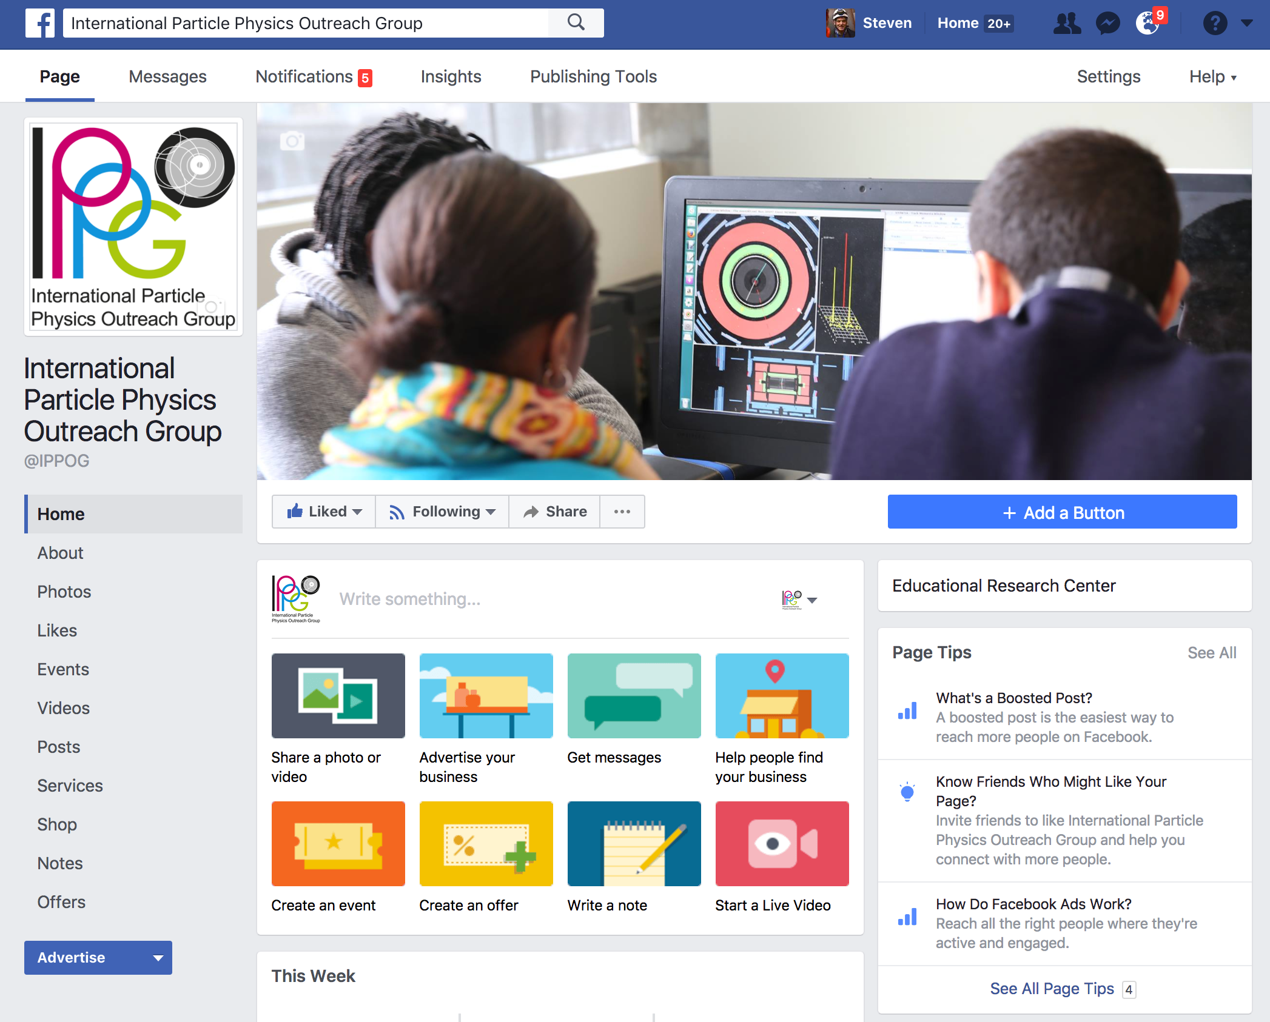

Slide 11
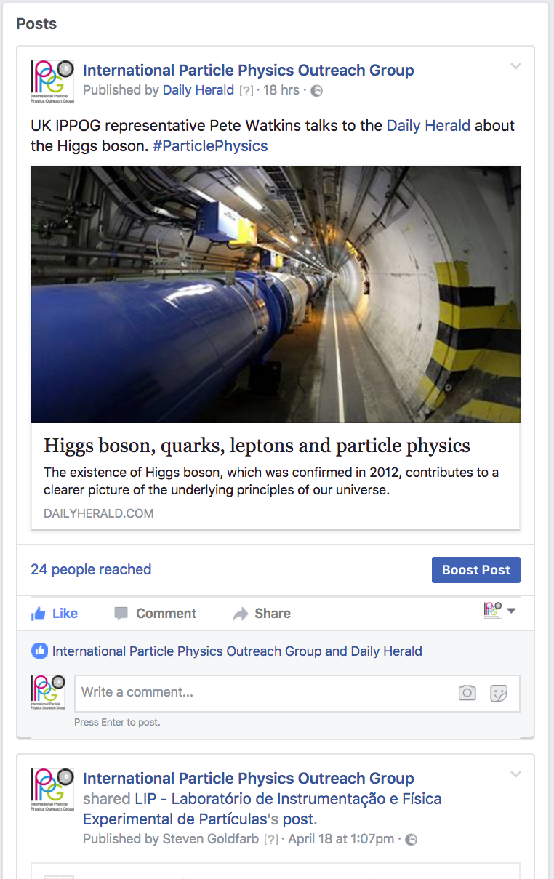
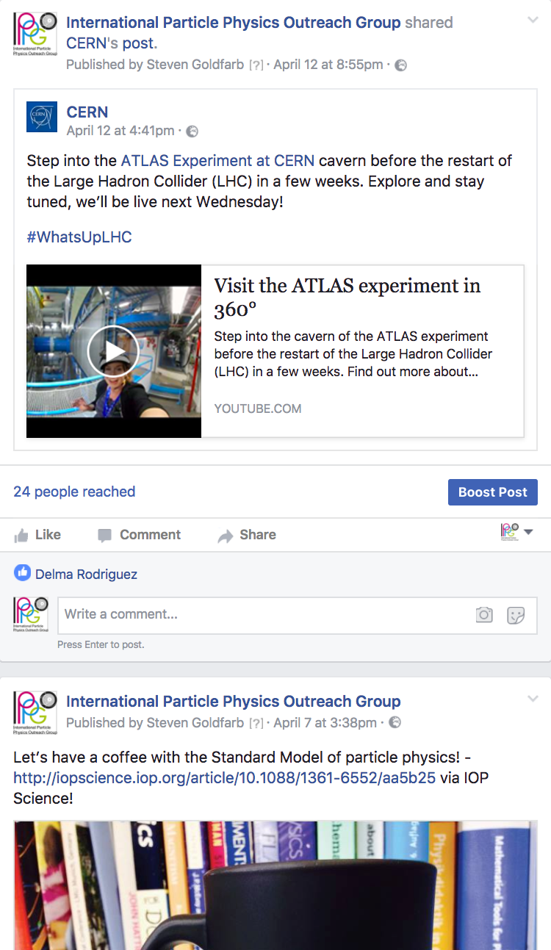

Slide 12
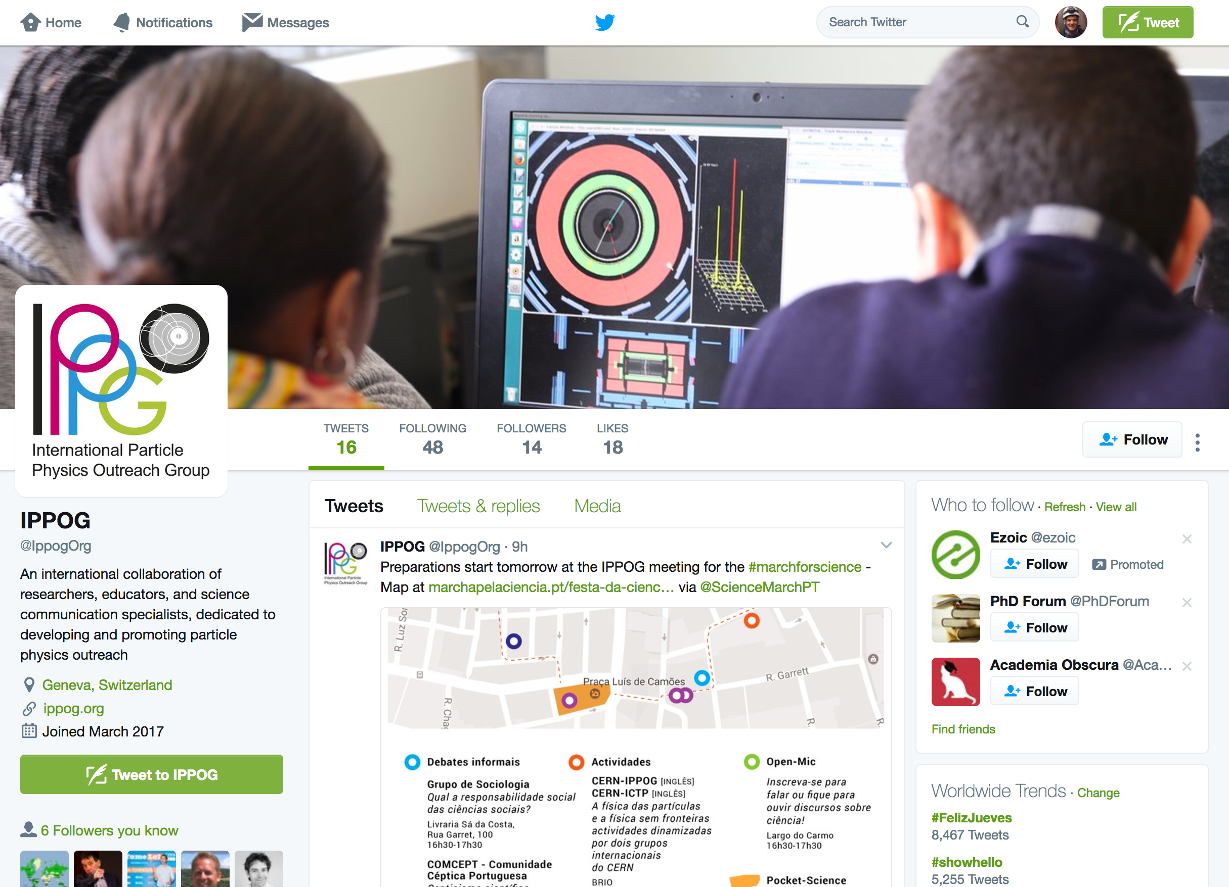

Slide 13
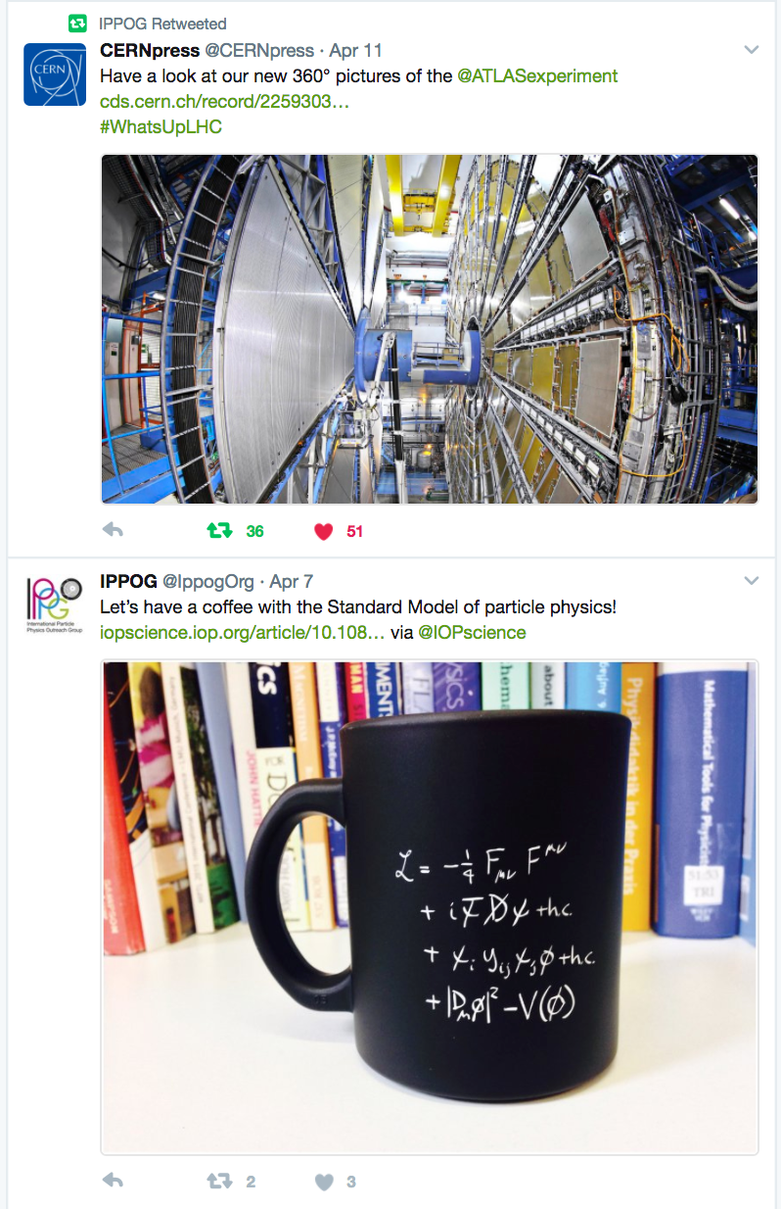
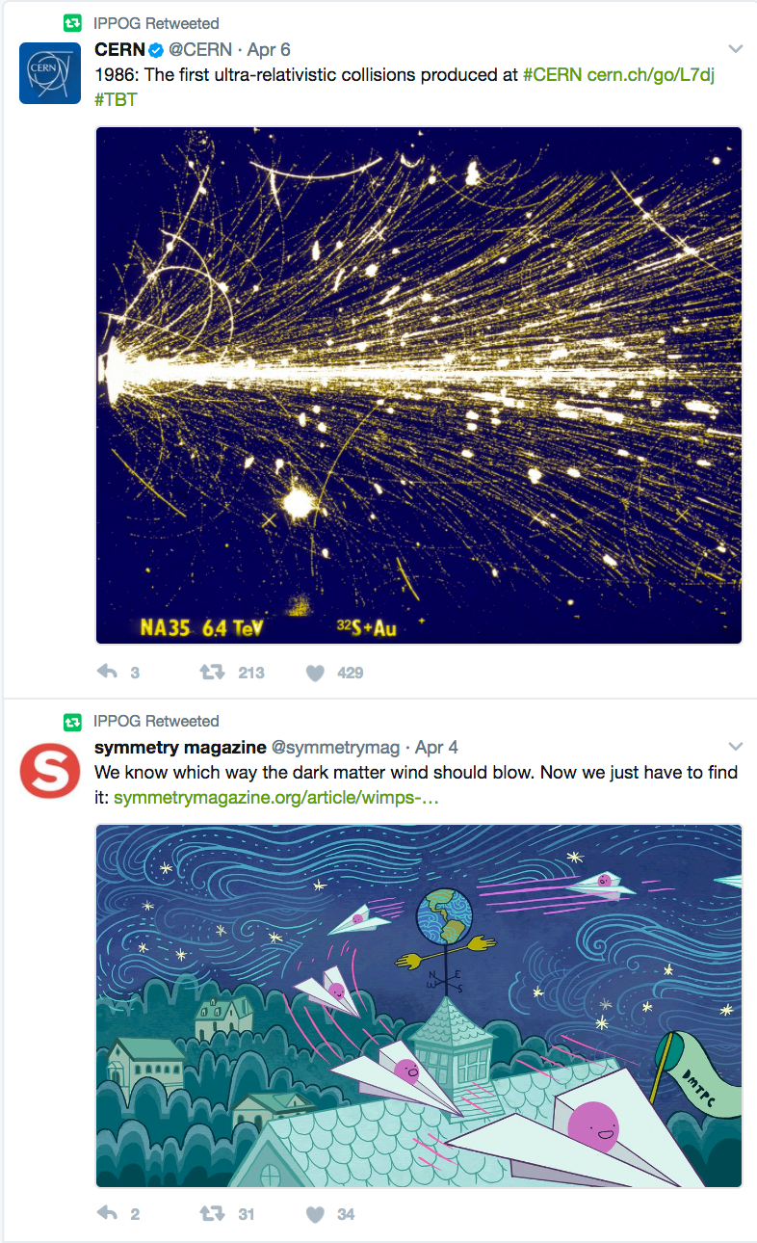

Slide 14
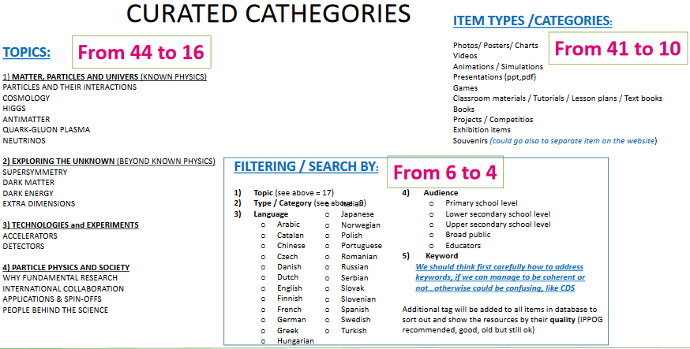
Spare slide – new DB categories

Slide 15
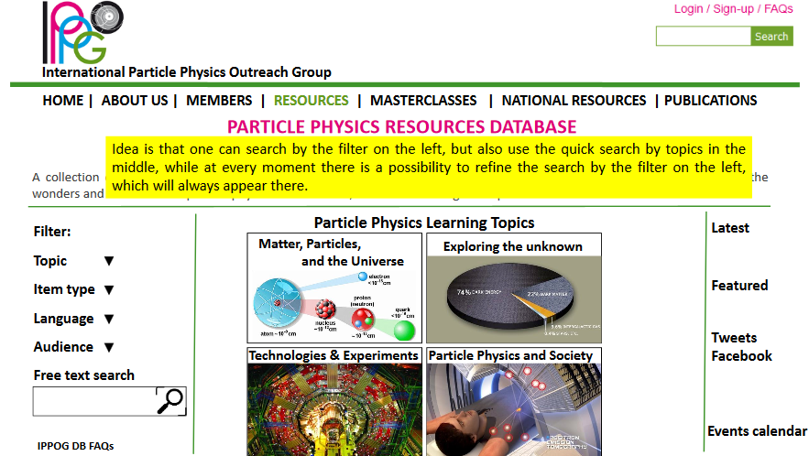
Spare slide – Searching in DB

