Slide 1
Report on Masterclasses-to-New-Countries meeting
What follows:
  Status of opening to new countries
  What we hope to accomplish
  What we discussed
Elements of several member contributions
This is open to correction and modification by members (please speak up)
Some of this is still speculative

Slide 2
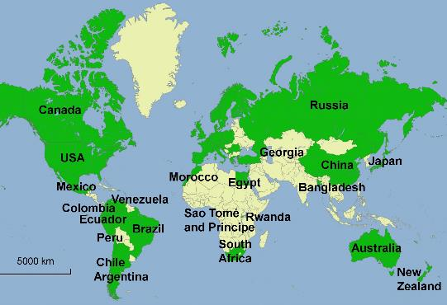
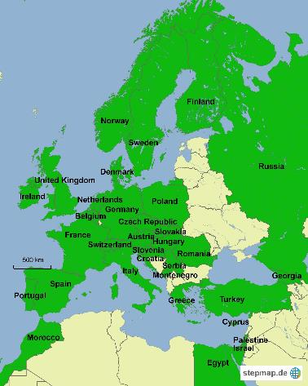
From IMC Steering Group:
International Masterclasses 2017
1.3. - 11.4.2017
50 countries involved
New countries:
Russia (ALICE and LHCb)
Georgia (CMS, ATLAS) (Ken + Uta greeted on video)
Bangladesh (ALICE) (planned also on UN Girls day, but had to cancel)
Philippines (CMS, ATLAS)
Montenegro (CMS)
Almost - Rwanda planned to participate, but had to cancel (next year!)

Slide 3
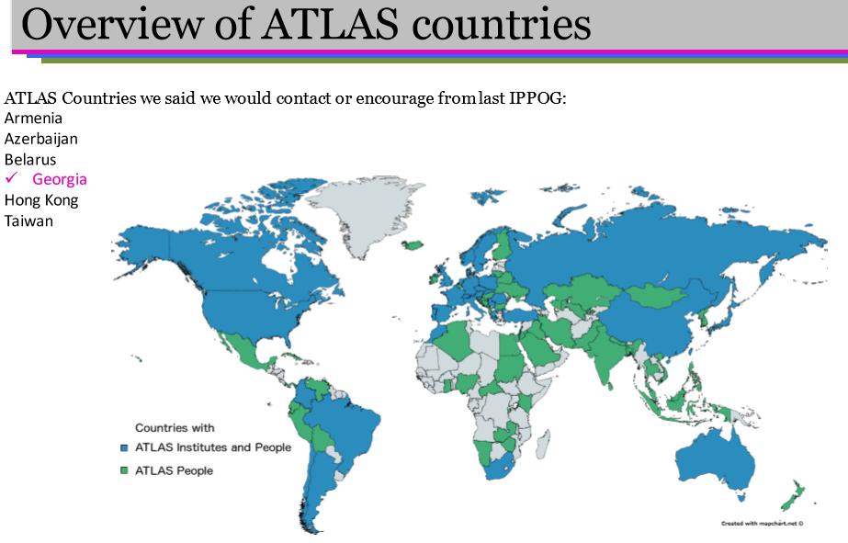

Slide 4
Kate’s Challenge and follow-up
Work on the list
  Hong Kong a good possibility (add Macao?)
All ATLAS countries join IMC
  e.g. Mozambique – get help from SA?
  then, non-ATLAS countries too
Reciprocal challenge to other LHC experiments
  IMC extended in Japan
  Lebanon joining CMS
  Marzena made list of 16 CMS countries not in IMC

Slide 5
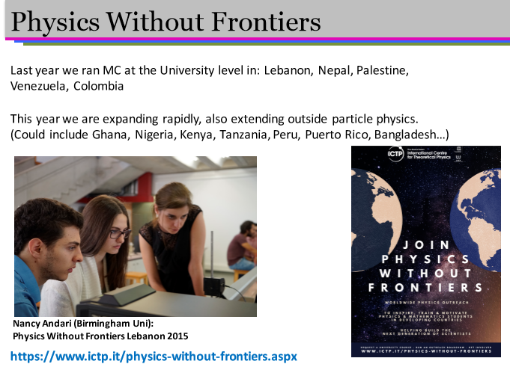

Slide 6
Speculation on new approaches
Physics Without Frontiers works with University students – collaborate more?
  Add masterclass training of lecturers
  We (MC2NC) follow up to foster international masterclasses at universities visited
Return to “Expanding Masterclasses” concept?
  Expand in orthogonal direction
  New measurements in other areas of physics

Slide 7
More
Create a page on IPPOG site to keep members current on what we are doing
Change approach – it had gotten redundant
  As a working group, do more between IPPOG meetings and report at IPPOG meetings
More from members

