Slide 1

IPPOG Meeting, 20-22 April 2017
Hans Peter Beck: IPPOG Co-chair, Bern University
Steve Goldfarb: IPPOG Co-chair, Melbourne

Slide 2
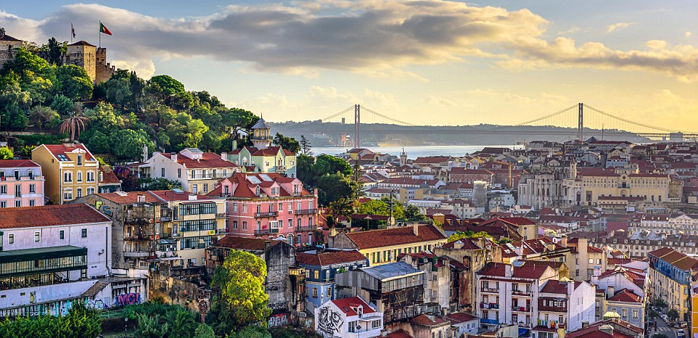

International Particle Physics
Outreach Group
A big Thank You to Pedro, Catarina and the whole LIP team to make this 13th IPPOG meeting possible in Portugal!
We are looking forward to three interesting and stimulating days in a wonderful place.

Slide 3

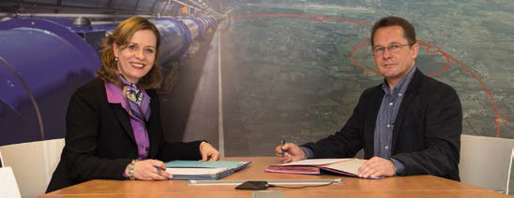
IPPOG an established Collaboration
December 19, 2016
Marks the birthday of IPPOG entering a new phase in its 20 years history from
EPPOG (1997) to IPPOG (2010) and to the IPPOG Collaboration (2016).
The 10th signatory of the MoU has signed on December 19, 2016, which, according to the MoU defines the entry into force of the MoU and thus the birth of the IPPOG Collaboration.

Slide 4
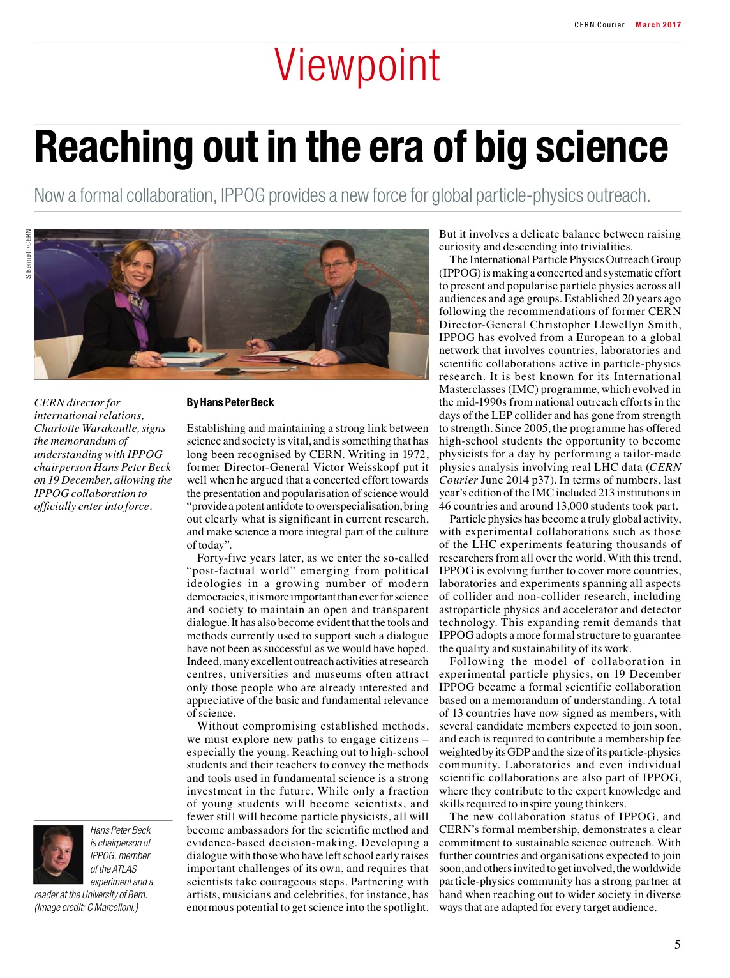
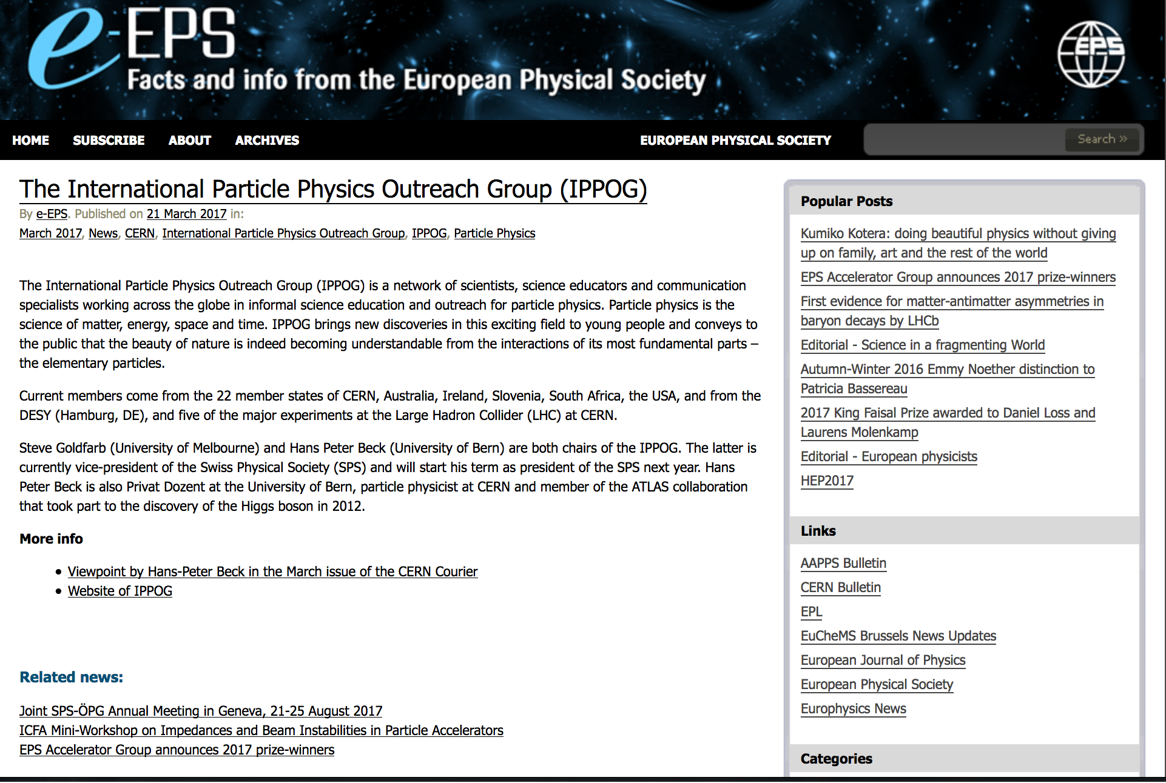
IPPOG headlines
  CERN Courier March 2017
    Viewpoint Article
    http://cerncourier.com/cws/article/cern/67712
  INFN Newsletter
    http://home.infn.it/newsletter-eu/pdf/NEWSLETTER_INFN_33_inglese_pag11.pdf
  EPS newsletter
    http://www.epsnews.eu/2017/03/the-international-particle-physics-outreach-group-ippog/

Slide 5
 | Organization | Country/Lab/Experiment | Date signed
1 | NIKHEF | The Netherlands | 22 September 2016
2 | DESY for KET | Germany | 23 September 2016
3 | Physics Department of University of Oslo | Norway | 21 October 2016
4 | LIP | Portugal | 1 November 2016
5 | The Section for Elementary Particle and Astroparticle Physics of the Swedish Physical Society through the Swedish LHC Consortium | Sweden | 1 November 2016
6 | CHIPP | Switzerland | 4 November 2016
7 | Ministry of Education, Science, Research and Sport | Slovak Republic | 15 November 2016
8 | Institute of Atomic Physics | Romania | 17 November 2016
9 | Helsinki Institute of Physics | Finland | 29 November 2016
10 | FWO + F.R.S.-FNRS | Belgium | 30 November 2016
11 | CERN | CERN | 19 December 2016
12 | INFN | Italy | 21 December 2016
13 | CNRS/IN2P3 | France | 23 December 2016
14 | The Henryk Niewodniczański Institute of Nuclear Physics Polish Academy of Sciences | Poland | 29 December 2016
15 | CoEPP | Australia | 14 February 2017
16 | The University of Notre Dame on behalf of Quarknet | USA | 14 March 2017

Slide 6
IPPOG Candidate Members
IPPOG Members as of the pre-collaboration phase that have not yet signed
the MoU automatically are now Candidate Members – until 18 December 2018.
Austria, Bulgaria, Czech Republic, Denmark, Greece, Ireland, Israel, Spain, South Africa, UK
ATLAS, ALICE,CMS, LHCb, TOTEM
DESY (as representing itself as a lab)
  3.6 Current IPPOG participants shall join the IPPOG Collaboration as Members through the mechanism set out above in the course of a two-year period from the date of entry into force of this MoU. This period may be prolonged by a decision of the Collaboration Board where justified by exceptional circumstances. During this period, they shall have the status of “Candidate” with the same rights and obligations as Members, except as provided otherwise in this MoU.
  3.8 Candidates shall have no voting rights and no annual membership fees shall be due.

Slide 7
New URL, new e-groups
CERN is a Member in IPPOG (with adequate and negotiated support to IPPOG), and not the other way round; i.e. IPPOG is a truly international body.
http://ippog.org is the new URL for the IPPOG home page was ippog.web.cern.ch before…
ippog-ct@cern.ch IPPOG Coordination Team: Chair(s) and Scientific Secretary
ippog-forum@cern.ch All and everybody in IPPOG.
Use this list for lively discussions on all aspects related to
IPPOG matters.
(To my taste, this list is still too quiet...)
ippog-cb@cern.ch Collaboration Board
(includes Member Reps and Candidate Member Reps.)

Slide 8
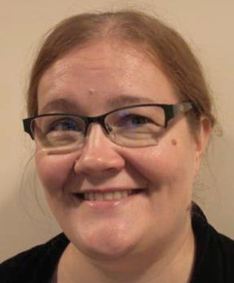
New Representative – Finland
http://ippog.org/ippog_membership
  Kati Lassila-Perini has been nominated to the new Teacher and Student Forum at CERN
  Panja Luukka has been
  appointed by HIP as the new Finish
  representative to IPPOG.
  Panja is based in Helsinki, is very well
  involved in and informed of the various
  outreach activities taking place in Finland.
  http://ippog.org/members/finland

Slide 9
Vacant Representative – Bulgaria
http://ippog.org/ippog_membership
Still no representative from Bulgaria identified.
The situation is evolving, but not yet settled. Now in contact with Venelin Kozhuharov:
Dear IPPOG Chairs,
I'm contacting you because we are in a process of selecting the Bulgarian member of the International Particle Physics Outreach Group. Could you please tell me what should be the requirements for a member of such a group? Should he/she be connected with an organization that is currently participating in the CERN experimental programme or the position could be held by an external person?
We do have a candidate that had organized multiple events for high-school students (like Virtual Visits at CERN experiments, etc.) but the candidate is doing this on a volunteer basis. The candidate succeeded to I consider this even more important but let me know if there are some rules about the IPPOG members that I might miss.
Another question is if it is possible Bulgarian representation in the IPPOG to be shared between two persons, who are both very actively communicating CERN activities among students?
Thanks in advance and best regards
Venelin

Slide 10
Expressed interest – Brazil
Marcelo Gameiro Munhoz, Universidade de São Paulo, Brazil, member of the ALICE collaboration and member of the Education Committee of the Brazilian Physics Society contacted IPPOG for evaluating the possibilities for Brazil to join IPPOG.
After many discussions (face to face and e-mail), and exchange of MoU and draft addenda, Brazil has expressed their formal wish to join IPPOG formally.
IPPOG MoU
3.11 Accession to membership shall be decided by the Collaboration Board by a two-thirds majority of the votes cast on the basis of a written application to the Chairperson of the Collaboration Board (the “Chairperson”) and taking into account the principles governing eligibility to apply for membership
set out above.

Slide 11

Brazilian Application to IPPOG
Brazilian National Network of High Energy Physics

Slide 12
Brazilian Application to IPPOG
The Brazilian HEP community has great interest and a large involvement with particle physics outreach activities
  For instance, Brazil has a large participation in the Masterclasses Hands On Particle Physics
The Brazilian HEP community wishes to become part of IPPOG in order to greatly improve the dissemination of particle physics nationwide

Slide 13
Brazilian HEP community
16 institutions in 6 different Brazilian states (Brazil has 26 states in total)
120 faculties/researchers
70 graduate students
30 technical staff
Participation in:
  the four LHC large experiments and ALPHA experiment at CERN
  Pierre Auger Observatory and Cherenkov Telescope Array
  neutrino experiments (DUNE, Double Chooz, etc.)

Slide 14
Brazilian National Network of High Energy Physics
RENAFAE (Rede Nacional de Física de Altas Energias, in Portuguese)
  is a National Network officially created by the Brazilian Ministry of Science and Technology in 2008 in order to coordinate the national effort in High Energy Physics
  is composed by ALL Brazilian physicists that work with High Energy Physics
Therefore, RENAFAE is the ideal organization to represent Brazil in IPPOG

Slide 15
Brazilian National Network of High Energy Physics
The Brazilian National Network of High Energy Physics (http://mesonpi.cat.cbpf.br/renafae) has four main objectives as part of its mission:
  promote the scientific and technological advancement of the investigation of the properties of particles and their fundamental interaction
  consolidate and expand research in high-energy physics, expanding scientific training and techniques needed to explore the resulting benefits of the associated developments and their technological implications
  develop a program that mobilizes businesses in Brazil to work on the development of instrumentation of software for the area´s international collaborations
  The Scientific and Technical Committee of Renafae (CTC Renafae) will coordinate the activities of groups acting in high energy physics and in particular, activities associated with large international collaborations.

Slide 16
Further interests
Turkey – Bilge Demirkos is coordinating and running Masterclasses in Turkey, and is interested to make Turkey a Member in IPPOG.
GSI/FAIR – Yiota Foka is with us here in Lisbon, well known to IPPOG through the ALICE Masterclass program, and is interested to bring GSI/FAIR closer to IPPOG.
Belle II – Toru Iijima and Zdenek Dolezal have been joining the previous IPPOG meeting at CERN in November 2016. They are waiting for the final addenda to the MoU, explaining the modalities for Collaborations to join.
DUNE – Mark Thomson, Spokesperson of DUNE, invited the IPPOG CT to a brownbag lunch at CERN, when DUNE hat its Collaboration meeting in January 2017. DUNE is highly interested in Outreach and IPPOG, but still in an early phase.

Slide 17
IPPOG MoU
Will clarify in the upcoming CB meeting remaining points and questions raised.
Addenda to MoU clarify the
expectations we have for Members
  Countries
  Scientific Collaborations
  Laboratories
A provisionary Budget has been distributed
Addenda and Budget will be discussed and put forward for a vote.

Slide 18
IPPOG MoU – 1st CB meeting
6.5 The first meeting of the Collaboration Board shall be convened by the
incumbent IPPOG co-chairs.
6.6 The Collaboration Board shall, by a two-thirds majority of the votes cast,
elect the Chairperson for a term of office of three years maximum,
renewable once by three years maximum. Election shall normally be from
among the Representatives, except where so decided by the Collaboration
Board by two-thirds majority of the votes cast, from among the Candidate
Representatives and the conveners of, or participants in, Working Groups
and Activities, it being understood that the candidate(s) for this position
shall have an existing affiliation with a Member or a Candidate Member.
The Chairperson shall be elected by a two-thirds majority of the votes cast.
Playing strictly to these words, Steve and HP are the ‘incumbent IPPOG co-chairs’
The Chair(s) need to be elected in the CB meeting – which is on Saturday.

Slide 19
IPPOG MoU – 1st CB meeting
3.3 Members (the “Member(s)”) shall appoint a single representative (“Representative”) to serve on the Collaboration Board. Where a Representative is elected as the Chairperson, the Member concerned shall appoint a new Representative.
Playing strictly to these words, if HP and Steve shall be confirmed on Saturday, then HP can no longer represent Switzerland, and a new person representing Switzerland will need to be found.
3.5 Members shall cover the cost of travel, accommodation and other expenses
incurred in relation to membership, and in general with their participation
in the IPPOG Collaboration, and shall not receive financial support from
the IPPOG Collaboration, except by a decision of the Collaboration Board
where justified by exceptional circumstances.
6.3 Each Member, through its Representative, shall have one vote in the
Collaboration Board. The Chairperson shall have no vote.
6.9 The cost of travel, accommodation and other expenses necessarily incurred
by the Chairperson in the execution of his or her mandate shall be covered
by the IPPOG Collaboration.

Slide 20
IPPOG Working Groups discussions
In parallel with
Science March Strategy & Poster Making Workshop
Thursday 12:30 – 15:00 (Fingerfood Lunch)
Explaining hot PP topics to lay audience
Angelos Alexopoulos, Barbora Bruant Gulejova, Beatrice Bressan, Catarina Espirito Santo, Celso Martinez Rivero, Dirk Ryckbosch, Farid Ould-Saada, Gabriel Stoicea, Hans Peter Beck, Ivan Melo, Jiri Rames, Jon-Ivar Skullerud, Panja Luukka, Peter Watkins, Rasmus Mackeprang, Steven Goldfarb
Masterclasses in new countries
Angelos Alexopoulos, Beatrice Bressan, Catarina Espirito Santo, Celso Martinez Rivero, Gabriel Stoicea, Kate Shaw, Kenneth William Cecire, Marzena Lapka, Natascha Krammer, Pedro Abreu, Rasmus Mackeprang, Steven Goldfarb, Uta Bilow
Publications and Speakers Committee
Angelos Alexopoulos, Beatrice Bressan, Celso Martinez Rivero, Christine Kourkoumelis, Despina Hatzifotiadou, Farid Ould-Saada, Gabriel Stoicea, Ivan Melo, Marge Bardeen, Panja Luukka, Pedro Abreu, Peter Watkins, Rasmus Mackeprang, Steven Goldfarb, Yiota Foka

Slide 21
Panel Preparations
Friday 11:00-13:00
11:00-12:00 Exhibitions and Event Highlights
Angelos Alexopoulos, Catarina Espirito Santo, Catia Peduto, Celso Martinez Rivero, Charles Timmermans, Christine Kourkoumelis, Despina Hatzifotiadou, Katarina Anthony, Kenneth William Cecire, Marge Bardeen, Nicolas Arnaud, Panja Luukka, Peter Watkins
11:00-12:00 Impact of Science on Society
Barbora Bruant Gulejova, Beatrice Bressan, Dirk Ryckbosch, Farid Ould-Saada, Gabriel Stoicea, Hans Peter Beck, Ivan Melo, Jon-Ivar Skullerud, Kate Shaw, Marzena Lapka, Natascha Krammer, Pedro Abreu, Rasmus Mackeprang, Steven Goldfarb, Uta Bilow, Yiota Foka
12:00-13:00 Reaching to New Audiences / Non-conventional Methods
Angelos Alexopoulos, Beatrice Bressan, Catia Peduto, Dirk Ryckbosch, Gabriel Stoicea, Hans Peter Beck, Jon-Ivar Skullerud, Kate Shaw, Marzena Lapka, Pedro Abreu, Steven Goldfarb, Yiota Foka
12:00- 13:00 Impact on Educational Programs for Students and Teachers
Barbora Bruant Gulejova, Catarina Espirito Santo, Celso Martinez Rivero, Charles Timmermans, Christine Kourkoumelis, Despina Hatzifotiadou, Farid Ould-Saada, Ivan Melo, Katarina Anthony, Kenneth William Cecire, Marge Bardeen, Nicolas Arnaud, Panja Luukka, Peter Watkins, Rasmus Mackeprang, Uta Bilow

Slide 22
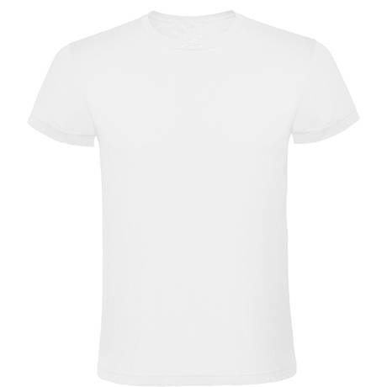
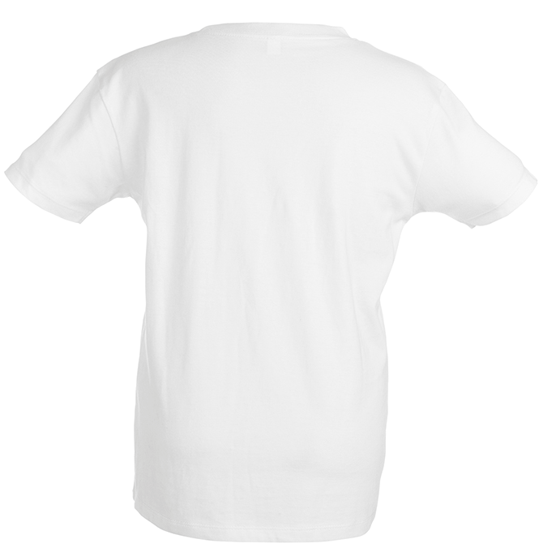
March for Science
Saturday Afternoon, Marches for Science will be organized in many cities around the globe.
IPPOG is supporting the March and participates in the local March here in Lisbon.
WE SPEAK
PARTICLE PHYSICS

Slide 23
Friday Evening
18:00-19:30
Exhibition on "Challenges in Particle Physics for the Next decades”
20:00
IPPOG Dinner

Slide 24
IPPOG
International Particle Physics Outreach Group
an example for concerted and systematic effort for outreach
Enabling Outreach Globally
as a Collaboration in a collaborative effort

