Slide 1
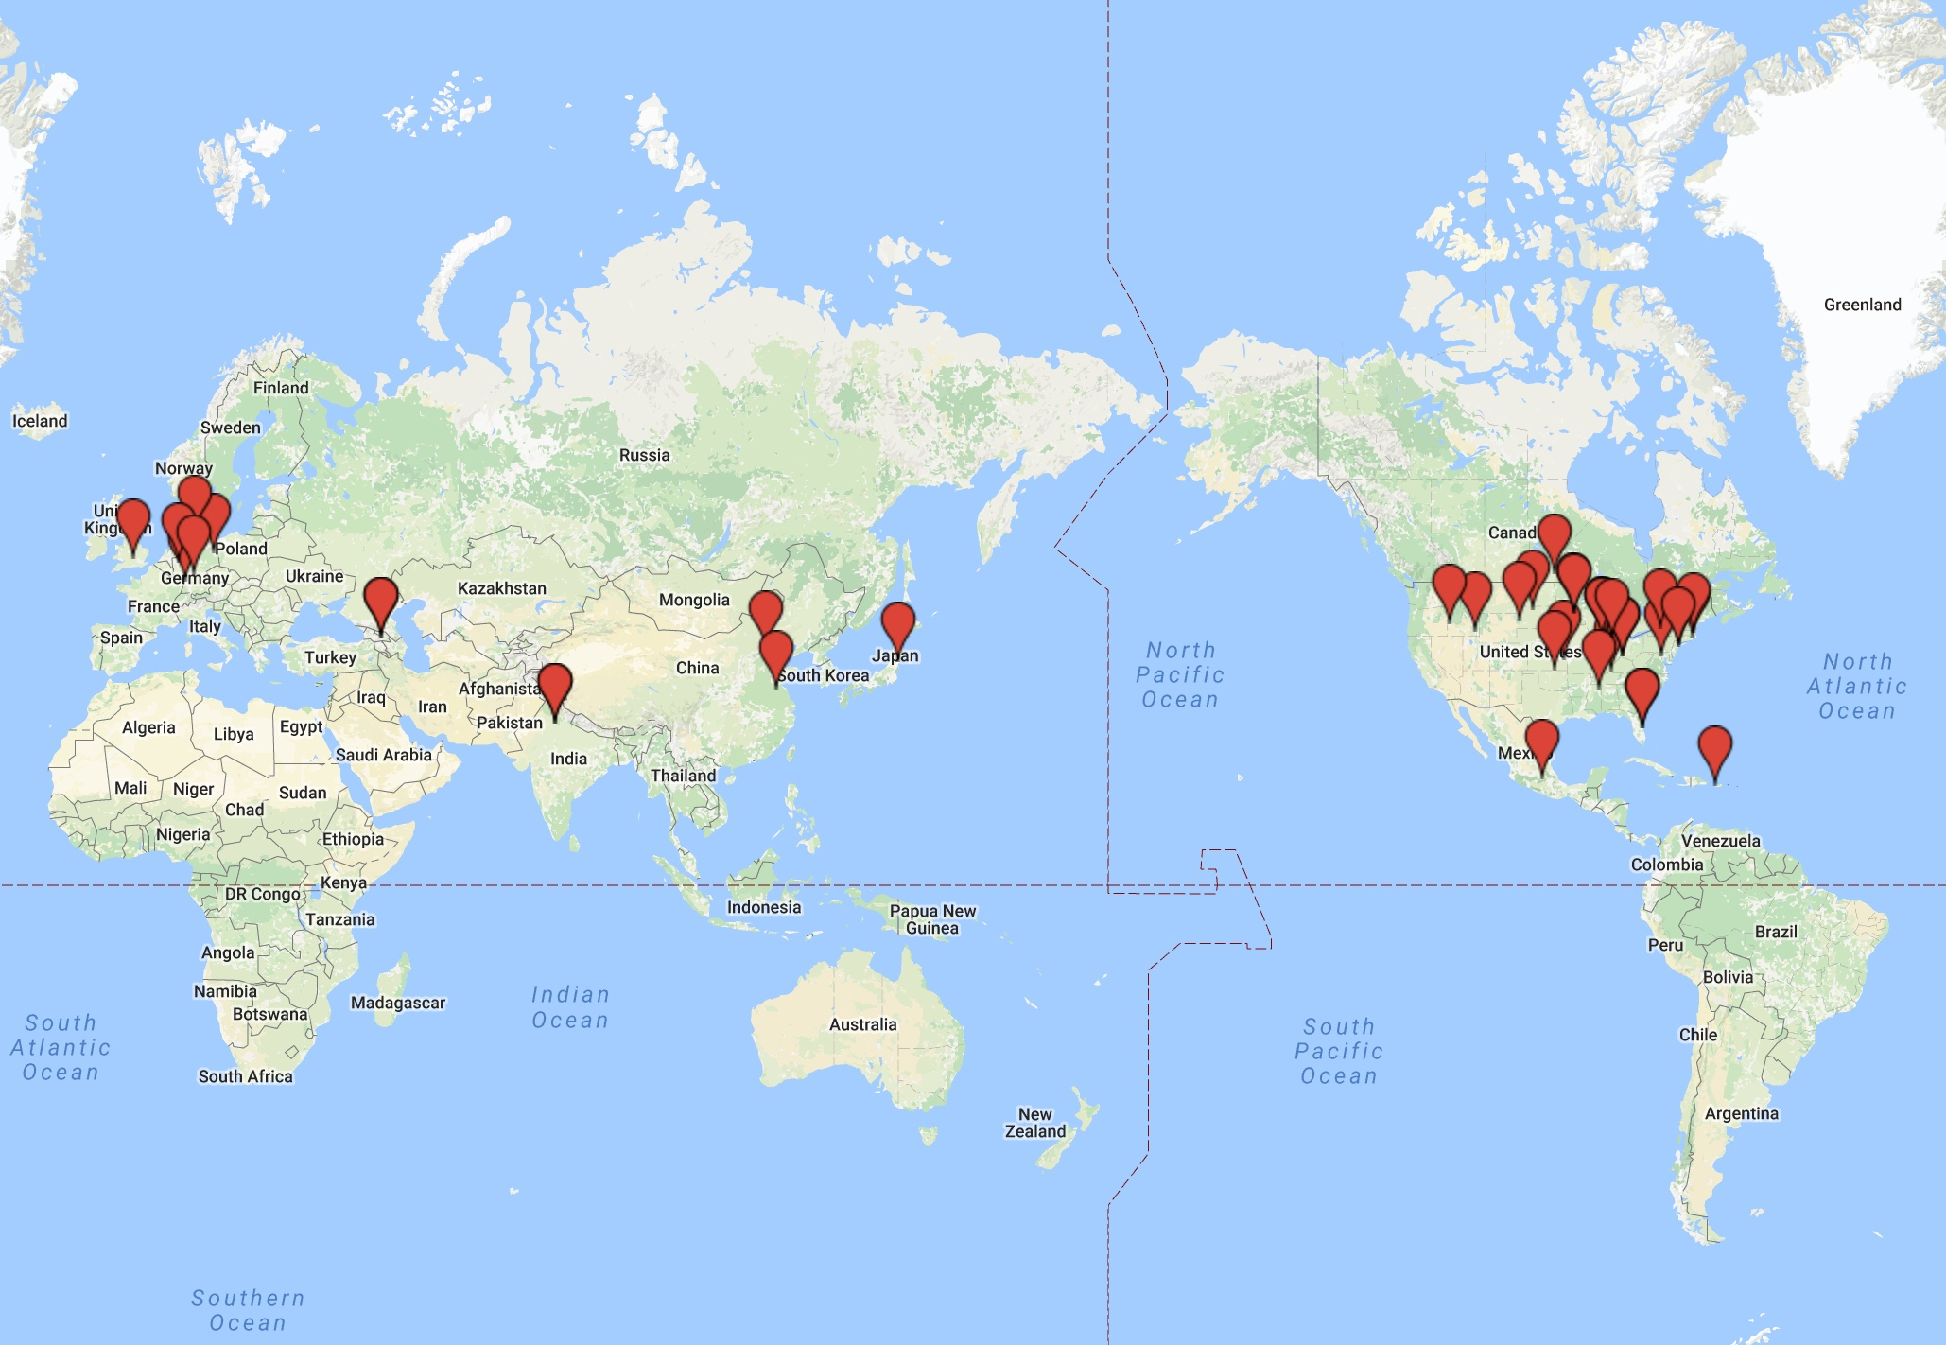
International Muon Week 2017
International Muon Week
March 13-17, 2017
47 schools from 10 countries
U.S. – Canada – Mexico - Puerto Rico – Japan – China – India – Georgia - U.K. - Germany

Slide 2
2017 Solar Eclipse Project
Measuring muon rate from directions near the sun
August 21

