Slide 1
Online data processing in ALICE
B. von Haller
CERN
23.03.2017

Slide 2

Overview
Context
  Major upgrade of ALICE for Run 3 and 4 (i.e. post 2020)
  O² project : a common online/offline computing system
Outline
  Rationales for O2 and online data processing
  Requirements, architecture and design
  Data quality control

Slide 3


Today’s system
Triggered
  only a small amount of events is actually recorded
Limited online processing
  the High Level Trigger processes the data of the largest detector
  a few calibration are done online without human intervention
Full reconstruction and calibration is done offline, in the days, weeks and months after the data taking
ALICE
Online
Offline
Notes:
TODO add drawing

Slide 4


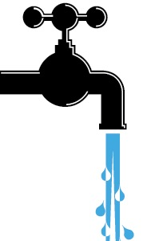
Rationales for a new computing system
After LS2, LHC min bias PbPb at 50 kHz
  ~100 x higher event rate than during Run 1
  Too much data to be stored
Physics topics addressed by ALICE upgrade
  Rare processes, very small signal over background ratio
  Needs large statistics of reconstructed events, 13nb-1 for PbPb
  Triggering techniques very inefficient or impossible in most cases
TPC inherent rate (drift time ~100 µs) < 50 kHz
  Support for continuous read-out, as well as triggered read-out

Slide 5

Tomorrow’s system
Read-out the data of all collisions
Compress these data intelligently by reconstructing and calibrating them online
One common online-offline computing system: O²
Paradigm shift compared to today’s approach
But built on our experience with the HLT

Slide 6
Functional flow
Trigger system
Detectors electronics
Continuous and triggered streams of raw data
3.4 TB/s HI:50kHz pp/pA:200kHz
Base Line correction, zero suppr.
Readout
Data aggregation
Local data processing
First Level Processors (FLP)
Compressed Sub-Timeframes
500 GB/s HI:50kHz pp/pA:200kHz
Data aggregation
Synchronous global
data processing
Event Processing Nodes (EPN)
Compressed Timeframes
90 GB/s HI:50kHz pp/pA:200kHz
Synchronous
Data storage (60 PB)
1 year of compressed data
Write 170 GB/s, Read 270 GB/s
Tier 0, Tiers 1 and Analysis facilities
20 GB/s
Asynchronous
Compressed Timeframes
Reconstructed events
Asynchronous (few hours)
event reconstruction with
final calibration
Notes:
Consider removing Tiers

Slide 7
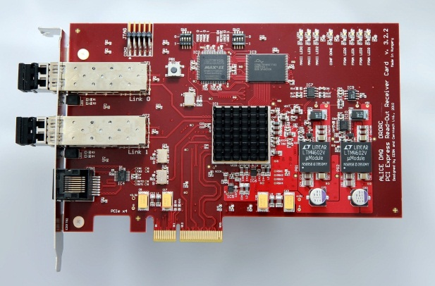
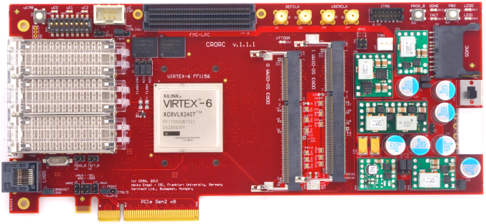
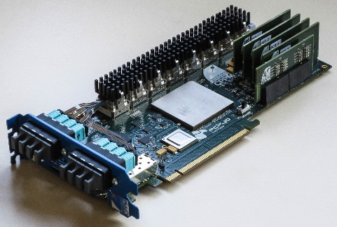
Readout & FPGA Hardware acceleration
RORC 1 | C-RORC | CRU
2 ch @ 2 Gb/s PCIe gen.1 x4 (1 GB/s) | 12 ch @ up to 6 Gb/s PCIe gen.2 x 8 (4 GB/s) | 24 ch @ 5 Gb/s PCIe gen.3 X 16 (16 GB/s)
Custom DDL protocol | Custom DDL protocol (same protocol but faster) | GBT
Protocol handling TPC Cluster Finder | Protocol handling TPC Cluster Finder | Protocol handling TPC Cluster Finder Common-Mode correction Zero suppression
Run 1
LS1
Run 2
LS 2
Run 3

Slide 8
Hardware acceleration (FPGA)
Performance of the FPGA-based FastClusterFinder algorithm for DDL1 (Run1) and
DDL2 (Run2) compared to the software implementation on a recent server PC.

Slide 9
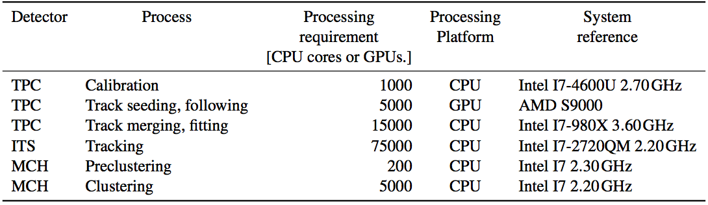
Computing requirements for online processing
Computing requirements -> Total : ~ 100000 CPU cores 5000 GPU chips
Goes together, merging and fitting can run on GPUs too
Being ported to GPU, conversion factor unknown
Theoretically could run on GPU
Notes:
In case of GPUs, we will refer to the number of GPU cards.}
TPC 1000 -> 6000
Effective CPU (if GPU: 26 CPUs + 3 CPUs) : 235000

Slide 10
Hardware acceleration (GPU)
For TPC track finding on EPNs (as today’s HLT)
Possibly more use cases depending on R&D
Tracking time of HLT TPC Cellular Automata tracker on Nehalem CPU (6Cores) and NVIDIA Fermi GPU.

Slide 11
O2 Hardware facility
270 FLPs
First Level
Processors
(FLPs)
1500 EPNs
Event Processing
Nodes
(EPNs)
34 Storage
Servers
68 Storage
Arrays
60 PB
RD and WR
440 GB/s
Detectors
Switching
Network
Storage
Network
9000 Read-out
Links
Input: 270 ports
Output : 1500 ports
Input: 1500 ports
Output : 34 ports
3.4 TB/s
500 GB/s
90 GB/s

Slide 12

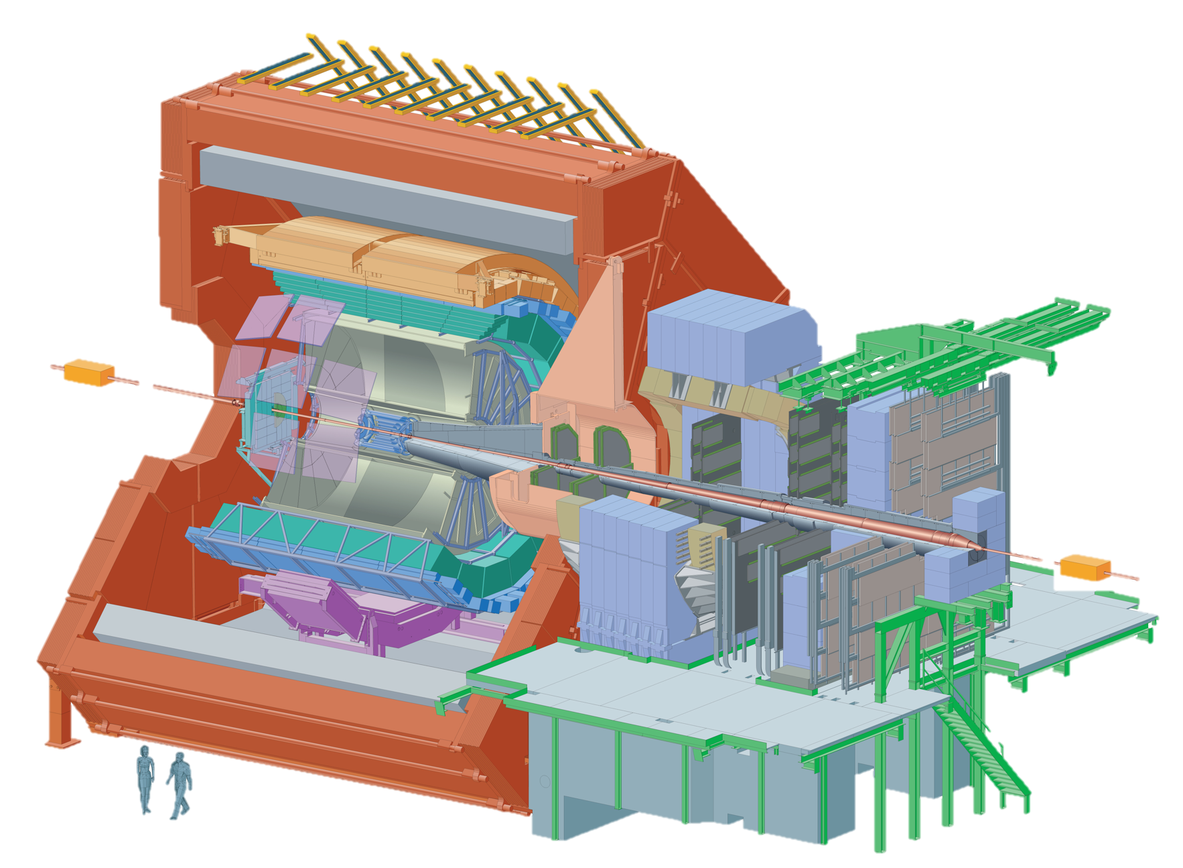
O² Farm
~100k CPUs, ~5k GPUs, ~500 FPGAs
FLPs at P2 in existing CR1
EPNs and storage need a new dedicated room
  Space and weight limitations
Two scenarios
  CR0
    Container(s)
    Call for tender (common with LHCb and neutrino platform)
  Common Data Center in Prevessin
    An alternative to the CR0 at P2 has been proposed by CERN
    New common data center in Prevessin
    Being studied
CR0
IT network
CR1
9000
optical
fibers
Notes:
TODO rework the image

Slide 13
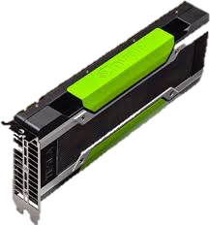
Software for online processing
Design
Message-based multi-processing
  Ease of development
  Ease to scale horizontally
  Possibility to extend with
  different hardware
  Multi-threading possible
  within processes
ALFA : ALICE-FAIR concurrency framework
  Data transport layer
  ZeroMQ
  Multi-process
  First version available, development ongoing
AliceO2
  Prototyping
  Steady started
EPN 1
1
…
2
…
EPN m
n
Panda
. . . . . . .
Cbm
AliceO2
FairRoot
ALFA
Libraries and tools
Notes:
TODO add schema for the multi-process vs mutli-threading

Slide 14
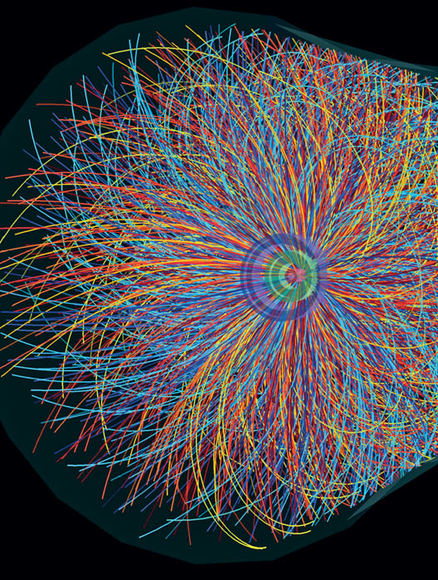

Data Quality Control
Run 3 Data Quality Control (QC) combines
  Data Quality Monitoring (online)
    Make sure to record and reconstruct high quality data
  Quality Assurance (offline)
    Make sure to reconstruct and analyze high quality data
Crucial because we do a lossy compression
  Get feedback on the quality of the data and the processing
  Identify and solve issues early
    With or without human interventions
  Help streamline the processing by identifying ”good” data
Without QC we are blind
Dataflow
Storage
Monitoring Object Generation
Automatic
Quality Assessment
Visualization
Notes:
Involves
[Online gathering of data]
Analysis by user-defined algorithm
Production of monitoring objects such as histograms
Assessment of the quality of the data based on the objects
Storage of monitoring data
Visualization (+ human assessment of quality)

Slide 16
QC requirements
Based on 2 detailed surveys and on our experience
100 tasks (most are parallelized over 100s of machines)
Analysing 1-100% of the data
  Possibly in stage, not everything synchronously with data
10’000 objects (mostly histos) after merging, updated every minute
  We actually expect 25’000 objects and plan for peaks of 50’000
5% of objects to be kept forever, all the rest kept for days or weeks
Short feedback loop (seconds) with initial setup within minutes
Automatic as much as possible, machine learning ideally

Slide 17



Summary
O2 is a project with ambitious requirements
  > 3.4TB/s detector input, ~100x more than today
  Online synchronous compression factor of >30
  Major paradigm change with combined offline and online system
Hardware
  HW acceleration (FPGAs, GPUs) for online processing
  O2 farm with ~100 k CPU cores and ~5000 GPUs
Software
  Multi-processes + multi-threaded
  Data Quality Control is both crucial and challenging

Slide 19

O² Schedule
2012-2013
2014-2015
2016-2017
2018-2019
2020-2021
High-Level Design
R&D
Trigger TDR
Project organization
Design
R&D
Demonstrators
O² TDR
Products selection
Detailed design
R&D
Prototyping
Development
Products selection
Prototypes
Detailed design
R&D
Prototyping
Development
Products selection
Prototypes
Final components
Deployment
Commissioning
Development
Products selection
Final components
Deployment
Commissioning
Production
Run 1
LS1
Run 2
LS 2
Run 3

Slide 20
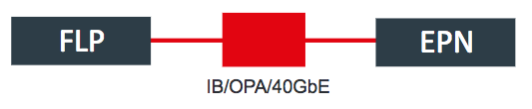
Network performance tests
Comparison of Ethernet,
IP over InfiniBand and IP over Omni-Path
1K 10K 100K 1MB 10M 100M
40 GbE: 40 Gigabit Ethernet OPA: Intel® Omni-Path IB: InfiniBand O2: ALICE Online-Offline framework
Notes:
If needed, remove the one on the right.
If needed remove the FDT.

Slide 21
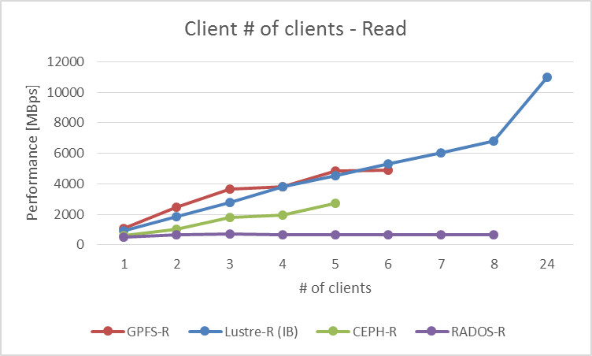
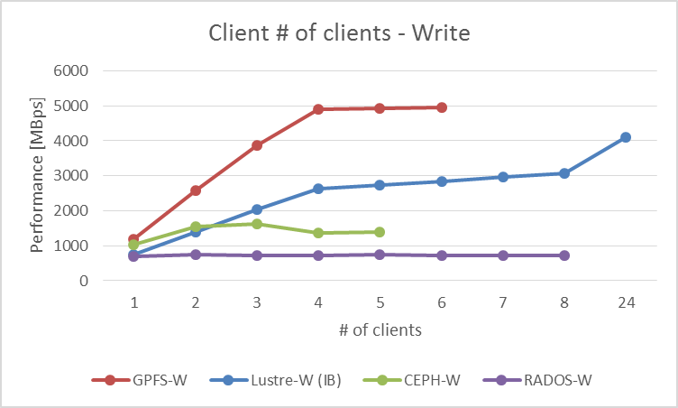
Storage
Client File Systems performance tests
ADM: Administration server
MD: Metadata server
DS: Data server
CLI: Client
GE: Gigabit Ethernet
IB: InfiniBand
GPFS: General Parallel File System
Lustre: open-source parallel file system
Ceph: distributed object store
RADOS: Reliable Autonomic Distributed Object Store
Notes:
capacity and throughput on a set budget
The R&D is set up in three layers:
(basic) storage elements, technology
SSD storage
Magnetic rotating disks storage
All-Flash, NVMe storage
Storage systems (enclosures, servers, ..)
Storage Chassis
Storage Servers
Storage Racks
Flash Arrays
Client access (file systems)

Slide 22
Physics software design
Online processing workflow
All FLPs
EPN: synchronous asynchronous
Raw data
Local Processing E.g. Clusterization
Calibration
Detector Reconstruction
E.g. TPC & ITS
Track finding
Inter-detector
matching procedures
Final calibration, 2nd matching
Final matching, PID, Event extraction
CTF
AOD
Step 0
Step 1
Step 2
Step 3
Step 4
Notes:
also muon pre-clustering, calorimeters cell energy and time extraction
TPC and ITS track finding, ITS vertexing, MCH track clusterization, FIT -> multiplicity,
inter-detector matching procedures
TRD: Matching of TPC tracks to TRD online tracklets
ITS/TPC: standalone tracks matching (full or partial, depending on ITS noise)
TPC calib : Drift velocity from limited sample TPC/ITS matching
TPC calib : Gain, space charge an drift velocity; TRD calib: Chamber status and gain.
TPC, ITS : final tracking ; MFT MUON track finding and matching
matching to TOF, HMPID, calorimeters, PID calibrations and the event build/extraction

Slide 23
Computing Model
T0/T1
CTF -> ESD -> AOD
1..n
O²
RAW -> CTF -> ESD
-> AOD
1
CTF
Glossary
RAW: raw data
CTF: Compressed Time Frame
ESD: Event Summary Data
AOD: Analysis Data Object
O2: Online-Offline facility
T0, T1, T2: Grid Tier 0, 1, 2
AF: Analysis Facility
MC: Monte-Carlo
HISTO: Subset of AOD specific for a given analysis
AOD
AOD
AOD
T2
MC -> CTF -> ESD
-> AOD
1..n
AF
AOD -> HISTO
1..3
Notes:
The AF must have very good network connectivity and a large, efficient local disk buffer 5PB dedicated to the storage of an entire set of active ALICE AODs with the associated CPU capacity for efficient processing of AODs several times per day.

