Slide 1
(quasi) real-time connectivity requirements
”CERN openlab workshop 23/4/17”
https://www.afinite.co.uk/media/85/Connectivity.jpg
Niko Neufeld
niko.neufeld@cern.ch

Slide 2
Acknowledgements & disclaimer
Most of this is not original, though some of it I arrived at independently ☺
Too vast a topic for 15 minutes, you will be subject to heavy presenter’s bias

Slide 3
The 4 tasks with data
Getting from the sensors
Distributing
Processing
Storing
Specific to Online computing
Both Online & Offline
Repeated cycles
Not covered in this talk

Slide 4
The ideal experiment: get all data which your instrument provides!
In theory this should allow you to extract anything of interest
In practice this can be a lot of data. Typical LHC experiment has 10^7 sensors with new values every 25 ns – assuming (pessimistically) 8 bit ADC for each sensor – this gives 400 Tbyte / second (!)
What is limiting us?

Slide 5
The 4 limitations with data
Getting from the sensors
Distributing
Processing
Storing
Specific to Online computing
Not covered in this talk
Not covered in this talk

Slide 6
The readout chain
Ideally all these functions are integrated in the front-end chip
There will be challenges with power (dissipation), in particular at high rate detectors, and, in some cases, radiation
Detector / Sensor
Amplifier
Filter
Shaper
Range compression
clock
Sampling
Digital filter
Zero suppression
Buffer
Feature extraction
Buffer
Format & Readout
to Data Acquisition System

Slide 7
The last (first) mile
The last mile is (still) in copper
Optical modules too large / too power hungry / not radiation hard enough
But copper is not what we want in the way of our particles!
This is the ultimate limit to high-rate read-out

Slide 8
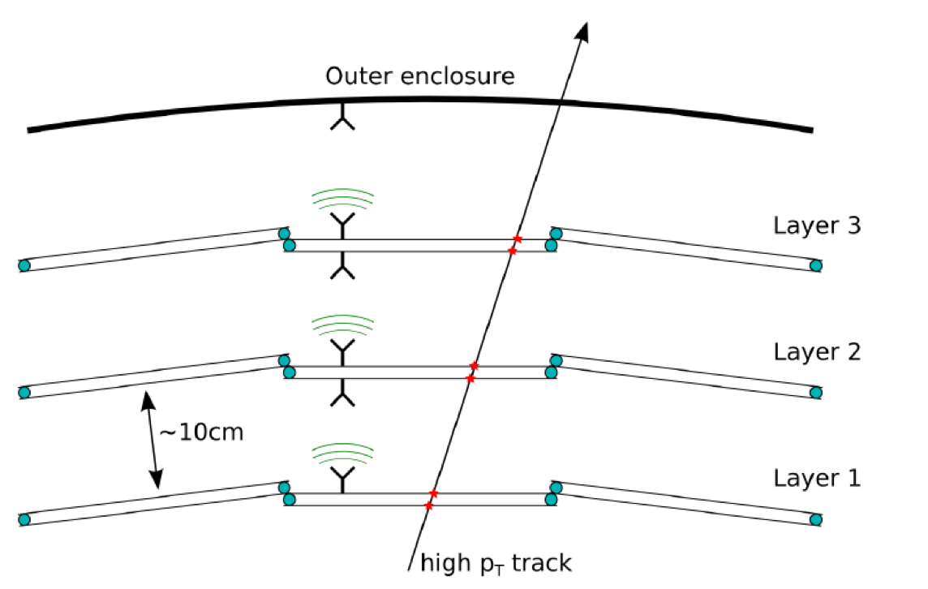
Very high density readout 1): wireless
Wadapt: “Wireless Allowing Data And Power Transmission”
Original idea by R. Brenner (Uppsala)
Radial Datatransfer
  Communication between layers
Signal cannot traverse layers
  Reuse of frequency channels

Slide 9
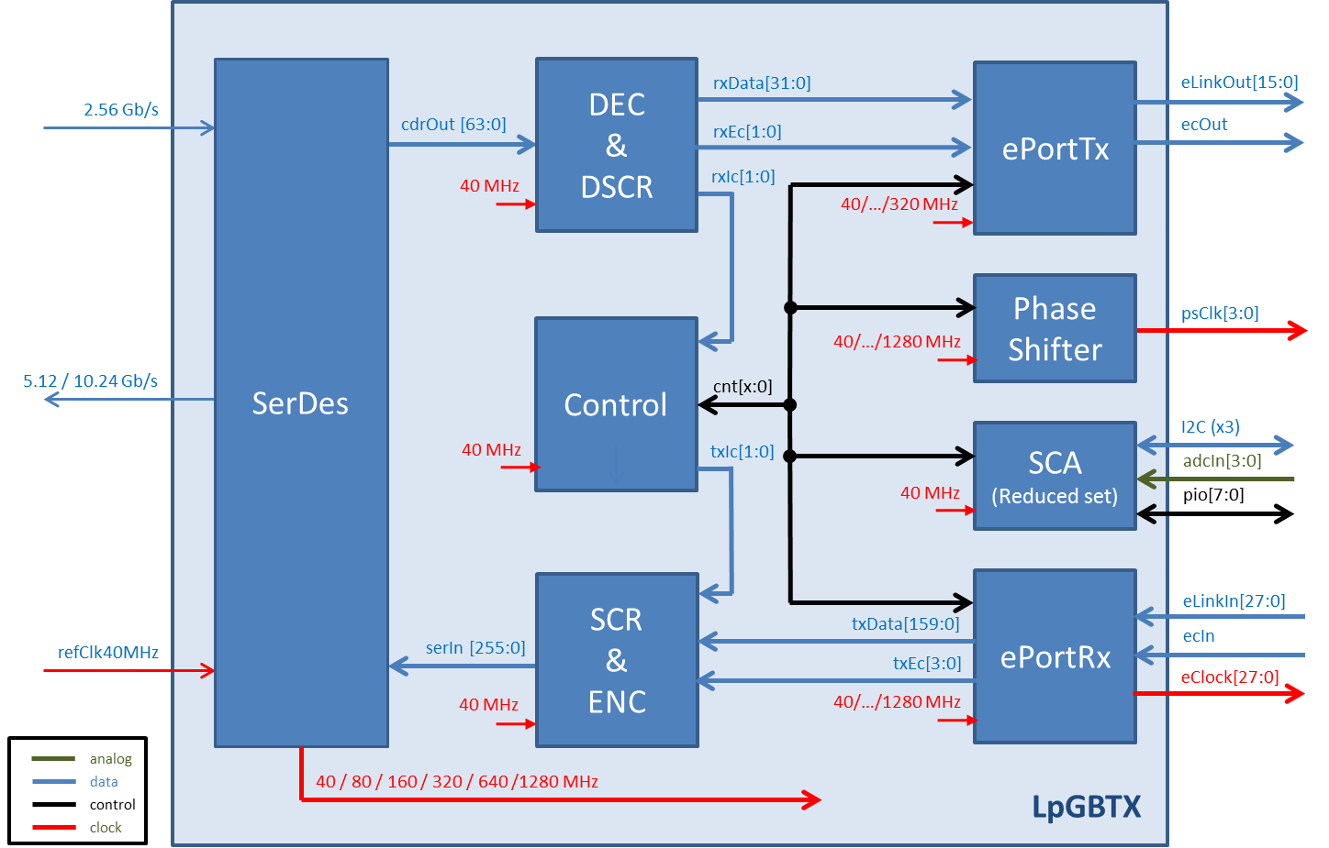
The next link for LHC: LpGBTX (draft characteristics)
500 mW (target)
  5.12 Gbit/s low power
10.24 Gbit/s (”high” speed)
Includes possibility for strong Forward Error Correction (FEC)
Bidirectional link including possibility to use for synchronous (trigger) commands, clock and slow-control: one link for everything
https://espace.cern.ch/GBT-Project/default.aspx

Slide 10
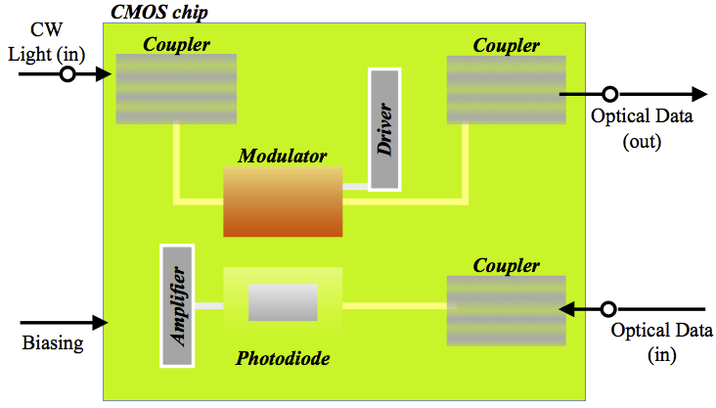
Silicon photonics
Challenging, but very hot topic → industry interest (hint, hint ☺)
  High bandwidth (10, 25 Gbit/s)…
Allows very tight integration, very compact, dense optical transmitters directly from front-end ASICs
Lots of challenges:
  Integration with other electronics and packaging
  Radiation hardness needs to be established (some first encouraging results have been achieved)
Source: S. Seif El Nasr-Storey et al. http://http://cds.cern.ch/record/2025925

Slide 11
Transiting to COTS
Commercial of the Shelf
Custom Electronics
Transition module
Switching network
On-detector
Off-detector
Processing Elements
Data
formatting
MUX
Data
formatting
Zero-
suppression
DAQ
Data buffering
during trigger
Optional, if
event-building required
Derandomizer buffer

Slide 12
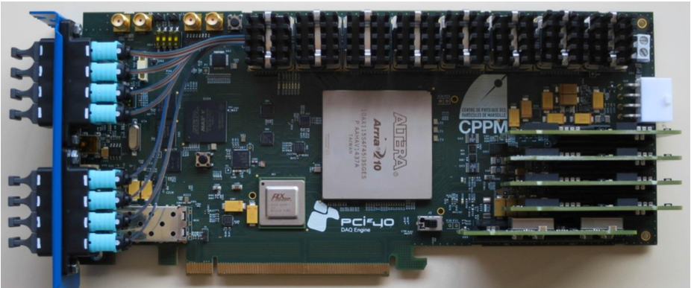
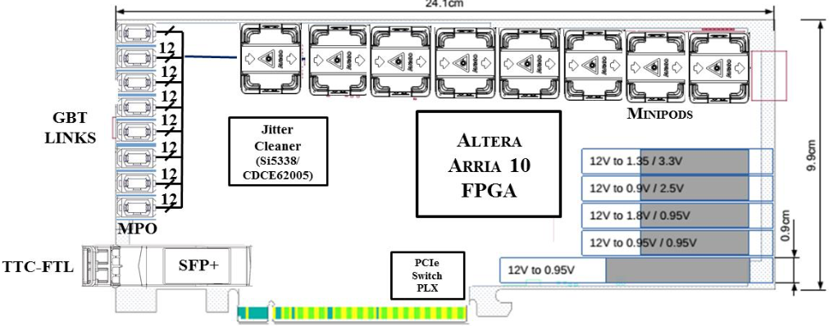
Transitioning to COTS using PCIe and an (intel) FPGA
Today transitioning to COTS means PCIe or Ethernet
Example: PCIe40, developed by CPP Marseille
Will be used by ALICE and LHCb for LHC run-3
48 bi-directional links
  up to 10 gbit/s
  Free choice of protocol (ex. Gbt, ethernet etc…
  Multimode fibre 850 nm
Can bring up to 110 Gbit/ into a PC over PCIe
High-port density, cost-effective solution – more integration possible? CPU/FPGA?

Slide 13

Event-building
Detector
Every Readout Unit has a piece of one data-set (“event”)
If all pieces must be brought together into a single compute unit for filtering then event-building is required
This can be most easily be done by a switching network
Readout Units
Switching network
100 m rock
Compute Units

Slide 14
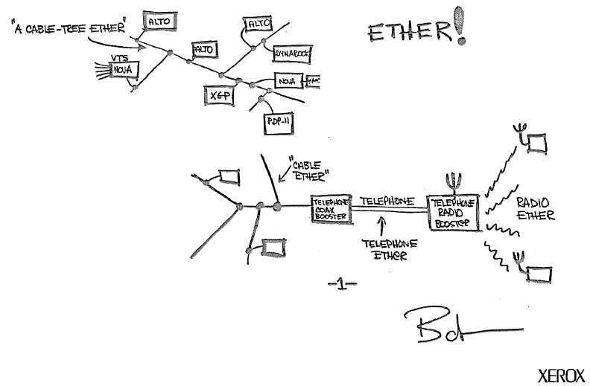
LAN technologies
Ethernet (Ieee 802.3 xx)
  The LAN
  Normally used in conjunction with IP (and tcp)
Infiniband (IB)
  Open standard, single vendor
  Complete stack(no need for IP or TCP) rmance computing and as a back-end for storage
  Low cpu usage on clients by using remote direct memory access (rdma)
  Low latency
Omni-path
  Intel alternative to infiniband
  Lowest cost per unit bandwidth
Anything else is exotic
http://www.digibarn.com/collections/diagrams/ethernet-original/composit-ethernet-sketch.jpg

Slide 15
DAQ challenges
Transport multiple Terabit/s reliably and cost-effectively
500 port full duplex, full bi-sectional bandwidth network, aiming at 80% sustained link-load @ >= 100 Gbit/s / link
Integrate the network closely and efficiently with compute resources (be they classical CPU, “many-core” or accelerator-assisted)
Multiple network technologies should seamlessly co-exist in the same integrated fabric (“the right link for the right task”)

Slide 16
Future network needs for LHC DAQ
2020
2026
2026
2020

Slide 17
The evolution of Network Interconnects
HDR (200 Gb/s) HCA
expected
Only general purpose technologies shown
Driven by SERDES speed: 10, 25, 50 GHz
PCIe Gen3
available
PCIe Gen4
100 GbE NIC

Slide 18
How much does a Gigabit/s cost?
Source: http://www.kernelsoftware.com/products/catalog/mellanox.html

Slide 19
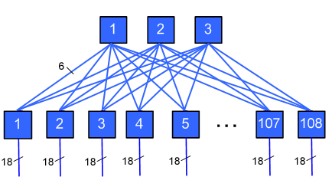
Cost example DAQ (Fat Tree)
Based on Ethernet (40G)
Assume 100 data sources and
150 computers, 40G / server!
The radix is here 32
We need 35 switches, 474 cables
Cost (assuming typical discounts) ~ 333000 USD
Assumes perfect scaling!
Source: https://computing.llnl.gov/tutorials/lc_resources/
DIY:
http://www.broadcom.com/application/cloud_scale_network/cloud_configurator.php
(design the network + network costs)
http://www.colfaxdirect.com (adapter cost)

Slide 20
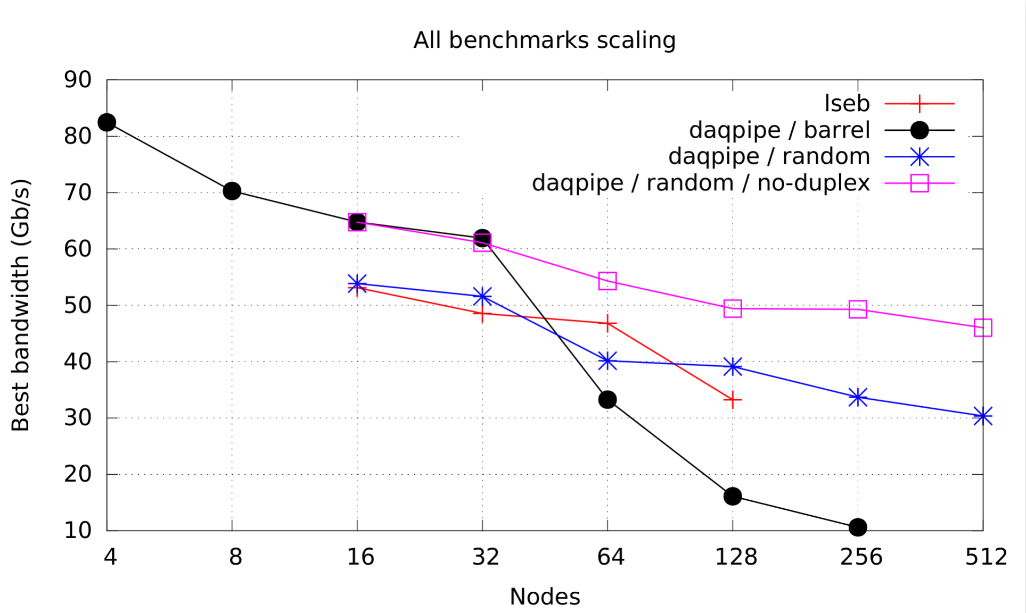
Scaling in practice
A lot of challenges remain!
Notes:
The good: more than 31 Tbit/s in flight!
The bad: between 4 and 512 nodes loose more than 50%

Slide 21
Long-distance data-transport a.k.a. the Prevessin challenge
The servers can be hosted elsewhere. In that case the 32 Tbit/s raw data need to be transported off-site
Distance: about 4 km (for ALICE and LHCb)
Lay many new fibres or use of DWDM
Using 25 GHz wavelength about 1200 lambdas are needed in the maximum configuration
The solution should be compact, does not need 99.999% availability, it should be scalable (starting smaller to be ramped up to max later)
Traffic is essentially uni-directional → Could this be exploited?
In any case data transport cost / Tbit/s is significant, compression of data is attractive, if cost-efficient

Slide 22
Conclusions
Significant challenges remain in all areas of data movement
  Not only online but also offline
Getting the data out and distributed is crucial for more and better physics in all future experiments
LAN growth is still strong, but Online requirements are very high and budgets are limited

