Slide 1


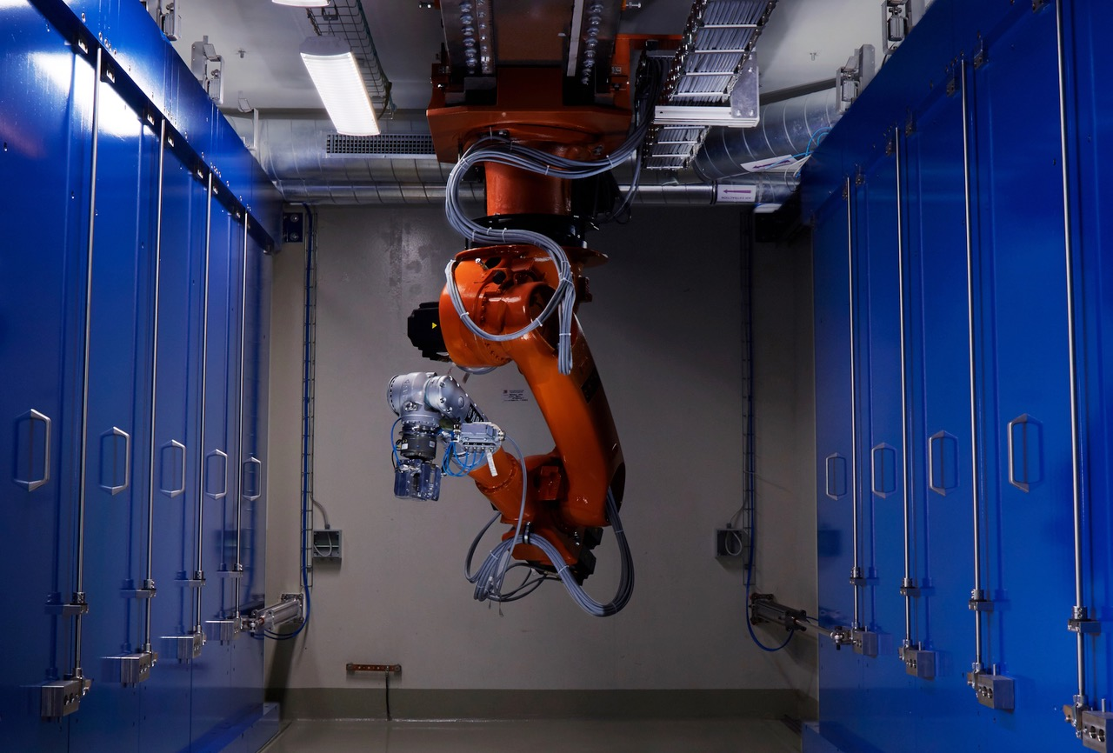
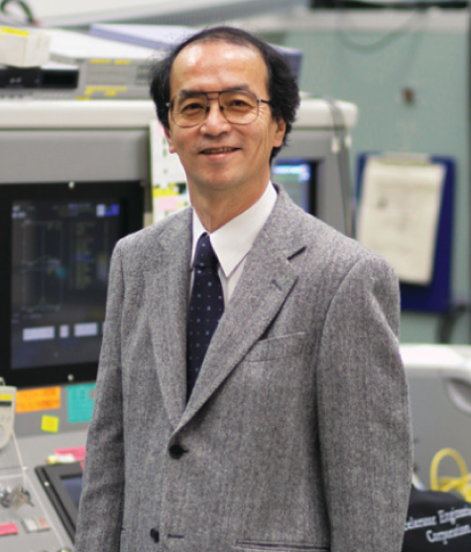
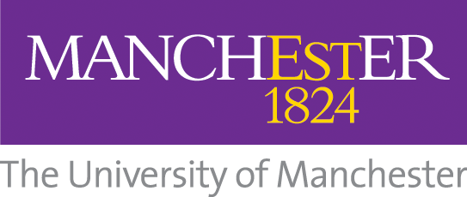
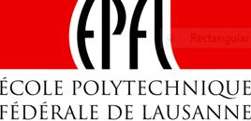

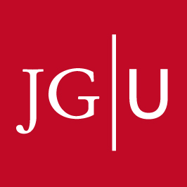
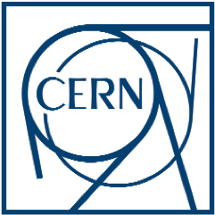


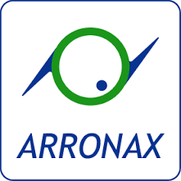
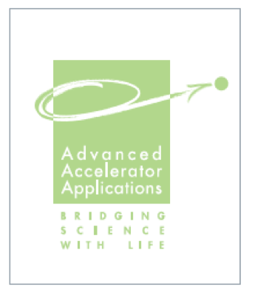
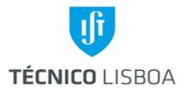
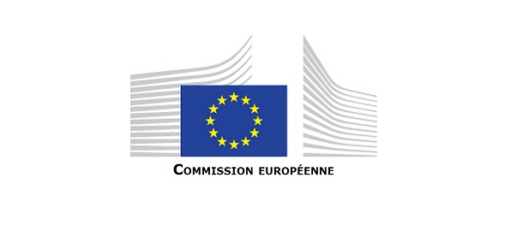
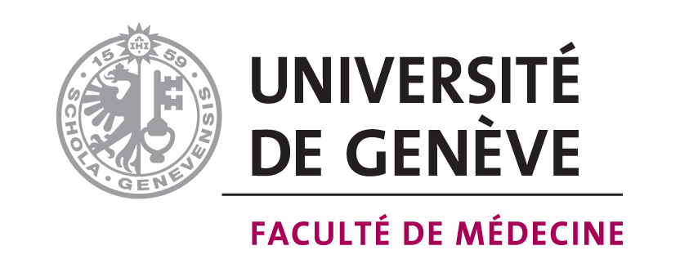
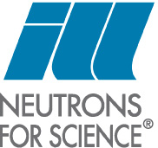

HEAVY-ION
RADIOTHERAPY
WITH HIMAC
MR. Koji Noda
General Director
National Institute of Radiological Sciences, Japan
Heavy-Ion Medical Accelerator in Chiba, HIMAC, was constructed for the cancer radiotherapy (RT) with heavy-ions. In 2003, the Japanese government approved the carbon-ion RT with HIMAC as a highly advanced medical technology. After that, NIRS developed a standard carbon-ion RT facility in order to boost the carbon-ion RT.
At present, NIRS has just proposed a new research project for super compact heavy-ions RT facility, the so-called 5th generation heavy-ion RT machine in Japan. In the treatment, multi-ions will be used in order to control both the biological dose and the RBE. We will report the development of heavy-ion RT with HIMAC and also the new project.
Public Lecture
Monday 5th June
18:00-19:00 Fondazione CNAO, Auditorium
Free entrance – Conference in English
This project has received funding from the European Union’s Horizon 2020 research and innovation programme under the Marie Skłodowska-Curie Grant Agreement No 642889

