Slide 1

Introduction to health economic evaluation:
The case of proton therapy in head and neck cancer
Bram Ramaekers, PhD
Department of Clinical Epidemiology & Medical Technology Assessment
bram.ramaekers@mumc.nl

Slide 2

What is health economic evaluation?
= ???

Slide 3


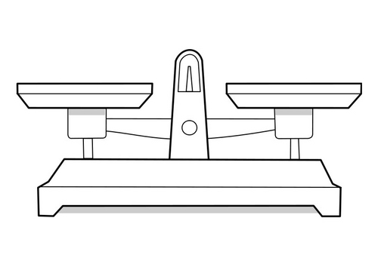
What is health economic evaluation?
Examines value for money of (innovative) treatments compared with current practice
QALY

Slide 4
Health economic evaluation
Reimbursement decisions
  Using economic evaluation
  Implies valuing the worth of a QALY
Example nivolumab for metastatic lung cancer in NL
  Gain: 3 months
  €134,000 per QALY gained
  Budget impact €200 million per year
  Dutch Health care institute: too expensive (Dec 2015)
    Minister of Health (Schippers) agreed
  Dutch Cancer Society: impermissible to restrict access for financial reasons (Dec 2015)
Notes:
https://www.rijksoverheid.nl/actueel/nieuws/2016/01/28/schippers-longkankermedicijn-nivolumab-vergoed-via-basispakket
https://www.kwf.nl/over-kwf/Pages/pb-kwfreactie-advies-medicijn-nivolumab.aspx

Slide 5
Statement
It is unethical to use economic evaluation to inform reimbursement decisions
(i.e. putting a value to what an additional QALY is allowed to cost)

Slide 6
Outline
Economic evaluation
Valuating Health effects: Quality Adjusted Life Years (QALY)
Interpretation and relevance of Economic evaluation
Case: proton therapy in head and neck cancer

Slide 7
Health Technology Assessment
“Health technology assessment is a multidisciplinary process that summarises information about the medical, social, economic and ethical issues related to the use of a health technology in a systematic, transparent, unbiased, robust manner.”
(EunetHTA 2007)

Slide 8
Clinical effectiveness
Medical & biological knowledge
Social aspects
HTA
Epidemiology
Economic aspects
Organisatio-nal aspects
Ethical conse-quences
Habbema et al., 1989

Slide 9
Clinical effectiveness
Medical & biological knowledge
Social aspects
HTA
Epidemiology
Economic aspects
Organisatio-nal aspects
Ethical conse-quences
Habbema et al., 1989

Slide 10
Economic evaluation
‘The comparative analysis of alternative courses of action in terms of both their costs and their effects’.
(Drummond et al., 1996)
Value for money

Slide 11
Characteristics of health care evaluations
 | Examines only consequences | Examines only costs | Examines both effects and costs
No comparison | Outcome description | Cost description | Cost-outcome description
Comparison | Efficacy or effectiveness evaluation | Cost analysis | Full economic evaluation
Drummond M et al. Methods for the Economic Evaluation of Health Care Programmes (Fourth Edition). Oxford 2015

Slide 12
Types of economic evaluation
Types | Evaluation of costs | Evaluation of effectiveness
Cost-minimalisation | Yes | No, equal effectiveness has already been demonstrated
Cost-effectiveness | Yes | Yes, clinical outcomes (recurrence, disease-free survival, etc)
Cost-utility | Yes | Yes, Quality adjusted life-years: QALY’s
(cost-effectiveness)
Cost-benefit | Yes | Yes, in monetary units
EQ5D
Drummond M et al. Methods for the Economic Evaluation of Health Care Programmes (Fourth Edition). Oxford 2015

Slide 13
Valuating health effects
Measures of health effects
Intermediate outcomes
Final outcomes
Glyceamic control
Cholesterol
Single dimension
Mortality rate
Events
Multiple dimensions
Attributes of health
Why should we use QALYs (EQ5D)?
How would you measure / valuate health effects for use in an economic evaluation?
Disease-specific
Generic
EORTC-QLQ
EQ5D
Drummond M et al. Methods for the Economic Evaluation of Health Care Programmes (Fourth Edition). Oxford 2015

Slide 14
Disease-specific instruments
Pro’s
Clinically sensible & relevant
Are more responsive for specific impact of a particular disease
Con’s
Do not allow cross-condition comparison
Limited to comparing treatments within a disease

Slide 15
Generic instruments
Pro’s
Include a broad range of dimensions related to quality of life.
Capture the impact of co-morbidities and side-effects of a treatment.
Comparison between different diseases is possible
Con’s
Less sensitive for minor change

Slide 16
Utility
Preference based
  Preference an individual/society has for a certain health state
Utility values
  1.00 = perfect health
  0.00 = death
  <0.00 = health states worser than death
Direct measurment (standard gamble)
Indirect measurement (multi-attribute questionnaires)
  e.g. EQ5D
  (most commonly used and preferred by National Health authorities such as NICE and ZiNL)

Slide 17
Euroqol (EQ5D questionnaire)
Mobility
1. No problems walking
2. Some problem walking about
3. Confined to bed
Self-care
1. No problems with self-care
2. Some problems washing or dressing self
3. Unable to wash or dress self
Usual activities
1. No problems with performing usual activities (e.g. work, study, housework, family or leisure activities)
2. Some problems with performing usual activities
3. Unable to perform usual activities
Pain/discomfort
1. No pain or discomfort
2. Moderate pain or discomfort
3. Extreme pain or discomfort
Anxiety/depression
1. Not anxious or depressed
2. Moderately anxious or depressed
3. Extremely anxious or depressed

Slide 18
Euroqol (EQ5D questionnaire)
Mobility
1. No problems walking
2. Some problem walking about
3. Confined to bed
Self-care
1. No problems with self-care
2. Some problems washing or dressing self
3. Unable to wash or dress self
Usual activities
1. No problems with performing usual activities (e.g. work, study, housework, family or leisure activities)
2. Some problems with performing usual activities
3. Unable to perform usual activities
Pain/discomfort
1. No pain or discomfort
2. Moderate pain or discomfort
3. Extreme pain or discomfort
Anxiety/depression
1. Not anxious or depressed
2. Moderately anxious or depressed
3. Extremely anxious or depressed
Health status 11223

Slide 19
Scoring patient 11223
(Dolan tariff)
Full health = 1.000
Constant -0.081
Mobility (level 1) - 0
Self-care (level 1) - 0
Usual activities (level 2) - 0.036
Pain/discomfort (level 2) - 0.123
Anxiety/depression (level 3) - 0.236
N3 - 0.269
Estimated value for 11223 0.255

Slide 20
From a utility to a QALY…
1.0
Utility
Area under the curve:
QUALITY ADJUSTED LIFE YEARS
0
0 1 2 3 4 5 6 7 8 9
Time in years t

Slide 21
Quality Adjusted Life Year
Utility
4 * 0,9 = 3,6
3 * 0,7 = 2,1
4 * 0,2 = 0,8
Total QALY: 6,5
(area under the curve)
1.0
0.9
0.7
0.2
0
4
7
11
Life years
Notes:
Effects van behandelingen worden vaak in QALYs of adjusted life years

Slide 22
Interpretation of economic evaluations
Multiple alternatives
Considering both Costs and Effects
Incremental cost-effectiveness ratio (ICER):
Costs_{A} - Costs_{B}
Effects_{A} - Effects_{B}
Treatment A
Effects A
Costs A
Choice
Costs B
Treatment B
Effects B
Difference in Costs? (Costs_{A} - Costs_{B})
Difference in Effects? (Effects_{A} - Effects_{B})

Slide 23
Interpretation of economic evaluations
The costs of an additional QALY gained (ICER):
€9000 / 0.15 = €60,000

Slide 24
Cost-effectiveness plane
More expensive
Less effective
More effective
(QALYs)
Less expensive
Notes:
De resultaten van een economische evaluatie worden weergegeven in deze grafiek.
Op de horizontale-as staat het verschil in Effects tussen de behandelingen, uitgedrukt in QALYs. Op de verticale-as staan de Costs, dus of de nieuwe behandeling duurder of goedkoper is dan de huidige behandeling.
Wanneer de nieuwe behandeling in vergelijking tot de huidige behandeling zowel effectiever als goedkoper is, bevindt de nieuwe behandeling ze zich in het groene kwadrant rechtsonder. Wanneer de behandeling zowel duurder als minder effectief is, zien we de behandeling in het rode kwadrant linksboven. In deze gevallen is het eenvoudig om vast te stellen of de behandeling wel of niet Costseffectief is.
Wanneer de behandeling zowel duurder als effectiever is, moeten we weten hoeveel we als maatschappij bereid zijn om te betalen per eenheid gezondheidswinst om te bepalen welke behandeling Costseffectief is. Dus wat is 1 extra QALY ons waard uitgedrukt in €.
In Nederland wordt vaak aangenomen dat deze drempelwaarde €80,000 is per extra QALY. Dit is nu weergegeven door de groene lijn. Wanneer de gemiddelde Costseffectiviteit onder deze drempelwaarde valt dan is de behandeling Costseffectief, wanneer de gemiddelde Costseffectiviteit boven deze drempelwaarde valt is de nieuwe behandeling dus gemiddeld niet Costseffectief.

Slide 25
Cost-effectiveness plane
More expensive
Less effective
More effective
Less expensive
Notes:
We kunnen het gedeelte van het oranje gebied onder deze drempelwaarde lijn dus ook groen arceren wat aangeeft dat in dit gebied de nieuwe behandeling Costseffectief is. Hetzelfde geld voor het oranje gebied boven de groene lijn, wanneer de Costseffectiviteitsschatting hier wordt weergegeven is de nieuwe behandeling dus niet Costseffectief.

Slide 26
Cost-effectiveness plane
Notes:
Laten we dit illustreren met een voorbeeld waarbij een nieuwe behandeling duurder en effectiever is dan bestaande behandeling. De gemiddelde Costseffectiviteit wordt weergegeven boven de drempelwaarde. Dus de nieuwe behandeling is niet Costseffectief en zou op basis van deze gegevens niet vergoed worden.

Slide 27
Cost-effectiveness plane
⓪
⓪
⓪
⓪
⓪
⓪
⓪
①
⓪
①
①
⓪
①
①
⓪
①
①= female
⓪= male
①
①
①
①
Notes:
Echter wanneer we de verschillen tussen patiënten meenemen en naar de individuele Costseffectiviteit kijken, dit zijn de mannetjes en de vrouwtjes in het figuur, wordt het duidelijk dat de gemiddelde Costseffectiviteit niet van toepassing is op iedereen. Voor sommige individuen is de behandeling Costseffectief en voor anderen niet. Wanneer we kijken naar subgroepen op basis van geslacht, zou de behandeling gemiddeld wel Costseffectief zijn voor vrouwen, dit is geïllustreerd met de rode driehoek. Voor mannen is het gemiddeld niet Costseffectief want de blauwe vierkant ligt boven de drempelwaarde lijn, voor sommige individuele mannen is de nieuwe behandeling zelfs minder effectief, zie de 2 MANNETJES aan de linker zijde van de verticale as.
Wanneer we enkel naar de gemiddelde Costseffectiviteit zouden kijken, zou de nieuwe behandeling op basis van deze informatie voor niemand worden vergoed, dit terwijl de nieuwe behandeling wel Costseffectief is voor vrouwen. De behandeling wel vergoeden voor vrouwen zou een betere optie zijn vanuit het Costseffectiviteit oogpunt.

Slide 28
Relevance of economic evaluations
Why should we care about these assessments?

Slide 29
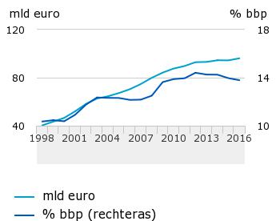
Dutch Health care expensis
2016: €96 bln
(€27 bln hospital
costs)
13.8% of GDP
https://www.cbs.nl/nl-nl/nieuws/2017/20/zorguitgaven-stijgen-in-2016-met-1-8-procent
Notes:
Bbp (bruto binnenlands product) = GDP (Gross Domestic Product)
https://www.cbs.nl/nl-nl/nieuws/2017/20/zorguitgaven-stijgen-in-2016-met-1-8-procent
In 2016 is ruim 96 miljard euro uitgegeven aan zorg. Dat is 1,7 miljard euro (1,8 procent) meer dan in 2015. Het grootste deel, bijna 60 miljard euro, is gefinancierd via de Zorgverzekeringswet en de Wet langdurige zorg. Het was het vierde jaar op rij dat de zorgCosts minder toenamen dan het bbp. Dit meldt het CBS op basis van de nieuwste, voorlopige, cijfers over de zorguitgaven.Grote veranderingen in de uitgaven aan de aanbieders van zorg zijn er in 2016 niet geweest. Aan ziekenhuizen (inclusief medisch specialisten) is 27 miljard euro uitgegeven, 0,6 miljard (2,5 procent) meer dan in 2015. De uitgaven aan geneesmiddelen via openbare apotheken, drogisten en supermarkten waren 5,6 miljard euro, ruim 3 procent meer dan in 2015. De uitgaven aan langdurige zorg (ouderenzorg en gehandicaptenzorg) zijn licht gestegen, na een daling in 2015. Vooral de betalingen via het persoonsgebonden budget van de Wet langdurige zorg namen fors toe, met 11,5 procent.
Een relatief gering bedrag van 1,1 miljard euro is in 2016 uitgegeven aan asielzoekerscentra en overige internaten, Costs die onder de zorguitgaven vallen. Deze uitgaven namen met ruim 200 miljoen euro (29 procent) toe. Het gemiddeld aantal asielzoekers in de opvang was in 2016 groter dan in 2015.
De 1,7 miljard euro extra uitgaven aan zorg in 2016 zijn voor het overgrote deel (1,2 miljard euro) gefinancierd via de Zorgverzekeringswet. De financiering via de eigen betalingen en de aanvullende verzekeringen was 0,2 miljard hoger dan in 2015. De rest van de extra uitgaven is gedaan via de overheid en de Wet langdurige zorg.
Verhouding tot bbp
De zorguitgaven zijn voor het vierde jaar op rij minder hard gegroeid dan het bbp. De zorgCosts stegen met 1,8 procent, minder dan de groei van het bbp (3,1 procent, in werkelijke prijzen). Het aandeel van de zorguitgaven in het bbp daalde van 14,0 procent in 2015 tot 13,8 procent in 2016. Afgebakend volgens internationaal afgesproken richtlijnen vormen de uitgaven aan gezondheidszorg 10,5 procent van het bbp. Ook dit cijfer was lager dan in 2015.

Slide 30
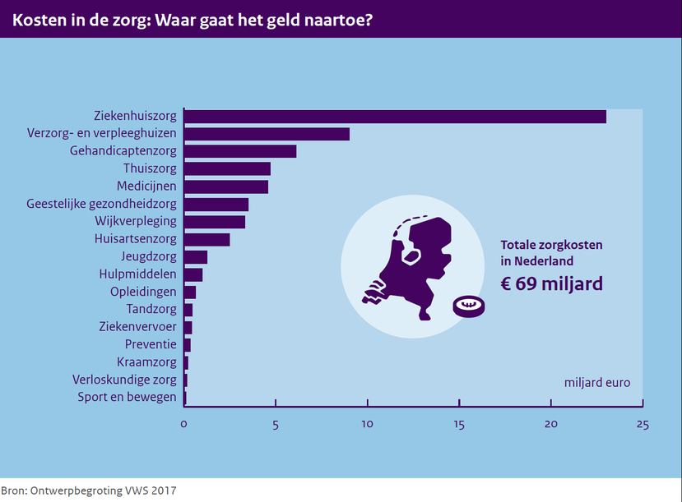

Slide 31
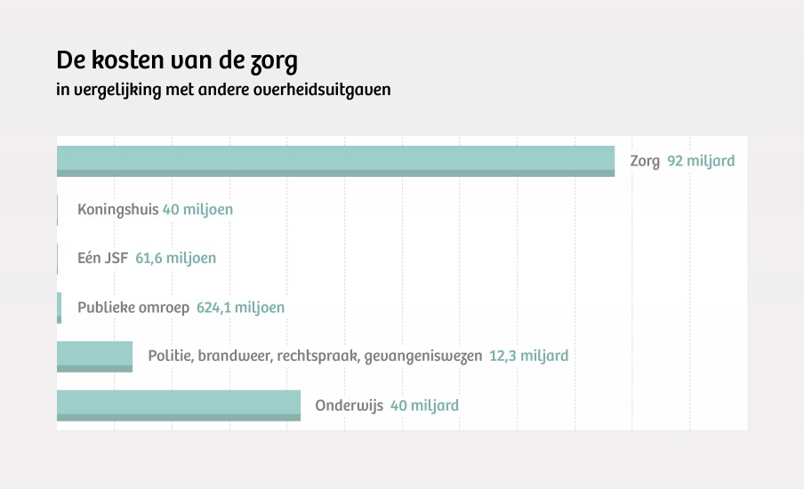
Dutch Health care expensis (2012)

Slide 32
Health care resources are scarce
Health care budget is finite
  Large numer of innnovations entering the market
  Reimbursing all → displacement of available
  Decisions need to be made
    Often health maximization is one major obective
    (i.e. generating as much health as possible with available budget)
Notes:
Health Econ Policy Law. 2016 Oct;11(4):415-32. doi: 10.1017/S1744133116000049. Epub 2016 Feb 24.
Cost-effectiveness thresholds in health care: a bookshelf guide to their meaning and use.
Culyer AJ¹.
https://www.york.ac.uk/che/research/teehta/thresholds/

Slide 33
Cost-effectiveness threshold

Slide 34
Cost-effectiveness threshold
How to decide (with the aim of maximizing health)?
Notes:
Z adopted and H displaced

Slide 35
Cost-effectiveness threshold
Cost-effectiveness threshold to maximize health
Culyer 2016 et al:
  Failure to set threshold involves avoidable deaths and morbidity
  Setting threshold too high/low as well

Slide 36
What is a QALY worth?
  NICE: £30,000-£50,000/QALY
  RVZ (2006): up to €80,000/QALY (depending on disease burden)
  Emperical work:
    Claxton et al (HTA 2015): £12,936 per QALY
    Van Baal (symposium Feb 9th, 2017): €41,000 per QALY
  However, other aspects can also be taken into consideration for reimbursement: (public) opinion, ethical, legal aspects
  Dakin et al (OHE 2013) on NICE decision making
    Cost-effectiveness alone correctly predicted 82% of decisions
    Potential other factors: end of life criteria, uncertainty, publication date, clinical evidence, only treatment, paediatric population, patient group evidence, appraisal process, orphan status, innovation and use of probabilistic sensitivity analysis
    At £40,000 per QALY 50% chance of NICE rejection
Notes:
https://www.york.ac.uk/che/research/teehta/thresholds/
So the threshold might be too high or the budget too low

Slide 37
Proton therapy in head and neck cancer
Survival: =
Toxicity: ?
Radiation dose
photons
protons
ideal
Depth in patient
Tumour
Notes:
Proton therapy is an emerging radiation technology world-wide
Based on theoretical considerations, the in-depth dose distribution of proton therapy allows a more accurate dose administration, compared to tradiational photon therapy.
Potential to: 1) administer a higher dose to the tumor (increasing tumor control( and/or 2) lower dose to health tissues (decreasing treatment toxicity)
In HNC the benefit of proton therapy is mainly expected in decreasing treatment toxicity
Next to the benefits proton therapy is associated with increased costs
Estimated investment ± €100 mln
Estimated cost per treatment €10,036 vs €21,077

Slide 38
Objective
To explore the potential cost-effectiveness of the following strategies:
  Photon therapy for all patients (IMRT)
  Proton therapy for all patients (IMPT)
  Proton therapy only for patients for whom it is cost-effective
Notes:
In the absence of comparative effectiveness research (as is the case with many innovative RT techniques).
Strategieen uitleggen!!!
NTCP models can be used to estimate the probability of toxicity based on the RT dose to the organs at risk. For example, based on the expected dose to the swallowing structures we can estimate the probability of dysphagia or swallowing difficulties based on NTCP models.
These dose parameters which are used can be estimated using planning studies. These are theoretical models estimate based on a CT scan the dose distribution in an individual patient and thus can be used to estimate the radiation dose to organs at risk. Per patient, this can be done for each radiotherapy technique separately.

Slide 39
Markov model
Cycle time: 6 months during the first year, afterwards 1 year
Time horizon: life-time
Perspective: health care perspective
Outcome: Quality Adjusted Life-years

Slide 40
(a) Disease free
no toxicity
†
(b) Disease free
xerostomia
grade ≥2
(c) Disease free
dysphagia & xerostomia
grade ≥2
(d) Disease free
dysphagia
grade ≥2
†
(e) Loco-regional
recurrence
(f) Distant
metastasis
†
†
Notes:
To explore the value of NTCP models combined with planning studies in analyzing the potential cost-effectiveness of proton radiotherapy as opposed to photon radiotherapy we constructed a Markov model
We constructed a Markov model to synthesize all available evidence. Our objective was to estimate the cost-effectiveness of proton therapy in head and neck cancer compared with the best available photon radiation (IMRT), we constructed a Markov model.
Cut-off toxicity grade 2 and higher (both xerostomia and dysphagia)
Cycle time: 6 months during the first year, afterwards 1 year
Life-time time horizon
Health care perspective
This is the visual representation of the Markov model
Disease-free patients were subdivided according to the degree of toxicity (xerostomia and/or dyspahgia). After the first year, toxicity was assumed to be constant.
Disease free patients were at risk for loco-regional recurrences and distant metastases. After disease progression, patients were not subdivided according toxicity.
The final absorbing state was death (either cancer related or due to other causes)
Major assumption: that probability of disease progression and mortality were assumed to be equal for both comparators.

Slide 41
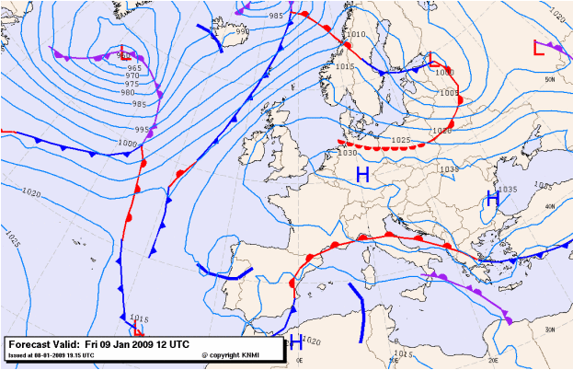
Het blijft een model
A model is a ‘simple’ reflection of former, current or future reality
Notes:
Alhoewel deze selectie methode veelbelovend is en er weinig of geen alternatieven beschikbaar zijn dient men zich te realiseren dat het een model betreft dat de werkelijkheid tracht te voorspellen. Wanneer geschikte empirische data beschikbaar komen dient dit model gevalideerd en eventueel geüpdatet te worden.

Slide 42
Exploring treatment effectiveness (toxicity)
Model based economic evaluation
Photons Protonsen
Dosimetric data
Toxicity probability
Dosis respons models
(logistic regression models)

Slide 43
Data sources
Parameter |  | Source
Probabilities
 | Survival & Recurrence | Literature (assumed equal for both comparators)
 | Toxicity | NTCP models combined with planning studies (N=25)
Utility scores |  | Cross-sectional survey (Ramaekers et al; Oral Oncol 2011 [Accepted])
Costs |  | Cross-sectional survey and Literature

Slide 44

Exploring effectiveness: toxicity
Photons
Protons
Widesott L. et al. IJROBP, 2008;72(2):589-596
Notes:
Comparison based on theoretical advantages
Do these theoretical advantages result in clinical benefits for HNC patients?
The overall quantity and quality of clinical proton therapy data is poor
There is no clinical evidence which support the superiority of proton therapy over photon therapy
Main benefit of proton therapy expected in reducing toxicity
Although we don’t have any data, we have models which can predict the expected toxicity probability based on these dose distributions.

Slide 45
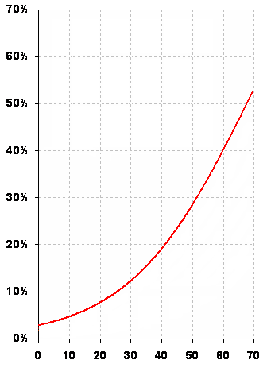
Exploring effectiveness: toxicity
Photon radiation
Mean dose to swallowing structure = 60 Gy
  Probability of swallowing difficulties = 40%
Proton radiation
Mean dose to swallowing structure = 50 Gy
  Probability of swallowing difficulties = 30%
Probability of swallowing difficulties
Mean dose to swallowing structure
Notes:
To illustrate this with an example wherein we predict dysphagia using proton therapy and photon therapy.
Patients treated with proton therapy will have a lower probability of dysphagia
Did this for 25 patients for both IMRT and iMPT. In the probabilistic analyses we incorporated the NTCP or logistic regression models into a Cholesky Decomposition, to account for the correlation between parameters.

Slide 46
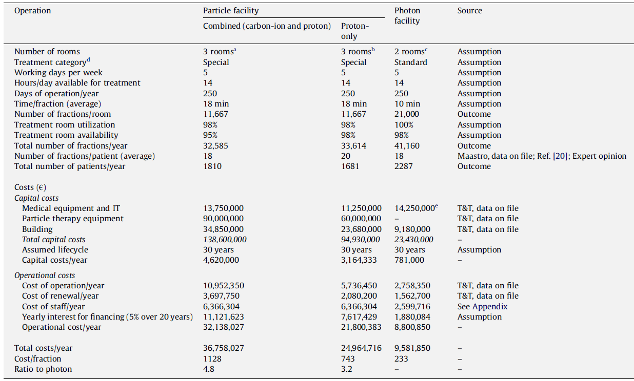
Treatment costs
Peeters A, Grutters JP, Pijls-Johannesma M, Reimoser S, De Ruysscher D, Severens JL, Joore MA, Lambin P. How costly is particle therapy? Cost analysis of external beam radiotherapy with carbon-ions, protons and photons. Radiother Oncol. 2010 ;95(1):45-53.

Slide 47
Cost-effectivenss of proton therapy for head and neck cancer
Ramaekers BL, Grutters JP, Pijls-Johannesma M, Lambin P, Joore MA, Langendijk JA. Protons in head-and-neck cancer: bridging the gap of evidence. Int J Radiat Oncol Biol Phys. 2013 1;85(5):1282-8

Slide 48
Cost-effectivenss of proton therapy for head and neck cancer
Ramaekers BL, Grutters JP, Pijls-Johannesma M, Lambin P, Joore MA, Langendijk JA. Protons in head-and-neck cancer: bridging the gap of evidence. Int J Radiat Oncol Biol Phys. 2013 1;85(5):1282-8
Notes:
Dus net zoals in het eerder genoemde voorbeeld is het gemiddeld niet kosteneffectief, maar wel voor een geselecteerde subgroep.

Slide 49
In summary
Economic evaluation tool to estimate cost per QALY
  Value for money (ICER)
  Maximize health with available budget
Economics is unavoidable because scarcity is unavoidable
Important to get the threshold right
Proton therapy cost-effective for selected HNC patients

Slide 50
Final remark on place of economic evaluation (HTA)
Ijzerman MJ and Steuten LMG: Early assessment of medical technologies to
inform product development and market access. A review of methods and applications. Applied Health Economics & Health Policy, 2011
Notes:
OTHER applications of HTA

Slide 51
Statement
It is unethical to use economic evaluation to inform reimbursement decisions
(i.e. putting a value to what an additional QALY is allowed to cost)
It is unethical not to use economic evaluation to inform reimbursement decisions

Slide 52
Thank you for your attention
Questions?
bram.ramaekers@mumc.nl

