Slide 1
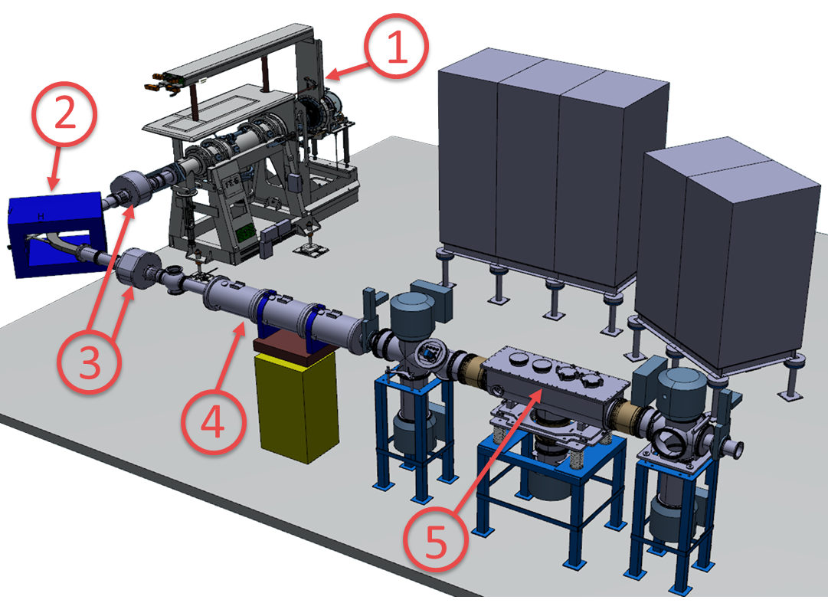
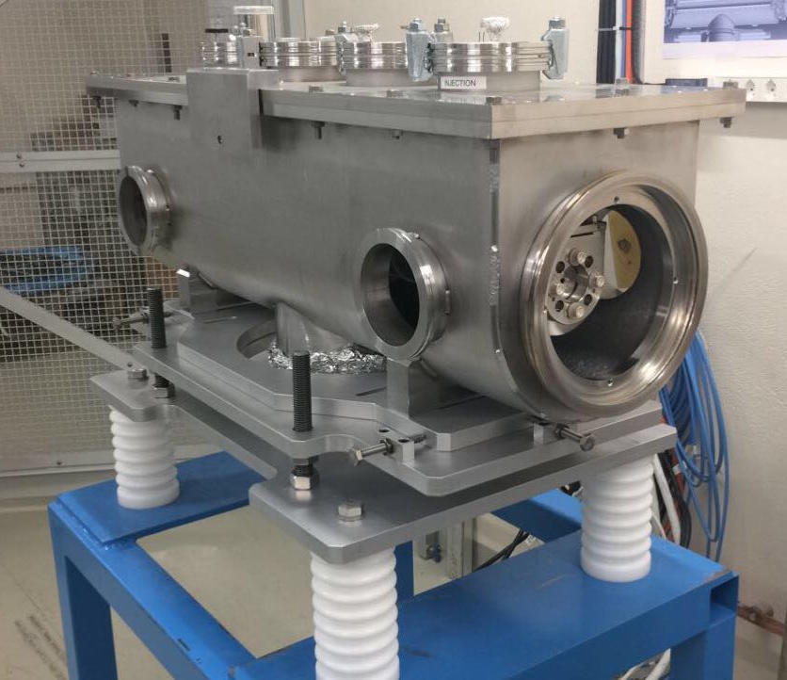
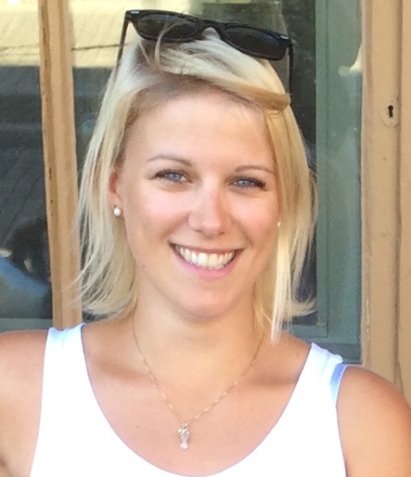

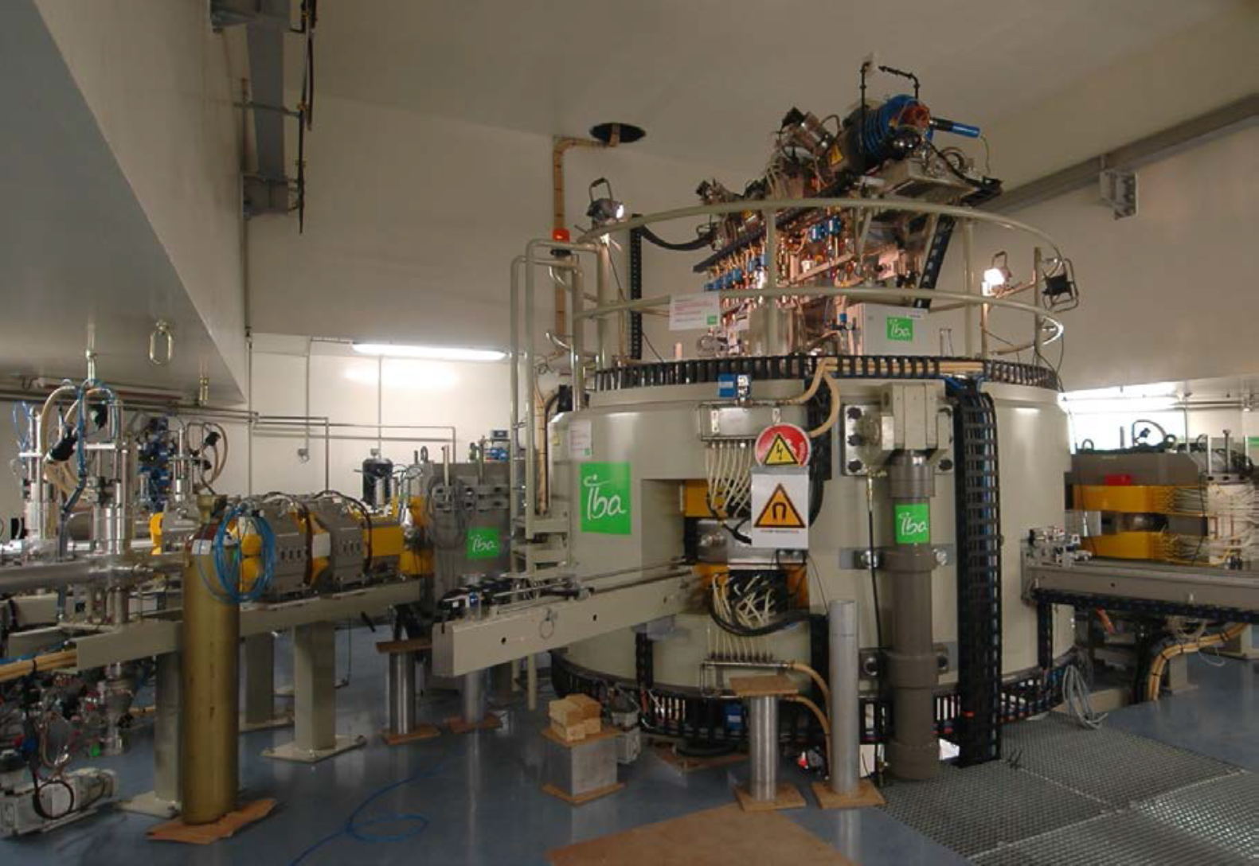
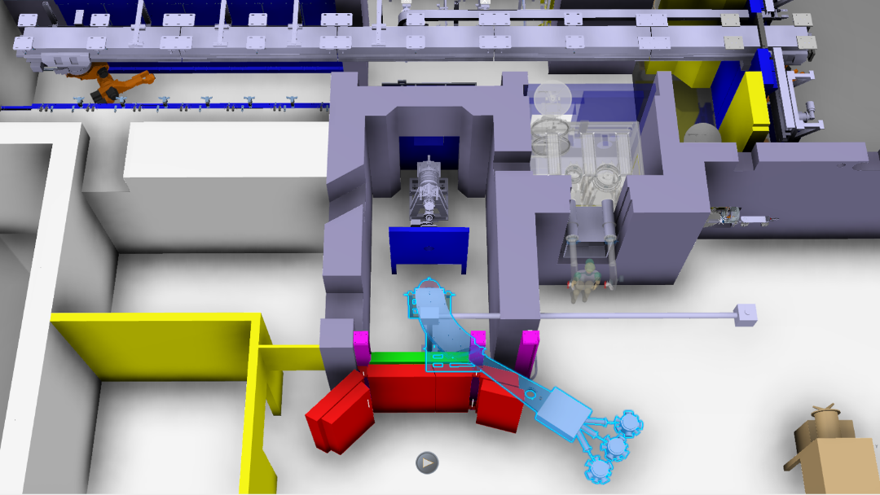
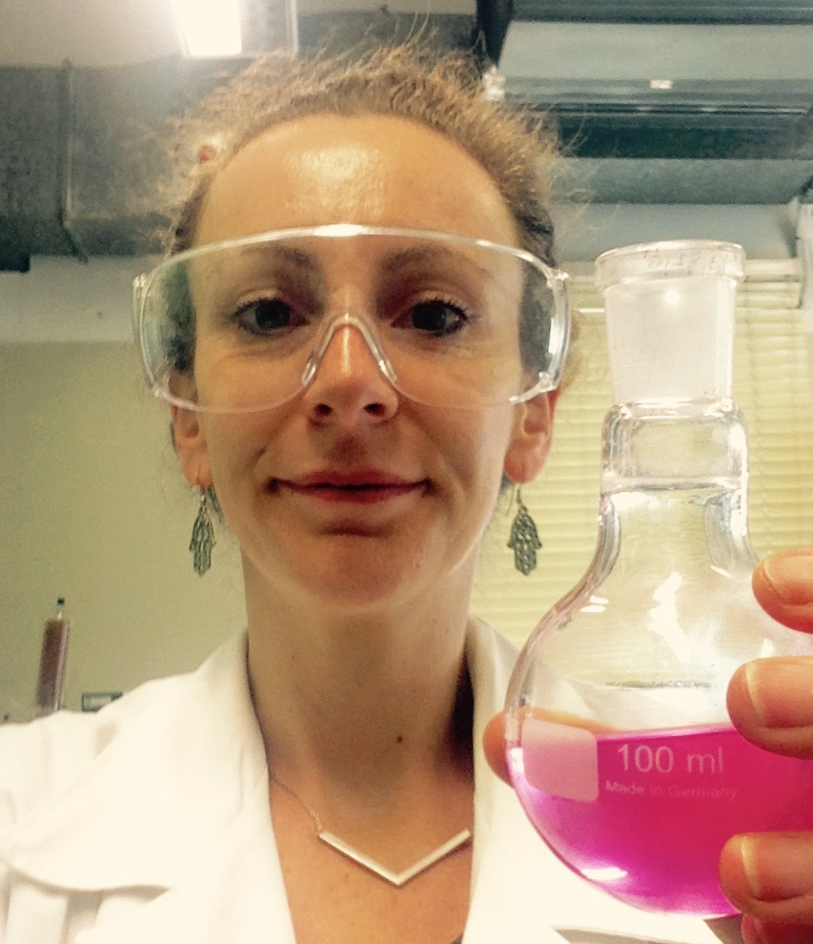
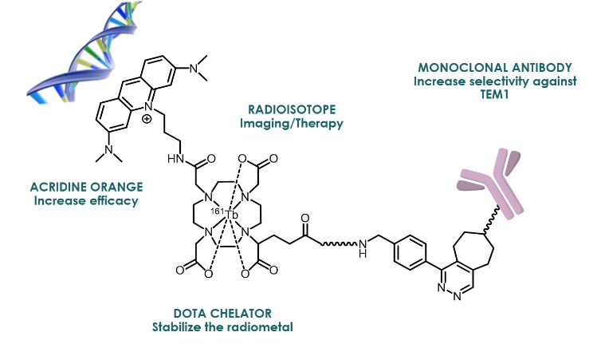
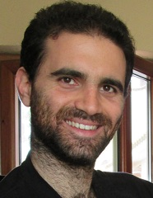
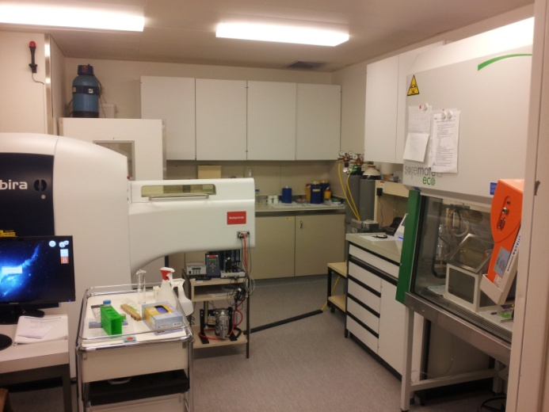
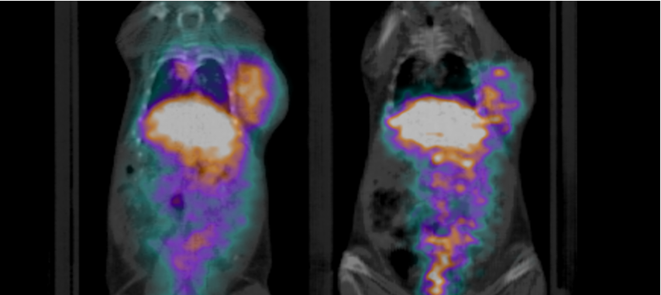

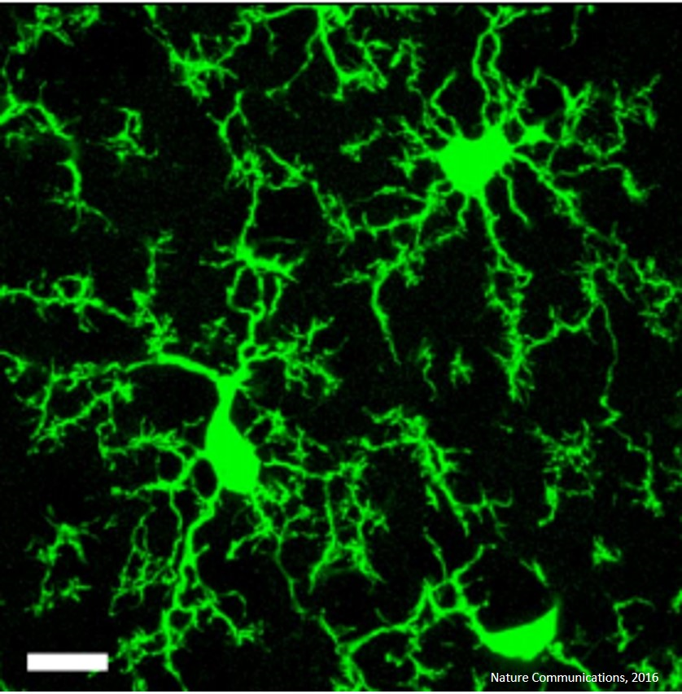


Theranostic radiopharmaceuticals for imaging/treatment of cancer
MEDICIS-Promed Work Package 3
Francesco Cicone¹, Alice D’Onofrio², Roberto Formento Cavaier³, Ioanna Prionisti⁴, Annie Ringvall Moberg⁵, Ilyes Zahi³
Lausanne University Hospital¹, IST^{2,} , AAA³, University of Geneva⁴, CERN⁵
Introduction
Work package 3 (WP£) is one ofthe three work packages within MEDICIS-Promed. It consists of 5 out of a total of 15 Early stage Researchers (ESRs) and one work package leader who are all working at various places in Europe.
WP3 – Leader + ESRs positions
WP leader: Ilyes Zahi
ESR1. Annie Ringvall Moberg
ESR6. Roberto Formento Cavaier
ESR8. Alice D’Onofrio
ESRCH2. Francesco Cicone
ESRCH3. Ioanna Prionisti
Objectives of WP3
Optimised and industrial performant production of new radioisotopes for theranostic using mass separation technology.
Synthesis and design of bio-conjugated molecules for the specific DNA-targeting of tumor cells.
Radioimmunotherapy and biodistribution studies on small animals as a proof of concept of the chosen radionuclides.
ESRs and their projects
ESR1. Annie Ringvall Moberg
In order to further develop ion sources and target units at ISOLDE, CERN, a non-radioactive test laboratory, Off-line 2, is currently under construction. Off-line 2 will also allow for improvements of beam manipulation techniques using a Radio-Frequency Quadrupole Cooler and Buncher (RFQCB). My primary task will be to take part in the construction and commissioning of Off-line 2 along with the RFQCB and also to further develop and improve the RFQCB.
Figure of Off-line 2.
1. ISOLDE Front-end,
2. 90 degree mass separator magnet,
3. Beam diagnostics, 4. Ion optics (quadrupole triplets), 5. RFQCB.
Image: Stuart Warren
A part of the RFQCB assembly at the ISOLDE Off-line 2 facility.
ESR6. Roberto Formento Cavaier
The objective of this work is to study the production of innovative radionuclides such as Tb-149 using a commercial middle sized high-current cyclotron (GIP Arronax) while exploiting the technology of the mass separator developed within the MEDICIS-PROMED project at CERN.
PRODUCTION OF HIGH SPECIFIC ACTIVITIES INNOVATIVES RADIONUCLIDES
+
=
Arronax IBA C70 cyclotron, Nantes
CERN-MEDICIS mass separator (light blue)
ESR8. Alice D’Onofrio
The final goal of this project is the synthesis and the biological evaluation of bifunctional compounds for theranostic applications. Those compounds, consisting of a central DOTA chelator that will stabilize the radioisotope, will be functionalized with a DNA-targeting moiety to increase the efficacy of Auger electrons and with a mAb fragment for the specific recognition of tumor cells. Furthermore, we intend to evaluate the influence of in-vivo click chemistry and of a bio-cleavable linker on the pharmacokinetic and biological behavior of such complexes.
Desired bi-functional Radio-immuno conjugates
ESRCH2. Francesco Cicone
¹⁵²Tb-CHX-A’’-DTPA-ScFv78Fc anti TEM1
As a Nuclear Medicine physician, I am the end-user of the novel radio-immunoconjugates synthesized within the frame of the MEDICIS-PROMED with the aim of imaging and treating cancer. In particular, I will perform preliminary in vitro and in vivo tests on mouse models of human sarcoma and neuroblastoma, hopefully driving a successful translation into patient clinic.
ESRCH3. Ioanna Prionisti
Micro PET/SPECT/CT
24 hours
60 hours
The radioisotopes produced at the CERN-MEDICIS facility will be implanted in rodents to assess their efficacy for the treatment of glioblastoma. The project focuses on developing new instruments and delivery methods for brachytherapy and investigates the impact and efficiency of these methods at the cellular and organ levels. In particular, the project investigates how brachytherapy affects the brain’s microvasculature and immune system.
Microglia-immune cells of the CNS
This research project has been supported by a Marie Skłodowska-Curie innovative training network fellowship of the European commission’s horizon 2020 program under contract number 642889 MEDICIS-PROMED.

