Slide 1
LIU-SPS EVM Status
Data extraction: 7 March 2017

Slide 2
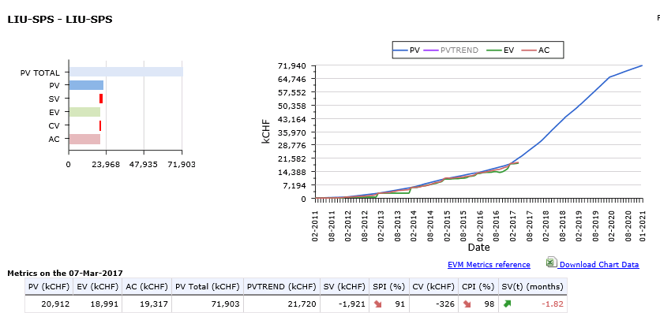
LIU-SPS Dashboard

Slide 3
LIU-SPS Crosstab by Group

Slide 4
Spare Slides

Slide 5
LIU-SPS Crosstab – BE Department

Slide 6
LIU-SPS Crosstab – EN Department

Slide 7
LIU-SPS Crosstab – HSE Department

Slide 8
LIU-SPS Crosstab – TE Department

