Slide 1
SMP:
Summary of changes and re-commissioning after EYETS 2016-17
I. Romera, S. Gabourin

Slide 2
Summary of changes - LHC
Timeout for Setup Beam Flag equations => From 4.5h to 12h
Squeezing Factor window limits => From beta* = 10m to 30m between max and min limits that can be set by LHC-OP
New intensity link from 24-bit BCTDC module located close to monitors (see P. Odier – 141st MPP)
  2 new optical links to SMP, successfully tested in 2016 TS3
  No change required on the SMP (intensities have the same format and units)

Slide 3
LHC BCTDC links to SMP in 2016
P. Odier

Slide 4
LHC BCTDC links to SMP in 2017
P. Odier

Slide 5
Summary of changes - SPS
No changes on firmware/hardware
New link from BCT5 in BA5 for high intensity beam measurements (protons), 16 bit, 100Samples/s, rms noise ~ 1.5E9 charges (see P. Odier – 141st MPP)
Copper link from BCT4 has been replaced by optical link (CTDAB and CIBL)

Slide 6
SPS BCTDC links to SMP in 2016

Slide 7
SPS BCTDC links to SMP in 2017

Slide 8
Machine checkout
Commissioning steps defined on MPS document (EDMS 1112187)
LHC
  Verification of intensity reception (especially from new 24-bit BCTDC during/after calibration)
  Verification of energy reception with a ramp from injection to physics (no circulating beam) and flags generation and transmission
  Verification of SFs and broadcast to GMT
SPS
  Verification of intensity reception (especially from new BCT5 and new BCT4 optical channel), flags generation (SBF and PBF) and transmission to EXT BICs and SPS Timing
  Verification of energy reception, flags generation (E_LHC_FLAG, E_AWAKE_FLAG, E_HIRADMAT_FLAG) and transmission to extraction BICs and LHC timing

Slide 9
Commissioning with beam
LHC
  Verification of BPF reception and transmission for both beams
  Verification of SBF equations (NORMAL, RESTRICTED, BEAM_SETUP & IONS) for different intensities and energies, and SBF transmission
  Verification of Moveable Devices and STable Beam flag generation and transmission
  Cross checker validation
SPS
  Verify correct flag generation (PBF and SBF) and transmission to EXT BICs and GMT (for I <1E11 p+, >1e11p+, >5E11 p+)

Slide 10
SPARE SLIDES

Slide 11
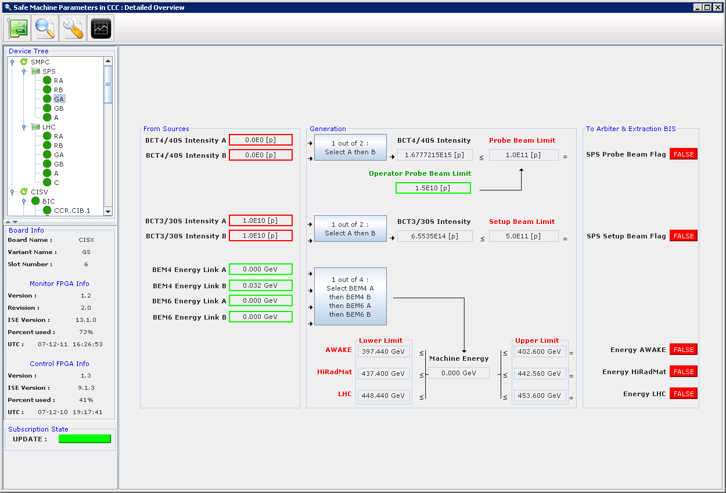
SPS PBF, SBF, ENERGY

Slide 12
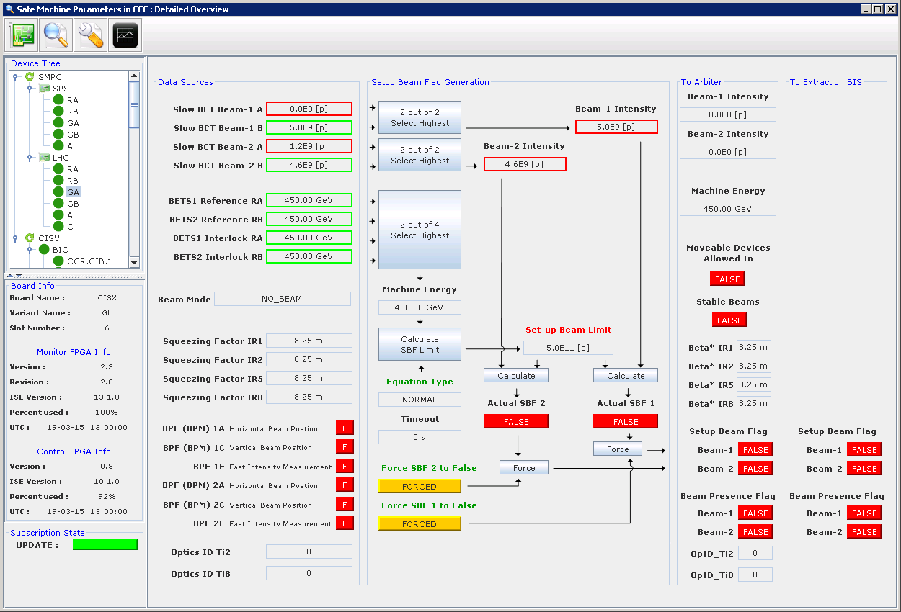
LHC SBF

Slide 13
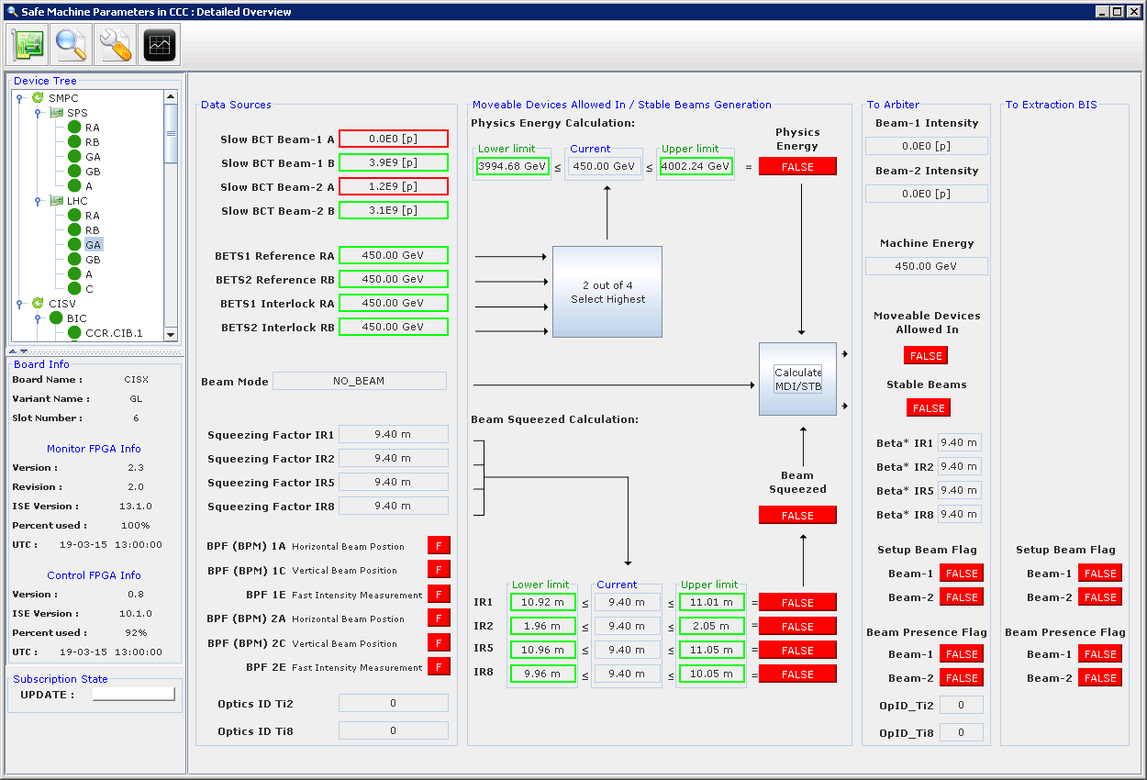
LHC STB & Moveable devices

