Slide 1


ALICE distributed data processing
14 March 2017
Latchezar Betev - ALICE

Slide 2

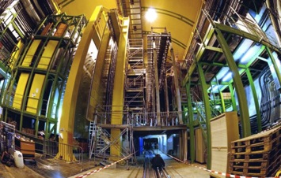
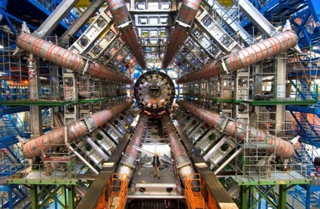
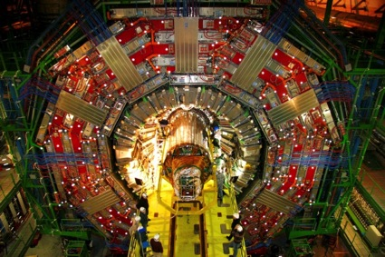
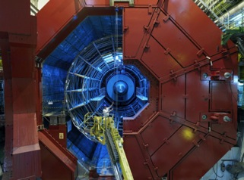
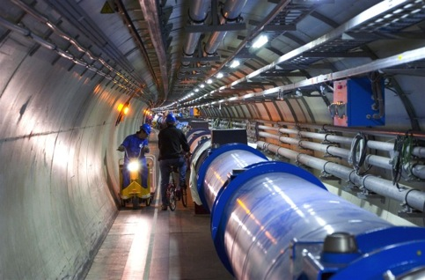

LHC and Experiments
p-p
B-Physics, CP Violation
(matter-antimatter symmetry)
LHCb
CMS
ATLAS
General purpose,
p-p, heavy ions
New physics: Higgs boson, SuperSymmetry
Exploration of a new energy frontier
in p-p and Pb-Pb collisions
ALICE
LHC:
27 km circumference
p-p, heavy ions, p-A
14TeV Center of mass energy
Bunch collision rate 40MHz
CERN: ~10000 scientists
Heavy ions, pp
Quark-Gluon Plasma
(state of matter of early universe)
Notes:
2

Slide 3
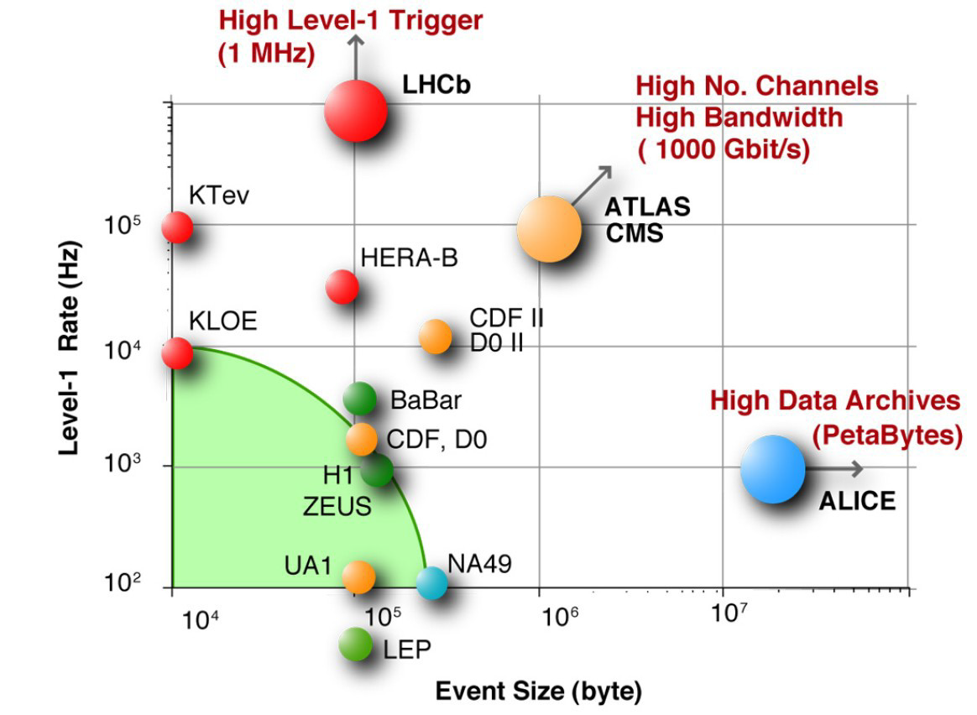
The data challenge in HEP
Today: 1 year of LHC data
Is ~40 PB

Slide 4
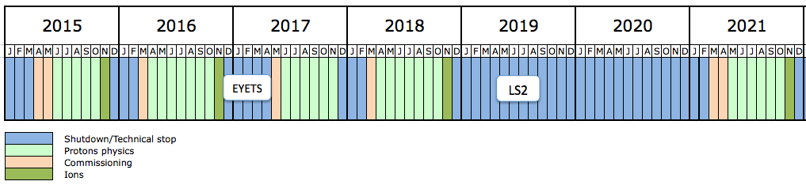
CERN Schedule
4 years
LS1 Run 2 LS2 Run 3
LS2 2019-2020
  Upgrades of ALICE and LHCb
LS3 2024-2026
  Upgrades of ATLAS and CMS (HL-LHC)
ALICE upgrade ready in Spring 2021 – 4 years from now, fits well with the CERN openlab next project phase

Slide 5











Grid projects timeline
MONARC project
CERN
LHC Approval
Hoffmann Review
Computing TDRs
LHC Run 1
Run 2
1994 | 1995 | 1996 | 1997 | 1998 | 1999 | 2000 | 2001 | 2002 | 2003 | 2004 | 2005 | 2006 | 2007 | 2008 | 2009 | 2010 | 2011 | 2012 | 2013 | 2014 | 2015
PPDG+GriPhyN+iVDGL

Slide 6
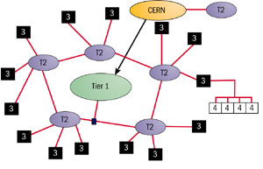
MONARC model (1999)
Models of Networked Analysis at Regional Centres for LHC Experiments
Very specific data paths
Network grows faster than
expected
Tier names remain for
historical reasons
Now the Grid looks like a cloud
CERN - Tier0
Large regional centres - Tier1s
Institute/university centres - Tier2
Smaller centres - Tier3
Red lines – data paths

Slide 7
Grid building blocks (layers)
Network connects Grid resources
Resource layer is the actual grid resources: computers and storage
Middleware provides the tools that enable the network and resources layers to participate in a Grid
Application software scientific/engineering programs running on the Grid + portals and development toolkits to support the applications

Slide 8
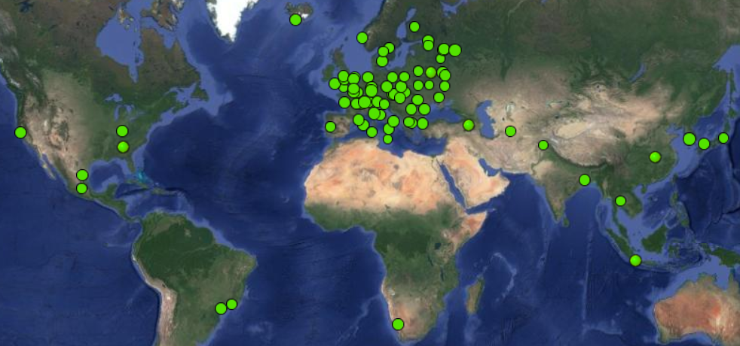
The ALICE Grid sites
56 in Europe
10 in Aisa
3 in North America
1 in Africa
2 in South America

Slide 9
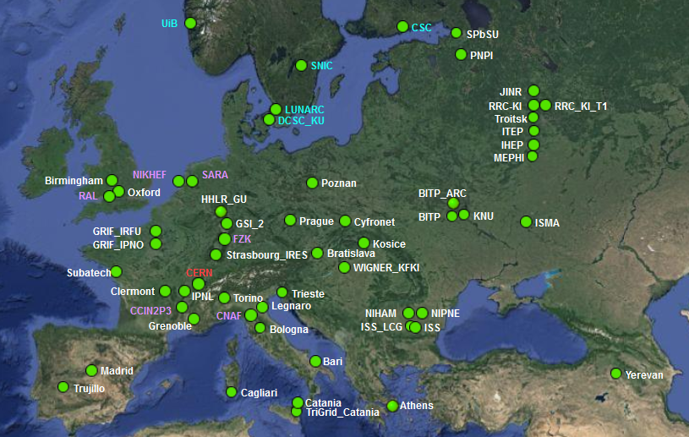
Zoom on Europe

Slide 10
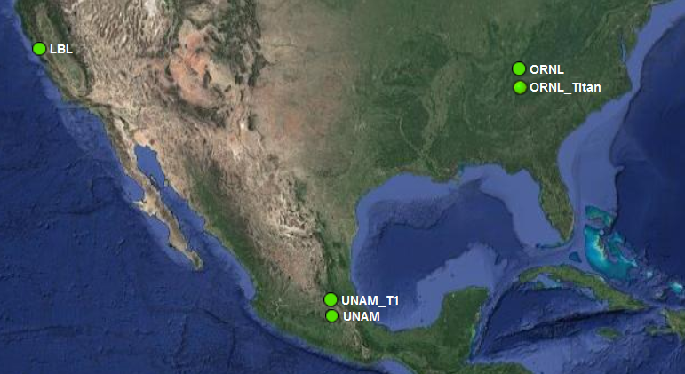
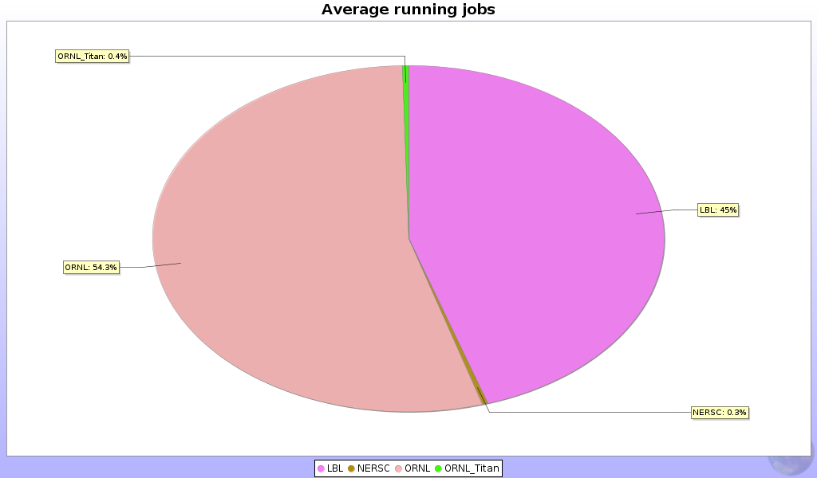
Zoom on North America
US T2s
2017 CPU hours:
680 Mio hours total
US = 7.5%

Slide 11
Use cases - Offline data processing
RAW data collection and distribution
  Unprocessed events from the detectors
Data processing
  Calibration, tracking, simulation (physics and detector)
Analysis objects
  The data containers for physics analysis
Analysis
  The analysis process, resulting in publications

Slide 12
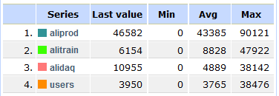
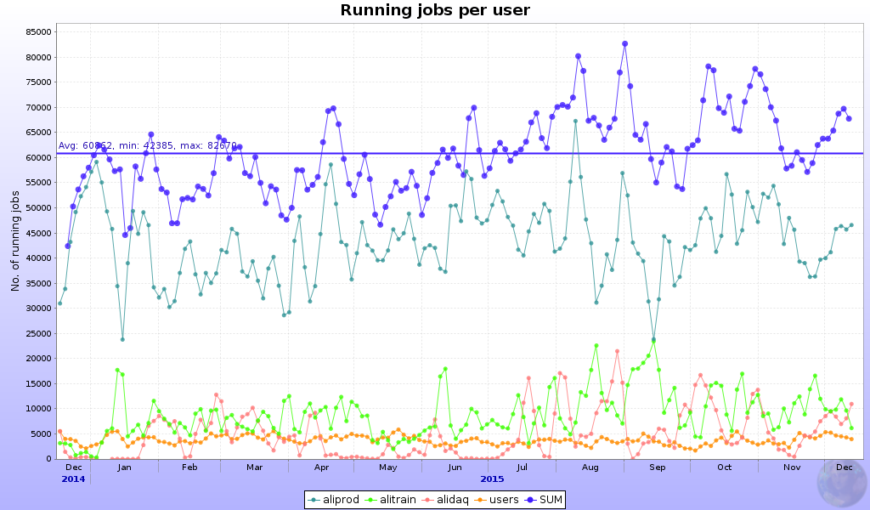
Resources share
71% - MC
14% - Organized analysis
9% - RAW data reconstruction
6% - user analysis

Slide 13
ALICE data model
All ALICE data are annotated in the AliEn catalogue
  Including the location on site SEs
Data files are accessed directly
  Jobs go to the data, in case of local failure reads from closest replica
  User access to data is managed through a shell, which connects to the catalogue and downloads/uploads data to the site SEs
Exclusive use of xrootd protocol
  Also supporting http, ftp, torrent for downloading other input files
  At the end of the job N replicas are uploaded from the job itself (2x ESDs, 2xAODs, 1x logs and other service files)

Slide 14
Computing tasks and workflow
Centrally managed
PWG managed
Individually managed
RAW, MC productions
Organized analysis (trains)
Individual analysis
Priority 1
Priority 3
Priority 2
AliEn Central Task Queue
Computing centre
Computing centre
Computing centre
Computing centre
.....
Computing centre

Slide 15
RAW Data distribution
T1
DAQ/HLT
of the
experiment
RAW data is first collected
at the T0 centre (CERN)
One or two copies are made to
the remote T1s with custodial
storage capabilities
Custodial (MSS) usually means
tape system (but not necessarily!)
The RAW data is irreplaceable,
hence multiple copies
T0
MSS
MSS
T1
MSS

Slide 16
RAW data processing
RAW data is read from the
T0/T1s storage locally and
processed through the
experiment’s applications
These are complex algorithms
for tracking, momentum fitting,
particle identification, etc..
Each event takes from few secs
to minutes to process (depending
on complexity, collision type)
The results are stored for analysis
Processing
(reconstructon)
application
T1
Processing
(reconstructon)
application
T0
MSS
T1
MSS
Processing
(reconstructon)
application
MSS

Slide 17
Monte-Carlo production
Simulation of detector response,
various physics models
Corrections of experimental
results, comparison to theoretical
predictions
MC has little input, output is the
Same type of objects (ESDs/AODs)
Processing time is far greater
Than RAW data processing
MC runs everywhere
Physics gener.+
Transport MC+
Processing
application
T2
Physics gener.+
Transport MC+
Processing
application
T0
T1
Physics gener.+
Transport MC+
Processing
application

Slide 18
Distributed analysis – data aggregation
Physicits
Input data selection
Optimization
Sub-selection 1
Sub-selection 2
Sub-selection n
Grouped by data locality
Job output
Brokering to proper location
Computing centre 1
partial analysis
Executes user code
Computing centre 1
partial analysis
Executes user code
Computing centre n
partial analysis
Executes user code
File merging

Slide 19
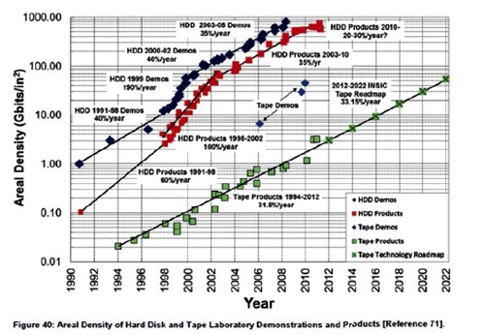
Size and evolution of the Grid
Cores per site vary from hundreds (few) to tens of thousands
  Average site is 1000 cores
~200K CPU cores in the WLCG Grid
Storage capacity per site – hundred of TBs to tens of PBs
In a “Flat budget world” Grid growth is assured by technology advances: Moore’s law (or whatever is left of it) and Kryder’s law (with modifications)
In general, the Grid
resources grow at about
20% per year (Grid’s law)

Slide 20
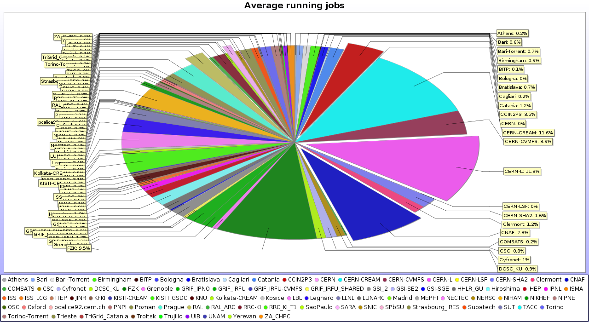
Resources distribution
Remarkably stable 50/50 share between T1s and T2s over 10 years

Slide 21
Central services
AliEn FC
Central catalogue of logical file names (LFN)
With owner:group and unix-style permissions
Size, MD5 of files, metadata
A GUID is associated to each LFN
Multiple physical file names (PFN) can be associated to a LFN
root://<redirector>//<HH>/<hhhhh>/<GUID>
    HH and hhhhh are hashes of the GUID
Task queue
Central queue for all jobs executed on the Grid
Master Jobs are using JDL and submitted to the queue
A service splits the jobs into sub-jobs matching sites capabilities
Job broker assigns jobs to sites
Job traces are kept of each sub- and master job from start to completion
Quotas and priorities are assigned to each user and job
Splitter,
Optimizer,
LDAP,
Authen,
Broker
API services
All running on a set of servers at CERN

Slide 22
GRID node
CPU
3GB/core RAM
10GB/core HDD
MC & analysis
OUT – data
to other centres
Local traffic – one copy of all locally processed data + all analysis jobs I/O
IN – data replicas
from other centres
Disk storage
xrootd managed
1TB/core
OUT – remote WNs data requests (small volumes)
AliEn + Grid services
Batch services

Slide 23
Structure of a T2
VO-box
ALICE-specific software
Public IP address
Incoming and outgoing network connectivity
Batch system
control node
Gateway
EMI standard software
WNs
WNs
Storage nodes
Public IP address
Incoming and outgoing network connectivity
WNs
Storage nodes
Public IP address
Incoming and outgoing network connectivity
WNs
Storage nodes
Public IP address
Incoming and outgoing network connectivity
WNs
WNs

Slide 24
Storage types, protocol and interactions
AliEn catalogue
CASTOR (2)
xrootd (41)
Grid client
xrdcp
EOS (12)
Users
xrd3cp
xrdcp
dCache (3)
RAW data +
replication
File location
Authorization
Replicas
DPM (1)

Slide 25
Contribution - USA
Based on the present contribution to M&O-A
  44 US M&O payers for a total of 615 - 54 (CERN)
  => 7.84%, from October 2016 RRB and based on the requirements document for the CRSG
  2020 either the same as in 2019, or the same as in 2019 and less in 2019 to have a smooth growth, or +20% as compared to 2019 to prepare for RUN3.
Year | CPU KHS06 (cores*) | Disk PB
2017 | 48.8 (3250) | 4.4
2018 | 58.3 (3890) | 5.7
2019 | 89.1 (5940) | 7.1
*assumes
15HS06/core

Slide 26
ALICE O² in a nutshell
Unmodified raw data of all interactions shipped from detector
to online farm in triggerless continuous mode
Requirements
LHC min bias Pb-Pb at 50 kHz
~100 x more data than during Run 1
Physics topics addressed by ALICE upgrade
  Rare processes
  Very small signal over background ratio
  Needs large statistics of reconstructed events
  Triggering techniques very inefficient if not impossible
50 kHz > TPC inherent rate (drift time ~100 µs)
Support for continuous read-out (TPC)
  Detector read-out triggered or continuous
HI run 3.3 TByte/s
Baseline correction and zero suppression
Data volume reduction by zero cluster finder. No event discarded.
Average compression factor 6.6
500 GByte/s
Data volume reduction by online tracking.
Only reconstructed data to data storage.
Average compression factor 5.5
90 GByte/s
New computing system
Read-out the data of all interactions
Compress these data intelligently
by online reconstruction
One common online-offline
computing system: O²
Paradigm shift compared to approach for Run 1 and 2
90 GByte/s
Data Storage: 1 year of compressed data
Bandwidth: Write 90 GB/s Read 20 GB/s
Capacity: 60 PB
20 GByte/s
Tier 0, Tiers 1 and
Analysis Facilities
Asynchronous (few hours) event reconstruction with final calibration

Slide 27
Data flow & processing (1)
Detectors electronics
Trigger and clock
TPC
…
ITS
…
TRD
Detector data samples
synchronized
by heartbeat triggers
Raw data input
FLPs
O(100)
FLPs
Buffering
Local aggregation
QC
First-Level
Processors (FLPs)
Time slicing
Local processing
Sub-Time Frames
Data Reduction 0
e.g. clustering
Calibration 0
on local data,
ie. partial detector
Tagging
Synchronous
Load balancing & dataflow regulation
Frame dispatch
Partially compressed
sub-Time Frames
EPNs
Time Frame building
O(1000)
Full Time Frames
Detector reconstruction
e.g. track finding
Calibration 1
on full detectors
e.g. space charge distortion
Event Processing
Nodes (EPNs)
Global processing
Sub-Time Frames
Time Frames
Compressed Time Frames
AOD
Data Reduction 1
QC
Quality Control
Compressed Time Frames
QC data
Storage
O²/T0/T1
T0/T1
Storage
Archive
CTF
AOD

Slide 28

Data flow & processing (2)
Compressed Time Frames
O²/T0/T1
T0/T1
Sub-Time Frames
Time Frames
Compressed Time Frames
AOD
Storage
Archive
Storage
CTF
AOD
Quality Control
Compressed Time Frames
ESD, AOD
QC data
O(1)
O²/T0/T1
Global
reconstruction
Calibration 2
Reconstruction
passes
and event extraction
Event extraction
Tagging
Asynchronous
CCDB Objects
Condition & Calibration Database
AOD extraction
QC
ESD, AOD
Event Summary Data
Analysis Object Data
O(10)
T2
AOD
Reconstruction
Event building
AOD extraction
QC
Simulation
CTF
Simulation
O(1)
Analysis Facilities
Analysis
Analysis
Storage
AOD
Histograms,
trees

Slide 29
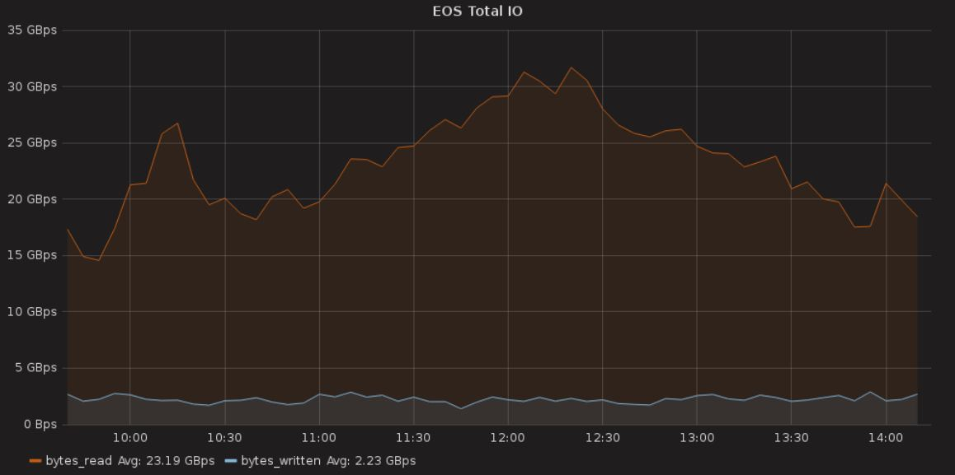
Challenges
Rates to storage – write 90GB/sec , read 20GB/sec out (+ delta)
Capacity – 60PB in a single instance (first year)
High availability – on the critical path for data taking
Complex interactions with various systems – experiment/Grid/analysis
Current experience (borrowed from EOS)
ALICE needs factor 4 in rate in 2021 (reversed)

