Slide 1
Symposium Logistics
Before we start I have some quick logistics to make you aware of…
Shawn McKee for the Organizing Committee

Slide 2
Symposium Logistics: Overview
Meeting overview: Today we started at 1:00 PM and should finish around 5:00 PM. Tomorrow, light breakfast served at 8:15 AM, first session at 9:00 AM and we finish at 5:00 PM.
Coffee and snacks available at the break this afternoon at 15:15 PM and at the two breaks tomorrow (10:00 AM and 2:30 PM)
Lunch tomorrow is on your own
Social dinner tonight (see later slide)
Group photo Friday during the first break (10:00 AM)

Slide 3
Symposium Logistics: Wireless
Networking: Eduroam is available: See http://www.itcom.itd.umich.edu/wireless/eduroam.php
If needed we have guest wireless access: Wireless Network is "MGuest" Connect to network and open a web browser to login as 'guest'. Network speed and allowed ports are limited. Details available at http://www.itcom.itd.umich.edu/wireless/mguest.php

Slide 4
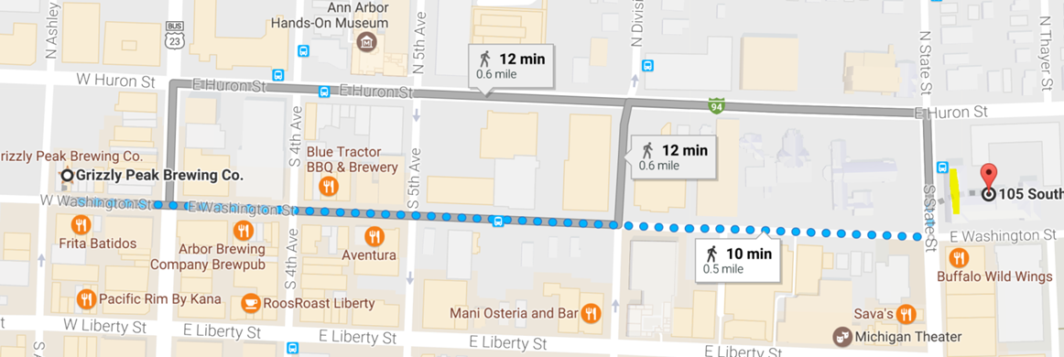
Symposium Logistics: Social Dinner
We have organized a dinner at Grizzly Peak, please join us!
  This is a "self-pay" dinner at Grizzly Peak http://grizzlypeak.net/ at 7 PM.
  Walking directions https://goo.gl/maps/s6Y5aAJ4wyB2

Slide 5
Symposium Logistics: Questions?
  The main meeting Indico page is at https://indico.cern.ch/event/622909/overview
  We are ready to help if you have questions or problems. See the above URL for “Symposium Support” in the bottom left
Questions?

