Slide 1
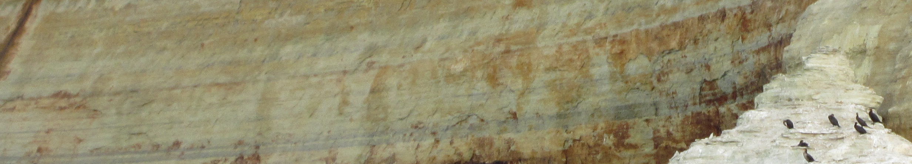








The OSiRIS Project: Collaborative Access to Data
CNSECCS Symposium – May 18, 2017
Open Storage Research Infrastructure
Project Outline rationale general goals Project Components technical goals science users | Future Plans current science domains science domain roadmap technical focus areas Community Benefits technical contributions scientific advancement

Slide 2

Those responsible...
The OSiRIS project engineering is coordinated by University Of Michigan Advanced Research Computing - Technology Services (ARC-TS).
OSiRIS PIs
Shawn McKee Lead PI University of Michigan
Patrick Gossman Co-PI Wayne State University
Kenneth Merz Co-PI Michigan State University
Martin Swany Co-PI Indiana University
OSiRIS Staff
Jayashree Candadai IU Principal Research Engineer
Joseph Cottam IU Research Scientist
Ezra Kissel IU Lead Research Scientist
Jeremy Musser IU Student Engineer
Jeff Goeke-Smith MSU Network Engineer
Xiaoxing (Adele) Han MSU OSiRIS Logo Design
Andy Keen MSU Lead Engineer
Charlie Miller MSU Engineer
Lillian Huang UM Student Engineer (Summer 2016)
Jerome Kinlaw UM Engineer
Dan Kirkland UM Network Engineer
Benjeman Meekhof UM Lead Engineer
Michael Gregorowicz WSU Systems Architect
Matt Lessins WSU Network Engineer
Carlo Musante WSU Network Engineer
Michael Thompson WSU Lead Engineer
‹#›

Slide 3
Rationale for OSiRIS
THE PROBLEM: Storing, managing, transforming, sharing, and copying large research data sets is costly both in terms of dollars and time and impedes research and research collaboration..
OUR SOLUTION: Create an affordable and extensible, high-performance research storage cloud with properties not currently available commercially or in the open-source community. Create OSiRIS -- Open Storage Research InfraStructure.
‹#›

Slide 4
OSiRIS Project Goals
Make data access and sharing easy by creating a new form of data infrastructure with the following properties:
  Direct access to storage across sites, eliminating the need for copy, compute, copy-back workflows.
  Support for block, object and filesystem storage in the same cloud.
  Streamlined data discovery, group management tools and underlying security to augment sharing and collaboration capabilities
  Automated network optimization and monitoring across storage sites to ensure quality of service.
Contain costs - use off the shelf hardware and open source software.
Enable authentication/authorization tools already in use at our campuses
Make it easy to extend/replicate the infrastructure regionally and nationally.
METAGOAL: Enable scientists to collaboratively pursue their research goals without requiring significant infrastructure expertise.
‹#›

Slide 5
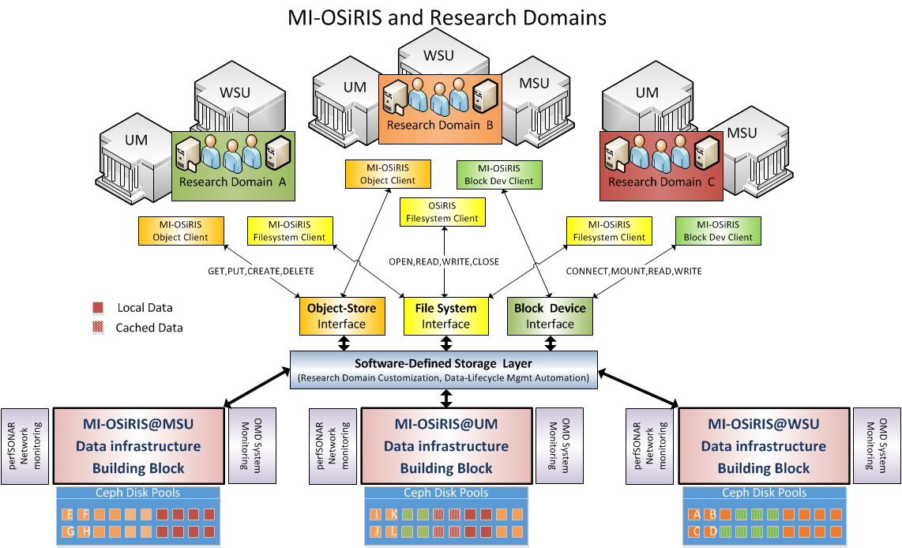
OSiRIS Overview
Logical View of OSiRIS Concept (from our Proposal)
Science
Domains
Multiple
Interfaces
Distributed
Ceph
‹#›

Slide 6
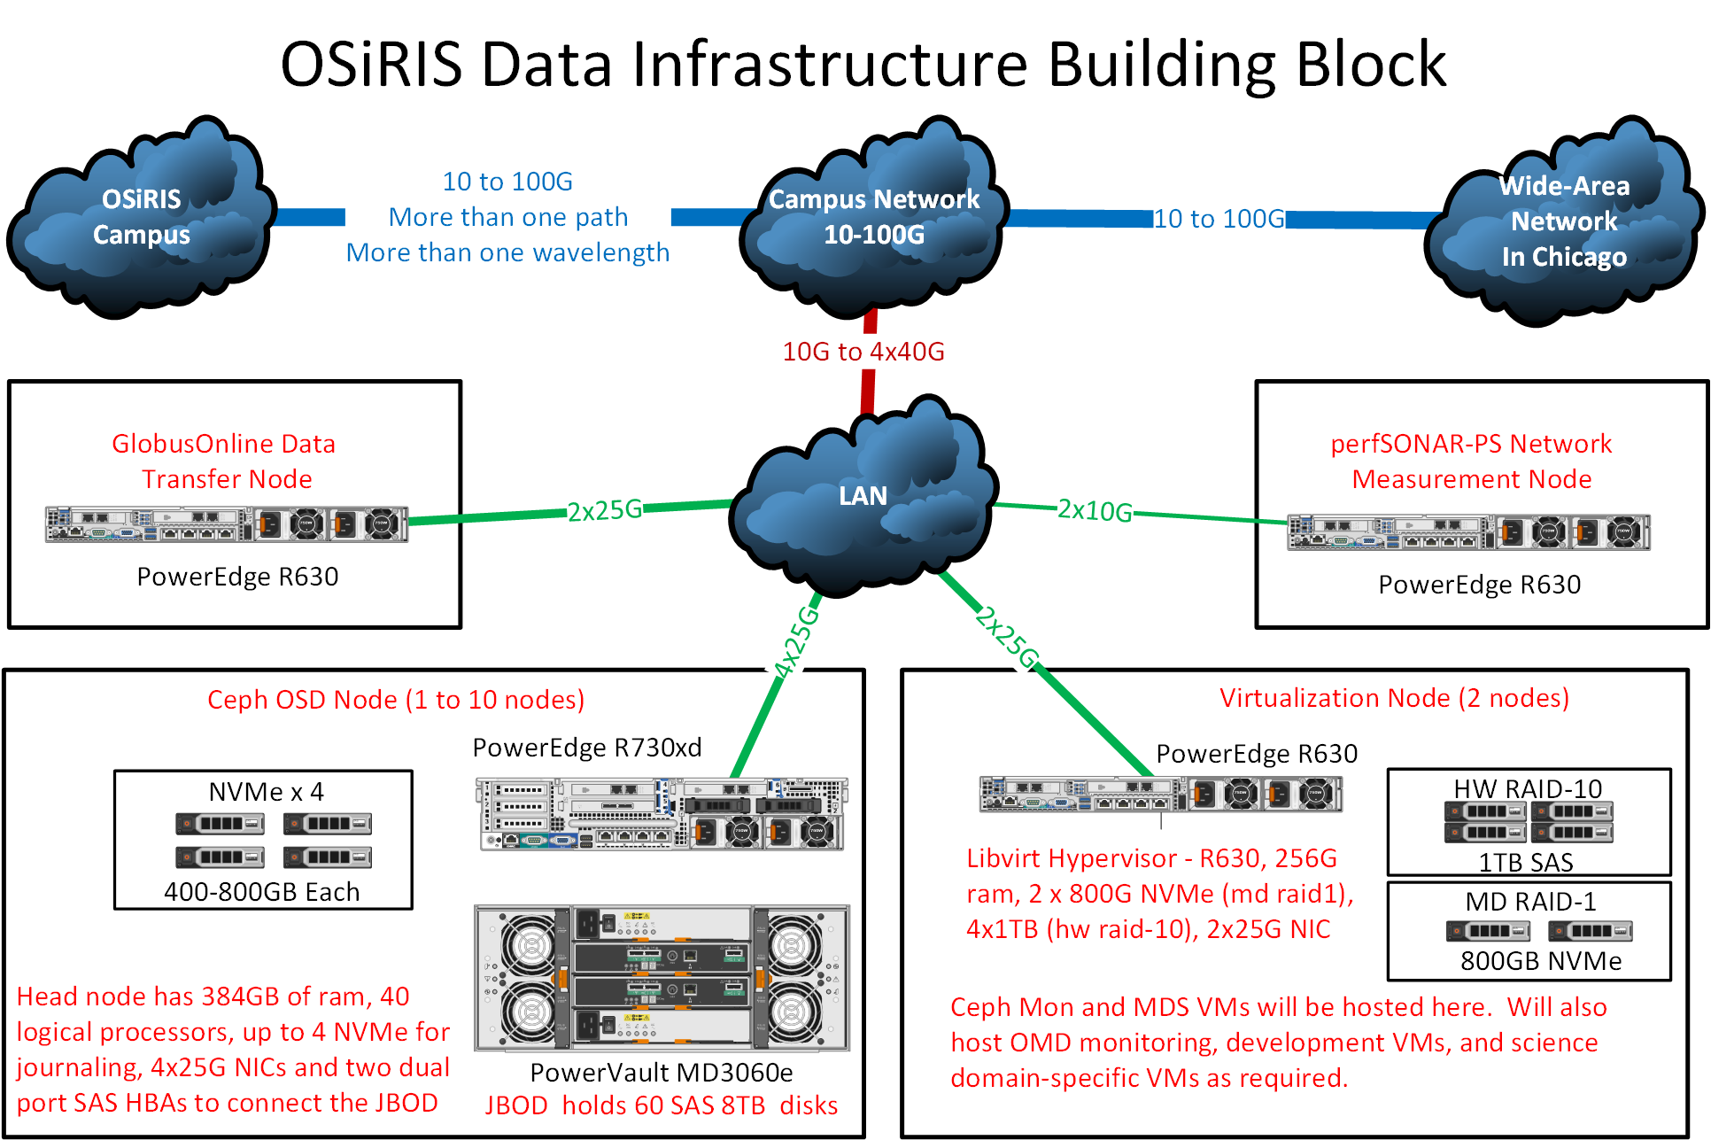
OSiRIS Site View
Example
OSiRIS Site
Michigan State
University
University of
Michigan
Wayne State
University
‹#›

Slide 7
OSiRIS Status and Technical Details
To implement the OSiRIS concepts requires an extensive amount of technical work in many areas
  System provisioning and version control
  Ceph deployment, configuration and tuning
  Network monitoring, measuring and management
  Infrastructure monitoring and management
  Science-user management and interfacing
  Security and science domain organization and authorization
In the slides that follow I provide information about our efforts to-date framed in the context of specific goals, the status of the project, our results from our early adopters and our near and long term plans.
‹#›

Slide 8
Project High Level Technical Goals
Provide templated provisioning for future OSiRIS-like deployments
Tools to build, configure, manage services across diverse sites
Optimizations to use Ceph across WAN deployments with good performance
Documentation of components, services and design choices with examples
Develop OSiRIS Access Assertions (OAA) - Leverage existing institutional credentials via auth federations like InCommon for access to project resources including storage, network information, and other potential services
Develop Network Management Abstraction Layer (NMAL) - Extend perfSONAR/Leverage software defined networking (SDN) tools for efficient and flexible network orchestration
Create tools that others can leverage
Dynamic insight into network topology
Using network topology to efficiently route data
Deploy detailed monitoring and auditing of services for internal troubleshooting, usage analysis, security and science user optimization.
‹#›

Slide 9
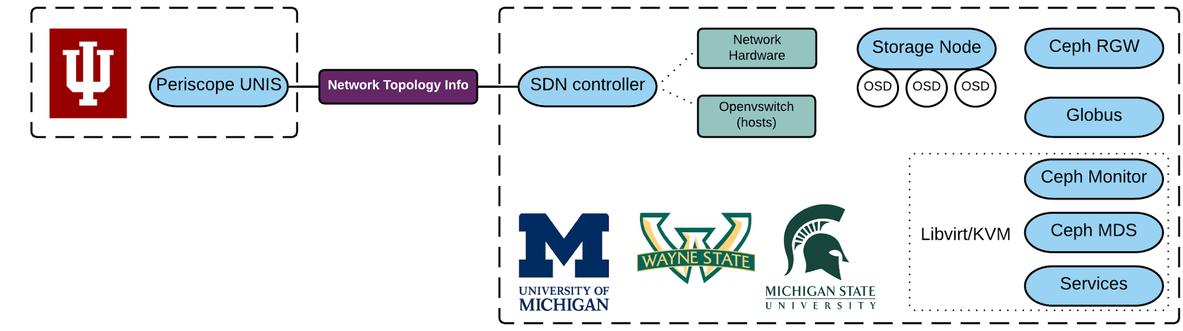
Technical Goals - Ceph Deployment
GOAL: A distributed Ceph deployment as the basis of a storage infrastructure
We implemented a multi-institutional Ceph storage platform reachable via Posix/CephFS mount, S3/Object store interface, and block device map.
Ceph cluster has been operational for more than 1 year
Now: 660 Ceph OSD (Object Storage Daemon; 1/disk), 5.2PB raw storage.
UM - 240 OSD
WSU - 180 OSD
MSU - 240 OSD
‹#›

Slide 10
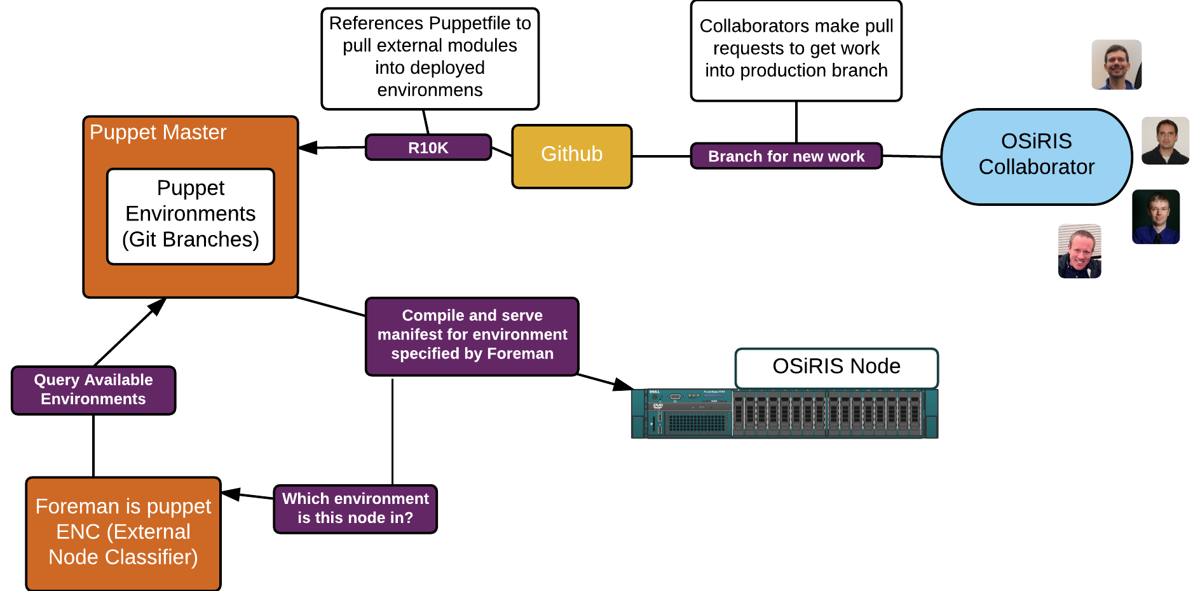
Technical Goals - Service Management
GOAL: Scalable and cooperative management of our deployment
Puppet, Foreman with Git based workflow for project admins
‹#›

Slide 11
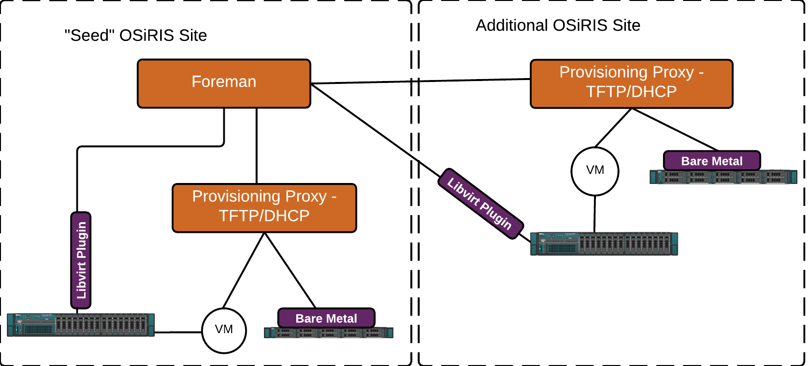
Technical Goals - Site Deployment
GOAL: A framework to consistently seed future OSiRIS sites or manage nodes at non-OSiRIS sites
For non-OSiRIS sites lacking the ‘Provisioning Proxy’ component we can generate independent media to bootstrap them and connect to our management
‹#›

Slide 12
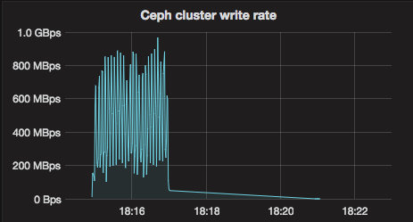
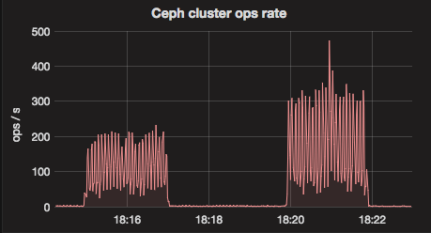
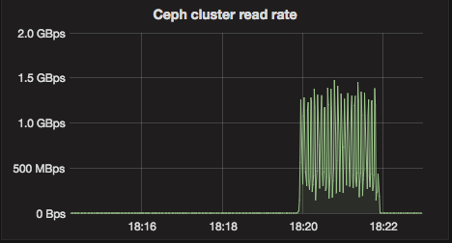
Technical Goals - Performance
GOAL: High performance for our Ceph deployment between participating campuses and for clients outside the project
Results so Far
User experience with Naval ocean model data: “Surprisingly the transfer from your machine to our machine (overseas) was not slower than locally moving the files between machines”
ATLAS S3 Object store testing: “Your system is responding much faster and with fewer errors. I would suggest letting others in USATLAS know of your settings.”
Benchmark rates for on-campus client (min 10Gb to our sites)
‹#›

Slide 13
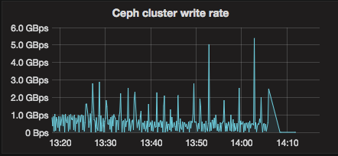
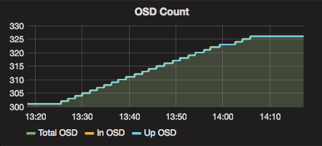
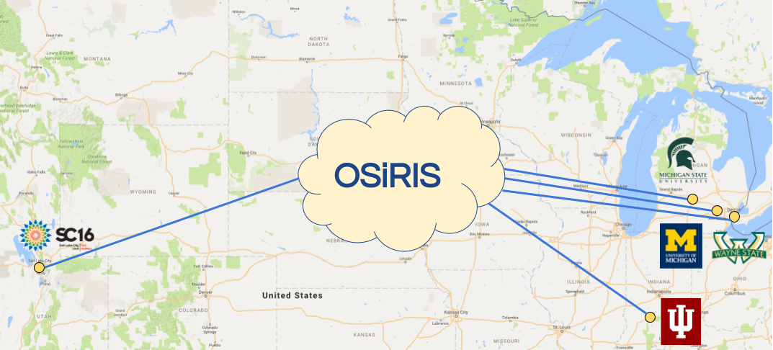
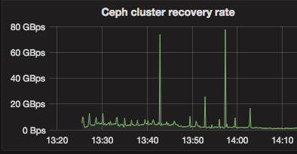
Technical Goals - Understand Geographical Scaling
GOAL: Understand how far can we stretch an OSiRIS deployment. Demo at SC16 augmented existing OSiRIS cluster with new site at Salt Lake City, Utah.
Showed we could scale to ~42 ms RTT with acceptable performance.
As we added OSD in Salt Lake City the cluster was able to maintain good write and ‘backfill’ recovery of data replicas to the new OSD
Peaks are due to aggregate stats from LAN nodes with 100Gb local links
‹#›

Slide 14
Technical Goals - Support Science Domains
GOAL: Capability to easily incorporate new science domain storage
Our automation and provisioning tools make adding storage for new domains straightforward.
We create dedicated data pools for each science domain and enable access to only the relevant pool(s) via access tokens.
  Domains will control the visibility of their domain data (ie, browse directories in CephFS or access objects via S3) via OAA.
  At this phase of the project we are easily able to manage manual administration of tokens but OAA will allow us to remove that burden and scale to larger numbers of self-managed domains and users.
Our S3 object gateways run multiple separate instances of the “Rados Gateway” client
  Each science domain is assigned its own instance(s) allowing us to tune/throttle each to fair-share resources and provide QoS.
‹#›

Slide 15
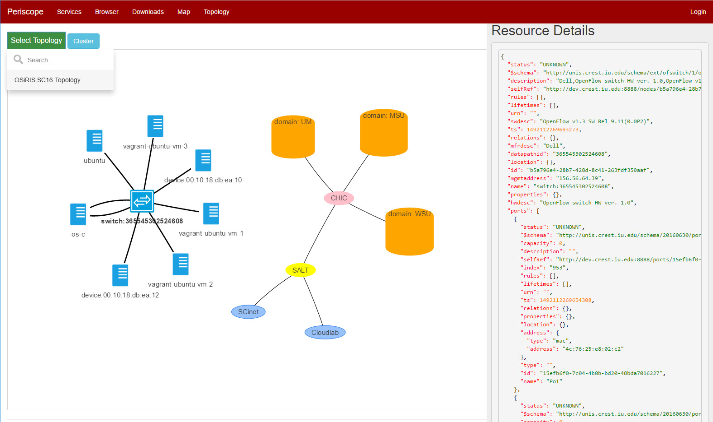
Technical Goals - Topology Discovery
GOAL: Network topology discovery
We have developed a discovery
application integrated with the Ryu
SDN controller
Network resource information
derived from both LLDP and SNMP
We have extended the Periscope/UNIS schemas to support visualization and programmatic use of the topology within NMAL.
Next steps: integrating techniques for capturing inter-site layer-3 topology
‹#›

Slide 16
Technical Goals - SDN
GOAL: Software Defined Networking (SDN) component control
While our initial networking focus has been on understanding the topology and load within our networks, we are targeting the ability to orchestrate our network components to meet the needs of our OSiRIS users
We completed initial testing to ensure OpenFlow configuration works as expected across OSiRIS switching hardware and Open vSwitch instances
A Ryu library has been developed to inspect and modify OpenFlow device configuration, both programmatically and via a command line interface
Next steps: integrate Ryu library with our UNIS runtime (UNIS-RT) to effect dynamic topology changes based on observed network state.
Long term goal: The ability to orchestrate the use of all available network paths to simultaneously satisfy the requirements of multiple science domains and optimize the overall performance of the infrastructure
‹#›

Slide 17
Technical Goals - Identity
GOAL: Utilize federated campus identities to access OSiRIS and enable fine grained access control for services and resources.
Developed OSiRIS Access Assertions (OAA) -- SAML compliant middleware to enable secure federated access to Ceph storage as well as secure access for network management
NSF’s Center for Trusted Scientific Cyberinfrastructure (CTSC) was engaged early in the OAA development process (July 2016)
  CTSC strongly influenced the design of OAA
  CTSC review of the completed software very positive
  CTSC report published March 31, 2017 (review packet has a copy)
OAA software published as open source and is expected to have much broader use than just with OSiRIS
User interfaces and OSiRIS integration now in development
‹#›

Slide 18
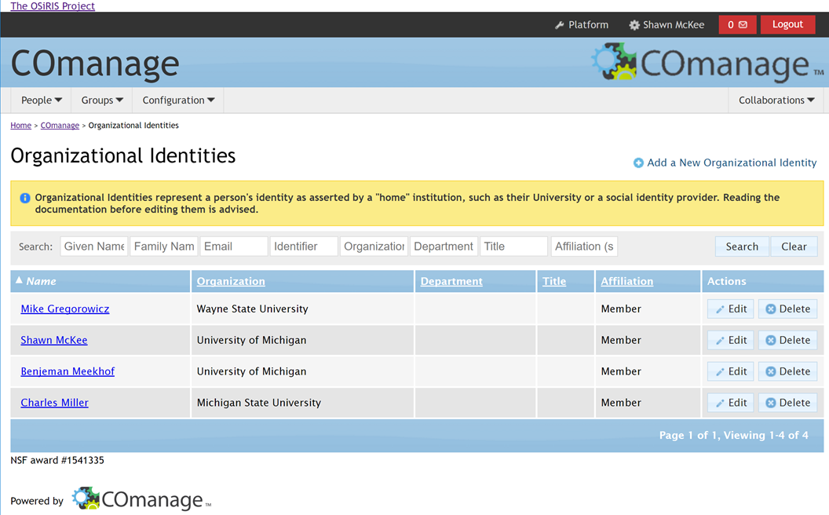
Technical Goals - Self Management
GOAL: Science domains must be able to self-organize their own users and groups for Authentication, Authorization, Accounting (AAA) to Ceph and to network components
NSF’s CoManage envisioned as the main interface to Ceph
Multi-Master LDAP deployed March 2017 for CoManage/OAA framework
User interfaces now under development
‹#›

Slide 19
Technical Goals: Securing OSiRIS Infrastructure
GOAL: Securing and hardening OSiRIS infrastructure.
All operating system installs use SELinux in enforcing mode.
We install fail2ban (www.fail2ban.org) which blocks brute force attackers.
Network ACLs in place to isolate backend network access
  Backend network is for Ceph and administration use
We only allow ssh login on the backend network except for site admin VMs (e.g., um-admin01).
All logs are sent to a distributed central syslog using the ELK stack for monitoring and analysis.
‹#›

Slide 20
Technical Goals - Monitoring
GOAL: Monitor and visualize OSiRIS storage, network, and related services.
Multi-faceted approach to monitor status, logs, and metrics. You can’t manage what you can’t see! We currently have deployed:
Check_mk monitors host and service status
Collectd/Influx/Grafana gather a variety of time-series data - network bytes/errors, Ceph service/cluster stats, host resources, etc
Filebeat/Logstash/Elasticsearch ships, parses/normalizes logs, and indexes them for searching
Monitoring is an area that will evolve with the project. We anticipate adding new sources of monitoring data as well as improving our ability to benefit from our existing monitoring through targeted analytics.
‹#›

Slide 21
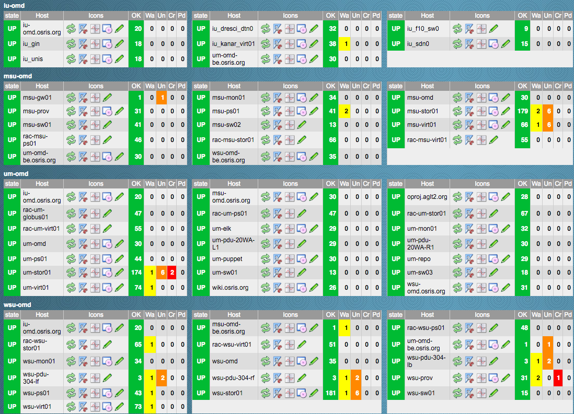
Check_mk Monitoring Services
Check_mk gives us a detailed overview of hosts and services
Alerts sent when hosts or services not reachable, services cross thresholds (high CPU, too much disk, etc).
Alerts configurable by rules to alert groups depending on resource classifications
Email or other alerts (we get them in Slack for example)
‹#›

Slide 22
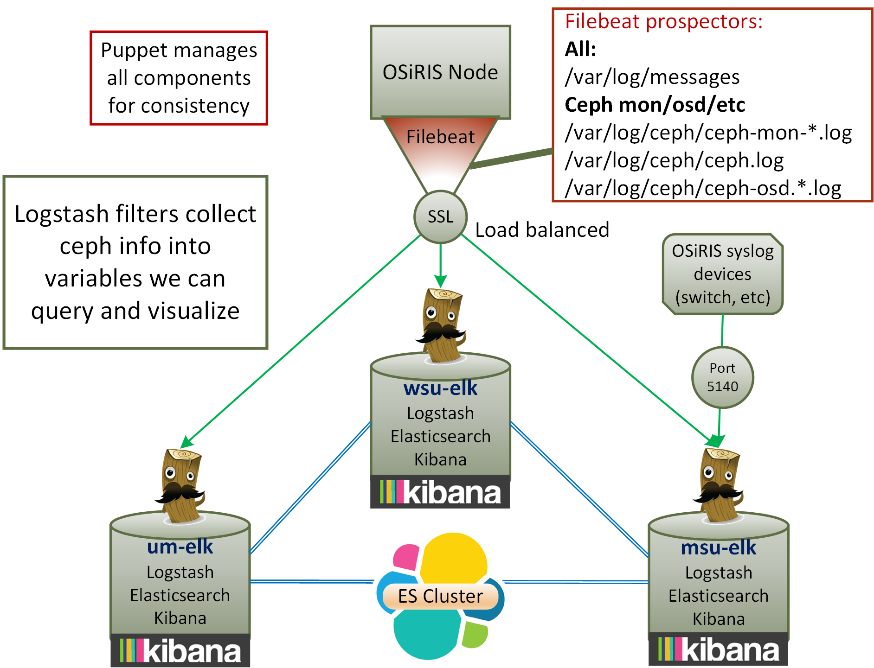
ELK for Monitoring Logging Data
System and service specific logs are shipped to an elasticsearch cluster at UM, WSU, MSU.
Logstash pipeline lets us filter out specific strings later usable as time-series data for Grafana to visualize usage data from logs
Kibana web gui provides flexible text searching and sorting for problem diagnosis
‹#›

Slide 23
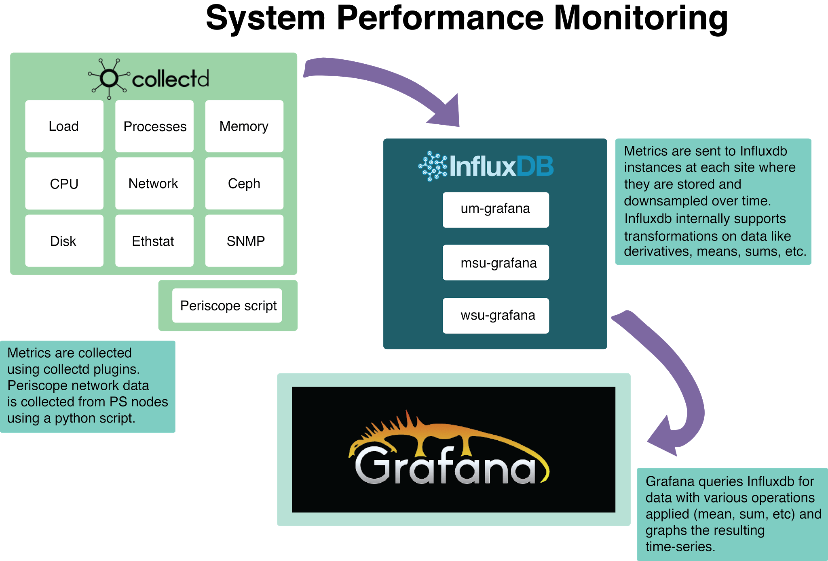
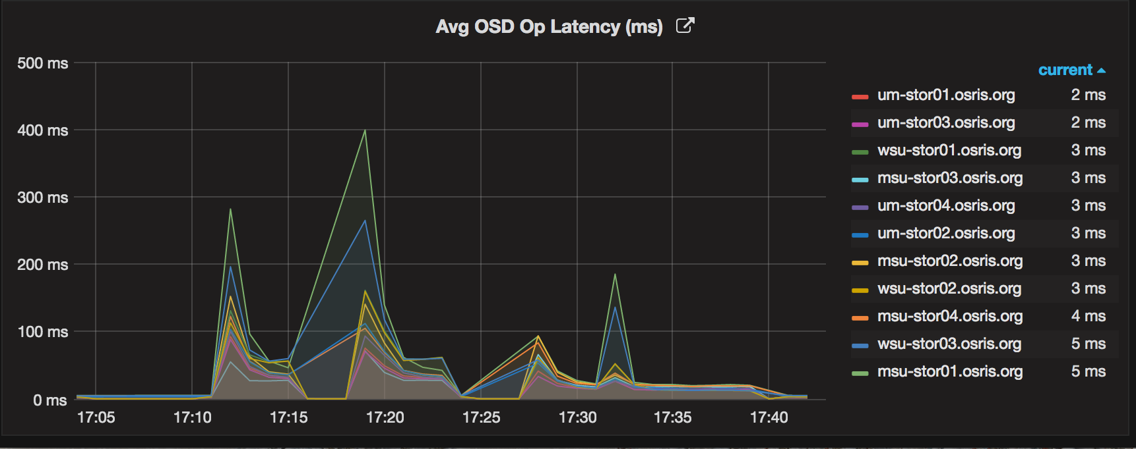
Collectd/Grafana: Monitoring System Performance
Sample: OSD op latency average for storage blocks from collectd-ceph
‹#›

Slide 24
OSiRIS Science Domain Engagement
So far we have covered the technical work to enable OSiRIS. What is important is how all this enables us to support and expedite scientific research.
We have already begun engaging with two of our science domains to find out: physical ocean modeling and high-energy physics
These two were selected as early adopter communities for OSiRIS because:
Both were willing to work collaboratively with the OSiRIS team to test and develop an initial storage infrastructure, understanding things might not start out at “production quality”
Both had near-term needs for the capabilities OSiRIS was targeting
Both were interested in use of “Object-store” capabilities
These two domains have helped us better understand the challenges and requirements needed to effectively support diverse science users.
‹#›

Slide 25
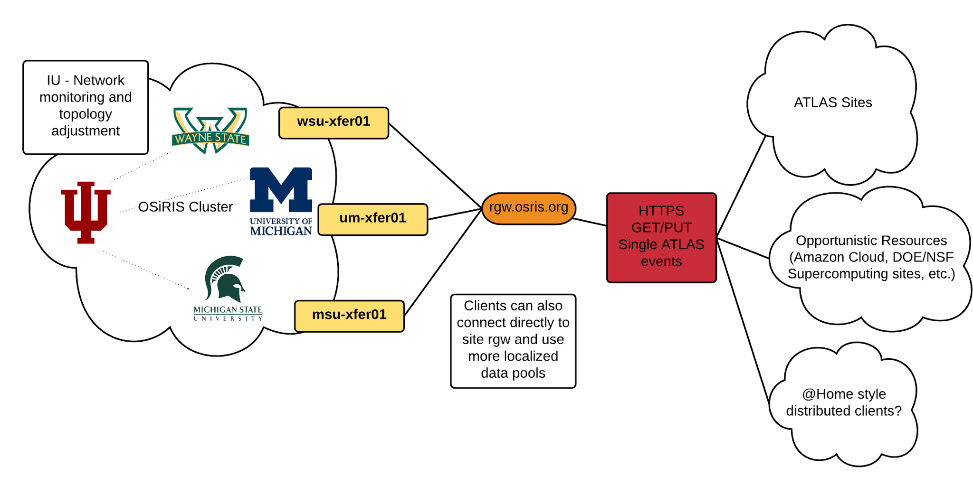
Science Domain - ATLAS
What is the ATLAS use case for OSiRIS? ATLAS seeks to leverage commodity S3-style object storage such as OSiRIS. Our engagement includes providing assistance optimizing job pilots to efficiently access this type of storage.
OSiRIS event service gateways for ATLAS are balanced across 3 sites or optionally clients can target a specific OSiRIS gateway site
‹#›

Slide 26
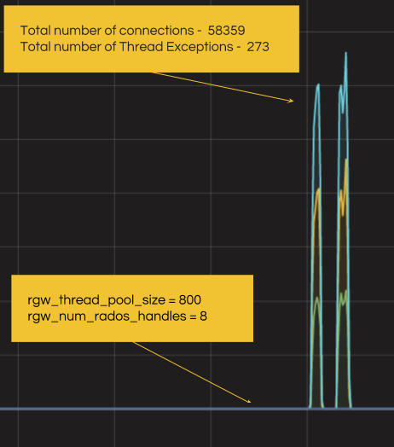
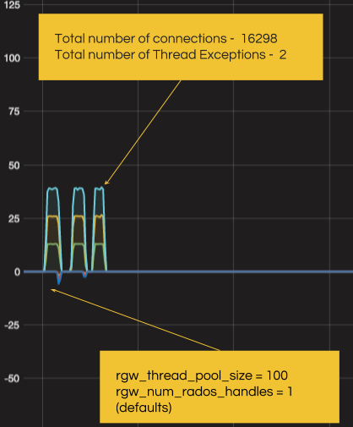
Science Domain - ATLAS
So far our testing with ATLAS grid clients has resulted in improved tunings for the Ceph Rados Gateway (S3 provider) allowing an instance to process more simultaneous client ops.
40 requests / second
150 requests / second
‹#›

Slide 27
Next Steps - ATLAS
ATLAS wants to work closely with people who know about object stores.
ATLAS is especially interested in monitoring and visibility into how the object stores behave. We have a lot of expertise here
ATLAS is providing two people to drive the ATLAS use-cases for object stores but they want experts on the other end to work with
At a meeting at CERN with the ATLAS distributed data management team they specifically requested help from OSiRIS in the areas of monitoring and optimization of object stores.
We participate in collab email list atlas-comp-event-service@cern.ch
Join bi-weekly meetings of ATLAS event service and object store experts
GOAL: Have OSiRIS as a “production” ATLAS event store by Fall 2017
‹#›

Slide 28
Science Domain - Physical Ocean Modeling
US Navy transferred HYCOM tides data to OSiRIS to enable wider scientific collaboration. Storage is on CephFS posix filesystem accessible via direct mount or our general transfer gateways providing scp, FDT, and Globus.
Current users:
Karlsruhe Institute of Technology (Germany) - Project: Temporal variation of tidal parameters. Funded by DFG.
University of Michigan, collaboration with Navy (Arbic)
University of Washington, collaboration with Navy
SRI International (Ann Arbor, does work for ONR)
‹#›

Slide 29
Next Steps - Physical Ocean Modeling
We will move this domain to self-managed OSiRIS Access Assertion system when fully implemented later this year.
Allows this community to define and manage their own membership
Coming next: Improving the ability to work directly with their data. We will work with them to enable direct mount of OSiRIS storage from relevant clusters instead of using transfer gateways to move data in/out of OSiRIS
They have more users wanting to collaborate on existing data as well as plans to move significantly more data into OSiRIS (~100s of TB)
Longer-term we are discussing using S3 (object) storage as an indexed data retrieval method…the object namespace could reference objects by data resolution, time, location and/or type.
‹#›

Slide 30
Science Domain Roadmap
OSiRIS has a roadmap of science domain engagements planned beyond High-energy physics and High-Resolution Ocean Modeling.
As discussed in our proposal we will be engaging a diverse set of science “customers” who indicated their timelines for joining OSiRIS at our kick-off meeting in September 2015:
Aquatic Bio-Geochemistry (year-2)
Biosocial methods and Population Studies (year-2)
Neuro-degenerative Diseases (year-3)
Bioinformatics (year-4)
Genomics (year-4)
Statistical Genetics (year-4)
Additional recruited science domains (years 2-5)
Since the proposal we have been contacted by Faculty from Biomedical Engineering and Mechanical Engineering (focus on turbulence and multiphase flows) asking to join OSiRIS and we intend to incorporate them as we have the effort available.
‹#›

Slide 31
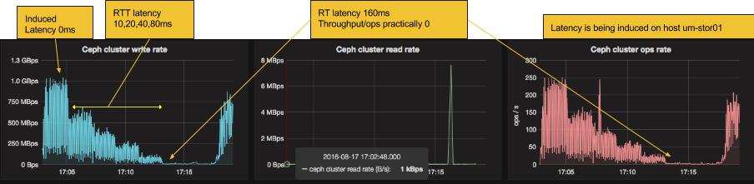
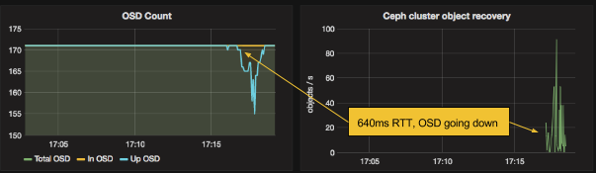
Technical Contributions – Ceph Latency Tests
Project Goal: Understand the WAN-related limitations of Ceph; how far can we “stretch” a single Ceph cluster in terms of latency and what are the latency-related impacts?
Using ‘netem’ we simulated degrees of latency to a single storage block to quantify the effect on cluster throughput and ops capability: http://www.osris.org/performance/latency
Answer: Unusable at 160 ms, recovers at 80 ms Our guess is 80 ms is a practical limit
Results verified in real situation at SC16: http://www.osris.org/article/2016/11/15/provisioning-osiris-at-sc16
‹#›

Slide 32
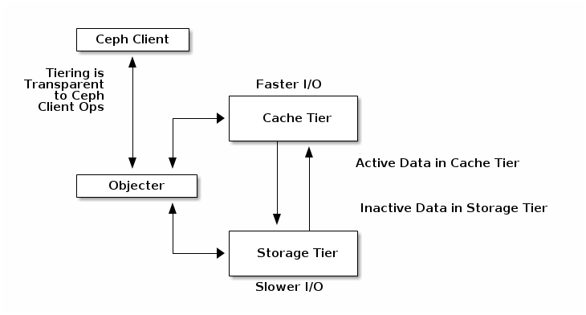
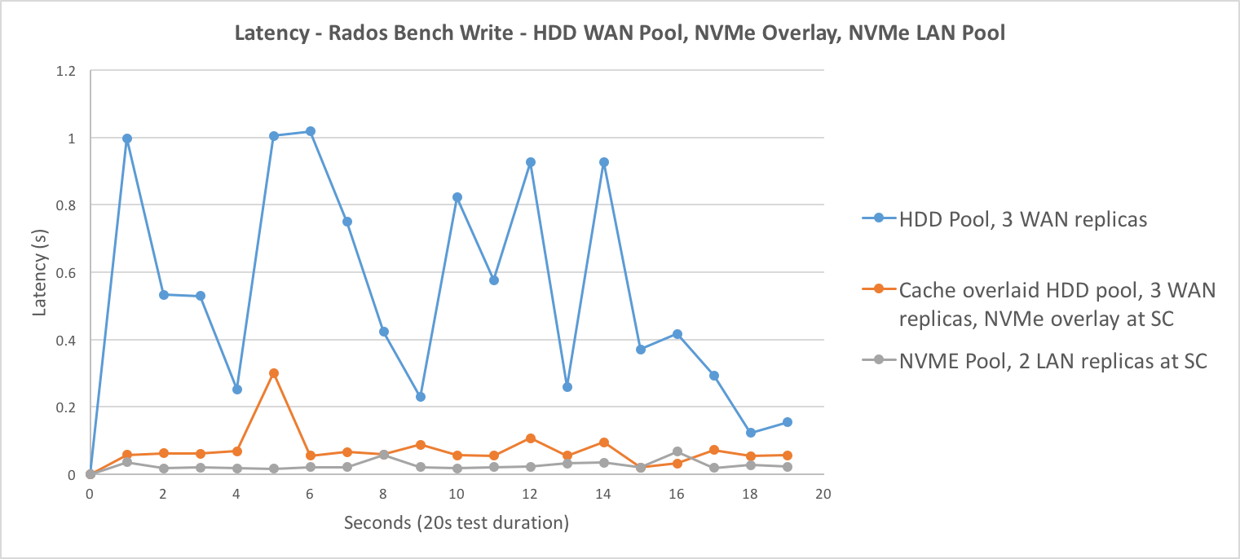
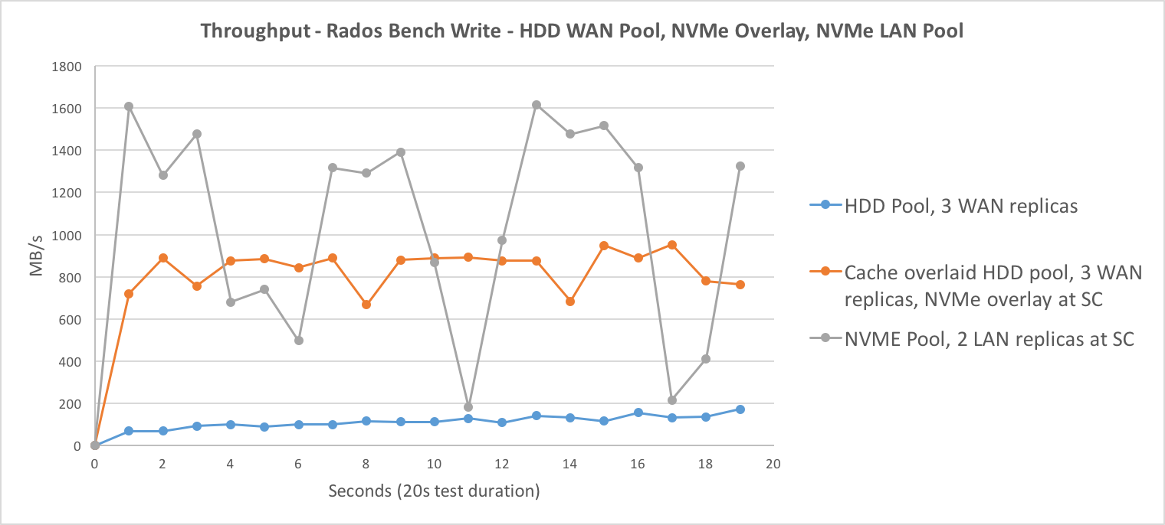
Technical Contributions – Ceph Cache Testing
Project Goal: Explore Ceph’s caching capabilities to increase performance on a regional basis for science domains
Ceph Cache tiers can be ‘overlaid’ on top of distributed data pools so writes and some reads are redirected to storage elements closer to the users needing the data most
Our tests found it can improve both latency and throughput for users near the cache
Lower latency, similar to site-local pool
Higher throughput than distributed pool
http://www.osris.org/article/2016/11/16/ceph-cache-tiering-with-liqid-nvme-at-sc16
‹#›

Slide 33
Technical Focus - next year
Complete implementation of OSiRIS Access Assertions
Integration with Ceph services
Provisioning flow from Comanage sign-in with InCommon federation
Self-management procedures for scientific users; possibly integration of Grouper: http://www.internet2.edu/products-services/trust-identity/grouper/
Develop client bundle for CephFS Posix mounts
Integrates with OAA credentials obtained via InCommon sign-in
Packages OSiRIS Ceph configuration and client software
Handles POSIX UID mapping
Very likely to be a container-based release, Docker or Singularity
‹#›

Slide 34
Technical Focus - next year
Initial implementation of NMAL components into “production”
Self-adjusting conflict-free test meshes as new sites are added or existing site configurations are modified
NMAL components integrated within OAA architecture to provide access restrictions
All SDN resources enabled, discovered, and managed
Enable initial science domain onboarding automation process
CoManage self-registration flow with institutional credentials
OAA Resource self-provisioning (Ceph data pools, client access keys, etc)
‹#›

Slide 35
Technical Focus - long term
Highlights of our longer term goals for the remaining years of the OSiRIS project
Network orchestration - OSiRIS intends to discover and control the networks between OSiRIS resources and science users
  This enables us to avoid network use conflict, steering traffic on distinct paths
  We intend to shape traffic to optimize QoS for our users.
Data Lifecycle Management - Working with our institutional library and information science colleagues we intend to automate the collection of suitable science-domain specific meta-data
  The goal is to enrich the data being stored in OSiRIS, making it both discoverable and better managed
Project Whitepaper (How to Create your Own OSiRIS Deployment)
  Details of how to replicate OSiRIS with tuning and deployment considerations and options explained
‹#›

Slide 36
Conclusion and Post-Project
OSiRIS is a 5-year project to develop and validate the concept of “multi-institutional, computable storage”. We anticipate a significant number of benefits.
Scientists get customized, optimized data interfaces for their multi-institutional data needs.
Network topology and perfSONAR-based monitoring components ensure the distributed system can optimize its use of the network for performance, conflict avoidance and resiliency.
Ceph provides seamless rebalancing and expansion of the storage.
A single, scalable infrastructure is much easier to build and maintain.
  Allows institutions to reduce cost via economies-of–scale while better meeting the research needs of their campus.
Eliminates isolated science data silos on campus:
  Data sharing, archiving, security and life-cycle management are feasible to implement and maintain with a single distributed service.
  Configuration for each research domain can be optimized for performance and resiliency.
We have agreements from each of our institutions that they will continue to maintain and evolve their components of the infrastructure at the end of the project, assuming there are institutional science users benefiting from OSiRIS. Our goal is to benefit as many science domains as possible!
‹#›

Slide 37
Questions / Discussion ?
We have covered a lot of technical detail and explored OSiRIS from a high-level in this presentation.
Questions or comments?
‹#›

Slide 38
Resources
OSiRIS Website:
http://www.osris.org
OSiRIS Internal Wiki (InCommon sign in and authorization required, contact us):
https://wiki.osris.org
OSiRIS Github Organization:
https://github.com/MI-OSiRIS/
Periscope-PS Github Organization
https://github.com/periscope-ps
Performance monitoring dashboards (read-only, public: kopakibana/OSiRIS#2):
https://grafana.osris.org
Status monitoring dashboards (read-only, public: OSiRIS-guest/Guest)
http://um-omd.osris.org/OSiRIS
‹#›

Slide 39
Anticipated Project Challenges
OSiRIS dynamic SYSTEM optimization to maintain a sufficient quality of service for all stakeholders.
Infrastructure management capable of delivering a production system on research infrastructure.
Enabling and automating the gathering and use of metadata to support data lifecycle management.
Research domain customization toolkit using Ceph API and/or additional services.
Network visibility and control using NMAL tools.
Management of quotas and ACLs with Ceph and OSiRIS.
Authorization which transparently integrates with each campuses existing systems as well as all OSiRIS services and components.
‹#›

