Slide 1
Injection from booster to collider rings
Schemes, specifications and discussions
Masamitsu Aiba, PSI
03.05.2017
FCC-ee injector meeting

Slide 2
Contents
Summary from previous studies
Conventional injection scheme
Multipole kicker injection
(Tentative) Specifications
Discussion for filling patterns
(Booster and Collider)
Summary

Slide 3
Summary from previous studies
Requirement/Assumption for top-up injection
  Similar emittance in booster and collider (1.3 nm @ 175 GeV)
  ~1.5 km straight section available in collider
  5 sigma clearance for high injection efficiency
  (Limited) dynamic aperture: ~15 sigma for on-energy, 5 sigma up to +/- 2% off-energy
  Septum
    Blade thickness of 5 mm (3 mm + mechanical margin)
    Wire septum of 0.2 mm (~20 um + mechanical margin)
Two viable injection schemes found, but with some “weak points”
  Conventional injection scheme (on-energy/off-energy)
    Both on- and off-energy injection require a wire septum unless beta function at the septum is enhanced to >1 km
    Beam disturbance (coherent betatron oscillation) due to a bump leakage in practice
  Multipole kicker injection (on-energy/off-energy)
    Nonlinear kicker is essential to avoid strong injection beam mismatch
    Unavoidable emittance growth up to 30% due to the limited dynamic aperture or (normalised) dispersion

Slide 4
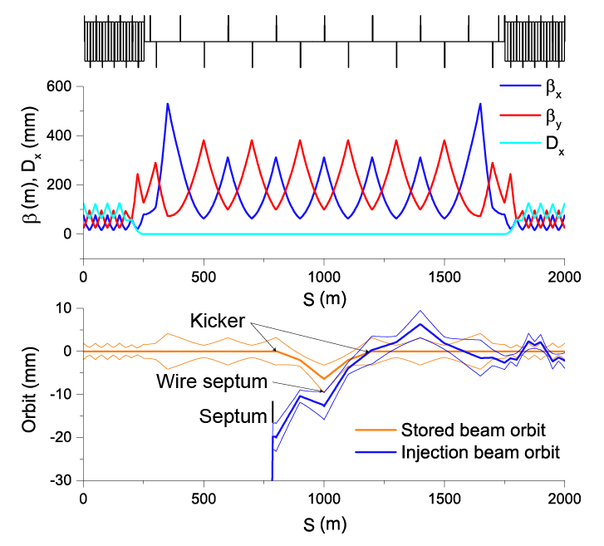
Conventional injection (1)
Optics and orbits for on-energy
injection with wire septum
Required dynamic aperture

Slide 5
Conventional injection (2)
Reconsideration of magnetic septum assumptions
  Present assumption: 3 mm blade (5 mm septum thickness with margin)
    To achieve strong enough (~0.5 T) field to inflect the injection beam
    The blade should be thick enough to suppress stray field
  Thinner septum?
    Field of ~0.1 T is enough since a very long straight section is available (Also a large ring beta, >100m, helps for 90 deg. upstream thick/DC septum)
    Allow (some) stray field but compensate for by other means rather than by thick blade
    With a lower field and a less stringent stray field criterion, the thickness can be thinner
  Possible revised assumption: 1.5 mm including mechanical margin
    Easy for conventional injection scheme (e.g. no wire septum and easy-handling beta)

Slide 6
Conventional injection (3)
“Compensation septum” (or “Dummy septum”)
  Put another septum to compensate for the stray field disturbance
  2π injection orbit bump with Compensation and Injection septa at the peak of bump with a π phase advance in-between
  Stray field generate a closed π bump → No bump leakage in principle when the two septa are identical
  Note that orbit bumpers and septa do not necessarily have same pulse duration/shape
Compensation septum
Orbit bumper
Orbit bumper
Injection orbit bump
Orbit bump
due to stray field
(added to injection bump)
Injection beam
Injection septum

Slide 7
Conventional injection (4)
Optics and orbits for on-energy
injection with thin septum and compensation septum
Kicker
Compensation septum
Thick septum
(Can be DC magnet)
Injection septum (1.5 mm)
Integrated field = 0.1 Tm

Slide 8
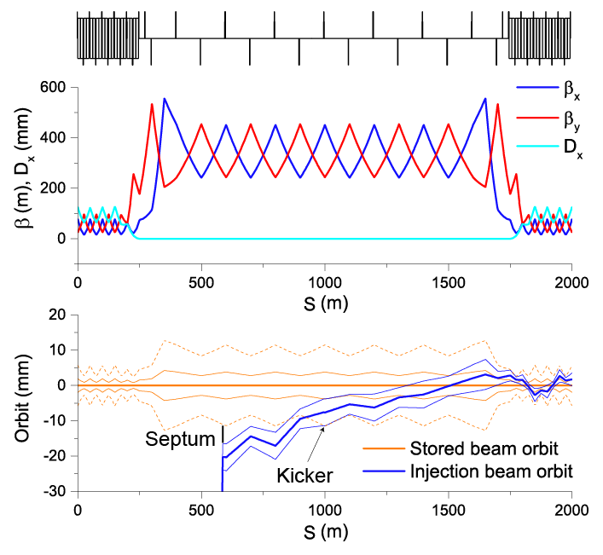
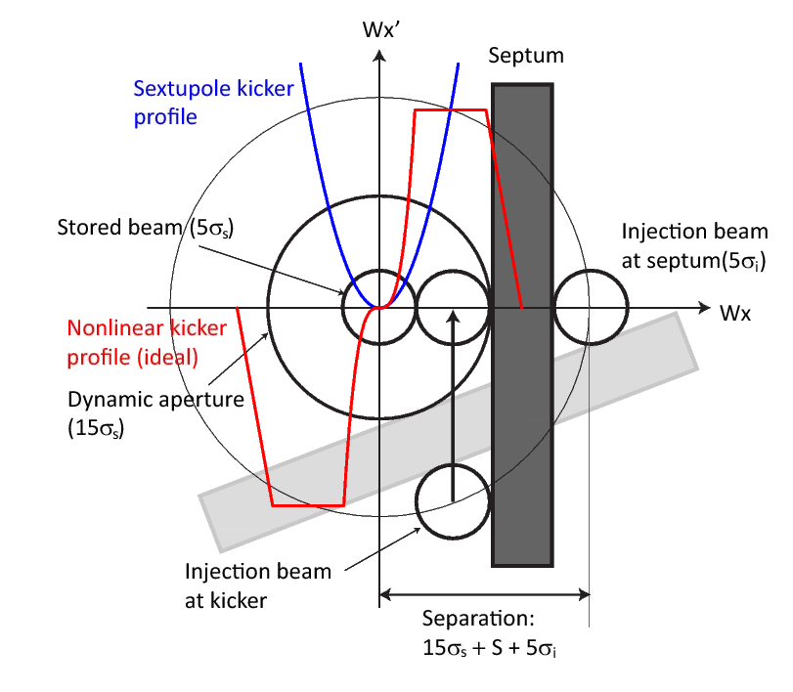
Multipole kicker injection (1)
Optics and orbits for on-energy
injection with septum (5 mm)
How the beams are “packed”
in the phase space…

Slide 9
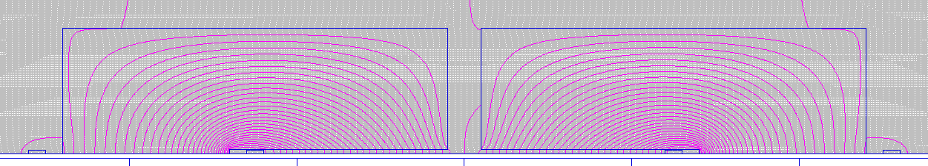
Multipole kicker injection (2)
Similar approach to “Compensation septum”
  Compensate for the emittance growth by another kicker, “Compensation kicker”
  With π phase advance between two kickers, the disturbance to the beam is to be compensated for (up to any high multipole)
  Sextupole-like nonlinear kicker:
Field profile expected for on-energy inj.
(Poisson computation for static field)
Two C-shape kickers
+
Dipole kicker to cancel
the dipole component at the centre
I=160 A for 4 mm full gap
With dipole kicker attached
Residual dipole kick is also compensated
when two kickers are identical
Can be Quad+Octupole kicker if we accept
“beta function bump”

Slide 10
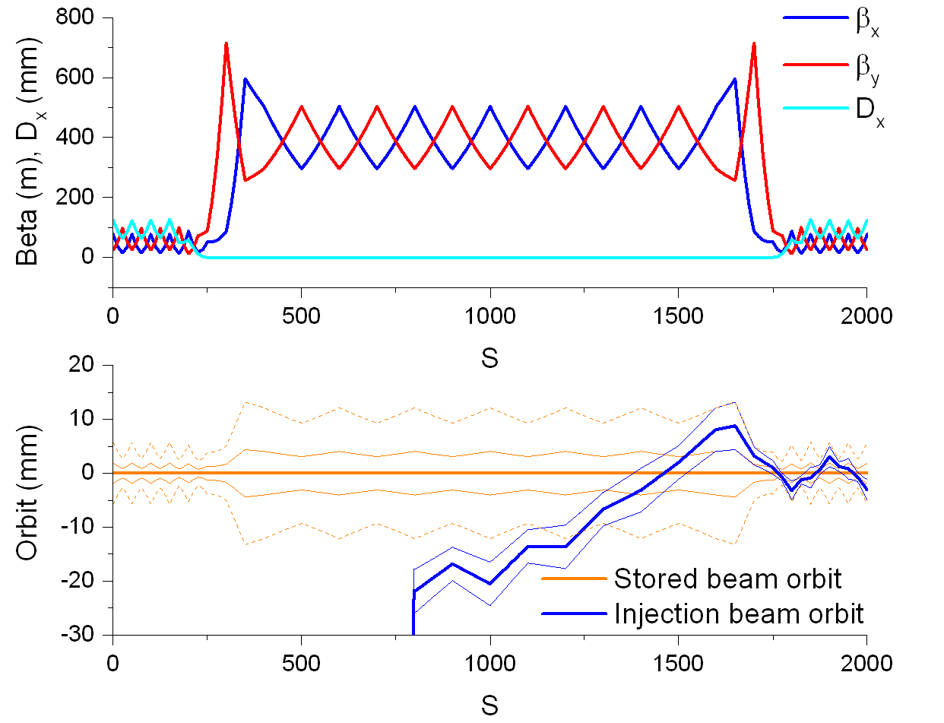
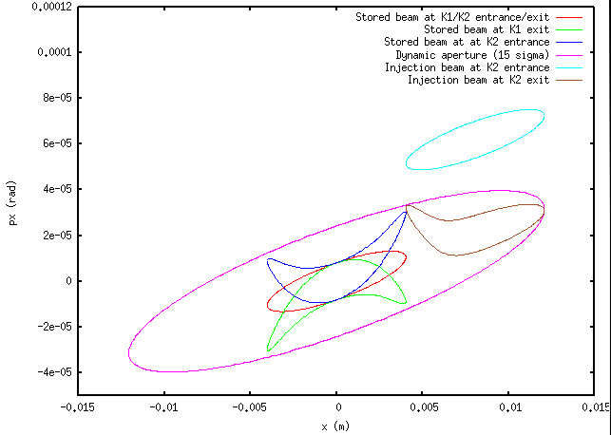
Multipole kicker injection (3)
Optics and orbits for on-energy
injection with multipole kicker and compensation kicker
Beams in phase space
Comp.Kicker
Kicker
Septum (5 mm)

Slide 11
Specifications
Parameters | Conventional injection (on-/off-energy) | Multipole kicker injection (on-/off-energy)
Beta at septum and kicker (m) | 310/310 (or 1200/1800) | ~400 m
Type of kicker | Dipole kickers | Nonlinear kicker
Integrated kicker field (Tm) | 0.012/0.025 (or weaker) | 0.025/0.03 (Plateau)
Type of septum | Wire septum (or 5-mm septum) | 5-mm septum or wire septum
Required DA (σ) | ~15/5@-1.8% | 15/5@-2%
(Tentative) specifications are found
Similar specifications apply to the compensation kicker/septum schemes
Kicker and septum pulse durations are still missing

Slide 12
Filling pattern (1)
Collider
  The four operation modes require very different filling patterns (number of bunches, bunch spacing)
  Common RF scheme (with no separator) assumes only a half of collider ring to be filled (K. Oide, FCC week 2016)
  RF beam loading study suggests rather uniform filling (with various fine structures, “by2”, “by4”, etc.)
  (D.Teytelman,https://indico.cern.ch/event/590639/contributions/2382368/attachments/1377659/2092710/dt_beam_loading.pdf)
Booster
  Any constraint in the filling pattern?
Booster to Collider transfer
  Bunch-by-bunch transfer may not be realistic because of the large number of bunches in Z mode?
  Burst mode can adopt different bunch spacing as demanded?

Slide 13
Filling pattern (2)
Long-flat-top kicker and septum may be applicable to any filling pattern
  Single train in the booster is required… Compatible with the injector chain?
  For the collider beam lifetime of ~1 hour, need to top-up the two collider rings by 6~8 booster cycles
  This corresponds to 83~111 μs flat-top when the collider ring is fully filled, or 42~55 μs flat top for half filling

Slide 14
Summary
Two viable injection schemes identified
Possible improvements of these schemes are under investigation
(Tentative) Specifications for injection found though still missing ones of pulse duration
Long-flat-top kicker and septa may be applicable and flexible to realise various filling pattern (if it is fine for booster)

